Slide 1
UNIT - IV GATHERING AND WRANGLING DATA
Gathering And Wrangling Data: Identifying, Gathering And Importing Data From Desperate Sources, Wrangling And Cleaning Data, Tools For Gathering, Importing, Wrangling And Cleaning, Characteristic, Applications And Limitations.

Slide 2
Data Wrangling
Data wrangling is a generic phrase capturing the range of tasks involved in preparing your data for analysis. Data wrangling begins with accessing your data. Sometimes, access is gated on getting appropriate permission and making the corresponding changes in your data infrastructure. Access also involves manipulating the locations and relationships between datasets. This kind of data wrangling involves everything from moving datasets around a folder hierarchy, to replicating datasets across warehouses for easier access, to analyzing differences between similar datasets and assessing overlaps and conflicts.

Slide 3
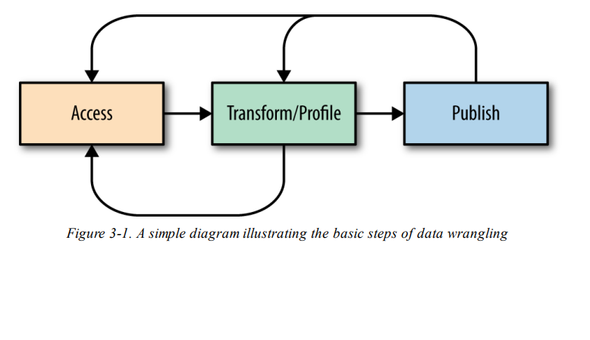
Steps of Data Wrangling

Slide 4
wrangling begins with access. From there, the bulk of time and energy is spent transforming and profiling the results of the transformation. Finally, the desired output is published for downstream consumption

Slide 5
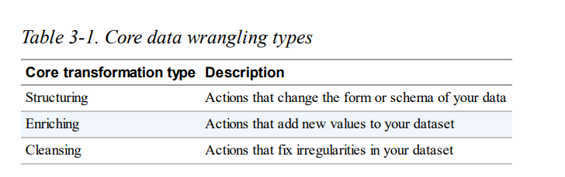

Slide 6
The core types of transformation are structuring, enriching, and cleansing. Structuring primarily involves moving record field values around, and in some cases summarizing those values. Structuring might be as simple as changing the order of fields within a record. More complex transformations that restructure each record independently include breaking record fields into smaller components or combining fields into complex structures. At the interrecord level, some structuring transformations remove subsets of records

Slide 7
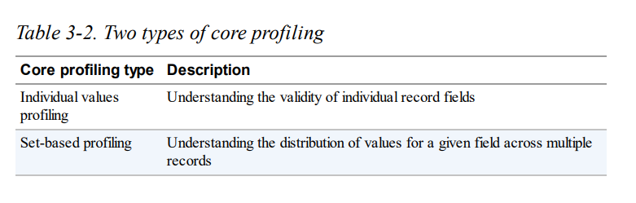

Slide 8
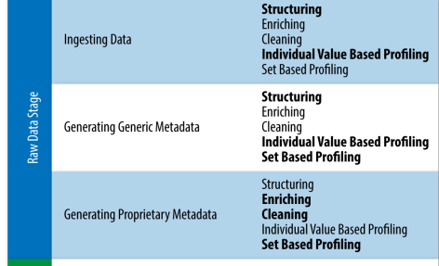

Slide 9
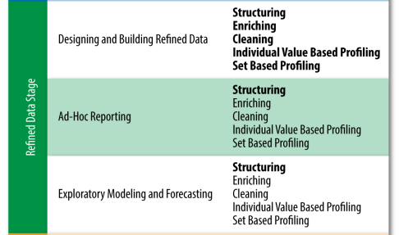

Slide 10
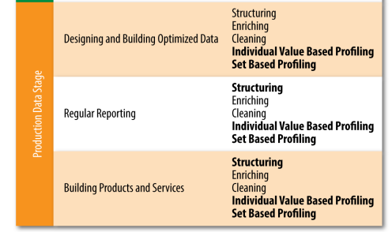

Slide 11
Transformation: Enriching
There are three primary types of enriching transformations:
Unions
Joins
Deriving new fields

Slide 12
Unions
Unions append additional records to an existing dataset. In other words, when you perform a union, you are taking two related datasets and stacking them vertically to create a single dataset.

Slide 13
Joins
Joins are the most common enrichment action. The most common form of a join involves linking records from one dataset to records from the other dataset via exact matches of a single field in each of the dataset records. The field used in the match is often referred to as the key field in both datasets.

Slide 14
Inner Inner joins only produce a record when there are matching records from each dataset being blended. Note that if there are duplicate keys, the output records are similarly duplicated.
Left outer This type of join retains all records from the left (or initial) dataset, even if there is no matching record in the right (or incoming) dataset.
Right outer These joins retain all records from the right (or incoming) dataset, even if there is no matching record in the left (or initial) dataset.
Full outer Full outer joins retain all records from both datasets, even if they have a corresponding match.

Slide 15
Using Transformation to Clean Data
Addressing Missing/NULL Values
There are two basic approaches to addressing missing/null values. On the one hand, you can filter out records with missing or NULL fields. On the other hand, you can replace missing or NULL values. Often referred to as data imputation, filling in missing or NULL values might utilize many different strategies. In some cases, the best approach involves inserting the average or median value.

Slide 16
Addressing Invalid Values
Extending beyond missing values, another key set of cleaning transformations deals with invalid values—invalid because they are inconsistent with other fields (e.g., a customer age compared with their data of birth), ambiguous (e.g., two-digit years or abbreviations like “CT”—is that Connecticut or Court?), or improperly encoded. In some cases, the correct or consistent value for the field can be calculated and used to overwrite the original value in the dataset. In other cases, it might make sense for you to simply mark values as invalid

Slide 17
Data Wrangling Tools
use a desktop application to wrangle terabytes or petabytes of data— imagine how slowly your computer would run! On the other hand, if your total data size is only a few megabytes, investing in a big data distributed processing platform like a Hadoop cluster would be a massively wasteful use of computing power and budget

Slide 18
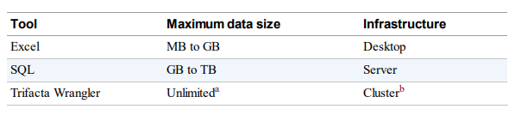

Slide 19
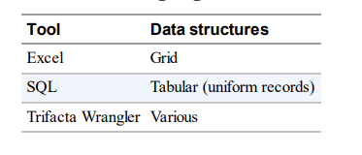
Data Structures

Slide 20
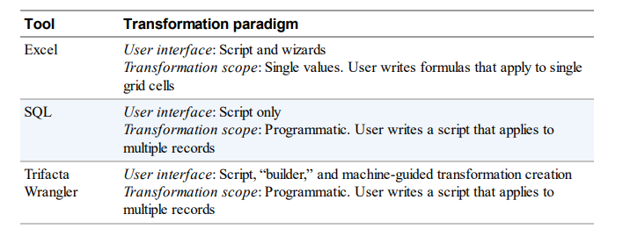
Transformation Paradigms

Slide 21
Advantages:
Improved data quality: Data wrangling helps to improve the quality of data by identifying and correcting errors, inconsistencies, and missing values.
Increased data usability: Data wrangling helps to make data more usable by converting it into a format that is compatible with the desired end system.
Improved data accessibility: Data wrangling helps to make data more accessible by organizing it in a way that is easy to understand and navigate.
Increased data efficiency: Data wrangling helps to increase data efficiency by reducing the amount of time and resources required to process and analyze data.
Improved decision-making: Data wrangling helps to improve decision-making by providing data that is accurate, consistent, and accessible.

Slide 22
Disadvantages:
Time-consuming: Data wrangling can be a time-consuming process, especially for large and complex datasets.
Complex: Data wrangling can be a complex process, requiring a variety of skills and knowledge.
Error-prone: Data wrangling can be an error-prone process, especially if not done carefully.
Costly: Data wrangling can be a costly process, especially if specialized tools and resources are required.

Slide 23
Some characteristics of data wrangling include:
Data integration: Can improve data quality, lower IT costs, and free up resources
Data governance: Especially important for sensitive data
Enriching: Involves gathering data from sources and understanding its distribution, type, and format
Feature engineering: Involves engineering new features to increase the accuracy of forecasting models

