Slide 1
Weather Trend Forecasting Using Machine Learning
Global Weather Repository Dataset
Dulce Alberto Manjate AI Engineer Internship Technical Assessment

Slide 2
Executive Summary
Analyzed 141,898 global weather observations
Best RMSE: 4.71
Best R²: 0.765
Performed climate, environmental, and anomaly analysis
Built and compared 8 machine learning models
Ensemble Model achieved the best performance
SHAP identified UV Index, Pressure, and Humidity as key predictors

Slide 3
Project Objective
The goal of this project was to analyze global weather data to:
• Forecast temperature trends
• Explore climate and environmental patterns
• Detect weather anomalies
• Compare multiple machine learning models
• Improve forecasting accuracy using ensemble learning

Slide 4
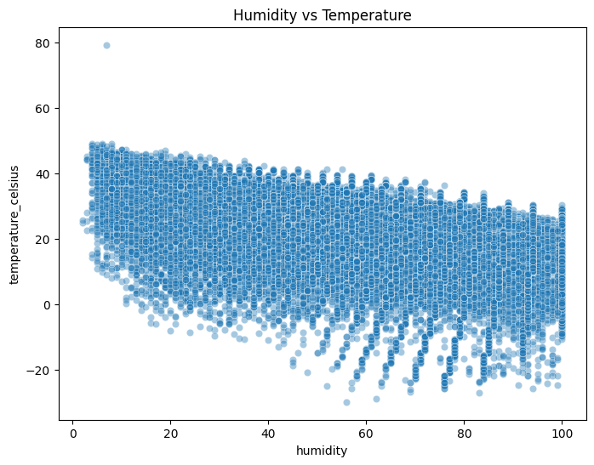
Data Cleaning & Exploratory Data Analysis (EDA)
Preprocessing Included:
• Missing value handling
• Invalid value replacement
• Datetime transformation
• Feature engineering
• Temperature categorization
EDA revealed strong relationships between temperature, humidity, UV index, pressure, and air quality variables.

Slide 5
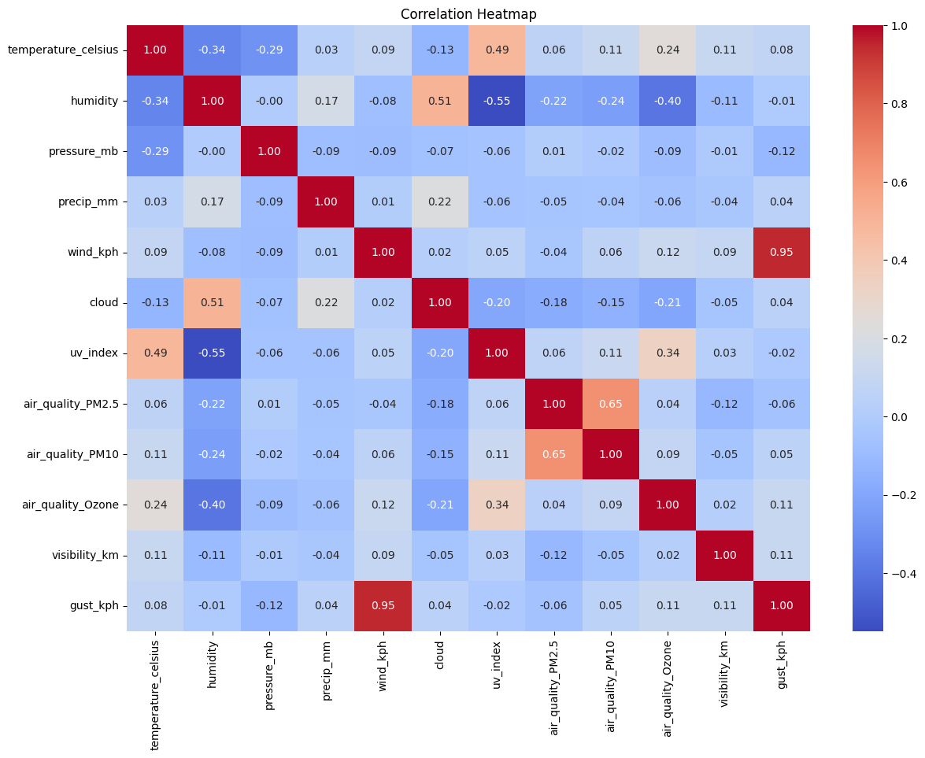
Correlation Analysis
The correlation analysis showed strong relationships between temperature, humidity, UV index, pressure, and environmental variables, helping guide feature selection for forecasting models.
Temperature ↔ Feels Like Temperature (strong positive)
Temperature ↔ UV Index (positive)
Temperature ↔ Humidity (negative)
PM10 ↔ PM2.5 (positive)

Slide 6
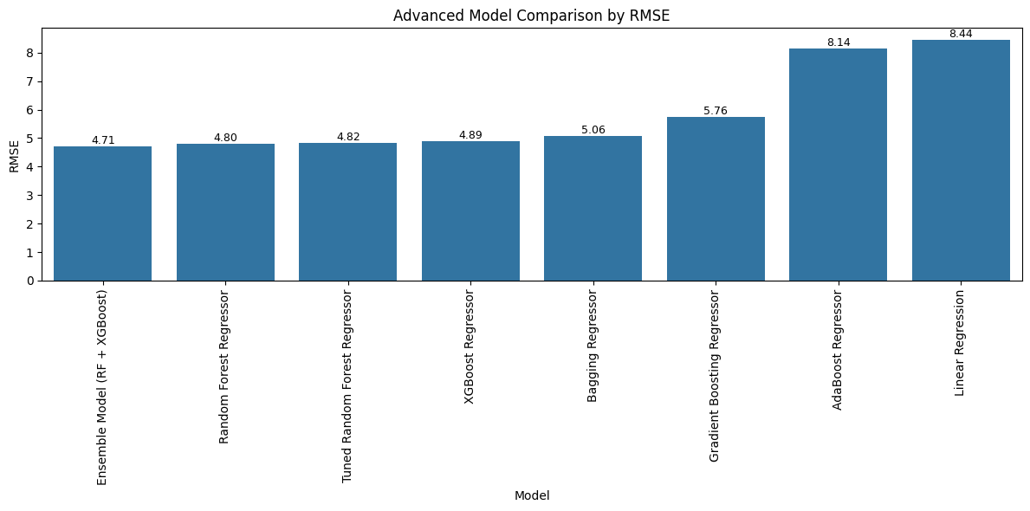
Forecasting Models
Rank | Model | RMSE
1 | Ensemble RF + XGBoost | 4.71
2 | Random Forest | 4.80
3 | Tuned Random Forest | 4.82
4 | XGBoost | 4.89
5 | Bagging | 5.06
6 | Gradient Boosting | 5.76
7 | AdaBoost | 8.14
8 | Linear Regression | 8.44
Tree-based and ensemble models significantly outperformed traditional linear approaches.

Slide 7
Best Model Performance
Best Model: Ensemble (Random Forest + XGBoost)
RMSE
4.71
Lower is Better
MAE
3.19
Lower is Better
R² Score
0.765
Higher is Better
The ensemble model achieved the best forecasting accuracy and strongest predictive capability.

Slide 8
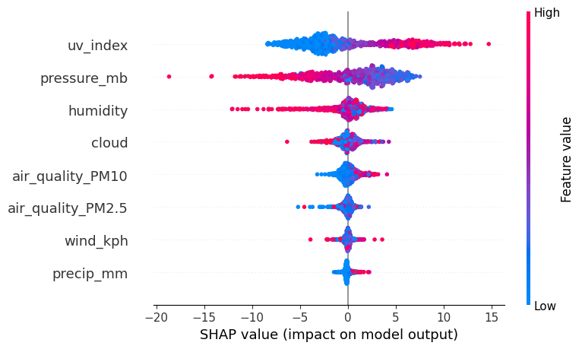
Feature Importance & Explainable AI
Most Influential Features:
• UV Index
• Pressure
• Humidity
• Cloud Coverage
• Air Quality
SHAP analysis improved model interpretability and explained how environmental variables influence temperature predictions.

Slide 9
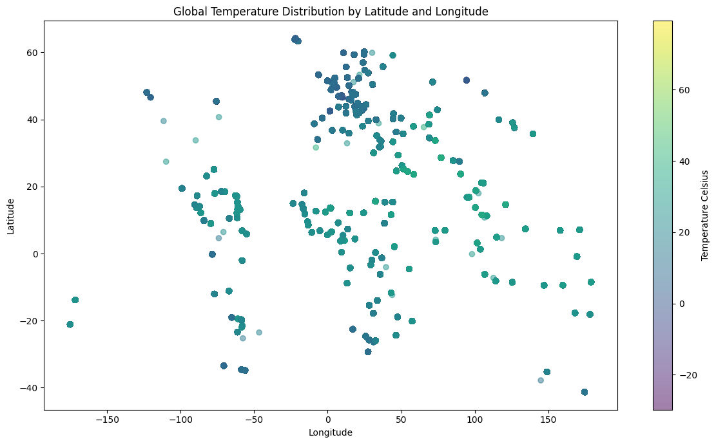
Climate & Spatial Analysis
• Higher temperatures near equatorial regions
• Lower temperatures at high latitudes
• Strong geographical climate variability
• Temperature distribution follows global latitude patterns

Slide 10
Business Recommendations
• AI-driven weather forecasting
• Environmental monitoring systems
• Climate anomaly detection
• Real-time forecasting dashboards
• Sustainability and climate planning
• Support climate risk management and sustainability initiatives

Slide 11
Final Conclusion
This project demonstrated that machine learning and ensemble forecasting techniques can accurately predict temperature trends while providing valuable climate, environmental, and anomaly detection insights.
The Ensemble Model (Random Forest + XGBoost) achieved the highest forecasting accuracy with RMSE = 4.71 and R² = 0.765, while SHAP analysis identified UV Index, Pressure, and Humidity as the most influential variables.
These findings support the use of AI-driven weather intelligence systems for environmental monitoring, climate analysis, and data-driven decision-making.

