Slide 1


PLEDGE TO PROGRESS Sustainability Hackathon
Sponsored By
Your Team Name :
Your team bio : Damanjeet Kaur (Project Manager in NetProphet Pvt Ltd)
Date :24 April 2023

Slide 2
MobileApp development methodology for a Green IT environment Under Sustainable Computing
sustainable development needs to satisfy the requirements of three dimensions, which are the society, the economy and the environment.

Slide 3
User Segment & Pain Points
• How is it possible to establish sustainable and green software engineering process?
• How to help and guide developers to optimize their source code in order to build efficient, sustainable and green software?
• How the common quality criteria are important for sustainability of System?

Slide 4
Pre-Requisite
Sustainable Software
Green Software
Green with Software
Cloud Computing
Internet of Things
Dematerialization
Virtualization
……..
Green within Software
Product
Process
Usage
Design
Development
….

Slide 5
Tools or resources
When we are talking about Green Computing, We have two aspect of discussion. One aspect is ‘Green with Software’ in which we have the concept of Cloud Computing, IOT, Dematerialization, Virtualization etc. that comes under Green IT 1.0 and other aspect is ‘Green within Software’ in which we are giving importance to Product ,Process, Usage, Libraries , Design , Development utilization in effective way that comes under Green IT 2. In this area of tools representation, my aim is to briefly present the different organization tools/products that are used in Cross platform mobile application development with their usage. As my area of concern is ‘Green with in Software’ in which I am pushing towards the product usage for maximization.

Slide 6
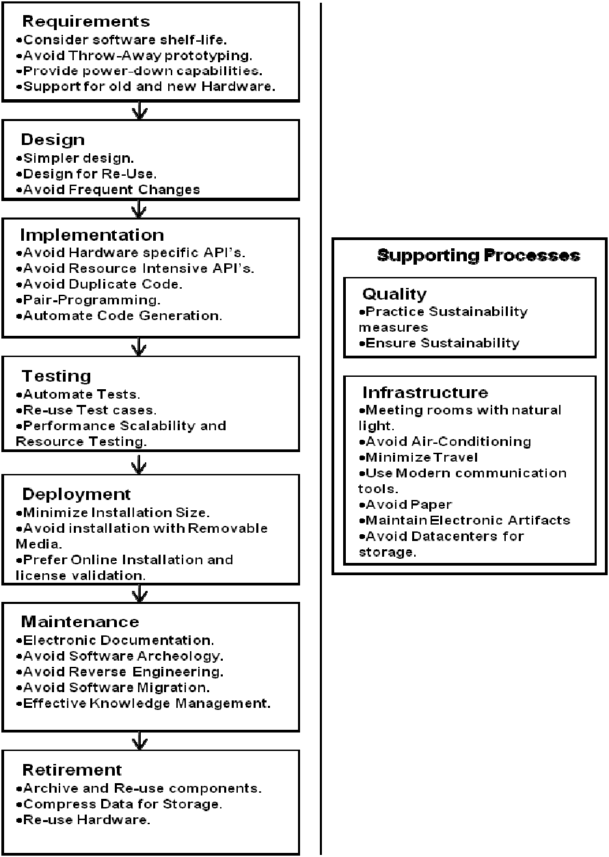
Key Differentiators & Adoption Plan
How is your solution better than alternatives and how do you plan to build adoption?

Slide 7
GitHub Repository Link
https://github.com/damanjeetkaurchadha/GreenSoftwareheckthone.git

Slide 8
Thank You
Damanjeet Kaur
Project Manager (Netprophets Cyberworks private limited, noida)

