Slide 1
Phylogenetic trees from dna sequences
By: Daman Mulye
Notes:
Phylogenetic Tree:
Graph that represents an inference about the evolutionary history of different organisms
We do this through analyzing the differences in the genetic sequences or protein sequences of different organisms
Now at first glance I thought this project would be fairly straightforward, however I was completely wrong. I thought from the beginning that my program would be able to do all the steps from A-Z but this was not the case. Here I can show you the work flow for how phylogenetic trees are created.

Slide 2
Workflow
Make the dataset (My Program)
Generate a multiple sequence alignment (ClustalW)
Make a neighbor joining tree (MEGA)
Notes:
My program ultimately made the datasets that would be used for the two other parts to create the tree.
ClustalW: ClustalW is a popular program used for multiple sequence alignment and for preparing phylogenetic trees. Its portability amongst various computing platforms is the main reason for its widespread use.
MEGA: Molecular Evolutionary Genetics Analysis, is a freely available software for conducting statistical analysis of molecular evolution and for constructing phylogenetic trees.

Slide 3
Method
Scientific name for viruses
Search in genome
Convert genome to nucleotide
User selects a couple complete genomes to use
BLAST search is used
Download sequences from blast search
Notes:
dMy program starts off with user input asking for at least two scientific names for viruses.
It then runs a search on the ncbi website using the database genome to find the complete genome of the virus
After finding the results, elink was used to convert the genome id to a nuccore id
After finding the nuccore id I used the efetch go grab whats called the accession number and the name of the entry
The user will then get asked for input on which accession numbers to use, then the program uses another ncbi tool called blast
BLAST for Basic Local Alignment Search Tool is an algorithm for comparing primary biological sequence information, such as the amino-acid sequences of different proteins or the nucleotides of DNA sequences. A BLAST search enables a researcher to compare a query sequence with a library or database of sequences, and identify library sequences that resemble the query sequence above a certain threshold.
So with the result from blast I get back a list of all sequences that have an Expect value of 0, and this means that you can expect that there are going to be 0 hits when you search similar sequences in a database
What this allows us to do is to take into account different strains of viruses to be subjected to this phylogenetic analysis
Finally using the result from the blast search my program makes one final call to the ncbi nucleotide database to download the full sequences for the different strains found

Slide 4
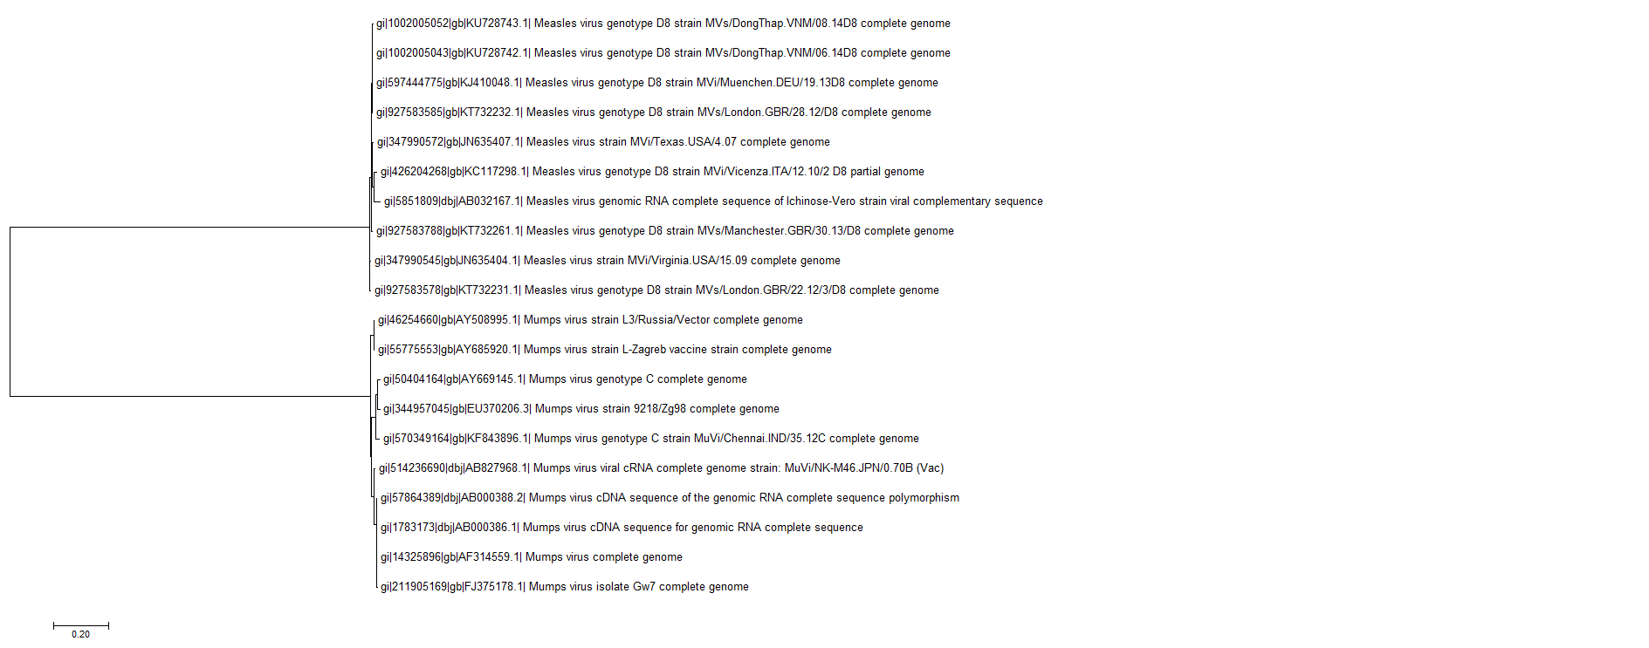
Results
Notes:
So with my first run I compared two types of viruses measles and mumps. Now my blast search wielded many different trains, and I decided to keep about 20 of them. Talk about clustalW being slow

Slide 5
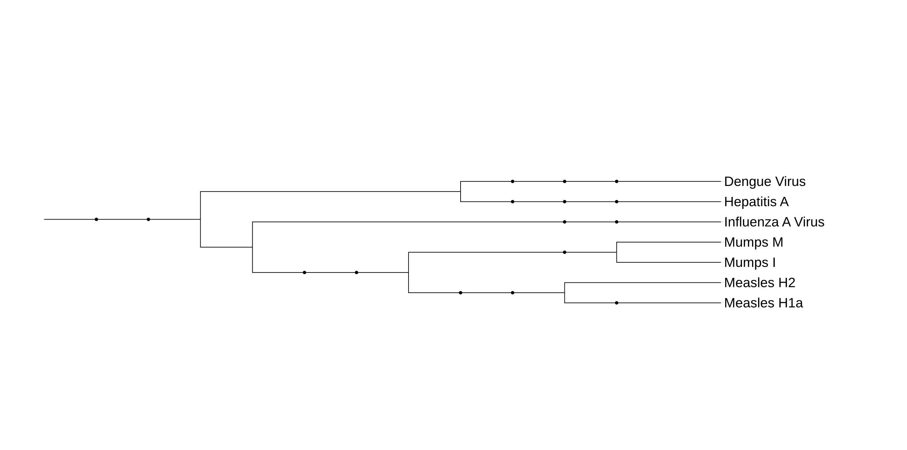
Results

Slide 6
Discussion
Improves understanding of evolution
Changes in the past can predict the future
Notes:
Phylogenetics is important because it enriches our understanding of how genes, genomes, species (and molecular sequences more generally) evolve. Through phylogenetics, we learn not only how the sequences came to be the way they are today, but also general principles that enable us to predict how they will change in the future.

Slide 7
Conclusion
The program is like a baby
Notes:
I think the best way to describe my program is like a baby. Because its very fragile, and if the user isn’t careful their results could be inaccurate. So going forward with this project I think the best additions to make would be to make the program more intelligent so the user doesn’t have to be. For example, in phylogenetic analysis it’s very important not to use sequences of different types such as comparing RNA to DNA and right now my program doesn’t account for that.

