Slide 1
Global Fashion Retail Sales – Interactive Dashboard Project
Tableau | Data-Driven Retail Insights
Task: 4 | Dashboard Design
Elevate Labs
Damanti Murmu
Data Analyst
Intern

Slide 2
Project Overview & Objective
Dataset Overview
Table | Columns
customers | Customer ID, Name, Gender, DOB, Country, City, etc.
discounts | Start date, End date, Category, Sub-category, Discount value
employees | Employee ID, Store ID, Name, Position
products | Product ID, Category, Sub-category, Production cost, Descriptions
stores | Store ID, Country, City, No. of Employees, Latitude, Longitude
transactions | Invoice ID, Customer ID, Product ID, Quantity, Price, Store, Employee
Business objective: “To analyze global fashion retail performance and build a dashboard for stakeholder decision-making.”
Tools used: Tableau and Excel

Slide 3
Methodology: From Data to Dashboard
Layout: 5-stage visual process (flowchart or horizontal steps)
Steps:
Data Cleaning & Preprocessing
KPIs Identification
Visualization Design in Tableau
Dashboard Interactivity & Testing

Slide 4
Dashboard Features
KPI Cards: Total Sales, Quantity Sold, Discounts Applied
Geo Maps: Sales by Country & City
Time Series: Yearly Sales Trend
Customer Segmentation: Top 10 customers
Product Breakdown: Top Performing Subcategories
Top Transactions: High-value Customers and Stores
Filters/Slicers: Category, Month
Navigation Menu: Monthly Sales Trend

Slide 5
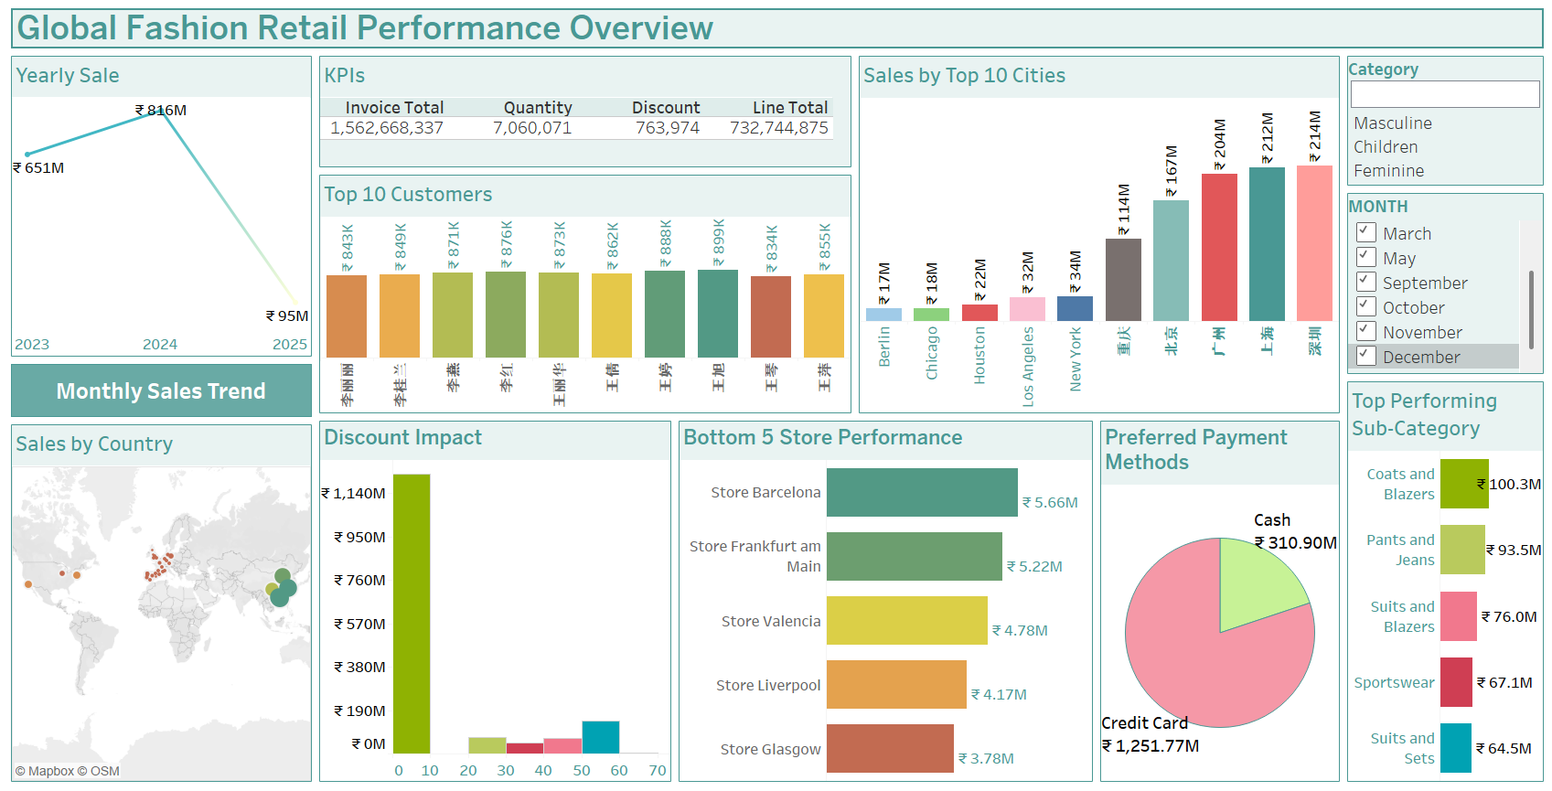

Slide 6
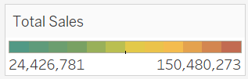
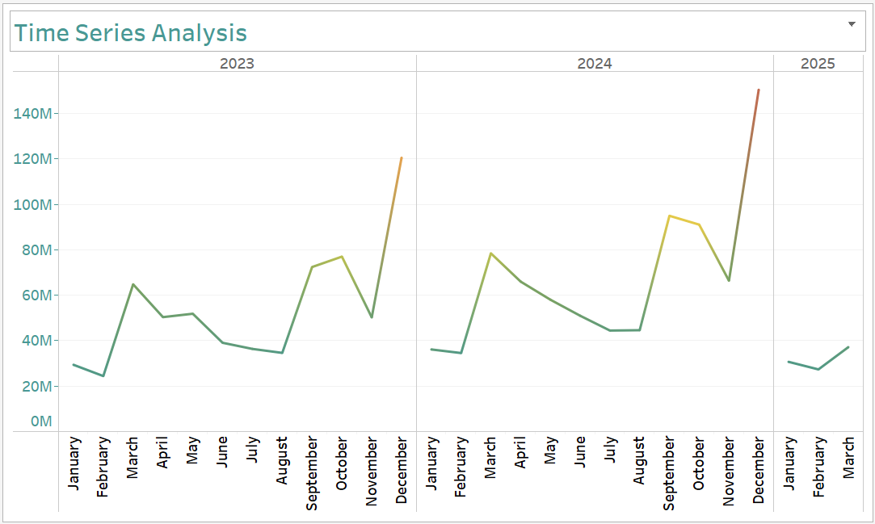
Insight 1: Time Series Analysis
Sales have fluctuated but have shown overall increasing trends from Jan 2023 to Mar 2025.
Key spikes are observed during December each year, with Dec 2024 hitting the highest at 70.59M.
🔺 Peak Periods:
December consistently records the highest sales—most likely due to holiday and year-end shopping surges.
🔻 Low Sales Months:
Notable dips in February 2023, August 2023, and July 2024.
Seasonal & Growth Pattern:
A clear seasonal trend of year-end spike suggests a strong holiday season impact.
Sales generally rebound in Q4 and then drop slightly in Q1 of the following year.
Recommendations:
Prioritize year-end promotions & stock planning
Investigate slow months for demand drivers

Slide 7
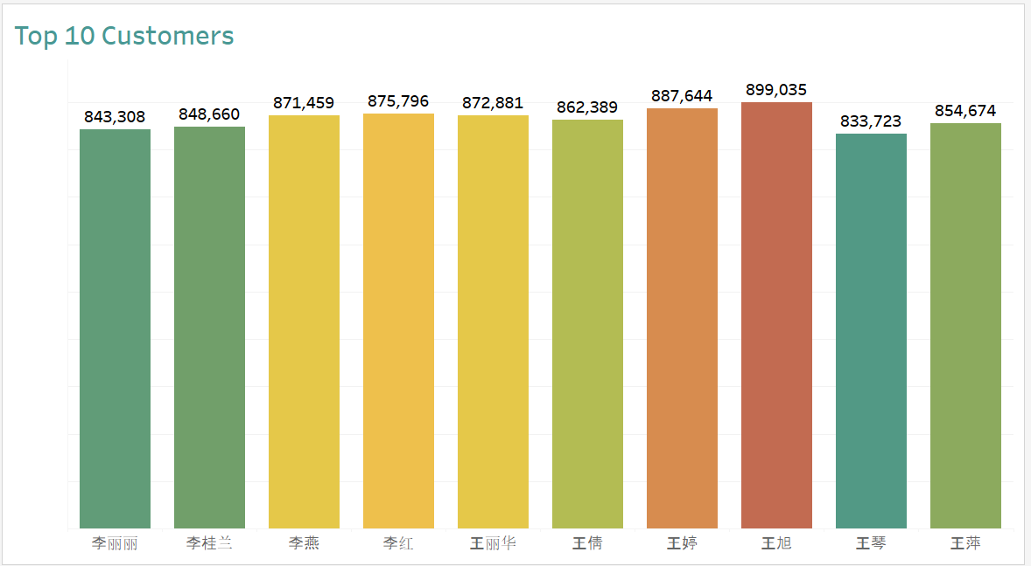
Insight 2: Customer Segmentation
The top 10 customers generated revenues ranging between 833K to 899K.
Customer "王旭" leads with the highest revenue at 899,035.
There is a relatively narrow revenue gap among these top contributors, suggesting a consistently valuable segment.
Chinese characters in customer names indicate that a significant revenue share is driven by customers from Chinese-speaking regions.
🔍 Insights:
A loyal, high-value customer base could be targeted for premium offerings or loyalty programs.
These customers likely exhibit frequent or high-volume purchase behavior and may respond well to personalized engagement strategies.
Retention and upselling within this segment could significantly boost overall profitability.
Further segmentation by region, age, or purchase category may uncover deeper behavioral patterns for these top-tier clients.
Recommendations
Target marketing to leading demographics
Explore new acquisition strategies for underrepresented groups

Slide 8
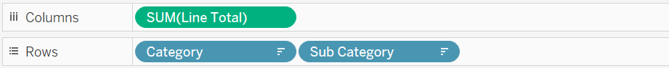

Insight 3: Top Performing Product Categories
Suits and Blazers (Masculine) – 75,986,465
Suits and Sets (Feminine) – 64,478,237
Coats and Blazers (Masculine) – 54,563,778
Pants and Jeans (Masculine) – 51,652,271
Coats and Blazers (Feminine) – 45,716,602
Insight:
Masculine Suits and Blazers lead all subcategories in sales.
Feminine Suits and Sets are the top-selling product in the feminine category.
Outerwear items like Coats and Blazers perform well in both genders.
Masculine Pants and Jeans have higher sales than the same feminine category.
Sportswear ranks lower in both segments, indicating relatively weaker performance.
Recommendations:
Focus on high-margin formalwear for both genders.
Launch bundled outfits (e.g., Blazers + Pants).
Invest in outerwear promotions across seasons.
Rebrand or reassess Sportswear product positioning.

Slide 9

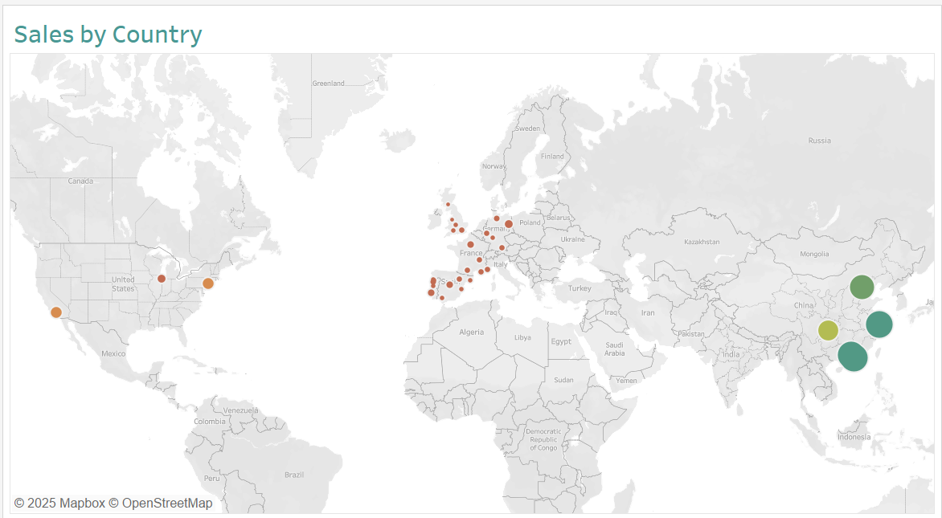
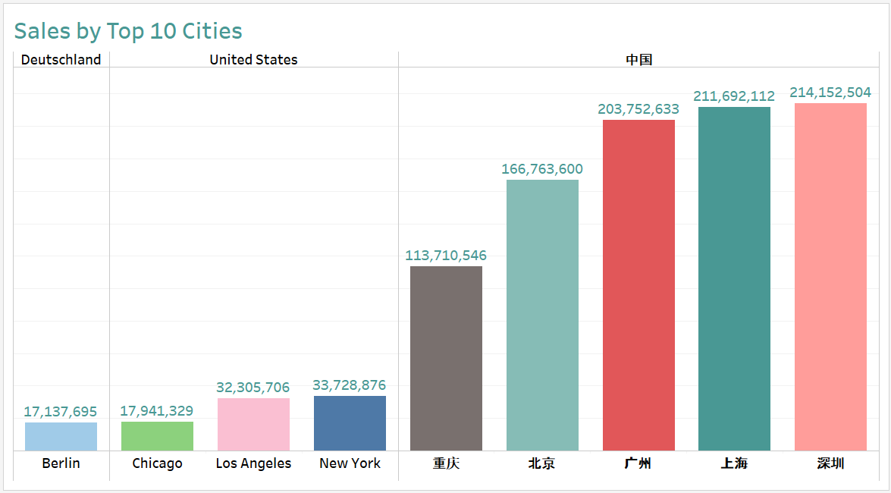
Insight 4: Global Sales Trend
Observations:
China
Shenzhen: $214,152,504
Shanghai: $211,692,112
Guangzhou: $203,752,633
Beijing: $166,763,600
Chongqing: $113,710,546
U.S. Cities:
New York: $33,728,876
Los Angeles: $32,305,706
Chicago: $17,941,329
Germany:
Berlin: $17,137,695
Insights:
China dominates the top 5 spots, each city exceeding $100 million in sales.
U.S. cities trail far behind, with New York being the highest at just over $33 million.
European cities like Berlin show moderate performance.
Recommendations:
Increase inventory and store presence in top Chinese cities.
Launch regional and culturally tailored campaigns.
Use geo-targeted e-commerce to grow reach in moderate cities.
Promote in Western cities with urban youth-focused marketing.

Slide 10
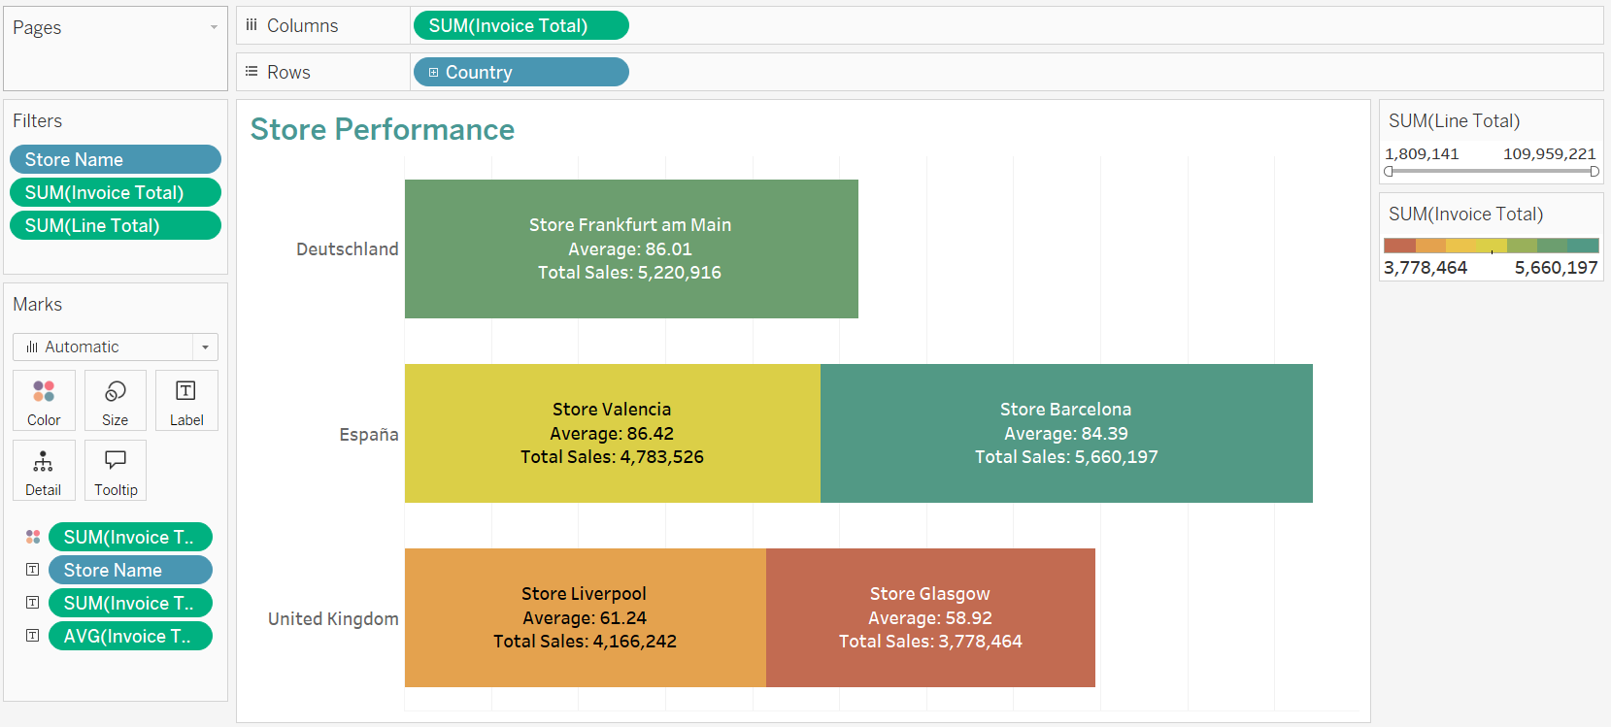
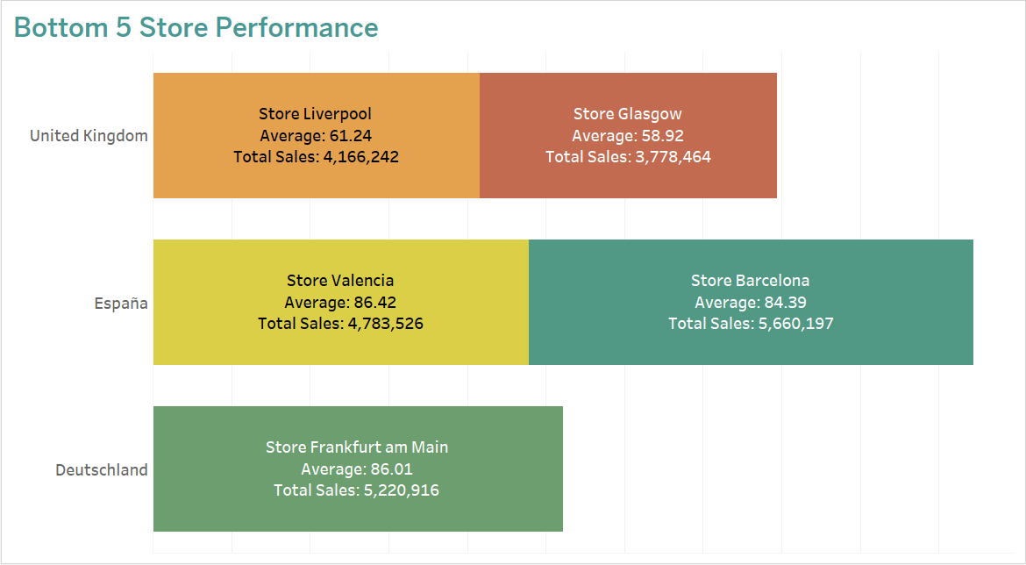
Insight 5: Bottom 5 Store Performance
Observations:
Glasgow recorded the lowest total sales at $3.78M and lowest avg. invoice ($58.92)
Liverpool had $4.17M in sales with an avg. invoice of $61.24
Valencia and Frankfurt, while at the bottom, show high avg. invoice values: $86.42 and $86.01 respectively
Barcelona, though part of the bottom set, had the highest sales at $5.66M
Insights:
UK stores (Glasgow, Liverpool) underperform on both revenue and avg. invoice
High invoice value ≠ high revenue – seen in Valencia and Frankfurt
Possible underutilization of strong purchase intent in high-invoice stores
Recommendations:
Boost UK stores through product bundling, upselling & local campaigns
Leverage high avg. invoice stores (Valencia, Frankfurt) with better footfall strategies
Analyze store traffic vs. conversion to improve lower-performing locations

Slide 11
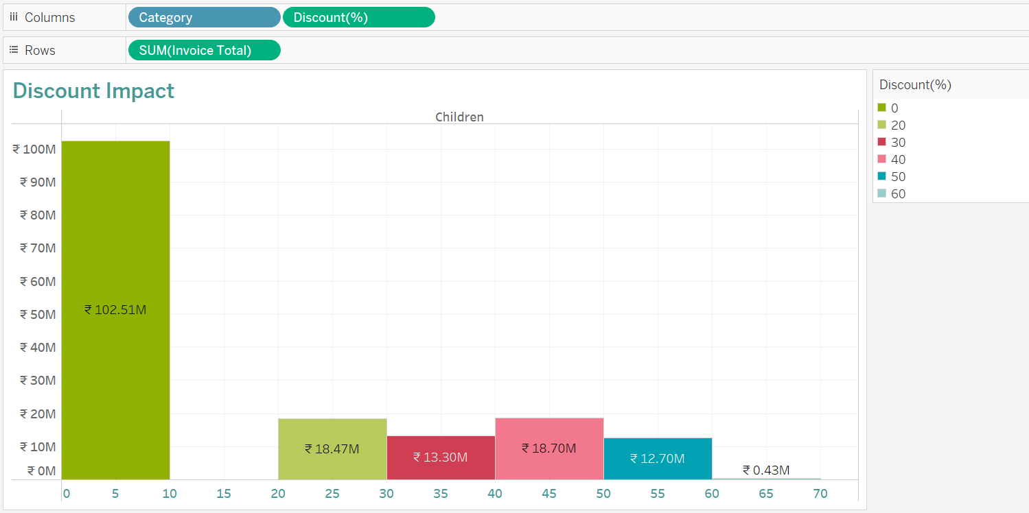
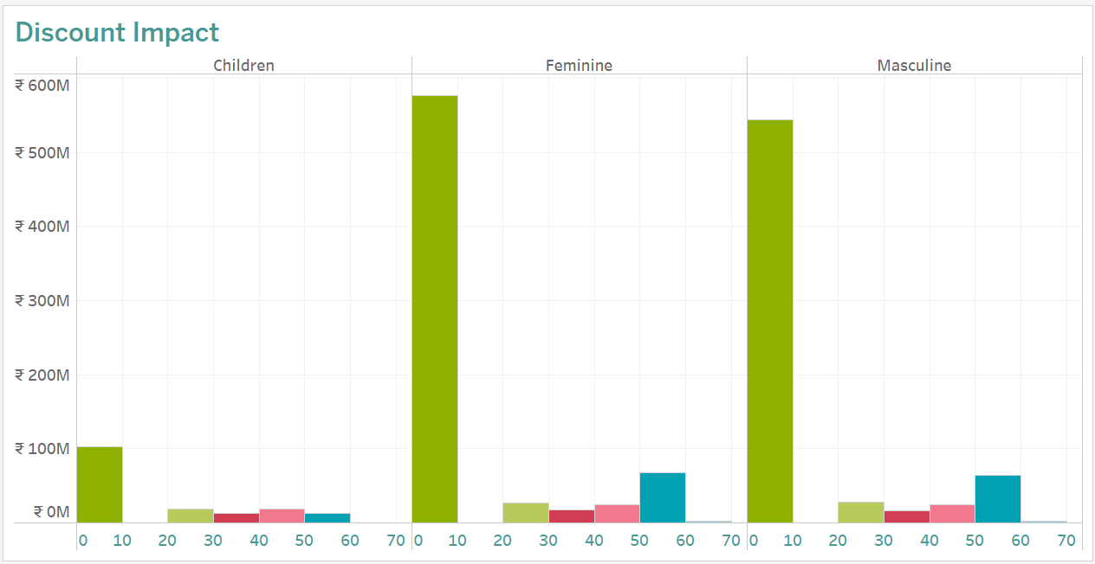
Insight 6: Discount Impact Analysis by Category
Observations
0–10% discount brackets generate the highest revenue across all categories:
Feminine: ₹577.19M
Masculine: ₹544.33M
Children: ₹102.51M
As discounts increase, revenue significantly drops, especially above 20%
60% discount range contributes the least
Insights
Customers purchase more at lower discount ranges, indicating strong brand or product loyalty
Higher discounts don't proportionally boost revenue — possible over-discounting
Children’s segment consistently lags behind others in revenue, regardless of discount
Recommendations
Focus on maintaining 0–10% discount strategies to maximize profitability
Use higher discounts (40%+) only on overstocked or aging inventory
Reevaluate pricing & promotion strategies for the Children's category
A/B test 20–40% ranges to find optimal balance between discount and volume

Slide 12
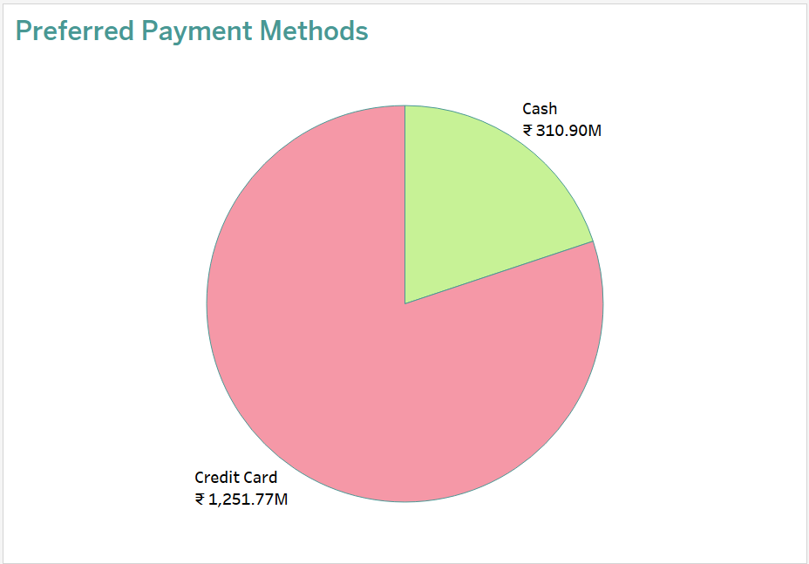
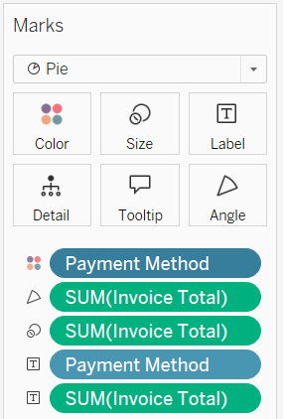
Insight 7: Preferred Payment Methods
Observations:
Credit Card payments dominate with ₹1,251.77M in sales
Cash transactions are significantly lower at ₹310.90M
Over 80% of revenue is processed through credit cards
Insights:
Customers show a strong preference for digital payments
Higher ticket items may be more likely to be purchased via credit cards
Indicates customer trust and comfort with card-based payments
Recommendations:
Strengthen digital infrastructure to ensure smooth credit card processing
Offer loyalty or cashback incentives for credit card users
Explore BNPL (Buy Now, Pay Later) or EMI options to boost conversion rates
Streamline cash handling for operational efficiency but focus on digital-first strategy

Slide 13
Key Insights
Yearly Sales Trends
Peak sales in 2024 (₹816M), up from ₹651M in 2023, but a drastic drop to ₹95M in 2025.
Indicates a need to investigate 2025 underperformance.
Top Performing Cities
Shenzhen (₹215M) and Shanghai (₹212M) lead sales.
Non-Asian cities like New York (₹34M) and Houston (₹22M) are underperforming.
Top 10 Customers
Key customers are mostly concentrated in Asian markets, showing high individual spending (₹843K–₹855K range).
Sales by Country
Strong presence in East and Southeast Asia, less penetration in the Americas and Europe.
Top Performing Sub-Categories
Coats and Blazers (₹100.3M) and Pants and Jeans (₹93.5M) lead sales.
Suits and Sets (₹64.5M) underperform comparatively.
Discount Impact
High sales (₹1,140M) correlated with minimal discounting (0–10% range).
Indicates customers are willing to pay full price for value.
Bottom 5 Stores
Poor performance in European stores: Glasgow, Liverpool, Valencia, Frankfurt, Barcelona.
All generated less than ₹6M in sales.
Preferred Payment Methods
Credit Cards (₹1,251.77M) are dominant over Cash (₹310.90M).
Reflects high customer comfort with digital payments.

Slide 14
Recommendations
Customer Retention
Introduce loyalty programs or VIP services for top customers.
Personalized marketing based on spending habits.
Payment Strategy
Enhance digital payment infrastructure.
Consider adding flexible payment options like BNPL (Buy Now Pay Later).
Discount Management
Keep discounts limited; maintain focus on value-based pricing.
Leverage occasional markdowns only for aged inventory.
Sales Recovery Strategy for 2025
Conduct root cause analysis for the sharp sales drop.
Strengthen promotional campaigns and product launches.
Geographic Reallocation
Invest further in Asian markets where demand is high.
Reassess viability of underperforming European stores.
Product Strategy Optimization
Promote top-selling categories through featured collections and upselling.
Consider bundling or discounts for lower-performing categories like Suits and Sets.

Slide 15
Strategic Implications
Focus on Asian Markets: Expand supply chain, marketing, and product range tailored to Asian customers.
Reconsider Western Footprint: Conduct cost-benefit analysis on underperforming European stores; explore e-commerce-only models in those regions.
Invest in Digital and Data: Leverage data analytics to anticipate buying patterns, personalize marketing, and strengthen inventory control.
Protect Brand Value: Avoid over-discounting; explore premium collections or capsule collaborations.
Elevate Top Customers: Offer exclusive programs and targeted experiences to top spenders to increase retention and lifetime value.

Slide 16
Summary
This dashboard provides a holistic view of the global sales performance of a fashion retail brand across years, countries, cities, and customer segments. With a peak in 2024 and a subsequent decline in 2025, the focus must shift to diagnosing and addressing this sales dip. Asia, especially cities like Shenzhen and Shanghai, dominates the revenue landscape, with key customer loyalty and preference for premium categories.
The dominance of credit card payments signals a mature, digitally fluent customer base. Sub-category analysis indicates product lines like Coats and Blazers are revenue drivers. Strategic decisions on geographical focus, product portfolio refinement, and enhanced customer engagement will be critical for reversing the sales downturn in 2025 and ensuring sustainable growth.

Slide 17
THANK YOU

