Slide 1

Group 1
Abeer
David
Xiang
Level of Expertise: Dora the Explorer

Slide 2
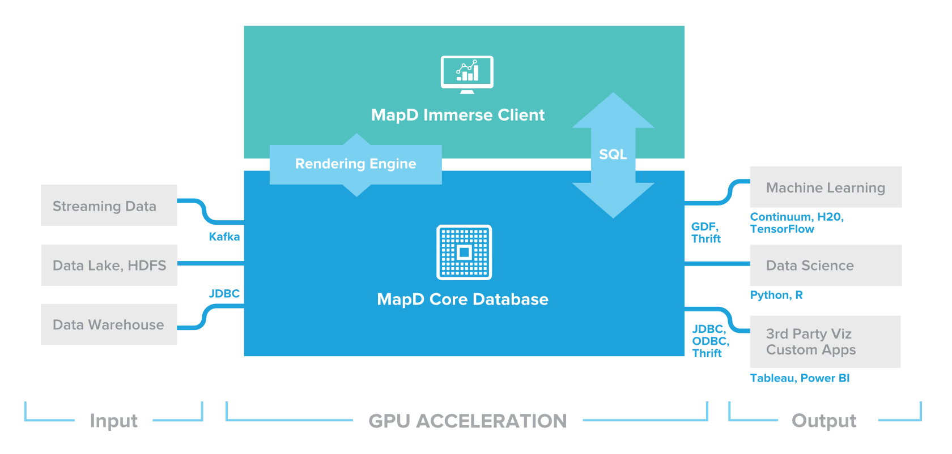

GPU optimized, in-memory column-store database + VISUALIZATION TOOL
MapD

Slide 5
MapD Optimizations
Apache Calcite

Slide 8
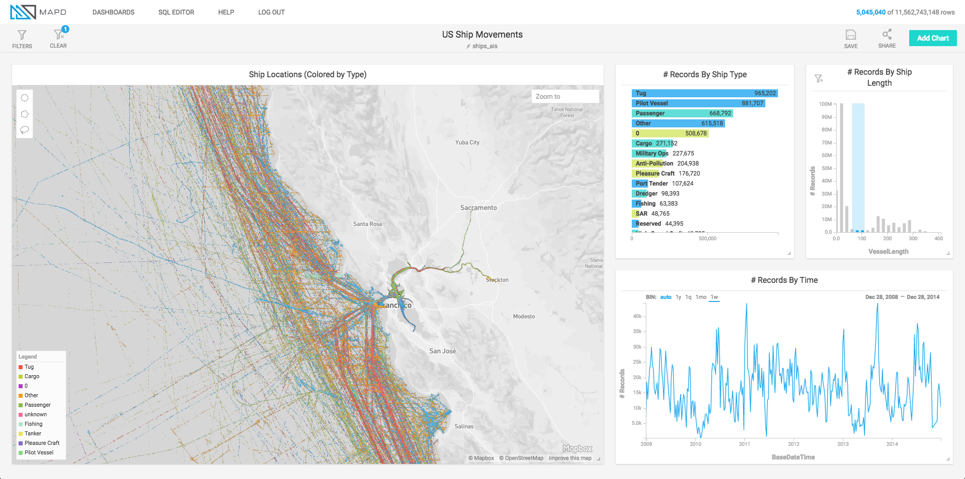

Slide 9
Other considerations
Idea behind in-memory DB: increase performance by keeping data and code as local (to CPU) as possible
Other low level optimizations:
Hardware – use GPU
Compile queries (translate to machine code prior to running)

Slide 10
Query compiling in mapd
Just in Time (JIT) compiling using LLVM (Low Level Virtual Machine) compiler infrastructure
LLVM
Customizable compiler infrastructure
Converts code to an intermediate representation (LLVM IR), and then into machine code using architecture-specific backends
Built-in code validation APIs and tools (ensures well-formed queries)
Optimizes code at runtime based on dynamic information

Slide 11
Query Compiling in mapd
Query execution:
Query Plan
Intermediate Representation (LLVM IR)
Native CPU Code
CPU
Query Plan
Intermediate Representation (LLVM IR)
PTX (using NNVM)
Native GPU Code
GPU
From LLVM IR
To desired
architecture

Slide 12
Mapd vs. traditional dmbs compiler infrastructure
Key components of LLVM infrastructure:
Compiled
Low level
JIT (just in time)

Slide 13
Compiled vs. interpreted
Traditional DBMS Interpreted (translated to machine code at runtime, line by line)
Interpreted vs Compiled: x*2+3
Evaluate x*2 for a number of rows
Store in buffer
Read intermediate result from buffer
Compute final result (add 3)
Evaluate x*2
Store in register
Compute final result (add 3)
Compiled query avoids:
Write to buffer
Read from buffer
Using memory for above ops
Using cache
Compiled query adds:
Compile overhead
LLVM JIT compiling means that compilation only occurs if the benefits are greater than the costs

Slide 14
Low level vs. high level compilER
 | LLVM | JVM
VM architecture | Register-based low level very fast | Stack-based Higher level garbage collection, objects, etc. VM runs during program execution
Compiles to… | Native Code | Bytecode
Output processing | NA | Bytecode interpreted by VM (translated at runtime) or compiled to native code
Interprets
Compiles
Compiled
Interpreted

Slide 15
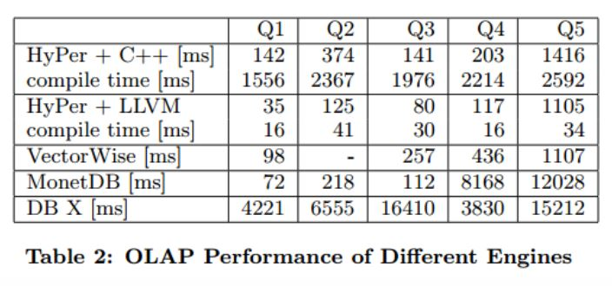
JIT vs. non-optimized low level compiler
Efficiently Compiling Efficient Query Plans for Modern Hardware – Neumann, VLDB, 2011
Used 5 different types of query to benchmark LLVM-compiled query, C++ compiled query, standard disk-based DBMS, and two others:

Slide 16
COMPILED
INTERPRETED
LLVM
MapD
JVM
Oracle
memSQL
Cloudera Impala
Apache Spark
VitesseDB
Other Interpreted
PostgreSQL*
Many others

Slide 17

QUANTUM Query Compiling?
Query Plan
QASM (using ScaffCC)
Scaffold
Scaffold: C-like quantum programming language, high-level
ScaffCC: LLVM-based compiler framework for Scaffold
QASM: Quantum assembly language (native code for quantum machines)
Query Plan
GPU
QPU
CPU

Slide 18



What we learned, blob edition: IF you have a good idea, it will be absorbed by the big 3…
Big 3 (Oracle, IBM, MS)
Niche
MapD
Your Favorite DB Tech
In-memory: MS Hekaton, IBM DB2 and Oracle (since 11) have in-memory options
GPU optimization: IBM D2, Kinetica + MS Azure

Slide 19

What we learned, NON-blob edition:
Find (or develop) a solution suited to particular data needs
No solution is strictly better than another, there are only tradeoffs
Innovations often arise from application of solutions to a specific problem domain
Mapd - PHD candidate wanted to analyze tweets during the Arab Spring
Needs: fast, handle very large real-time datasets, excel at visualization
Not needed/prioritized: persistence
Solutions: in-memory, GPU optimization
Use of GPU opens the door to optimization/ implementation of algorithms that benefit from the parallel nature of the processors (i.e. bucket select)
In addition to cost-based query optimizations, there are hardware and other low-level optimizations available (kernel fusion, loop fusion, pipeline push, etc.)

