Slide 1





Group 1
Abeer Xiang David
Group DBA Level: Dora the Explorer

Slide 2
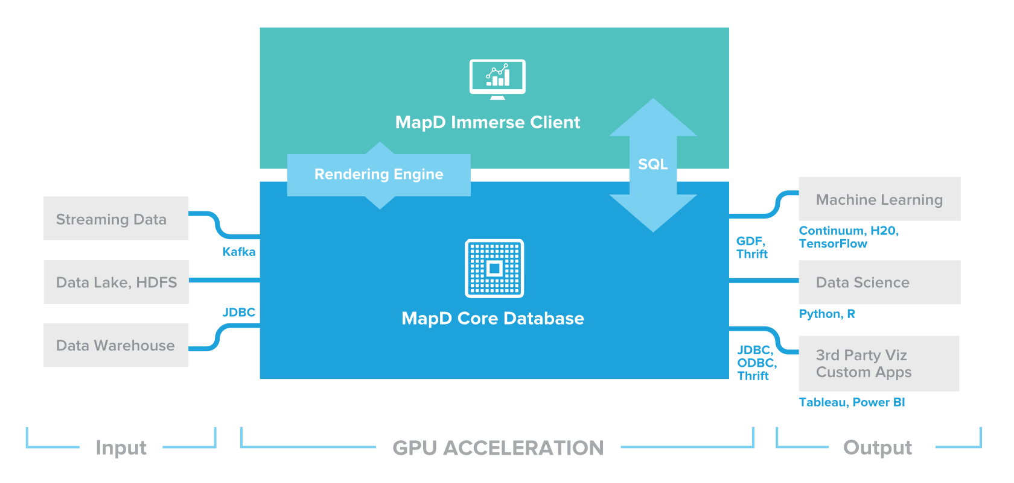

GPU optimized, in-memory column-store database + VISUALIZATION TOOL
MapD

Slide 3
Objectives
To understand the effectiveness of MapD in graphics processing units (GPU);
To review the data storage, architecture, and access systems used in MapD;
To understand the strengths and weaknesses of MapD.
The objectives of this project are manifold. First, it will attempt to understand the effectiveness of MapD in GPUs. Then it will review the data storage, architecture, and access systems used in MapD. Finally, it will compare MapD to traditional technologies and decipher its strengths and weaknesses.
Notes:
This is a review of MapD graphics processing units and how they enhance the way visual and graphical data is processed and stored.

Slide 4
Overview of MapD
A visualization and database platform which uses the power of GPUs to process data faster;
Used to instantly analyze large amounts of data;
Improves performance of systems.
So now the question comes, what is MapD. MapD is a visualization and database platform which uses the power of GPUs and causes faster data processing. In doing so, it exponentially improves the performance of systems. It is primarily used to instantly analyze large amounts of data.

Slide 5
Data Management Functions of MapD
Processes information in GPUs;
Facilitates video rendering;
Helps communication by making database management systems process data;
Performs analytics of data.
MapD has many functions that are used in data management. It processes information in GPUs and performs data analysis. MapD is also used in video rendering. It helps communication as well by faster processing of data, and thereby facilitates learning and performance.
Notes:
MapD has become important in recent times, due to the rise of big data and the needs for data analytics. The software uses the memory of the hardware it is paired with to improve video rendering, improve communication, and enable people to work and learn faster.

Slide 6
Architecture, Data Storage, and Access
Data is passed on through GPU frames;
SQL queries are divided up into small chunks and then combined at the end;
Data is stored in datasets arranged in rows;
Data is accessed using GPU frames, by being mapped on top of the frames.
This portion talks about the technology and architecture of data storage and access in MapD. First, data is passed through the GPU frames. After that, SQL queries are divided into small chunks and sorted in datasets, which are then arranged in rows. This data is combined together at the end. This data can be accessed by using GPU frames, as they are mapped on top of the frames.

Slide 7
Strengths and Weaknesses
RDBMS is mostly used for storage of data. MapD can help with advanced tasks like processing and analytics;
RDBMS can only present data in form of relations. MapD can presents the data in any format, as required;
Data in RDBMS is manipulated in tables, which can be beneficial for someone looking to deal with exclusively that format. This is not the case for MapD.
As can be seen from the above discussion, in many cases, MapD is preferable over traditional technologies like RDBMS. For example, RDBMS can only help in the storage of data, but MapD can do other tasks like processing and analysis on top of that. RDBMS also presents data only in the form of relations, unlike MapD, which can provide the data in any format, as requested. Data in RDBMS is manipulated exclusively in table format, which can be beneficial for someone looking to work in simple formats. However, MapD uses better technology in data manipulation.

Slide 8
MapD Optimizations
Apache Calcite

Slide 12
Other considerations
Idea behind in-memory DB: increase performance by keeping data and code as local (to CPU) as possible
Other low level optimizations:
Hardware – use GPU
Compile queries (translate to machine code prior to running)

Slide 13
Query compiling in mapd
Just in Time (JIT) compiling using LLVM (Low Level Virtual Machine) compiler infrastructure
LLVM
Customizable compiler infrastructure
Converts code to an intermediate representation (LLVM IR), and then into machine code using architecture-specific backends
Built-in code validation APIs and tools (ensures well-formed queries)
Optimizes code at runtime based on dynamic information

Slide 14
Query Compiling in mapd
Query execution:
Query Plan
Intermediate Representation (LLVM IR)
Native CPU Code
CPU
Query Plan
Intermediate Representation (LLVM IR)
PTX (using NNVM)
Native GPU Code
GPU
From LLVM IR
To desired
architecture

Slide 15
Mapd vs. traditional dmbs compiler infrastructure
Key components of LLVM infrastructure:
Compiled
Low level
JIT (just in time)

Slide 16
Compiled vs. interpreted
Compiled
Traditional DBMS Interpreted (translated to machine code at runtime, line by line)
Interpreted vs Compiled: x*2+3
Evaluate x*2 for a number of rows
Store in buffer
Read intermediate result from buffer
Compute final result (add 3)
Evaluate x*2
Store in register
Compute final result (add 3)
Compiled query avoids:
Write to buffer
Read from buffer
Using memory for above ops
Using cache
Compiled query adds:
Compile overhead
LLVM JIT compiling means that compilation only occurs if the benefits are greater than the costs

Slide 17
Low level vs. high level compilER
Low Level
 | LLVM | JVM
VM architecture | Register-based low level very fast | Stack-based Higher level garbage collection, objects, etc. VM runs during program execution
Compiles to… | Native Code | Bytecode
Output processing | NA | Bytecode interpreted by VM (translated at runtime) or compiled to native code
Interprets
Compiles
Compiled
Interpreted
SPEED
FLEXIBILITY

Slide 18
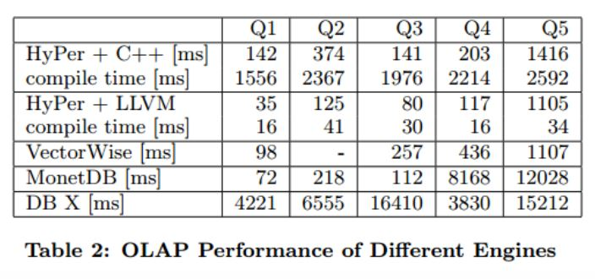

JIT vs. non-optimized low level compiler
J I T
Efficiently Compiling Efficient Query Plans for Modern Hardware – Neumann, VLDB, 2011
Used 5 different types of query to benchmark LLVM-compiled query, C++ compiled query, standard disk-based DBMS, and two others:
Fast execution
Large compile time
Fast execution
Small compile time
Traditional DBMS

Slide 19
COMPILED
INTERPRETED
LLVM
MapD
JVM
Oracle
memSQL
Cloudera Impala
Apache Spark
VitesseDB
Other Interpreted
PostgreSQL*
Many others

Slide 20

QUANTUM Query Compiling?
Query Plan
QASM (using ScaffCC)
Scaffold
Scaffold: C-like quantum programming language, high-level
ScaffCC: LLVM-based compiler framework for Scaffold
QASM: Quantum assembly language (native code for quantum machines)
Query Plan
GPU
QPU
CPU

Slide 21



What we learned, blob edition: IF you have a good idea, it will be ingested by the big 3…
Big 3 (Oracle, IBM, MS)
Niche
All your whitepapers belong to us.
MapD
Your Favorite DB Tech
In-memory: MS Hekaton, IBM DB2 and Oracle (since 11) have in-memory options
GPU optimization: IBM D2, Kinetica + MS Azure

Slide 22

What we learned, NON-blob edition:
Innovations often arise from solutions tailored to a specific problem domain
Mapd - PHD candidate wanted to analyze tweets during the Arab Spring
Needs: fast, handle very large real-time datasets, excel at visualization
Not needed/prioritized: persistence
Solutions: in-memory, GPU optimization
No solution is strictly better than another, there are only tradeoffs
Use of GPU allows optimization/ implementation of algorithms that benefit from the parallel nature of the processors (i.e. bucket select)
In addition to cost-based query optimizations, there are hardware and other low-level optimizations available (kernel fusion, loop fusion, pipeline push, etc.)

