Slide 1
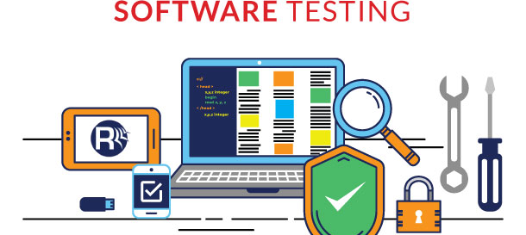

The different types of software testing
Damaris Saavedra

Slide 2


Software testing
What is Testing? Testing is the process of evaluating a system or its component(s) with the intent to find whether it satisfies the specified requirements or not.
Gaps
Errors
missing requirements

Slide 3


What we need to know
Requirement analysis.
Test planning.
Test case design and development.
Test environment setup.
Test execution.
Test cycle closure.

Slide 4
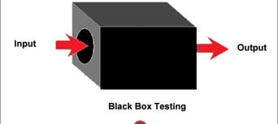

Study
Black box testing
A tester provides an input, and observes the output generated by the system under test.

Slide 5
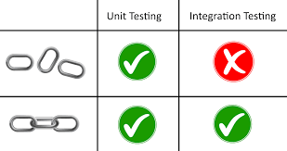
Integration Testing
Integration testing (sometimes called integration and testing, abbreviated I&T) is the phase in software testing in which individual software modules are combined and tested as a group.

Slide 6
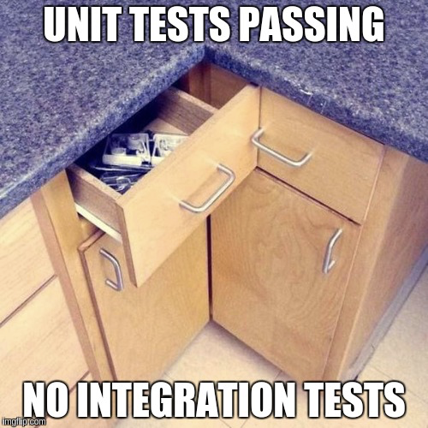
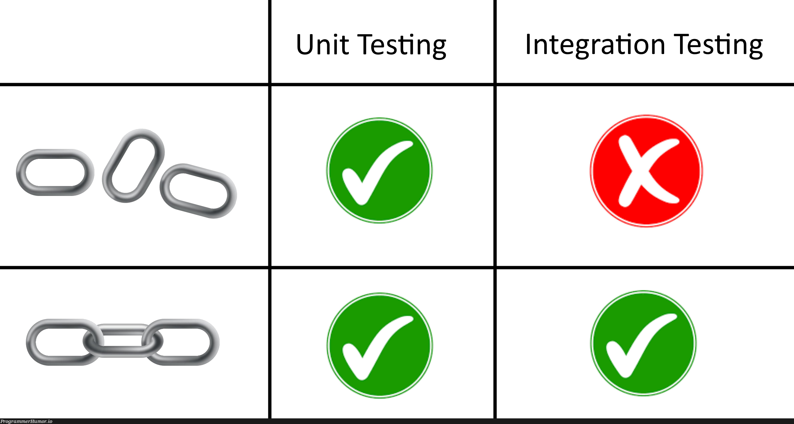
Unit Testing
A unit test is a way of testing a unit - the smallest piece of code that can be logically isolated in a system.

Slide 7
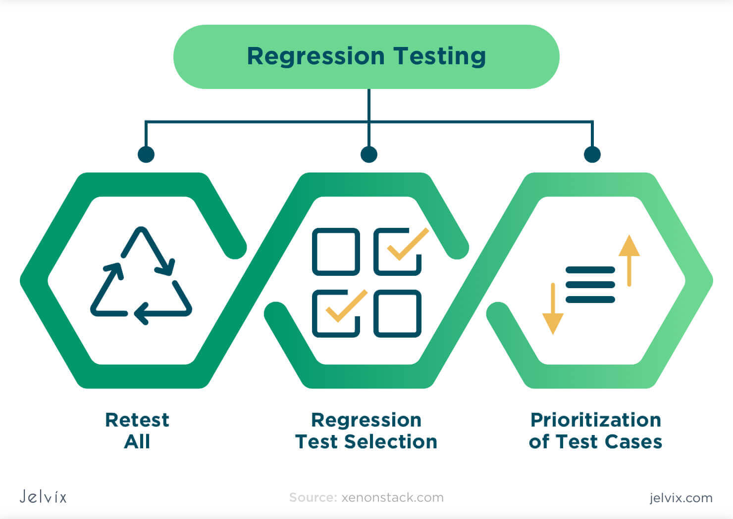
Regressional Testing
Regression testing is defined as a type of software testing technique that re-runs functional and non-functional tests to ensure that a software application works as intended after any code changes, updates, revisions, improvements, or optimizations.
Add text, images, art, and videos.
transitions, animations, and motion.
Save to OneDrive, to get to your presentations from your computer, tablet, or phone.
Open the Design Ideas pane for instant slide makeovers.
When we have design ideas, we’ll show them to you right there.

Slide 8

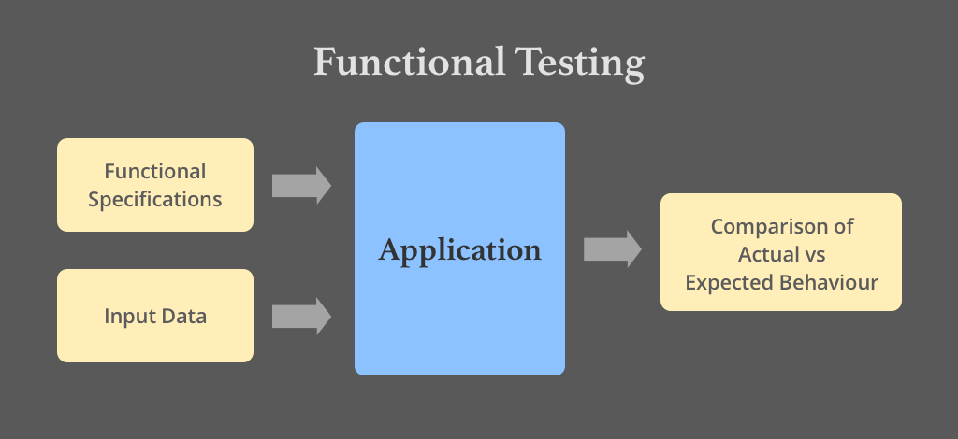
Functional Testing
• Functional testing: checks an application, website, or system to ensure it’s doing exactly what it’s supposed to be doing.

Slide 9


Thank You
Damaris Saavedra
Damaris.svdra@gmail.com

