Slide 1

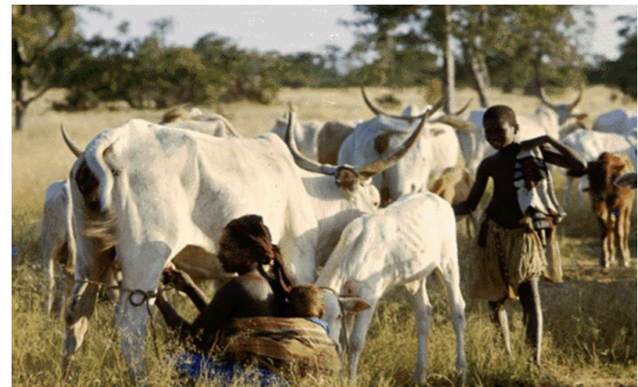
Modeling missed Cattle Rift Valley fever disease cases by the time of first death in Ntungamo District, Uganda
Abel Wilson Walekhwa
Damaris Kimonge
Angela Lang’at
Godfrey Madigu

Slide 2
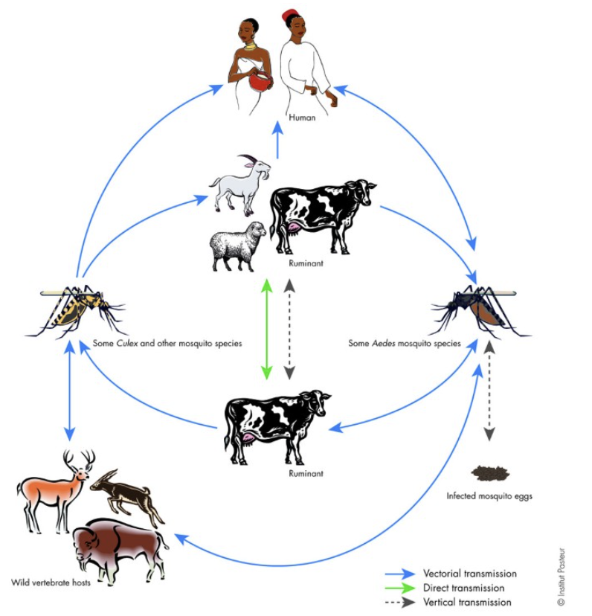
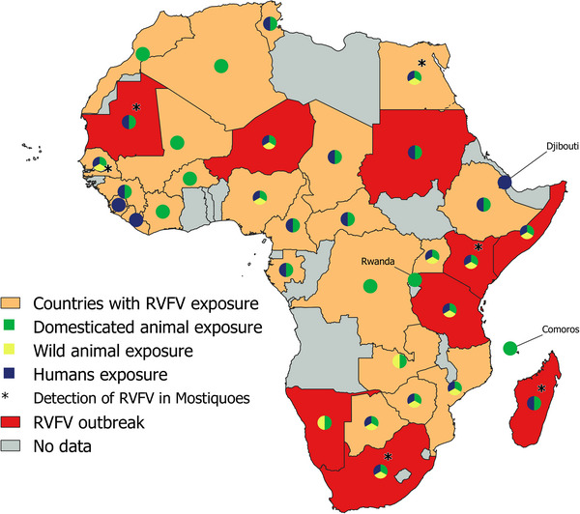
About Rift Valley fever disease (RVF)

Slide 3
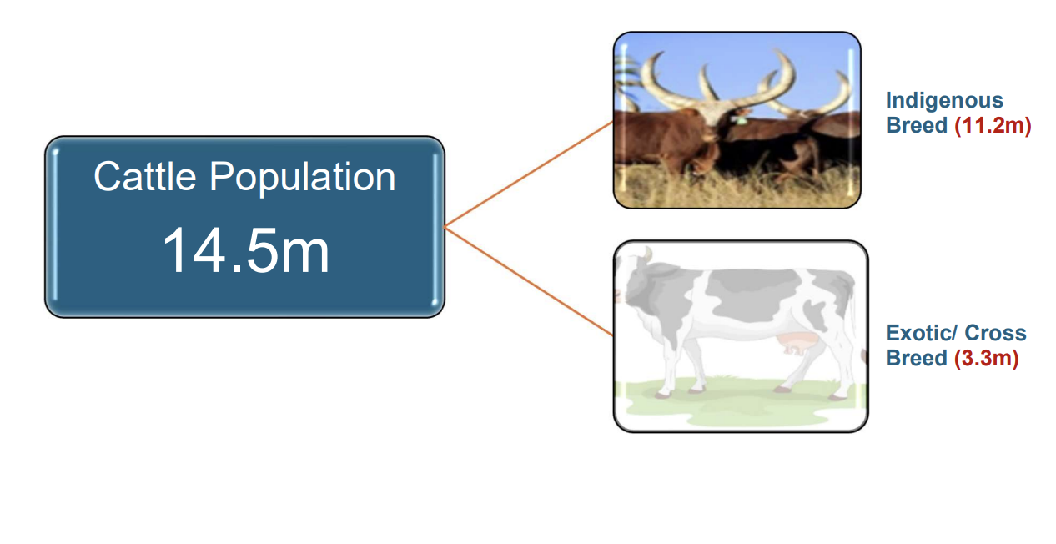
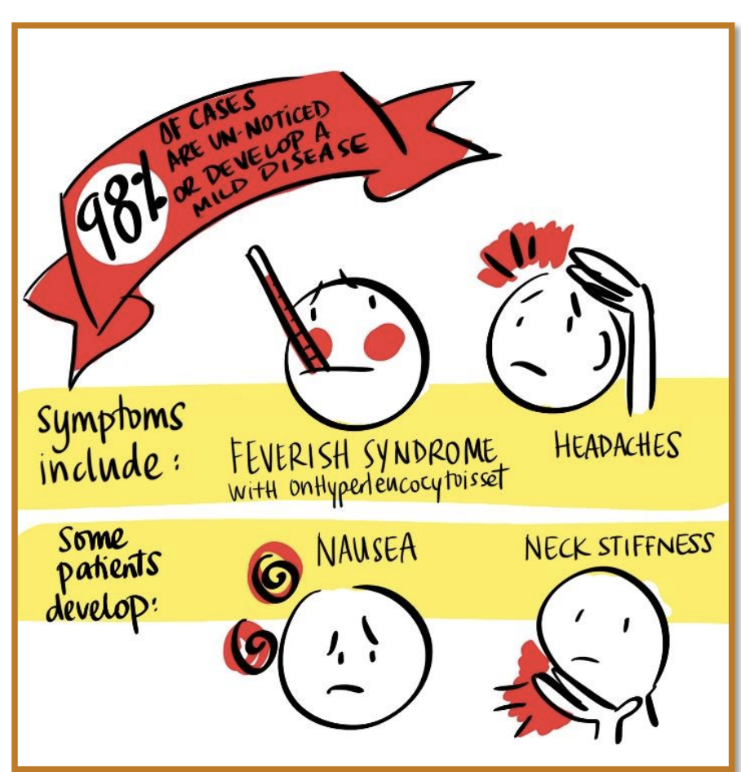
Research gap and Question
How many RVF infections have we missed by the time of the first cattle death?

Slide 4
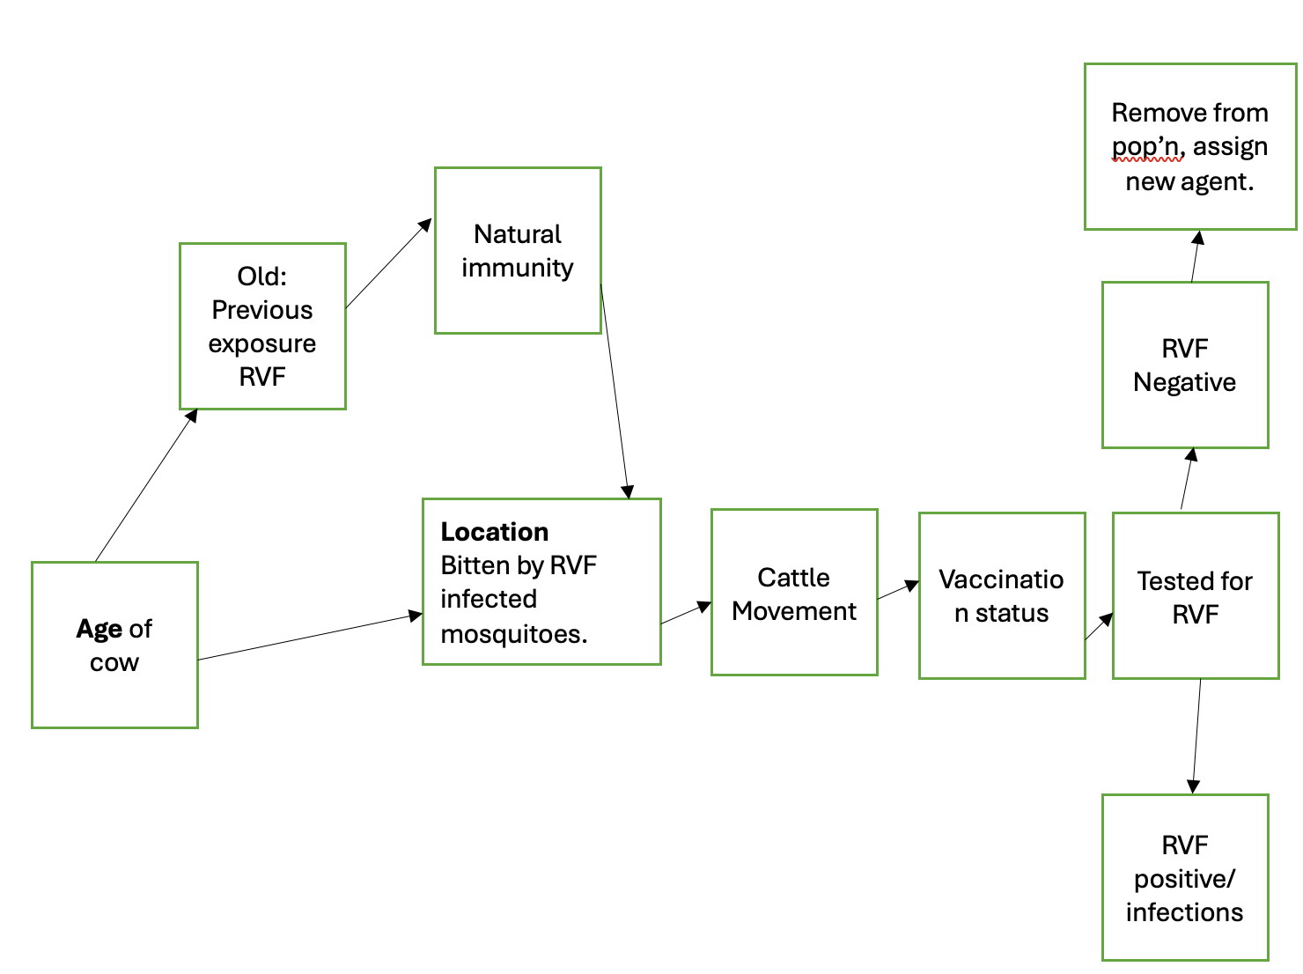
Research methods
Target population and subgroups: Cattle
Setting and location: Two districts of Uganda
Time horizon: First 100 days after an infected cow is introduced

Slide 5
Description of outcomes
Introducing one infected cow into the cattle population.
Outcomes of interest: Number infected cattle, Number of symptomatic cases, new RVF deaths, cumulative deaths, new RVF infections.
Assumptions:
Single cow bitten by an infected Culex mosquito is introduced in Ntungamo district through routine livestock movement.
Ntungamo and Kampala modelled as states.
The movement network is random.
The testing starts after single death and clinical signs

Slide 6
Parametizing and Calibrating the Model
S/N | Parameter | Value | Citation
1 | Duration from exposure to infection | 0.001 days | Expert Opinion
2 | Duration of infection | 14 days | Anywaine et al, 2023
3 | Mortality rate for cattle from RVF | 10% | (Pennsylvania Dept. of Health)
4 | Transmissibility (1/R0=1/2.5) | 0.04 | Tennant et al 2021
5 | Waning rate from Natural Immunity after infection | 0.05 | Expert Opinion
6 | Relative susceptibility of the cattle in Kampala | 1 | Expert Opinion
7 | Relative susceptibility of the cattle in Ntungamo | 1.2 | Expert Opinion
8 | Probability of cattle movement from Ntungamo to Kampala | 0.006% | MAAIF Livestock census report, 2021
9 | Probability of cattle movement from Kampala to Ntungamo | 0.001% | MAAIF Livestock census report, 2021
10 | Cattle average birth rate | 32.6% | MAAIF, 2021
11 | Cattle death rate in Uganda | 30% | MAAIF, 2021

Slide 7
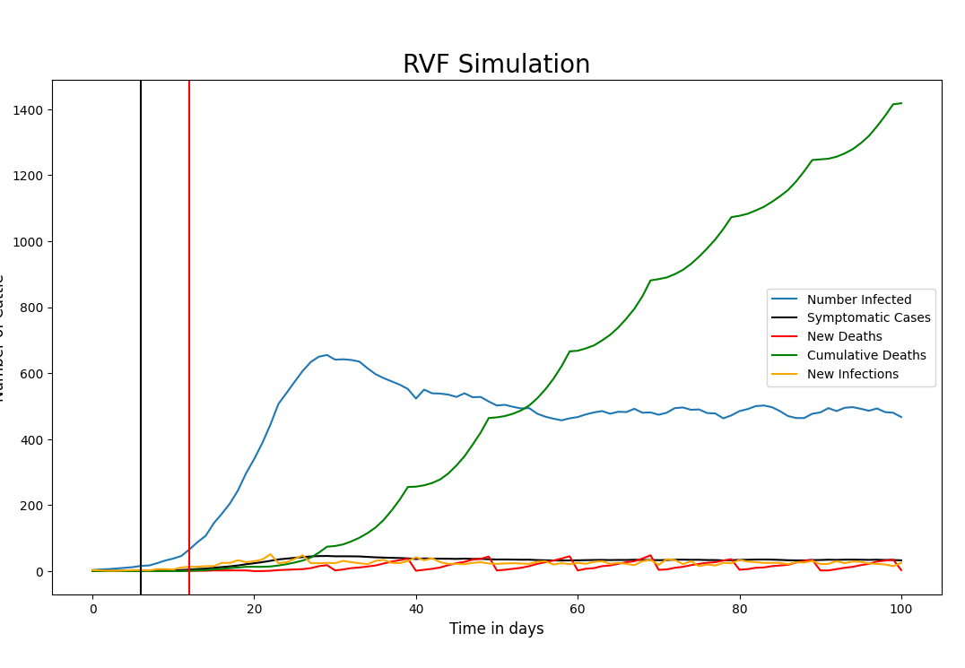
Results
If we begin testing after a single cow presents signs and symptoms, 15 RVF cases are missed
By the first symptoms presentation it implies that virus was circulating for the last 6 days.
61 RVF cases are missed if we wait to begin testing after a single death
By the first single death, it implies that virus was circulating for the last 12 days.

Slide 8
Conclusions and limitations
No available culex mosquito data
Only considered two districts for this model
No in-district – cattle movements
Did not consider the accuracy of the tests used
Did not model availability of test kits
Cost effectiveness of mass testing
Due to asymptomatic nature for RVF, there is need for ongoing systematic testing for early detection
By a single RVF death, 66 cattle are infected thus mass testing is recommended at farm level.

Slide 9
Next steps
Build a dynamic movement network: 1st May 2024
Include all 136 districts in Uganda: 10th May 2024
Incorporate the accuracy of diagnostics: 10th May 2024
Assess the best interventions (Quarantine, Vaccination or both) : 20th May 2024
Conducting Model sensitivity analysis : 25th May 2024
Develop a policy brief to MAAIF and submit abstract to IDM: 30th May 2024
Develop a scientific manuscript for publications: Nov 2024

Slide 10
References
Uganda Bureau of Statistics, Uganda National Animal Census 2021.
Anywaine et al. Clinical Manifestations of Rift Valley Fever in Humans: Systematic Review and meta-analysis(2021). PLOS Neglected Tropical Diseases
Pennsylvania Department of Health. Rift Valley Fever Factsheet (2013).
MAAIF Animal Movement Dataset: Animal Movement Permits (2015-2021).
Tennant et al. Modelling the persistence and control of Rift Valley fever virus in a spatially heterogeneous landscape (2021). Nature communications

