Slide 1



Universidade Federal do Pará Instituto de Tecnologia Laboratório de Planejamento de Redes de Alto Desempenho
Introdução a Linguagem Python
- Aplicações em Bioinformática -
Diego Damasceno
damasceno.diego@gmail.com
http://damascenodiego.wordpress.com

Slide 2
Tópicos Abordados
Objetivos
Histórico
Caraterísticas Gerais
Aplicações
Sintaxe
Tipos de Dados
Estruturas de Dados
Estruturas de Controle
Expressões Regulares
BioPython
Referências

Slide 3
Objetivos
Overview na linguagem
Nivelar membros da equipe
Introduzir um novo ferramental

Slide 4
Histórico
Criada em 1989
Guido van Rossum

Slide 5
Histórico
Há mais de seis anos, em dezembro de 1989, eu estava procurando por um projeto de programação como "hobby" que me mantivesse ocupado durante a semana próxima ao Natal. Meu escritório... estaria fechado, mas eu tinha um computador em casa, e não muito mais do que isso em mãos. Eu decidi escrever um interpretador para a nova linguagem de scripting sobre a qual eu vinha pensando ultimamente: uma descendente da ABC que agradaria a hackers de Unix/C. Eu escolhi Python como um título provisório para o projeto, sendo que eu estava num humor um pouco irreverente (e sendo também um grande fã do Monty Python's Flying Circus).
— Introdução de Programming Python, por Mark Lutz, O'Reilly

Slide 6
Características Gerais
Multi-Paradigma
Imperativa,OO e Funcional
Interpretada
Case Sensitive
Tipagem Dinâmica
Propósito Geral
Web,Scripting, GUI
Multiplataforma
Windows, Mac,Linux

Slide 7
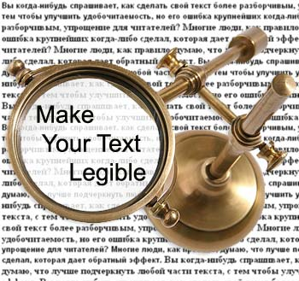
Características Gerais
Legibilidade
Fácil leitura do código
“Human Readable”
http://masterview.ikonosnewmedia.com/2007/10/26/information_design_how_to_make.htm

Slide 8

Características Gerais
Funcionalidades Embutidas
Leitura/Escrita de arquivos
Leitura/Escrita XML
Leitura/Escrita zip
Acesso a URLs
http://www.thisoldhouse.com/toh/photos/0,,20155914,00.html

Slide 9
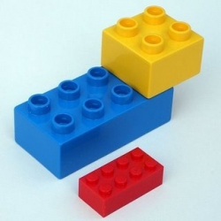
Características Gerais
Diversos módulos
Bioinformatica
Gerador de PDF
Acesso a bancos de dados
Animações
Gráficos 2D/3D
http://i2.squidoocdn.com/resize/squidoo_images/250/draft_lens3869662module25552252photo_1240440069lego.jpg

Slide 10
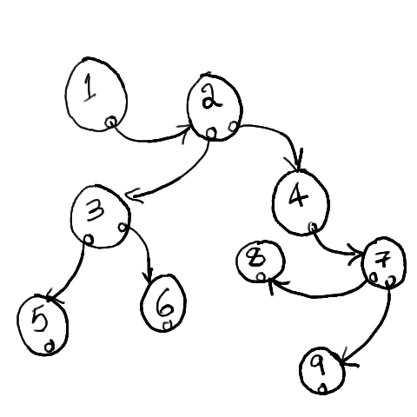
Características Gerais
Estruturas de dados em alto nivel
Dictionary
Set
Lists
Tuples
http://splat.wisetome.com/sites/default/files/node/146/data-structure.png

Slide 11

Características Gerais
Multiparadigma
Procedural
Orientado a Objeto
http://christophergrant.org/2009/12/07/object-oriented-thinking-for-the-procedural-programmer/

Slide 12
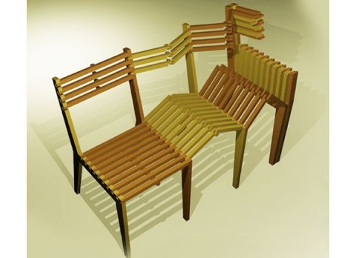
Características Gerais
Extensível
Bindings
Third Party Modules
Bibliotecas
http://trendirs.com/home/furniture-designs/extensible-chairs/

Slide 13

Características Gerais
Open Source
Pode ser usada livremente
Distribuida livremente
http://www.designer-daily.com/wp-content/uploads/2009/03/opensource-logo.jpg

Slide 14

Características Gerais
Multiplataforma
Interpretador
Windows, Linux,Mac
http://christophergrant.org/2009/12/07/object-oriented-thinking-for-the-procedural-programmer/

Slide 15

Características Gerais
Comunidade Próspera
Comunidade científica
Diversas bibliotecas
Suporte
http://www.rtpi.org.uk/download/118/world-connect-people-community-international.jpg

Slide 16
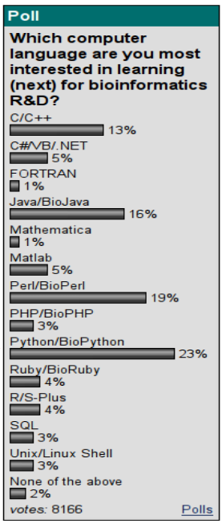
Características Gerais
Fonte: www.bioinformatics.org

Slide 17
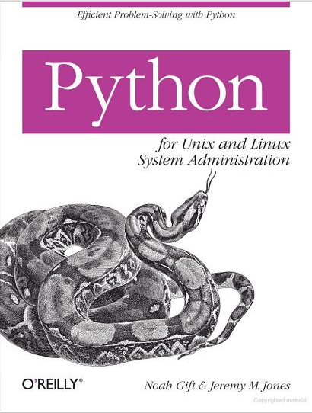
Aplicações
Scripting

Slide 18
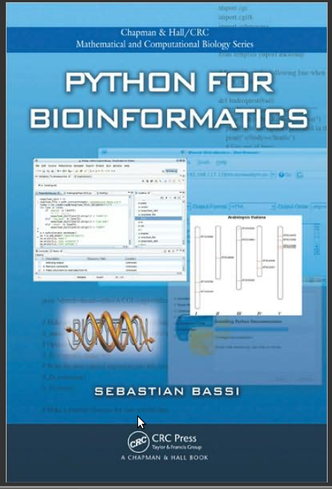
Aplicações
Bioinformática

Slide 19
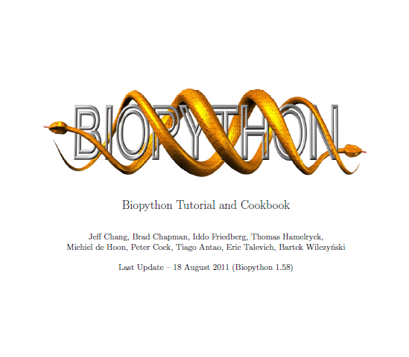
Aplicações
Bioinformática

Slide 20
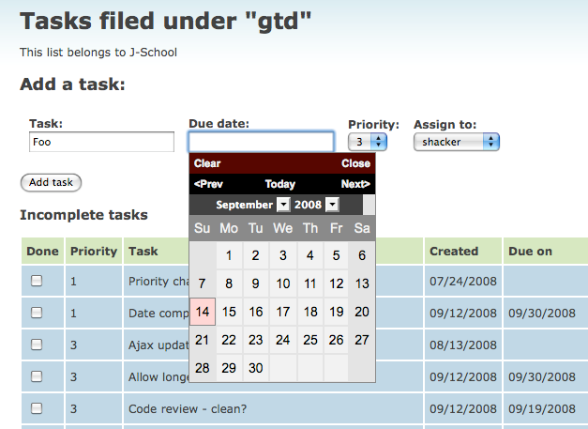

Aplicações
Aplicações Web - Django

Slide 21
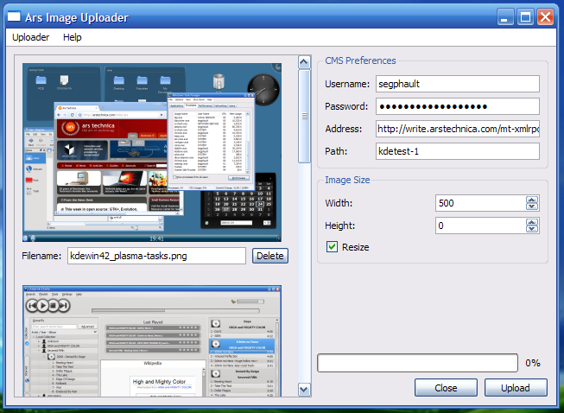
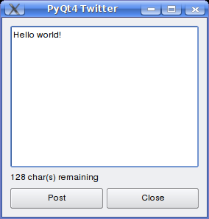
Aplicações
GUI - PyQT

Slide 22
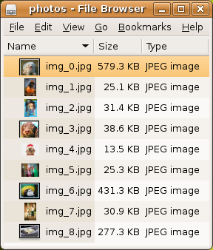
Aplicações
GUI - PyGTK

Slide 23

Aplicações
Jogos - PyGame

Slide 24
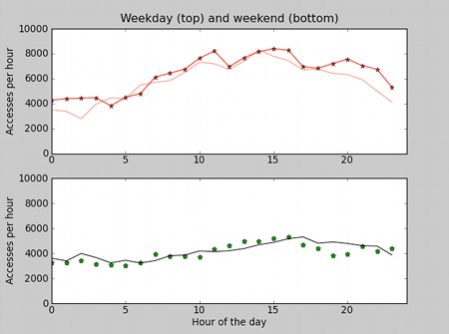

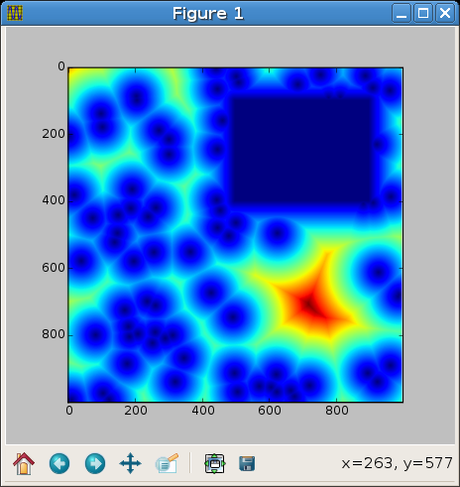
Aplicações
Computação Científica – SciPy, NumPy

Slide 25
Relevância para Bioinformática
Freely available
Open source tools
Available for all the major operating systems
Very high-level programming language
Easy to learn syntax
Object Oriented programming capabilities
Wide array of libraries
Can interface to optimized code written in C, C++ or even FORTRAN
Numerical Python project numpy (Oliphant, 2006)
Scientific programming (Oliphant, 2007)
Molecular dynamics (Hinsen, 2000).
High-quality plotting libraries such as matplotlib
(matplotlib.sourceforge.net)
Cock et al. Biopython: freely available Python tools for computational molecular biology and bioinformatics.
Bioinformatics (2009) vol. 25 (11) pp. 1422-1423 http://www.ncbi.nlm.nih.gov/pubmed/19304878

Slide 26
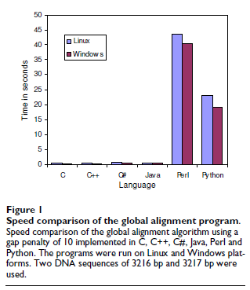
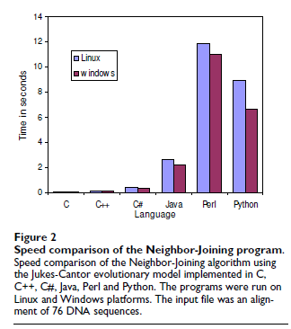
Relevância para Bioinformática
Mathieu Fourment, Michael R Gillings (2008) A comparison of common programming languages used in bioinformatics.http://www.ncbi.nlm.nih.gov/pubmed/18251993

Slide 27
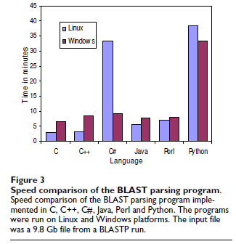
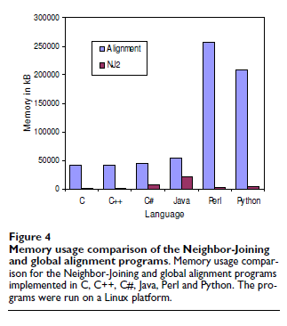
Relevância para Bioinformática
Mathieu Fourment, Michael R Gillings (2008) A comparison of common programming languages used in bioinformatics.http://www.ncbi.nlm.nih.gov/pubmed/18251993

Slide 28
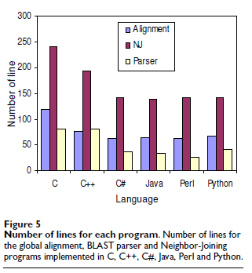
Relevância para Bioinformática
Mathieu Fourment, Michael R Gillings (2008) A comparison of common programming languages used in bioinformatics.http://www.ncbi.nlm.nih.gov/pubmed/18251993

Slide 29
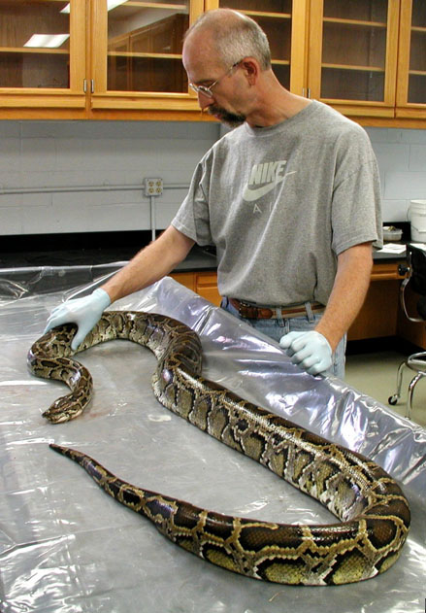
Hands On Python !

Slide 30
Abrir o Ambiente
$ python <Enter>

Slide 31

PyDev - Eclipse
http://pydev.org/

Slide 32
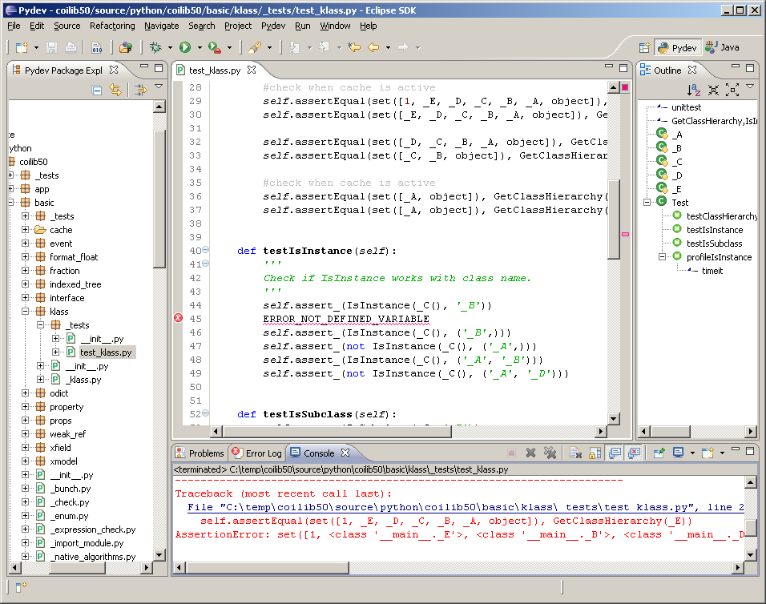
PyDev - Eclipse

Slide 33
Duvidas ?
>>>help()

Slide 34
Hello World!
>>>print(“\nHello ACTG!”)
* python 2.x
** python 3.x

Slide 35
Comentários
# isto é um comentário

Slide 36
hashbang (#!)
#!/usr/bin/env python
#!/usr/bin/python

Slide 37
Encoding
# -*- coding: ENCODING -*-
ascii, latin1, 8859-1, UTF-8 ...

Slide 38
Executando um .py
chmod +x ./meuPrograma.py
python ./meuPrograma.py

Slide 39
Entrada de Dados Via Teclado
>>> name = raw_input("Enter your name: ") (*)
Enter your name: Seba
>>> name
’Seba’
>>> name = input("Enter your name: ") (**)
Enter your name: Seba
>>> name
’Seba’
* python 2.x
** python 3.x

Slide 40
Tipagem Dinâmica
>>>X= 50
>>>type(X)
>>>X=“meu nome”
>>>type(X)
>>>X= 1.2345
>>>type(X)

Slide 41
Operações Básicas
>>>3+4 # Adição
>>>10-9 # Subtração
>>>23*10 # Multiplicação
>>>100/2 # Divisão
>>>3%2 # Resto

Slide 42
Strings Criação
>>>"This is a string in Python"
>>>’This is a string in Python’
>>>’’’This is a string in Python’’’
>>>"""This is a string in Python"""
python 2.x - ASCII
python 3.x - UNICODE

Slide 43
Strings Atribuição e Alteração da Caixa
>>> signal_peptide="MASKATLLLAFTLLFATCIA"
>>> signal_peptide.lower()
’maskatlllaftllfatcia’
>>> signal_peptide
’MASKATLLLAFTLLFATCIA’
>>> signal_peptide=signal_peptide.lower()
>>> signal_peptide
’maskatlllaftllfatcia’

Slide 44
Strings Substituição
>>> DNAseq="TTGCTAG"
>>> mRNAseq=DNAseq.replace("T","U")
>>> mRNAseq
’UUGCUAG’

Slide 45
Strings Contagem e Localização de Caracteres
>>> c=DNAseq.count("C")
>>> g=DNAseq.count("G")
>>> float(c+g)/len(DNAseq)*100
48.387096774193552
>>> mRNAseq.find("UAG")
4
>>> mRNAseq.find("xxx")
-1
>>> mRNAseq.index("xxx")
ValueError

Slide 46
Strings Divisão de Strings em Pontos Específicos
>>> "This string has words separated by spaces".split()
[’This’, ’string’, ’has’, ’words’, ’separated’, ’by’, ’spaces’]
>>> "Alex Doe,5555-2333,nobody@example.com".split(",")
[’Alex Doe’, ’5555-2333’, ’nobody@example.com’]

Slide 47
Strings Concatenação e Medição
>>> aseq="atggctaggc"
>>> list(aseq)
[’a’, ’t’, ’g’, ’g’, ’c’, ’t’, ’a’, ’g’, ’g’, ’c’]
>>> "".join([’a’, ’t’, ’g’, ’g’, ’c’, ’t’, ’a’, ’g’, ’g’, ’c’])
’atggctaggc’
>>> DNAseq="ATGCTAGACGTCCTCAGATAGCCG"
>>> TATAbox="TATAAA"
>>> TATAbox+DNASeq
’TATAAAATGCTAGACGTCCTCAGATAGCCG’
>>> my_sequence="MRVLLVALALLALAASATS"
>>> len(my_sequence)
19

Slide 48
Strings Substrings
>>> nome="ACTCGTCACGTAC"
>>> print(nome[:10])
ACTCGTCACG
>>> print(nome[-3])
T
>>> print(nome[5:10])
TCACG

Slide 49
Strings Iteração
>>> nome= "mini curso do LPRAD"
>>> for i in nome:
>>> print(i)

Slide 50
Strings Existencia de Elemento
letras=”ACGTGCACGAT”
“u” in letras
“A” in letras

Slide 51
Listas Criação, Inserção, Remoção, Inversão, Ordenação e Intervalos Numéricos
Lista=[]
Lista=list()
Lista=[“yo”]
Lista.append(“hehe”)
Lista.pop()
Lista.reverse()
Lista.sort()
range(100) # (**)
xrange(10000) # (*)
Lista1.append(“item”)
Lista2.append(“coisa”)
Lista2.extend(Lista1)
Lista1[1]=“treco”
Lista1.insert(2, “outraCoisa”)
Lista1+=[“maisUmaCoisa”]
Lista1+=“maisUmaCoisa”
del Lista2[1]
Lista2.remove(“coisa”)
Lista2.index(“coisa”)
* python 2.x
** python 3.x

Slide 52
Tuplas
>>> point=tuple()
>>> point=(23,56,11)
>>> point[2]
* imutável

Slide 53
Dicionários
>>> IUPAC = {’A’:’Ala’,’C’:’Cys’,’E’:’Glu’}
>>> print("C stands for the amino acid "+IUPAC[’C’])
C stands for the amino acid Cys
>>> IUPAC[’E’]
’Glu’
>>> IUPAC.keys()
['A', 'C', 'E']
>>> IUPAC.values()
['Ala', 'Cys', 'Glu']
>>> IUPAC.items()
[('A', 'Ala'), ('C', 'Cys'), ('E', 'Glu')]
>>> IUPAC.get(’A’,’No translation’)
’Ala’
>>> IUPAC.get(’Z’,’No translation’)
’No translation’
>>> del IUPAC[’A’]
>>> IUPAC
[(’C’, ’Cys’), (’E’, ’Glu’), (’F’, ’Phe’)]

Slide 54
Conjuntos
>>> first_set = set([’CP0140.1’,’EF3613.1’,’EF3616.1’])
>>> first_set = set()
>>> first_set.add(’CP0140.1’)
>>> first_set.add(’EF3613.1’)
>>> first_set.add(’EF3616.1’)
>>> first_set
set([’CP0140.1’,’EF3613.1’,’EF3616.1’])

Slide 55
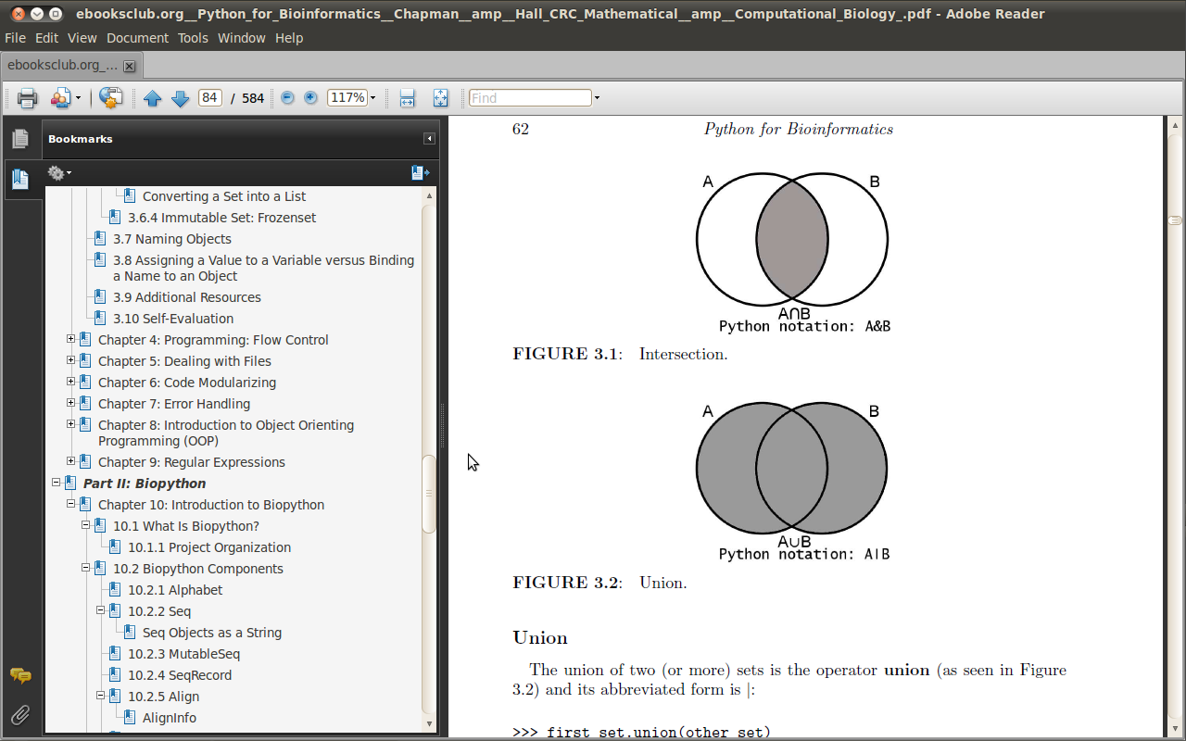
Conjuntos
>>> first_set = set([’CP0140.1’,’EF3613.1’,’EF3616.1’])
>>> other_set = set([’CP0140.2’,’EF3613.1’,’EF3616.2’])
>>> common = first_set.intersection(other_set)
>>> common = first_set & other_set
>>> common
set([’EF3613.1’])

Slide 56
Conjuntos
>>> first_set.union(other_set)
set([’EF3616.2’, ’EF3613.1’, ’EF3616.1’, ’CP0140.1’, ’CP0140.2’])
>>> first_set | other_set
set([’EF3616.2’, ’EF3613.1’, ’EF3616.1’, ’CP0140.1’, ’CP0140.2’])

Slide 57
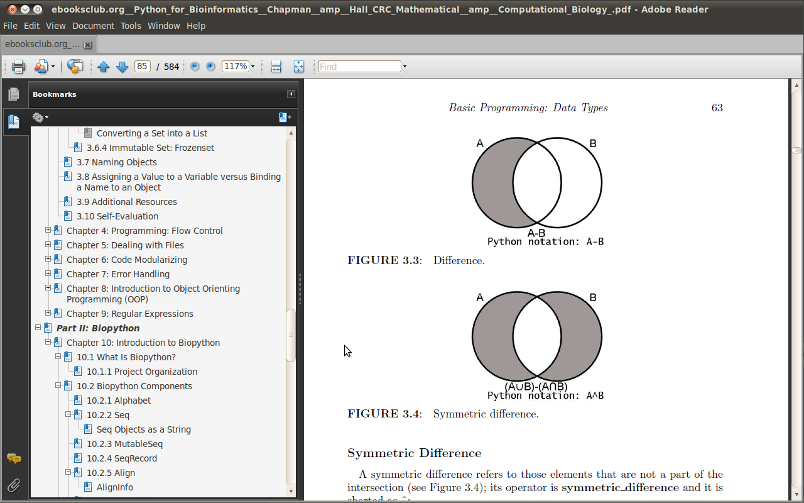
Conjuntos
>>> first_set.difference(other_set)
set([’CP0140.1’, ’EF3616.1’])
>>> first_set - other_set
set([’CP0140.1’, ’EF3616.1’])

Slide 58
Conjuntos
>>> first_set.symmetric_difference(other_set)
set([’EF3616.2’, ’CP0140.1’, ’CP0140.2’, ’EF3616.1’])
>>> first_set ^ other_set
set([’EF3616.2’, ’CP0140.1’, ’CP0140.2’, ’EF3616.1’])

Slide 59
Indentação
#Espaços em branco fazem a indentação
if(x==10):
print(“eh dez”)
else:
print(“naum eh dez”)

Slide 60
Estrutura de Decisão - if
if <test>:
<bloco do TRUE>
else:
<bloco do FALSE>

Slide 61
Estrutura de Decisão - switch
Não há “switch”!
if <test>:
<bloco do TRUE>
elif <test>:
<bloco do FALSE>
elif <test>:
<bloco do FALSE>
(...)
else:
<bloco do FALSE>

Slide 62
Estrutura de Repetição - for
for <indice> in <objeto>:
<bloco do for>
…
…
…
if <test>: break
if <test>: continue
else:
<bloco caso não ocorra break>

Slide 63
Estrutura de Repetição - while
while <test>
<bloco do for>
…
…
…
if <test>: break
if <test>: continue
else:
<bloco caso não ocorra break>

Slide 64
Pass - Não fazer nada!
if <test>:
pass
else:
<bloco do true>

Slide 65
Leitura/Escrita de Arquivos
fh = open(’/home/sb/seqA.fas’)
name = fh.readline()[1:-1]
sequence = ""
for line in fh:
sequence += line.replace(’\n’,’’)
print ("The name is: %s"%name)
print ("The sequence is: %s"%sequence)
fh.close()

Slide 66
Leitura/Escrita de Arquivos
fh = open(’/home/sb/bioinfo/seqA.fas’)
myfile = fh.read() #myfile is a string
name = myfile.split(’\n’)[0][1:]
sequence = ’’.join(myfile.split(’\n’)[1:])
print("The name is: %s"%name)
print("The sequence is: %s"%sequence)
fh.close()

Slide 67
Leitura/Escrita de Arquivos
fh = open(’/home/sb/seqA.fas’)
FirstLine = fh.readline()
name = FirstLine[1:-1]
sequence = ""
while True:
line = fh.readline()
if line=="":
break
sequence += line.replace(’\n’,’’)
print("The name is: %s"%name)
print("The sequence is: %s"%sequence)
fh.close()

Slide 68
Leitura/Escrita de Arquivos
import csv
tlen=0;n=0
lines = csv.reader(open('B1.csv'))
lines.next()
for line in lines:
tlen += int(line[1])
n += 1
print(tlen/float(n))
csv.reader(open("data.csv"), delimiter=’:’)
csv.reader(open("data.csv"), dialect=’excel’)
csv.Sniffer().sniff(open(’data.csv’).read())

Slide 69
Leitura/Escrita de Arquivos
fh = open(’prot.fas’)
fh.readline()
sequence = ""
for line in fh:
sequence += line[:-1].upper()
fh.close()
charge = -0.002
AACharge={"C":-.045,"D":-.999,"E":-.998,"H":.091,
"K":1,"R":1,"Y":-.001}
for aa in sequence:
charge += AACharge.get(aa,0)
fhout = open(’out.txt’,’w’)
fhout.write(str(charge))
fhout.close()

Slide 70
Outros Módulos
>>> import os
>>> os.getcwd()
>>> os.chdir(’..’)
>>> os.getcwd()
>>> os.listdir(’/home/sb/bioinfo/seqs’)
>>> os.path.isfile(’/home/sb’)
False
>>> os.path.isdir(’/home/sb’)
True
>>> os.remove(’/home/sb/bioinfo/seqs/ms115.ab1’)
>>> os.rename(’/home/sb/seqs/readme.txt’,’/home/sb/Readme’)
>>> os.mkdir(’/home/sb/processed-seqs’)
>>> os.path.join(os.getcwd(), "images")
>>> os.path.exists(os.path.join(os.getcwd(), "images"))
False
>>> os.path.split(’/home/sb/seqs/ms2333.ab1’)
(’/home/sb/seqs’, ’ms2333.ab1’)
>>> os.path.splitext(’/home/sb/seqs/ms2333.ab1’)
(’/home/sb/seqs/ms2333’, ’.ab1’)

Slide 71
Outros Módulos
import os
mypath=’/home/sb/bioinfo/test/’
AACharge = {"C":-.045,"D":-.999,"E":-.998,
"H":.091,"K":1,"R":1,"Y":-.001}
for x in os.listdir(mypath):
if os.path.splitext(x)[1]==’.fas’:
fh = open(os.path.join(mypath,x),’U’)
name = fh.readline()[1:-1]
seq = ""
for line in fh:
seq = seq + line[:-1].upper()
fh.close()
charge = -0.002
for aa in seq:
charge += AACharge.get(aa,0)
fh = open(os.path.join(mypath,’netvalues.txt’),’a’)
fh.write("%s,%s\n"%(name,charge))
fh.close()

Slide 72
Funções
def FunctionName(argument1, argument2, ...):
""" Optional Function description (Docstring) """
... FUNCTION CODE ...
return DATA

Slide 73
Funções
def chargeandprop(AAseq):
""" Returns the net charge of a protein sequence
and proportion of charged amino acids """
protseq = AAseq.upper()
charge = -0.002
cp = 0
AACharge={"C":-.045,"D":-.999,"E":-.998,"H":.091,
"K":1,"R":1,"Y":-.001}
for aa in protseq:
charge += AACharge.get(aa,0)
if aa in AACharge:
cp += 1
prop = 100.*cp/len(AAseq)
return (charge,prop)
>>> chargeandprop("QTALLVVLVLLAVALQATEAGPYGA")
(-1.0009999999999999, 8.0)
>>> chargeandprop("EEARGPLRGKGDQKSAVSQKPRSRGILH")
(4.0940000000000003, 39.285714285714285)

Slide 74
Funções
def savelist(L,fname="temp.txt"):
""" A list (L) is saved to a file (fname) """
fh = open(fname,"w")
for x in L:
fh.write(str(x)+"\n")
fh.close()
return None
mylist = [’MS233’,’MS772’,’MS120’,’MS93’,’MS912’]
>>> savelist(mylist)

Slide 75
Funções
def commandline(name, **parameters):
line = ""
for parname,parvalue in parameters.iteritems():
line = line + " -" + parname + " " + parvalue
return name+line
>>> commandline("formatdb",t="Caseins",i="indata.fas")
’formatdb -i indata.fas -t Caseins’
>>> commandline("formatdb",t="Caseins",i="indata.fas",p="F")
’formatdb -i indata.fas -p F -t Caseins’

Slide 76
Funções Generators
def isprime(n):
for i in range(2,n-1):
if n%i == 0:
return False
return True
def putn(n):
p = [ ]
for i in xrange(1,n):
if isprime(i):
p.append(i)
return p
def gputn(n):
for i in xrange(1,n):
if isprime(i):
yield i

Slide 77
Módulos
>>> import os
>>> os.getcwd()
>>> from os import getcwd
>>> getcwd()
>>> from os import *
>>> getcwd()
>>> import xml.etree.ElementTree as ET
>>> tree = ET.parse("/home/sb/bioinfo/smallUniprot.xml")
>>> import sys
>>> sys.path
[’/home/sb’, ’/usr/local/bin’]
>>> sys.path.append("/home/sb/MyPyModules")
$ sudo easy_install <module_name>

Slide 78
Tratamento de Excessão
import os
while True:
try:
iname = raw_input("Enter input filename: ")
oname = raw_input("Enter output filename: ")
fh = open(iname)
line = fh.readline()
fh.close()
value = line.split(’\t’)[0]
fw = open("/home/sb/"+oname,"w")
fw.write(str(int(value)*.2))
fw.close()
except IOError, (errno,errtext):
if errno==13:
print "Can’t write to outfile."
elif errno==2:
print "File not exist"
except ValueError, strerror:
if "substring not found" in strerror.message:
print "There is no tab"
elif "invalid literal for int" in strerror.message:
print "The value can’t be converted to int"
else:
print "Thank you!. Everything went OK."
break

Slide 79
Tratamento de Excessão
def avg(numbers):
if not numbers:
raise ValueError("Please enter at least one element")
return sum(numbers)/len(numbers)
class NotDNAException(Exception):
""" A user-defined exception."""
def __init__(self, dna):
self.dna = dna
def __str__(self):
for nt in self.dna:
If nt not in ’atcg’:
return nt

Slide 80
Orientação a Objetos
class Sequence:
TranscriptionTable = {"A":"U","T":"A","C":"G","G":"C"}
def __init__(self, seqstring):
self.seqstring=seqstring.upper()
def transcription(self):
tt = ""
for x in self.seqstring:
if x in ’ATCG’:
tt += self.TranscriptionTable[x]
return tt

Slide 81
Orientação a Objetos
>>> DangerousVirus=Sequence(’atggagagccttgttcttggtgtcaa’)
>>> DangerousVirus.seqstring
’ATGGAGAGCCTTGTTCTTGGTGTCAA’
>>> HarmlessVirus=Sequence(’aatgctactactattagtagaattgatgcca’)
>>> HarmlessVirus.seqstring
’AATGCTACTACTATTAGTAGAATTGATGCCA’
>>> DangerousVirus.transcription()
’GCUAAGAGCUCGCGUCCUCAGAGUUUAGGA’

Slide 82
Orientação a Objetos
class TestClass:
def a(self):
pass
def __b(self):
# mangled to _TestClass__b
pass
>>> MyObject = TestClass()
>>> MyObject.a()
>>> MyObject.__b()
Traceback (most recent call last):
File "<pyshell#14>", line 1, in <module>
MyObject.__b()
AttributeError: TestClass instance has no attribute ’__b’

Slide 83
Expressões Regulares
>>> import re
>>> mo = re.search("hello","Hello world, hello Python!")
>>> mo.group()
’hello’
>>> mo.span()
(13, 18)
>>> re.findall("[Hh]ello","Hello world, hello Python,!")
[’Hello’, ’hello’]
>>> rgx = re.compile("[Hh]ello")
>>> rgx.findall("Hello world, hello Python,!")
[’Hello’, ’hello’]
>>> mos = re.finditer("[Hh]ello","Hello world, hello Python,!")
>>> for x in mos:
print x.group()
print x.span()
>>> mo = re.match("hello", "Hello world, hello Python!")
>>> print mo
None

Slide 84
Expressões Regulares
import re
regex = re.compile(’ |\d|\n|\t’)
seq = ’’
for line in open(’pMOSBlue.txt’):
seq += regex.sub(’’,line)
print seq
ATGACCATGA TTACGCCAAG CTCTAATACG ACTCACTATA GGGAAAGCTT GCATGCCTGC
AGGTCGACTC TAGAGGATCT ACTAGTCATA TGGATATCGG TCCCCGGGT ACCGAGCTCG
AATTCACTGG CCGTCGTTTT
ATGACCATGATTACGCCAAGCTCTAATACGACTCACTATAGGGAAAGCTTGCATGCCTGC
AGGTCGACTCTAGAGGATCTACTAGTCATATGGATATCGGATCCCCGGGTACCGAGCTCG
AATTCACTGGCCGTCGTTTT

Slide 85
BioPython
Biopython (Agosto de 1999)
Iniciado por Jeff Chang e Andrew Dalke
Tarefas repetitivas no processo de análise
Inspirado no BioPerl
Open Bioinformatics Foundation
Bio*
Código disponível na internet
http://www.biopython.org
Usuários podem contribuir com o projeto
Sugestões de funcionalidades
Propostas de código
Problemas

Slide 86
BioPython Componentes (Classes)
Alphabet
Seq
MutableSeq
SeqRecord
Alignment
ClustalW
SeqIO
AlignIO
BLAST
Entrez
PDB
PROSITE
Restriction
SeqUtils
Sequencing
SwissProt

Slide 87
BioPython Alphabet
>>> import Bio.Alphabet
>>> Bio.Alphabet.ThreeLetterProtein.letters
[’Ala’, ’Asx’, ’Cys’, ’Asp’, ’Glu’, ’Phe’, ’Gly’, ’His’, <=
’Ile’, ’Lys’, ’Leu’, ’Met’, ’Asn’, ’Pro’, ’Gln’, ’Arg’, <=
’Ser’, ’Thr’, ’Sec’, ’Val’, ’Trp’, ’Xaa’, ’Tyr’, ’Glx’]
>>> from Bio.Alphabet import IUPAC
>>> IUPAC.IUPACProtein.letters
’ACDEFGHIKLMNPQRSTVWY’
>>> IUPAC.unambiguous_dna.letters
’GATC’
>>> IUPAC.ambiguous_dna.letters
’GATCRYWSMKHBVDN’
>>> IUPAC.ExtendedIUPACProtein.letters
’ACDEFGHIKLMNPQRSTVWYBXZ’
>>> IUPAC.ExtendedIUPACDNA.letters
’GATCBDSW’

Slide 88
BioPython Seq
>>> from Bio.Seq import Seq
>>> import Bio.Alphabet
>>> seq = Seq(’CCGGGTT’,Bio.Alphabet.IUPAC.unambiguous_dna)
>>> seq.transcribe()
Seq(’CCGGGUU’, IUPACUnambiguousRNA())
>>> seq.translate()
Seq(’PG’, IUPACProtein())
>>> rna_seq = Seq(’CCGGGUU’,Bio.Alphabet.IUPAC.unambiguous_rna)
>>> rna_seq.transcribe()
Traceback (most recent call last):
File "<stdin>", line 1, in <module>
File "/home/sb/Seq.py", line 520, in transcribe
raise ValueError("RNA cannot be transcribed!")
ValueError: RNA cannot be transcribed!
>>> rna_seq.translate()
Seq(’PG’, IUPACProtein())
>>> rna_seq.back_transcribe()
Seq(’CCGGGTT’, IUPACUnambiguousDNA())

Slide 89
BioPython MutableSeq
>>> seq = Seq(’CCGGGTTAACGTA’,Bio.Alphabet.IUPAC.unambiguous_dna)
>>> seq[:5]
Seq(’CCGGG’, IUPACUnambiguousDNA())
>>> len(seq)
13
>>> print seq
CCGGGTTAACGTA
>>> seq[0]=’T’
Traceback (most recent call last):
File "<stdin>", line 1, in ?
AttributeError: ’Seq’ instance has no attribute ’__setitem__’
>>> mut_seq = seq.tomutable()
>>> mut_seq
MutableSeq(’CCGGGTT’, IUPACUnambiguousDNA())
>>> mut_seq[0]=’T’
>>> mut_seq
MutableSeq(’TCGGGTT’, IUPACUnambiguousDNA())

Slide 90
BioPython MutableSeq
>>> mut_seq.reverse()
>>> mut_seq
MutableSeq(’TTGGGCT’, IUPACUnambiguousDNA())
>>> mut_seq.complement()
>>> mut_seq
MutableSeq(’AACCCGA’, IUPACUnambiguousDNA())
>>> mut_seq.reverse_complement()
>>> mut_seq
MutableSeq(’TCGGGTT’, IUPACUnambiguousDNA())

Slide 91
BioPython SeqRecord
>>> from Bio.SeqRecord import SeqRecord
>>> from Bio.Seq import Seq
>>> from Bio.Alphabet import generic_protein
>>> rec = SeqRecord(Seq("mdstnvrsgmksrkkkpkttvidddddcmtcsacqs"\+ "klvkisditkvsldyintmrgntlacaacgsslkllndfas", generic_protein),
id="P20994.1", name="P20994", description="Protein A19", dbxrefs=["Pfam:PF05077", "InterPro:IPR007769", "DIP:2186N"])
>>> rec.annotations["note"] = "A simple note"

Slide 92
BioPython Alignment
>>> # Import all required classes
... from Bio import Alphabet
>>> from Bio.Alphabet import IUPAC
>>> from Bio.Align.Generic import Alignment
>>> from Bio.Seq import Seq
>>> # Create and name our two sequences
... seq1 = 'MHQAIFIYQIGYPLKSGYIQSIRSPEYDNW'
>>> seq2 = 'MH--IFIYQIGYALKSGYIQSIRSPEY-NW'
>>> # Initialize an alignment object
... a = Alignment(Alphabet.Gapped(IUPAC.protein))
>>> # Add the sequences to this alignment object
... a.add_sequence("asp",seq1)
>>> a.add_sequence("unk",seq2)
>>> print a
Gapped(IUPACProtein(), '-') alignment with 2 rows and 30 columns
MHQAIFIYQIGYPLKSGYIQSIRSPEYDNW asp
MH--IFIYQIGYALKSGYIQSIRSPEY-NW unk

Slide 93
BioPython ClustalW
>>> from Bio.Clustalw import MultipleAlignCL
>>> cl = MultipleAlignCL(’inputfile.fasta’)
>>> cl.set_output(’cltest.txt’)
>>> print("Command line: %s"%cl)
Command line: clustalw inputfile.fasta -OUTFILE=cltest.txt
>>> clpath=’c:\\windows\\program file\\clustal\\clustalw.exe’
>>> cl = MultipleAlignCL(’inputfile.fasta’,command=clpath)
>>> from Bio.Clustalw import do_alignment
>>> align = do_alignment(cl)
##########################################
>>> from Bio.Clustalw import MultipleAlignCL
>>> cl = MultipleAlignCL(’inputfile.fasta’)
>>> cl.gap_open_pen=5
>>> cl.gap_ext_pen=3
>>> cl.new_tree=’outtree.txt’
>>> print(cl)
clustalw inputfile.fasta -NEWTREE=outtree.txt -align -GAPOPEN=5<=
-GAPEXT=3

Slide 94
BioPython SeqIO
>>> #### LEITURA DE ARQUIVOS
>>> from Bio import SeqIO
>>> f_in = open(’/home/sb/bioinfo/a19.gbk’)
>>> SeqIO.parse(f_in,’genbank’).next()
SeqRecord(seq=Seq(’MDSTNVRSGMKSRKKKPKTTVIDDDDDCMTCSACQSKLVKISDIT<=
KVSLDYINT...FAS’, IUPACProtein()), id=’P20994.1’, name=’P20994’,<=
description=’Protein A19.’, dbxrefs=[])
>>> from Bio import SeqIO
>>> f_in = open(’/home/sb/bioinfo/a19.gbk’)
>>> SeqIO.parse(f_in,’genbank’).next()
SeqRecord(seq=Seq(’MDSTNVRSGMKSRKKKPKTTVIDDDDDCMTCSACQSKLVKISDIT<=
KVSLDYINT...FAS’, IUPACProtein()), id=’P20994.1’, name=’P20994’,<=
description=’Protein A19.’, dbxrefs=[])

Slide 95
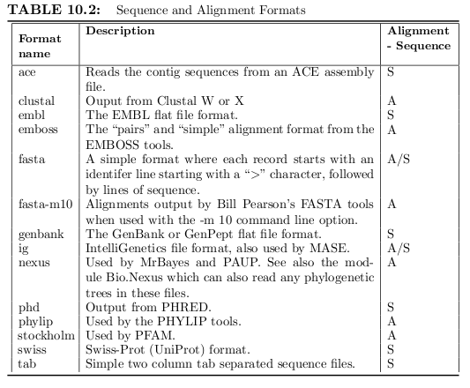
BioPython SeqIO

Slide 96
BioPython SeqIO
>>> #### ESCRITA DE ARQUIVOS
>>> from Bio import SeqIO
>>> from Bio.Seq import Seq
>>> from Bio.SeqRecord import SeqRecord
>>> fh = open(’NC2033.txt’)
>>> f_out = open(’NC2033.fasta’,’w’)
>>> rawseq = fh.read().replace(’\n’,’’)
>>> #record = [SeqRecord(Seq(rawseq),’NC2033.txt’,’’,’’)]
>>> record = (SeqRecord(Seq(rawseq),’NC2033.txt’,’’,’’),)
>>> SeqIO.write(record, f_out,’fasta’)
>>> f_out.close()
>>> fh.close()
>>>
>>> from Bio import SeqIO
>>> fo_handle = open(’myseqs.fasta’,’w’)
>>> readseq = SeqIO.parse(open(’myseqs.gbk’), "genbank")
>>> SeqIO.write(readseq, fo_handle, "fasta")
>>> fo_handle.close()

Slide 97
BioPython AlignIO
fi = open(’/home/sb/bioinfo/example.aln’)
fo = open(’/home/sb/bioinfo/example.phy’,’w’)
align = AlignIO.read(fi,"clustal")
AlignIO.write([alig],fo,"phylip")
fo.close()

Slide 98
BioPython BLAST
Basic Local Alignment Search Tool (BLAST)
Programa de busca de similaridades entre sequencias
Busca uma consulta em um banco de dados
Execução remota (NCBI) e local

Slide 99
BioPython BLAST
# blastall(blast executable, program name, database, input file, [align_view=7], [parameters])
>>> from Bio.Blast import NCBIStandalone as BLAST
>>> b_exe = ’/home/sb/blast-2.2.20/bin/blastall’
>>> f_in = ’seq3.txt’
>>> b_db = ’/home/sb/blast-2.2.20/data/TAIR8cds’
>>> rh, eh = BLAST.blastall(b_exe, "blastn", b_db, f_in)
>>>
>>> rh.readline()
<?xml version="1.0"?>
>>> rh.readline()
’<!DOCTYPE BlastOutput PUBLIC "-//NCBI//NCBI BlastOutput/EN"<=
"http://www.ncbi.nlm.nih.gov/dtd/NCBI_BlastOutput.dtd">\n’

Slide 100
BioPython BLAST
>>> fh = open(’testblast.xml’,’w’)
>>> fh.write(rh.read())
>>> fh.close()
from Bio.Blast import NCBIXML
for blast_record in NCBIXML.parse(rh):
# Do something with blast_record

Slide 101
BioPython BLAST
from Bio.Blast import NCBIXML
xmlfh = open('/home/sb/bioinfo/other.xml') # BLAST output file.
for record in NCBIXML.parse(xmlfh):
for align in record.alignments:
print align.title
gi|110804074|ref|NC_008258.1| Shigella flexneri 5 str. 8401
gi|89106884|ref|AC_000091.1| Escherichia coli W3110 DNA
gi|117622295|ref|NC_008563.1| Escherichia coli APEC O1

Slide 102
BioPython Entrez - eUtils: Retrieving Bibliography
from Bio import Entrez
my_em = ’user@example.com’
db = "pubmed"
# Search de Entrez website using esearch from eUtils
# esearch returns a handle (called h_search)
h_search = Entrez.esearch(db=db, email=my_em,
term="python and bioinformatics")
# Parse the result with Entrez.read()
record = Entrez.read(h_search)
# Get the list of Ids returned by previous search
res_ids = record["IdList"]
# For each id in the list
for r_id in res_ids:
# Get summary information for each id
h_summ = Entrez.esummary(db=db, id=r_id, email=my_em)
# Parse the result with Entrez.read()
summ = Entrez.read(h_summ)
print(summ[0][’Title’])
print(summ[0][’DOI’])
print(’==============================================’)

Slide 103
BioPython Entrez - eUtils: Gene Information
from Bio import Entrez
my_em = ’user@example.com’
db = "gene"
term = ’cobalamin synthase homo sapiens’
h_search = Entrez.esearch(db=db, email=my_em, term=term)
record = Entrez.read(h_search)
res_ids = record["IdList"]
for r_id in res_ids:
h_summ = Entrez.esummary(db=db, id=r_id, email=my_em)
summ = Entrez.read(h_summ)
print(r_id)
print(summ[0][’Description’])
print(summ[0][’Summary’])
print(’==============================================’)

Slide 104
BioPython PDB (Protein Database)
import gzip
from Bio.PDB.PDBParser import PDBParser
def disorder(structure):
for chain in structure[0].get_list():
for residue in chain.get_list():
for atom in residue.get_list():
if atom.is_disordered():
print residue, atom
return None
pdbfn = ’/home/sb/bioinfo/pdb1apk.ent.gz’
handle = gzip.GzipFile(pdbfn)
parser = PDBParser()
structure = parser.get_structure("test", handle)
disorder(structure)

Slide 105
BioPython PROSITE
from Bio import Prosite
handle = open("prosite.dat")
records = Prosite.parse(handle)
for r in records:
print(r.accession)
print(r.name)
print(r.description)
print(r.pattern)
print(r.created)
print(r.pdoc)
print("===================================")
PS00001
ASN_GLYCOSYLATION
N-glycosylation site.
N-{P}-[ST]-{P}.
APR-1990
PDOC00001
===================================
PS00004
CAMP_PHOSPHO_SITE
cAMP- and cGMP-dependent protein kinase phosphorylation site.
[RK](2)-x-[ST].
APR-1990
PDOC00004
===================================

Slide 106
BioPython Restriction
>>> from Bio import Restriction
>>> Restriction.EcoRI
EcoRI
>>> from Bio.Seq import Seq
>>> from Bio.Alphabet.IUPAC import IUPACAmbiguousDNA
>>> alfa = IUPACAmbiguousDNA()
>>> gi1942535 = Seq(’CGCGAATTCGCG’, alfa)
>>> Restriction.EcoRI.search(gi1942535)
[5]
>>> Restriction.EcoRI.catalyse(gi1942535)
(Seq(’CGCG’, IUPACAmbiguousDNA()), Seq(’AATTCGCG’, IUPACAmbiguousDNA()))
>>> enz1 = Restriction.EcoRI
>>> enz2 = Restriction.HindIII
>>> batch1 = Restriction.RestrictionBatch([enz1, enz2])
>>> batch1.search(gi1942535)
{EcoRI: [5], HindIII: []}

Slide 107
BioPython Restriction
>>> dd = batch1.search(gi1942535)
>>> dd.get(Restriction.EcoRI)
[5]
>>> dd.get(Restriction.HindIII)
[]
>>> batch1.add(Restriction.EarI)
>>> batch1
RestrictionBatch([’EarI’, ’EcoRI’, ’HindIII’])
>>> batch1.remove(Restriction.EarI)
>>> batch1
RestrictionBatch([’EcoRI’, ’HindIII’])

Slide 108
BioPython SeqUtils – DNA Utils
CG , GC skew
Percentual de Purinas e Piridiminas
>>> from Bio.SeqUtils import GC
>>> GC(’gacgatcggtattcgtag’)
50.0
Melting Temperature
Temperatura de Desnaturação
>>> from Bio.SeqUtils import MeltingTemp
>>> MeltingTemp.Tm_staluc(’tgcagtacgtatcgt’)
42.211472744873447

Slide 109
BioPython SeqUtils – DNA Utils
Checksum Algorithms
Calcula Checksum dos arquivos (Integridade)
>>> from Bio.SeqUtils import CheckSum
>>> myseq = ’acaagatgccattgtcccccggcctcctgctgctgct’
>>> CheckSum.gcg(myseq)
1149
>>> CheckSum.crc32(myseq)
-2106438743
>>> CheckSum.crc64(myseq)
’CRC-A2CFDBE6AB3F7CFF’
>>> CheckSum.seguid(myseq)
’9V7Kf19tfPA5TntEP75YiZEm/9U’

Slide 110
BioPython SeqUtils - Protein Utils
from Bio.SeqUtils.ProtParam import ProteinAnalysis
from Bio.SeqUtils import ProtParamData
from Bio import SeqIO
fh = open(’/home/sb/bioinfo/pdbaa’)
for rec in SeqIO.parse(fh,’fasta’):
myprot = ProteinAnalysis(str(rec.seq))
print(myprot.count_amino_acids())
print(myprot.get_amino_acids_percent())
print(myprot.molecular_weight())
print(myprot.aromaticity())
print(myprot.instability_index())
print(myprot.flexibility())
print(myprot.isoelectric_point())
print(myprot.secondary_structure_fraction())
print(myprot.protein_scale(ProtParamData.kd, 9, .4))
fh.close()

Slide 111
BioPython Sequencing - Phd Files (Phred)
import pprint
from Bio.Sequencing import Phd
fn = ’/home/sb/bt/biopython-1.50/Tests/Phd/phd1’
fh = open(fn)
rp = Phd.RecordParser()
# Create an iterator
it = Phd.Iterator(fh,rp)
for r in it:
# All the comments are in a dictionary
pprint.pprint(r.comments)
# Sequence information
print(’Sequence: %s’ % r.seq)
# Quality information for each base
print(’Quality: %s’ % r.sites)
fh.close()

Slide 112
BioPython Sequencing - Ace Files (CAP3,Phrap...)
import pprint
from Bio.Sequencing import Phd
fn = ’/home/sb/bt/biopython-1.50/Tests/Phd/phd1’
fh = open(fn)
rp = Phd.RecordParser()
# Create an iterator
it = Phd.Iterator(fh,rp)
for r in it:
# All the comments are in a dictionary
pprint.pprint(r.comments)
# Sequence information
print(’Sequence: %s’ % r.seq)
# Quality information for each base
print(’Quality: %s’ % r.sites)
fh.close()

Slide 113
BioPython SwissProt
from Bio import SwissProt
fh = open(’spfile.txt’)
records = SwissProt.parse(fh)
for record in records:
print(’Entry name: %s’ % record.entry_name)
print(’Accession(s): %s’ % ’,’.join(record.accessions))
print(’Keywords: %s’ % ’,’.join(record.keywords))
print(’Sequence: %s’ % record.sequence)
fh.close()
from Bio import SwissProt
fh = open(’/home/sb/bioinfo/spfile.txt’)
record = SwissProt.parse(fh).next()
for att in dir(record):
if not att.startswith(’__’):
print(att,getattr(record,att))

Slide 114
Referências
http://www.python.org/
http://diveintopython.org/
http://www.wellho.net/mouth/2992_Matplotlib-graphing-in-Python-teaching-examples.html
http://logarithmic.net/pfh/blog/01185880752
http://www.scipy.org/
Bassi, Sebastian, Python for Bioinformatics. Sep 2009

Slide 115
Obrigado! \o/

