Slide 1



Evaluating Finite State Machine-Based Testing Methods on RBAC systems
Carlos Diego Nascimento Damasceno – damascenodiego@usp.br
Advisor: Prof. Dr. Adenilso da Silva Simão
Laboratory of Software Engineering – LabES
Institute of Mathematics and Computer Science – ICMC
University of Sao Paulo – USP
Sao Carlos – SP – Brazil
Notes:
Primeiramente boa tarde
Meu nome é
Agradecer à presença da banca, adenilso e demais pessoas…
Nesta apresentação do meu trabalho de mestrado entitulado…

Slide 2
Agenda
Context, Motivation and Objectives
Role-Based Access Control (RBAC) Testing
Comparing FSM-Based Testing Methods on RBAC
Investigating Test Prioritization on RBAC
Conclusion, Limitations, Results and Future work
Notes:
Fiz dois experimentos:
Comparação de metodos de teste mef
Tecnicas de priorizacao de teste

Slide 3

Context
Software security is a major requirement of industrial-scale IT systems
Confidentiallity information
Access control systems
Mediates user access to resources
Role-Based Access Control (RBAC)
Organizational roles ↔ Privileges assignment

Slide 4

Motivation
Faults on RBAC systems can threat user's privacy
Software testing is necessary!
Model Based Security Testing
State based models (e.g. Finite State Machines - FSM) ^{[1,2]}
[1] FELDERER, M.; ZECH, P.; BREU, R.; BÜCHLER, M.; PRETSCHNER, A. Model-based security testing: a taxonomy and systematic classification. Software Testing, Verification and Reliability, p. n/a–n/a, 2015.
[2] DAMASCENO, C. D. N.; DELAMARO, M. E.; SIMÃO, A. d. S. Uma revisão sistemática em teste de segurança baseado em modelos. In: Anais do Workshop Brasileiro de Testes de Software Automatizados e Sistemático - CBSoft - Congresso Brasileiro de Software: Teoria e Prática. Porto Alegre: SBC, 2014. p. 31–40.

Slide 5
Motivation
FSM-Based Testing on RBAC ^{[3]}
Model-Based Testing
Test Prioritization
Masood et al. (2009)
XACML Similarity ^{[6]}
Evaluating FSM-Based Testing Methods ^{[4]}
Bertolino et al. (2015)
Endo & Simão (2013)
Similarity Based Test Prioritization
(MBT) ^{[5]}
Cartaxo et al. (2011)
[3] MASOOD, A.; BHATTI, R.; GHAFOOR, A.; MATHUR, A. P. Scalable and effective test generation for role-based access control systems. IEEE Transactions on Software Engineering, IEEE Press, Piscataway, NJ, USA, v. 35, n. 5, p. 654–668, Sep. 2009.
[4] ENDO, A. T.; SIMAO, A. Evaluating test suite characteristics, cost, and effectiveness of fsmbased testing methods. Information and Software Technology, v. 55, n. 6, p. 1045 – 1062, 2013.
[5] CARTAXO, E. G.; MACHADO, P. D. L.; NETO, F. G. O. On the use of a similarity function for test case selection in the context of model-based testing. Software Testing, Verification and Reliability, John Wiley & Sons, Ltd., v. 21, n. 2, p. 75–100, 2011.
[6] BERTOLINO, A.; DAOUDAGH, S.; KATEB, D. E.; HENARD, C.; TRAON, Y. L.; LONETTI, F.; MARCHETTI, E.; MOUELHI, T.; PAPADAKIS, M. Similarity testing for access control. Information and Software Technology, v. 58, p. 355 – 372, 2015.

Slide 6
Research Objectives
Compare recent and traditional FSM-based testing methods on RBAC domain
Test characteristics and Effectiveness
number of resets, avg. test case length and test suite length
RBAC fault domain
Resemblance between FSMs expressing RBAC policies and random FSM models is unclear ^{[1]}
[4] ENDO, A. T.; SIMAO, A. Evaluating test suite characteristics, cost, and effectiveness of fsmbased testing methods. Information and Software Technology, v. 55, n. 6, p. 1045 – 1062, 2013.

Slide 7
Research Objectives
Investigate and compare test prioritization approaches for RBAC testing
Similarity-based test prioritization for RBAC domain
Simple similarity ^{[5]}
XACML similarity ^{[6]}
Effectiveness of test criteria → Ability to represent specific-domain faults ^{[1]}
[1] FELDERER, M.; ZECH, P.; BREU, R.; BÜCHLER, M.; PRETSCHNER, A. Model-based security testing: a taxonomy and systematic classification. Software Testing, Verification and Reliability, p. n/a–n/a, 2015.
[5] CARTAXO, E. G.; MACHADO, P. D. L.; NETO, F. G. O. On the use of a similarity function for test case selection in the context of model-based testing. Software Testing, Verification and Reliability, John Wiley & Sons, Ltd., v. 21, n. 2, p. 75–100, 2011.
[6] BERTOLINO, A.; DAOUDAGH, S.; KATEB, D. E.; HENARD, C.; TRAON, Y. L.; LONETTI, F.; MARCHETTI, E.; MOUELHI, T.; PAPADAKIS, M. Similarity testing for access control. Information and Software Technology, v. 58, p. 355 – 372, 2015.

Slide 8
Role-Based Access Control Testing

Slide 9
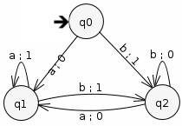
Role-Based Access Control Testing
(FSM-Based Testing)
Finite state machines (FSM) are widely used for modeling reactive systems ^{[7]}
FSM-Based Testing → Check that an FSM behavior conforms to given specifications
Mealy Machine is a 5-tuple M = <I , O , S , 𝛿, 𝜆>
Mutation Analysis
Model faults in SUTs
Mutation operators
Represent typical faults
[7] BROY, M.; JONSSON, B.; KATOEN, J.-P.; LEUCKER, M.; PRETSCHNER, A. Model-Based Testing of Reactive Systems: Advanced Lectures (Lecture Notes in Computer Science). Secaucus, NJ, USA: Springer-Verlag New York, Inc., 2005. I
Notes:
Metodos recentes sao capazes de gerar casos de teste mais curtos em menor quantidade tao eficientes quanto os tradicionais

Slide 10
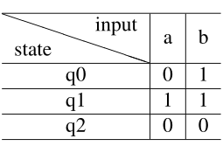
Role-Based Access Control Testing
(FSM-Based Testing)
FSM-Based Testing Methods ^{[7]}
Traditional methods (W and HSI)
State and transition cover sets
Characterization set (W set) / Harmonized Identifiers (H_{i})
Recent methods (SPY method)
Sufficient conditions and on-the-fly test sequence generation
Reduces test tree branching → On average 40% shorter than HSI
Higher fault detection effectiveness (underestimating extra states)
Recent test methods rely on fewer and longer test cases (random FSMs)^{[4]}
Characterization Set
[7] BROY, M.; JONSSON, B.; KATOEN, J.-P.; LEUCKER, M.; PRETSCHNER, A. Model-Based Testing of Reactive Systems: Advanced Lectures (Lecture Notes in Computer Science). Secaucus, NJ, USA: Springer-Verlag New York, Inc., 2005. I
[4] ENDO, A. T.; SIMAO, A. Evaluating test suite characteristics, cost, and effectiveness of fsmbased testing methods. Information and Software Technology, v. 55, n. 6, p. 1045 – 1062, 2013.
Notes:
Metodos recentes sao capazes de gerar casos de teste mais curtos em menor quantidade tao eficientes quanto os tradicionais

Slide 11
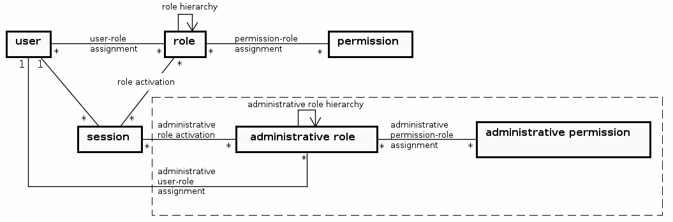
Role-Based Access Control Testing
(RBAC model)
RBAC: Users receive privileges through role assignments
ANSI RBAC and Administrative RBAC models ^{[8]}
[8] FADHEL, A. B.; BIANCULLI, D.; BRIAND, L. A comprehensive modeling framework for role-based access control policies. J. Syst. Softw., Elsevier Science Inc., New York, NY, USA, v. 107, n. C, p. 110–126, Sep. 2015.
Notes:
Grouping privileges
Reduce the complexity of security management routines

Slide 12
Role-Based Access Control Testing
(RBAC constraints)
RBAC constraints ^{[8]}
Cardinality constraints
Separation of duty (SoD) constraints
[8] FADHEL, A. B.; BIANCULLI, D.; BRIAND, L. A comprehensive modeling framework for role-based access control policies. J. Syst. Softw., Elsevier Science Inc., New York, NY, USA, v. 107, n. C, p. 110–126, Sep. 2015.

Slide 13
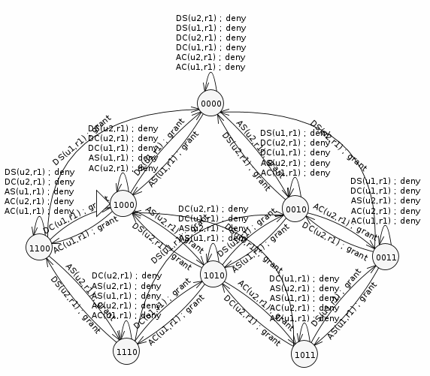
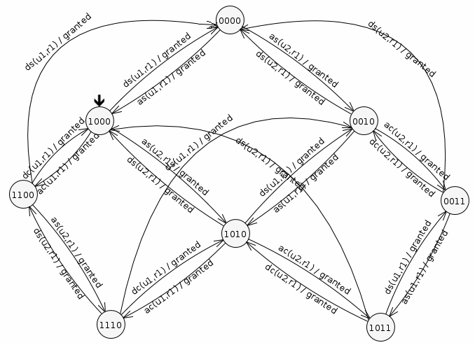
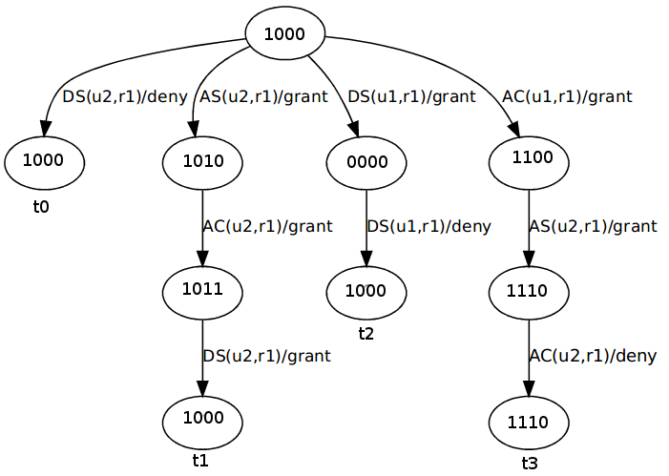
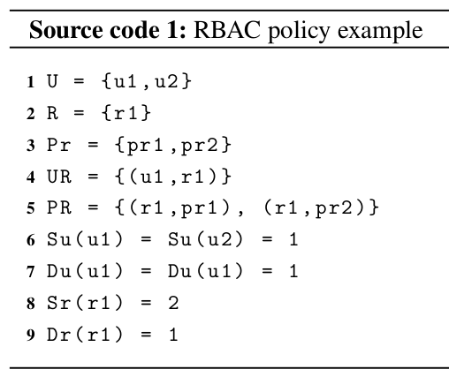
Role-Based Access Control Testing
(FSM-Based Testing of RBAC systems) ^{[3]}
1000
User Cardinality
Role Cardinality
1111
[3] MASOOD, A.; BHATTI, R.; GHAFOOR, A.; MATHUR, A. P. Scalable and effective test generation for role-based access control systems. IEEE Transactions on Software Engineering, IEEE Press, Piscataway, NJ, USA, v. 35, n. 5, p. 654–668, Sep. 2009.
Notes:
Linha 1, 2 e 3: usuarios, papeis e permissoes
Linha 4: u1 atribuido ao papel r1 (estado inicial)
Linhas 6 e 7 : cardinalidade de usuario estatica (S) e dinamica (D)
Linhas 8 e 9: cardinalidade de papel (estatica e dinamica)
Em especial linha 9: limita o total de usuarios q podem ativar r1
Estado 1111: nao e alcancavel (MUTANTE!!)

Slide 14
Comparing FSM-Based Testing Methods on RBAC

Slide 15
Comparing FSM-Based Testing Methods on RBAC
Compare recent and traditional FSM-based testing methods on RBAC domain
Recent (SPY) and Traditional (W and HSI) methods
Test characteristics and Effectiveness
number of resets, avg. test case length and test suite length
RBAC fault domain

Slide 16
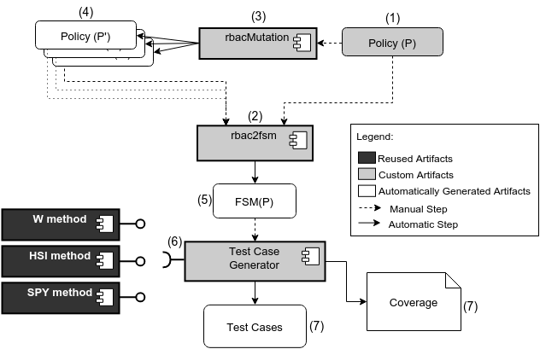
Comparing FSM-Based Testing Methods on RBAC

Slide 17
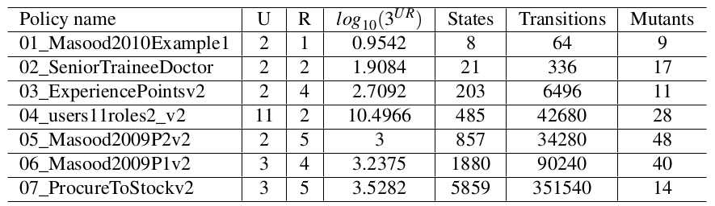
Comparing FSM-Based Testing Methods on RBAC
(Selection of RBAC policies)
15 test scenarios: {W,HSI,SPY} ⨉ {P01,P02,P03,P04,P05}
Notes:
7 politicas selecionadas
5 politicas adaptadas → state explosion
5 politicas convertidas → state explosion
Cerca de 1 minuto o tempo de duração

Slide 18
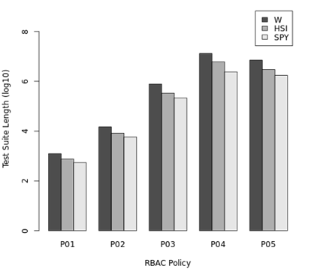
Comparing FSM-Based Testing Methods on RBAC
(Test Suite Length)
Test generation duration
Total: 63 hours
Min: 5 ms / Max: 24 h
Strong positive correlation ^{[4]}
|Users|×|Roles|
SPY test suite length (average)
61% of HSI
31% of W
[4] ENDO, A. T.; SIMAO, A. Evaluating test suite characteristics, cost, and effectiveness of fsm based testing methods. Information and Software Technology, v. 55, n. 6, p. 1045 – 1062, 2013.

Slide 19
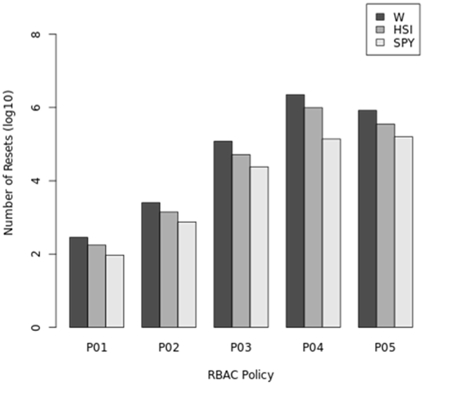
Comparing FSM-Based Testing Methods on RBAC
(Number of Resets)
Strong positive correlation ^{[4]}
SPY number of resets (average)
42.3% of HSI
Corroborated SPY’s paper ^{[9]}
21.5% of W
[4] ENDO, A. T.; SIMAO, A. Evaluating test suite characteristics, cost, and effectiveness of fsmbased testing methods. Information and Software Technology, v. 55, n. 6, p. 1045 – 1062, 2013.
[9] SIMÃO, A.; PETRENKO, A.; YEVTUSHENKO, N. Generating reduced tests for fsms with extra states. In: NUNEZ, M.; BAKER, P.; MERAYO, M. (Ed.). Testing of Software and Communication Systems. Springer Berlin Heidelberg, 2009, (Lecture Notes in Computer Science, v. 5826). p. 129–145.

Slide 20
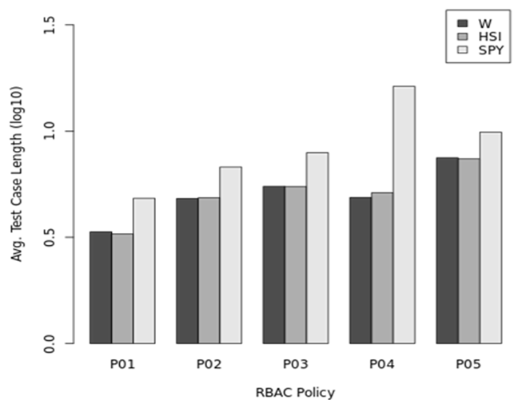
Comparing FSM-Based Testing Methods on RBAC
(Average Test Case Length)
No negative correlation ^{[4]}
Average test case length
W and HSI were similar
SPY ~78% longer than {W, HSI}
Maximum test case length
SPY was 14 times longer
Test case length tends to increase
SPY method
[4] ENDO, A. T.; SIMAO, A. Evaluating test suite characteristics, cost, and effectiveness of fsmbased testing methods. Information and Software Technology, v. 55, n. 6, p. 1045 – 1062, 2013.
Notes:
Approx 14 times longer (media and mediana)

Slide 21
Comparing FSM-Based Testing Methods on RBAC
(Test analysis)
The SPY testing method enabled significant reduction of the overall test costs
Lower: Test Suite Length, Number of Resets
Greater: Average Test Case Length
100% of effectiveness on all 15 scenarios: {W,HSI,SPY} ⨉ {P01,P02,P03,P04,P05}
State and transition coverage ^{[4]}
Order of dominance: SPY > HSI > W
A large amount of test cases tends to be generated on RBAC domain
|Users|×|Roles|
[4] ENDO, A. T.; SIMAO, A. Evaluating test suite characteristics, cost, and effectiveness of fsmbased testing methods. Information and Software Technology, v. 55, n. 6, p. 1045 – 1062, 2013.

Slide 22
Investigating Test Prioritization on RBAC

Slide 23
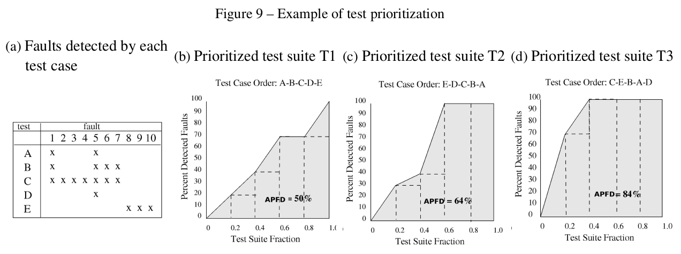
Investigating Test Prioritization on RBAC
(Test Prioritization) ^{[10]}
Time and resources constraints
Identify an efficient ordering of the test cases to maximize certain properties
Average Percentage Fault Detected (APFD)
[10] ELBAUM, S.; MALISHEVSKY, A. G.; ROTHERMEL, G. Prioritizing test cases for regression testing. SIGSOFT Softw. Eng. Notes, ACM, New York, NY, USA, v. 25, n. 5, p. 102–112, Aug. 2000.
Notes:
APFD
Average Percentage Fault Detected
Média da Percentagem de Detecção de Defeitos

Slide 24
Investigating Test Prioritization on RBAC
(Test Similarity)
Similar test cases are redundant ^{[6]}
Resembling fault detection capabilities → No additional gain
Test similarity on XACML and MBT domains
On MBT, test similarity can be more effective than random approaches ^{[5]}
XACML prioritization effectiveness is higher than of random prioritization ^{[6]}
[5] CARTAXO, E. G.; MACHADO, P. D. L.; NETO, F. G. O. On the use of a similarity function for test case selection in the context of model-based testing. Software Testing, Verification and Reliability, John Wiley & Sons, Ltd., v. 21, n. 2, p. 75–100, 2011.
[6] BERTOLINO, A.; DAOUDAGH, S.; KATEB, D. E.; HENARD, C.; TRAON, Y. L.; LONETTI, F.; MARCHETTI, E.; MOUELHI, T.; PAPADAKIS, M. Similarity testing for access control. Information and Software Technology, v. 58, p. 355 – 372, 2015.

Slide 25
Investigating Test Prioritization on RBAC
Investigate and compare test prioritization approaches for RBAC testing
Simple similarity
RBAC similarity
Random prioritization

Slide 26

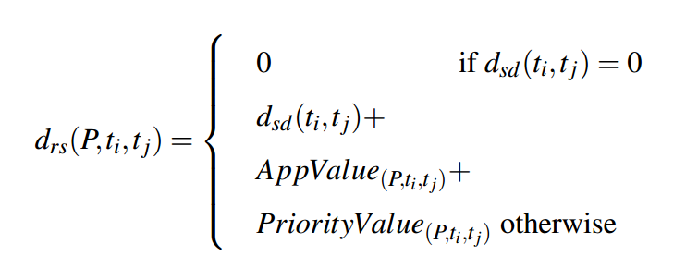
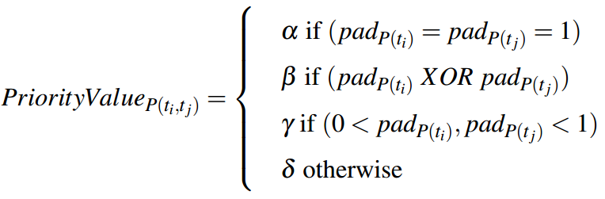
Investigating Test Prioritization on RBAC
(RBAC Similarity)
Simple similarity (d_{sd}): number of distinct transitions
Applicability degree (AppValue)
Policy Applicability Degree (pad_{P(t)})
Assignment Applicability Degree (asad_{P(t)})
Activation Applicability Degree (acad_{P(t)})
Permission Applicability Degree (prad_{P(t)})
Priority value (PriorityValue)
alpha > beta > gamma > delta

Slide 27
Investigating Test Prioritization on RBAC
Test Prioritization methods
RBAC similarity
Simple similarity
Random prioritization
Test fragmentations
21 fragments
Test analysis
Test effectiveness
APFD metric
Notes:
Average Percentage Faults Detected

Slide 28
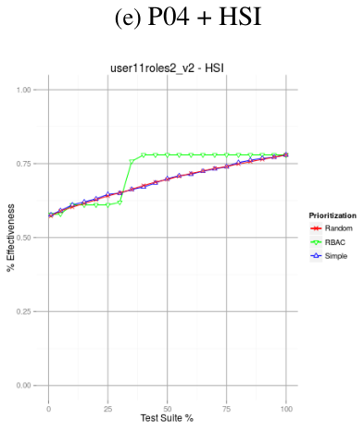
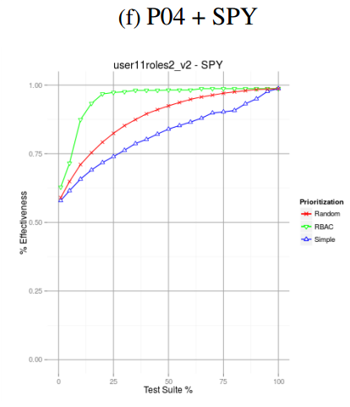
Investigating Test Prioritization on RBAC

Slide 29
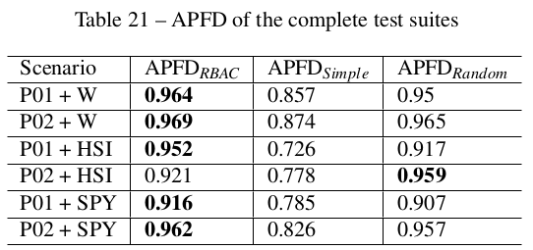
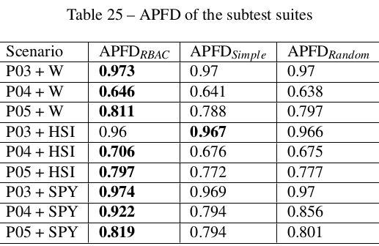
Investigating Test Prioritization on RBAC
(Test analysis)
RBAC presented better APFD
Issues on {P02,P03} + HSI
Good prioritization: W and SPY
Some “oscillations”
5 to 25% test suite → Max. effectiv.
Test prioritization methods
RBAC > Random > Simple

Slide 30
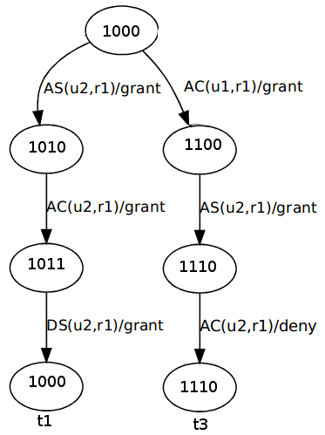
Investigating Test Prioritization on RBAC
(Test analysis)
Random prioritization outperformed Simple similarity
Similar tests have resembling effectiveness
RBAC fault domain
One RBAC fault → Many FSM(P) transitions
Dissimilarity ⇏ Applicability
Applicability degree can improve RBAC prioritization
Similarity + Applicability
Distinct test cases but with different AppValue (e.g. Sr(r1)=1)

Slide 31
Conclusion, Limitations, Results and Future work

Slide 32
Conclusion
On comparing FSM-based testing methods on RBAC
Recent FSM testing methods can be mode adequate on RBAC testing
Less resets (test cases)
Shorter test suites
Longer test cases
Fault detection does not change (100% effective)

Slide 33
Conclusion
On investigating test prioritization criteria on RBAC
Random prioritization outperformed simple similarity
Distribution of RBAC faults along FSM(P)
On average, the proposed RBAC similarity
Outperformed simple similarity and random prioritization

Slide 34
Limitations
Other test generation methods
Test prioritization effectiveness depends on the test cases
Role hierarchies (Hierarchical RBAC)
Large number of users and roles → State explosion

Slide 35
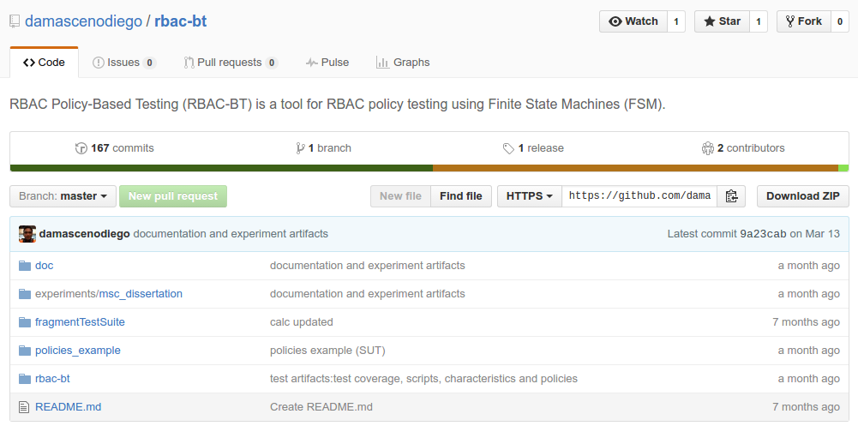
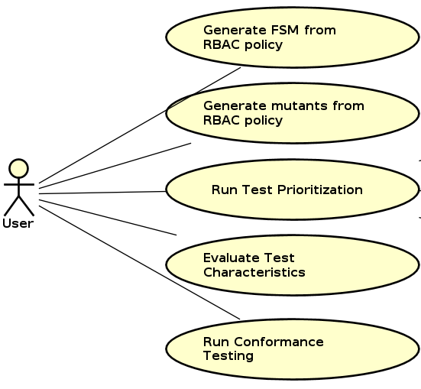
Results
Lab package for further replications
Test artifacts: RBAC policies, protocols, test suites...
RBAC-BT tool: https://github.com/damascenodiego/rbac-bt

Slide 36
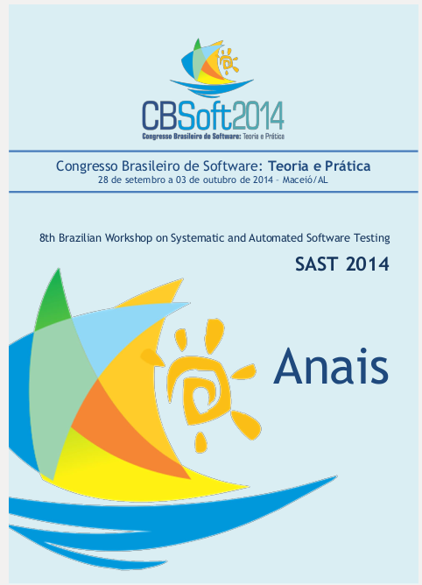
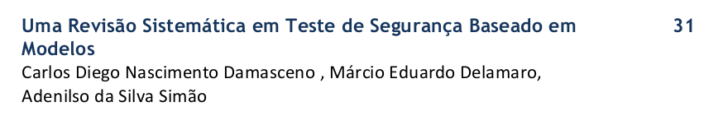
Results
One published work → Workshop on Systematic and Automated Software Testing (SAST 2014)
Authors: DAMASCENO, C. D. N.; DELAMARO, M. E.; SIMÃO, A. S.
Title: Uma revisão sistemática em teste de segurança baseado em modelos. ^{[2]}
In: Congresso Brasileiro de Software: Teoria e Prática (CBSoft) Porto Alegre,
Year: 2014
Source: http://www.ic.ufal.br/evento/cbsoft2014/anais/sast_v1_p.pdf
[2] DAMASCENO, C. D. N.; DELAMARO, M. E.; SIMÃO, A. d. S. Uma revisão sistemática em teste de segurança baseado em modelos. In: Anais do Workshop Brasileiro de Testes de Software Automatizados e Sistemático - CBSoft - Congresso Brasileiro de Software: Teoria e Prática. Porto Alegre: SBC, 2014. p. 31–40.

Slide 37
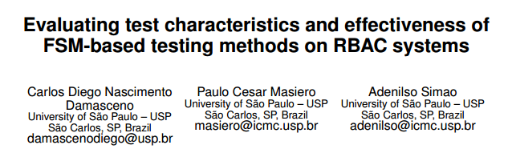
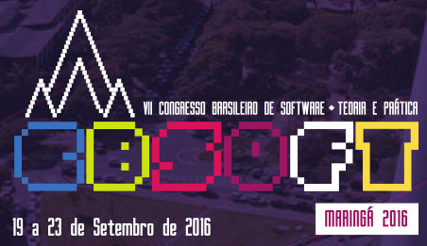
Results
One submitted work → XXX Simpósio Brasileiro de Engenharia de Software 2016 (SBES 2016)
Authors: DAMASCENO, C. D. N.; MASIERO, P. C.; SIMÃO, A. S.
Title: Evaluating test characteristics and effectiveness of FSM-based testing methods on RBAC systems.
Year: 2016.

Slide 38
Future work
Under development
Title: Similarity Testing for Role Based Access Control Systems
Research Topics
Test prioritization for Role Based Access Control
Compare RBAC similarity vs. Simple similarity vs. Random prioritization

Slide 39
Future work
Further replications
Other policies and/or test generation methods
Extending RBAC-BT with Hierarchical RBAC
RBAC similarity as test criteria
Deterministic generation
Random generation
Search-Based Software Testing

Slide 40
References
[1] FELDERER, M.; ZECH, P.; BREU, R.; BÜCHLER, M.; PRETSCHNER, A. Model-based security testing: a taxonomy and systematic classification. Software Testing, Verification and Reliability, p. n/a–n/a, 2015.
[2] DAMASCENO, C. D. N.; DELAMARO, M. E.; SIMÃO, A. d. S. Uma revisão sistemática em teste de segurança baseado em modelos. In: Anais do Workshop Brasileiro de Testes de Software Automatizados e Sistemático - CBSoft - Congresso Brasileiro de Software: Teoria e Prática. Porto Alegre: SBC, 2014. p. 31–40.
[3] MASOOD, A.; BHATTI, R.; GHAFOOR, A.; MATHUR, A. P. Scalable and effective test generation for role-based access control systems. IEEE Transactions on Software Engineering, IEEE Press, Piscataway, NJ, USA, v. 35, n. 5, p. 654–668, Sep. 2009.
[4] ENDO, A. T.; SIMAO, A. Evaluating test suite characteristics, cost, and effectiveness of fsm based testing methods. Information and Software Technology, v. 55, n. 6, p. 1045 – 1062, 2013.
[5] CARTAXO, E. G.; MACHADO, P. D. L.; NETO, F. G. O. On the use of a similarity function for test case selection in the context of model-based testing. Software Testing, Verification and Reliability, John Wiley & Sons, Ltd., v. 21, n. 2, p. 75–100, 2011.
[6] BERTOLINO, A.; DAOUDAGH, S.; KATEB, D. E.; HENARD, C.; TRAON, Y. L.; LONETTI, F.; MARCHETTI, E.; MOUELHI, T.; PAPADAKIS, M. Similarity testing for access control. Information and Software Technology, v. 58, p. 355 – 372, 2015.
[7] BROY, M.; JONSSON, B.; KATOEN, J.-P.; LEUCKER, M.; PRETSCHNER, A. Model-Based Testing of Reactive Systems: Advanced Lectures (Lecture Notes in Computer Science). Secaucus, NJ, USA: Springer-Verlag New York, Inc., 2005.
[8] FADHEL, A. B.; BIANCULLI, D.; BRIAND, L. A comprehensive modeling framework for role-based access control policies. J. Syst. Softw., Elsevier Science Inc., New York, NY, USA, v. 107, n. C, p. 110–126, Sep. 2015.
[9] SIMÃO, A.; PETRENKO, A.; YEVTUSHENKO, N. Generating reduced tests for fsms with extra states. In: NUNEZ, M.; BAKER, P.; MERAYO, M. (Ed.). Testing of Software and Communication Systems. Springer Berlin Heidelberg, 2009, (Lecture Notes in Computer Science, v. 5826). p. 129–145.
[10] ELBAUM, S.; MALISHEVSKY, A. G.; ROTHERMEL, G. Prioritizing test cases for regression testing. SIGSOFT Softw. Eng. Notes, ACM, New York, NY, USA, v. 25, n. 5, p. 102–112, Aug. 2000.

Slide 41
Thank you!
Carlos Diego Nascimento Damasceno – damascenodiego@usp.br
Advisor: Prof. Dr. Adenilso da Silva Simão
Laboratory of Software Engineering – LabES
Institute of Mathematics and Computer Science – ICMC
University of Sao Paulo – USP
Sao Carlos – SP – Brazil

