Slide 1
Real-Time Email Phishing Detection Using a Custom DistilBERT Model
Edafe Maxwell Damatie, Amna Eleyan, Tarek Bejaoui
Manchester Metropolitan University, University of Carthage
Notes:
"Good day everyone, and thank you for joining me! My name is [Your Name], and today, we're diving into how we can fight back against one of the most persistent threats in cybersecurity: phishing attacks. Our work focuses on Real-Time Email Phishing Detection Using a Custom DistilBERT Model."

Slide 2
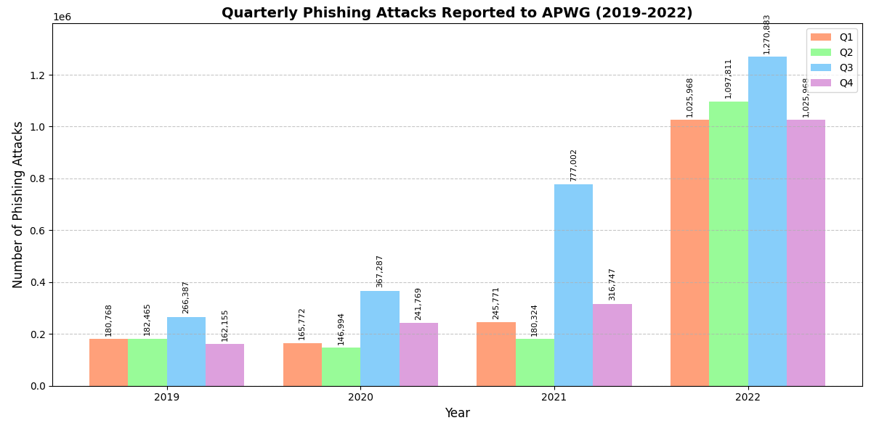
Introduction
Problem: Email phishing remains a persistent cybersecurity threat.
Statistics: In Q1 2020, 165,772 phishing attacks were reported [1].
Goal: Develop a real-time email phishing detection system using a custom DistilBERT model.
Notes:
"Let me ask you this: Have you ever received an email that looked suspicious? An email that made you second-guess clicking that link? Phishing emails have become a massive threat in recent years, and in the first quarter of 2020 alone, over 165,000 phishing attacks were reported.Our goal was simple: we wanted to develop a system that could detect phishing emails in real-time—because in this fight, every second counts."

Slide 3
Motivation & Importance
Phishing attacks are becoming more sophisticated and frequent.
Key Challenge:
Detection systems must have high accuracy with low false positives.
Real-time detection is essential for preventing phishing attacks.
Notes:
"So why is this important? Why should we care about phishing attacks in 2024? Because phishing attacks are getting more sophisticated and harder to spot. And if they keep slipping through the cracks, the damage they cause can be devastating.
But here's the challenge: we need systems that are both accurate and fast. We can’t afford false positives that waste time, nor can we allow phishing emails to slip by unnoticed. This is where real-time detection becomes essential."

Slide 4
Existing Solutions (Related Work)
Overview:
DNN, PhishKiller, RNN-GRU models.
Challenges:
High computational demand, real-time constraints, lack of adaptive learning.
Notes:
"Now, let’s take a step back and look at what’s already out there. We have models like DNN, PhishKiller, and RNN-GRU that have made strides in phishing detection.But here’s the issue: these models tend to be resource-heavy, slow, or simply not adaptable enough to the ever-evolving phishing landscape. Our work fills in those gaps by using a custom approach to DistilBERT—making detection not only faster but smarter."

Slide 5
Proposed Solution
DistilBERT: Compressed version of BERT, 40% smaller and 60% faster.
Customizations: Dynamic threshold adjustment, enhanced classifier head optimized for email content.
Notes:
"Let’s get into the heart of our solution. We used DistilBERT, a lighter and faster version of the BERT model, which retains 97% of BERT's capabilities but is 60% faster.But we didn’t stop there. We customized DistilBERT by adding dynamic threshold adjustments and an enhanced classifier head, fine-tuned specifically for email content. The result? Real-time phishing detection at a whole new level."

Slide 6
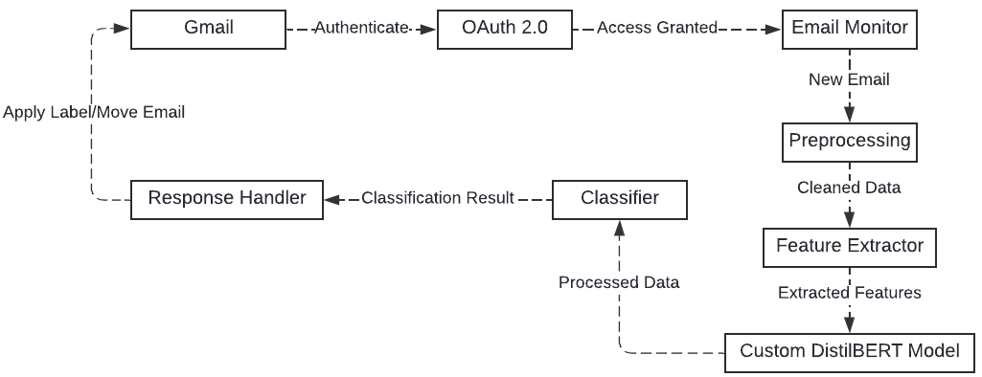
System Architecture
Data Flow Diagram (Gmail integration for real-time email processing).
Notes:
"Let me show you how it works. Our system integrates seamlessly with Gmail, using its API to scan incoming emails in real-time. It applies our DistilBERT model to each email, and if it detects phishing, it flags the email and moves it out of the inbox.This happens in under 2 seconds! Think about that: by the time you’ve even seen the email, the system has already done the work for you."

Slide 7
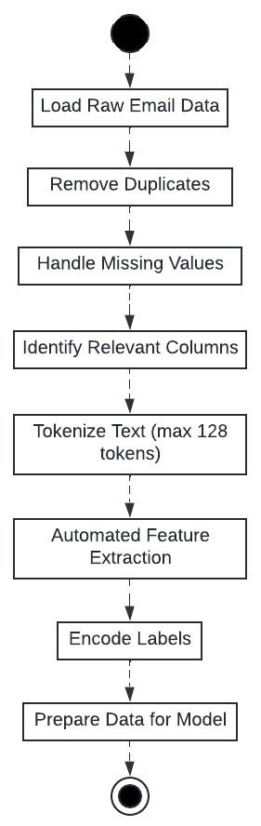
Methodology
Preprocessing Pipeline Flowchart.
Notes:
"So, how did we build this? First, we took a comprehensive dataset of emails, cleaned and tokenized it, and used the DistilBERT tokenizer to extract the relevant features.What’s exciting here is that we didn’t have to manually engineer any features—DistilBERT did all the heavy lifting, learning patterns automatically from the data. This means our model is more efficient and adaptable."

Slide 8
Experimental Setup
Dataset: Phishing email dataset from Kaggle (82,486 emails).
Controlled Testing: Training/validation/testing split (70-15-15).
Real-world Testing: System integration with Gmail API for live email monitoring.
Notes:
"Now, you’re probably wondering—how well does this actually work? We trained our model using a dataset from Kaggle, consisting of over 82,000 phishing and non-phishing emails , which we splited into training, validation, and testing sets. We tested the system both in controlled settings using the testing sets and in real-world conditions with 22 incoming emails, where it was integrated with Gmail. This gave us insights not only into how it performs in a lab but also how it works when facing actual phishing attacks."

Slide 9
Results
Controlled Environment
Metric | Value
Accuracy | 99.29%
Precision | 99.29%
Recall | 99.29%
F1-Score | 99.29%
AUC-ROC | 0.9994
FPR | 0.69%
Real-World Performance
Metric | Value
Accuracy | 95.45%
Precision | 87.50%
Recall | 100%
F1-Score | 93.33%
FPR | 6.67%
Accuracy | 95.45%
Avg. Response Time | 1.88s
Notes:
"Now, let’s talk about the results, because they really speak for themselves. In our controlled tests, the system achieved an impressive 99.29% accuracy with a false positive rate as low as 0.69%. This is incredibly efficient when dealing with a large dataset, but we didn’t stop there.
We put the system to the real test: real-world conditions. We connected it to a live Gmail inbox with 22 incoming emails via Gamil API integration—14 legitimate, 7 phishing, and 1 email that was misclassified as phishing.
Even in this real-world setting, the system maintained a strong 95.45% accuracy, flagging the phishing emails almost instantly, and here’s the kicker: it had an average response time of just 1.88 seconds.
Think about that: less than 2 seconds to detect and deal with a phishing email in real-time. Imagine how much damage that speed can prevent in a real-world scenario where phishing emails are often opened within minutes by unsuspecting users."*
(Pause here to let the significance sink in.)

Slide 10
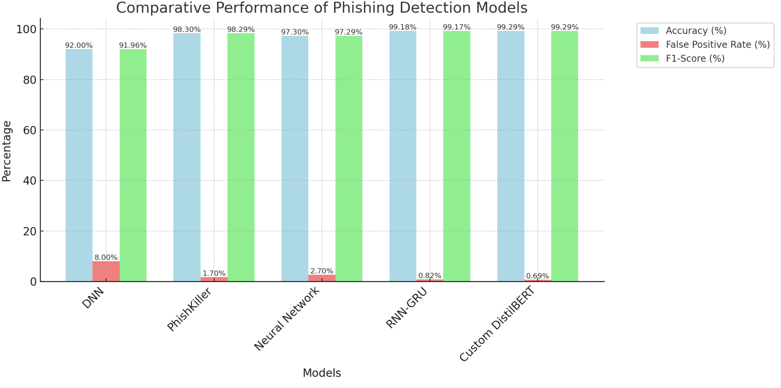
Comparative Analysis
Model | Real-time Capability
[2] DNN Approach | No
[3] PhishKiller | Yes (81.68ms)
[6] Neural Network | Yes (unspecified)
[7] RNN-GRU | Yes (unspecified)
Custom DistilBERT Model | Yes (1.88s)
Real-time capability
Notes:
"So, how does our system stack up against others? We compared our model with state-of-the-art solutions like DNN, PhishKiller, and RNN-GRU.Our custom DistilBERT model outperformed them in terms of both accuracy and false positive rate. What’s more, our system’s real-time capability makes it far more practical for deployment in real-world email environments."

Slide 11
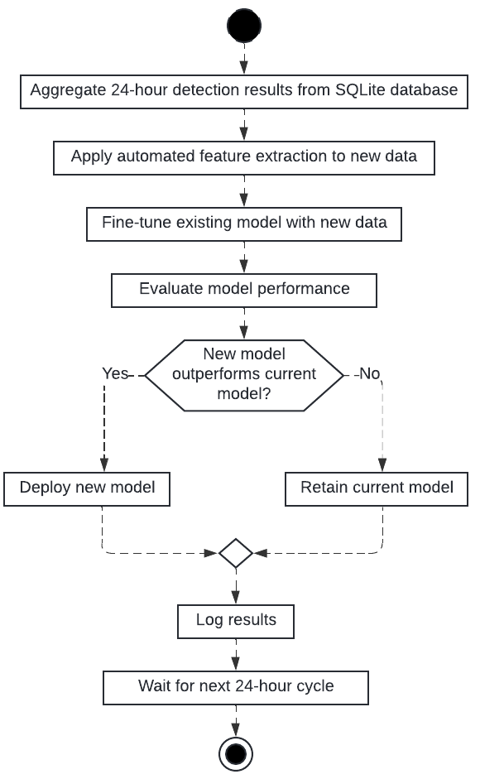
Novelty and Contributions
Daily Retraining
Notes:
"What makes this approach stand out? First, it’s one of the few system using DistilBERT for real-time phishing detection.Second, we introduced dynamic thresholding, which allows the system to adapt to new and evolving phishing techniques. And here's the kicker: the system retrains itself daily, learning from new data and keeping itself up to date."

Slide 12
Conclusion
A real-time phishing detection system using custom DistilBERT.
Achieved high accuracy and low FPR in real-world testing.
Future Work: Expand real-world testing across diverse email ecosystems, optimize retraining for large-scale deployments.
Notes:
"So, what have we achieved? We’ve built a system that is fast, accurate, and adaptable. It detects phishing emails in real-time with high accuracy and low false positives—exactly what’s needed in today’s fast-paced cyber environment. Moving forward, we aim to expand real-world testing to even more diverse email ecosystems and further optimize the system’s retraining process. But what we’ve built today is already a significant step forward."

Slide 13
References
[1] Alkhalil, Z., Hewage, C., Nawaf, L., & Khan, I., 2021. Phishing Attacks: A Recent Comprehensive Study and a New Anatomy. , 3. https://doi.org/10.3389/fcomp.2021.563060.
[2] Sumathi, K., & Sujatha, V., 2019. Deep Learning Based-Phishing Attack Detection. International Journal of Recent Technology and Engineering. https://doi.org/10.35940/ijrte.c6527.098319.
[3] Martins de Souza, C. H., Lemos, M. O., Dantas Silva, F. S., & Souza Alves, R. L. (2019). On detecting and mitigating phishing attacks through featureless machine learning techniques. Internet Technology Letters, 3(1), e135. https://doi.org/10.1002/itl2.135.
[4] Alam, N., 2021. Phishing Email Dataset. Kaggle. Available at: https://www.kaggle.com/datasets/naserabdullahalam/phishing-email-dataset [Accessed: 5 August 2024].
[5] Sanh, V., Debut, L., Chaumond, J., & Wolf, T. (2019). DistilBERT, a distilled version of BERT: smaller, faster, cheaper and lighter. arXiv preprint arXiv:1910.01108..
[6] D. Oña et al., "Phishing Attacks: Detecting and Preventing Infected E-mails Using Machine Learning Methods," CSNet, 2019.
[7] Tang, L., & Mahmoud, Q., 2022. A Deep Learning-Based Framework for Phishing Website Detection. IEEE Access, 10, pp. 1509-1521. https://doi.org/10.1109/ACCESS.2021.3137636.
[8] Google Developers 2024, Gmail API overview, Google Developers. Available at: https://developers.google.com/gmail/api/guides [Accessed: 5 August 2024].

Slide 14
Questions & Answers
Notes:
"And with that, I’d love to open the floor for any questions. I’m excited to hear your thoughts, ideas, and feedback on this work!"

