Slide 1

ATAI Final Work
Team JBromas

Slide 2
ALLIED Strategies
1.- Rush the flag
2.- Avoiding friendly fire
3.- Human shield formation

Slide 3
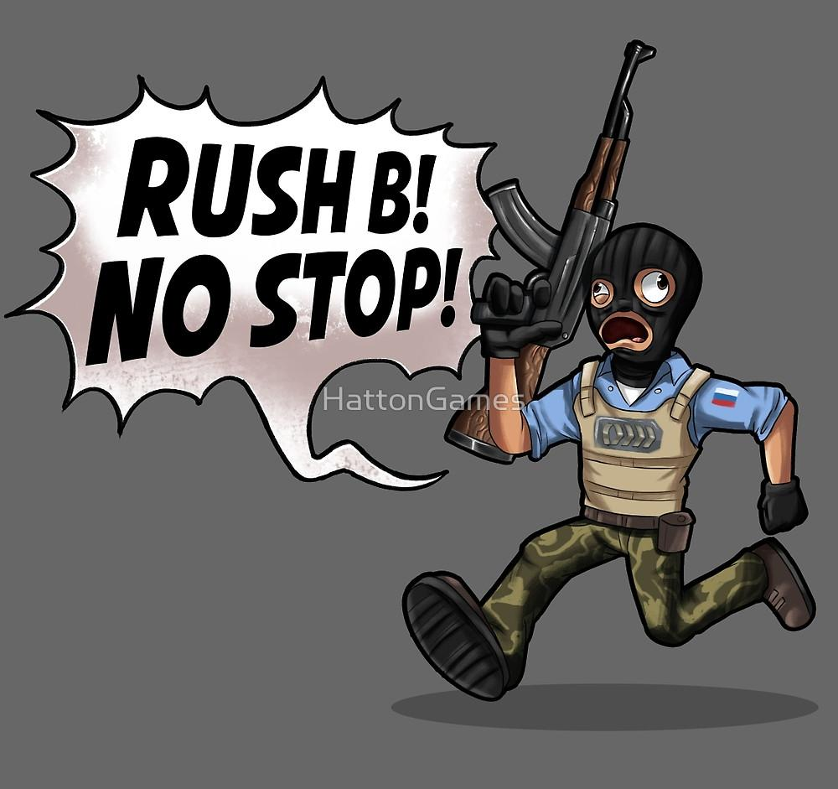
Rush the flag

Slide 4


Avoiding Friendly Fire
X

Slide 5
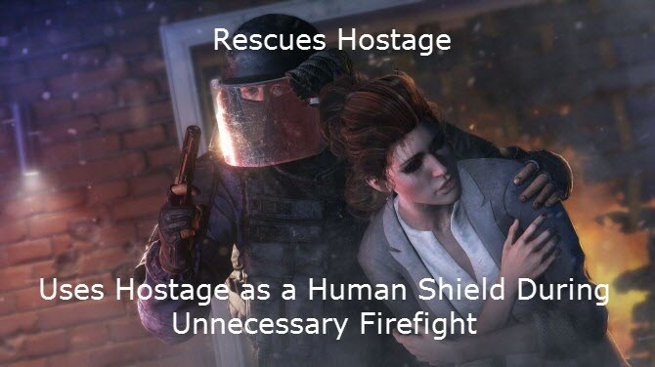
Human Shield Formation

Slide 6
AXIS Strategies
1.- Patrol the flag: we protect our flag with our lives!!
2.- Stupid mode attack: when someone comes near we all attack him!
3.- Win: when we try we win!

Slide 7

Patrol the flag

Slide 8
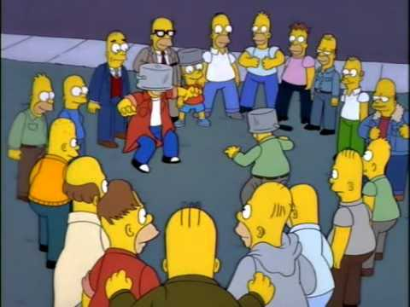

Stupid mode attack

Slide 9
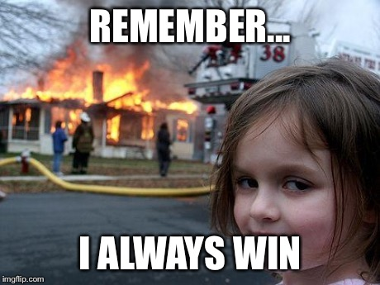
Win, we
guess

