Slide 1
A Software Development of DICOM Image Processing Based on QT, VTK & ITK
MM 802 - Presentation
DAMAYANTI GHOSH
Student - ID : 1505857
SUN Mengmeng, WU Shuicai*
Collage of Life Science and Bioengineering, Beijing University of Technology, Beijing 100124, China

Slide 2
GOAL
display and process images in different DICOM formats
a practical and cross-platform GUI for users to process the images in DICOM format
software can read and display DICOM images with different suffixes to process medical images with much ease

Slide 3
SOFTWARES
Windows 7
Visual Studio 2008
VTK
ITK
QT

Slide 4
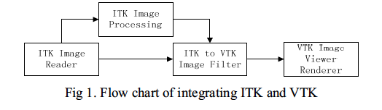
INTEGRATION OF ITK & VTK
data read using ITK reading function
data type converted to the one supported by VTK with or without Image processing
data displayed using vtkImageViewer

Slide 5
INTEGRATION OF VTK & QT
Qt widget is connected to VTK by QVTKWidget by adding the header file “QVTKWidget.h”.
This widget gets Render Window from vtkImageViewer2 using its function SetRenderWindow() and encapsulates the VTK window in the widget supported by Qt.

Slide 6
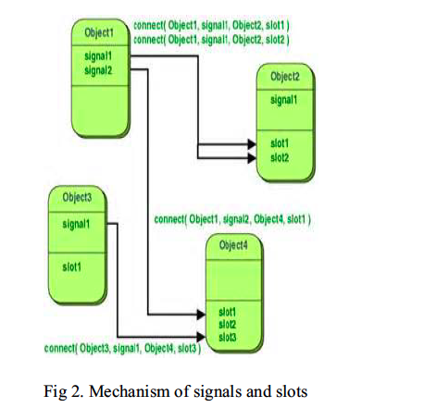
INTERFACE DESIGN
Qt provides a
higher-level interface module called signals/slots.
Signals and slots are used for communication between objects.

Slide 7
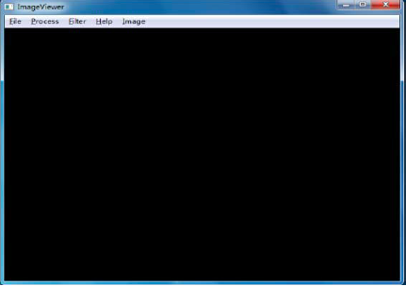
SOFTWARE INTERFACE

Slide 8
IMAGE PROCESSING
itkGrayscaleErodeImageFilter
itkGrayscaleFunctionDilateImageFilter
itkCannyEdgeDetectionImageFilter

Slide 9
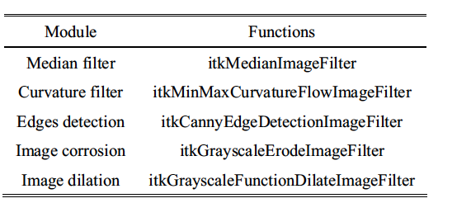
IMAGE PROCESSING

Slide 10

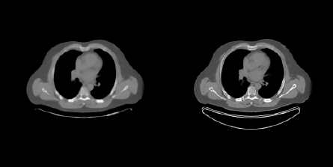
IMAGE SMOOTHING
MinMaxCurvatureFlowImageFilter
MEDIAN FILTERING

Slide 11
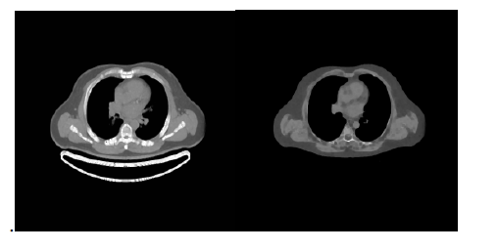
IMAGE MORPHOLOGY
IMAGE AFTER DIALTION
IMAGE AFTER EROSION

Slide 12
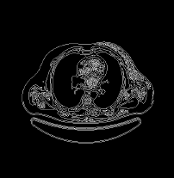
EDGE DETECTION USING CANNY KERNEL

Slide 13
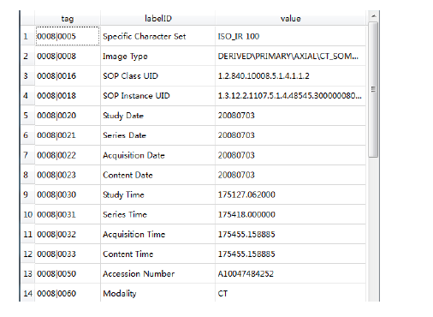
DICOM HEADER INFORMATION
GDCMImageIO ->GetMetaDataDictionary();

Slide 14
FUTURE WORK
adding functions to display 3D images
adding image registration and image segmentation to the software

Slide 15
THANK YOU

