Slide 1
POST-QUANTUM CRYPTOGRAPHY
ADAPTIVE PQC WRAPPER
Quantum-Resilient Security Architecture with Threat Detection, Incident Response & Crypto Agility
◉ DETECT
Threat-aware
⊘ RESPOND
Contain incidents
↔ ADAPT
Change approved PQC
ML-KEM • ML-DSA • Algorithm Agility • Secure Recovery
ADAPTIVE PQC WRAPPER • QUANTUM-RESILIENT SECURITY
1

Slide 2
01 • CONCEPT
Executive Concept
A cryptographic control plane that sits between the application and PQC primitives.
▣ APPLICATION
Python / Java / C / APIs Sends and receives protected data. The application uses a stable security interface.
⚙ ADAPTIVE PQC WRAPPER
Policy Engine Threat Monitor Incident Counter Crypto Abstraction Key / Session Manager Quarantine Controller Audit Logger
🔐 PQC CRYPTO LAYER
ML-KEM ML-DSA Approved alternatives Controlled transition Fresh security context
APPLICATION CODE STAYS STABLE → SECURITY POLICY CAN EVOLVE
ADAPTIVE PQC WRAPPER • QUANTUM-RESILIENT SECURITY
2

Slide 3
02 • MOTIVATION
Why Do We Need an Adaptive Wrapper?
Quantum-safe migration is not only an algorithm problem; it is also an operational resilience problem.
⚠ QUANTUM THREAT
Future quantum computers threaten widely used public-key assumptions.
▣ STATIC CRYPTOGRAPHY
A hard-coded algorithm creates a difficult migration point.
! INCIDENT RESPONSE
Detection alone is insufficient if the session keeps operating.
🔑 KEY / SESSION RISK
A compromised context should not simply continue unchanged.
↔ CRYPTO AGILITY
Security policies need a controlled way to adopt approved alternatives.
✓ RECOVERY
A secure system must verify before returning to normal service.
DESIGN QUESTION: How can the system DETECT → CONTAIN → VERIFY → ADAPT → RECOVER?
ADAPTIVE PQC WRAPPER • QUANTUM-RESILIENT SECURITY
3

Slide 4
03 • ARCHITECTURE
Layered Quantum-Resilient Architecture
Separate application logic, security policy, incident response and cryptographic primitives.
APPLICATION / DATA
Business logic • files • messages • APIs
LAYER 1
PQC WRAPPER API
encrypt() • decrypt() • establish_session() • rotate_security()
LAYER 2
POLICY + DETECTION
Threat score • threshold • approved algorithm list • audit
LAYER 3
RESPONSE CONTROLLER
Block • quarantine • integrity check • recovery state
LAYER 4
PQC PRIMITIVES
ML-KEM • ML-DSA • approved future alternatives
LAYER 5
ADAPTIVE PQC WRAPPER • QUANTUM-RESILIENT SECURITY
4

Slide 5
04 • WORKFLOW
Full Adaptive Security Workflow
The core logic follows the architecture in your supplied diagram.
APPLICATION / DATA
Input protected data
NORMAL PATH
PQC WRAPPER
Current approved algorithm
NO INCIDENT → MONITOR → CONTINUE
SUSPICIOUS ACTIVITY?
Decision point
COUNT + VERIFY
Validate incident
ESCALATION PATH
COUNT ≥ N ?
Threshold decision
INCIDENT → BLOCK → QUARANTINE → ADAPT
BLOCK
Restrict suspicious session
QUARANTINE
Isolate affected data
SECURITY VERIFICATION
Check integrity / indicators
VERIFY STATUS
Can it safely continue?
CHANGE ALGORITHM
Select approved alternative
RE-ESTABLISH SECURITY
New keys / session
RESUME SECURE DATA
Protected operation
ADAPTIVE PQC WRAPPER • QUANTUM-RESILIENT SECURITY
5

Slide 6
05 • DETECTION
Threat Detection & Confidence Model
Use multiple signals rather than treating a single anomaly as a confirmed attack.
• AUTHENTICATION
Repeated failures / unusual identity context
Σ THREAT SCORE
Signal inputs ↓ Normalize ↓ Weight ↓ Calculate risk ↓ Compare policy threshold
◉ LOW / MEDIUM RISK
Monitor + log Do not disrupt normal operation.
• TRAFFIC
Unexpected rate, pattern or endpoint behavior
• INTEGRITY
Unexpected modification indicators
! HIGH RISK
Verify incident → threshold → block / quarantine.
• SESSION
Abnormal session transitions / behavior
• POLICY
Violation of approved security rules
✓ IMPORTANT
Detection ≠ proof. Verification precedes escalation.
ADAPTIVE PQC WRAPPER • QUANTUM-RESILIENT SECURITY
6

Slide 7
06 • RESPONSE POLICY
Attack Counter & Threshold Logic
The threshold creates a controlled escalation mechanism and reduces reaction to isolated anomalies.
1 EVENT 1
Suspicious signal
2 EVENT 2
Suspicious signal
3 EVENT 3
Suspicious signal
N EVENT N
Threshold reached
NO COUNT < N
Monitor + continue observing Log event • increase counter • verify future events
YES COUNT ≥ N
Escalate Block session • quarantine affected data • begin security verification
⚙ N IS A POLICY PARAMETER
It should be tuned and validated for the deployment environment.
ADAPTIVE PQC WRAPPER • QUANTUM-RESILIENT SECURITY
7

Slide 8
07 • CONTAINMENT
Quarantine as a Security Boundary
Containment isolates the affected security context while trusted components remain operational.
✓ NORMAL ZONE
Trusted application Protected data Active secure sessions Approved PQC policy
⊘ QUARANTINE ZONE
Suspicious session Affected data Evidence / logs Restricted access
✓ VERIFICATION ZONE
Integrity checks Leak indicators Session validation Recovery decision
KEY IDEA: QUARANTINE FIRST → INVESTIGATE SAFELY → RESTORE ONLY AFTER VERIFICATION
ADAPTIVE PQC WRAPPER • QUANTUM-RESILIENT SECURITY
8

Slide 9
08 • CRYPTO AGILITY
Crypto Agility: Controlled Algorithm Switching
The wrapper abstracts the cryptographic implementation from the application.
A CURRENT MODE
Application ↓ PQC Wrapper ↓ Current approved algorithm Example: ML-KEM / ML-DSA
! TRIGGER
Verified incident + Threshold reached + Policy permits transition No arbitrary algorithm choice.
⚙ POLICY ENGINE
Approved list Version check Compatibility Security level Audit reason
B NEW MODE
Fresh keys + session
ALGORITHM AGILITY ≠ RANDOM SWITCHING | POLICY-CONTROLLED TRANSITION
ADAPTIVE PQC WRAPPER • QUANTUM-RESILIENT SECURITY
9

Slide 10
09 • RECOVERY
Re-Establish Security After an Incident
A secure recovery path should create a fresh cryptographic context instead of blindly resuming the old one.
1 Invalidate affected context
Do not reuse compromised session state.
2 Select approved mode
Apply the current cryptographic policy.
3 Establish fresh keys
Create a new protected session.
Do not reuse compromised session state.
Apply the current cryptographic policy.
Create a new protected session.
4 Authenticate
Verify peer / endpoint identity.
5 Verify integrity
Check data and security indicators.
6 Resume
Return to protected service.
Verify peer / endpoint identity.
Check data and security indicators.
Return to protected service.
✓ RECOVERY GATE
Only transition to RESUME when required checks pass.
ADAPTIVE PQC WRAPPER • QUANTUM-RESILIENT SECURITY
10

Slide 11
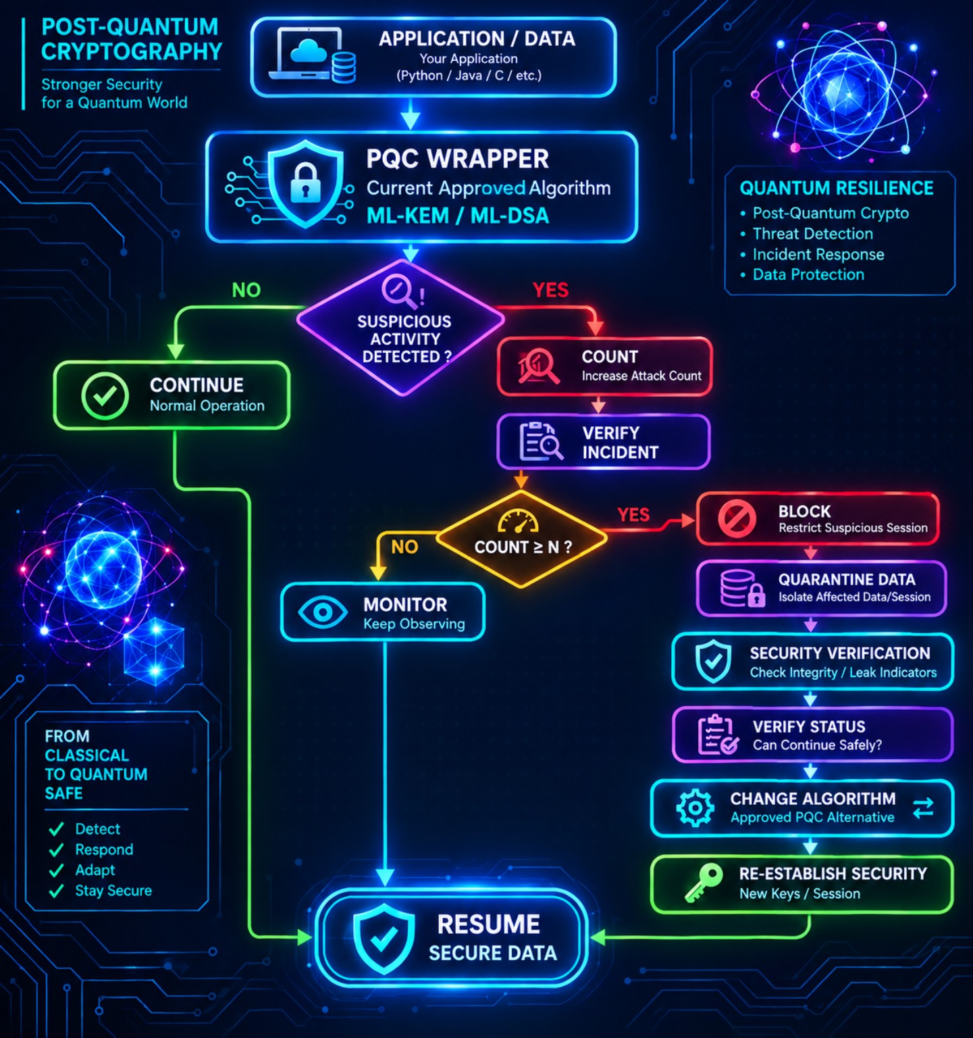
10 • SYSTEM VIEW
Reference Architecture: Detect → Respond → Adapt
Your original architecture visualized as the system's operational control loop.
01 DETECT
Suspicious activity
02 RESPOND
Count • verify • block • quarantine
03 ADAPT
Approved PQC alternative
04 RECOVER
New security context
ADAPTIVE PQC WRAPPER • QUANTUM-RESILIENT SECURITY
11

Slide 12
11 • CONTROL LOGIC
Controller Logic: State Machine
A deterministic controller makes the response auditable and testable.
1 NORMAL
Monitor
2 SUSPECTED
Count + verify
3 ESCALATED
Threshold reached
4 QUARANTINED
Isolate
5 VERIFYING
Integrity / status
6 ADAPTING
Approved algorithm
7 RECOVERY
Fresh session
8 RESUMED
Secure data
⚙ CONTROLLER RULE
Every transition has a trigger, a policy check, an action and an audit event.
ADAPTIVE PQC WRAPPER • QUANTUM-RESILIENT SECURITY
12

Slide 13
12 • DEMO
Prototype Demonstration Plan
A strong demo should show both the normal path and the adaptive recovery path.
Normal secure message
→ Application → Wrapper → PQC → Receiver
DEMO A
Suspicious events
→ Generate test anomalies → counter increments → monitoring
DEMO B
Threshold reached
→ Verify → block → quarantine
DEMO C
Recovery
→ Integrity check → policy decision → new session
DEMO D
Algorithm transition
→ Wrapper selects an approved alternative → secure channel resumes
DEMO E
● SHOW ON SCREEN
Attack counter • current algorithm • security state • event log
ADAPTIVE PQC WRAPPER • QUANTUM-RESILIENT SECURITY
13

Slide 14
13 • VALIDATION
Evaluation Metrics
Measure whether the wrapper improves resilience without creating unacceptable overhead.
✓ SECURITY
Detection precision / false-positive rate
✓ RESPONSE
Time from verified incident to block
✓ CONTAINMENT
Time to quarantine affected context
✓ RECOVERY
Time to establish fresh secure session
✓ AGILITY
Algorithm transition success rate
✓ PERFORMANCE
Latency + CPU / memory overhead
✓ RELIABILITY
Recovery success under repeated events
✓ AUDIT
Completeness of security event records
TARGET: SECURITY RESILIENCE + CRYPTO AGILITY + CONTROLLED PERFORMANCE COST
ADAPTIVE PQC WRAPPER • QUANTUM-RESILIENT SECURITY
14

Slide 15
14 • DESIGN PRINCIPLES
Security Design Principles
Advanced creativity is useful only when it is backed by disciplined security controls.
◆ DEFAULT DENY
Unexpected transitions should fail safely.
◆ APPROVED LIST
Only vetted algorithms can be selected.
◆ VERIFY BEFORE ESCALATE
Separate anomaly detection from incident confirmation.
◆ VERIFY BEFORE RESUME
Recovery requires explicit security checks.
◆ FRESH CONTEXT
Do not blindly reuse affected keys or sessions.
◆ AUDIT EVERYTHING
Record security decisions and transitions.
★ SECURITY PHILOSOPHY
Detect early • contain quickly • adapt safely • recover explicitly
ADAPTIVE PQC WRAPPER • QUANTUM-RESILIENT SECURITY
15

Slide 16
15 • ROADMAP
Future Enhancements
The wrapper can evolve from a prototype into a policy-driven security control plane.
01 Risk-aware detection
Combine multiple telemetry signals into explainable risk scoring.
02 Policy engine
Versioned policies for algorithm selection and incident response.
03 Hardware-backed keys
Integrate protected key storage where available.
04 Distributed resilience
Coordinate security state across multiple services.
05 Continuous validation
Automated testing of migration, recovery and failure modes.
06 Zero-trust integration
Make identity, session and policy checks continuous.
VISION: A CRYPTOGRAPHIC CONTROL PLANE THAT CAN ADAPT WITHOUT BREAKING THE APPLICATION
ADAPTIVE PQC WRAPPER • QUANTUM-RESILIENT SECURITY
16

Slide 17
FROM CLASSICAL TO QUANTUM-SAFE
Adaptive PQC Wrapper
Detect → Respond → Adapt → Re-establish → Resume
◉ DETECT
Threat awareness
⊘ CONTAIN
Block + quarantine
↔ ADAPT
Approved PQC switch
✓ RECOVER
Fresh secure context
ML-KEM • ML-DSA • Threat Detection • Incident Response • Crypto Agility
ADAPTIVE PQC WRAPPER • QUANTUM-RESILIENT SECURITY
17

