Slide 1
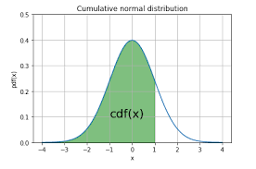
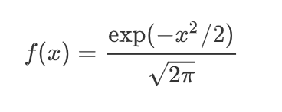
Probability density function for Standard Normal Distribution is given by:
Area below one standard deviation
From Z table, the cumulative probability:
P(-∞ ≤ Z ≤1) = P(- ∞ ≤ Z ≤0) + P(0 < Z ≤ 1)
= 0.50 + 0.34 = 0.84

