Slide 1
Determination of adequate Ticket Price
for Big Mountain Resort, Montana Based on Data Analysis
Problem Identification:
Taking into account the advanced facilities in Big Mountain, the ticket price of Big Mountain is considered to be lower as compared to the other resorts in the market.
The lack of proper capitalization hampering its investment strategy.

Slide 2
Recommendations based on Data analysis:
The Weekend Adult ticket Price: $94.22.
There is a further scope of increase in ticket price of $10.39.
Addition of one more chair lift to the resort.
Up to 5 runs can be closed as it has very less effect on the ticket price and revenue of the resort.
Key finding:
Some of the features in Big Mountain are more than average as compared to the facilities available in the market. The features are vertical drop, Snow Making area, total number of chairs, number of fast four persons chair, longest run and skiable terrain area. The model took into account all these advanced facilities and calculated the increase in ticket price.
One additional chair lift to the resort will increase the ticket price $8.46, also increases revenue of $14811594.
Closing up to 5 runs will not have any significant effect on the ticket price.

Slide 3

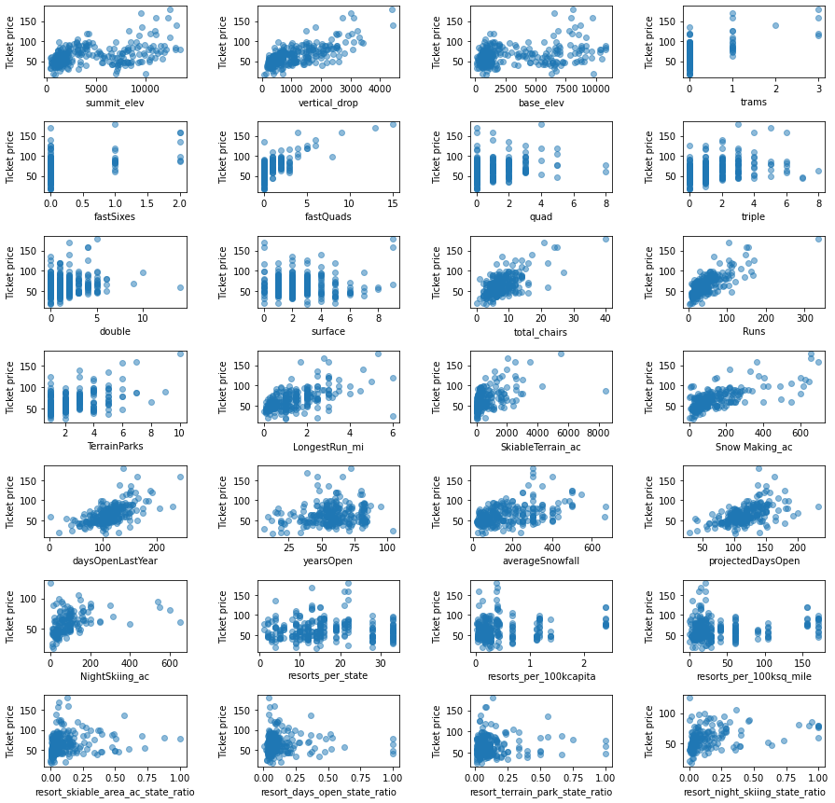
Modeling results and
analysis:
Before building a model to predict the ticket price, Exploratory Data Analysis was carried out and listed the features which affect the price most.
Vertical drop
Snow Making_ac
total_chairs
fastQuads
Runs
LongestRun_mi
trams
SkiableTerrain_ac

Slide 4
11.793
Model Building:
Based on these features correlation to the ticket price two models were built; a linear regression model and a Random Forest Regressor model.
Using the Linear Regression model, with SelectKBest, we found that 15 features can be used to build a model to predict the ticket price.
Next, using Cross validation on the above Linear Regression model, model gave the best performance score with with 8 features.
Finally:
Outcomes from Linear Regression model:
Mean Absolute Error: 11.793
Mean of Mean Absolute Error: 10.499
Std of Mean Absolute Error: 1.622
Outcomes from Random Forest Regressor model:
Mean Absolute Error: 9.495
Mean Mean Absolute Error: 9.659
Std of Mean Absolute Error: 1.349

Slide 5
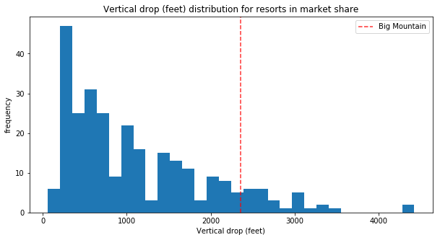
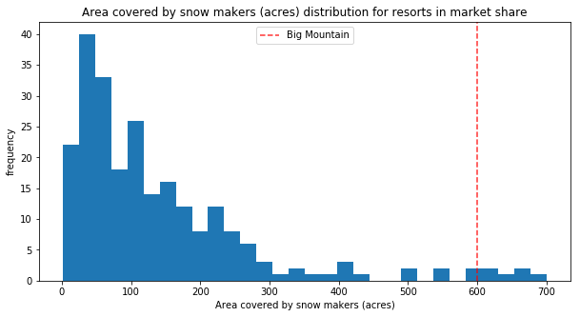
Modeling ticket price using the Random Forest Regressor model:
Based on the selected features, the Random Forest Regressor model predicted the Weekend Adult ticket Price: $94.22, which is more than the current ticket price of $81.00.
Also there is room for increasing the ticket price by $10.39, as per the model’s Mean Absolute Error value.

Slide 6
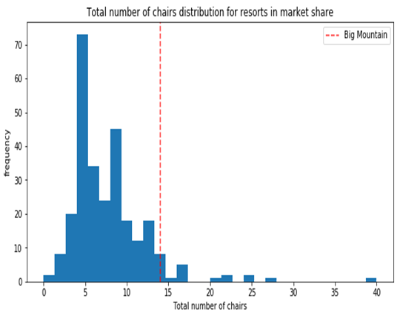
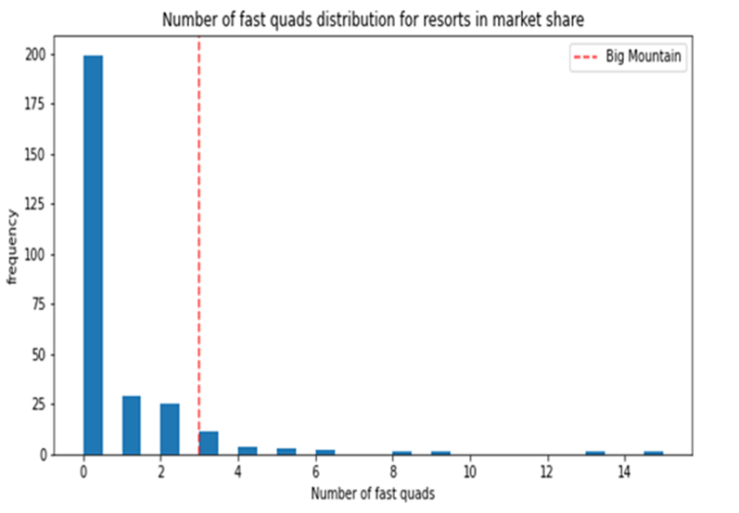


Slide 7
Further analysis was carried out on few of the features to see the effect on the ticket price and revenue:
Case-1: Addition of one more chair lift
This supports the increase in ticket price of $8.46 and revenue of $14811594, which is expected to cover the operational cost of the resort.
Case-2: Closing of runs
Closing of Runs up to 5 runs does not significantly affect the ticket price or the revenue of the resort.
Case-3: Increasing the snow making area
Increasing the snow making area by 2 acres, will neither significantly increase the ticket price($9.75) as compared to the one additional chair lift case nor the revenue ($17068841).
Case-4: Increasing the length of the Run and snowmaking area
This does not not at all affect the ticket price or revenue.

Slide 8
Summary and Conclusion:
Taking into consideration some of the advanced facilities (i.e more than the average facilities) in the market, the ticket price can be increased to $94.22 from its current price of $81.00.
Upto 5 runs can be closed in the resort without any significant effect on the resort’s operation.
Following further studies are considered to be beneficial:
Effect of the “number of visitors per year” on ticket price. (There is no data available in the data set on the number of visitors per year).
Study the model prediction altering the features value.

