Slide 1


Prediction of Netflix Movie Rating
Damayanti Naik, PhD
Data science Career Track, Capstone Project, December 2020 Cohort
Thanks to springboard mentor: Yadunath Gupta

Slide 2

About Netflix
Netflix is a subscription-based online streaming service that offers streaming of films and television series.
It started in 1997 in USA and now makes its service available in most of the countries in the world.
Netflix recommendation system
Netflix is well known for its efficient recommendation engines providing users choice of movies/shows. The engines work behind the scene and based on:
Content-based filtering algorithm
Collaborative filtering algorithm
Hybrid of both

Slide 3
Problem statement
In Netflix’s recommendation system, user’s rating plays an important role. Here, I’ll build a predictive model to predict movie rating (user review).
To carry out this
Different predictive models will be developed to predict movies’ rating.
The best one will be selected based on the R2 score (co-efficient of determination) i.e how close the actual ratings are to the predicted values.
Data
Data has been collected from
Kaggle
IMDB

Slide 4
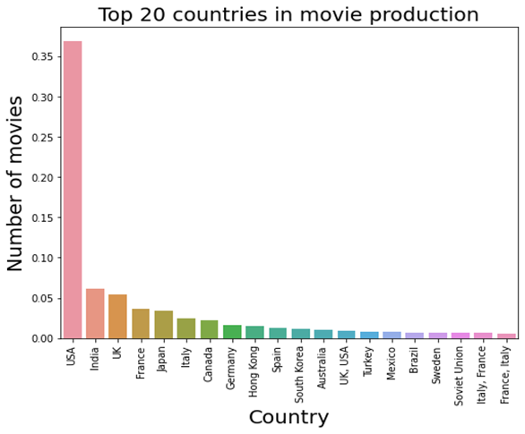
Key findings from Exploratory Data Analysis
USA ranked Number One in movie production, while India ranked Second followed by United Kingdom in Third place.

Slide 5
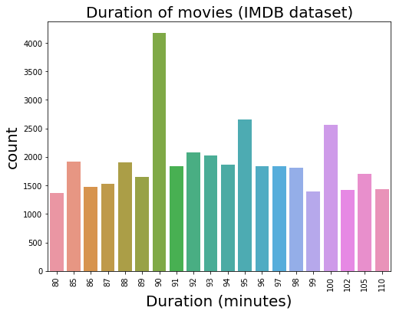
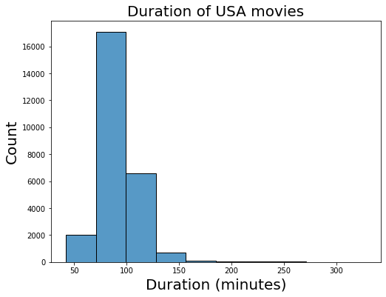
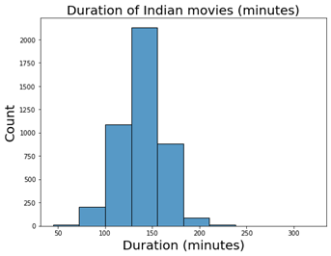
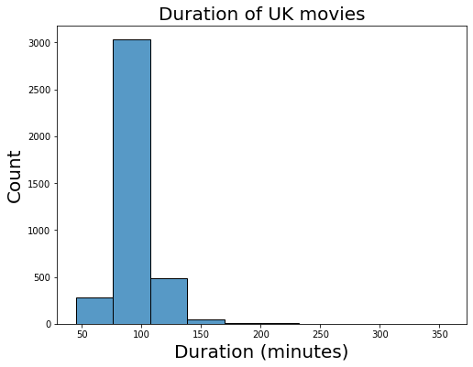
Key findings from Exploratory Data Analysis (continued):
Most of the movies are of duration (approximately) 90 mins. However, it varies in different countries. In USA and UK, movies are mostly of 90-100 minutes, whereas in India, movies are mostly of 120-150 minutes.

Slide 6
Key findings from Exploratory Data Analysis (continued):
These are three top movie production companies:
1. Metro-Goldwyn-Mayer
2. Warner Bros.
3. Columbia Pictures
Top movie production company of USA: Metro-Goldwyn-May
Top movie production company of India: NH Studioz
Top movie production company of UK: The Rank Organisation

Slide 7
Feature Engineering
Two new datasets were formed out of Kaggle and IMDB dataset before feature engineering:
Movies found only in IMDB dataset (not in Kaggle) were used for predictive model building.
Movies common to both were used for testing the model.
Feature engineering was carried out as follows:
Dummie variables were created out of categorical variables: genre, language, actors, directors, production company.
Genre, language have <300 unique values, so dummie values for all these features were created.
Actors, directors, production company have >300 unique values. Out of them, for top 200 unique values, dummie values were obtained.
Standard scaling was carried out on duration time, votes, reviews from users columns.
Outliers are filled with 95th percentile of the values of respective column.

Slide 8
Model development
Different Regression models were developed to predict the movies rating:
Simple Linear Regression
Lasso Regression
Ridge Regression
Random Forest Regressor
Gradient Boosting Regressor
Models’ performance
The Simple Linear regression model performance was poor, however it improved significantly when regularization was applied. Among Lasso and Ridge, the later performed best.
To have better performance, ensemble model Random Forest Regressor was developed. It improved the model performance as compared to Linear regression.
To achieve much higher performance, ensemble model Gradient Boosting Regressor was also developed. This model had the best performance among all the models.

Slide 9
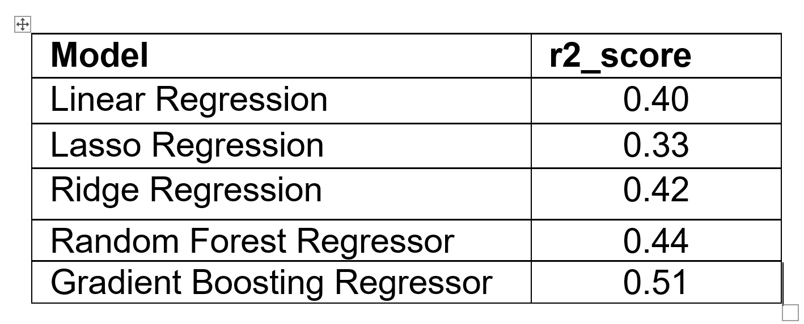
Principal Component Analysis application
To improve the models’ performance, PCA (Principal Component Analysis) was applied and models were trained again.
Though it improved Linear Regression’s performance and run time, it didn’t help both ensemble models.
Best model
Gradient Boosting Regressor was the best among all the predictive models.

Slide 10
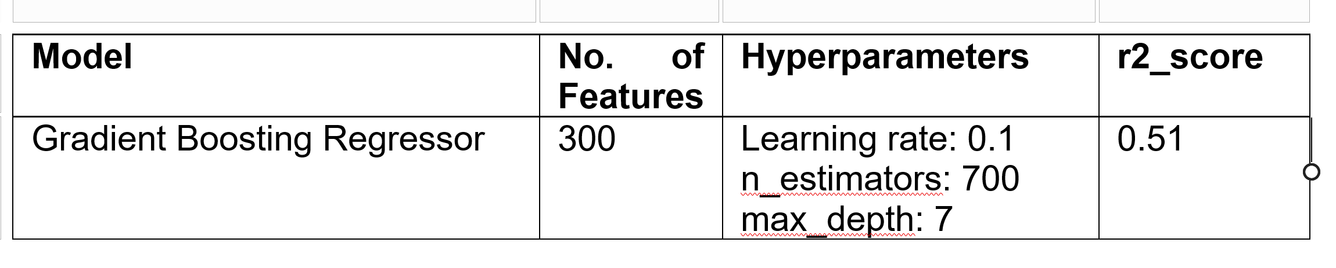
Gradient Boosting Regressor details

Slide 11
Model for future Use
Among all the predictive models, as Gradient Boosting Regressor was the best with R2 score 0.51, it was saved for deployment.
Future Recommendation
The model’s performance can be improved further with Inclusion of more movie features: music quality, picture quality, chorography quality, actors’ ranking, users’ age, etc. Hence data on these should be included in future model building.

Slide 12
Thank You
Thank You

