Slide 1

Prediction of Netflix Movie Rating (user review)
Problem statement:
Different predictive models will be developed to predict movies’ users rating and the best one will be selected based on the R2-score (co-efficient of determination).

Slide 2
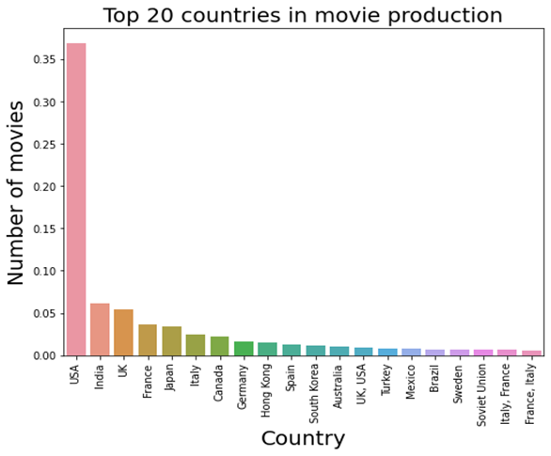
Netflix’s recommendation system is based on users’ rating and other features of the movies/shows. In this project, using Kaggle and IMDB data sets, ‘user rating’ prediction models were built.
Key findings from Exploratory Data Analysis:
USA ranked Number One in movie production, while India ranked Second followed by United Kingdom in Third place.

Slide 3
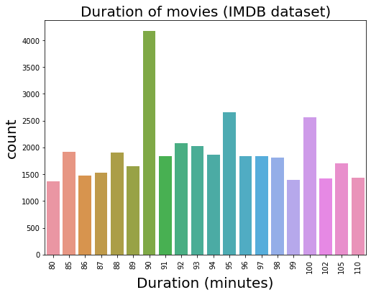
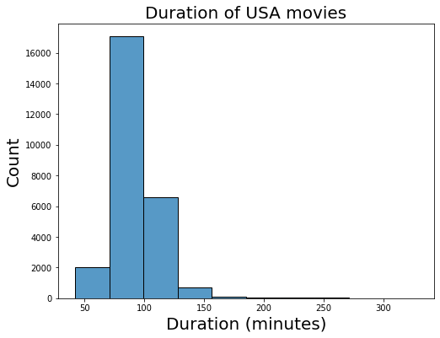
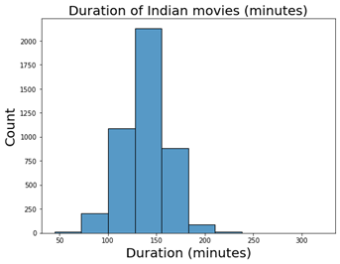
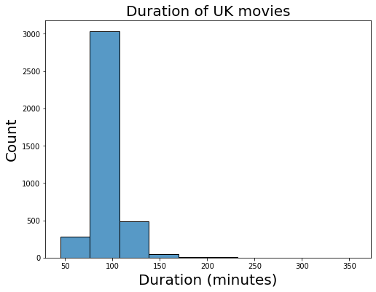
Key findings from Exploratory Data Analysis (continued):
Most of the movies are of duration (approximately) 90 mins. However, it varies for in different countries. In USA and UK, movies are mostly of 90-100 minutes, whereas in India, movies are mostly of 120-150 minutes.

Slide 4
Key findings from Exploratory Data Analysis (continued):
These are three movie production companies:
1. Metro-Goldwyn-Mayer
2. Warner Bros.
3. Columbia Pictures
USA top movie production company: Metro-Goldwyn-May
India top movie production company: NH Studioz
UK top movie production company: The Rank Organisation

Slide 5
Model development:
Different Regression models were developed to predict the user rating:
Simple Linear Regression
Lasso Regression
Ridge Regression
Random Forest Regressor
Gradient Boosting Regressor were developed
The Simple Linear regression model performance was poor, however it improved significantly when regularization was applied. Among Lasso and Ridge, the later performed better with r2_score : 0.42.
To have better performance, ensemble model Random Forest Regressor was developed. The highest r2_score obtained with this was 0.44.
To obtain further high performance, Gradient Boosting Regressor was developed. The highest r2_score obtained with this was 0.51 and this was the best model among all the models.

Slide 6
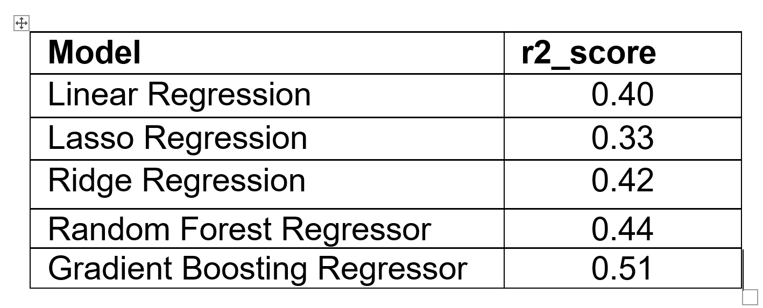
Principal Component Analysis application:
To improve the models’ performance, PCA (Principal Component Analysis) was applied and models were trained again.
Though it improved Linear Regression’s performance and run time, it didn’t help both ensemble models.
Best model:
Gradient Boosting Regressor was the best among all the predictive models, hence it is saved for deployment.

Slide 7
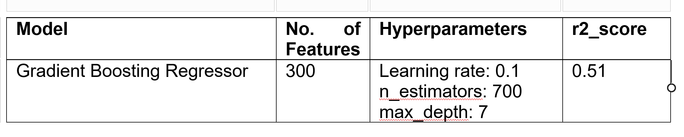
Gradient Boosting Regressor details:

Slide 8
Future Recommendations:
Inclusion of more movie features: music quality, picture quality, chorography quality, actors’ ranking, users’ age etc are believed to improve models’ performance, hence data on these features needs to be included in future model building.

