Slide 1




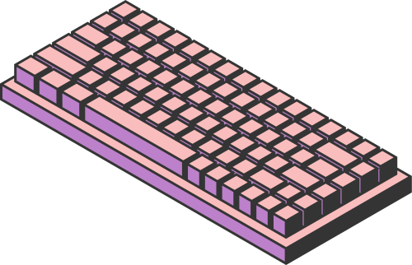
SCIENCE
TECHNOLOGY
SOCIETY
HOME
SERVICE
ABOUT US
CONTACT US
THE
INFORMATION
AGE
Presented by:
Ramosa, Jummel Mark M.
Sarzata, Kurt Harvy L.
Page 01

Slide 2

SCIENCE
TECHNOLOGY
SOCIETY
HOME
SERVICE
ABOUT US
CONTACT US
THE INFORMATION AGE
It is believed to have started in the last quarter of the 20th century.
It is characterized by rapid, effortless access, and management information through written or digital publication with the use of computer and computer networks.
It is also referred to as the Digital Age and the New Media Age.
Information gets ahead of us.
James R. Messenger proposed The Information Age in 1982
Page 02

Slide 3

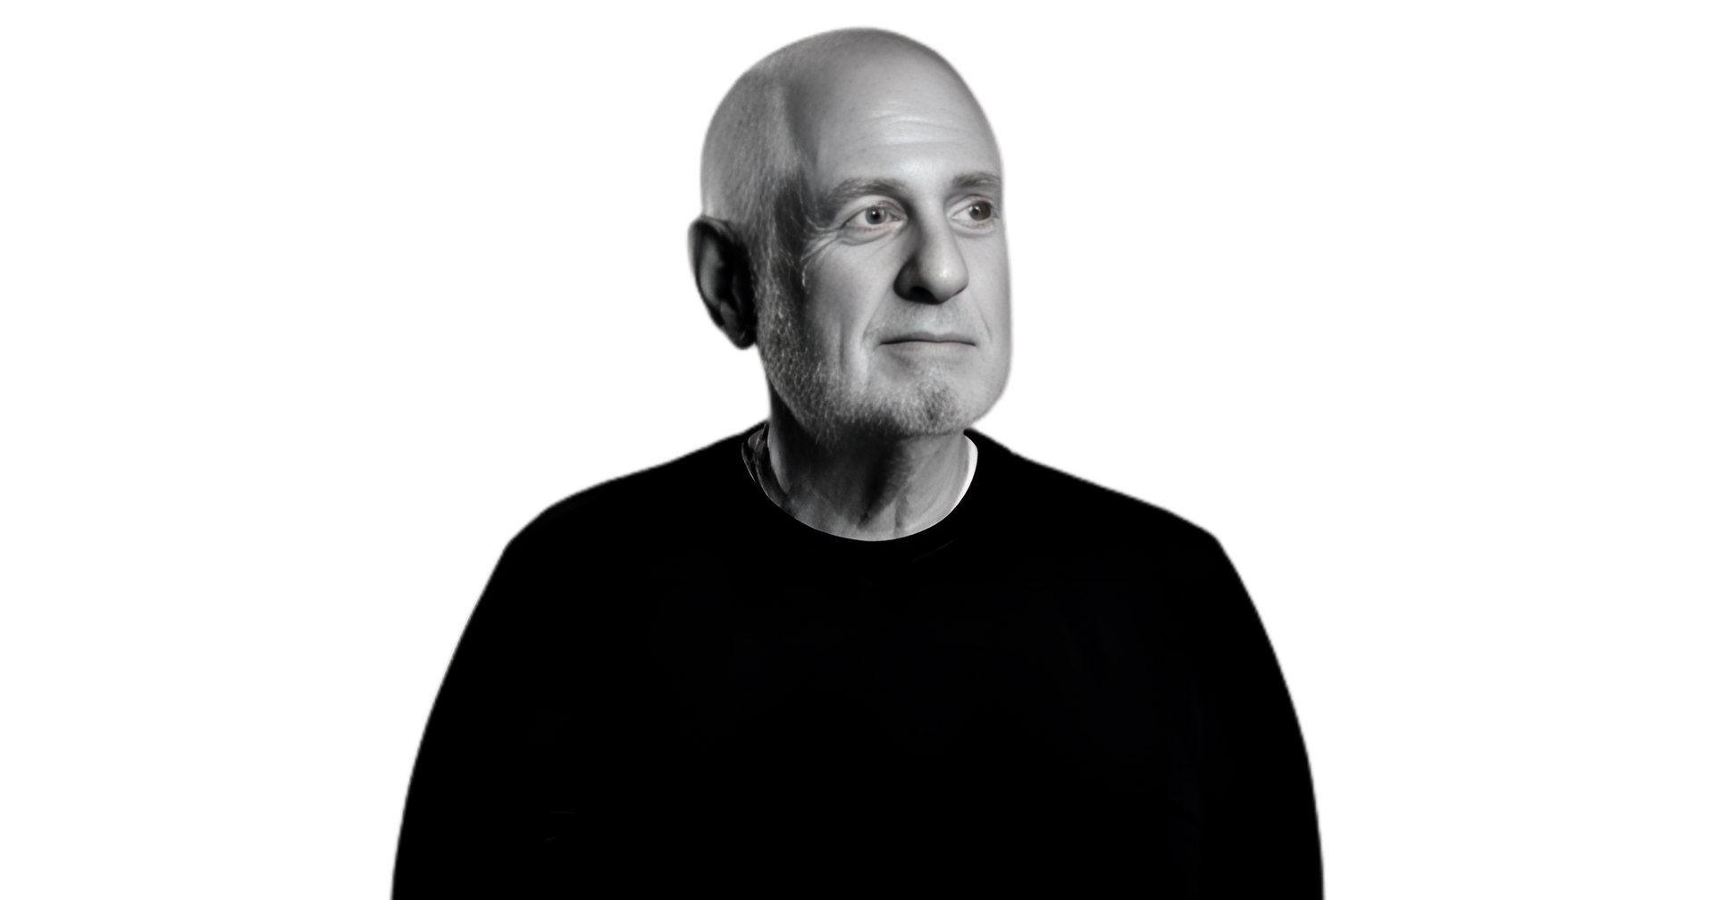
SCIENCE
TECHNOLOGY
SOCIETY
HOME
SERVICE
ABOUT US
CONTACT US
THE INFORMATION AGE
Richard Wurman
“Information Anxiety” by Richard Wurman
Information became the currency in the Business World
INFORMATI0N = POWER = SUCCESS
Information was the preferred medium of exchange and the information served as information officers.
Page 03

Slide 4




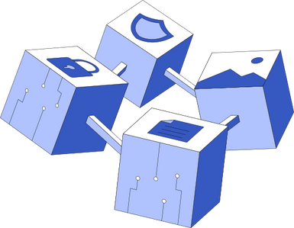


SCIENCE
TECHNOLOGY
SOCIETY
HOME
SERVICE
ABOUT US
CONTACT US
SEVERAL FIELDS OR DICIPLINES HAVE MERGE THESE FIELDS INCLUDE:
AI or Artificial Intelligence and Machine Learning
Robotics
Cloud and Edge Computing
Automation
Blockchain
Software and Application
Outsourcing
Communication and Networking
Page 04

Slide 5

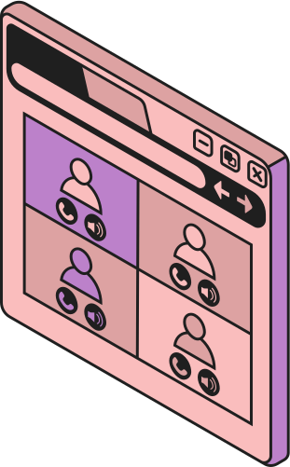
SCIENCE
TECHNOLOGY
SOCIETY
HOME
SERVICE
ABOUT US
CONTACT US
SCIENCE AND INFORMATION AGE
Information Age affected the scientific community.
·Bioinformatics, through this scientist apply the principles of computer science and statistical algorithms to store, process, and analyze extensive collection of data.
·The availability of wide range of information at hand also entails the call for responsible generation of information and proper citation and recognition of authors and publisher.
Page 05

Slide 6
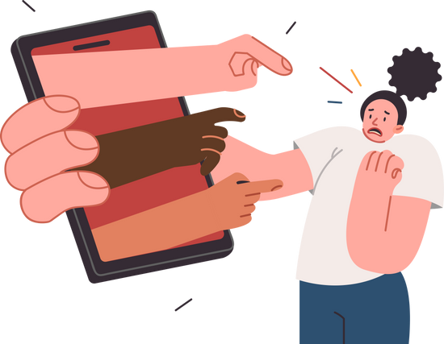
SCIENCE
TECHNOLOGY
SOCIETY
HOME
SERVICE
ABOUT US
CONTACT US
INFORMATION AGE AND CYBERBULLYING
·Words are so powerful that they can either make or break people and relationships.
·Social media has shaped recent events.
·It is but proper to visit the laws governing rights of people against cyberbullying.
Page 06

Slide 7
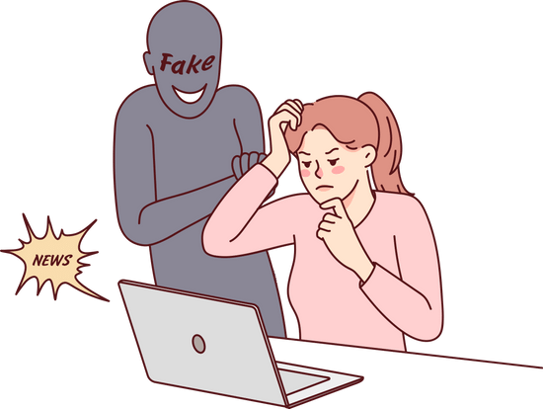

SCIENCE
TECHNOLOGY
SOCIETY
HOME
SERVICE
ABOUT US
CONTACT US
THE EMERGENCE OF FAKE NEWS
If truthful news is available, so does fake news.
One more factor that contributes to rapid dissemination of fake news is confirmation bias.
Page 07

Slide 8


SCIENCE
TECHNOLOGY
SOCIETY
HOME
SERVICE
ABOUT US
CONTACT US
HOW TO SPOT FAKE NEWS
Fake news tends to spread as fast as contagious diseases are.
So, it is just necessary to be guided and guarded from the ignorance and further damage that can be brought about by misinformation.
Page 08

Slide 9
SCIENCE
TECHNOLOGY
SOCIETY
HOME
SERVICE
ABOUT US
CONTACT US
HOW TO SPOT FAKE NEWS
The following practical tips form Nagler, C. (2017) of Harvard Division of Continuing Education can help us spot fake news.
Vet the publisher’s credibility.
Try to consider these questions whenever we see an article that captures our attentions.
Would the publishing site meet the academic citation standard?
Such as: APA, MLA, Chicago/Turabian, and IEEE
What is the domain name?
Ex. https://www.foxnews.com/
Who is the author?
What is the publications points of view?
Page 09

Slide 10
SCIENCE
TECHNOLOGY
SOCIETY
HOME
SERVICE
ABOUT US
CONTACT US
HOW TO SPOT FAKE NEWS
The following practical tips form Nagler, C. (2017) of Harvard Division of Continuing Education can help us spot fake news.
2. Pay attentions to quality and timelines.
Notice spelling errors and dramatic punctuations from the article. Check if the story is current or recycled
3. Check the source and citation
Notice spelling errors and dramatic punctuations from the article. Check if the story is current or recycled
How did you find the article?
Who is (or is not) quoted, and what do they say?
Is the information available on other sites?
Can you perform reverse researches and images?
Page 10

Slide 11
SCIENCE
TECHNOLOGY
SOCIETY
HOME
SERVICE
ABOUT US
CONTACT US
QUIZ
Page 11

Slide 12
SCIENCE
TECHNOLOGY
SOCIETY
HOME
SERVICE
ABOUT US
CONTACT US
QUIZ:
I. Multiple Choice
When is the Information Age believed to have started?
4. Who proposed the term The Information Age in 1982?
A. Early 20th century
B. Last quarter of the 20th century
C. 21st century
D. 19th century
A. Artificial Intelligence
B. Cloud Computing
C. Agriculture
D. Blockchain
2. What is another name for the Information Age?
5. Who is the author of the book Information Anxiety?
A. Stone Age
B. Industrial Age
C. Digital Age
D. Agricultural Age
A. James R. Messenger
B. Richard Wurman
C. Charles Nagler
D. Nicholas Carr
3. Who proposed the term The Information Age in 1982?
A. Richard Wurman
B. Charles Babbage
C. James R. Messenger
D. Steve Jobs
Page 12

Slide 13
SCIENCE
TECHNOLOGY
SOCIETY
HOME
SERVICE
ABOUT US
CONTACT US
QUIZ:
II. Enumeration
6-7. Enumerate at least 2 fields or disciplines that merged with Information Technology during the Information Age.
8-9. Enumerate the ways to spot fake news based on Nagler, C (2017)
Page 13

Slide 14
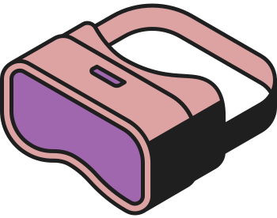



SCIENCE
TECHNOLOGY
SOCIETY
HOME
SERVICE
ABOUT US
CONTACT US
THANK YOU
Page 14

