Slide 1
Dengue Unleashed: Tracing the Outbreaks and Patterns of Dengue Cases in the Philippines (2016-2020)

Slide 2


Slide 3
Introduction!
What is Dengue?
What are we trying to solve with this research?
Why are we doing this?

Slide 4
Dengue? - a viral infection that spreads from mosquitoes to people. It is more common in tropical and subtropical climates.

Slide 5
01
Objectives

Slide 6
Help the people on identifying key pattern in dengue outbreak in the Philippines.
Provide an explanation of the trends in dengue cases in the Philippines as time passes by.

Slide 7


Slide 8
Methods
02

Slide 9
To gain a deeper understanding of the impact of climate change on dengue cases in the Philippines from 2016 to 2020, an empirical research approach will be employed. This research will involve conducting a thorough literature review to gather existing knowledge on climate change, dengue, and adaptation strategies in the Philippines. Additionally, data on dengue cases will be compiled from reliable sources, such as the Department of Health, to analyze trends and patterns over the specified period.

Slide 10
03
Result Analysis

Slide 11
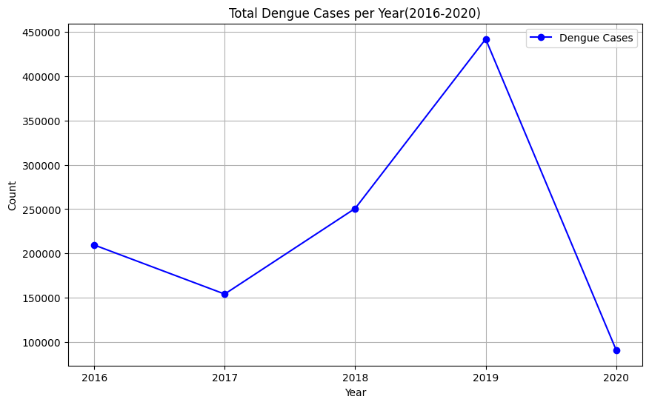

Slide 12
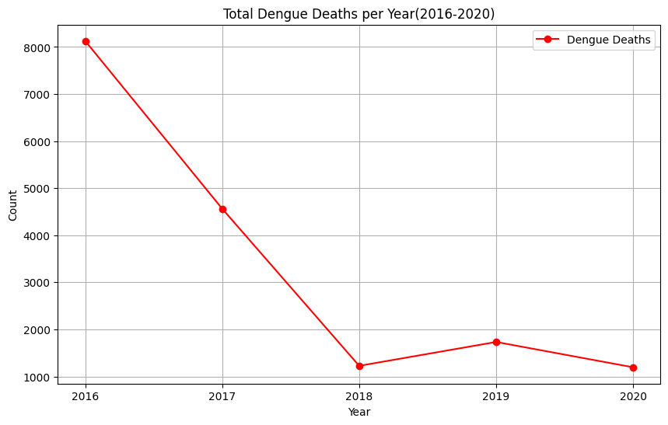

Slide 13
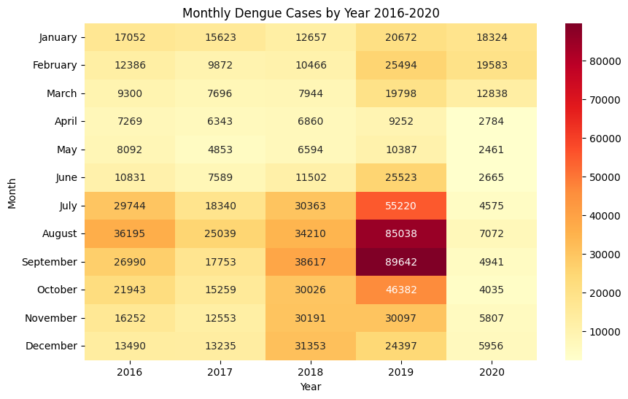

Slide 14
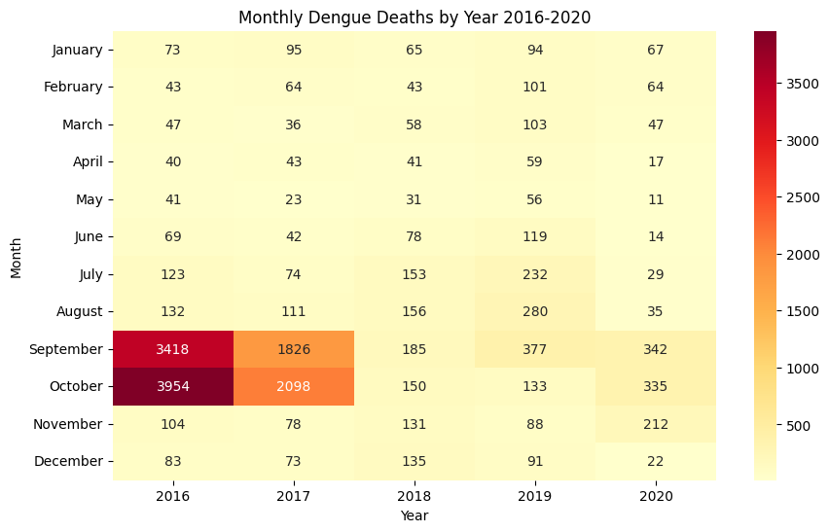

Slide 15
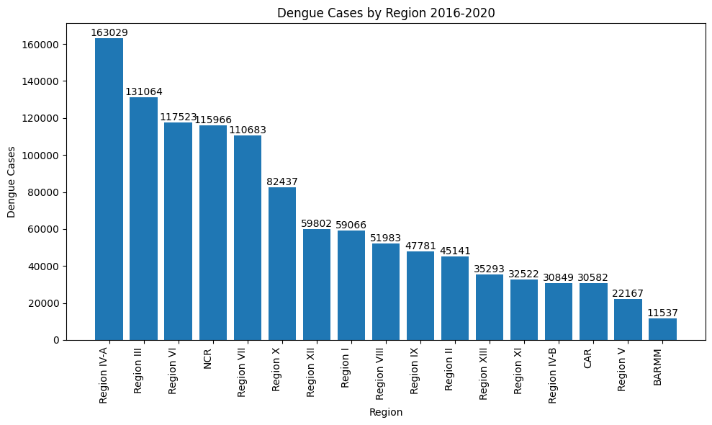

Slide 16
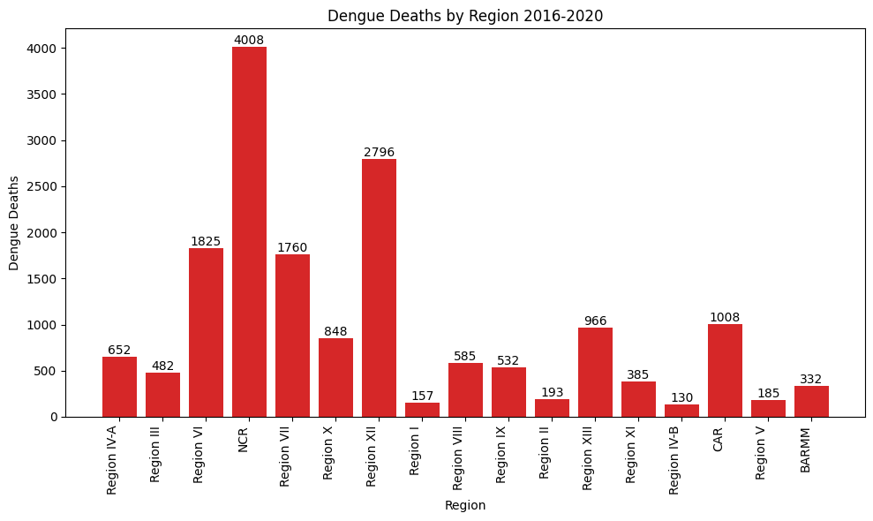

Slide 17
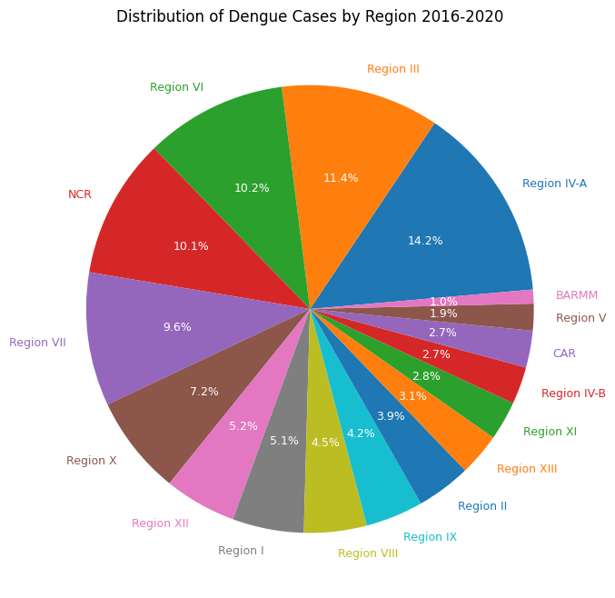

Slide 18
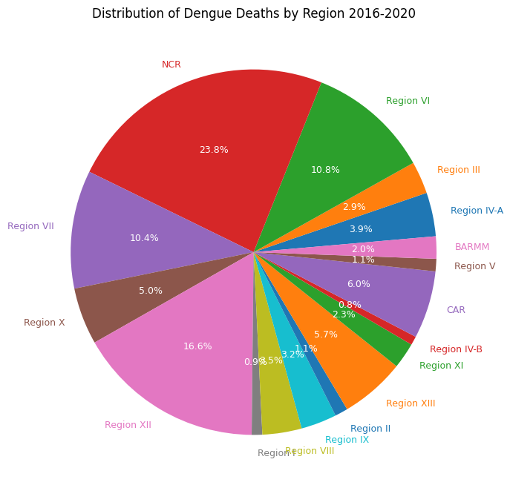

Slide 19
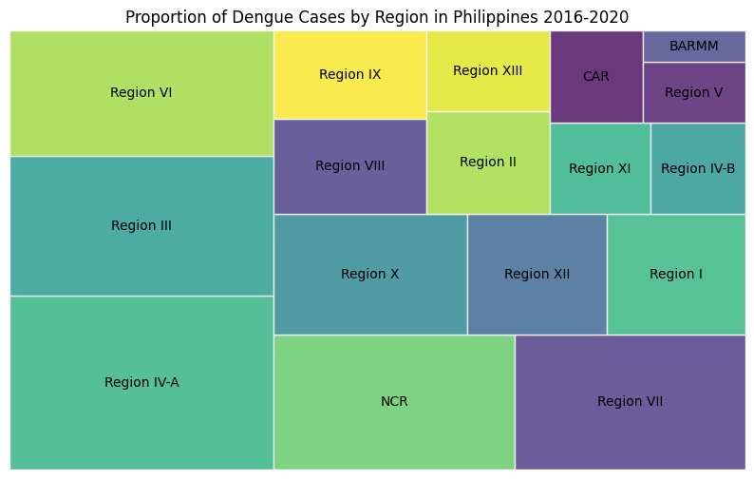

Slide 20
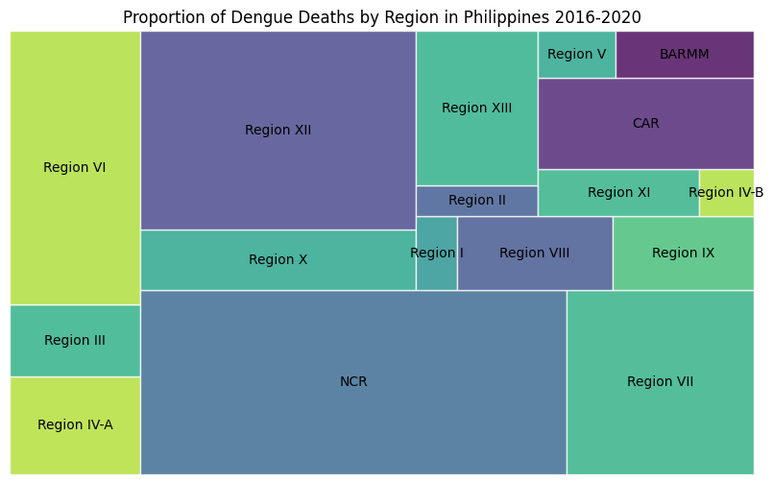

Slide 21
04
Conclusion

Slide 22
2019
Most Dengue Case - 441902

Slide 23
2016
Most Dengue Deaths - 8127

Slide 24
Region IV-A
Most Dengue Case- 163029

Slide 25
NCR
Most Dengue Deaths - 4008

Slide 26
REFERENCE
https://www.kaggle.com/datasets/vincentgupo/dengue-cases-in-the-philippines
Epidemiology of dengue disease in the Philippines (2000–2011): a systematic literature review. PLoS Negl Trop Dis. 2014; 8: e3027 https://doi.org/10.1371/journal.pntd.0003027
Compendium of Philippine environment statistics component 5: human settlements and environmental health [Internet]. Philippine Stat Author. 2021; ([cited 2022 April 13]. Available from:)
Current DF/DHF prevention and control prhttps://psa.gov.ph/press-releases/id/165164ogramme in the Philippines.
Dengue Prevention and Control Program [Internet]. Department of Health. [cited 2022 April 13]. Available from: https://doh.gov.phnational-dengue-prevention-and-control-program.
Communicating covid-19 vaccines: lessons from the dengue vaccine controversy in the Philippines. BMJ Glob Health. 2021; 6: e005422 https://doi.org/10.1136/bmjgh-2021-005422

Slide 27
Thank You!!!

