Slide 1
University of Udine
Formalizing Social Engineering attacks in the Symbolic Model
July 2023 – D’Ambrosi Denis

Slide 2
The Dolev Yao Model
Introduction
The Dolev Yao Model
Tamarin Prover Overview
Term-algebra
Equational theories
Protocols as sets of multiset rewriting rules
Security properties
Observational equivalences
Aiding termination
Formalizing Social-Engineering attacks
Introduction
Including human knowledge
Formalizing human errors
Rule-based human approach
Conclusions

Slide 3
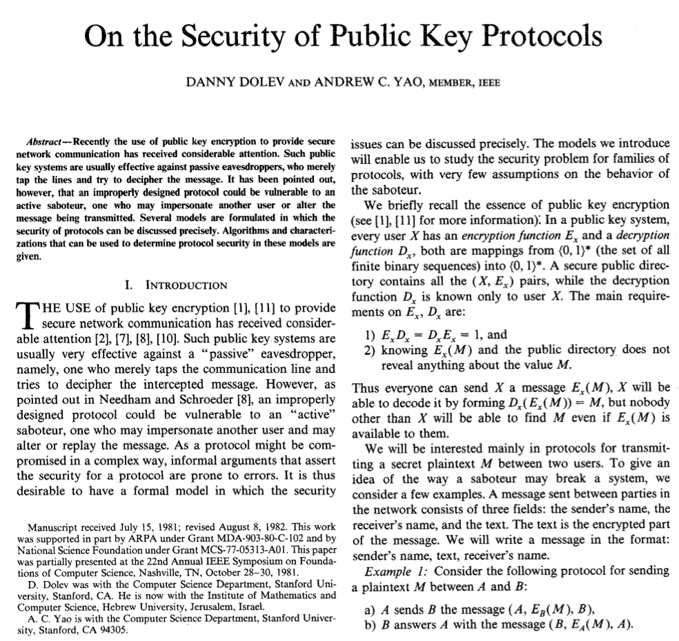

Introduction
Cryptographic protocols are complex to verify
We need:
A threat model
A (possibly automated) tool to verify the protocol in said model

Slide 4

The Dolev Yao Model
D. Dolev and A. Yao. On the security of public key protocols. IEEE Transactions on Information Theory, 1983.
M. Barbosa, G. Barthe, K. Bhargavan, B. Blanchet, C. Cremers, K. Liao, and B. Parno. Sok: Computer-aided cryptography. Cryptology ePrint Archive, 2019.
S. Even and O. Goldreich. On the security of multi-party ping-pong protocols. In 24th Annual Symposium on Foundations of Computer Science, 1983.
N Durgin, P. Lincoln, and J. Mitchell. Multiset rewriting and the complexity of bounded security protocols. Journal of Computer Security, 2004.

Slide 5



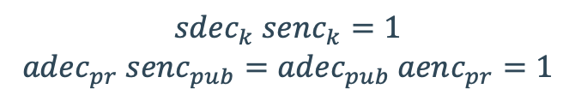
The Dolev Yao Model
Main features:
Attacker-controlled network
Term algebras for cryptography
Perfect cryptography assumption
$$sdec_{k} senc_{k}=1$$
$$adec_{pr} senc_{pub}=adec_{pub} aenc_{pr}=1$$
Perfect cryptography identities
Attacker controlled network with trusted party

Slide 6
The Dolev Yao Model
What can be specified:
What can be verified:
Sources of infinity
Unbounded sessions
Unbounded nonces
Unbounded messages
Limit nonces and messages → DEXP-complete
Limit sessions → NP-complete
… or try to address undecidability without loosing generality → Tamarin, ProverIf
Trace properties
Confidentiality
Integrity
Authentication
etc …
Observational equivalence properties:
Privacy
Indistinguishability
Undecidability
Infinite state space

Slide 7
Tamarin prover overview
S. Meier. Advancing automated security protocol verification. PhD thesis, ETH, 2013.
B. Schmidt. Formal analysis of key exchange protocols and physical protocols. PhD thesis, ETH, 2012.
The Tamarin Team. Tamarin-Prover Manual: Security Protocol Analysis in the Symbolic Model, 2023.
J. Dreier, C. Dumenil, S. Kremer, and R. Sasse. Beyond subterm-convergent equational theories in automated verification of stateful protocols. Principles of Security and Trust, 2017

Slide 8
Tamarin Prover overview
Term-algebra
Signature
Equation over 𝚺
Equational theory
𝚺-terms
Substitution
Mapping
(𝚺,E)-Unification
Convergent Theory
Subterm-convergent Equational Theory
Graph of the definitions introduced within this section
Convergent theory with finite variant property

Slide 9
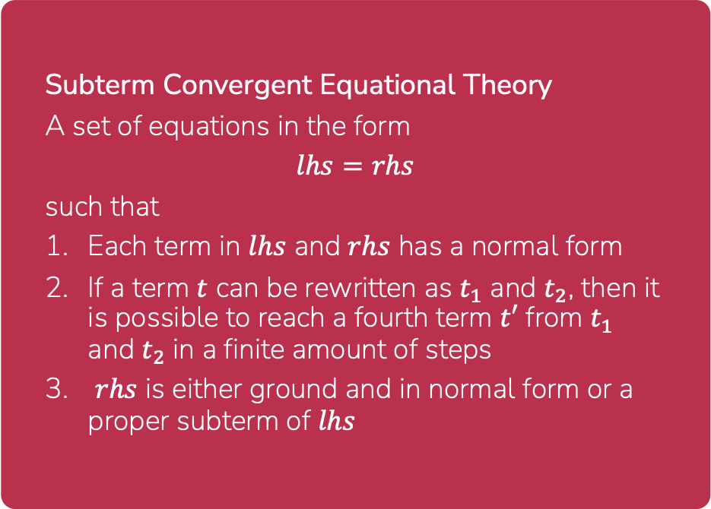
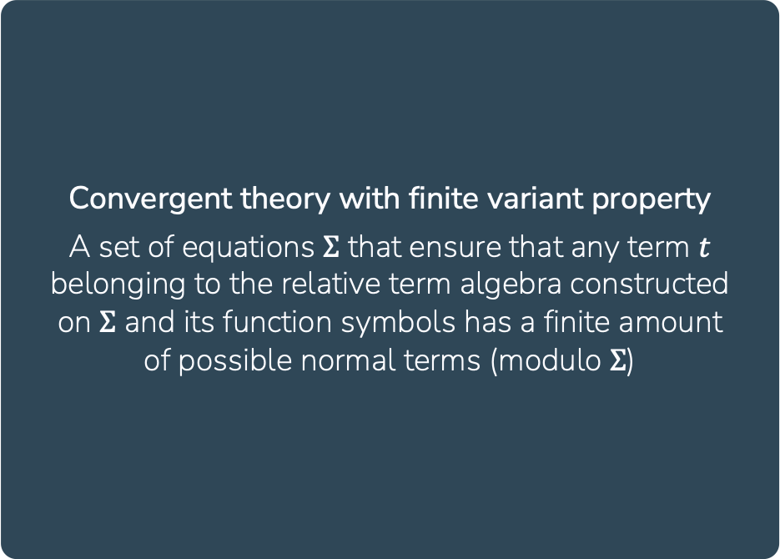
Tamarin Prover overview
Equational theories
Intuitive definitions of the equational theories accepted by Tamarin
Convergent theory with finite variant property
A set of equations $Σ$ that ensure that any term $t$ belonging to the relative term algebra constructed on $Σ$ and its function symbols has a finite amount of possible normal terms (modulo $Σ$)
Subterm Convergent Equational Theory
A set of equations in the form
$$lhs=rhs$$
such that
Each term in $lhs$ and $rhs$ has a normal form
If a term $t$ can be rewritten as $t_{1}$ and $t_{2}$, then it is possible to reach a fourth term $t′$ from $t_{1}$ and $t_{2}$ in a finite amount of steps
$rhs$ is either ground and in normal form or a proper subterm of $lhs$

Slide 10
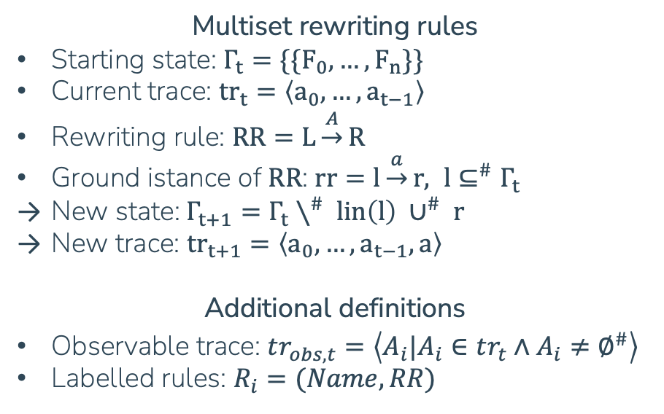
Tamarin Prover overview
Protocols as sets of multiset rewriting rules
State evolution in Tamarin: application of rewriting rules to multisets of facts
Facts
Intuitively, they represent true predicates
Fixed arity
Made up of terms
Multiset rewriting rules
Starting state: $Γ_{t}=\{\{F_{0}, …, F_{n}\}\}$
Current trace: ${tr}_{t}=\left\langle a_{0},…,a_{t−1}\right\rangle$
Rewriting rule: $RR=L\underset{→}{A}R$
Ground istance of $RR$: $rr=l\underset{→}{a}r, l⊆^{\#}Γ_{t}$
New state:$Γ_{t+1}=Γ_{t}∖^{\#} lin\left(l\right) ∪^{\#} r$
New trace: ${tr}_{t+1}=\left\langle a_{0},…,a_{t−1},a\right\rangle$
Additional definitions
Observable trace: $tr_{obs,t}=\left\langle A_{i}|A_{i}∈tr_{t}∧A_{i}≠∅^{\#}\right\rangle$
Labelled rules: $R_{i}=(Name, RR)$
Linear facts
Represent ephemeral information
Consumed just once
Persistent facts
Represent enduring knowledge

Slide 11
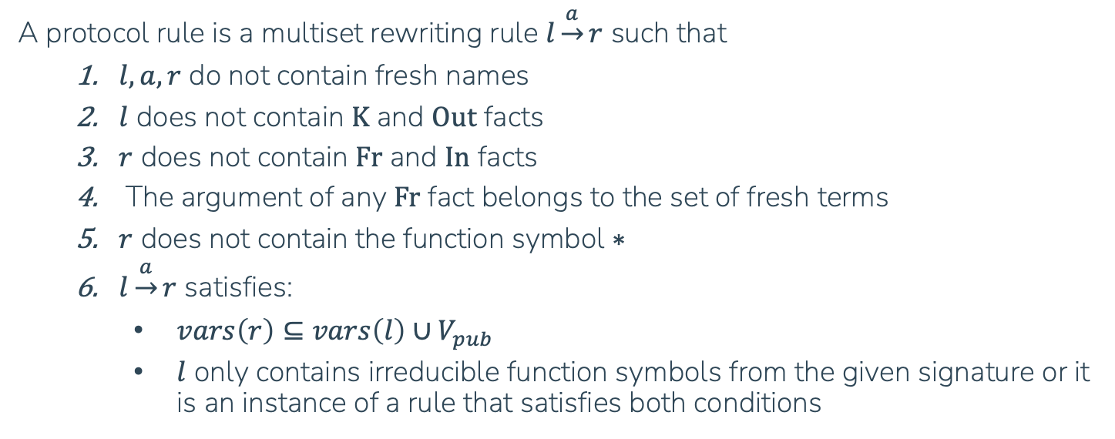
Tamarin Prover overview
Protocols as sets of multiset rewriting rules
Definition of protocol rules
A protocol rule is a multiset rewriting rule $l\underset{→}{a}r$ such that
$l,a,r$ do not contain fresh names
$l$ does not contain $\text{K}$ and $\text{Out}$ facts
$r$ does not contain $\text{Fr}$ and $\text{In}$ facts
The argument of any $\text{Fr}$ fact belongs to the set of fresh terms
$r$ does not contain the function symbol $∗$
$l\underset{→}{a}r$ satisfies:
$vars\left(r\right)⊆vars\left(l\right)∪V_{pub}$
$l$ only contains irreducible function symbols from the given signature or it is an instance of a rule that satisfies both conditions

Slide 12
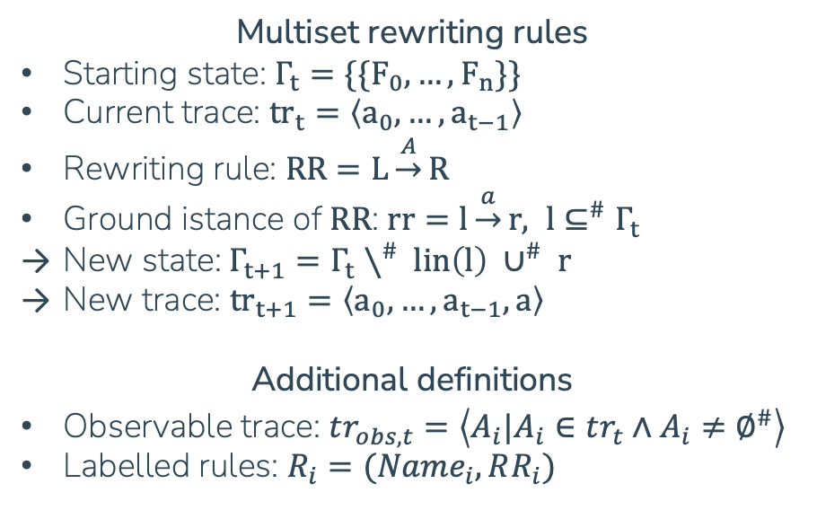

Tamarin Prover overview
Protocols as sets of multiset rewriting rules
State evolution in Tamarin: application of rewriting rules to multisets of facts
Example
$$P=\{ \left(N_{1}, { ∅}^{\#}−\left[ \left\{\left\{Init\left(0\right)\right\}\right\} \right]→\left\{\left\{A\left(0\right)\right\}\right\}\right), \\ \left(N_{2}, \left\{\left\{A\left(x\right)\right\}\right\}−\left[ ∅^{\#} \right]→\left\{\left\{B\left(x\right)\right\}\right\}\right), \\ \left(N_{3}, \left\{\left\{B\left(x\right)\right\}\right\}−\left[ \left\{\left\{Concl\left(x\right)\right\}\right\} \right]→∅^{\#}\right) \}$$
Apply $N_{1}, N_{2}, N_{1}, N_{3}$ to an initial empty state
$$Γ_{0}=∅^{\#} \\ tr_{0}=\left\langle \right\rangle \\ tr_{obs,0}=\left\langle \right\rangle$$
Multiset rewriting rules
Starting state: $Γ_{t}=\{\{F_{0}, …, F_{n}\}\}$
Current trace: ${tr}_{t}=\left\langle a_{0},…,a_{t−1}\right\rangle$
Rewriting rule: $RR=L\underset{→}{A}R$
Ground istance of $RR$: $rr=l\underset{→}{a}r, l⊆^{\#}Γ_{t}$
New state:$Γ_{t+1}=Γ_{t}∖^{\#} lin\left(l\right) ∪^{\#} r$
New trace: ${tr}_{t+1}=\left\langle a_{0},…,a_{t−1},a\right\rangle$
Additional definitions
Observable trace: $tr_{obs,t}=\left\langle A_{i}|A_{i}∈tr_{t}∧A_{i}≠∅^{\#}\right\rangle$
Labelled rules: $R_{i}=(Name_{i}, RR_{i})$

Slide 13

Tamarin Prover overview
Protocols as sets of multiset rewriting rules
State evolution in Tamarin: application of rewriting rules to multisets of facts
Example
$$P=\{ \left(N_{1}, { ∅}^{\#}−\left[ \left\{\left\{Init\left(0\right)\right\}\right\} \right]→\left\{\left\{A\left(0\right)\right\}\right\}\right), \\ \left(N_{2}, \left\{\left\{A\left(x\right)\right\}\right\}−\left[ ∅^{\#} \right]→\left\{\left\{B\left(x\right)\right\}\right\}\right), \\ \left(N_{3}, \left\{\left\{B\left(x\right)\right\}\right\}−\left[ \left\{\left\{Concl\left(x\right)\right\}\right\} \right]→∅^{\#}\right) \}$$
Apply $N_{1}, N_{2}, N_{1}, N_{3}$ to an initial empty state
$$Γ_{0}=∅^{\#} \\ Γ_{1}=∅^{\#} ∖^{\#} ∅^{\#}∪^{\#} \left\{\left\{A\left(0\right)\right\}\right\}=\left\{\left\{A\left(0\right)\right\}\right\} \\ tr_{1}=\left\langle Init(0)\right\rangle \\ tr_{obs,1}=\left\langle Init(0)\right\rangle$$
Multiset rewriting rules
Starting state: $Γ_{t}=\{\{F_{0}, …, F_{n}\}\}$
Current trace: ${tr}_{t}=\left\langle a_{0},…,a_{t−1}\right\rangle$
Rewriting rule: $RR=L\underset{→}{A}R$
Ground istance of $RR$: $rr=l\underset{→}{a}r, l⊆^{\#}Γ_{t}$
New state:$Γ_{t+1}=Γ_{t}∖^{\#} lin\left(l\right) ∪^{\#} r$
New trace: ${tr}_{t+1}=\left\langle a_{0},…,a_{t−1},a\right\rangle$
Additional definitions
Observable trace: $tr_{obs,t}=\left\langle A_{i}|A_{i}∈tr_{t}∧A_{i}≠∅^{\#}\right\rangle$
Labelled rules: $R_{i}=(Name_{i}, RR_{i})$

Slide 14

Tamarin Prover overview
Protocols as sets of multiset rewriting rules
State evolution in Tamarin: application of rewriting rules to multisets of facts
Example
$$P=\{ \left(N_{1}, { ∅}^{\#}−\left[ \left\{\left\{Init\left(0\right)\right\}\right\} \right]→\left\{\left\{A\left(0\right)\right\}\right\}\right), \\ \left(N_{2}, \left\{\left\{A\left(x\right)\right\}\right\}−\left[ ∅^{\#} \right]→\left\{\left\{B\left(x\right)\right\}\right\}\right), \\ \left(N_{3}, \left\{\left\{B\left(x\right)\right\}\right\}−\left[ \left\{\left\{Concl\left(x\right)\right\}\right\} \right]→∅^{\#}\right) \}$$
Apply $N_{1}, N_{2}, N_{1}, N_{3}$ to an initial empty state
$$Γ_{1}=\left\{\left\{A\left(0\right)\right\}\right\} \\ Γ_{2}=\left\{\left\{A\left(0\right)\right\}\right\}∖^{\#}\left\{\left\{A\left(0\right)\right\}\right\}∪^{\#} \left\{\left\{B\left(0\right)\right\}\right\}=\left\{\left\{B\left(0\right)\right\}\right\} \\ tr_{2}=\left\langle Init\left(0\right), { ∅}^{\#}\right\rangle \\ tr_{obs,2}=\left\langle Init(0)\right\rangle$$
Multiset rewriting rules
Starting state: $Γ_{t}=\{\{F_{0}, …, F_{n}\}\}$
Current trace: ${tr}_{t}=\left\langle a_{0},…,a_{t−1}\right\rangle$
Rewriting rule: $RR=L\underset{→}{A}R$
Ground istance of $RR$: $rr=l\underset{→}{a}r, l⊆^{\#}Γ_{t}$
New state:$Γ_{t+1}=Γ_{t}∖^{\#} lin\left(l\right) ∪^{\#} r$
New trace: ${tr}_{t+1}=\left\langle a_{0},…,a_{t−1},a\right\rangle$
Additional definitions
Observable trace: $tr_{obs,t}=\left\langle A_{i}|A_{i}∈tr_{t}∧A_{i}≠∅^{\#}\right\rangle$
Labelled rules: $R_{i}=(Name_{i}, RR_{i})$

Slide 15

Tamarin Prover overview
Protocols as sets of multiset rewriting rules
State evolution in Tamarin: application of rewriting rules to multisets of facts
Example
$$P=\{ \left(N_{1}, { ∅}^{\#}−\left[ \left\{\left\{Init\left(0\right)\right\}\right\} \right]→\left\{\left\{A\left(0\right)\right\}\right\}\right), \\ \left(N_{2}, \left\{\left\{A\left(x\right)\right\}\right\}−\left[ ∅^{\#} \right]→\left\{\left\{B\left(x\right)\right\}\right\}\right), \\ \left(N_{3}, \left\{\left\{B\left(x\right)\right\}\right\}−\left[ \left\{\left\{Concl\left(x\right)\right\}\right\} \right]→∅^{\#}\right) \}$$
Apply $N_{1}, N_{2}, N_{1}, N_{3}$ to an initial empty state
$$Γ_{2}=\left\{\left\{B\left(0\right)\right\}\right\} \\ Γ_{3}=\left\{\left\{B\left(0\right)\right\}\right\}∖^{\#}∅^{\#} ∪^{\#} \left\{\left\{A\left(0\right)\right\}\right\}=\left\{\left\{A\left(0\right),B\left(0\right)\right\}\right\} \\ tr_{3}=\left\langle Init\left(0\right), { ∅}^{\#}, Init(0)\right\rangle \\ tr_{obs,3}=\left\langle Init\left(0\right), Init(0)\right\rangle$$
Multiset rewriting rules
Starting state: $Γ_{t}=\{\{F_{0}, …, F_{n}\}\}$
Current trace: ${tr}_{t}=\left\langle a_{0},…,a_{t−1}\right\rangle$
Rewriting rule: $RR=L\underset{→}{A}R$
Ground istance of $RR$: $rr=l\underset{→}{a}r, l⊆^{\#}Γ_{t}$
New state:$Γ_{t+1}=Γ_{t}∖^{\#} lin\left(l\right) ∪^{\#} r$
New trace: ${tr}_{t+1}=\left\langle a_{0},…,a_{t−1},a\right\rangle$
Additional definitions
Observable trace: $tr_{obs,t}=\left\langle A_{i}|A_{i}∈tr_{t}∧A_{i}≠∅^{\#}\right\rangle$
Labelled rules: $R_{i}=(Name_{i}, RR_{i})$

Slide 16

Tamarin Prover overview
Protocols as sets of multiset rewriting rules
State evolution in Tamarin: application of rewriting rules to multisets of facts
Example
$$P=\{ \left(N_{1}, { ∅}^{\#}−\left[ \left\{\left\{Init\left(0\right)\right\}\right\} \right]→\left\{\left\{A\left(0\right)\right\}\right\}\right), \\ \left(N_{2}, \left\{\left\{A\left(x\right)\right\}\right\}−\left[ ∅^{\#} \right]→\left\{\left\{B\left(x\right)\right\}\right\}\right), \\ \left(N_{3}, \left\{\left\{B\left(x\right)\right\}\right\}−\left[ \left\{\left\{Concl\left(x\right)\right\}\right\} \right]→∅^{\#}\right) \}$$
Apply $N_{1}, N_{2}, N_{1}, N_{3}$ to an initial empty state
$$Γ_{3}=\left\{\left\{A\left(0\right),B\left(0\right)\right\}\right\} \\ Γ_{4}=\left\{\left\{A\left(0\right),B\left(0\right)\right\}\right\}∖^{\#}\left\{\left\{B\left(0\right)\right\}\right\} ∪^{\#}∅^{\#}=\left\{\left\{A\left(0\right)\right\}\right\} \\ tr_{4}=\left\langle Init\left(0\right), { ∅}^{\#}, Init\left(0\right), Concl(0)\right\rangle \\ tr_{obs,4}=\left\langle Init\left(0\right), Init\left(0\right), Concl(0)\right\rangle$$
Multiset rewriting rules
Starting state: $Γ_{t}=\{\{F_{0}, …, F_{n}\}\}$
Current trace: ${tr}_{t}=\left\langle a_{0},…,a_{t−1}\right\rangle$
Rewriting rule: $RR=L\underset{→}{A}R$
Ground istance of $RR$: $rr=l\underset{→}{a}r, l⊆^{\#}Γ_{t}$
New state:$Γ_{t+1}=Γ_{t}∖^{\#} lin\left(l\right) ∪^{\#} r$
New trace: ${tr}_{t+1}=\left\langle a_{0},…,a_{t−1},a\right\rangle$
Additional definitions
Observable trace: $tr_{obs,t}=\left\langle A_{i}|A_{i}∈tr_{t}∧A_{i}≠∅^{\#}\right\rangle$
Labelled rules: $R_{i}=(Name_{i}, RR_{i})$

Slide 17
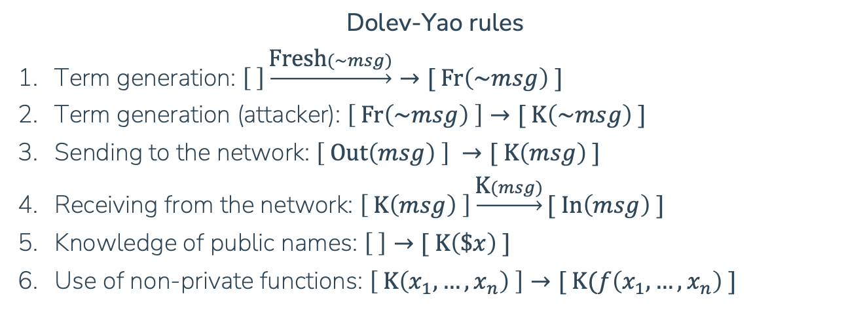
Tamarin Prover overview
Protocols as sets of multiset rewriting rules
Dolev-Yao rules
Term generation: $\left[ \right]\underset{→}{\text{F}\text{resh}(\sim msg)}→[ \text{Fr}\left(\sim msg\right) ]$
Term generation (attacker): $\left[ \text{Fr}\left(\sim msg\right) \right]→[ \text{K}\left(\sim msg\right) ]$
Sending to the network: $\left[ \text{Out}\left(msg\right) \right] →[ \text{K}\left(msg\right) ]$
Receiving from the network: $\left[ \text{K}\left(msg\right) \right]\underset{→}{\text{K}(msg)}[ \text{In}\left(msg\right) ]$
Knowledge of public names: $\left[ \right]→[ \text{K}\left(\$x\right) ]$
Use of non-private functions: $\left[ \text{K}\left(x_{1}, …, x_{n}\right) \right]→[ \text{K}(f\left(x_{1},…,x_{n}\right) ]$
Attacker controlled network with trusted party

Slide 18
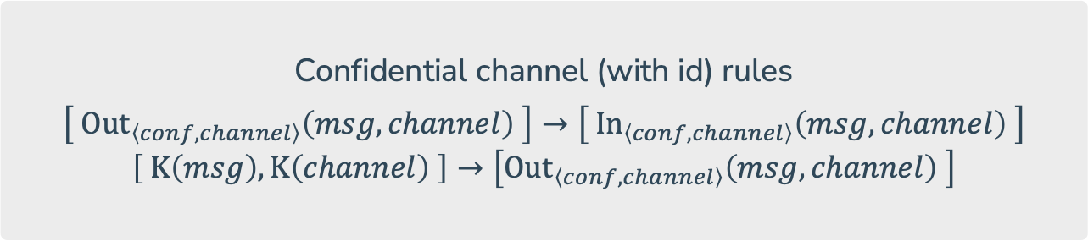
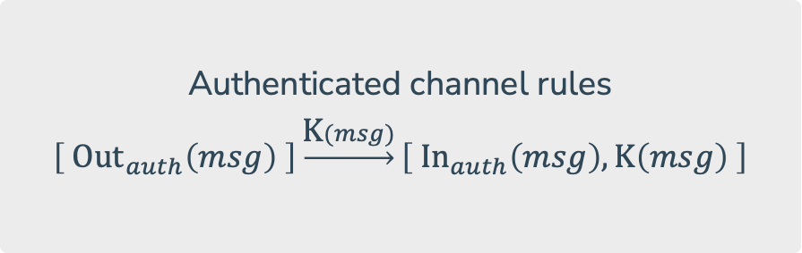
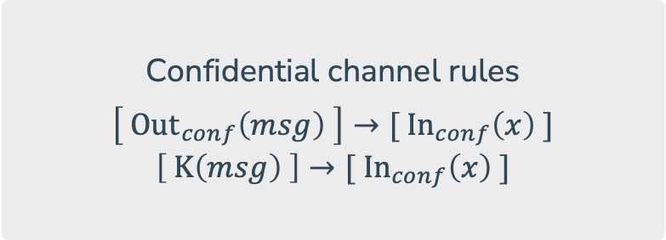
Tamarin Prover overview
Protocols as sets of multiset rewriting rules
Confidential channel rules
$$\left[ \text{Ou}{\text{t}}_{conf}\left(msg\right) \right]→[ \text{I}{\text{n}}_{conf}\left(x\right) ]$$
$$\left[ \text{K}\left(msg\right) \right]→[ \text{I}{\text{n}}_{conf}\left(x\right) ]$$
Authenticated channel rules
$$\left[ \text{Ou}{\text{t}}_{auth}\left(msg\right) \right]\underset{→}{\text{K}(msg)}\left[ \text{I}{\text{n}}_{auth}\left(msg\right),\text{K}\left(msg\right) \right]$$
Confidential channel (with id) rules
$$\left[ \text{Ou}{\text{t}}_{\left\langle conf,channel\right\rangle }\left(msg,channel\right) \right]→\left[ \text{I}{\text{n}}_{\left\langle conf,channel\right\rangle }\left(msg,channel\right) \right]$$
$$\left[ \text{K}\left(msg\right),\text{K}\left(channel\right) \right]→\left[\text{Ou}{\text{t}}_{\left\langle conf,channel\right\rangle }\left(msg,channel\right) \right]$$

Slide 19
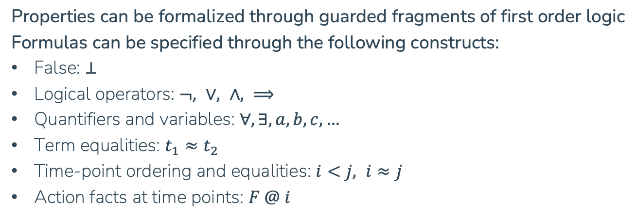

Tamarin Prover overview
Security properties
Properties can be formalized through guarded fragments of first order logic
Formulas can be specified through the following constructs:
False: $⊥$
Logical operators: $¬, ∨, ∧, ⟹$
Quantifiers and variables: $∀, ∃, a, b, c, …$
Term equalities: $t_{1}≈t_{2}$
Time-point ordering and equalities: $i<j, i≈j$
Action facts at time points: $F @ i$
Example of definition of Secrecy
$$∀m,t_{1}:Secret\left(m\right)@t_{1}⟹¬∃t_{2}:K\left(m\right)@t_{2}$$

Slide 20
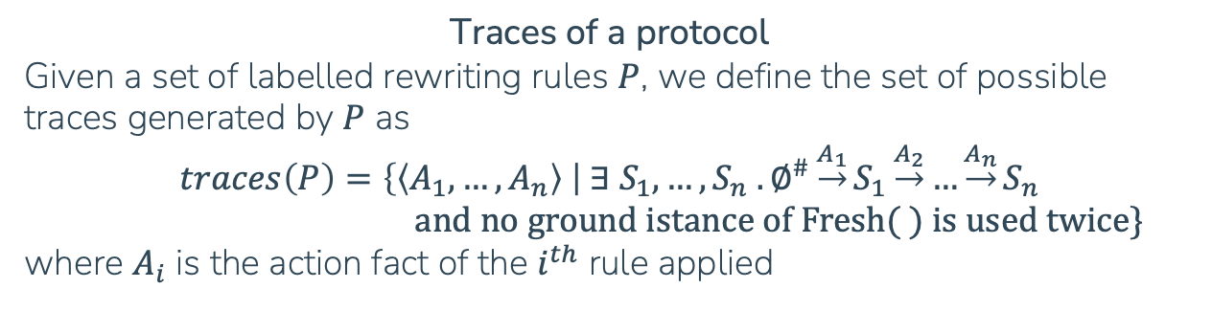
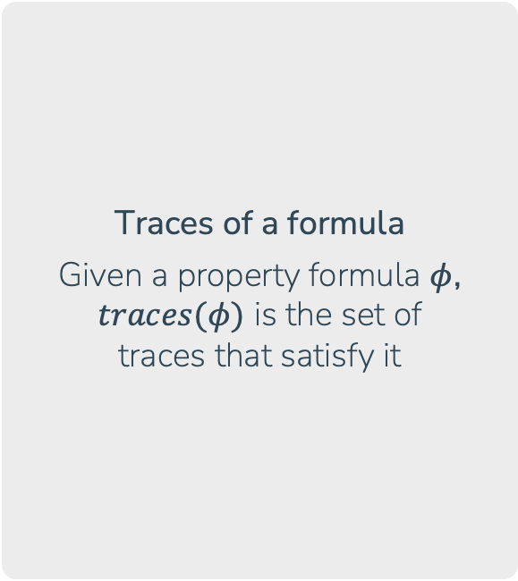

Tamarin Prover overview
Security properties
Traces of a formula
Given a property formula $φ$, $traces(φ)$ is the set of traces that satisfy it
Traces of a protocol
Given a set of labelled rewriting rules $P$, we define the set of possible traces generated by $P$ as
$$traces\left(P\right)=\left\{\left\langle A_{1},…,A_{n}\right\rangle \right| ∃ S_{1},…, S_{n} . ∅^{\#}\underset{→}{A_{1}}S_{1}\underset{→}{A_{2}}…\underset{→}{A_{n}}S_{n}$$ $\text{and} \text{no} \text{ground} \text{istance} \text{of} \text{Fresh}\text{(}\text{ ) }\text{is} \text{used} \text{twice}\}$
where $A_{i}$ is the action fact of the $i^{th}$ rule applied
Correctness
A protocol $P$ is said correct with regards to a formula (security property) $φ$ if:
$$P⊨φ ⟺traces\left(P\right)⊆traces(φ)$$
All traces belonging to $traces\left(P\right)\backslash traces(φ)$ represent valid attacks

Slide 21
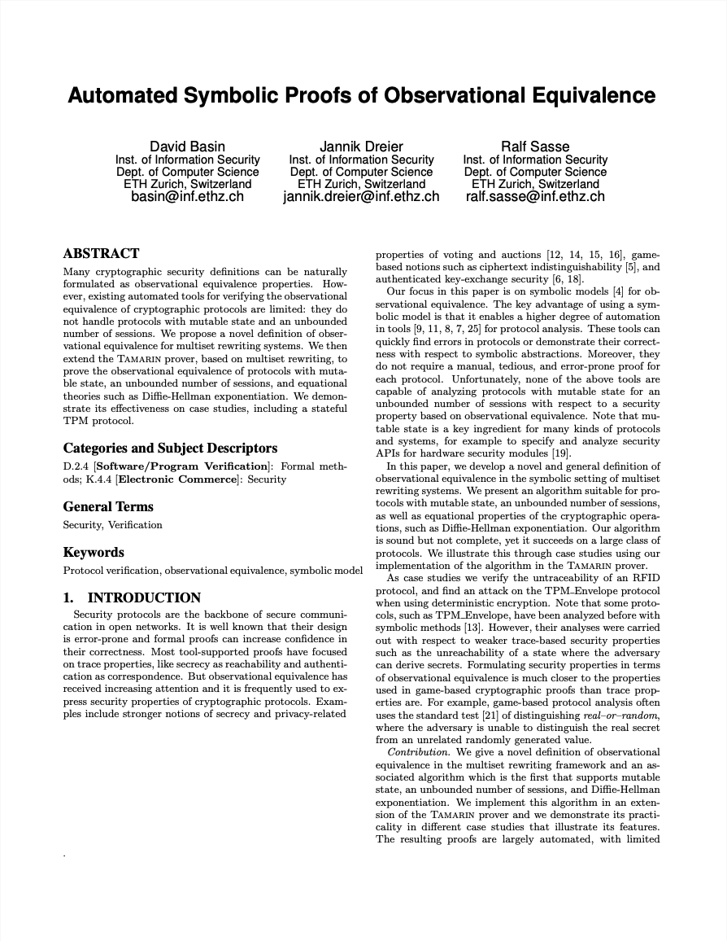
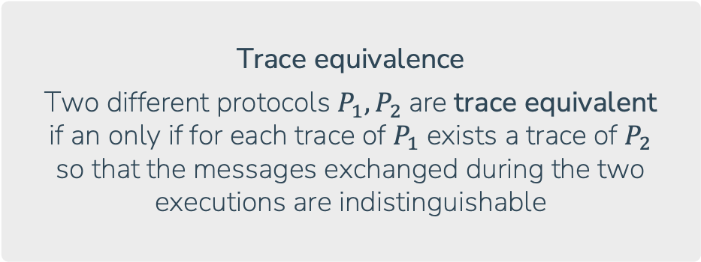
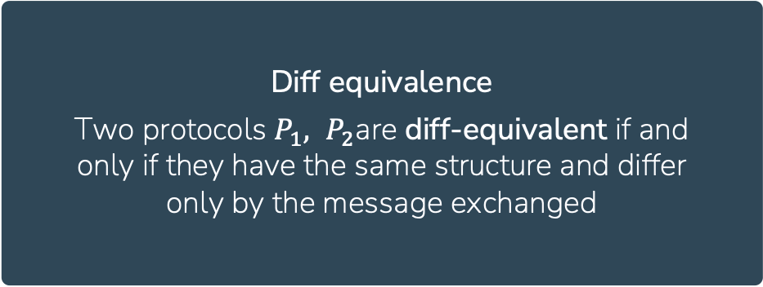
Tamarin Prover overview
Observational Equivalences
Introductory paper for the Observational Equivalence extension in Tamarin
Trace equivalence
Two different protocols $P_{1}, P_{2}$are trace equivalent if an only if for each trace of $P_{1}$ exists a trace of $P_{2}$ so that the messages exchanged during the two executions are indistinguishable
Diff equivalence
Two protocols $P_{1}, P_{2}$are diff-equivalent if and only if they have the same structure and differ only by the message exchanged

Slide 22
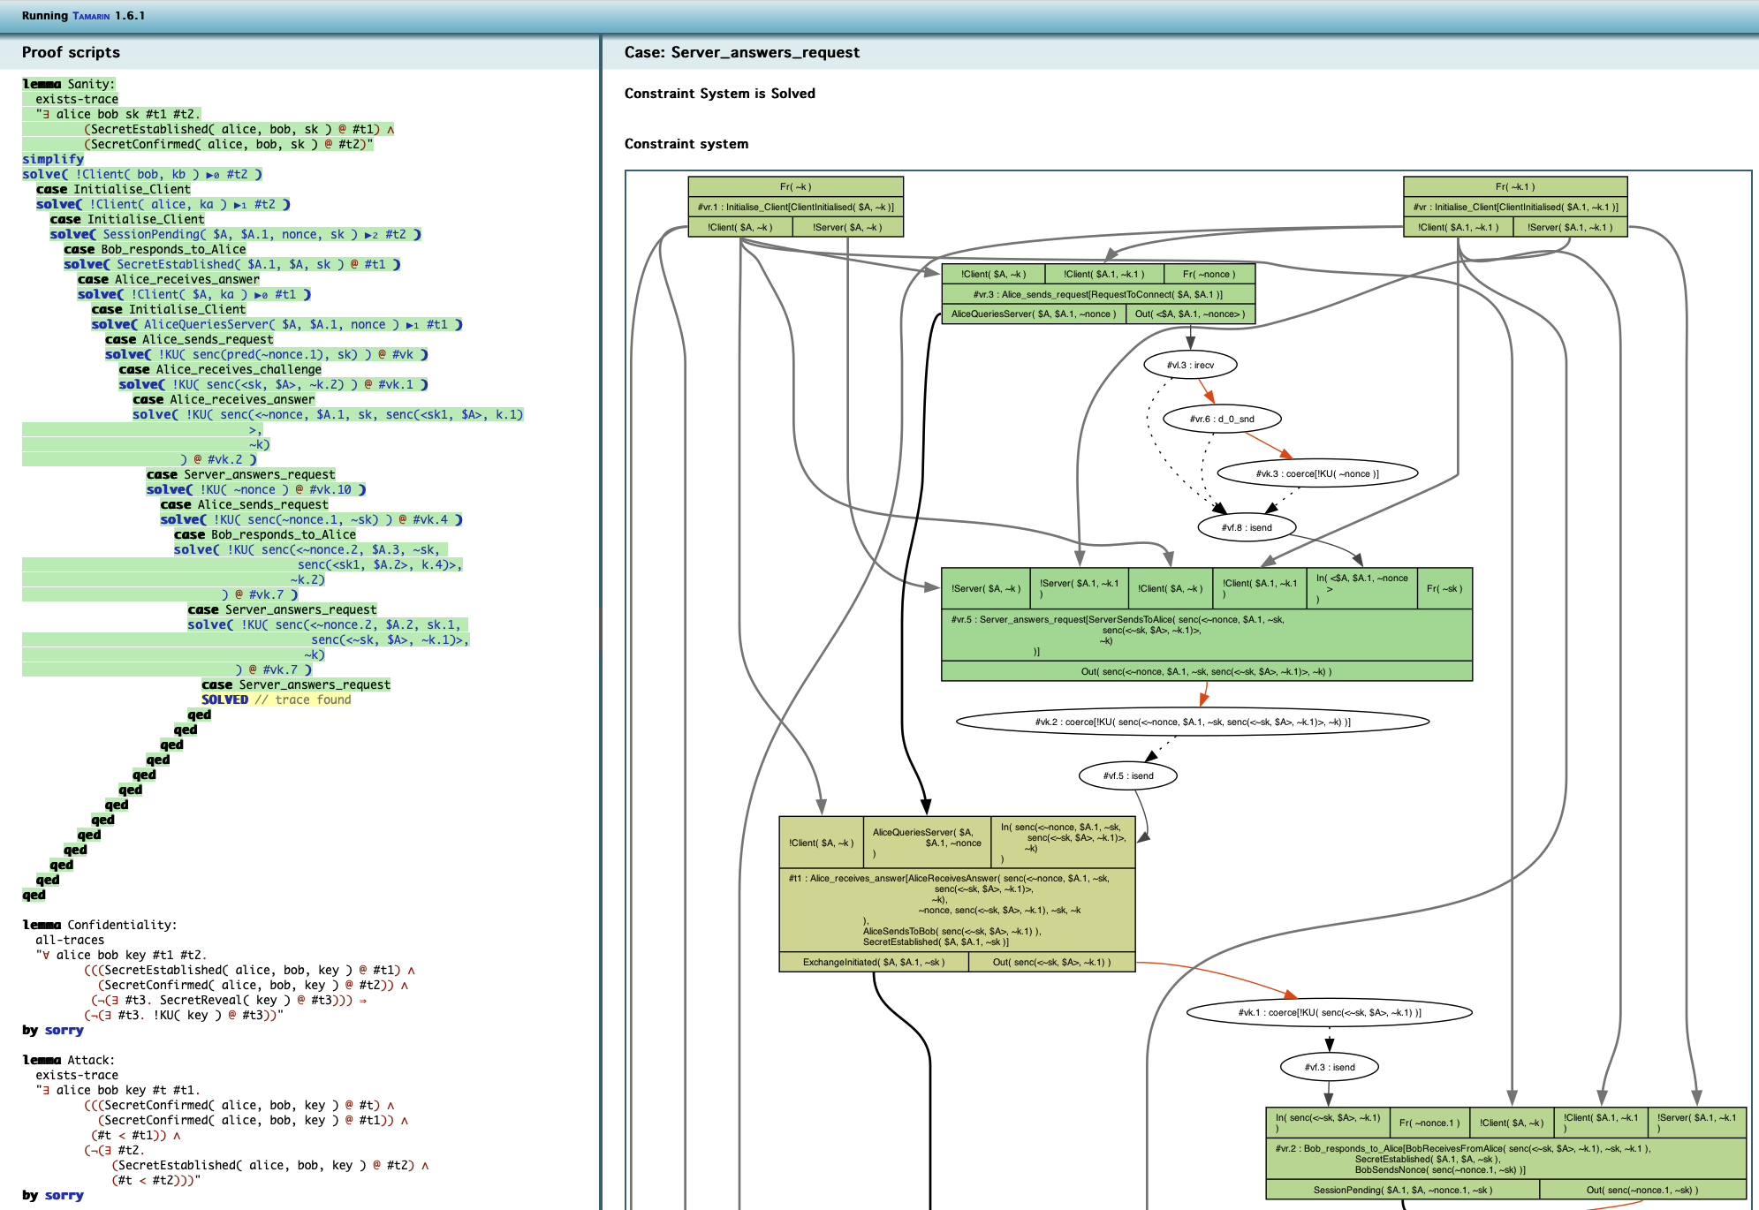
Tamarin Prover overview
Aiding termination
Tools provided to aid termination:
Source lemmas
Oracles
Interactive mode
Restrictions
Re-use lemmas
Tamarin’s interactive mode

Slide 23
Formalizing S-E attacks
D. Basin, S. Radomirovic, and L. Schmid. Modeling human errors in security protocols. In 2016 IEEE 29th Computer Security Foundations Symposium (CSF, 2016.
G. Lowe. A hierarchy of authentication specifications. In Proceedings of the 10th IEEE Workshop on Computer Security Foundations, CSFW ’97, 1997.
D. Basin, S. Radomirovic, and M. Schlapfer. A complete characterization of secure human-server communication. 2015 IEEE 28th Computer Security Foundations Symposium, 2015.

Slide 24

Formalizing S-E Attacks
Introduction
Phishing
Baiting
Pretexting
Summary
Ransomware
Impersonation on Help Desk
Diversion Theft
Dumpster Diving
Social Engineering is a prevalent threat, with 90% of data breaches having social engineering components and 62% of businesses experiencing attacks
Gitnux report of 2023
Shoulder Surfing
Quid Pro Quo
Pop-up Windows
Robocalls
Reverse Social Engineering
Online Social Engineering
Phone Social Engineering
Stealing important documents
Fake Software
Pharming
SMSishing
Whitelisting flow
Types of Social Engineering Attacks

Slide 25
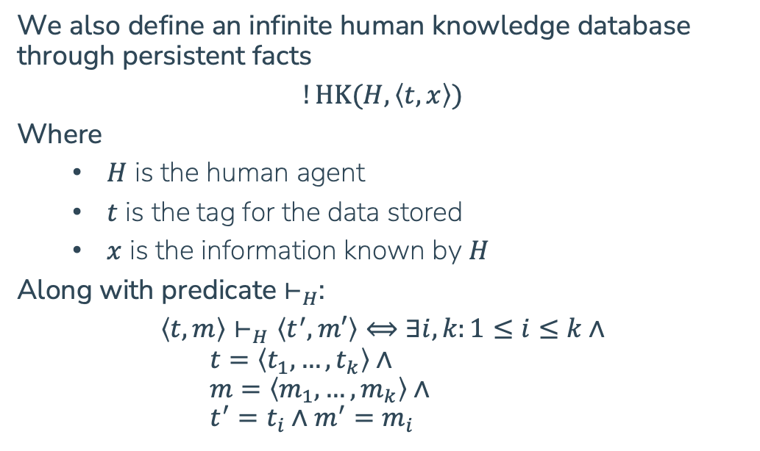
Formalizing S-E Attacks
Including human knowledge
We assume that a human can:
Send and receive messages on specified channels
Concatenate messages
Split concatenated messages
And cannot (unaided by a computer):
Encrypt messages
Decrypt messages
We also define an infinite human knowledge database through persistent facts
$$!\text{HK}(H,\left\langle t,x\right\rangle )$$
Where
$H$ is the human agent
$t$ is the tag for the data stored
$x$ is the information known by $H$
Along with predicate $⊢_{H}$:
$$\left\langle t,m\right\rangle ⊢_{H}\left\langle t^{′},m′\right\rangle ⟺∃i,k:1≤i≤k∧ \\ t=\left\langle t_{1},…,t_{k}\right\rangle ∧ \\ m=\left\langle m_{1},…,m_{k}\right\rangle ∧ \\ t^{′}=t_{i}∧m^{′}=m_{i}$$

Slide 26
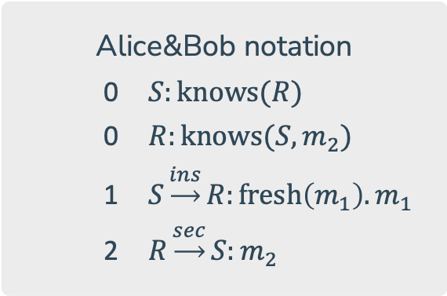
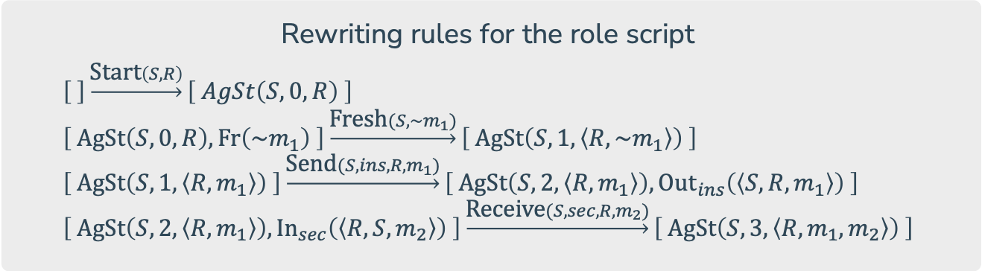
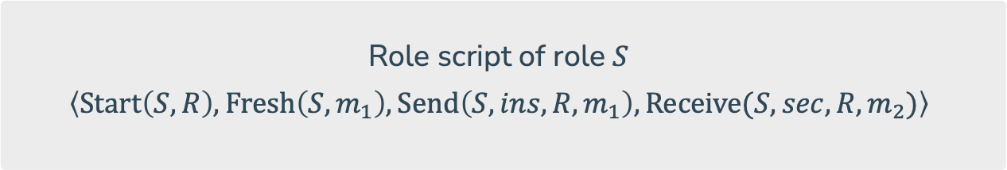
Formalizing S-E Attacks
Formalizing human errors
Rewriting rules for the role script
$$\left[ \right]\underset{→}{\text{S}\text{tart}\left(S,R\right)}\left[ AgSt\left(S,0,R\right) \right] \\ \left[ \text{AgSt}\left(S,0,R\right),\text{Fr}\left({\sim m}_{1}\right) \right]\underset{→}{\text{F}\text{resh}(S,\sim m_{1})}\left[ \text{AgSt}\left(S,1,\left\langle R,\sim m_{1}\right\rangle \right) \right] \\ \left[ \text{AgSt}\left(S,1,\left\langle R,m_{1}\right\rangle \right) \right]\underset{→}{\text{S}\text{end}(S,ins,R,m_{1})}\left[ \text{AgSt}\left(S,2,\left\langle R,m_{1}\right\rangle \right), \text{Ou}{\text{t}}_{ins}\left(\left\langle S,R,m_{1}\right\rangle \right) \right] \\ \left[ \text{AgSt}\left(S,2,\left\langle R,m_{1}\right\rangle \right), \text{I}{\text{n}}_{sec}\left(\left\langle R,S,m_{2}\right\rangle \right) \right]\underset{→}{\text{R}\text{eceive}(S,sec,R,m_{2})}\left[ \text{AgSt}\left(S,3,\left\langle R,m_{1},m_{2}\right\rangle \right) \right]$$
Turning Alice&Bob notation into role scripts for various actors
Alice&Bob notation
$S:\text{knows}(R)$
$R:\text{knows}(S,m_{2})$
$S\underset{→}{ins}R:\text{fresh}\left(m_{1}\right).m_{1}$
$R\underset{→}{sec}S:m_{2}$
Role script of role $S$
$$\left\langle \text{Start}\left(S,R\right),\text{Fresh}\left(S,m_{1}\right),\text{Send}\left(S,ins,R,m_{1}\right),\text{Receive}(S,sec,R,m_{2})\right\rangle$$

Slide 27
Formalizing S-E Attacks
Formalizing human errors
I
Human error
A human error is any deviation of a human from his role script
U
Approaches to introducing fallible humans:
On the left, the skilled human approach
On the right, the rule-based human approach

Slide 28
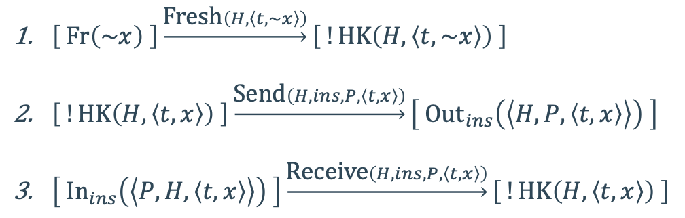
Formalizing S-E Attacks
Rule-based human approach
First we need to introduce the formalization of an untrained human…
(This agent must be able to follow any possible behavior)
$\left[ \text{Fr}\left(\sim x\right) \right]\underset{→}{\text{F}\text{resh}\left(H,\left\langle t,\sim x\right\rangle \right)}\left[ !\text{HK}\left(H,\left\langle t,\sim x\right\rangle \right) \right]$
$\left[ !\text{HK}\left(H,\left\langle t,x\right\rangle \right) \right]\underset{→}{\text{S}\text{end}\left(H,ins,P,\left\langle t,x\right\rangle \right)}\left[ \text{Ou}{\text{t}}_{ins}\left(\left\langle H,P,\left\langle t,x\right\rangle \right\rangle \right) \right]$
$\left[ \text{I}{\text{n}}_{ins}\left(\left\langle P,H,\left\langle t,x\right\rangle \right\rangle \right) \right]\underset{→}{\text{R}\text{eceive}\left(H,ins,P,\left\langle t,x\right\rangle \right)}\left[ !\text{HK}\left(H,\left\langle t,x\right\rangle \right) \right]$
Rewriting rules for the untrained human

Slide 29
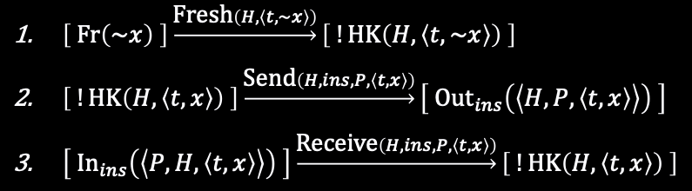
Formalizing S-E Attacks
Rule-based human approach
$\left[ \text{Fr}\left(\sim x\right) \right]\underset{→}{\text{F}\text{resh}\left(H,\left\langle t,\sim x\right\rangle \right)}\left[ !\text{HK}\left(H,\left\langle t,\sim x\right\rangle \right) \right]$
$\left[ !\text{HK}\left(H,\left\langle t,x\right\rangle \right) \right]\underset{→}{\text{S}\text{end}\left(H,ins,P,\left\langle t,x\right\rangle \right)}\left[ \text{Ou}{\text{t}}_{ins}\left(\left\langle H,P,\left\langle t,x\right\rangle \right\rangle \right) \right]$
$\left[ \text{I}{\text{n}}_{ins}\left(\left\langle P,H,\left\langle t,x\right\rangle \right\rangle \right) \right]\underset{→}{\text{R}\text{eceive}\left(H,ins,P,\left\langle t,x\right\rangle \right)}\left[ !\text{HK}\left(H,\left\langle t,x\right\rangle \right) \right]$
Untrained human rules
Avoiding leakage of private information
$$\text{NoTell}\left(H,tag\right)≔∀\text{Send}\left(H,l,P,\left\langle t,m\right\rangle \right)∈tr∈traces\left(P\right),t^{′},m^{′}:\left\langle t,m\right\rangle ⊢_{H}\left\langle t^{′},m^{′}\right\rangle ⟹t^{′}≠tag$$

Slide 30
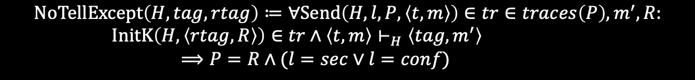
Formalizing S-E Attacks
Rule-based human approach
$\left[ \text{Fr}\left(\sim x\right) \right]\underset{→}{\text{F}\text{resh}\left(H,\left\langle t,\sim x\right\rangle \right)}\left[ !\text{HK}\left(H,\left\langle t,\sim x\right\rangle \right) \right]$
$\left[ !\text{HK}\left(H,\left\langle t,x\right\rangle \right) \right]\underset{→}{\text{S}\text{end}\left(H,ins,P,\left\langle t,x\right\rangle \right)}\left[ \text{Ou}{\text{t}}_{ins}\left(\left\langle H,P,\left\langle t,x\right\rangle \right\rangle \right) \right]$
$\left[ \text{I}{\text{n}}_{ins}\left(\left\langle P,H,\left\langle t,x\right\rangle \right\rangle \right) \right]\underset{→}{\text{R}\text{eceive}\left(H,ins,P,\left\langle t,x\right\rangle \right)}\left[ !\text{HK}\left(H,\left\langle t,x\right\rangle \right) \right]$
Untrained human rules
Safe comunications of credentials
$$\text{NoTellExcept}\left(H,tag,rtag\right)≔∀\text{Send}\left(H,l,P,\left\langle t,m\right\rangle \right)∈tr∈traces\left(P\right),m^{′},R: \\ \text{InitK}\left(H,\left\langle rtag,R\right\rangle \right)∈tr∧\left\langle t,m\right\rangle ⊢_{H}\left\langle tag,m^{′}\right\rangle \\ ⟹P=R∧(l=sec∨l=conf)$$

Slide 31
Formalizing S-E Attacks
Rule-based human approach
$\left[ \text{Fr}\left(\sim x\right) \right]\underset{→}{\text{F}\text{resh}\left(H,\left\langle t,\sim x\right\rangle \right)}\left[ !\text{HK}\left(H,\left\langle t,\sim x\right\rangle \right) \right]$
$\left[ !\text{HK}\left(H,\left\langle t,x\right\rangle \right) \right]\underset{→}{\text{S}\text{end}\left(H,ins,P,\left\langle t,x\right\rangle \right)}\left[ \text{Ou}{\text{t}}_{ins}\left(\left\langle H,P,\left\langle t,x\right\rangle \right\rangle \right) \right]$
$\left[ \text{I}{\text{n}}_{ins}\left(\left\langle P,H,\left\langle t,x\right\rangle \right\rangle \right) \right]\underset{→}{\text{R}\text{eceive}\left(H,ins,P,\left\langle t,x\right\rangle \right)}\left[ !\text{HK}\left(H,\left\langle t,x\right\rangle \right) \right]$
Untrained human rules
Protecting information integrity
$$\text{NoGet}\left(H,tag\right)≔∀\text{Receive}\left(H,l,P,\left\langle t,m\right\rangle \right)∈tr∈traces\left(P\right),t^{′},m^{′}:\left\langle t,m\right\rangle ⊢_{H}\left\langle t^{′},m^{′}\right\rangle ⟹t^{′}≠tag$$

Slide 32
Formalizing S-E Attacks
Rule-based human approach
$\left[ \text{Fr}\left(\sim x\right) \right]\underset{→}{\text{F}\text{resh}\left(H,\left\langle t,\sim x\right\rangle \right)}\left[ !\text{HK}\left(H,\left\langle t,\sim x\right\rangle \right) \right]$
$\left[ !\text{HK}\left(H,\left\langle t,x\right\rangle \right) \right]\underset{→}{\text{S}\text{end}\left(H,ins,P,\left\langle t,x\right\rangle \right)}\left[ \text{Ou}{\text{t}}_{ins}\left(\left\langle H,P,\left\langle t,x\right\rangle \right\rangle \right) \right]$
$\left[ \text{I}{\text{n}}_{ins}\left(\left\langle P,H,\left\langle t,x\right\rangle \right\rangle \right) \right]\underset{→}{\text{R}\text{eceive}\left(H,ins,P,\left\langle t,x\right\rangle \right)}\left[ !\text{HK}\left(H,\left\langle t,x\right\rangle \right) \right]$
Untrained human rules
Enforce important security checks
$$\text{ICompare}\left(H,tag\right)≔∀\text{Receive}\left(H,l,P,\left\langle t,m\right\rangle \right)∈tr∈traces\left(P\right),m^{′}: \\ \left\langle t,m\right\rangle ⊢_{H}\left\langle tag,m^{′}\right\rangle ⟹\text{InitK}\left(H,\left\langle tag,m^{′}\right\rangle \right)∈tr$$

Slide 33
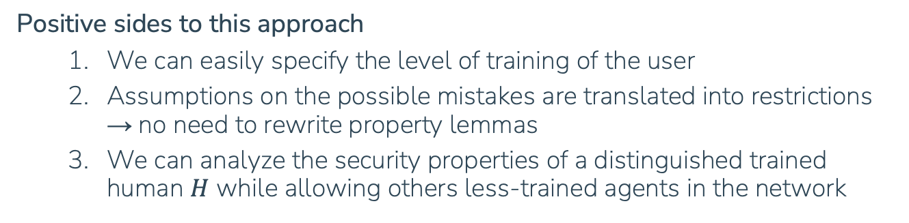
Formalizing S-E Attacks
Rule-based human approach
Positive sides to this approach
We can easily specify the level of training of the user
Assumptions on the possible mistakes are translated into restrictions → no need to rewrite property lemmas
We can analyze the security properties of a distinguished trained human $H$ while allowing others less-trained agents in the network

Slide 34
Conclusions
What have we seen today?
How is the Dolev Yao model useful for protocol verification
An introduction to the Tamarin prover from a user’s perspective
How to formalize Social Engineering attacks and human errors within Tamarin’s multiset rewriting system
Are there other Tamarin extensions available?
Automated analysis of security protocols with global state
Distance-Bounding Protocols: Verification without Time and Location
Alice and Bob Meet Equational Theories
… and (hopefully) more to come

