Slide 1

Evaluating untyped Lambda expressions in Haskell
Supervisor: prof. Alessi Fabio
Co-Superisor: prof. Di Gianantonio Pietro
Author: D’Ambrosi Denis
Scuola Superiore «Di Toppo Wassermann», October 2023

Slide 2
Table of Contents
Pure λ-Calculus
Evaluating λ-expressions
Lexing λ-expressions
Parsing λ-expressions
Evaluating λ-terms: the algebraic approach
Alpha conversion method
De Bruijn Indexes method
Evaluating λ-terms: the computational approach
Conclusions

Slide 3

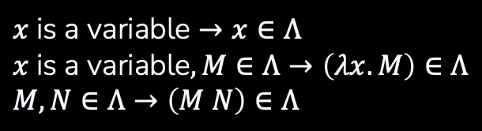
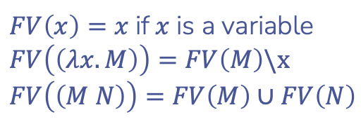
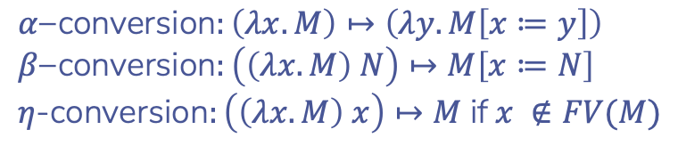
1. Pure λ-Calculus
2 key ingredients
A set of λ-terms $Λ$
Three reduction rules
+
$$x \text{is} \text{a} \text{variable}→x∈Λ \\ x \text{is} \text{a} \text{variable}, M∈Λ→\left(λx.M\right)∈Λ \\ M,N∈Λ→\left(M N\right)∈Λ$$
$$α\text{−}\text{conversion}:\left(λx.M\right)↦\left(λy.M\left[x≔y\right]\right) \\ β\text{−}\text{conversion}:\left(\left(λx.M\right) N\right)↦M\left[x≔N\right] \\ η\text{-}\text{conversion}:\left(\left(λx.M\right) x\right)↦M \text{if} x ∉FV(M)$$
… and a recursive formula
$$FV\left(x\right)=x \text{if} x \text{is} \text{a} \text{variable} \\ FV\left(\left(λx.M\right)\right)=FV\left(M\right)\backslash x \\ FV\left(\left(M N\right)\right)=FV\left(M\right)∪FV\left(N\right)$$

Slide 4
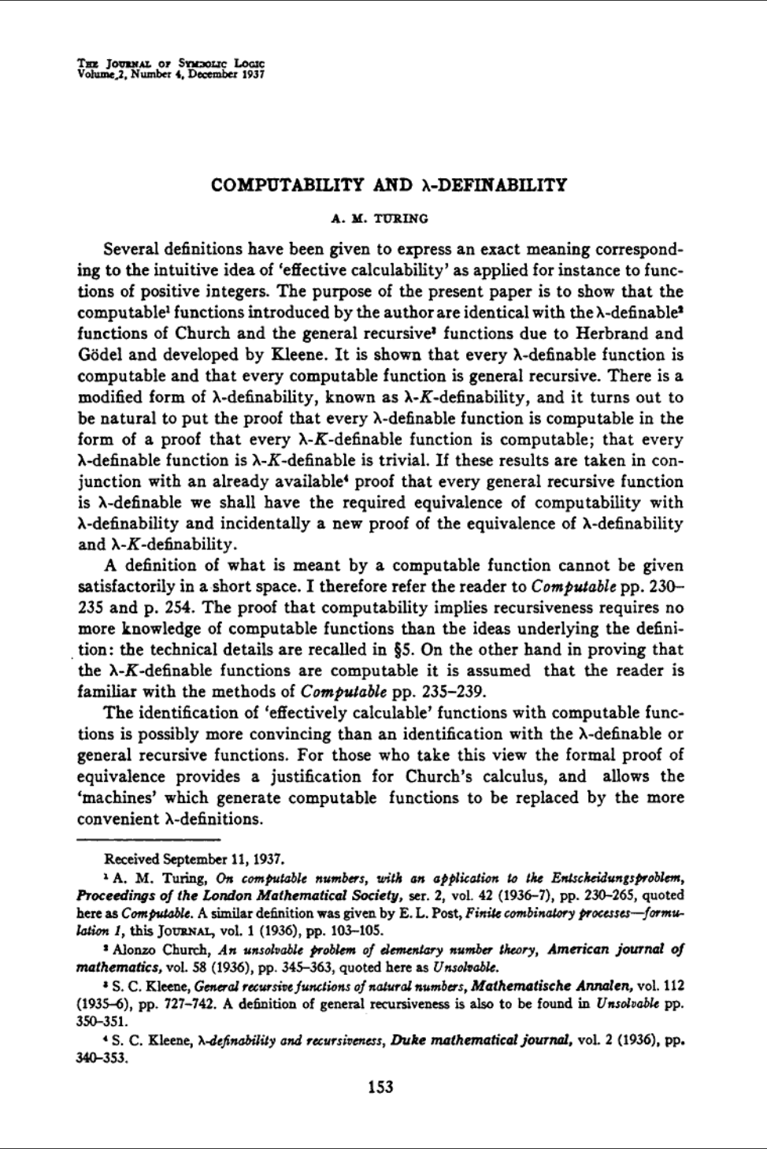

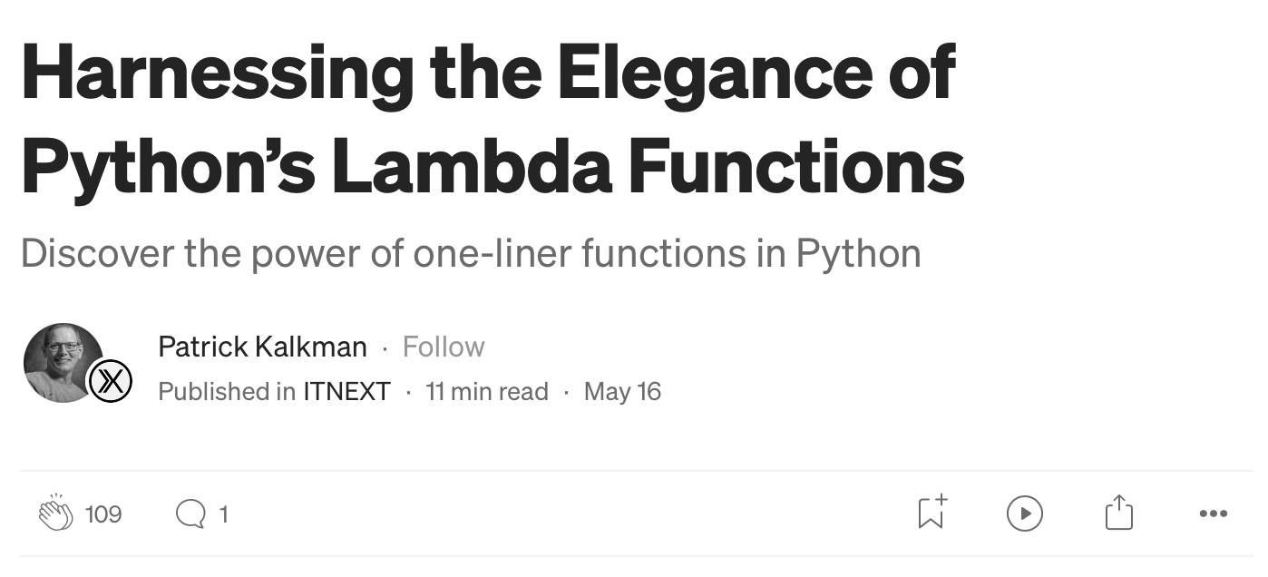

1. Pure λ-Calculus
Why is it still relevant?
Symple syntax and semantics, but still Turing complete!
Widely implemented in modern programming languages

Slide 5

2. Evaluating λ-expressions
Our pipeline:
1.
2.
3.
λ-term
Normalized λ-term
Lexer: Alex
Parser: Happy
Evaluator: Haskell

Slide 6

2.1 Lexing λ-expressions
Custom data type for tokens
Regexes for recognising the lexemes
data Token = NewLine
| Term String
| Dot
| Lambda
| OpenPar
| ClosedPar
deriving (Eq, Show)
$letter = [a-zA-Z]
tokens :- \n { \s -> NewLine }
$letter+ { \s -> Term s } \. { \s -> Dot } \λ { \s -> Lambda } \( { \s -> OpenPar }
\) { \s -> ClosedPar }
$white ;
+
Note that the lexer only recognises alphabetical identifiers!

Slide 7

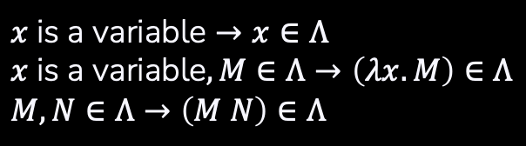
2.2 Parsing λ-expressions
Custom data type for λ-terms
Grammar specification with actions
data Term = Var String
| Abs String Term
| App Term Term | Empty
deriving (Eq)
%left ‘λ’ ‘.’ VAR
start : line { [$1] }
| start line { $2 : $1 }
line : NL { Empty }
| exp NL { $1 }
exp : VAR { Var $1 }
| ‘(‘ exp ‘)’ { $2 }
| ‘λ’ VAR ‘.’ exp { Abs $2 $4 }
| exp exp { App $1 $2 }
+
A set of λ-terms $Λ$
$$x \text{is} \text{a} \text{variable}→x∈Λ \\ x \text{is} \text{a} \text{variable}, M∈Λ→\left(λx.M\right)∈Λ \\ M,N∈Λ→\left(M N\right)∈Λ$$

Slide 8


2.3 Evaluating λ-expressions: the algebraic approach
A strategy to handle name clashes
+
Implementation of $β$-conversion $$\left(\left(λx.M\right) N\right)↦M\left[x≔N\right]$$
$α$-conversion
or
De Bruijn Indexes
$$x \text{is} \text{a} \text{variable}→x∈Λ \\ x \text{is} \text{a} \text{variable}, M∈Λ→\left(λx.M\right)∈Λ \\ M,N∈Λ→\left(M N\right)∈Λ$$

Slide 9
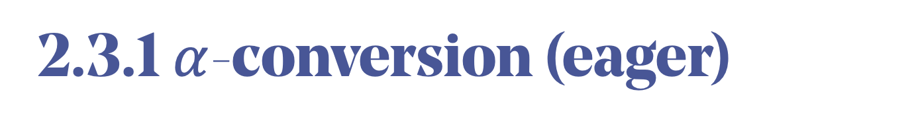

2.3.1 $α$-conversion (eager)
eval :: Term -> Term eval (App (Abs x t) t1) = let t1’ = eval t1 in eval (sub x t t1’)
eval (App t1 t2) = case eval t1 of
a@(Abs x t1) -> eval (App a t2)
t -> App t (eval t2) eval (Abs x t) = Abs x (eval t)
eval Empty = error «Empty detected»
eval t = t
A form of $β$-reduction with strict semantics is performed in the first pattern
$$x \text{is} \text{a} \text{variable}→x∈Λ \\ x \text{is} \text{a} \text{variable}, M∈Λ→\left(λx.M\right)∈Λ \\ M,N∈Λ→\left(M N\right)∈Λ$$

Slide 10
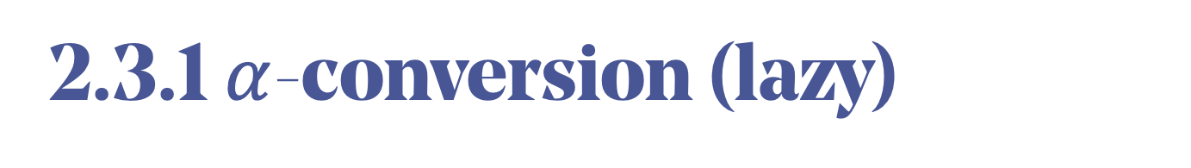

2.3.1 $α$-conversion (lazy)
eval :: Term -> Term eval (App (Abs x t) t1) = eval (sub x t t1)
eval (App t1 t2) = case eval t1 of
a@(Abs x t1) -> eval (App a t2)
t -> App t (eval t2) eval (Abs x t) = Abs x (eval t)
eval Empty = error «Empty detected»
eval t = t
A form of $β$-reduction with lazy semantics is performed in the first pattern
$$x \text{is} \text{a} \text{variable}→x∈Λ \\ x \text{is} \text{a} \text{variable}, M∈Λ→\left(λx.M\right)∈Λ \\ M,N∈Λ→\left(M N\right)∈Λ$$

Slide 11
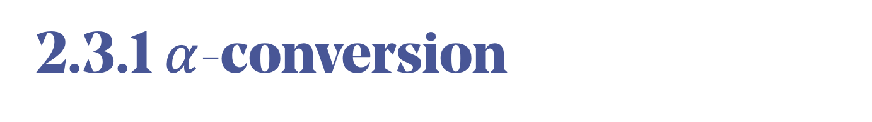
2.3.1 $α$-conversion
Don’t substitute further to allow name shadowing
sub :: String -> Term -> Term -> Term
sub x v@(Var y) newVal
| x == y = newVal
| otherwise = v sub x a@(Abs y t) newVal
| x == y = a | notElem y (freeVars newVal) = Abs y (sub x t newVal) | otherwise = let y’ = firstNameAvailable (freeVars newVal) in
Abs y’ (sub x (alphaConv y t y’) newVal)
sub x (App t1 t2) t = App (sub x t1 t) (sub x t2 t)
sub _ Empty _ = error "Empty detected"
$$x \text{is} \text{a} \text{variable}→x∈Λ \\ x \text{is} \text{a} \text{variable}, M∈Λ→\left(λx.M\right)∈Λ \\ M,N∈Λ→\left(M N\right)∈Λ$$

Slide 12
2.3.1 $α$-conversion
If the variable does not appear free, we can substitute
sub :: String -> Term -> Term -> Term
sub x v@(Var y) newVal
| x == y = newVal
| otherwise = v sub x a@(Abs y t) newVal
| x == y = a | notElem y (freeVars newVal) = Abs y (sub x t newVal) | otherwise = let y’ = firstNameAvailable (freeVars newVal) in
Abs y’ (sub x (alphaConv y t y’) newVal)
sub x (App t1 t2) t = App (sub x t1 t) (sub x t2 t)
sub _ Empty _ = error "Empty detected"
$$x \text{is} \text{a} \text{variable}→x∈Λ \\ x \text{is} \text{a} \text{variable}, M∈Λ→\left(λx.M\right)∈Λ \\ M,N∈Λ→\left(M N\right)∈Λ$$

Slide 13

2.3.1 $α$-conversion
Otherwise, we first need to apply $α$-conversion
sub :: String -> Term -> Term -> Term
sub x v@(Var y) newVal
| x == y = newVal
| otherwise = v sub x a@(Abs y t) newVal
| x == y = a | notElem y (freeVars newVal) = Abs y (sub x t newVal) | otherwise = let y’ = firstNameAvailable (freeVars newVal) in
Abs y’ (sub x (alphaConv y t y’) newVal)
sub x (App t1 t2) t = App (sub x t1 t) (sub x t2 t)
sub _ Empty _ = error "Empty detected"
$$x \text{is} \text{a} \text{variable}→x∈Λ \\ x \text{is} \text{a} \text{variable}, M∈Λ→\left(λx.M\right)∈Λ \\ M,N∈Λ→\left(M N\right)∈Λ$$

Slide 14
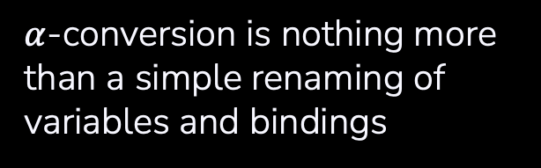
2.3.1 $α$-conversion
$α$-conversion is nothing more than a simple renaming of variables and bindings
alphaConv :: String -> Term -> String -> Term
alphaConv x v@(Var y) z
| x == y = Var z
| otherwise = v
alphaConv x (Abs y t) z
| x == y = Abs z (alphaConv x t z)
| otherwise = Abs y (alphaConv x t z) alphaConv x (App t1 t2) z = App (alphaConv x t1 z) (alphaConv x t2 z)
alphaConv _ Empty _ = error "Empty detected"
$$x \text{is} \text{a} \text{variable}→x∈Λ \\ x \text{is} \text{a} \text{variable}, M∈Λ→\left(λx.M\right)∈Λ \\ M,N∈Λ→\left(M N\right)∈Λ$$

Slide 15
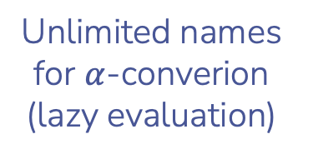
2.3.1 $α$-conversion
Additional notes
Names
Unlimited names for $α$-converion (lazy evaluation)
$$x \text{is} \text{a} \text{variable}→x∈Λ \\ x \text{is} \text{a} \text{variable}, M∈Λ→\left(λx.M\right)∈Λ \\ M,N∈Λ→\left(M N\right)∈Λ$$
variableSet :: [String]
variableSet = concatMap (\k -> replicateM k [‘a’..’z’]) [1..]

Slide 16
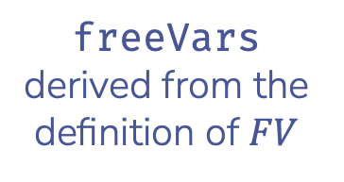
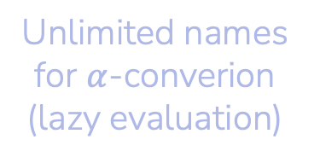
2.3.1 $α$-conversion
Additional notes
Names
FV
Unlimited names for $α$-converion (lazy evaluation)
freeVars derived from the definition of $FV$
freeVars :: Term -> [String]
freeVars (Var x) = [x]
freeVars (Abs x t1) = (freeVars t1) \\ [x]
freeVars (App t1 t2) = (freeVars t1) ++ (freeVars t2)
$$x \text{is} \text{a} \text{variable}→x∈Λ \\ x \text{is} \text{a} \text{variable}, M∈Λ→\left(λx.M\right)∈Λ \\ M,N∈Λ→\left(M N\right)∈Λ$$

Slide 17
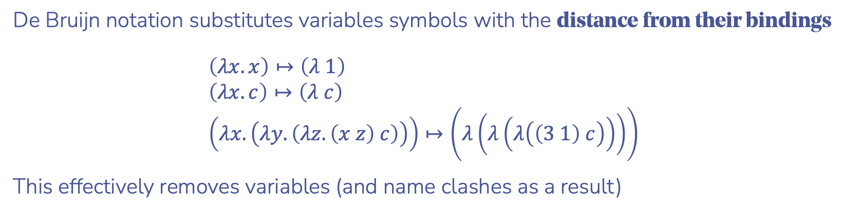
2.3.2 De Bruijn Indexes
De Bruijn notation substitutes variables symbols with the distance from their bindings
$$\left(λx.x\right)↦\left(λ 1\right) \\ \left(λx.c\right)↦\left(λ c\right) \\ \left(λx.\left(λy.\left(λz.\left(x z\right) c\right)\right)\right)↦\left(λ\left(λ\left(λ\left(\left(3 1\right) c\right)\right)\right)\right)$$
This effectively removes variables (and name clashes as a result)
$$x \text{is} \text{a} \text{variable}→x∈Λ \\ x \text{is} \text{a} \text{variable}, M∈Λ→\left(λx.M\right)∈Λ \\ M,N∈Λ→\left(M N\right)∈Λ$$

Slide 18

2.3.2 De Bruijn Indexes
De Bruijn notation substitutes variables symbols with the distance from their bindings
$$\left(λx.x\right)↦\left(λ 1\right) \\ \left(λx.c\right)↦\left(λ c\right) \\ \left(λx.\left(λy.\left(λz.\left(x z\right) c\right)\right)\right)↦\left(λ\left(λ\left(λ\left(\left(3 1\right) c\right)\right)\right)\right)$$
This effectively removes variables (and name clashes as a result)
We will need a new data type to handle this new form:
data DBTerm = DBVar Int | DBConst String | DBAbs DBTerm | DBApp DBTerm DBTerm
deriving (Eq)
$$x \text{is} \text{a} \text{variable}→x∈Λ \\ x \text{is} \text{a} \text{variable}, M∈Λ→\left(λx.M\right)∈Λ \\ M,N∈Λ→\left(M N\right)∈Λ$$

Slide 19
2.3.2 De Bruijn Indexes
toDeBruijn :: Term -> DBTerm
toDeBruijn = toDBRec [] where
toDBRec :: [String] -> Term -> DBTerm
toDBRec vars (Var x) = case elemIndex x vars of
Just n -> DBVar (n+1)
Nothing -> DBConst x toDBRec vars (Abs x t) = DBAbs (toDBRec (x:vars) t)
toDBRec vars (App t1 t2) = DBApp (toDBRec vars t1) (toDBRec vars t2) toDBRec _ Empty = error "Empty detected"
We exploit the Maybe monad to discriminate between variables and constants

Slide 20
2.3.2 De Bruijn Indexes
toDeBruijn :: Term -> DBTerm
toDeBruijn = toDBRec [] where
toDBRec :: [String] -> Term -> DBTerm
toDBRec vars (Var x) = case elemIndex x vars of
Just n -> DBVar (n+1)
Nothing -> DBConst x toDBRec vars (Abs x t) = DBAbs (toDBRec (x:vars) t)
toDBRec vars (App t1 t2) = DBApp (toDBRec vars t1) (toDBRec vars t2) toDBRec _ Empty = error "Empty detected"
By managing the set of bindings as a stack, we allow variable shadowing

Slide 21

2.3.2 De Bruijn Indexes (eager)
eval :: Term -> DBTerm eval t = dbEval (toDeBruijn t) where
dbEval :: DBTerm -> DBTerm dbEval (DBApp (DBAbs t) t1) = let t1’ = dbEval t1 in dbEval (sub t t1’ 1)
dbEval (DBApp t1 t2) = case dbEval t1 of
a@(DBAbs t) -> dbEval (DBApp a t2)
t -> DBApp t (dbEval t2)
dbEval (DBAbs t) = DBAbs (dbEval t)
dbEval t = t
A form of $β$-reduction with strict semantics is performed in the first pattern

Slide 22

2.3.2 De Bruijn Indexes (lazy)
eval :: Term -> DBTerm eval t = dbEval (toDeBruijn t) where
dbEval :: DBTerm -> DBTerm dbEval (DBApp (DBAbs t) t1) = dbEval (sub t t1 1)
dbEval (DBApp t1 t2) = case dbEval t1 of
a@(DBAbs t) -> dbEval (DBApp a t2)
t -> DBApp t (dbEval t2)
dbEval (DBAbs t) = DBAbs (dbEval t)
dbEval t = t
A form of $β$-reduction with lazy semantics is performed in the first pattern

Slide 23
2.3.2 De Bruijn Indexes
sub :: DBTerm -> DBTerm -> Int -> DBTerm
sub (DBVar n) t n’
| n == n’ = t
| otherwise = DBVar n sub c@(DBConst _) _ _ = c sub (DBAbs t1) t2 n = DBAbs (sub t1 t2 (n+1)) sub (DBApp t1 t2) t n = DBApp (sub t1 t n) (sub t2 t n)
Substitution is now straightforward: we only need to keep track of the level of nesting

Slide 24
2.4 Computational approach
We will need a new data type to exploit Haskell’s anonymous functions in a type-safe way
data CompTerm = CompVar String | CompAbs (CompTerm -> CompTerm)
| CompApp CompTerm CompTerm

Slide 25
2.4 Computational approach
We will need a new data type to exploit Haskell’s anonymous functions in a type-safe way
data CompTerm = CompVar String | CompAbs (CompTerm -> CompTerm)
| CompApp CompTerm CompTerm
Note that including anonymous functions in the constructors prevents us from deriving Eq and Show

Slide 26
2.4 Computational approach
eval :: Term -> CompTerm
eval = evalRec [] [] where
evalRec :: [CompTerm] -> [String] -> Term -> CompTerm
evalRec env vars (Abs v t) = CompAbs (\ x -> evalRec (x:env) (v:vars) t)
evalRec env vars (Var x) = case elemIndex x vars of
Just n -> env !! n
Nothing -> CompVar x
evalRec env vars (App t1 t2) = let t2' = evalRec env vars t2 in
case evalRec env vars t1 of
CompAbs f -> f t2'
v@(CompVar _) -> CompApp v t2'
a@(CompApp _ _) -> CompApp a t2'
evalRec _ _ Empty = error "Empty detected"
We have to build our own closures for the expressions

Slide 27
2.4 Computational approach
eval :: Term -> CompTerm
eval = evalRec [] [] where
evalRec :: [CompTerm] -> [String] -> Term -> CompTerm
evalRec env vars (Abs v t) = CompAbs (\ x -> evalRec (x:env) (v:vars) t)
evalRec env vars (Var x) = case elemIndex x vars of
Just n -> env !! n
Nothing -> CompVar x
evalRec env vars (App t1 t2) = let t2' = evalRec env vars t2 in
case evalRec env vars t1 of
CompAbs f -> f t2'
v@(CompVar _) -> CompApp v t2'
a@(CompApp _ _) -> CompApp a t2'
evalRec _ _ Empty = error "Empty detected"
When we reach the base case for the induction, we refer to the recursively built environment

Slide 28
2.4 Computational approach
eval :: Term -> CompTerm
eval = evalRec [] [] where
evalRec :: [CompTerm] -> [String] -> Term -> CompTerm
evalRec env vars (Abs v t) = CompAbs (\ x -> evalRec (x:env) (v:vars) t)
evalRec env vars (Var x) = case elemIndex x vars of
Just n -> env !! n
Nothing -> CompVar x
evalRec env vars (App t1 t2) = let t2' = evalRec env vars t2 in
case evalRec env vars t1 of
CompAbs f -> f t2'
v@(CompVar _) -> CompApp v t2'
a@(CompApp _ _) -> CompApp a t2'
evalRec _ _ Empty = error "Empty detected"
Application is straighforward: just exploit Haskell’s own anonymous function mechanisms

Slide 29
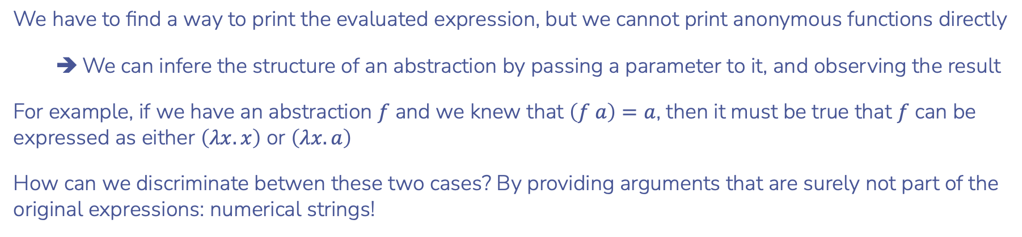
2.4 Computational approach
We have to find a way to print the evaluated expression, but we cannot print anonymous functions directly
We can infere the structure of an abstraction by passing a parameter to it, and observing the result
For example, if we have an abstraction $f$ and we knew that $\left(f a\right)=a$, then it must be true that $f$ can be expressed as either $\left(λx.x\right)$ or $\left(λx.a\right)$
How can we discriminate betwen these two cases? By providing arguments that are surely not part of the original expressions: numerical strings!
Remember that our lexer only recognises alphabetical identifiers

Slide 30

2.4 Computational approach
Our printing procedure:
1.
2.
3.
Black-box abstraction
Printable λ-term
Integers as arguments
Convert to Term
Substitute integers

Slide 31
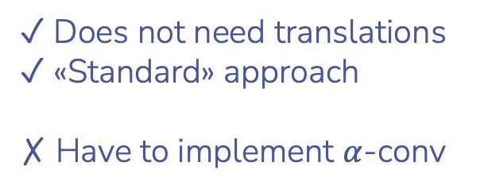

3. Conclusions
Pros and cons of each approach
$α$-conversion
✓︎ Does not need translations
✓ «Standard» approach
✗ Have to implement $α$-conv

Slide 32
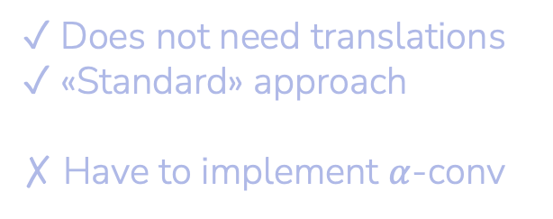

3. Conclusions
Pros and cons of each approach
$α$-conversion
De Bruijn Indexes
✓︎ Does not need translations
✓ «Standard» approach
✗ Have to implement $α$-conv
✓︎ Effortless substitution
✗ Need a translation ✗ Readability

Slide 33
3. Conclusions
Pros and cons of each approach
$α$-conversion
De Bruijn Indexes
Computational
✓︎ Does not need translations
✓ «Standard» approach
✗ Have to implement $α$-conv
✓︎ Effortless substitution
✗ Need a translation ✗ Readability
✓︎ Elegant applications
✓︎ No name clashes by default
✗ Need to create closures
✗ No default printing method

