Slide 1
WWC DATA SCIENCE WITH PYTHON
NLP SERIES
ACCESSING TEXT CORPORA

Slide 2
Accessing Text and Lexical Resources
Gutenberg Corpus
Web and Chat Text
Brown Corpus
Reuters Corpus
Annotated Corpora
Corpora in Other Languages
Unicode
Text Corpus Structure
Loading your own corpus

Slide 3
Text Processing with Unicode
There is no plain text.
The English world uses ASCII
Europe probably extended Latin character sets containing such characters as “Ø” for Danish and Norwegian
“ő” for Hungarian
“ñ” for Spanish
“ň” for Czech and Slovak
For all these other languages we use UNICODE

Slide 4
What is unicode?
Unicode supports over a million characters
Each character is assigned a number called code point.
In Python, code points are written in the form \uXXXX (XXXX is a 4-digit hexadecimal)
When Unicode characters are stored in files or displayed on a terminal, they must be encoded as a stream of bytes
Some encodings (ASCII and Latin-2) use single byte per code point, so they support a smaller set of Unicode

Slide 5
UTF-8
UTF-8 is a character encoding capable of encoding all possible characters, or code points, defined by Unicode and originally designed by Ken Thompson and Rob Pike. The encoding is variable-length and uses 8-bit code units.

Slide 6
How to translate into Unicode?
Translating to Unicode is called Decoding
To write out Unicode to a file or a terminal, this process is called Encoding
From Unicode perspective, characters are abstract entities that can be realized as one or more glyphs
Only glyphs can appear on a screen or be printed on paper.
A font is a mapping from characters to glyphs

Slide 7
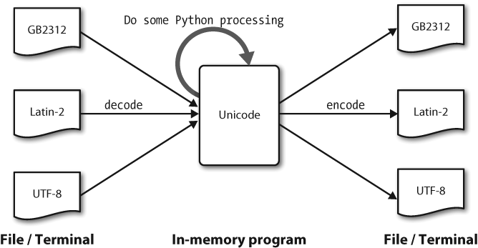
Decoding / Encoding with Python

Slide 8
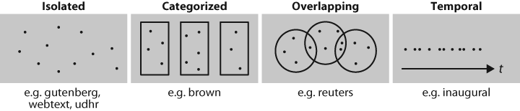
Common structures for text corpora

Slide 9
NLTK Basic Corpus Functionality
fileids() The files of the corpus
fileids([categories]) The files of the corpus corresponding to these categories
categories() The categories of the corpus
categories([fileids]) The categories of the corpus corresponding to these files
raw() The raw content of the corpus
raw(fileids=[f1,f2,f3]) The raw content of the specified files
raw(categories=[c1,c2]) The raw content of the specified categories
words() The words of the whole corpus
words(fileids=[f1,f2,f3]) The words of the specified fileids
words(categories=[c1,c2]) The words of the specified categories
sents() The sentences of the specified categories
sents(fileids=[f1,f2,f3]) The sentences of the specified fileids
sents(categories=[c1,c2]) The sentences of the specified categories
abspath(fileid) The location of the given file on disk
encoding(fileid) The encoding of the file (if known)
open(fileid) Open a stream for reading the given corpus file
root() The path to the root of locally installed corpus
readme() The contents of the README file of the corpus

