Slide 1
NLP Series Getting and Cleaning Data
Data Analytics with Python
Intermediate Group
Diana Amador

Slide 2
Agenda
Getting data: Hillary Clinton’s Emails
Reading files
Using Pandas to create a Dataframe in Python
Cleaning Data
Visualizing Data

Slide 3
Hillary Clinton’s Emails
Kaggle Datasets: https://www.kaggle.com/kaggle/hillary-clinton-emails
Data Description
Hillary-clinton-emails-release-*.zip contains four CSV tables and a SQLite database. The released archive is timestamped since the conversion process from the raw data is messy and imprecise, and it may be updated on a regular basis. Here's the code that creates this data release.
In this exercise we are using: emails.csv
The python code uses a small sample of the emails, you have to develop your own python script based on this exercise.

Slide 4
Packages
You will need to import:
Pandas
Numpy
NLTK
Matplotlib
wordcloud

Slide 5
Common Formats
Csv
Json
Xml
Txt
More on reading csv files in python:
http://pandas.pydata.org/pandas-docs/stable/generated/pandas.read_csv.html

Slide 6
Preprocessing with NLTK
The NLTK module is a Python kit to perform Natural Language Processing (NLP). With NLTK you would be able to split sentences from paragraphs, split up words, recognize the part of speech of those words, and highlight the main subjects. In this series, we're going to focus on subject/topic mining and sentiment analysis.

Slide 7
Vocabulary
Corpus - Body of text, singular. Corpora is the plural of this. Example: A collection of medical journals.
Lexicon - Words and their meanings. Example: English dictionary. Consider, however, that various fields will have different lexicons. For example: To a financial investor, the first meaning for the word "Bull" is someone who is confident about the market, as compared to the common English lexicon, where the first meaning for the word "Bull" is an animal. As such, there is a special lexicon for financial investors, doctors, children, mechanics, and so on.
Token - Each "entity" that is a part of whatever was split up based on rules. For examples, each word is a token when a sentence is "tokenized" into words. Each sentence can also be a token, if you tokenized the sentences out of a paragraph.
From:https://pythonprogramming.net/tokenizing-words-sentences-nltk-tutorial/

Slide 8
Cleaning
Eliminating punctuation
Eliminating stopwords
Normalizing data: converting to lower case
Tokenizing words

Slide 9
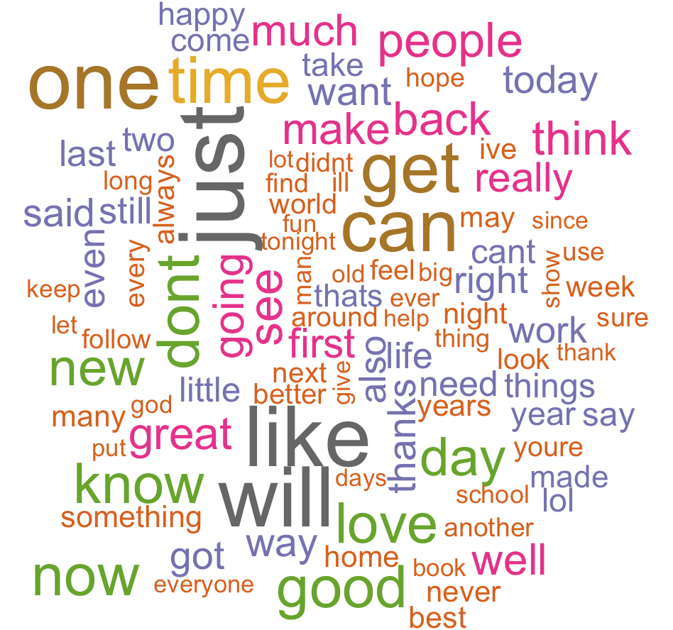
Exploring data: WordCloud
A WordCloud is an image composed of words used in a particular text or subject, in which the size of each word indicates its frequency or importance.

Slide 10
WordCloud Package
https://github.com/amueller/word_cloud
Check it for complete instructions on how to install Wordcloud and examples
Fast installation:
pip install wordcloud
Other source: https://pypi.python.org/pypi/wordcloud/1.0.0

Slide 11
Frequency Distribution
NLTK provides a method known as frequency distribution that counts the frequency of each vocabulary item in a text.
It is a distribution since it tells us how the total number of word tokens in the text are distributed across the vocabulary items.
It helps identifying the most informative words in a corpus.

Slide 12
Python Scripts
This presentation, Wordcloud code, and the Python Code (V 3.4) is available at:
https://github.com/damchilly/WWC-Getting-Cleaning-Data

