Slide 1
CPR E 281: Digital Logic
Md Maruf Ahamed
Office: 307 Durham Center
Phone: (515) 294-6323
Email: maruf@iastate.edu

Slide 2
Administrative Stuff
  Homework: HW #01 due on Sunday @ 11:59 PM
  Quiz: Quiz #2 due on Friday @ 4:25 PM
  Recitation: Recitation #02 next week
  Lab: Lab # 02 next week
      Submit pre-lab prior to the lab otherwise you will lose 20% points
  Lecture-6 Readings: Section 2.7

Slide 3
05 – Synthesis
  Operator Precedence
  Function Synthesis
  Canonical Sum-Of-Products (SOP)
  Minterms and Maxterms
  Canonical Product-of-Sums (POS)
  The Cost of a Circuit

Slide 4
Review

Slide 5

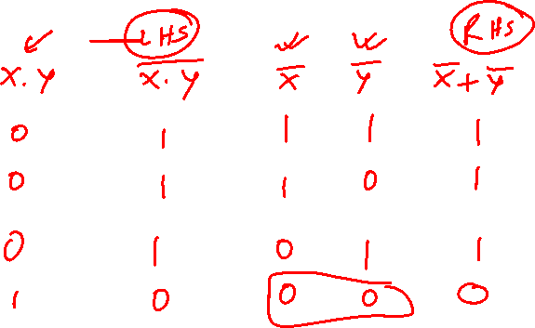
Proof of DeMorgan’s theorem
x y
0 0 0 1 1 0 1 1
[ Figure 2.13 from the textbook ]

Slide 6
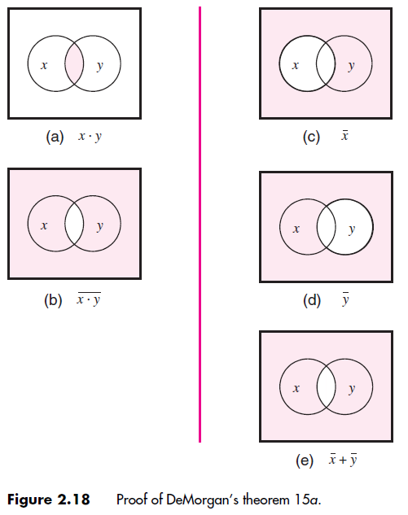
Alternative Proof of DeMorgan’s theorem
[ Figure 2.18 from the textbook ]

Slide 7
Venn Diagram Example
Proof of Property 17a

Slide 8
Left-Hand Side
x
y
x
y
x
y
x
y
z
z
z
z
x
y
y
z
x
z
x
y
+
x z
+
y
z
[ Figure 2.16 from the textbook ]

Slide 9
Left-Hand Side
x
y
x
y
x
y
x
y
z
z
z
z
x
y
y
z
x
z
x
y
+
x z
+
y
z
Right-Hand Side
x
y
x
y
x
y
z
z
z
x
y
x
z
x
y
+
x
z
[ Figure 2.16 from the textbook ]

Slide 10
Left-Hand Side
These two are equal
x
y
x
y
x
y
x
y
z
z
z
z
x
y
y
z
x
z
x
y
+
x z
+
y
z
Right-Hand Side
x
y
x
y
x
y
z
z
z
x
y
x
z
x
y
+
x
z
[ Figure 2.16 from the textbook ]

Slide 11
Synthesis
Using AND, OR, and NOT Gates
Reading – 2.6

Slide 12
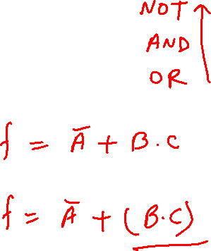
Operator Precedence
In regular arithmetic and algebra, multiplication takes precedence over addition
This is also true in Boolean algebra
NOT > AND > OR

Slide 13




Operator Precedence
(three different ways to write the same)

Slide 14
Function Synthesis

Slide 15
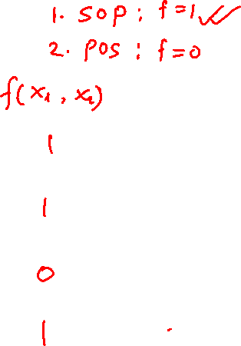
Synthesize the Following Function
The function of the circuit is to continuously monitor the state of the
switches and to produce an output logic value 1 whenever the switches x1, and x2 are in states ((0, 0), (0, 1), or (1, 1). If the state of the switches is (1, 0), the output should be 0.
x₁ | x₂
0 | 0
0 | 1
1 | 0
1 | 1

Slide 16
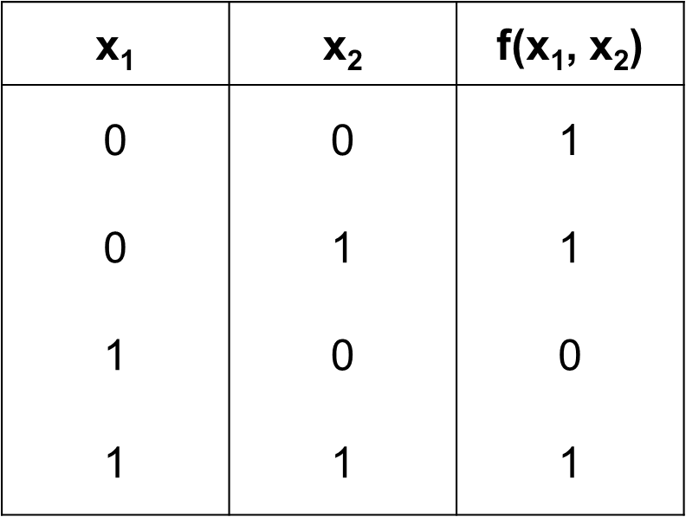
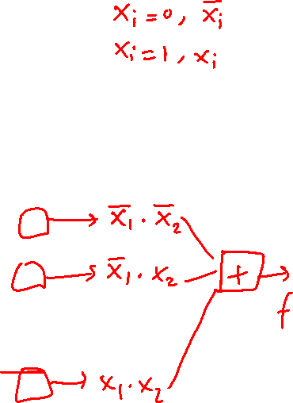
Summary of This Procedure
Get the truth table of the function
Form a product term (AND gate) for each row of the table for which the function is 1
Each product term contains all input variables
In each row, if x_{i} =1 enter it as x_{i} , otherwise use x_{i}
Sum all of these products (OR gate) to get the function

Slide 17
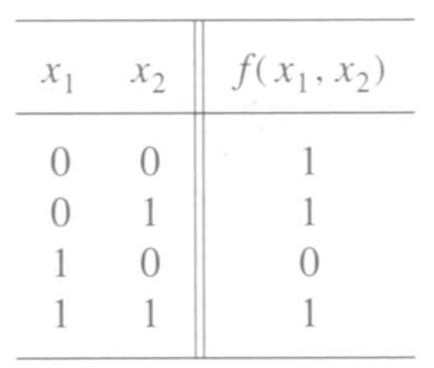

Let’s look at it row by row.
How can we express the last row?

Slide 18

What about this row?

Slide 19

What about the first row?

Slide 20
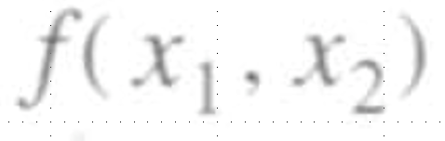
A function to be synthesized
[ Figure 2.19 from the textbook ]

Slide 21
A function to be synthesized
[ Figure 2.19 from the textbook ]

Slide 22
A function to be synthesized
x₁
x₂
[ Figure 2.19 from the textbook ]

Slide 23
A function to be synthesized
x₁
x₂
x₁
x₂
[ Figure 2.19 from the textbook ]

Slide 24

A function to be synthesized
x₁
x₂
x₁
x₂
x₁
x₂
[ Figure 2.19 from the textbook ]

Slide 25
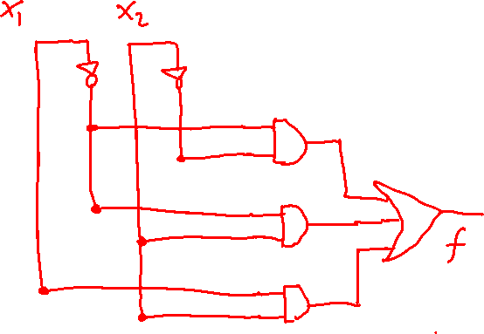
Putting it all together
x₁
x₂
x₁
x₂
x₁
x₂

Slide 26
Putting it all together
x₁
x₂
x₁
f
x₂
x₂
x₁
x₁
x₂

Slide 27

Let’s verify that this circuit implements correctly the target truth table
x
1
x
2
f
[ Figure 2.20a from the textbook ]

Slide 28
Canonical Sum-Of-Products (SOP)
x
1
x
2
f
[ Figure 2.20a from the textbook ]

Slide 29
Canonical Sum-Of-Products (SOP)
x
1
x
2
f
[ Figure 2.20a from the textbook ]

Slide 30


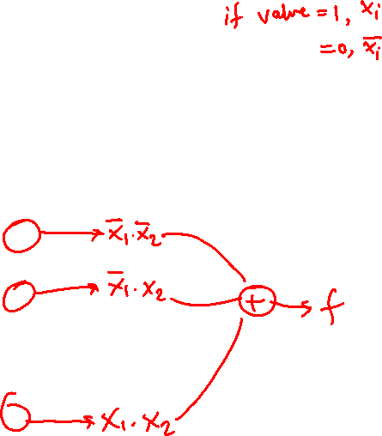
Summary of This Procedure
Get the truth table of the function
Form a product term (AND gate) for each row of the table for which the function is 1
Each product term contains all input variables
In each row, if x_{i} =1 enter it as x_{i} , otherwise use x_{i}
Sum all of these products (OR gate) to get the function

Slide 31
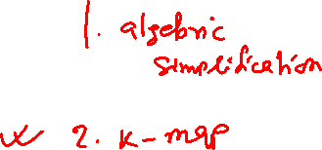
Two implementations for the same function
x
1
x
2
f
(a) Canonical sum-of-products
x
1
f
x
2
(b) Minimal-cost realization
[ Figure 2.20 from the textbook ]

Slide 32


SOP Simplification Steps
Distributive properties
12a. x • (y + z) = x•y + x•z
6a. x • 1 = x

Slide 33

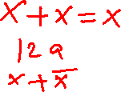
SOP Simplification Steps

Slide 34

Simplification Steps
Replicate this term (apply 7b)

Slide 35
Simplification Steps
Group these terms (apply 12a)

Slide 36

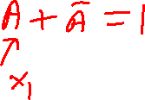
Simplification Steps
These two terms are trivially equal to 1 (apply 8b)

Slide 37

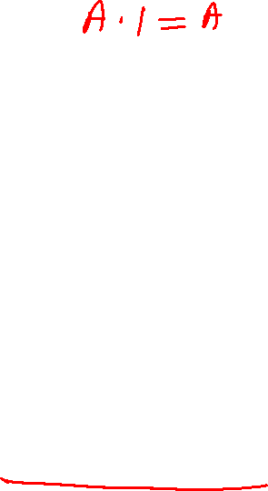
Simplification Steps
Drop the 1’s (apply 6a)

Slide 38
Minimal-cost realization
x
1
f
x
2
[ Figure 2.20b from the textbook ]

Slide 39
Two implementations for the same function
x
1
x
2
f
(a) Canonical sum-of-products
x
1
f
x
2
(b) Minimal-cost realization
[ Figure 2.20 from the textbook ]

Slide 40
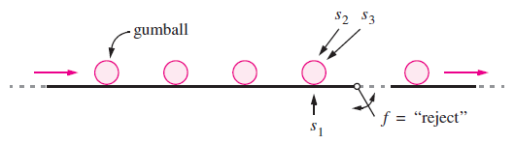

Example 2.7
The gumballs travel on a conveyor that has three associated sensors s₁, s₂, and s₃.
  If a gumball is not heavy enough to be acceptable then the sensor sets s₁=1.
  If a gumball is too small to be acceptable, then s₂=1
  If it is too large, then s₃=1.
A gumball should be rejected if it is too large, or both too small and too light. The trap door is opened by setting the logic function f to the value 1.
By inspection, f = s₃ + s₁s₂
[ Figure 2.21 from the textbook ]

Slide 41

Let’s look at another problem
S₁ | S₂ | S₃ | f
0 | 0 | 0
0 | 0 | 1
0 | 1 | 0
0 | 1 | 1
1 | 0 | 0
1 | 0 | 1
1 | 1 | 0
1 | 1 | 1
A gumball should be rejected if it is too large, or both too small and too light.
It sets f to 1 for each row in the table where s₃ has the value 1 (too large), as well as for each row where s₁ = s₂ = 1 (too light and too small).
[ Figure 2.21 from the textbook ]

Slide 42
Let’s look at another problem
S₁ | S₂ | S₃ | f
0 | 0 | 0 | 0
0 | 0 | 1 | 1
0 | 1 | 0 | 0
0 | 1 | 1 | 1
1 | 0 | 0 | 0
1 | 0 | 1 | 1
1 | 1 | 0 | 1
1 | 1 | 1 | 1
A gumball should be rejected if it is too large, or both too small and too light.
It sets f to 1 for each row in the table where s₃ has the value 1 (too large), as well as for each row where s₁ = s₂ = 1 (too light and too small).
[ Figure 2.21 from the textbook ]

Slide 43
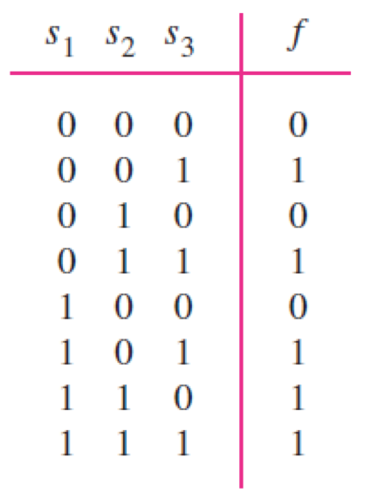
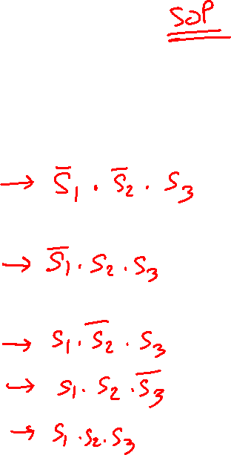
Let’s look at another problem

Slide 44





Let’s look at another problem

Slide 45

Let’s look at another problem
(minimization)

Slide 46
Let’s look at another problem
(minimization)
Replicate this term (apply 7b)

Slide 47
Let’s look at another problem
(minimization)
Group these terms (apply 12a)

Slide 48

Let’s look at another problem
(minimization)
(apply 8b), then (apply 6a)

Slide 49

Let’s look at another problem
(minimization)
Group these terms (apply 12a)

Slide 50

Let’s look at another problem
(minimization)
(apply 15b)

Slide 51

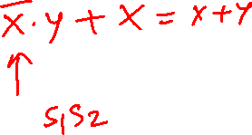
Let’s look at another problem
(minimization)
(apply 16a)

Slide 52
Let’s look at another problem
(minimization)
s₁
s₂
s₃
f

Slide 53
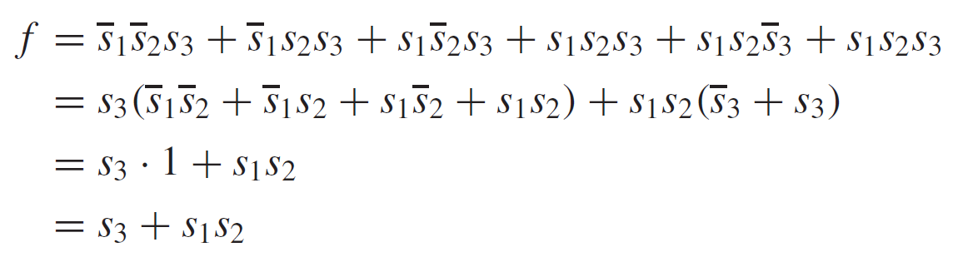
Example 2.8 minimization)
Replicate this term (apply 7b)
s₁
s₂
s₃
f

Slide 54
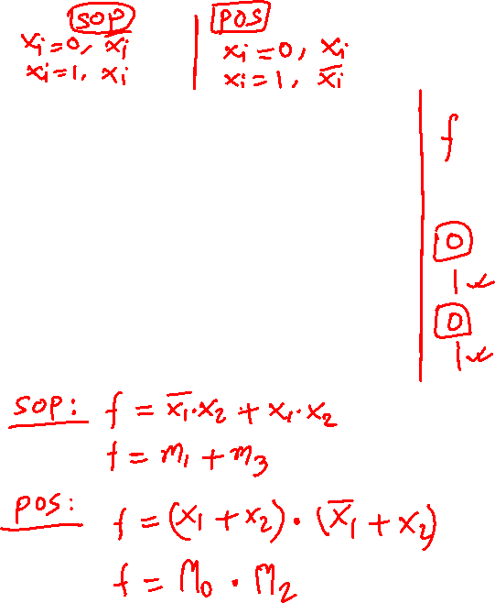
Minterms and Maxterms

Slide 55
Minterms and Maxterms
Use these for
Sum-of-Products
Minimization
(1’s of the function)
Use these for
Product-of-Sums
Minimization
(0’s of the function)

Slide 56
Sum-of-Products Form
(uses the ones of the function)

Slide 57

Sum-of-Products Form
(for the AND logic function)
f (x₁, x₂)

Slide 58
Sum-of-Products Form
(for the AND logic function)
f (x₁, x₂)
f (x₁, x₂) = m₃ = x₁ x₂
(In this case there is just one product and there is no need for a sum)

Slide 59
Another Example

Slide 60
Sum-of-Products Form
f (x₁, x₂)

Slide 61
Sum-of-Products Form
f (x₁, x₂)

Slide 62
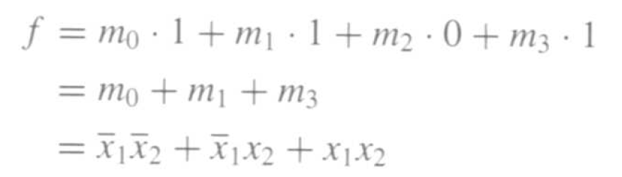

Sum-of-Products Form
f (x₁, x₂)

Slide 63
Product-of-Sums Form
(uses the zeros of the function)

Slide 64
Product-of-Sums Form
(for the OR logic function)
f (x₁, x₂)

Slide 65
Product-of-Sums Form
(for the OR logic function)
f (x₁, x₂)
f (x₁, x₂) = M₀ = x₁ + x₂
(In this case there is just one sum and there is no need for a product)

Slide 66
Another Example

Slide 67
Product-of-Sums Form
f (x₁, x₂)
We need to minimize using the zeros of the function f.
But let’s first minimize the inverse of f, i.e., f.

Slide 68

Product-of-Sums Form
f (x₁, x₂)
f (x₁, x₂)

Slide 69
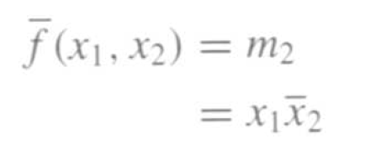
Product-of-Sums Form
f (x₁, x₂)
f (x₁, x₂)

Slide 70
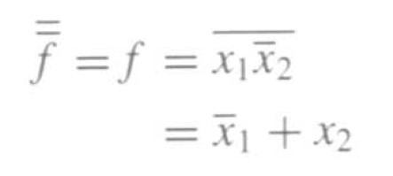
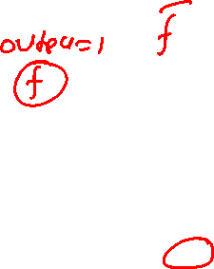
Product-of-Sums Form
f (x₁, x₂)
f (x₁, x₂)

Slide 71

Product-of-Sums Form
f (x₁, x₂)
f (x₁, x₂)

Slide 72
Minterms and Maxterms
(with three variables)
[ Figure 2.22 from the textbook ]

Slide 73
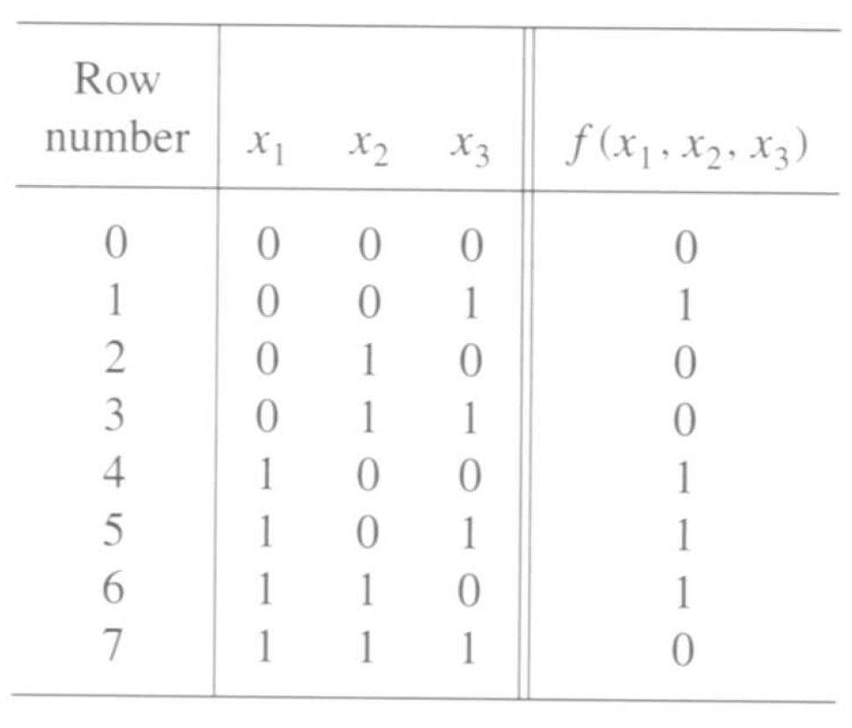
A three-variable function
[ Figure 2.23 from the textbook ]

Slide 74
Sum-of-Products Form

Slide 75
Sum-of-Products Form

Slide 76
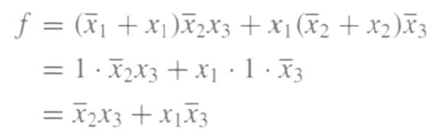
Sum-of-Products Form

Slide 77
A three-variable function
[ Figure 2.23 from the textbook ]

Slide 78
Product-of-Sums Form

Slide 79

Product-of-Sums Form
using the combining property 14b, the expression reduces to

Slide 80
POS Simplification Steps
Combining properties
6a. x • 1 = x

Slide 81

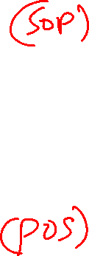
Two realizations of that function
x
2
f
x
3
x
1
(a) A minimal sum-of-products realization
x
1
x
3
f
x
2
(b) A minimal product-of-sums realization
[ Figure 2.24 from the textbook ]

Slide 82
The Cost of a Circuit
Count all gates
Count all inputs/wires to the gates

Slide 83
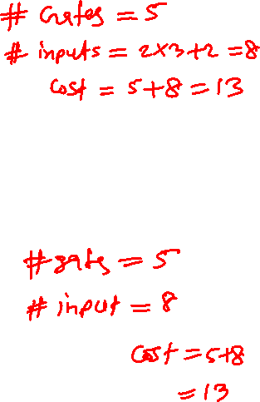
What is the cost of each circuit?
x
2
f
x
3
x
1
(a) A minimal sum-of-products realization
x
1
x
3
f
x
2
(b) A minimal product-of-sums realization
[ Figure 2.24 from the textbook ]

Slide 84
Lec 5: Test Q 1
What is the relative cost of this circuit?
x
1
x
2
f

Slide 85

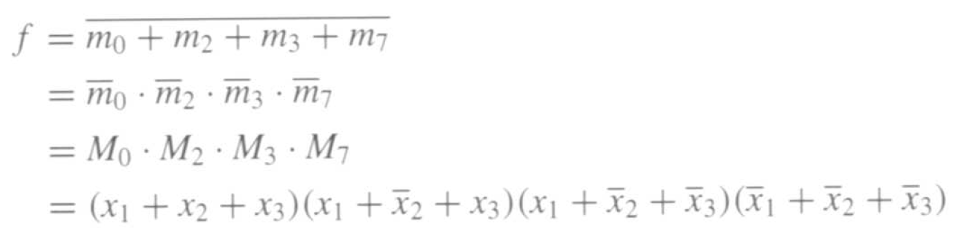
Minterms vs Maxterms
f(x₁, x₂, x₃ ) = m₁ + m₄ + m₅ + m₆

Slide 86
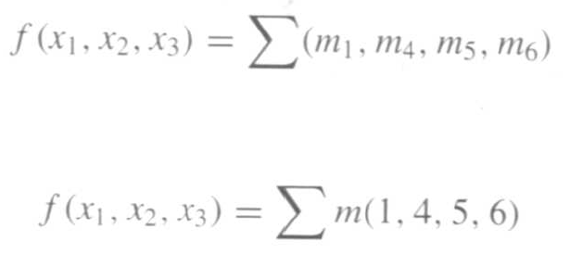
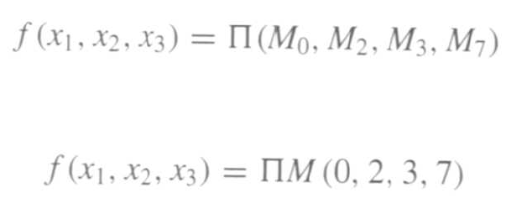
Shorthand Notation
Sum-of-Products
or
Product-of-sums
or

Slide 87

END Slide

