Slide 1
CPR E 281: Digital Logic
Md Maruf Ahamed
Office: 307 Durham Center
Phone: (515) 294-6323
Email: maruf@iastate.edu

Slide 2
Administrative Stuff
  Homework: HW #03 due on Sunday @ 11:59 PM
  Quiz: Quiz #3 due on Friday @ 4:25 PM
  Recitation: Recitation #03 this week
  Lab: Lab # 03 this week
      Submit pre-lab prior to the lab otherwise you will lose 20% points
  Lecture-11 Readings: Section 2.14, 2.15, 2.16
  Verilog part 2: Posted on Canvas under lec 8
  Midterm 1: Friday, Feb 18

Slide 3
10 – Minimization
  Karnaugh Map (K-map)
    Two-Variable K-map
    Three-Variable K-Map
    Four-Variable K-Map
    Five-Variable K-Map
  Strategy for Minimization
  Minimization of Sum-of-Products Forms
  Minimization of Product-of-Sums Forms

Slide 4
Review

Slide 5
Karnaugh Maps
Readings-2.11

Slide 6

Step-By-Step Example
x
1
1. Draw The Map
x
2
0
1
x
1
x
2
f
0
m
m
0
2
0
0
1
1
m
m
0
1
1
1
3
1
0
0
2. Fill The Map
x
1
x
2
1
1
1
0
1
0
1
0
3. Grouping
1
1
1
_
4. Write The Expression
x₁ + x₂
Note: Find which variable is constant

Slide 7
Grouping Rules
Group “1”s with rectangles
Both sides a power of 2:
  1x1, 1x2, 2x1, 2x2, 1x4, 4x1, 2x4, 4x2, 4x4
Can use the same minterm more than once
Can wrap around the edges of the map
Some rules in selecting groups:
  Try to use as few groups as possible to cover all “1”s.
  For each group, try to make it as large as you can (i.e., if you can use a 2x2, don’t use a 2x1 even if that is enough).

Slide 8
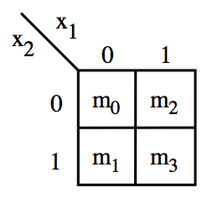

These are all valid groupings
In this case the result is the constant function 1.

Slide 9
These are all invalid groupings

Slide 10
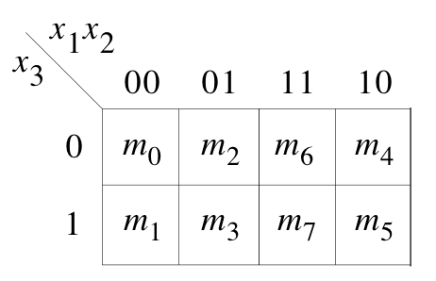
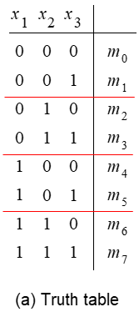
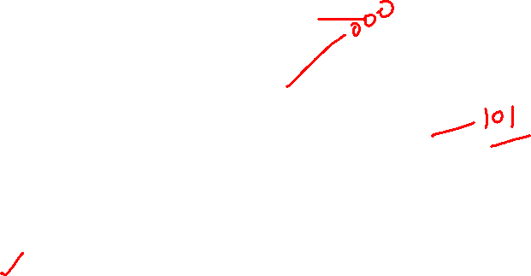
Three-Variable K-Map
Adjacent columns
m₄
m₀
m₂
m₅
m₁
m₃
As if the K-map were
drawn on a cylinder

Slide 11
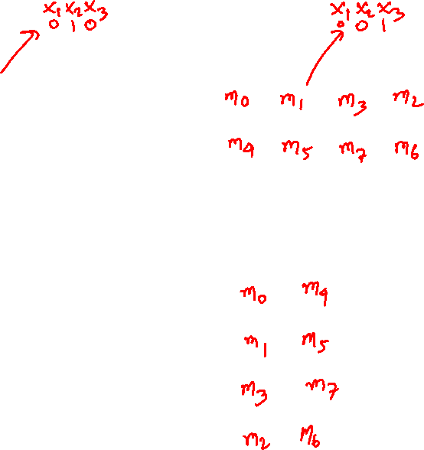
Three Different Ways to Draw the K-map
 | x₂x₃
x₁ |  | 00 | 01 | 11 | 10
 | 0
 | 1
Adjacent columns
 | x₁
x₂x₃ |  | 0 | 1
 | 00
 | 01
 | 11
 | 10

Slide 12
Three Different Ways to Draw the K-map
 | x₂x₃
x₁ |  | 00 | 01 | 11 | 10
 | 0 | m₀ | m₁ | m₃ | m₂
 | 1 | m₄ | m₅ | m₇ | m₆
Adjacent columns
 | x₁
x₂x₃ |  | 0 | 1
 | 00 | m₀ | m₄
 | 01 | m₁ | m₅
 | 11 | m₃ | m₇
 | 10 | m₂ | m₆

Slide 13
Three-Variable K-Map: Valid Grouping

Slide 14
Three-Variable K-Map: Invalid Groupings

Slide 15
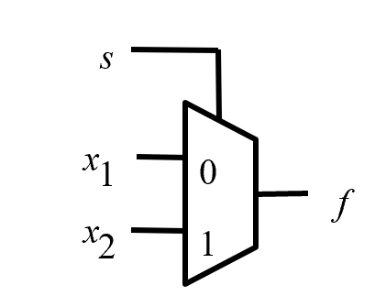
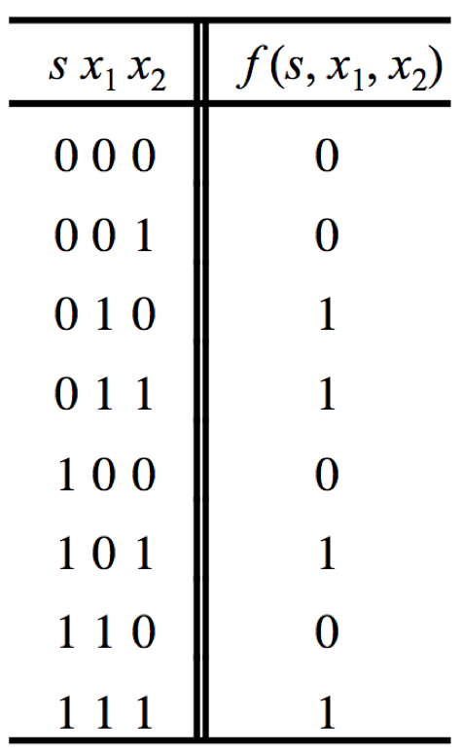
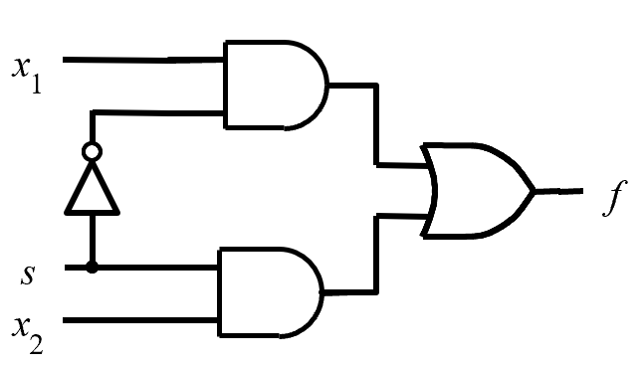
Example: K-Map for the 2-1 Multiplexer
Has two inputs: x₁ and x₂
Also has another input line s
If s=0, then the output is equal to x₁
If s=1, then the output is equal to x₂
f (s, x_{1,} x₂) =
s x₁
+
s x₂
[ Figure 2.33a from the textbook ]

Slide 16



Example: K-Map for the 2-1 Multiplexer
sx₁
x₂
00 01 11 10
0
1
sx₁
x₂
[ Figure 2.33a from the textbook ]

Slide 17
Example: K-Map for the 2-1 Multiplexer
s x₁
x₂
0
1
0
0
0
1
1
1
f (s, x_{1,} x₂) =
s x₁
+
s x₂
[ Figure 2.33a from the textbook ]

Slide 18
A four-variable Karnaugh map
x1 | x2 | x3 | x4
0 | 0 | 0 | 0 | m0
0 | 0 | 0 | 1 | m1
0 | 0 | 1 | 0 | m2
0 | 0 | 1 | 1 | m3
0 | 1 | 0 | 0 | m4
0 | 1 | 0 | 1 | m5
0 | 1 | 1 | 0 | m6
0 | 1 | 1 | 1 | m7
1 | 0 | 0 | 0 | m8
1 | 0 | 0 | 1 | m9
1 | 0 | 1 | 0 | m10
1 | 0 | 1 | 1 | m11
1 | 1 | 0 | 0 | m12
1 | 1 | 0 | 1 | m13
1 | 1 | 1 | 0 | m14
1 | 1 | 1 | 1 | m15
adjacent
rows
adjacent
columns

Slide 19
Some Valid Groupings

Slide 20
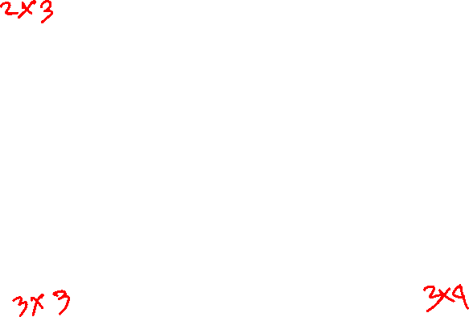
Some Invalid Groupings
All sides must be powers of 2.

Slide 21
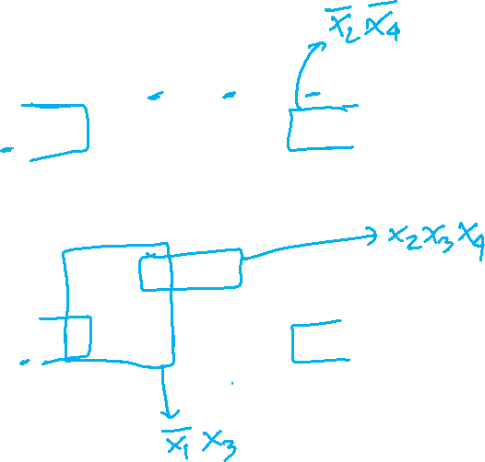
Example 6: four-variable Karnaugh map
x₁ x₂
x₃ x₄
00 01 11 10
00
01
11
10
1 0 0 1
0 0 0 0
1 1 1 0
1 1 0 1
[ Figure 2.54 from the textbook ]

Slide 22
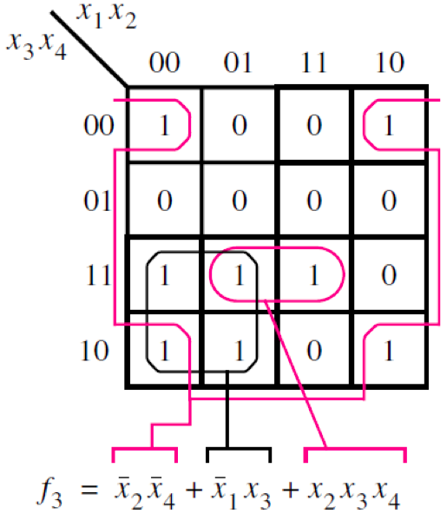
Example 6: four-variable Karnaugh map
[ Figure 2.54 from the textbook ]

Slide 23
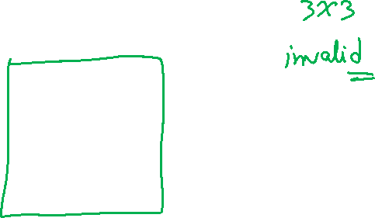
Example 7: Example of a four-variable Karnaugh map
x₁ x₂
x₃ x₄
00 01 11 10
00
01
11
10
1 1 1 0
1 1 1 0
1 1 1 0
0 0 0 0
[ Figure 2.54 from the textbook ]

Slide 24
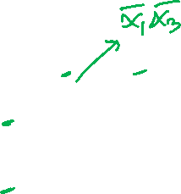
Example 7: Example of a four-variable Karnaugh map
x₁ x₂
x₃ x₄
00 01 11 10
00
01
11
10
1 1 1 0
1 1 1 0
1 1 1 0
0 0 0 0
[ Figure 2.54 from the textbook ]

Slide 25
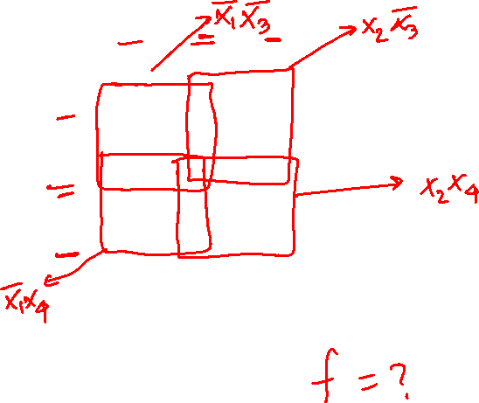
Example 7: Example of a four-variable Karnaugh map
x₁ x₂
x₃ x₄
00 01 11 10
00
01
11
10
1 1 1 0
1 1 1 0
1 1 1 0
0 0 0 0
[ Figure 2.54 from the textbook ]

Slide 26
Five-Variable K-Map

Slide 27
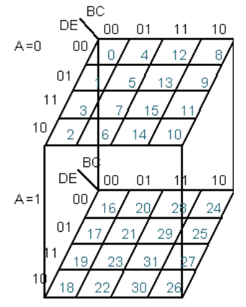
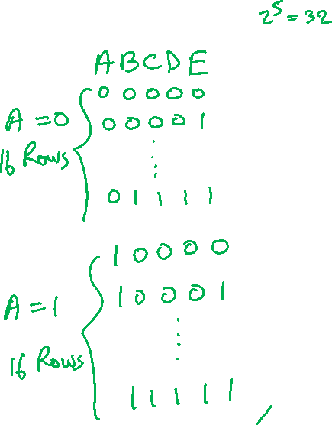
A five-variable Karnaugh map

Slide 28
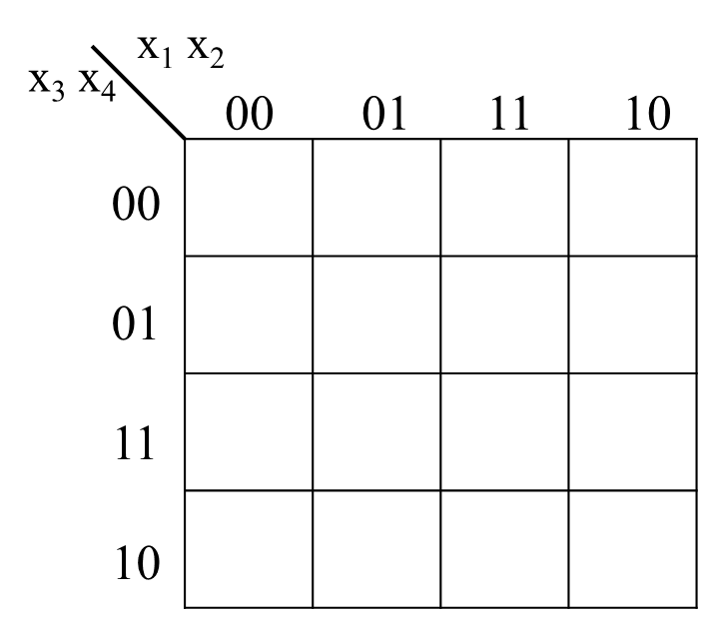
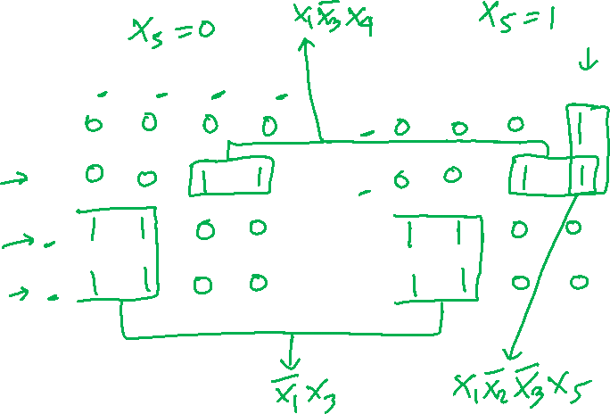
Five-variable function f (x₅,x₄,x₃,x₂,x₁) =
∑m(2, 3,6,7,9,13,18,19,22,23,24,25,29)

Slide 29
Five-variable function f (x₅,x₄,x₃,x₂,x₁) =
∑m(2, 3,6,7,9,13,18,19,22,23,24,25,29)
[ Figure 2.55 from the textbook ]

Slide 30
Strategy For Minimization
Readings-2.12

Slide 31
Why concerned with minimization?
Simplified function
Reduce the cost of the circuit
  Cost: Gates + Inputs
  Transistors

Slide 32
Terminology
  Literal: a variable (complemented or uncomplemented)
  Some Examples:
  X₁
  X₂
_

Slide 33
Terminology
Implicant: product term that indicates the input combinations for which the function output is 1
Example
  x₁ - indicates that x₁x₂ and x₁x₂ yield output of 1
_
_
_
_
x
1
x
2
0
1
0
1
0
1
1
0

Slide 34
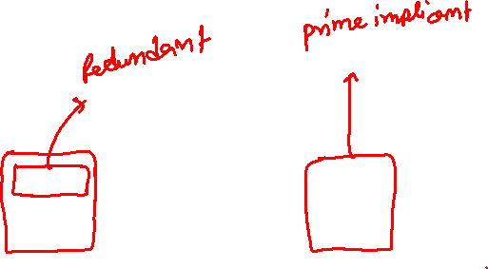
Terminology
Prime Implicant
  Implicant that cannot be combined into another implicant with fewer literals
  Some Examples
x
1
x
2
x
1
x
2
x
3
x
3
00
01
11
10
00
01
11
10
0
0
1
1
1
0
0
1
1
1
1
1
1
1
0
1
1
1
1
0
Not prime
Prime

Slide 35
Terminology
Prime Implicant
  Implicant that cannot be combined into another implicant with fewer literals
  Some Examples
x
1
x
2
x
1
x
2
x
3
x
3
00
01
11
10
00
01
11
10
0
0
1
1
1
0
0
1
1
1
1
1
1
1
0
1
1
1
1
0
Not prime
Prime

Slide 36
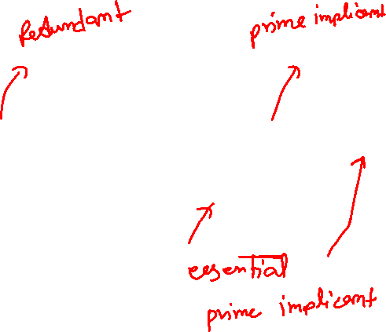
Terminology
Essential Prime Implicant
  Prime implicant that includes a minterm not covered by any other prime implicant
  Some Examples
x
1
x
2
x
x
x
1
2
3
00
01
11
10
x
3
00
01
11
10
0
0
1
1
1
0
0
1
1
1
1
1
1
0
0
1
1
1
1
0

Slide 37
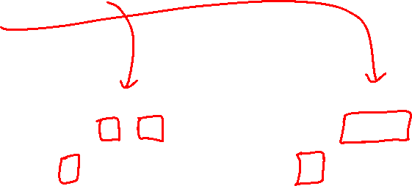
Terminology
Cover
  Collection of implicants that account for all possible input valuations where output is 1
  Ex. x₁’x₂x₃ + x₁x₂x₃’ + x₁x₂’x₃’
  Ex. x₁’x₂x₃ + x₁x₃’
x
x
x
1
x
2
1
2
x
x
3
3
00
01
11
10
00
01
11
10
0
0
0
1
1
0
0
0
1
1
1
0
1
0
0
1
0
1
0
0

Slide 38
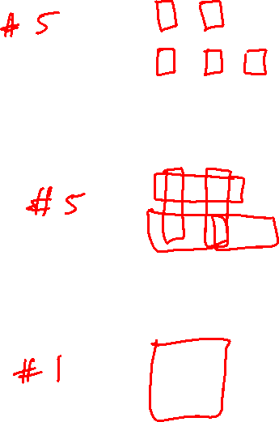
Example
x
1
x
2
x
3
Give the Number of
  Implicants?
  Prime Implicants?
  Essential Prime Implicants?
00
01
11
10
0
1
1
0
0
1
1
1
1
0
x
1
x
2
x
3
00
01
11
10
0
1
1
0
0
1
1
1
1
0
x
1
x
2
x
3
00
01
11
10
0
1
1
0
0
1
1
1
1
0

Slide 39

Example 1: Three-variable function
f (x₁, x₂, x₃) = ∑m(0, 1, 2, 3, 7)
x₁ x₂
x₃
00 01 11 10
0
1
1 | 1 | 0 | 0
1 | 1 | 1 | 0
Adjacent columns
[ Figure 2.56 from the textbook ]

Slide 40
Example 1: Three-variable function
f (x₁, x₂, x₃) = ∑m(0, 1, 2, 3, 7)
[ Figure 2.56 from the textbook ]

Slide 41

Example 2: Four-variable Karnaugh map
x₁ x₂
x₃ x₄
00 01 11 10
00
01
11
10
1 1 1 0
1 1 1 0
0 0 1 1
0 0 1 1
[ Figure 2.54 from the textbook ]

Slide 42

Example 2: Four-variable Karnaugh map
x₁ x₂
x₃ x₄
00 01 11 10
00
01
11
10
1 1 1 0
1 1 1 0
0 0 1 1
0 0 1 1
[ Figure 2.54 from the textbook ]

Slide 43
Example 2: Four-variable Karnaugh map
x₁ x₂
x₃ x₄
00 01 11 10
00
01
11
10
1 1 1 0
1 1 1 0
0 0 1 1
0 0 1 1
[ Figure 2.54 from the textbook ]

Slide 44
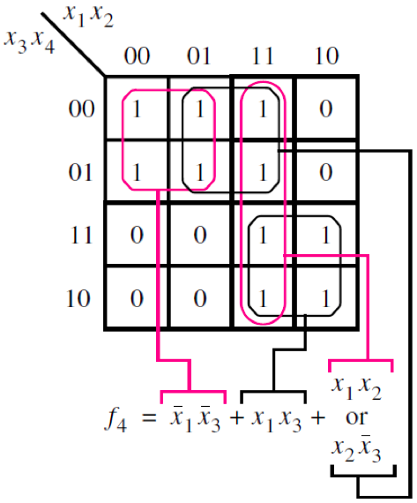
Example 2: Four-variable Karnaugh map
[ Figure 2.54 from the textbook ]

Slide 45

Example 3
x
x
x
x
1
2
3
4
00
01
11
10
00
1
1
01
1
1
11
1
1
10
1
1
x
x
x
1
x
2
3
4
00
01
11
10
00
1
1
01
1
1
11
1
1
10
1
1

Slide 46
Example 3
x
1
x
2
x
3
x
4
00
01
11
10
00
1
1
x
1
x
3
x
4
01
1
1
x
2
x
3
x
4
11
1
1
x
1
x
3
x
4
10
1
1
x
2
x
3
x
4
f =
x
x
x
+
x
x
x
+
x
x
x
+
x
x
x
1
3
4
2
3
4
1
3
4
2
3
4

Slide 47
Example 3: Another Solution
x
1
x
2
x
3
x
4
00
01
11
10
00
1
1
01
1
1
11
1
1
10
1
1
x
1
x
2
x
4
x
1
x
2
x
4
x
1
x
2
x
3
x
1
x
2
x
3
f =
x
x
x
+
x
x
x
+
x
x
x
+
x
x
x
1
2
4
1
2
3
1
2
4
1
2
3

Slide 48
Example 3: Both Are Valid Solutions
x
1
x
2
x
3
x
4
00
01
11
10
00
1
1
x
1
x
3
x
4
01
1
1
x
2
x
3
x
4
11
1
1
x
1
x
3
x
4
10
1
1
x
2
x
3
x
4
x
1
x
2
x
4
x
1
x
2
x
4
x
1
x
2
x
3
x
1
x
2
x
3
f =
x
x
x
+
x
x
x
+
x
x
x
+
x
x
x
1
3
4
2
3
4
1
3
4
2
3
4
f =
x
x
x
+
x
x
x
+
x
x
x
+
x
x
x
1
2
4
1
2
3
1
2
4
1
2
3

Slide 49
Minimization of Product-of-Sums Forms

Slide 50
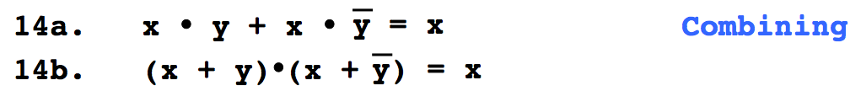

Do You Still Remember This
Boolean Algebra Theorem?

Slide 51
Grouping Example
x
1
x
1
x
2
x
2
0
1
0
1
0
0
1
0
1
0
1
1
1
1
1
1
M₀
M₂

Slide 52
Grouping Example
x
1
x
1
x
1
x
2
x
2
x
2
0
1
0
1
0
1
0
0
1
0
1
0
0
0
0
*
=
1
1
1
1
1
1
1
1
1
M₀
*
M₂
=
M₀ * M₂

Slide 53
Grouping Example
x
1
x
1
x
1
x
2
x
2
x
2
0
1
0
1
0
1
0
0
1
0
1
0
0
0
0
*
=
1
1
1
1
1
1
1
1
1
M₀
*
M₂
=
M₀ * M₂

Slide 54
Grouping Example
x
1
x
1
x
1
x
2
x
2
x
2
0
1
0
1
0
1
0
0
1
0
1
0
0
0
0
*
=
1
1
1
1
1
1
1
1
1
M₀
*
M₂
=
M₀ * M₂

Slide 55
Grouping Example
x
1
x
1
x
1
x
2
x
2
x
2
0
1
0
1
0
1
0
0
1
0
1
0
0
0
0
*
=
1
1
1
1
1
1
1
1
1
M₀
*
M₂
=
M₀ * M₂
_
( x₁ + x₂ )
*
( x₁+ x₂ )
=
x₂
Property 14b (Combining)

Slide 56
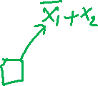
Step-By-Step Example
x
1
1. Draw The Map
x
2
0
1
x
1
x
2
f
0
m
m
0
2
0
0
1
1
m
m
0
1
1
1
3
1
0
0
2. Fill The Map
x
1
x
2
1
1
1
0
1
0
1
0
3. Grouping
1
1
1
4. Write The Expression
Note: Find which variable is constant

Slide 57
Step-By-Step Example
x
1
1. Draw The Map
x
2
0
1
x
1
x
2
f
0
m
m
0
2
0
0
1
1
m
m
0
1
1
1
3
1
0
0
2. Fill The Map
x
1
x
2
1
1
1
0
1
0
1
0
3. Grouping
1
1
1
_
4. Write The Expression
x₁ + x₂
Note: Find which variable is constant

Slide 58
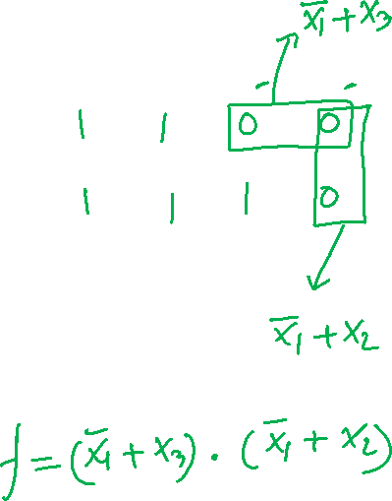
POS minimization of f (x₁, x₂, x₃) = ∏ M(4, 5, 6)
x₁ x₂
x₃
00 01 11 10
0
1
Adjacent columns
[ Figure 2.60 from the textbook ]

Slide 59
POS minimization of f (x₁, x₂, x₃) = ∏ M(4, 5, 6)
[ Figure 2.60 from the textbook ]

Slide 60
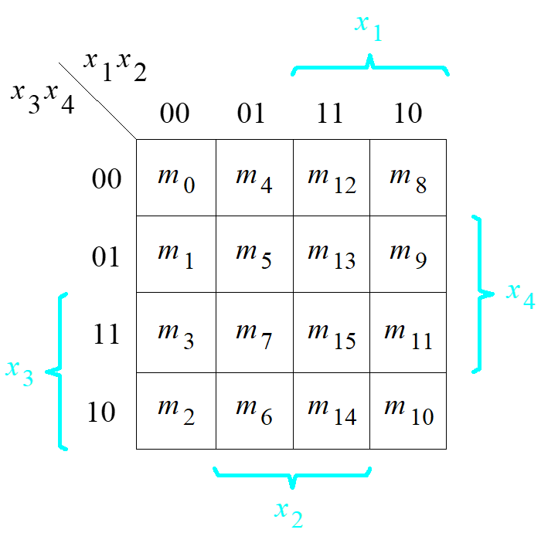
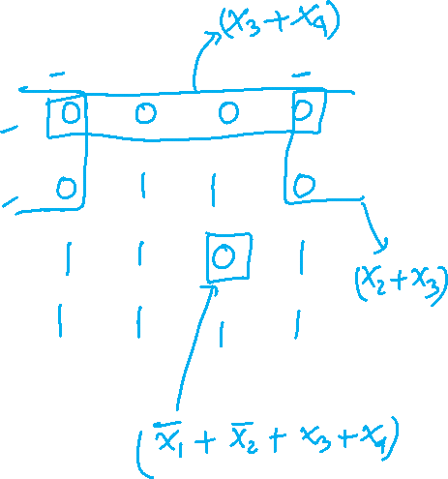
POS minimization of f ( x₁,…, x₄) = ∏ M(0, 1, 4, 8, 9, 12, 15)
x₁ x₂
x₃ x₄
00 01 11 10
00
01
11
10
[ Figure 2.61 from the textbook ]

Slide 61
POS minimization of f ( x₁,…, x₄) = ∏ M(0, 1, 4, 8, 9, 12, 15)
x
x
x
x
1
2
3
4
00
01
11
10
(
)
00
0
0
0
0
x
+
x
3
4
01
0
1
1
0
(
)
x
+
x
2
3
11
1
1
0
1
10
1
1
1
1
(
)
x
+
x
+
x
+
x
1
2
3
4
[ Figure 2.61 from the textbook ]

Slide 62

Lecture 10: Test Q1
Find the simplest POS form of the following functions using a K-map
x₁ x₂
x₃ x₄
00 01 11 10
00
01
11
10
1 1 1 0
1 1 1 0
1 1 1 0
0 0 0 0
[ Figure 2.54 from the textbook ]

Slide 63

END Slide

