Slide 1
CPR E 281: Digital Logic
Md Maruf Ahamed
Office: 307 Durham Center
Phone: (515) 294-6323
Email: maruf@iastate.edu

Slide 2
Administrative Stuff
  Homework:
  Quiz:
  Recitation: Recitation #04 next week
  Lab: Lab # 04 next week
      Submit pre-lab prior to the lab otherwise you will lose 20% points
  Lecture-12 Readings: Section 2.17
  Midterm 1: Friday, Feb 18
  Midterm 1 Samples: ( 2019 Exam)
  Midterm 1 bonus credit: Due before by Feb 18 @4:00pm

Slide 3
12–Examples
  Midterm 1 outlines
  Examples

Slide 4
Midterm 1 - Syllabus
  Lectures: Lec 01- Lec 12
  Homework: HW #00 ~ HW #03
  Quiz: Quiz #1 ~ Quiz #3
  Recitation: Recitation #01- 04
    Closed book
    No Calculator allowed
    You can use two pages (double sided) cheat sheet (printed or handwritten).

Slide 5

Midterm 1 - Topics
  Binary Numbers
  Octal Numbers
  Hexadecimal Numbers
  Conversion between the different number systems
  Truth Tables
  Boolean Algebra
  Logic Gates
  Circuit Synthesis with AND, OR, NOT
  Circuit Synthesis with NAND, NOR
  Converting an AND/OR/NOT circuit to NAND circuit
  Converting an AND/OR/NOT circuit to NOR circuit
  SOP and POS expressions
  Mapping a Circuit to Verilog code
  Mapping Verilog code to a circuit
  Multiplexers
  Venn Diagrams
  K-maps for 2, 3, and 4 variables
  Minimization of Boolean expressions using theorems
  Minimization of Boolean expressions with K-maps
  Incompletely specified functions (with don’t cares)
  Functions with multiple outputs

Slide 6
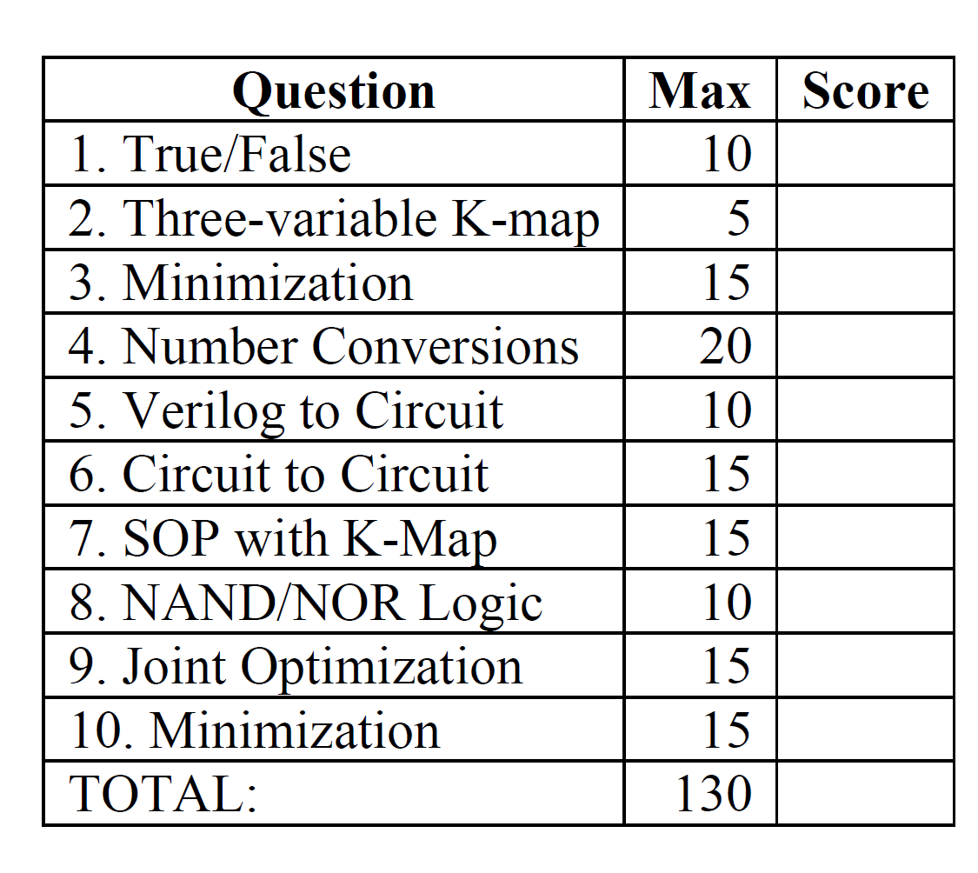
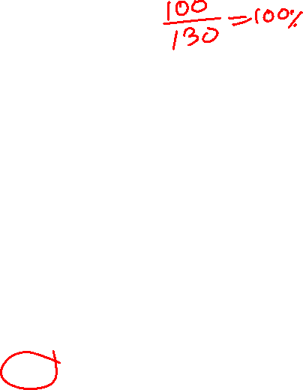
Midterm 1- sample outlines

Slide 7
Example 1
Determine if the following equation is valid

Slide 8
?
LHS
RHS

Slide 9
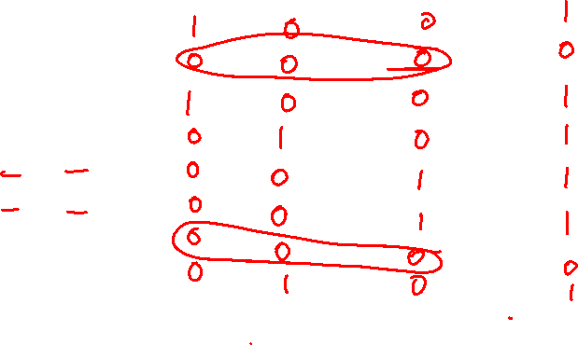
Left-Hand Side (LHS)

Slide 10
Left-Hand Side (LHS)

Slide 11
Left-Hand Side (LHS)

Slide 12

Right-Hand Side (RHS)

Slide 13
Right-Hand Side (RHS)

Slide 14
Right-Hand Side (RHS)

Slide 15

?
LHS
RHS
They are equal.

Slide 16
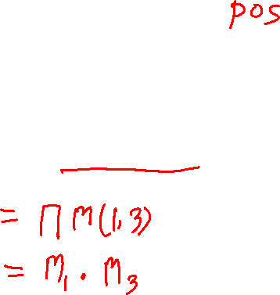
Example 2
Design the minimum-cost product-of-sums expression for the function
f(x₁, x₂, x₃) = Σ m(0, 2, 4, 5, 6, 7)

Slide 17
Minterms and Maxterms
(with three variables)
[ Figure 2.22 from the textbook ]

Slide 18
Minterms and Maxterms (with three variables)
The function is
1 for these rows

Slide 19
Minterms and Maxterms (with three variables)
The function is
1 for these rows
The function is
0 for these rows

Slide 20
Two different ways to specify the same function f of three variables
f(x₁, x₂, x₃) = Σ m(0, 2, 4, 5, 6, 7)
f(x₁, x₂, x₃) = Π M(1, 3)

Slide 21


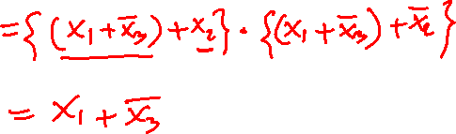
The POS Expression
f(x₁, x₂, x₃) = Π M(1, 3)
= M₁• M₃
= ( x₁ + x₂ + x₃)•( x₁ + x₂ + x₃)

Slide 22
The Minimum POS Expression
f(x₁, x₂, x₃)
= ( x₁ + x₂ + x₃)•( x₁ + x₂ + x₃)
= ( x₁ + x₃ + x₂)•( x₁ + x₃ + x₂)
= ( x₁ + x₃ )
Hint: Use the following Boolean Algebra theorem

Slide 23
Alternative Solution Using K-Maps

Slide 24
Alternative Solution Using K-Maps
f(x₁, x₂, x₃) = Π M(1, 3)

Slide 25
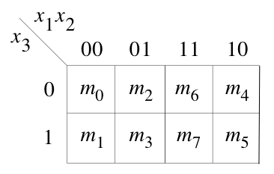
Alternative Solution Using K-Maps
1
1
1
1
0
0
1
1
f(x₁, x₂, x₃) = Π M(1, 3)

Slide 26
Alternative Solution Using K-Maps
1
1
1
1
0
0
1
1
f(x₁, x₂, x₃) = Π M(1, 3)
( x₁ + x₃ )

Slide 27
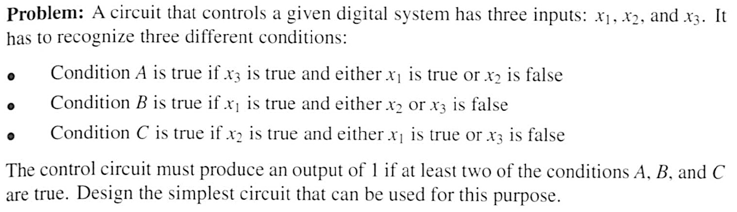

Example 3

Slide 28
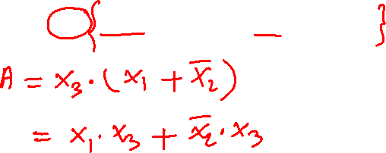
Condition A

Slide 29

Condition A

Slide 30
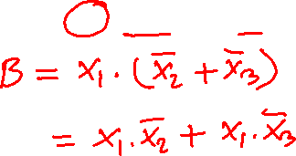
Condition B

Slide 31

Condition B

Slide 32
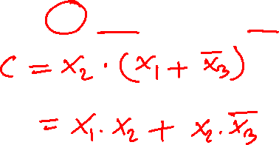
Condition C

Slide 33

Condition C

Slide 34
The output of the circuit can be expressed as f = AB + AC + BC

Slide 35
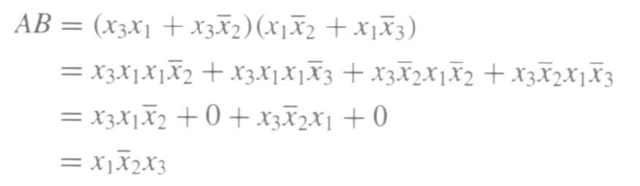
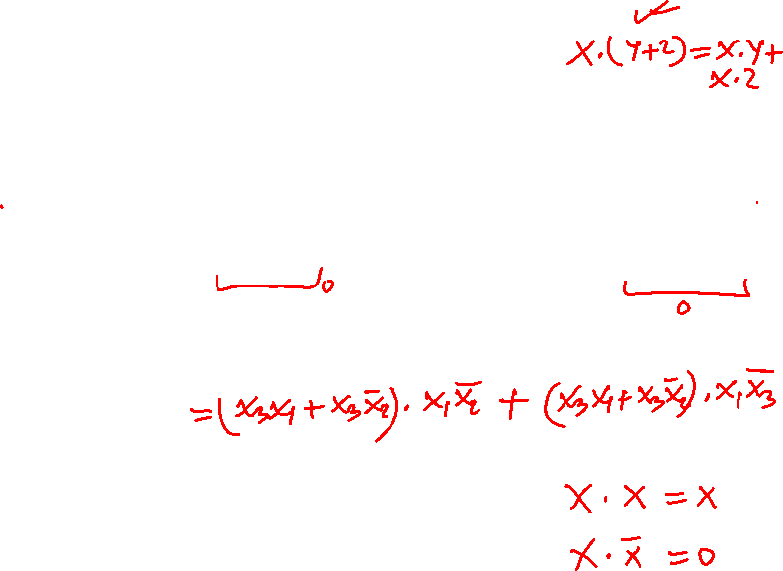
The output of the circuit can be expressed as f = AB + AC + BC

Slide 36
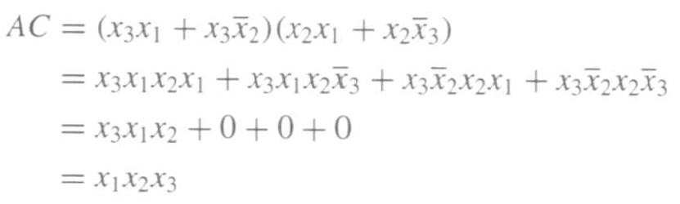
The output of the circuit can be expressed as f = AB + AC + BC

Slide 37
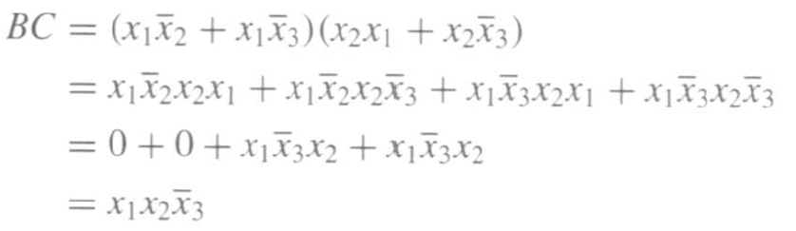
The output of the circuit can be expressed as f = AB + AC + BC

Slide 38
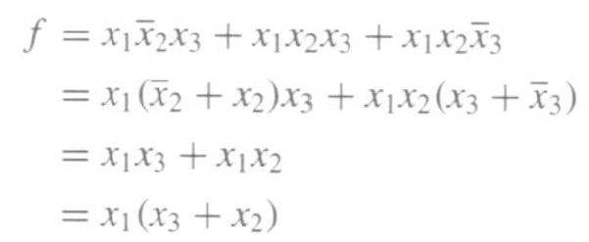

Finally, we get
f = AB + AC + BC

Slide 39
Example 4
Solve the previous problem using Venn diagrams.

Slide 40





Venn Diagrams
(find the areas that are shaded at least two times)
x₁
x₂
x₁
x₂
x₂
x₃
x₃
(a) Function
A:
(b) Function
B
x₁
x₂
x₁
x₂
x₃
x₃
(c) Function
C
(d) Function
f
[ Figure 2.66 from the textbook ]

Slide 41
Example 5
Design the minimum-cost SOP and POS expression for the function
f(x₁, x₂, x₃, x₄) = Σ m(4, 6, 8, 10, 11, 12, 15) + D(3, 5, 7, 9)

Slide 42
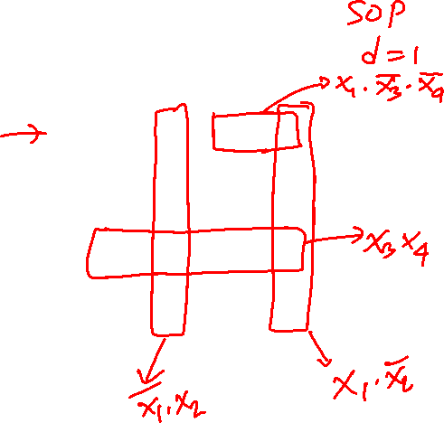
Example 5
Design the minimum-cost SOP and POS expression for the function
f(x₁, x₂, x₃, x₄) = Σ m(4, 6, 8, 10, 11, 12, 15) + D(3, 5, 7, 9)
0
1
1
1
0
d
0
d
d
d
1
1
0
1
0
1

Slide 43
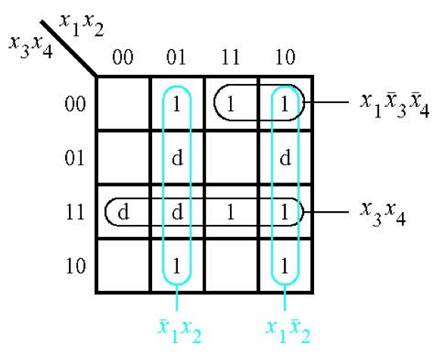
The SOP Expression
[ Figure 2.67a from the textbook ]

Slide 44
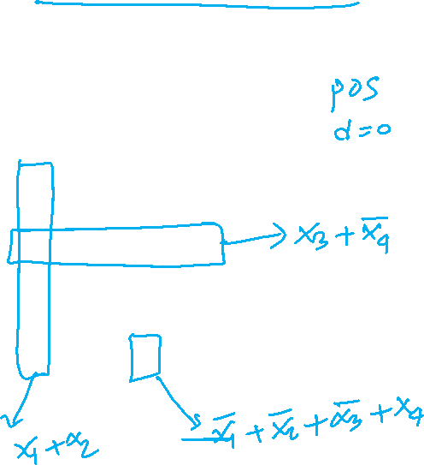
What about the POS Expression?
f(x₁, x₂, x₃, x₄) = Σ m(4, 6, 8, 10, 11, 12, 15) + D(3, 5, 7, 9)
0
1
1
1
0
d
0
d
d
d
1
1
0
1
0
1

Slide 45
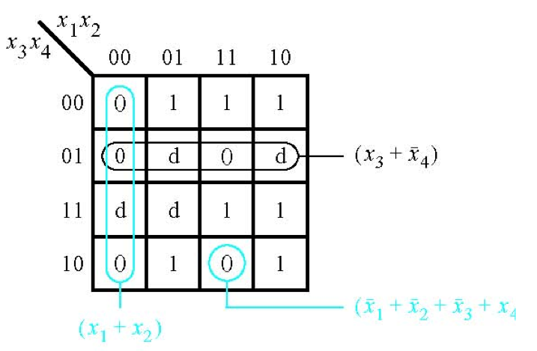
The POS Expression
[ Figure 2.67b from the textbook ]

Slide 46

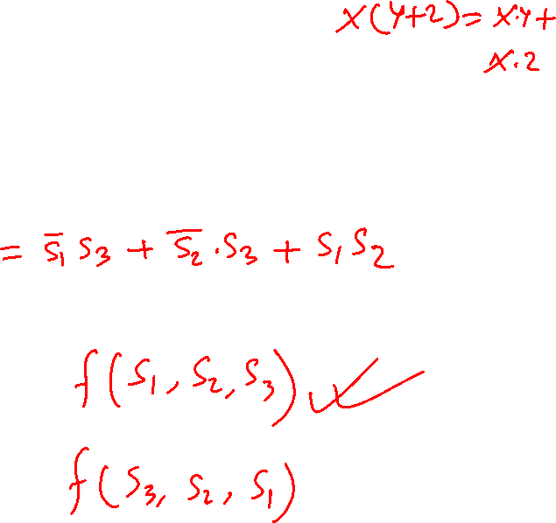
Example 6
Derive the minimum-cost SOP expression for

Slide 47

First, expand the expression using property 12a

Slide 48
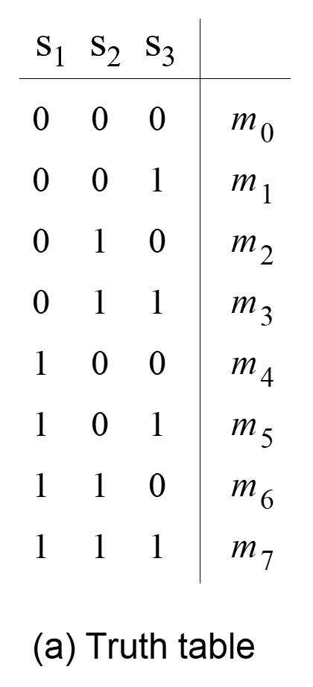

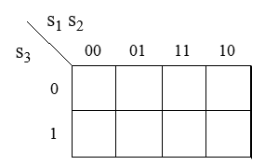
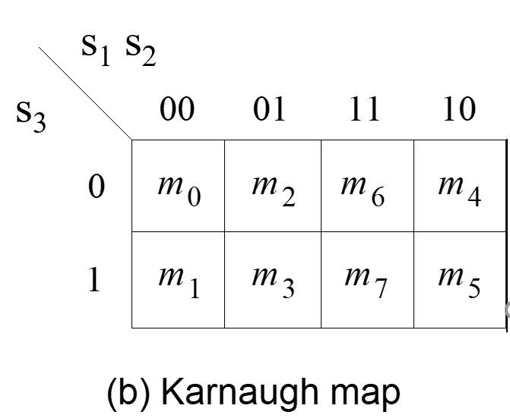
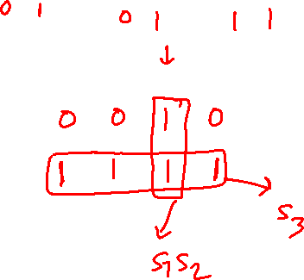
Construct the K-Map for this expression

Slide 49
Construct the K-Map for this expression
s₁ s₂ s₃
s₁ s₂
s₁ s₂
s₃
1
1
1
1
1
s₃
Simplified Expression: f = s₃ + s₁ s₂

Slide 50
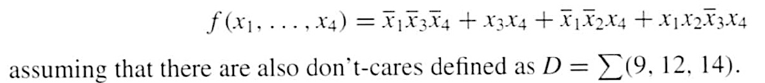
Example 7
Use K-maps to find the minimum-cost SOP and POS
expression for the function

Slide 51

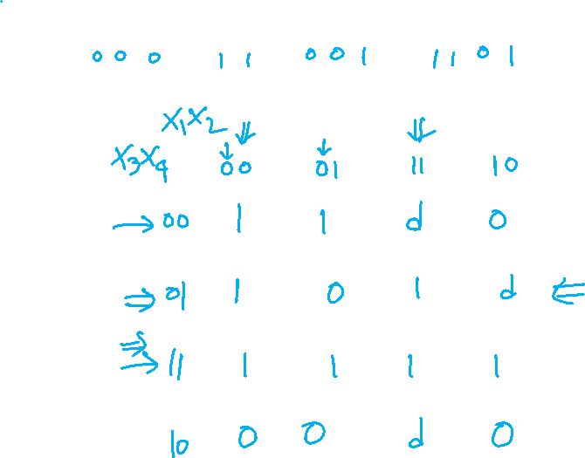
Let’s map the expression to the K-Map

Slide 52
Let’s map the expression to the K-Map
d
d
d

Slide 53

The SOP Expression
1
1
d
0
1
0
1
d
1
1
1
1
0
0
d
0

Slide 54
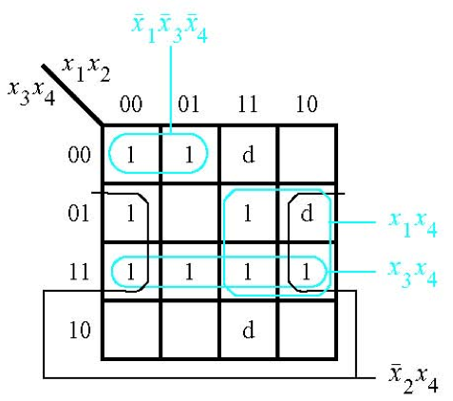


The SOP Expression
[ Figure 2.68a from the textbook ]

Slide 55
What about the POS Expression?
1
1
d
0
1
0
1
d
1
1
1
1
0
0
d
0

Slide 56
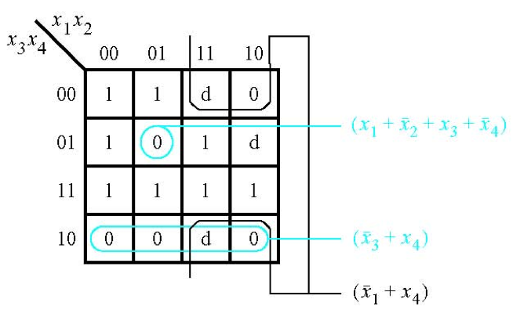

The POS Expression
[ Figure 2.68b from the textbook ]

Slide 57
Example 8
Write the Verilog code for the following circuit …

Slide 58
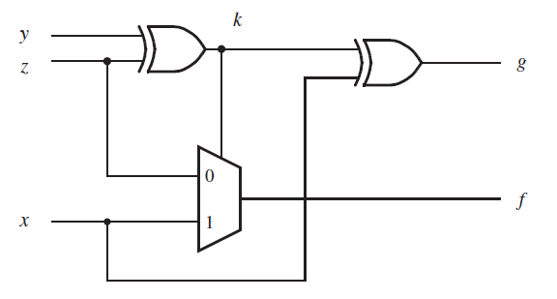
Logic Circuit
[ Figure 2.70 from the textbook ]

Slide 59

Logic Circuit
Circuit for 2-1 Multiplexer
x
1
s
f
x
1
0
f
s
x
2
1
x
2
(b) Circuit
(c) Graphical symbol
f (s, x_{1,} x₂) =
s x₁
+
s x₂
[ Figure 2.70 from the textbook ]

Slide 60
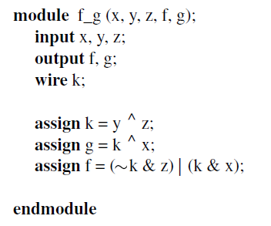
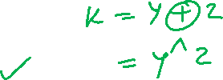
Logic Circuit vs Verilog Code
[ Figure 2.70 from the textbook ]
[ Figure 2.71 from the textbook ]

Slide 61
Example 9
Write the Verilog code for the following circuit …

Slide 62
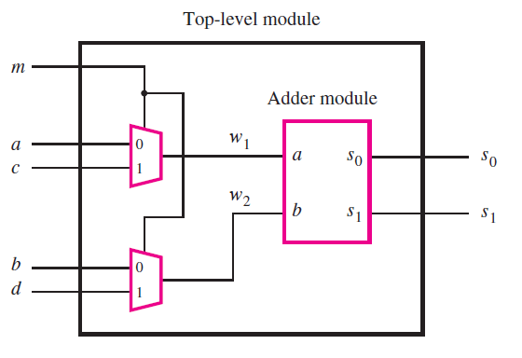
The Logic Circuit for this Example
[ Figure 2.72 from the textbook ]

Slide 63
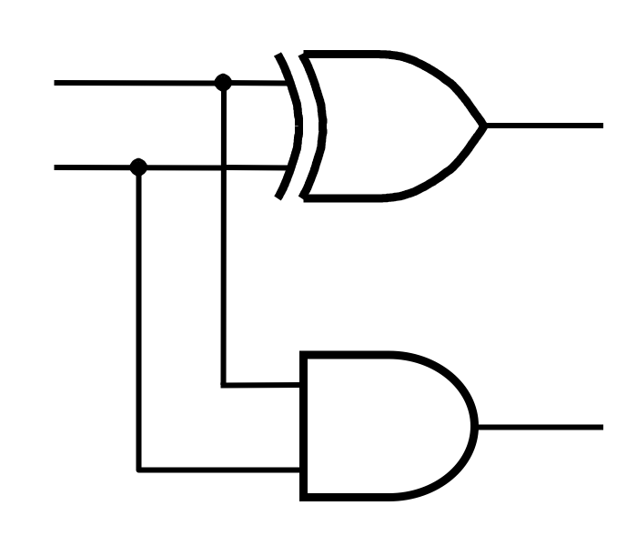
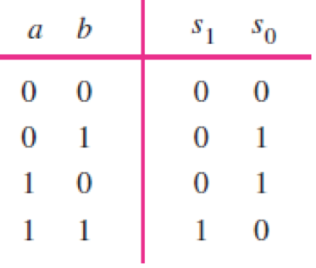
Addition of Binary Numbers

Slide 64

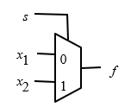
Logic Circuit vs Verilog Code
[ Figure 2.73 from the textbook ]

Slide 65
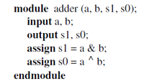
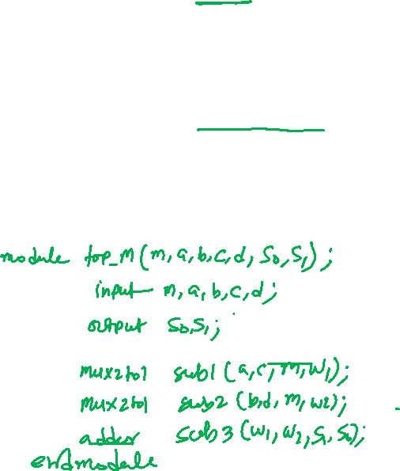
Logic Circuit vs Verilog Code
[ Figure 2.73 from the textbook ]

Slide 66
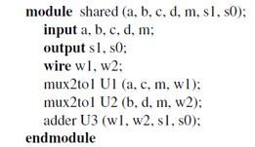
Logic Circuit vs Verilog Code
[ Figure 2.73 from the textbook ]

Slide 67
Lec 12: Test Q1

Slide 68

END Slide

