Slide 1
CPR E 281: Digital Logic
Md Maruf Ahamed
Office: 307 Durham Center
Phone: (515) 294-6323
Email: maruf@iastate.edu

Slide 2
Administrative Stuff
  Homework: HW#5 due on Sunday @ 11:59 PM
  Quiz: Quiz #5 due on Friday @ 4:25 PM
  Recitation:
  Lab:
  Mini project this week
    Submit pre-lab prior to the lab otherwise you will lose 20% points
  Lecture-18 Readings: Section 3.6

Slide 3
18–Multiplexers
  Floating-Point Numbers Representation
  Conversion of fractions from decimal to binary.
  Storing Floating-Point Numbers
  Multiplexers
  Building basic logic gates with Multiplexers
  Implementation of logic functions using Multiplexers
  Multiplexers Synthesis Using Shannon’s Expansion

Slide 4
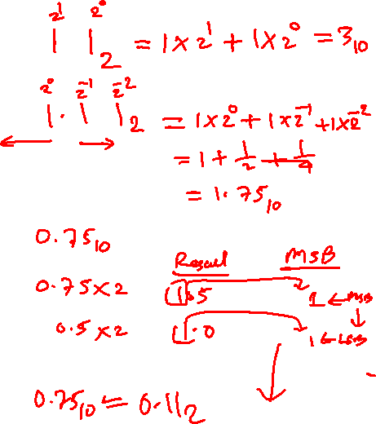
Conversion of fractions from binary to decimal.

Slide 5
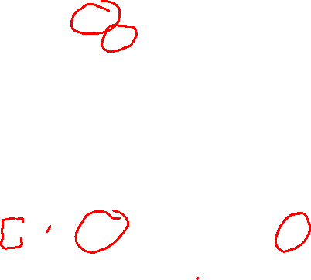

Float (32-bit) vs. Double (64-bit)
32 bits
S
E
M
Sign
0 denotes
+
8-bit
23 bits of mantissa
1 denotes
–
excess-127
exponent
(a) Single precision
64 bits
S
E
M
Sign
11-bit excess-1023
52 bits of mantissa
exponent
(b) Double precision
[Figure 3.37 from the textbook]

Slide 6
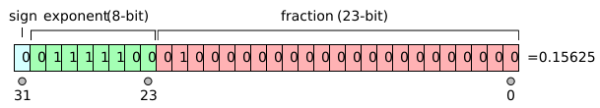
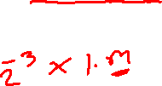
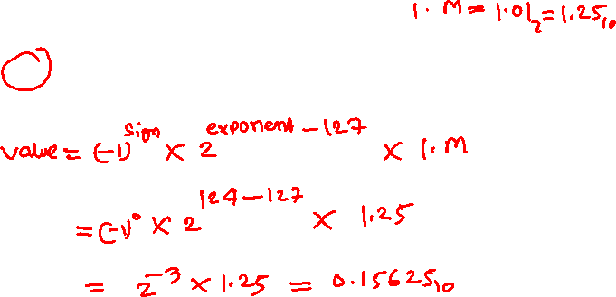
[http://en.wikipedia.org/wiki/IEEE_754]

Slide 7
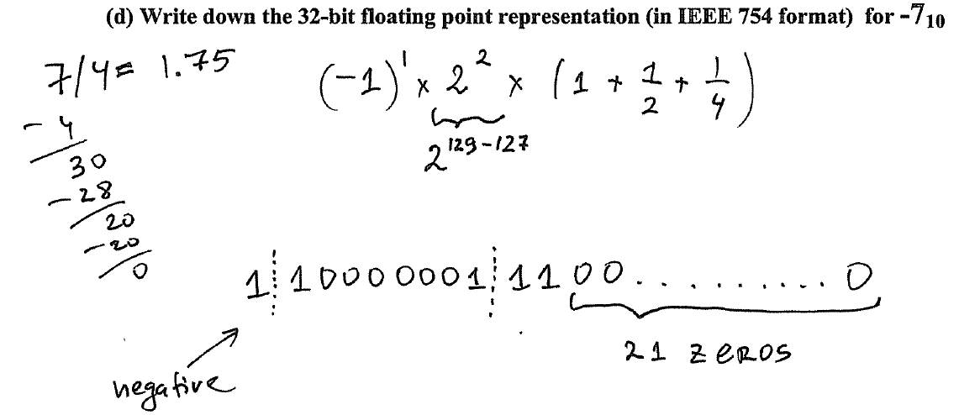
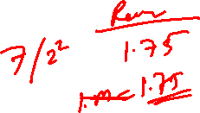

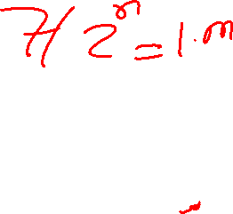
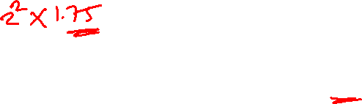
Sample Midterm2 Problem

Slide 8
Multiplexers
Reading 4.1

Slide 9

2-1 Multiplexer (Definition)
Has two inputs: x₁ and x₂
Also has another input line s
If s=0, then the output is equal to x₁
If s=1, then the output is equal to x₂
s
x
0
1
f
x
1
2

Slide 10
More Compact Truth-Table Representation
s
x₁
x₂
f (s, x₁, x₂)
s
f (s, x₁, x₂)
0
0
0
0
0
0
1
0
0
x₁
0
1
0
1
1
x₂
0
1
1
1
1
0
0
0
1
0
1
1
f (s, x_{1,} x₂) =
s x₁
+
s x₂
1
1
0
0
1
1
1
1
(a)
Truth
table
x
1
s
f
x
1
0
f
s
x
2
1
x
2
(b) Circuit
(c) Graphical symbol
[ Figure 2.33 from the textbook ]

Slide 11
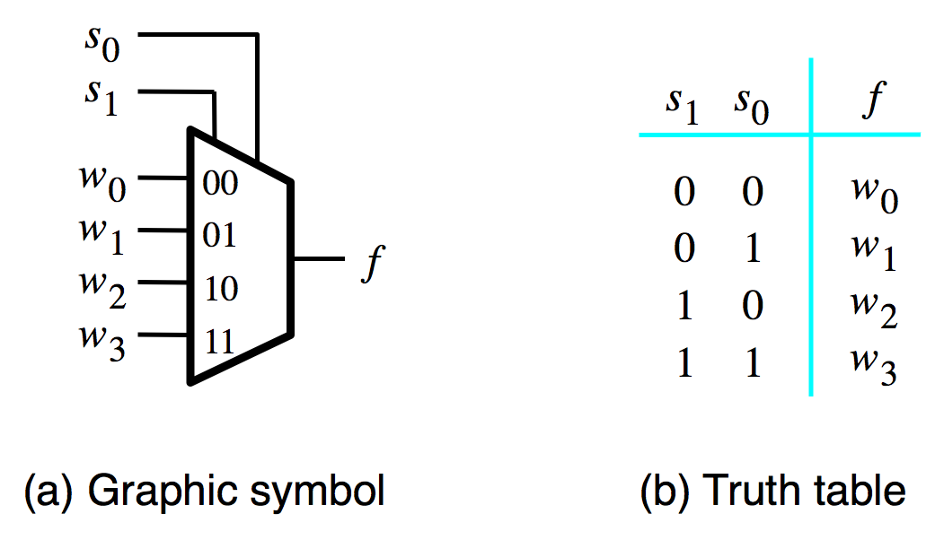
4-1 Multiplexer: Graphical Symbol and Truth Table
[ Figure 4.2a-b from the textbook ]

Slide 12
Multiplexers Are Special

Slide 13
The Three Basic Logic Gates
x
x
x
x
1
x
x
1
x
+
x
x
1
2
x
1
2
2
2
NOT gate
AND gate
OR gate
[ Figure 2.8 from the textbook ]

Slide 14
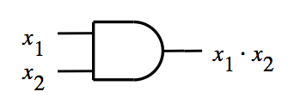
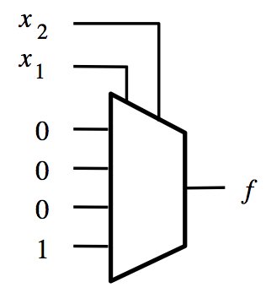
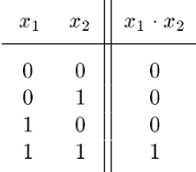
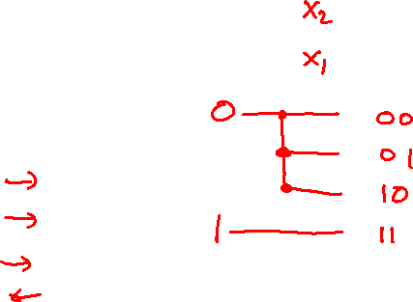
Building an AND Gate with 4-to-1 Mux

Slide 15
Building an AND Gate with 4-to-1 Mux
These two are the same.

Slide 16
Building an AND Gate with 4-to-1 Mux
These two are the same.
And so are these two.

Slide 17
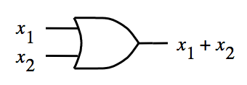
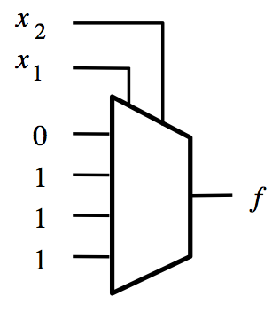
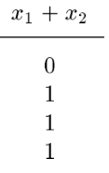
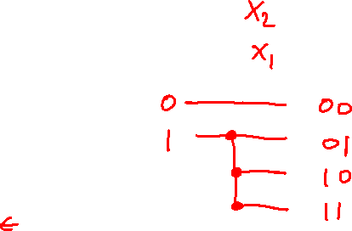
Building an OR Gate with 4-to-1 Mux

Slide 18
Building an OR Gate with 4-to-1 Mux
These two are the same.

Slide 19
Building an OR Gate with 4-to-1 Mux
These two are the same.
And so are these two.

Slide 20
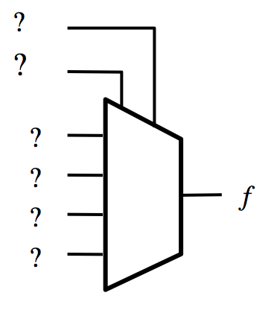
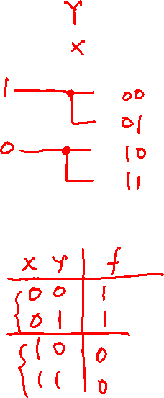
Building a NOT Gate with 4-to-1 Mux
x
x
x
x
0
1
1
0

Slide 21
Building a NOT Gate with 4-to-1 Mux
x
x
x | y | f
0 | 0 | 1
0 | 1 | 1
1 | 0 | 0
1 | 1 | 0
Introduce a dummy variable y.

Slide 22
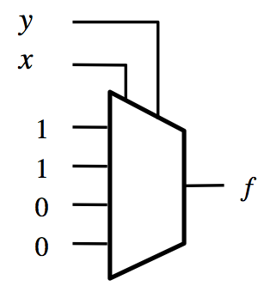
Building a NOT Gate with 4-to-1 Mux
x
x
x | y | f
0 | 0 | 1
0 | 1 | 1
1 | 0 | 0
1 | 1 | 0
Now set y to either 0 or 1 (both will work). Why?

Slide 23
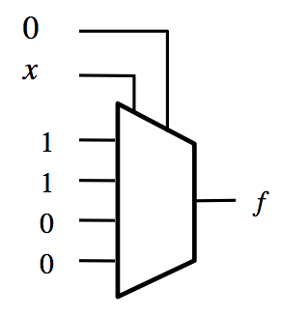
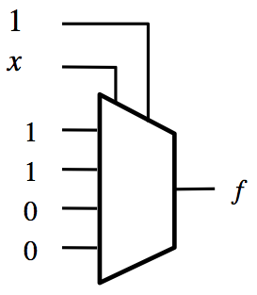
Building a NOT Gate with 4-to-1 Mux
x
x
x
x
x | y | f
0 | 0 | 1
0 | 1 | 1
1 | 0 | 0
1 | 1 | 0
0
1
1
0
Two alternative solutions.

Slide 24
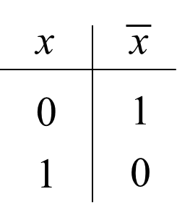
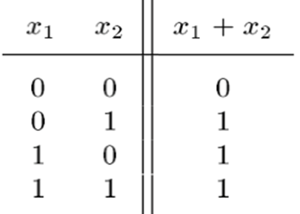
Implement Basic Logic Gates with 4-to-1 MUX
x
x
x
x
1
x
x
1
x
+
x
x
1
2
x
1
2
2
2
NOT gate
AND gate
OR gate

Slide 25
Implications
Any Boolean function can be implemented
using only 4-to-1 multiplexers!

Slide 26
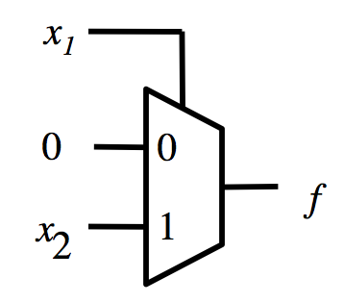
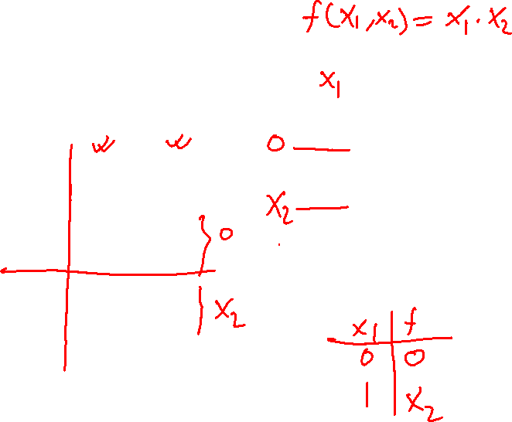
Building an AND Gate with 2-to-1 Mux

Slide 27
Building an AND Gate with 2-to-1 Mux

Slide 28
Building an AND Gate with 2-to-1 Mux
0
x₂

Slide 29
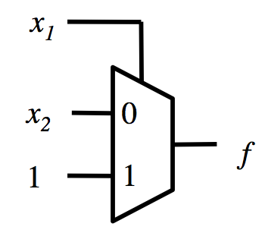
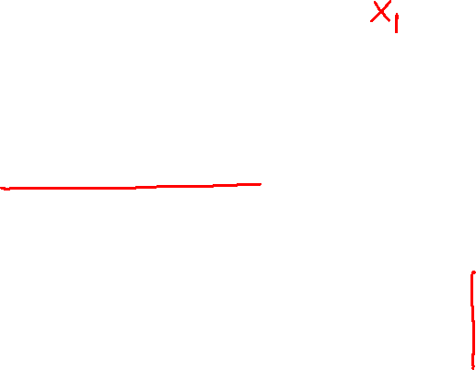
Building an OR Gate with 2-to-1 Mux

Slide 30
Building an OR Gate with 2-to-1 Mux

Slide 31
Building an OR Gate with 2-to-1 Mux
x₂
1

Slide 32
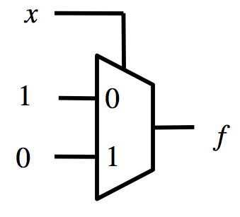
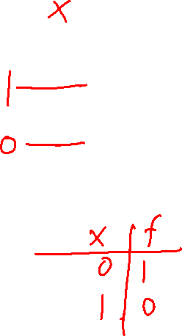
Building a NOT Gate with 2-to-1 Mux
x
x
x
x
0
1
1
0

Slide 33
Building a NOT Gate with 2-to-1 Mux
x
x
x
x
0
1
1
0

Slide 34
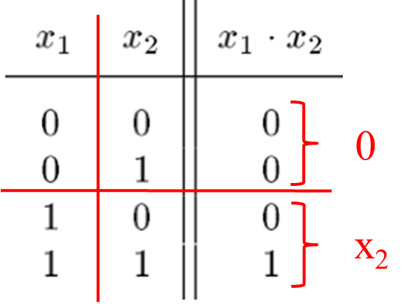
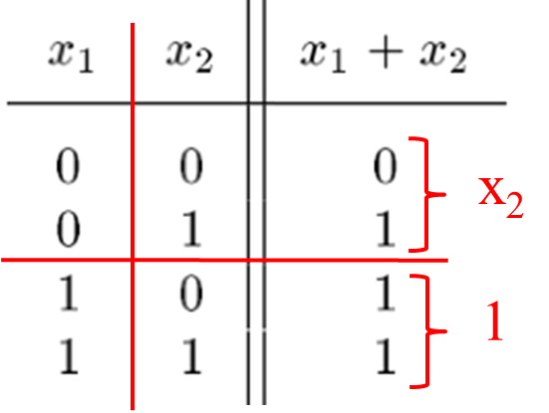
Implement Basic Logic Gates with 2-to-1 MUX
x
x
x
x
1
x
x
1
x
+
x
x
1
2
x
1
2
2
2
NOT gate
AND gate
OR gate
x
x
0
1
1
0
x
1
0
f
0
1

Slide 35
Implications
Any Boolean function can be implemented
using only 2-to-1 multiplexers!

Slide 36
Synthesis of Logic Circuits
Using Multiplexers

Slide 37
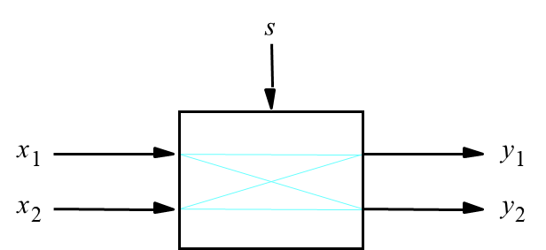
2 x 2 Crossbar switch
[ Figure 4.5a from the textbook ]

Slide 38
2 x 2 Crossbar switch
s=0
x
1
y
1
x
2
y
2
s=1
x
1
y
1
x
2
y
2

Slide 39
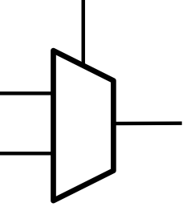
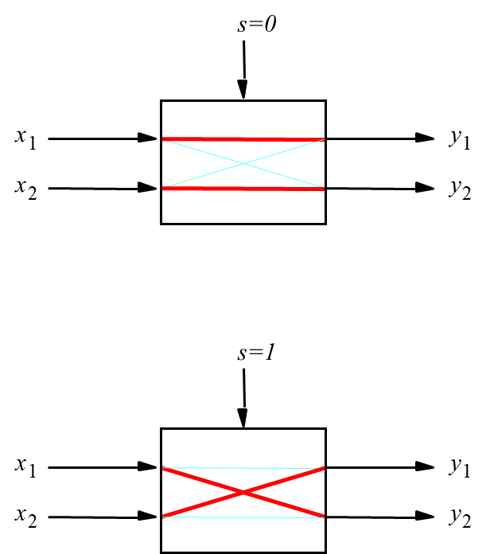
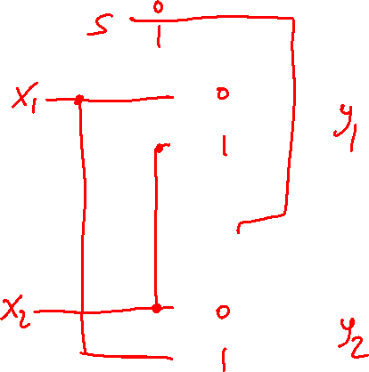
Implementation of a 2 x 2 crossbar switch with multiplexers
[ Figure 4.5b from the textbook ]

Slide 40
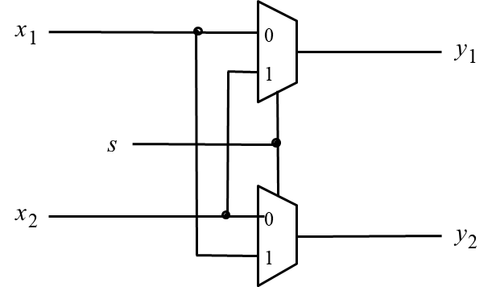
Implementation of a 2 x 2 crossbar switch with multiplexers
[ Figure 4.5b from the textbook ]

Slide 41
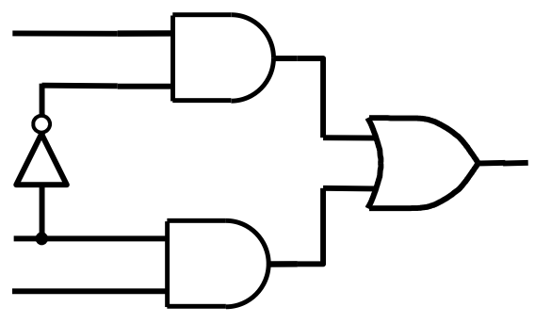
Implementation of a 2 x 2 crossbar switch with multiplexers

Slide 42
Implementation of a 2 x 2 crossbar switch with multiplexers
x₁
y₁
s
x₂
y₂

Slide 43
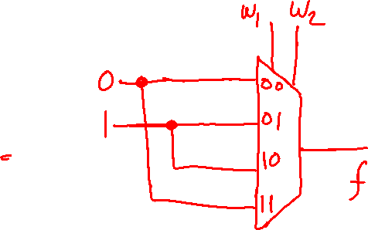
Implementation of a logic function with a 4x1 multiplexer
w
1
w
2
f
0
0
0
0
1
1
1
0
1
1
1
0
[ Figure 4.6a from the textbook ]

Slide 44
Implementation of a logic function with a 4x1 multiplexer
w
1
w
2
f
0
0
0
0
1
1
f
1
0
1
1
1
0
[ Figure 4.6a from the textbook ]

Slide 45
Implementation of a logic function with a 4x1 multiplexer
w
w
f
w
2
1
2
w
1
0
0
0
0
0
1
1
1
1
0
1
1
f
1
1
0
0
[ Figure 4.6a from the textbook ]

Slide 46
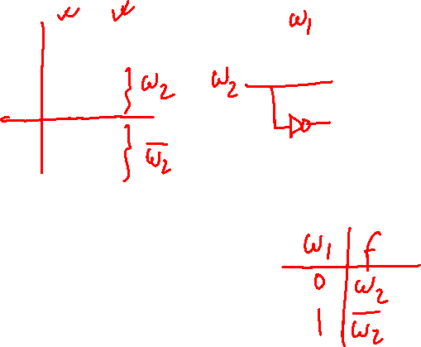
Implementation of a logic function with a 2x1 multiplexer
w
1
w
2
f
0
0
0
0
1
1
1
0
1
1
1
0
[ Figure 4.6a from the textbook ]

Slide 47
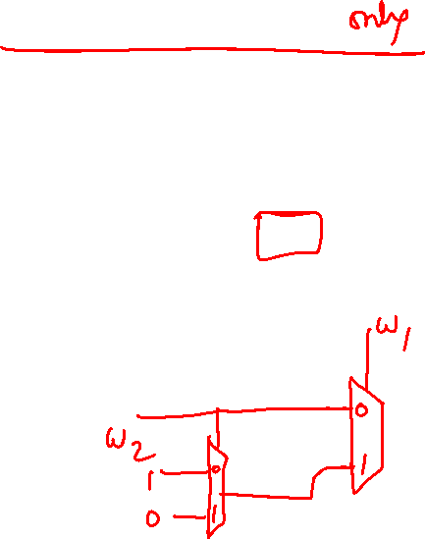
Implementation of the same logic function with a 2x1 multiplexer
w
1
w
2
f
w
f
1
w
0
0
0
w
1
0
2
0
1
1
w
w
1
2
2
1
0
1
f
1
1
0
(b) Modified truth table
(c) Circuit
[ Figure 4.6b-c from the textbook ]

Slide 48
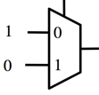
Implementation of the same logic function with a 2x1 multiplexer only
w
w
f
w
1
1
2
w
1
f
0
0
0
w
w
2
0
2
f
0
1
1
w
1
2
1
0
1
1
1
0
(b) Modified truth table
(c) Circuit
[ Figure 4.6b-c from the textbook ]

Slide 49
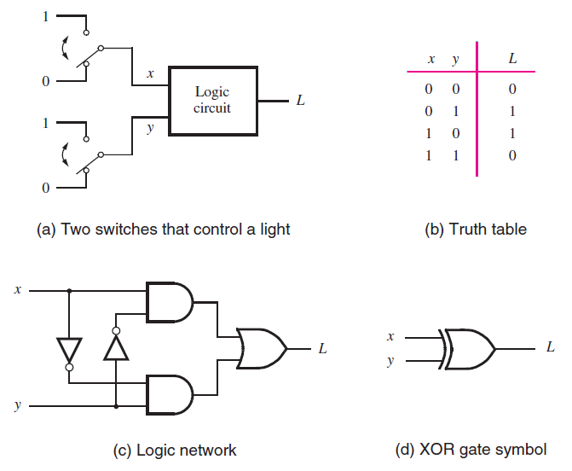
The XOR Logic Gate
[ Figure 2.11 from the textbook ]

Slide 50

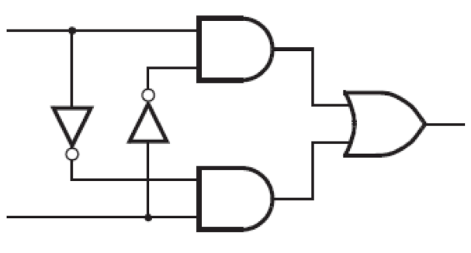
Implementation of the XOR Logic Gate with a 2-to-1 multiplexer and one NOT Gate
x
f
y
These two circuits are equivalent
(the wires of the bottom AND gate are flipped)

Slide 51

In other words,
all five of these are equivalent!
x
y
x
f
f
y
w
1
w
2
x
f
y
f
w
2
w
1
0
1
f
1
0

Slide 52
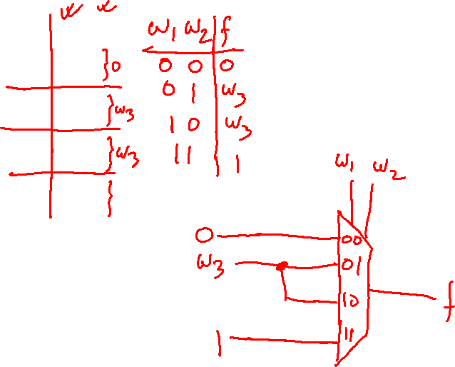
Example: Implement f using only a minimal number of 4-to-1 MUX and no other gates (NOT gates are not allowed, either).
w
1
w
2
w
3
f
0
0
0
0
0
0
1
0
0
1
0
0
0
1
1
1
1
0
0
0
1
0
1
1
1
1
0
1
1
1
1
1
[ Figure 4.7 from the textbook ]

Slide 53
Example: Implement f using only a minimal number of 4-to-1 MUX and no other gates (NOT gates are not allowed, either).
w
1
w
2
w
3
f
w
w
f
1
2
0
0
0
0
0
0
1
0
0
1
0
0
f
0
1
1
1
1
0
0
0
1
0
1
1
1
1
0
1
1
1
1
1
[ Figure 4.7 from the textbook ]

Slide 54
Example: Implement f using only a minimal number of 4-to-1 MUX and no other gates (NOT gates are not allowed, either).
w
1
w
2
w
3
f
w
1
w
2
f
0
0
0
0
0
0
0
1
0
0
0
0
1
w
3
0
1
0
0
1
0
w
3
0
1
1
1
1
1
1
1
0
0
0
1
0
1
1
1
1
0
1
1
1
1
1
[ Figure 4.7 from the textbook ]

Slide 55
Example: Implement f using only a minimal number of 4-to-1 MUX and no other gates (NOT gates are not allowed, either).
w
1
w
2
w
3
f
w
2
w
1
w
2
f
w
0
0
0
0
1
0
0
0
0
0
0
1
0
0
1
w
w
3
3
f
0
1
0
0
1
0
w
3
0
1
1
1
1
1
1
1
1
0
0
0
1
0
1
1
1
1
0
1
1
1
1
1
[ Figure 4.7 from the textbook ]

Slide 56
Another Example
(3-input XOR)

Slide 57
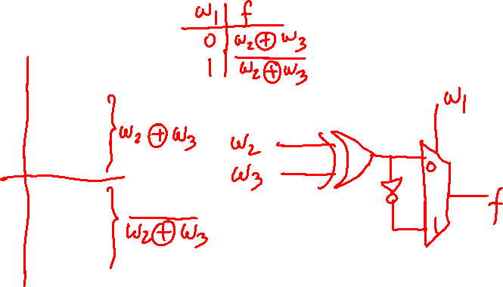
Implementation of 3-input XOR with 2-to-1 Multiplexers
w
1
w
2
w
3
f
0
0
0
0
0
0
1
1
0
1
0
1
0
1
1
0
1
0
0
1
1
0
1
0
1
1
0
0
1
1
1
1
[ Figure 4.8a from the textbook ]

Slide 58
Implementation of 3-input XOR with 2-to-1 Multiplexers
w
1
w
2
w
3
f
0
0
0
0
0
0
1
1
0
1
0
1
0
1
1
0
1
0
0
1
1
0
1
0
1
1
0
0
1
1
1
1
[ Figure 4.8a from the textbook ]

Slide 59
Implementation of 3-input XOR with 2-to-1 Multiplexers
w
w
w
f
1
2
3
0
0
0
0
0
0
1
1
w
⊕
w
0
1
0
1
2
3
0
1
1
0
1
0
0
1
1
0
1
0
w
⊕
w
1
1
0
0
2
3
1
1
1
1
[ Figure 4.8a from the textbook ]

Slide 60
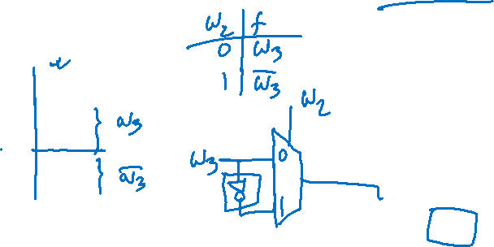
Implementation of 3-input XOR with 2-to-1 Multiplexers only
w
w
w
f
1
2
3
0
0
0
0
0
0
1
1
w
⊕
w
0
1
0
1
2
3
w
1
0
1
1
0
w
⊕
w
1
0
0
1
2
3
f
1
0
1
0
w
⊕
w
1
1
0
0
2
3
1
1
1
1
(a) Truth table
(b) Circuit
[ Figure 4.8 from the textbook ]

Slide 61
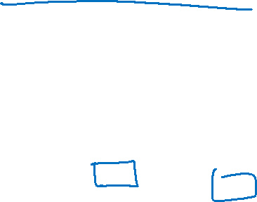
Implementation of 3-input XOR with 2-to-1 Multiplexers only
w
w
w
f
1
2
3
0
0
0
0
w₃
0
0
1
1
w
0
1
0
1
w₃
2
w
1
0
1
1
0
w
3
1
0
0
1
f
1
0
1
0
1
1
0
0
1
1
1
1
(a) Truth table
(b) Circuit
[ Figure 4.8 from the textbook ]

Slide 62
Implementation of 3-input XOR with 2-to-1 Multiplexers only
w
w
w
w
f
2
w
1
2
3
1
w
0
0
0
0
w₃
3
0
0
1
1
f
0
1
0
1
w₃
0
1
1
0
1
0
0
1
1
0
1
0
1
1
0
0
(b) Circuit
1
1
1
1
(a) Truth table
[ Figure 4.8 from the textbook ]

Slide 63
Implementation of 3-input XOR
with a 4-to-1 Multiplexer
w
1
w
2
w
3
f
0
0
0
0
0
0
1
1
0
1
0
1
0
1
1
0
1
0
0
1
1
0
1
0
1
1
0
0
1
1
1
1
[ Figure 4.9a from the textbook ]

Slide 64
Implementation of 3-input XOR
with a 4-to-1 Multiplexer
w
1
w
2
w
3
f
w
w
f
1
2
0
0
0
0
0
0
1
1
0
1
0
1
0
1
1
0
f
1
0
0
1
1
0
1
0
1
1
0
0
1
1
1
1
[ Figure 4.9a from the textbook ]

Slide 65
Implementation of 3-input XOR
with a 4-to-1 Multiplexer
w
1
w
2
w
3
f
0
0
0
0
w
0
0
1
1
3
0
1
0
1
w
0
1
1
0
3
1
0
0
1
w
1
0
1
0
3
1
1
0
0
w
1
1
1
1
3
[ Figure 4.9a from the textbook ]

Slide 66
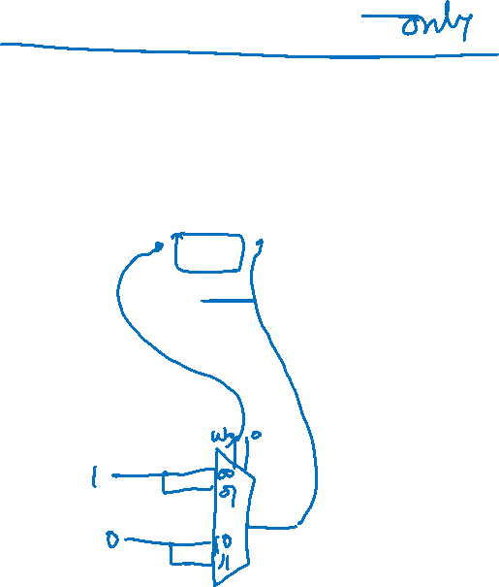
Implementation of 3-input XOR
with a 4-to-1 Multiplexer
w
1
w
2
w
3
f
0
0
0
0
w
0
0
1
1
3
w
2
w
1
0
1
0
1
w
0
1
1
0
3
w
3
1
0
0
1
w
f
1
0
1
0
3
1
1
0
0
w
1
1
1
1
3
(a) Truth table
(b) Circuit
[ Figure 4.9 from the textbook ]

Slide 67
Multiplexer Synthesis
Using Shannon’s Expansion

Slide 68
Three-input majority function
w
1
w
2
w
3
f
0
0
0
0
0
0
1
0
0
1
0
0
0
1
1
1
1
0
0
0
1
0
1
1
1
1
0
1
1
1
1
1
[ Figure 4.10a from the textbook ]

Slide 69
Three-input majority function
w
1
w
2
w
3
f
0
0
0
0
w
1
f
0
0
1
0
0
0
1
0
0
1
0
1
1
1
1
0
0
0
1
0
1
1
1
1
0
1
1
1
1
1
[ Figure 4.10a from the textbook ]

Slide 70
Three-input majority function
w
1
w
2
w
3
f
0
0
0
0
w
1
f
0
0
1
0
w
w
0
2
3
0
1
0
0
1
w
+
w
0
1
1
1
2
3
1
0
0
0
1
0
1
1
1
1
0
1
1
1
1
1
(b) Truth table
[ Figure 4.10a from the textbook ]

Slide 71

Three-input majority function
w
1
w
2
w
3
f
0
0
0
0
w
1
f
0
0
1
0
w
w
0
2
3
0
1
0
0
1
w
+
w
0
1
1
1
2
3
1
0
0
0
1
0
1
1
1
1
0
1
1
1
1
1
(b) Truth table
w
w
1
2
w
3
f
(b) Circuit
[ Figure 4.10a from the textbook ]

Slide 72



Three-input majority function
w
w
1
2
w
3
f
Multiplexer implementations of logic functions require that a given function be decomposed in terms of the variables that are used as the select inputs. This can be accomplished by means of a theorem proposed by Claude Shannon

Slide 73


Shannon’s Expansion Theorem
Any Boolean function can be rewritten in the form:

Slide 74

Shannon’s Expansion Theorem
Any Boolean function can be rewritten in the form:
cofactor
cofactor

Slide 75

Shannon’s Expansion Theorem (Example)

Slide 76


Shannon’s Expansion Theorem (Example)

Slide 77

Shannon’s Expansion Theorem (Example)

Slide 78
Shannon’s Expansion Theorem (Example)
w
w
1
2
w
3
f

Slide 79

Example: Implement f using only a minimal number of 2-to-1 MUX and no other gates (NOT gates are not allowed, either)
w
w
1
2
w
3
f

Slide 80

Shannon’s Expansion Theorem
(In terms of more than one variable)
This form is suitable for implementation with a 4x1 multiplexer.

Slide 81
Another Example

Slide 82

Lecture 17: Test Q1
Factor and implement the following function with a 2x1 multiplexer

Slide 83
Factor and implement the following function with a 2x1 multiplexer

Slide 84

Factor and implement the following function with a 2x1 multiplexer

Slide 85

Factor and implement the following function with a 2x1 multiplexer
f
w
[ Figure 4.11a from the textbook ]

Slide 86
Example: Implement f using only a minimal number of 2-to-1 MUX and no other gates (NOT gates are not allowed, either)
f
w
[ Figure 4.11a from the textbook ]

Slide 87
Factor and implement the following function with a 4x1 multiplexer

Slide 88
Factor and implement the following function with a 4x1 multiplexer

Slide 89


Factor and implement the following function with a 4x1 multiplexer
[ Figure 4.11b from the textbook ]

Slide 90
Yet Another Example

Slide 91
Example 1: Implement f using only a minimal number of 2-to-1 MUX and no other gates (NOT gates are not allowed, either)

Slide 92

Example 1: Implement f using only a minimal number of 2-to-1 MUX and no other gates (NOT gates are not allowed, either)

Slide 93
Example 1: Implement f using only a minimal number of 2-to-1 MUX and no other gates (NOT gates are not allowed, either)

Slide 94

Example 1: Implement f using only a minimal number of 2-to-1 MUX and no other gates (NOT gates are not allowed, either)

Slide 95
Example 1: Implement f using only a minimal number of 2-to-1 MUX and no other gates (NOT gates are not allowed, either)

Slide 96
Example 1: Implement f using only a minimal number of 2-to-1 MUX and no other gates (NOT gates are not allowed, either)

Slide 97
Example 2: Implement f using only a minimal number of 4-to-1 MUX and no other gates (NOT gates are not allowed, either)

Slide 98
Example 2: Implement f using only a minimal number of 4-to-1 MUX and no other gates (NOT gates are not allowed, either)

Slide 99
Example 2: Implement f using only a minimal number of 4-to-1 MUX and no other gates (NOT gates are not allowed, either)

Slide 100



Example 2: Implement f using only a minimal number of 4-to-1 MUX and no other gates (NOT gates are not allowed, either)

Slide 101

END Slide

