Slide 1
CPR E 281: Digital Logic
Md Maruf Ahamed
Office: 307 Durham Center
Phone: (515) 294-6323
Email: maruf@iastate.edu

Slide 2
24-Registers
  Register
  Parallel-Access Register
  Shift Register
  Parallel-Access Shift Register
  A shift register with parallel load and enable control inputs
  Parallel-access shift left/right register
  Design a Register File with four 2-bit Register.

Slide 3
Administrative Stuff
  Homework: HW#7 due on Sunday @ 11:59 PM
  Quiz: Quiz #8 due on Friday @ 4:25 PM
  Recitation: Recitation 8 next week
  Lab: Lab 8 next week
  Lecture-25 Readings: 5.9 and 5.10
  Midterm 2: Friday, April 1st @4:25 PM

Slide 4
Midterm 2: Bonus
Complete the Midterm 2 bonus activity by April 1 at 4:00 PM
  You might get up-to 5 points as a bonus which will be added to your Midterm 2 exam score to make it 100%.

Slide 5
Midterm 2: Format
Midterm 2 will be closed book and closed notes. But you are allowed to use 2 pages cheat-sheet (double sided-printed or handwritten)
The exam will be out of 130 points
You need 100/130 points to get 100% on this exam
It will be great if you can score more than 100 points.
  but you can’t roll over your extra points ☹

Slide 6
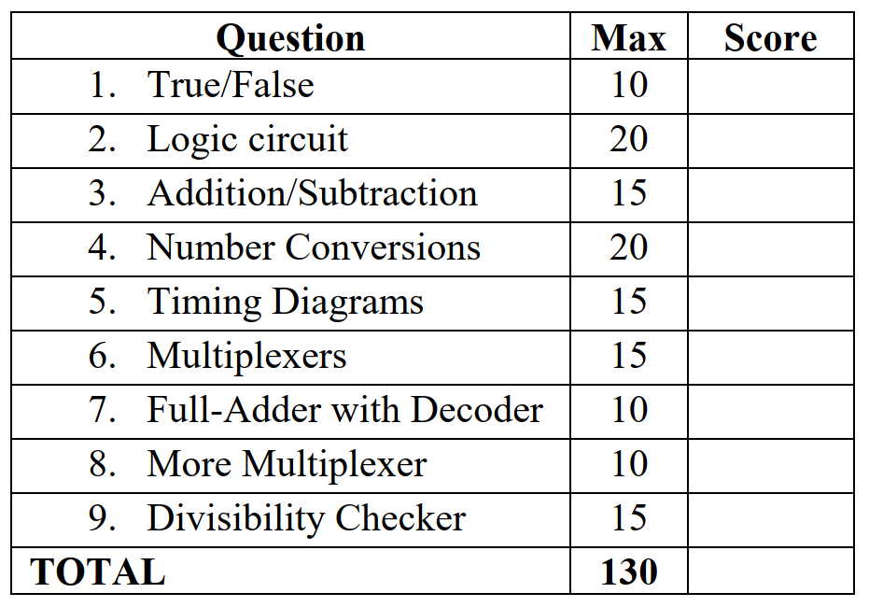
Midterm 2- sample outlines

Slide 7
Midterm 2: Syllabus
Syllabus:
Lectures: Lec 13 - Lec 26
Quiz: Quiz #4 - Quiz #8
Homework: HW #05 - HW #08
Recitation: Recitation #04 - 08

Slide 8

Midterm 2: Topics
Binary Numbers and Hexadecimal Numbers
1’s complement and 2’s complement representation
Addition and subtraction of binary numbers
Circuits for adders and fast adders
Single and Double precision IEEE floating point formats
Converting a real number to the IEEE format
Converting a floating point number to base 10
Multiplexers (circuits and function)
Synthesis of logic functions using multiplexers
Shannon’s Expansion Theorem

Slide 9
Midterm 2: Topics cont.
Decoders (circuits and function)
Demultiplexers
Encoders (binary and priority)
Code Converters
K-maps for 2, 3, and 4 variables
Synthesis of logic circuits using adders, multiplexers, encoders, decoders, and basic logic gates
Synthesis of logic circuits given constraints on the available building blocks that you can use
Latches (circuits, behavior, timing diagrams)
Flip-Flops (circuits, behavior, timing diagrams)
Registers and Register Files
Counters

Slide 10
Registers
Readings 5.8

Slide 11
Register (Definition)
A flip-flop stores one bit of information.
When a set of n flip-flops is used to store n bits of information, such as an n-bit number, we refer to these flip-flops as a register.

Slide 12
Parallel-Access Register

Slide 13
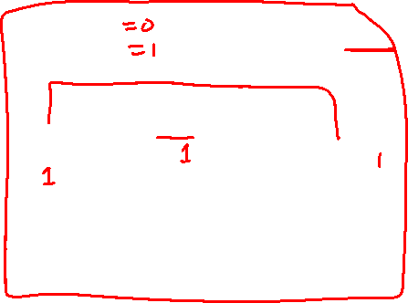
1-Bit Parallel-Access Register
Load
0
D
Q
Out
In
1
Q
Clock

Slide 14
1-Bit Parallel-Access Register
Load
0
D
Q
Out
In
1
Q
Clock
The 2-to-1 multiplexer is used to select whether to load a new value into the D flip-flop or to retain the old value.
The output of this circuit is the Q output of the flip-flop.

Slide 15
1-Bit Parallel-Access Register
Load
0
0
D
Q
Out
In
1
Q
Clock
If Load = 0, then retain the old value.

Slide 16
1-Bit Parallel-Access Register
Load
1
0
D
Q
Out
In
1
Q
Clock
If Load = 1, then load the new value from In.

Slide 17
1-Bit Parallel-Access Register
Load
0
D
Q
Out
In
1
Q
Clock
If Load = 0, then retain the old value.
If Load = 1, then load the new value from In.

Slide 18
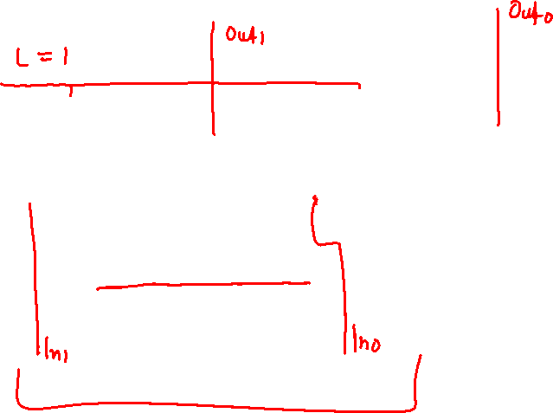
2-Bit Parallel-Access Register
Load
Load
0
0
D
Q
Out
D
Q
Out
In
1
In
1
Q
Q
Clock
Clock

Slide 19
2-Bit Parallel-Access Register
Out_1
Out_0
Load
0
0
D
Q
D
Q
1
1
Q
Q
Clock
In_1
In_0

Slide 20
2-Bit Parallel-Access Register
Parallel Output
Out_1
Out_0
Load
0
0
D
Q
D
Q
1
1
Q
Q
Clock
In_1
In_0
Parallel Input

Slide 21
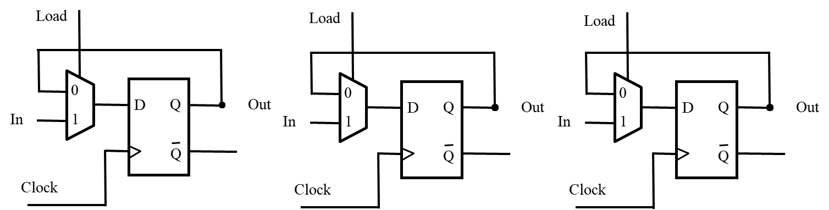
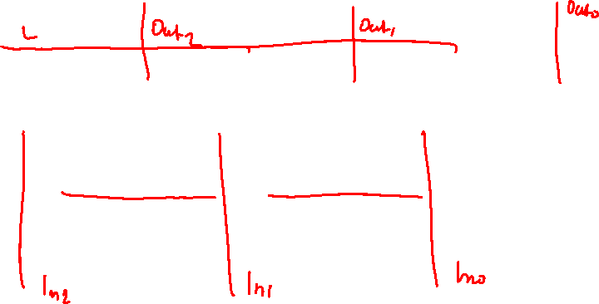
3-Bit Parallel-Access Register
Notice that all flip-flops are on the same clock cycle.

Slide 22
3-Bit Parallel-Access Register
Out_2
Out_1
Out_0
Load
0
0
0
D
Q
D
Q
D
Q
1
1
1
Q
Q
Q
Clock
In_2
In_1
In_0
Notice that all flip-flops are on the same clock cycle.

Slide 23
3-Bit Parallel-Access Register
Parallel Output
Out_2
Out_1
Out_0
Load
0
0
0
D
Q
D
Q
D
Q
1
1
1
Q
Q
Q
Clock
In_2
In_1
In_0
Parallel Input

Slide 24
4-Bit Parallel-Access Register
Out_3
Out_2
Out_1
Out_0
Load
0
0
0
0
D
Q
D
Q
D
Q
D
Q
1
1
1
1
Q
Q
Q
Q
Clock
In_3
In_2
In_1
In_0

Slide 25
4-Bit Parallel-Access Register
Parallel Output
Out_3
Out_2
Out_1
Out_0
Load
0
0
0
0
D
Q
D
Q
D
Q
D
Q
1
1
1
1
Q
Q
Q
Q
Clock
In_3
In_2
In_1
In_0
Parallel Input

Slide 26
4-Bit Parallel-Access Register
Out_3
Out_2
Out_1
Out_0
Load
0
0
0
0
D
Q
D
Q
D
Q
D
Q
1
1
1
1
Q
Q
Q
Q
Clock
In_3
In_2
In_1
In_0

Slide 27
4-Bit Parallel-Access Register
Out_3
Out_2
Out_1
Out_0
0
Load
0
0
0
0
D
Q
D
Q
D
Q
D
Q
1
1
1
1
Q
Q
Q
Q
Clock
In_3
In_2
In_1
In_0

Slide 28
4-Bit Parallel-Access Register
Out_3
Out_2
Out_1
Out_0
1
Load
0
0
0
0
D
Q
D
Q
D
Q
D
Q
1
1
1
1
Q
Q
Q
Q
Clock
In_3
In_2
In_1
In_0

Slide 29
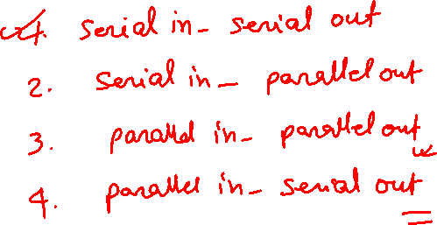
Shift Register

Slide 30
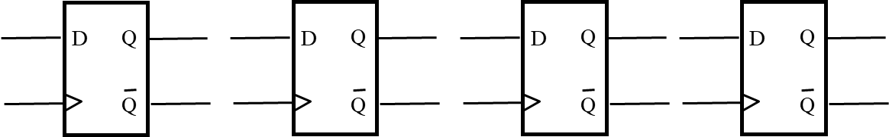
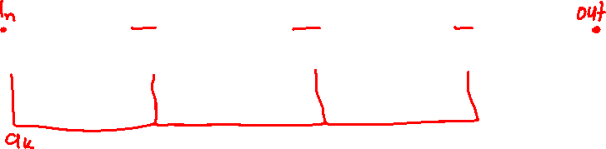
A simple shift register: Serial-in-Serial-out
[ Figure 5.17a from the textbook ]

Slide 31
A simple shift register
Q
Q
Q
Q
In
D
Q
1
D
Q
2
D
Q
3
D
Q
4
Out
Clock
Q
Q
Q
Q
Figure 5.17a shows a four-bit shift register that is used to shift its contents one bit-position to the right.
The data bits are loaded into the shift register in a serial fashion using the In input.
The contents of each flip-flop are transferred to the next flip-flop at each positive edge of the clock.
[ Figure 5.17a from the textbook ]

Slide 32
A simple shift register
Q
Q
Q
Q
In
D
Q
1
D
Q
2
D
Q
3
D
Q
4
Out
Clock
Q
Q
Q
Q
Positive-edge-triggered
D Flip-Flop

Slide 33
A simple shift register
Q
Q
Q
Q
In
D
Q
1
D
Q
2
D
Q
3
D
Q
4
Out
Clock
Q
Q
Q
Q
Master
Slave
Q
m
Q
D
D
Q
D
Q
s
Q
Clock
Clk
Q
Clk
Q
Q

Slide 34
A simple shift register
Q
Q
Q
Q
In
D
Q
1
D
Q
2
D
Q
3
D
Q
4
Out
Clock
Q
Q
Q
Q
D –Flip-Flop
Master
Slave
Q
m
Q
D
D
Q
D
Q
s
Q
Clock
Clk
Q
Clk
Q
Q
Gated D-Latch
Gated D-Latch

Slide 35
A simple shift register
Q
Q
Q
Q
In
D
Q
1
D
Q
2
D
Q
3
D
Q
4
Out
Clock
Q
Q
Q
Q

Slide 36
A simple shift register
Q
Q
Q
Q
In
D
Q
1
D
Q
2
D
Q
3
D
Q
4
Out
Clock
Q
Q
Q
Q
Master
Slave
Master
Slave
Master
Slave
Master
Slave
In
D
Q
D
Q
D
Q
D
Q
D
Q
D
Q
D
Q
D
Q
Clock
Q
Q
Q
Q
Clk
Q
Clk
Q
Clk
Q
Clk
Q
Clk
Clk
Clk
Clk

Slide 37
A simple shift register
Q
Q
Q
Q
In
D
Q
1
D
Q
2
D
Q
3
D
Q
4
Out
Clock
Q
Q
Q
Q
Master
Slave
Master
Slave
Master
Slave
Master
Slave
In
D
Q
D
Q
D
Q
D
Q
D
Q
D
Q
D
Q
D
Q
Clock
Q
Q
Q
Q
Clk
Q
Clk
Q
Clk
Q
Clk
Q
Clk
Clk
Clk
Clk

Slide 38
A simple shift register
Q
Q
Q
Q
In
D
Q
1
D
Q
2
D
Q
3
D
Q
4
Out
Clock
Q
Q
Q
Q
Master
Slave
Master
Slave
Master
Slave
Master
Slave
In
D
Q
D
Q
D
Q
D
Q
D
Q
D
Q
D
Q
D
Q
Clock
Q
Q
Q
Q
Clk
Q
Clk
Q
Clk
Q
Clk
Q
Clk
Clk
Clk
Clk

Slide 39
A simple shift register
Q
Q
Q
Q
In
D
Q
1
D
Q
2
D
Q
3
D
Q
4
Out
Clock
Q
Q
Q
Q
Master
Slave
Master
Slave
Master
Slave
Master
Slave
In
D
Q
D
Q
D
Q
D
Q
D
Q
D
Q
D
Q
D
Q
Clock
Q
Q
Q
Q
Clk
Q
Clk
Q
Clk
Q
Clk
Q
Clk
Clk
Clk
Clk

Slide 40
A simple shift register
Q
Q
Q
Q
In
D
Q
1
D
Q
2
D
Q
3
D
Q
4
Out
Clock
Q
Q
Q
Q
Master
Slave
Master
Slave
Master
Slave
Master
Slave
In
D
Q
D
Q
D
Q
D
Q
D
Q
D
Q
D
Q
D
Q
Clock
Q
Q
Q
Q
Clk
Q
Clk
Q
Clk
Q
Clk
Q
Clk
Clk
Clk
Clk

Slide 41
A simple shift register
Master
Slave
Master
Slave
Master
Slave
Master
Slave
In
D
Q
D
Q
D
Q
D
Q
D
Q
D
Q
D
Q
D
Q
Clock
Q
Q
Q
Q
Clk
Q
Clk
Q
Clk
Q
Clk
Q
Clk
Clk
Clk
Clk

Slide 42
A simple shift register
Master
Slave
Master
Slave
Master
Slave
Master
Slave
In
D
Q
D
Q
D
Q
D
Q
D
Q
D
Q
D
Q
D
Q
Clock
Q
Q
Q
Q
Clk
Q
Clk
Q
Clk
Q
Clk
Q
Clk
Clk
Clk
Clk
Clock

Slide 43
A simple shift register
Master
Slave
Master
Slave
Master
Slave
Master
Slave
In
D
Q
D
Q
D
Q
D
Q
D
Q
D
Q
D
Q
D
Q
Clock
Q
Q
Q
Q
Clk
Q
Clk
Q
Clk
Q
Clk
Q
Clk
Clk
Clk
Clk
Clock

Slide 44
A simple shift register
Master
Slave
Master
Slave
Master
Slave
Master
Slave
In
D
Q
D
Q
D
Q
D
Q
D
Q
D
Q
D
Q
D
Q
Clock
Q
Q
Q
Q
Clk
Q
Clk
Q
Clk
Q
Clk
Q
Clk
Clk
Clk
Clk
Clock

Slide 45
A simple shift register
Master
Slave
Master
Slave
Master
Slave
Master
Slave
In
D
Q
D
Q
D
Q
D
Q
D
Q
D
Q
D
Q
D
Q
Clock
Q
Q
Q
Q
Clk
Q
Clk
Q
Clk
Q
Clk
Q
Clk
Clk
Clk
Clk
Clock

Slide 46
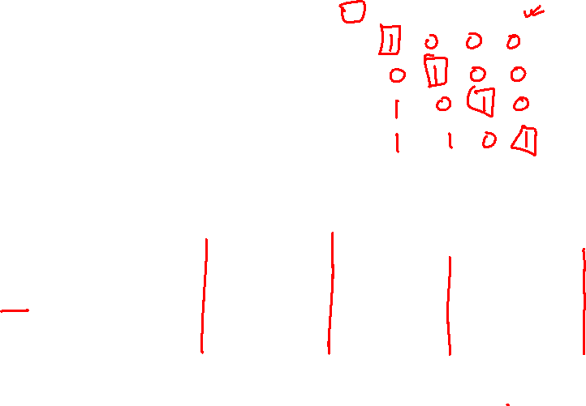
A simple shift register
In
Q
Q
Q
Q
=
Out
1
2
3
4
t
0
1
0
0
0
0
t
1
0
1
0
0
0
t
2
1
0
1
0
0
t
3
1
1
0
1
0
t
4
1
1
1
0
1
t
5
0
1
1
1
0
t
6
0
0
1
1
1
t
7
0
0
0
1
1
(b) A sample sequence
In: 1 0 1 1 1 0 0 0
Q
Q
Q
Q
In
D
Q
1
D
Q
2
D
Q
3
D
Q
4
Out
Clock
Q
Q
Q
Q
(a) Circuit
[ Figure 5.17 from the textbook ]

Slide 47
A simple shift register (serial in and out)
Q
Q
Q
Q
In
D
Q
1
D
Q
2
D
Q
3
D
Q
4
Out
Clock
Q
Q
Q
Q
(a) Circuit
In
Q
Q
Q
Q
=
Out
1
2
3
4
t
0
1
0
0
0
0
t
1
0
1
0
0
0
t
2
1
0
1
0
0
t
3
1
1
0
1
0
t
4
1
1
1
0
1
t
5
0
1
1
1
0
t
6
0
0
1
1
1
t
7
0
0
0
1
1
(b) A sample sequence
[ Figure 5.17 from the textbook ]

Slide 48
Parallel-Access Shift Register

Slide 49
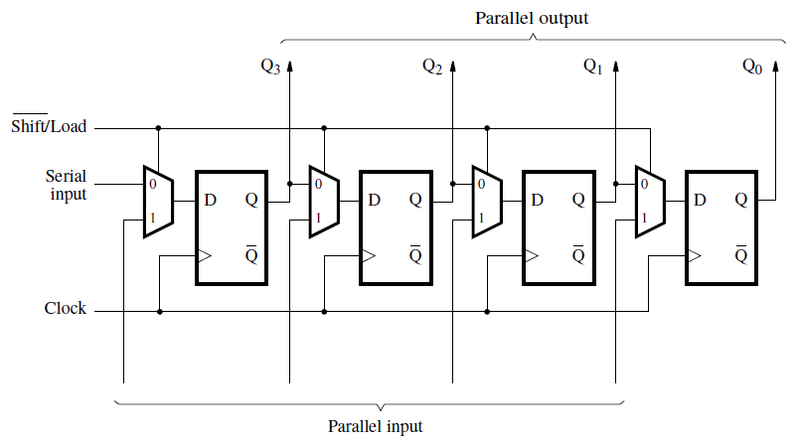
Parallel-access shift register
I₃
I₂
I₁
I₀
[ Figure 5.18 from the textbook ]

Slide 50
Parallel-access shift register
0
I₃
I₂
I₁
I₀
When Load=0, this behaves like a shift register.
[ Figure 5.18 from the textbook ]

Slide 51
Parallel-access shift register
1
I₃
I₂
I₁
I₀
When Load=1, this behaves like a parallel-access register.
[ Figure 5.18 from the textbook ]

Slide 52
Shift Register With
Parallel Load and Enable

Slide 53
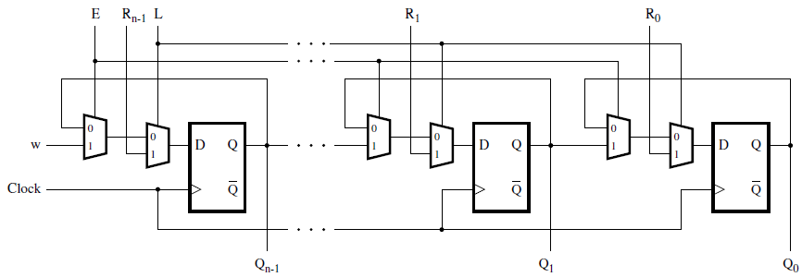

A shift register with parallel load and enable control inputs
[ Figure 5.59 from the textbook ]

Slide 54
A shift register with parallel load and enable control inputs
The directions of the input and output lines are switched relative to the previous slides.
[ Figure 5.59 from the textbook ]

Slide 55
A shift register with parallel load and enable control inputs
Parallel Input
Parallel Output
When L = 1, the register is loaded in parallel from the R input.
When L = 0 and E = 1, the data in the shift register is shifted in a left-to-right direction.
[ Figure 5.59 from the textbook ]

Slide 56
A shift register with parallel load and enable control inputs
0
0
[ Figure 5.59 from the textbook ]

Slide 57
A shift register with parallel load and enable control inputs
0
1
[ Figure 5.59 from the textbook ]

Slide 58
A shift register with parallel load and enable control inputs
1
0
[ Figure 5.59 from the textbook ]

Slide 59
A shift register with parallel load and enable control inputs
1
1
[ Figure 5.59 from the textbook ]

Slide 60
Parallel-access
shift left / right register

Slide 61
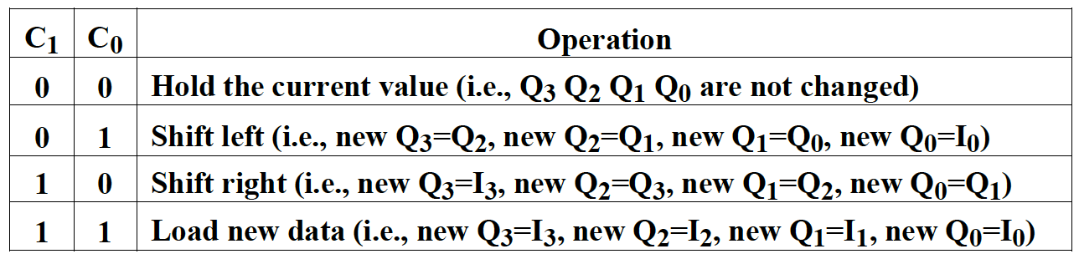
Parallel-access shift left/right register
Complete the following circuit diagram to implement a 4-bit register that has both parallel load and shift left/right functionality. The register has two control inputs (C1 and C0), four parallel input lines (I3, I2, I1, and I0), and four output lines (Q3, Q2, Q1, and Q0). Depending on the values of C1 and C0, the register performs one of the following four operations:

Slide 62
Parallel-access shift left/right register
D
Q
D
Q
D
Q
D
Q
Q
Q
Q
Q

Slide 63
Parallel-access shift left/right register
D
Q
D
Q
D
Q
D
Q
Q
Q
Q
Q
Clock

Slide 64
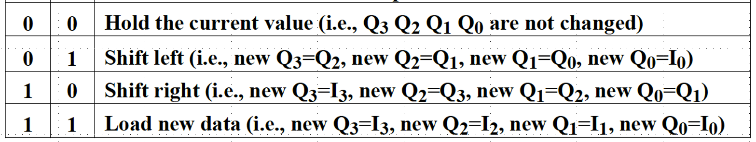
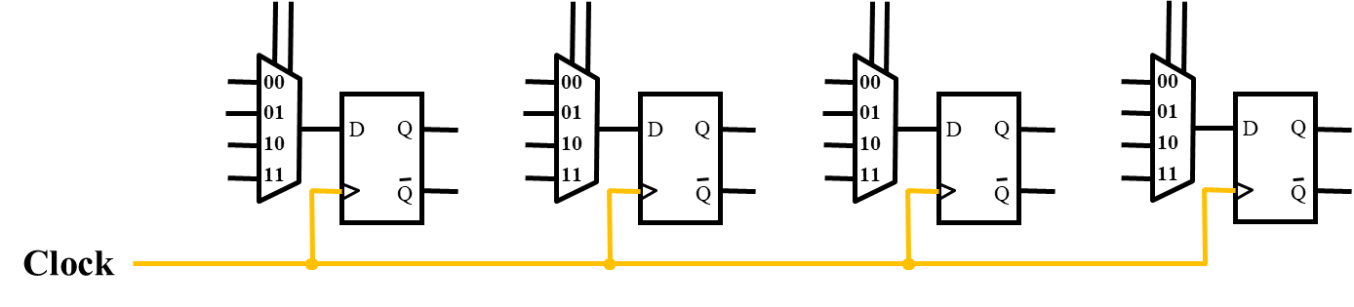
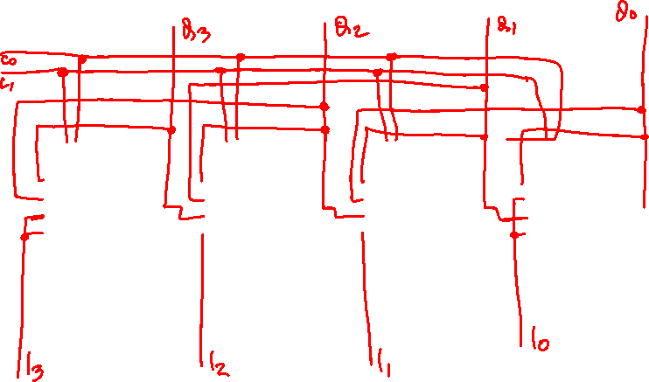
Parallel-access shift left/right register

Slide 65
Parallel-access shift left/right register
00
01
10
11
00
01
10
11
00
01
10
11
00
01
10
11
D
Q
D
Q
D
Q
D
Q
Q
Q
Q
Q
Clock

Slide 66
Parallel-access shift left/right register
Out_3
Out_2
Out_1
Out_0
00
01
10
11
00
01
10
11
00
01
10
11
00
01
10
11
D
Q
D
Q
D
Q
D
Q
Q
Q
Q
Q
Clock

Slide 67
Parallel-access shift left/right register
Out_3
Out_2
Out_1
Out_0
00
01
10
11
00
01
10
11
00
01
10
11
00
01
10
11
D
Q
D
Q
D
Q
D
Q
Q
Q
Q
Q
Clock
In_0

Slide 68
Parallel-access shift left/right register
Out_3
Out_2
Out_1
Out_0
00
01
10
11
00
01
10
11
00
01
10
11
00
01
10
11
D
Q
D
Q
D
Q
D
Q
Q
Q
Q
Q
Clock
In_3
In_0

Slide 69
Parallel-access shift left/right register
Out_3
Out_2
Out_1
Out_0
00
01
10
11
00
01
10
11
00
01
10
11
00
01
10
11
D
Q
D
Q
D
Q
D
Q
Q
Q
Q
Q
Clock
In_3
In_2
In_1
In_0

Slide 70
Parallel-access shift left/right register
Out_3
Out_2
Out_1
Out_0
00
01
10
11
00
01
10
11
00
01
10
11
00
01
10
11
D
Q
D
Q
D
Q
D
Q
Q
Q
Q
Q
Clock
In_3
In_2
In_1
In_0

Slide 71
Parallel-access shift left/right register
Out_3
Out_2
Out_1
Out_0
C₀
C₁
00
01
10
11
00
01
10
11
00
01
10
11
00
01
10
11
D
Q
D
Q
D
Q
D
Q
Q
Q
Q
Q
Clock
In_3
In_2
In_1
In_0

Slide 72
Parallel-access shift left/right register
Out_3
Out_2
Out_1
Out_0
C₀
C₁
00
01
10
11
00
01
10
11
00
01
10
11
00
01
10
11
D
Q
D
Q
D
Q
D
Q
Q
Q
Q
Q
Clock
In_3
In_2
In_1
In_0

Slide 73
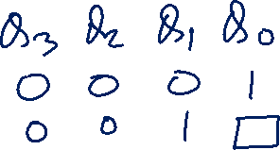
Multiplexer Tricks
(select one of two 2-bit numbers)

Slide 74
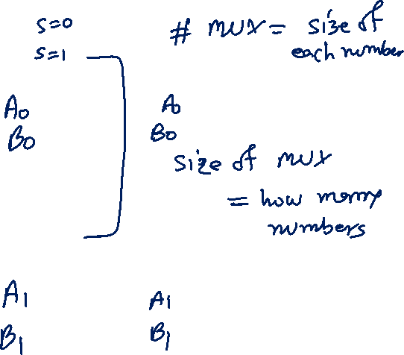
Select Either A=A₁A₀ or B=B₁B₀
s
0
F₀
1
0
F₁
1

Slide 75
Select Either A=A₁A₀ or B=B₁B₀
s
A₀
0
F₀
B₀
1
A₁
0
F₁
B₁
1

Slide 76
Select Either A=A₁A₀ or B=B₁B₀
0
s
A₀
0
F₀
= A₀
B₀
1
A₁
0
F₁
= A₁
B₁
1

Slide 77
Select Either A=A₁A₀ or B=B₁B₀
1
s
A₀
0
F₀
= B₀
B₀
1
A₁
0
F₁
= B₁
B₁
1

Slide 78

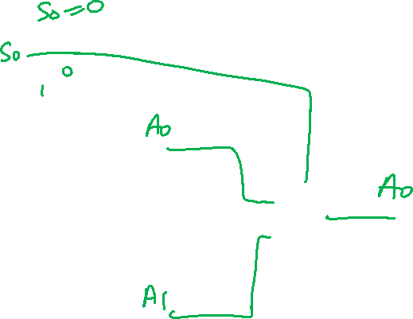
Select Either A=A₁A₀ or B=B₁B₀
s
A₀
0
B₀
F₀
1
A₁
0
B₁
F₁
1

Slide 79
Multiplexer Tricks
(select one of four 2-bit numbers)

Slide 80
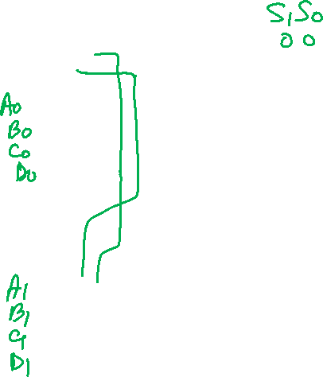
Select A=A₁A₀ or B=B₁B₀ or C=C₁C₀ or D=D₁D₀
s
1
s
0
00
01
10
11
F₀
00
01
10
11
F₁

Slide 81
Select A=A₁A₀ or B=B₁B₀ or C=C₁C₀ or D=D₁D₀
s
1
s
0
A₀
00
01
10
11
B₀
C₀
F₀
D₀
A₁
00
01
10
11
B₁
C₁
F₁
D₁

Slide 82
Select A=A₁A₀ or B=B₁B₀ or C=C₁C₀ or D=D₁D₀
0
0
s
1
s
0
A₀
00
01
10
11
B₀
C₀
F₀
= A₀
D₀
A₁
00
01
10
11
B₁
C₁
F₁
= A₁
D₁

Slide 83
Select A=A₁A₀ or B=B₁B₀ or C=C₁C₀ or D=D₁D₀
0
1
s
1
s
0
A₀
00
01
10
11
B₀
C₀
F₀
= B₀
D₀
A₁
00
01
10
11
B₁
C₁
F₁
= B₁
D₁

Slide 84
Select A=A₁A₀ or B=B₁B₀ or C=C₁C₀ or D=D₁D₀
1
0
s
1
s
0
A₀
00
01
10
11
B₀
C₀
F₀
= C₀
D₀
A₁
00
01
10
11
B₁
C₁
F₁
= C₁
D₁

Slide 85
Select A=A₁A₀ or B=B₁B₀ or C=C₁C₀ or D=D₁D₀
1
1
s
1
s
0
A₀
00
01
10
11
B₀
C₀
F₀
= D₀
D₀
A₁
00
01
10
11
B₁
C₁
F₁
= D₁
D₁

Slide 86
Register File

Slide 87
Design a register file with four 2-bit registers, one write port, one read port, and one write enable line.

Slide 88
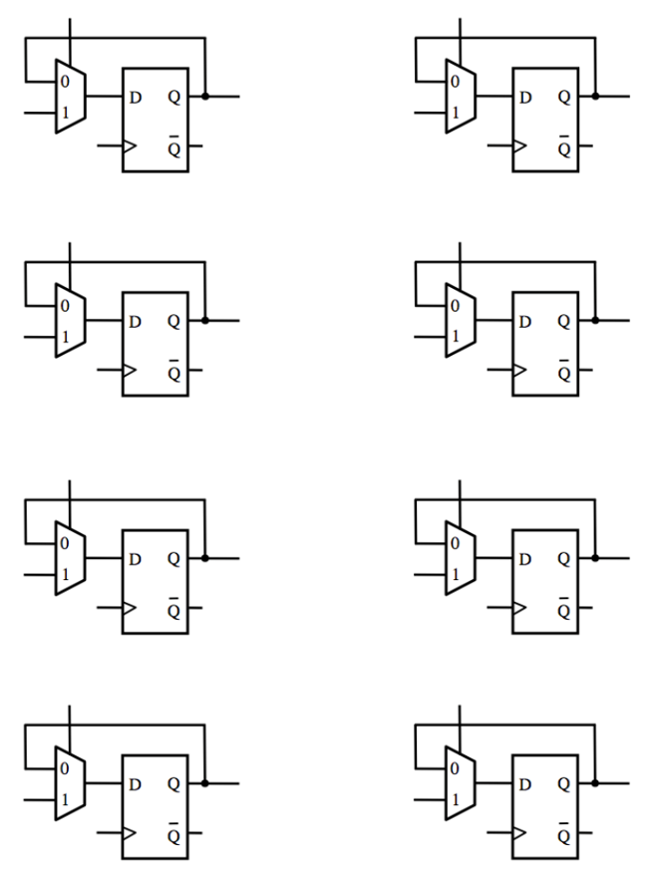
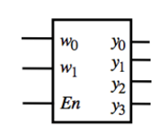
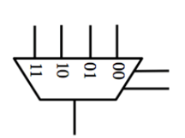
Design a register file with four 2-bit registers, one write port, one read port, and one write enable line.

Slide 89
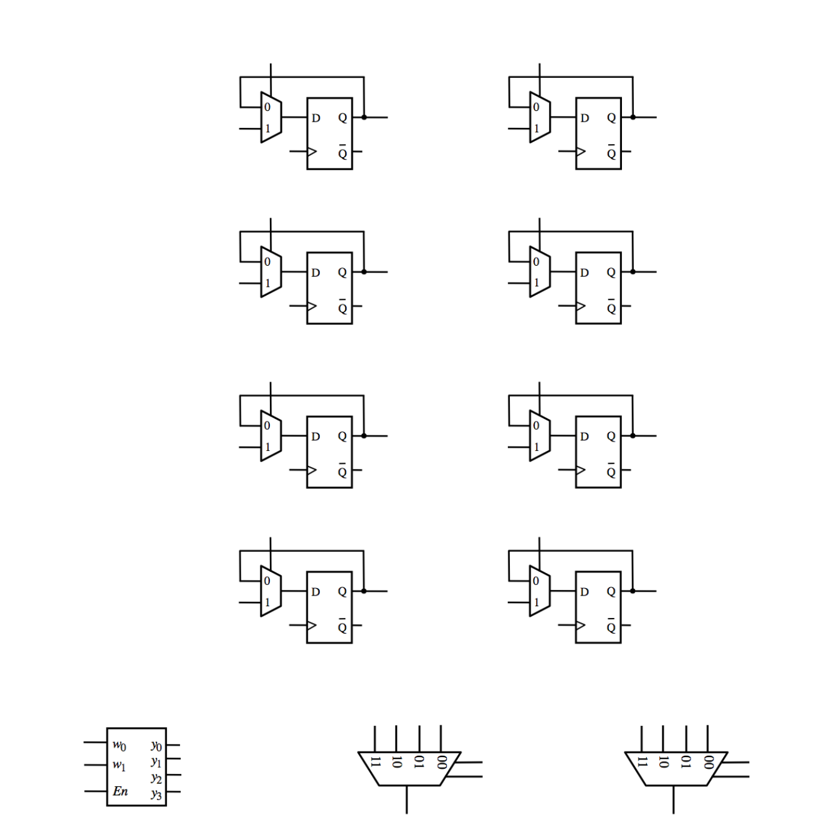
Four 2-bit registers, one write port, one read port, and one write enable line.

Slide 90
Four 2-bit registers, one write port, one read port, and one write enable line.
Register A
Register B
Register C
Register D

Slide 91
Four 2-bit registers, one write port, one read port, and one write enable line.
A₁
A₀
Register A
B₁
B₀
Register B
C₁
C₀
Register C
D₁
D₀
Register D

Slide 92
Four 2-bit registers, one write port, one read port, and one write enable line.
In₁
In₀
A₁
A₀
Register A
B₁
B₀
Register B
C₁
C₀
Register C
D₁
D₀
Register D

Slide 93
Four 2-bit registers, one write port, one read port, and one write enable line.
In₁
In₀
A₁
A₀
Register A
B₁
B₀
Register B
C₁
C₀
Register C
D₁
D₀
Register D
Write_address_0
Write_address_1
Write_enable

Slide 94
Four 2-bit registers, one write port, one read port, and one write enable line.
In₁
In₀
A₁
A₀
Register A
B₁
B₀
Register B
C₁
C₀
Register C
D₁
D₀
Register D
Write_address_0
Write_address_1
Write_enable

Slide 95
Four 2-bit registers, one write port, one read port, and one write enable line.
In₁
In₀
A₁
A₀
Register A
B₁
B₀
Register B
C₁
C₀
Register C
D₁
D₀
Register D
Write_address_0
Write_address_1
Read_address_1
Write_enable
Read_address_0
Out₁
Out₀

Slide 96
Four 2-bit registers, one write port, one read port, and one write enable line.
In₁
In₀
A₁
A₀
Register A
B₁
B₀
Register B
C₁
C₀
Register C
D₁
D₀
Register D
Clock
Write_address_0
Write_address_1
Read_address_1
Write_enable
Read_address_0
Out₁
Out₀

Slide 97
Four 2-bit registers, one write port, one read port, and one write enable line.
In₁
In₀
A₁
A₀
B₁
B₀
C₁
C₀
D₁
D₀
Clock
Write_address_0
Write_address_1
Read_address_1
Write_enable
Read_address_0
Out₁
Out₀

Slide 98

END Slide

