Slide 1
CHAPTER TWO
Algorithms and Flowcharts
Introduction
A program is a set of instruction gave to the computer to execute successive operations leads to solve specific problem. In general to solve any problem in computer we must follow these steps:
1. Analyze the problem.
2. Write an Algorithm.
3. Draw flowchart.
4. Convert the flowchart to program.
5. Run the program and test the solution.

Slide 2
1-1: Algorithms
It is a combination of phrases and events that can be arranged as steps to solve a specific problem. That can be done by understanding this problem whether it mathematic or logic before convert it to flow chart. As example when we borrow some books from the library, the remaining books number (N_{R}) is the subtraction of the borrowed books number (N_{B}) from the original number (N_{O}). To write the algorithm for this simple problem we will follow these steps:
Input the number of books in the library (N_{O}).
Input the number of borrowed books (N_{B}).
Find the remaining books number (N_{R}), N_{R} = N_{O}-N_{B}
Print N_{R}

Slide 3
1-2: Flowcharts
Flowcharts are graphs that represent the formal view used to solve any problem. Flowcharts help the programmer to write his program. Flowcharts consist of a shapes connected by a straight lines. The following table shows these shapes and their operations.

Slide 4
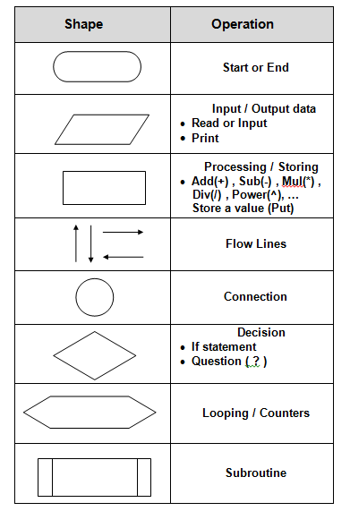

Slide 5
We can summarize the use of algorithms and flowcharts as follow:
To show the mathematical logic used to solve problems.
To show how the data processing is done.
Helps the programmer to write his program.
Divides the big problem to smaller parts.
To avoid the errors that occurred during writing the program.
It is a middle step between problem difficulty and its conversion to suitable program.
Easy to convert it to any programming language.

Slide 6
In general, we can divide flowcharts to a four shapes (charts):
Simple sequence charts
Branched charts.
Single loop charts.
Multi-loop charts.

Slide 7
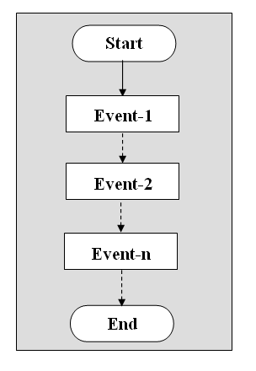
1-2-1: Simple sequence charts The events arrangement of this type is as straight sequence from the beginning of the program to the end (Event-1 to Event-n in figure below). This type of charts does not have any branches or loops.

Slide 8
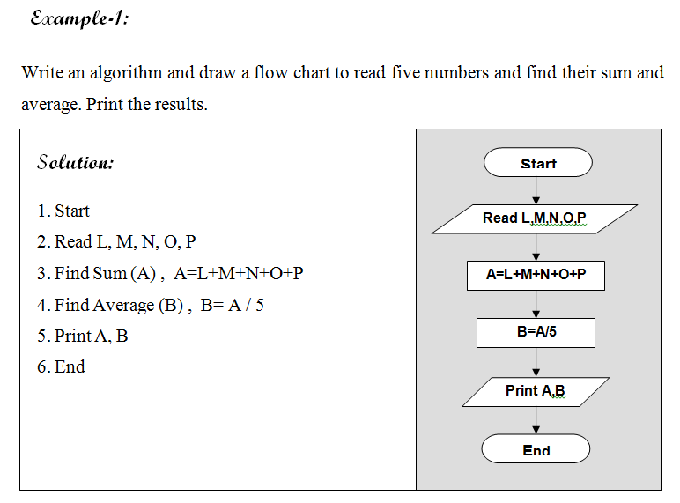

Slide 9
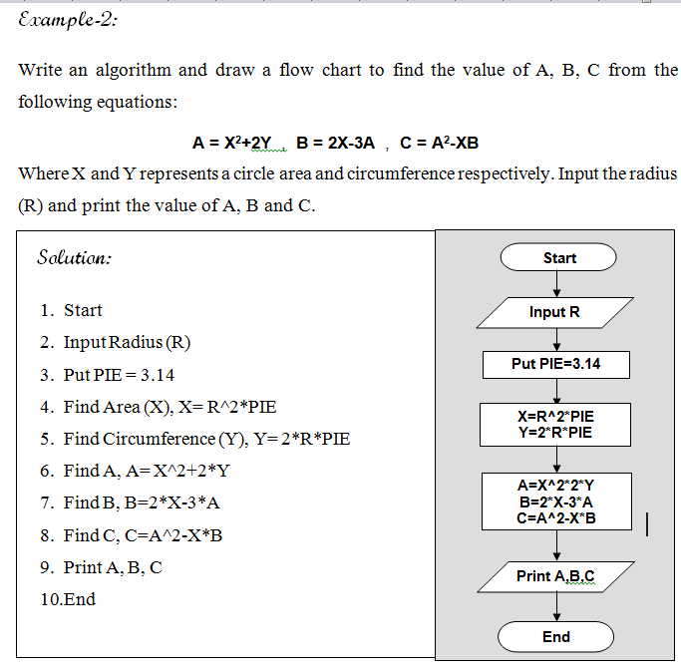

Slide 10
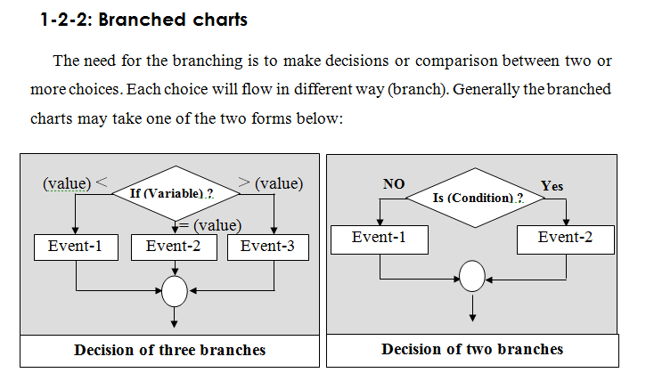

Slide 11
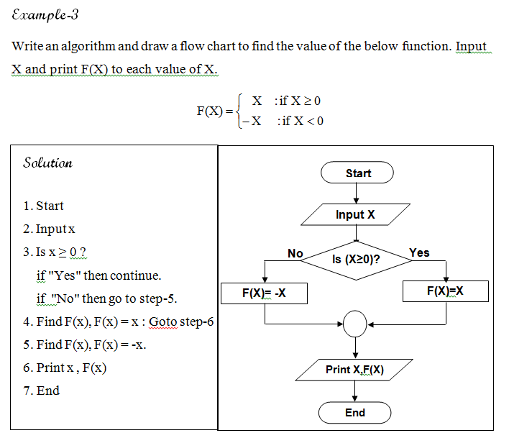

Slide 12
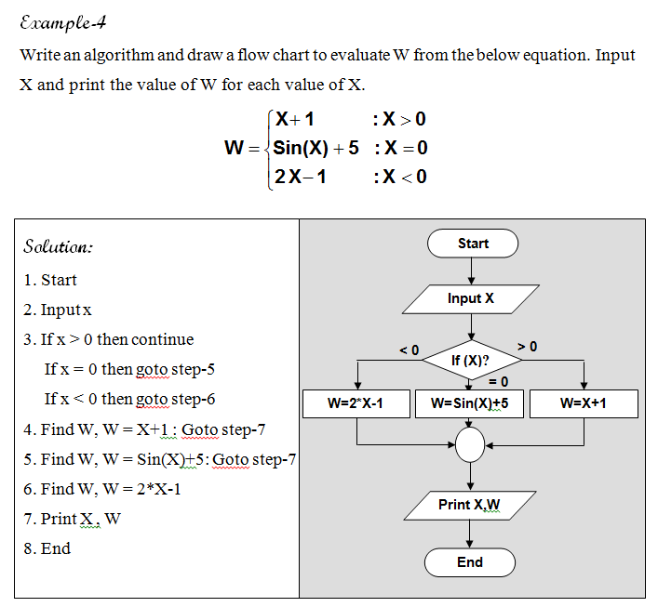

Slide 13
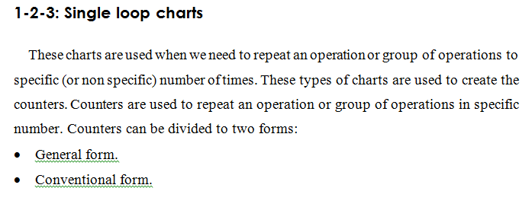

Slide 14
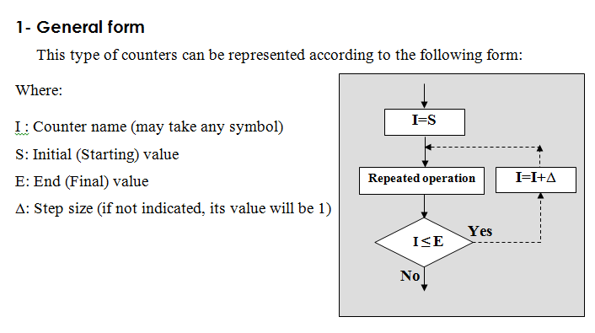
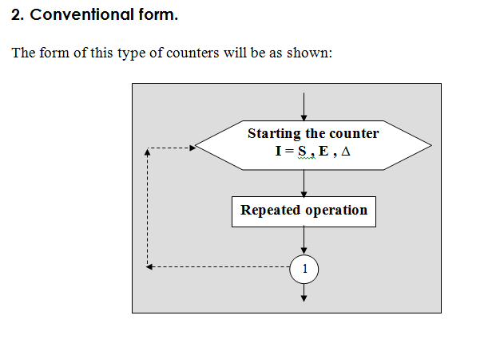

Slide 15
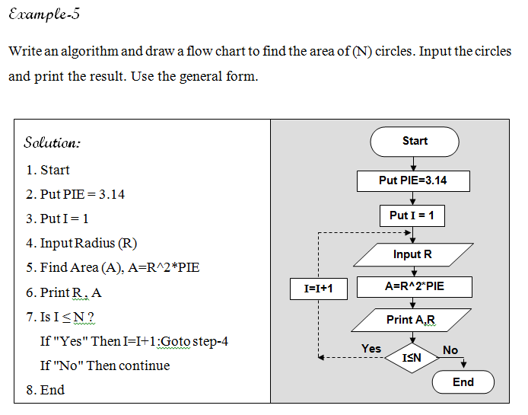

Slide 16
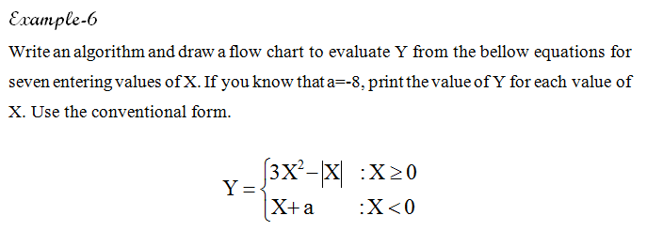
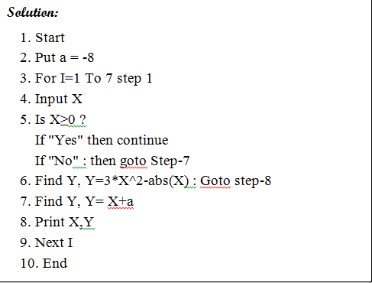
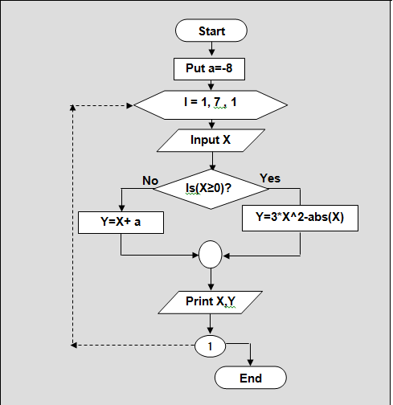

Slide 17
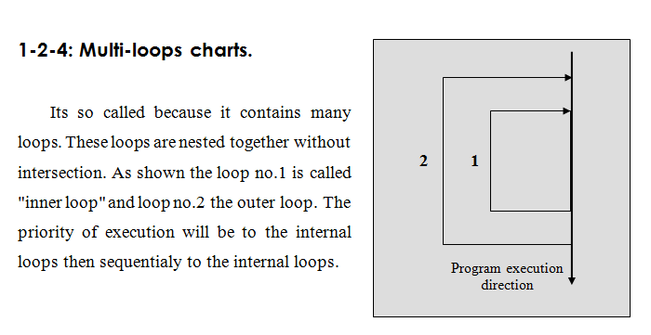

Slide 18
