Slide 1

Message Model

Slide 2
Apache Camel

Slide 3
Introduction
Apache Camel is described on its as "a versatile open-source integration framework based on known Enterprise Integration Patterns." The Camel framework is based on the book Enterprise Integration Patterns and provides implementations of the patterns described in the book.

Slide 4
Apache Camel is messaging technology glue with routing. It joins together messaging start and end points allowing the transference of messages from different sources to different destinations. For example: JMS->JSON, HTTP->JMS or funneling FTP->JMS, HTTP->JMS, JMS=>JSON.

Slide 5
Camel Message Model
Message
Exchange

Slide 6
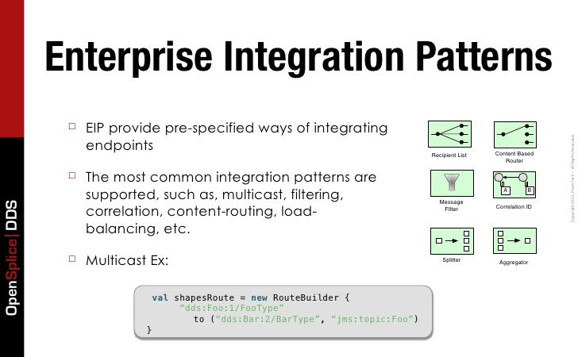

Slide 7
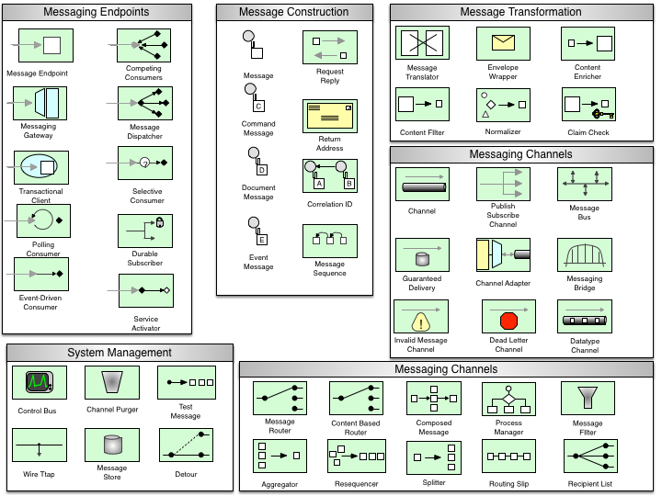

Slide 8
Message
Message
Headers
Attachments
Body
A Message consist of a Body, Headers, and optional Attachments.

Slide 9
Continue..
Headers :-
    These are name-value pairs
    Headers are stored as a Map within the message
Body :-
    It is of java.lang.object type and can store any kind of content
    When sender and reciever have different body fomats then camels comes into picture

Slide 10
Exchange
Exchange
Exchange Id
Exchange Id
MEP
Properties
In Message
In Message
Out Message
Headers
Headers
Attachements
Attachements
Body
Body

Slide 11
Continue..
An Exchange in camel is the Message container during Routing
Exchange Id :- Unique Id to identify exchanges
MEP (Message Exchange Pattern:-
    Pattern that denotes whether the message is InOnly or InOut messaging style

Slide 12
Continue..
Properties :-
    Similar to message headers, but last for the duration of entire exchange
In Message :-
    Message Input, Mandatory
Out Message :-
    Optional, and only exists if MEP is InOut

Slide 13
Camel vs Spring Integration.
Both Apache Camel and Spring share the same goal: to provide an easy-to-use mechanism for implementing typical integration tasks (such as mediation, routing, protocol adaptation), in a non-obtrusive way with small footprint and overhead, embeddable in your existing application infrastructure. Out of the box, you get a fair amount of (and steadily growing) transport adapters, ready-made implementations of EIPs, as well as basic management support via JMX. Hence from a functionality point of view, the two frameworks are quite equal.

Slide 14
Camel vs Spring Integration.
Apache Camel was released in version 1.0 in 2007. Already from version 1.0, it came with a Java DSL as well as an XML DSL built on top of Spring XML. Now being at version 2.15, there are additional DSLs in a wide variety of languages (among them Groovy and Scala).
Spring Integration was released in version 1.0.0 two years later, in 2009. Being part of the Spring family, XML-based configuration was initially the only option, but since recently Spring Integration also provides a Java DSL.

