Slide 1
Collections

Slide 2
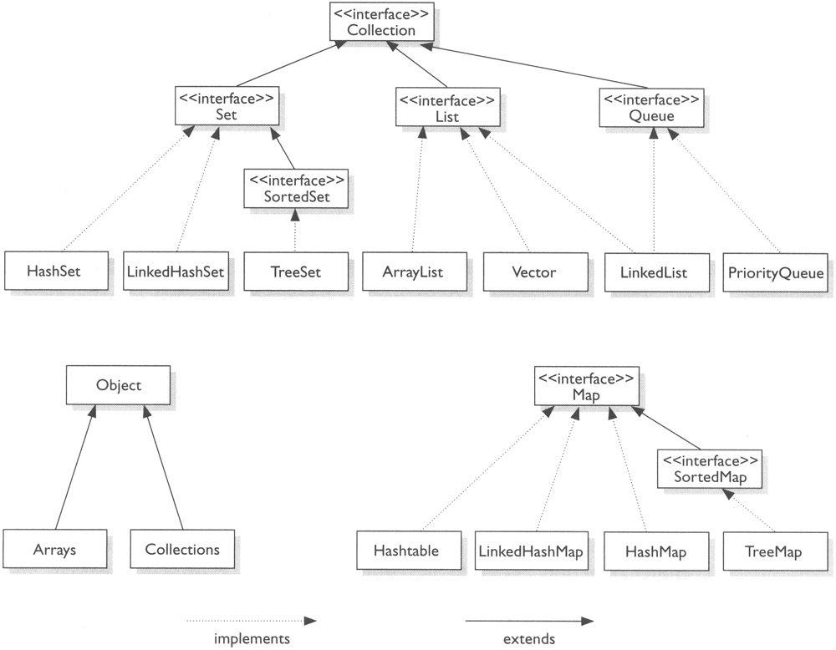
What is a Collection

Slide 3
Linked List
LinkedList and ArrayList are two different implementations of the List interface. LinkedList implements it with a doubly-linked list. ArrayList implements it with a dynamically re-sizing array.
As with standard linked list and array operations, the various methods will have different algorithmic runtimes.
For LinkedList<E>
get(int index)
add(E element)
add(int index, E element)
remove(int index)
Iterator.remove()
ListIterator.add(E element)
List
Linked List
ArrayList

Slide 4
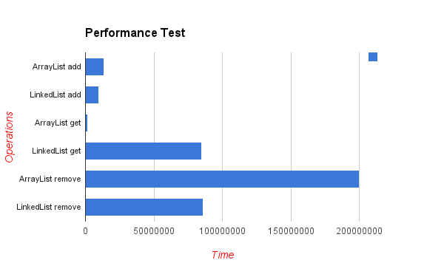
Performance

Slide 5
Choose the right Java List interface
ArrayList – items are ordered during insertion. Search operations on ArrayLists is faster compared to search operations on LinkedLists
LinkedList – has fast adding to the start of the list, and fast deletion from the interior via iteration

Slide 6
Choose the right Java Map interface
HashMap – use this implementation if the order of items while iterating is not important to you. HashMap has better performance compared to TreeMap and LinkedHashMap
TreeMap – is ordered and sorted but slower compared to HashMap. TreeMap has ascending order of keys, according to its Comparator
LinkedHashMap – it orders items by key during insertion

Slide 7
Choose the right Java Set interface
HashSet – use this implementation if the order of items while iterating is not important to you. HashSet has better performance compared to TreeSet and LinkedHashSet
LinkedHashSet – it orders items during insertion
TreeSet – has ascending order of keys, according to its Comparator

Slide 8
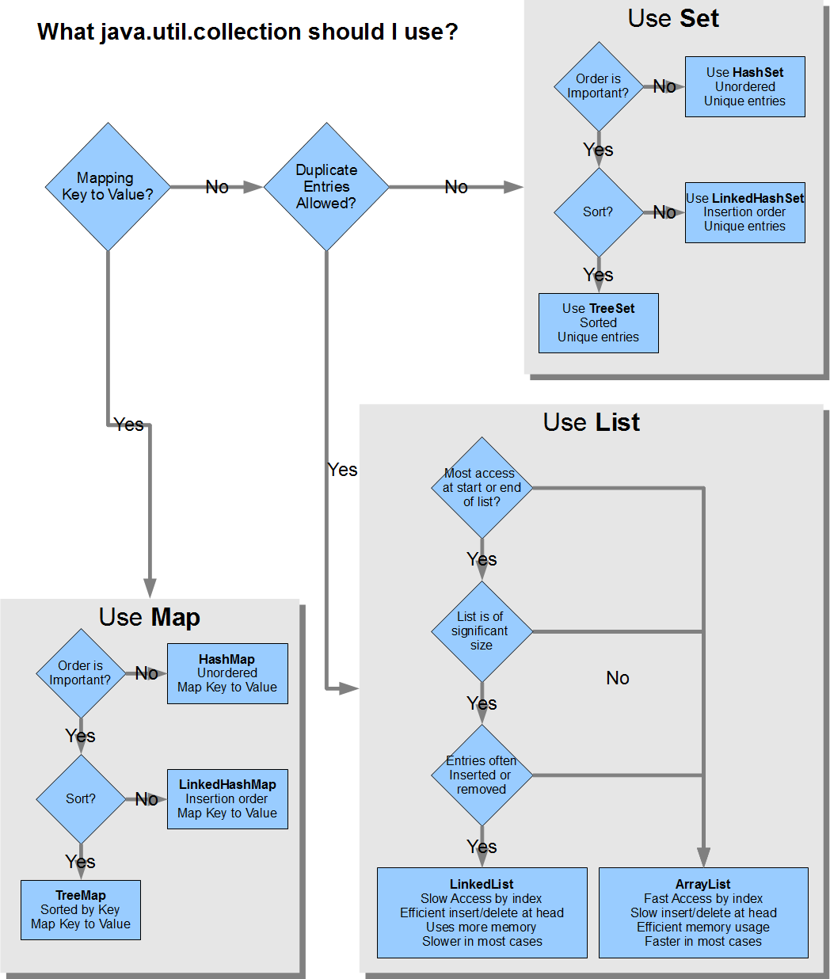

Slide 9
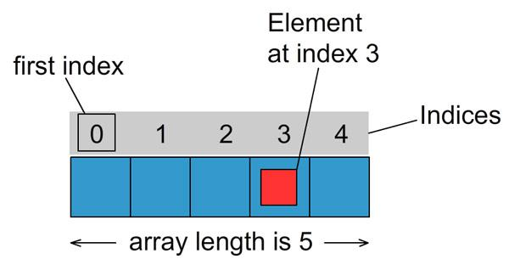
Array
Each item in an array is called an element, and each element is accessed by its numerical index.
As shown in the preceding illustration, numbering begins with 0. The 4th element, for example, would therefore be accessed at index 3.

Slide 10
Initialize Array
Lets create an array to store the salaries of all employees in a small company of 5 people.
int salaries[] = new int[5];
The type of the array (in this case int) applies to all values in the array. You can not mix types in one array.

Slide 11
Put Values into Array
Now that we have our salaries array initialized we want to put some values into it. We can do this either during the initialization like this:
int salaries[] = {50000, 75340, 110500, 98270, 39400};
or do it at a later point like this:
int salaries[] = new int[5];
salaries[0] = 50000;
salaries[1] = 75340;
salaries[2] = 110500;
salaries[3] = 98270;
salaries[4] = 39400;

Slide 12
Iterate over Arrays
You can work with the value of specific element by calling it like this:
System.out.println("The value of the 4th element in the array is " + salaries[3]);
This will produce the output:
The value of the 4th element in the array is 98270
or you can iterate over the values of all elements in the array using for loop or while loop.

Slide 13
ArrayExample
public class ArrayExample {
public static void main(String[] args) {
int salaries[] = {50000, 75340, 110500, 98270, 39400,45000};
for(int i=0; i<salaries.length; i++) {
System.out.println("The element at index " + i + " has the value of " + salaries[i]);
}
}
}
Arrays in java have the length property which returns the length of the array.
The output the program above produces is:
The element at index 0 has the value of 50000
The element at index 1 has the value of 75340
The element at index 2 has the value of 110500
The element at index 3 has the value of 98270
The element at index 4 has the value of 39400
The element at index 5 has the value of 45000

Slide 14
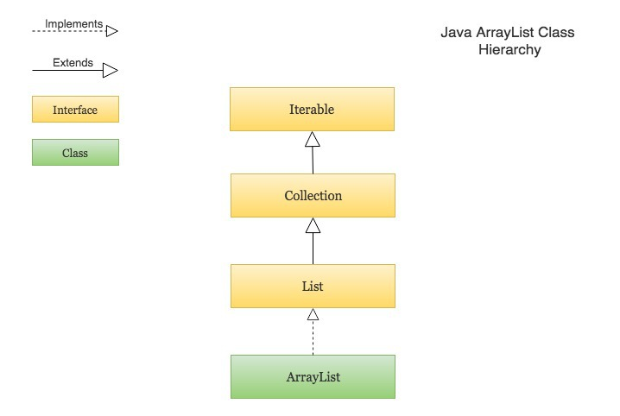
ArrayList
ArrayList in Java is used to store dynamically sized collection of elements. Contrary to Arrays that are fixed in size, an ArrayList grows its size automatically when new elements are added to it.
ArrayList is part of Java’s collection framework and implements Java’s List interface.

Slide 15
ArrayList<E>
For ArrayList<E>
get(int index)
add(E element)
add(int index, E element)
remove(int index)
Iterator.remove()
ListIterator.add(E element)

Slide 16
Points to remember about ArrayList
Following are few key points to note about ArrayList in Java -
An ArrayList is a re-sizable array, also called a dynamic array. It grows its size to accommodate new elements and shrinks the size when the elements are removed.
ArrayList internally uses an array to store the elements. Just like arrays, It allows you to retrieve the elements by their index.
Java ArrayList allows duplicate and null values.
Java ArrayList is an ordered collection. It maintains the insertion order of the elements.
You cannot create an ArrayList of primitive types like int, char etc. You need to use boxed types like Integer, Character, Boolean etc.
Java ArrayList is not synchronized. If multiple threads try to modify an ArrayList at the same time, then the final outcome will be non-deterministic. You must explicitly synchronize access to an ArrayList if multiple threads are going to modify it.

Slide 17
Creating an ArrayList and adding new elements to it
import java.util.ArrayList;
import java.util.List;
public class CreateArrayListExample {
public static void main(String[] args) {
// Creating an ArrayList of String
List<String> animals = new ArrayList<>();
// Adding new elements to the ArrayList
animals.add("Lion");
animals.add("Tiger");
animals.add("Cat");
animals.add("Dog");
System.out.println(animals);
// Adding an element at a particular index in an ArrayList
animals.add(2, "Elephant");
System.out.println(animals);
}
}
# Output
[Lion, Tiger, Cat, Dog]
[Lion, Tiger, Elephant, Cat, Dog]
This example shows:
How to create an ArrayList using the ArrayList() constructor.
Add new elements to an ArrayList using the add() method.

Slide 18
Creating an ArrayList from another collection
import java.util.ArrayList; import java.util.List; public class CreateArrayListFromCollectionExample { public static void main(String[] args) { List<Integer> firstFivePrimeNumbers = new ArrayList<>(); firstFivePrimeNumbers.add(2); firstFivePrimeNumbers.add(3); firstFivePrimeNumbers.add(5); firstFivePrimeNumbers.add(7); firstFivePrimeNumbers.add(11); // Creating an ArrayList from another collection List<Integer> firstTenPrimeNumbers = new ArrayList<>(firstFivePrimeNumbers); List<Integer> nextFivePrimeNumbers = new ArrayList<>(); nextFivePrimeNumbers.add(13); nextFivePrimeNumbers.add(17); nextFivePrimeNumbers.add(19); nextFivePrimeNumbers.add(23); nextFivePrimeNumbers.add(29); // Adding an entire collection to an ArrayList firstTenPrimeNumbers.addAll(nextFivePrimeNumbers); System.out.println(firstTenPrimeNumbers); } } # Output [2, 3, 5, 7, 11, 13, 17, 19, 23, 29]
This example shows:
How to create an ArrayList from another collection using the ArrayList(Collection c) constructor.
How to add all the elements from an existing collection to the new ArrayList using the addAll() method.

Slide 19
Accessing elements from an ArrayList
import java.util.ArrayList;
import java.util.List;
public class AccessElementsFromArrayListExample {
public static void main(String[] args) {
List<String> topCompanies = new ArrayList<>();
// Check if an ArrayList is empty
System.out.println("Is the topCompanies list empty? : " + topCompanies.isEmpty());
topCompanies.add("Google");
topCompanies.add("Apple");
topCompanies.add("Microsoft");
topCompanies.add("Amazon");
topCompanies.add("Facebook");
// Find the size of an ArrayList
System.out.println("Here are the top " + topCompanies.size() + " companies in the world");
System.out.println(topCompanies);
// Retrieve the element at a given index
String bestCompany = topCompanies.get(0);
String secondBestCompany = topCompanies.get(1);
String lastCompany = topCompanies.get(topCompanies.size() - 1);
System.out.println("Best Company: " + bestCompany);
System.out.println("Second Best Company: " + secondBestCompany);
System.out.println("Last Company in the list: " + lastCompany);
// Modify the element at a given index
topCompanies.set(4, "Walmart");
System.out.println("Modified top companies list: " + topCompanies);
}} contd…
This example shows:
How to check if an ArrayList is empty using the isEmpty() method.
How to find the size of an ArrayList using the size() method.
How to access the element at a particular index in an ArrayList using the get() method.
How to modify the element at a particular index in an ArrayList using the set() method.

Slide 20
Output
# Output
Is the topCompanies list empty? : true
Here are the top 5 companies in the world
[Google, Apple, Microsoft, Amazon, Facebook]
Best Company: Google
Second Best Company: Apple
Last Company in the list: Facebook
Modified top companies list: [Google, Apple, Microsoft, Amazon, Walmart]

Slide 21
Removing elements from an ArrayList
This example shows:
How to remove the element at a given index in an ArrayList | remove(int index)
How to remove an element from an ArrayList | remove(Object o)
How to remove all the elements from an ArrayList that exist in a given collection | removeAll()
How to remove all the elements matching a given predicate | removeIf()
How to clear an ArrayList | clear()

Slide 22
Remove element from arraylist
import java.util.ArrayList;
import java.util.List;
import java.util.function.Predicate;
public class RemoveElementsFromArrayListExample {
public static void main(String[] args) {
List<String> programmingLanguages = new ArrayList<>();
programmingLanguages.add("C");
programmingLanguages.add("C++");
programmingLanguages.add("Java");
programmingLanguages.add("Kotlin");
programmingLanguages.add("Python");
programmingLanguages.add("Perl");
programmingLanguages.add("Ruby");
System.out.println("Initial List: " + programmingLanguages);
// Remove the element at index `5`
programmingLanguages.remove(5);
System.out.println("After remove(5): " + programmingLanguages);
// Remove the first occurrence of the given element from the ArrayList
// (The remove() method returns false if the element does not exist in the ArrayList)
boolean isRemoved = programmingLanguages.remove("Kotlin");
System.out.println("After remove(\"Kotlin\"): " + programmingLanguages);
// Remove all the elements that exist in a given collection
List<String> scriptingLanguages = new ArrayList<>();
scriptingLanguages.add("Python");
scriptingLanguages.add("Ruby");
scriptingLanguages.add("Perl");
programmingLanguages.removeAll(scriptingLanguages);
System.out.println("After removeAll(scriptingLanguages): " + programmingLanguages);
// Remove all the elements that satisfy the given predicate
programmingLanguages.removeIf(new Predicate<String>() {
@Override
public boolean test(String s) {
return s.startsWith("C");
}
});

Slide 23
Search Elements in ArrayList
import java.util.ArrayList;
import java.util.List;
public class SearchElementsInArrayListExample {
public static void main(String[] args) {
List<String> names = new ArrayList<>();
names.add("John");
names.add("Alice");
names.add("Bob");
names.add("Steve");
names.add("John");
names.add("Steve");
names.add("Maria");
// Check if an ArrayList contains a given element
System.out.println("Does names array contain \" Maria \"? : " + names.contains(“Maria"));
// Find the index of the first occurrence of an element in an ArrayList
System.out.println("indexOf \"Steve\": " + names.indexOf("Steve"));
System.out.println("indexOf \"Mark\": " + names.indexOf("Mark"));
// Find the index of the last occurrence of an element in an ArrayList
System.out.println("lastIndexOf \"John\" : " + names.lastIndexOf("John"));
System.out.println("lastIndexOf \"Bill\" : " + names.lastIndexOf("Bill"));
}
}
# Output
Does names array contain " Maria "? : true
indexOf "Steve": 3
indexOf "Mark": -1
lastIndexOf "John" : 4
lastIndexOf "Bill" : -1

Slide 24
ArrayList of user defined objects
public class ArrayListUserDefinedObjectExample {
public static void main(String[] args) {
List<User> users = new ArrayList<>();
users.add(new User("Rajeev", 25));
users.add(new User("John", 34));
users.add(new User("Steve", 29));
users.forEach(user -> {
System.out.println("Name : " + user.getName() + ", Age : " + user.getAge());
});
}
}
# Output
Name : Rajeev, Age : 25
Name : John, Age : 34
Name : Steve, Age : 29
import java.util.ArrayList;
import java.util.List;
class User {
private String name;
private int age;
public User(String name, int age) {
this.name = name;
this.age = age;
} public String getName() {
return name;
}public void setName(String name) {
this.name = name;
}
public int getAge() {
return age; } public void setAge(int age) {
this.age = age;
}
}

Slide 25
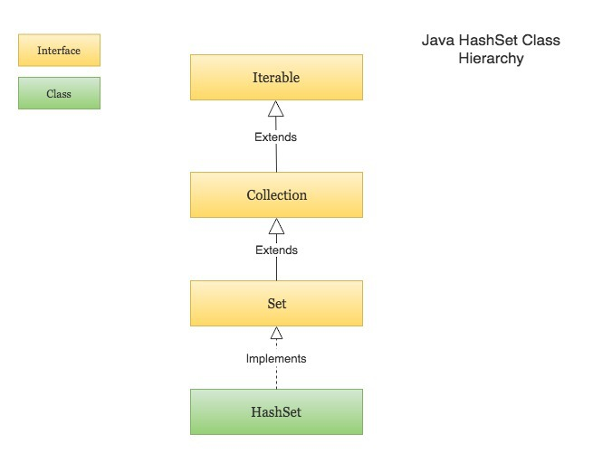
HashSet
Java HashSet class is a member of Java collections framework. It implements the Set interface. HashSets are used to store a collection of unique elements.
Following are few key points to note about HashSet in Java –
HashSet cannot contain duplicate values.
HashSet allows null value.
HashSet is an unordered collection. It does not maintain the order in which the elements are inserted.
HashSet internally uses a HashMap to store its elements.
HashSet is not thread-safe. If multiple threads try to modify a HashSet at the same time, then the final outcome is not-deterministic. You must explicitly synchronize concurrent access to a HashSet in a multi-threaded environment.

Slide 26
HashSet using the HashSet() constructor,
import java.util.HashSet;
import java.util.Set;
public class CreateHashSetExample {
public static void main(String[] args) {
// Creating a HashSet
Set<String> daysOfWeek = new HashSet<>();
// Adding new elements to the HashSet
daysOfWeek.add("Monday");
daysOfWeek.add("Tuesday");
daysOfWeek.add("Wednesday");
daysOfWeek.add("Thursday");
daysOfWeek.add("Friday");
daysOfWeek.add("Saturday");
daysOfWeek.add("Sunday");
// Adding duplicate elements will be ignored
daysOfWeek.add("Monday");
System.out.println(daysOfWeek);
}
}
# Output
[Monday, Thursday, Friday, Sunday, Wednesday, Tuesday, Saturday]

Slide 27
Create HashSet From CollectionExample
import java.util.ArrayList;
import java.util.HashSet;
import java.util.List;
import java.util.Set;
public class CreateHashSetFromCollectionExample {
public static void main(String[] args) {
List<Integer> numbersDivisibleBy5 = new ArrayList<>();
numbersDivisibleBy5.add(5);
numbersDivisibleBy5.add(10);
numbersDivisibleBy5.add(15);
numbersDivisibleBy5.add(20);
numbersDivisibleBy5.add(25);
List<Integer> numbersDivisibleBy3 = new ArrayList<>();
numbersDivisibleBy3.add(3);
numbersDivisibleBy3.add(6);
numbersDivisibleBy3.add(9);
numbersDivisibleBy3.add(12);
numbersDivisibleBy3.add(15);
// Creating a HashSet from another collection (ArrayList)
Set<Integer> numbersDivisibleBy5Or3 = new HashSet<>(numbersDivisibleBy5);
// Adding all the elements from an existing collection to a HashSet
numbersDivisibleBy5Or3.addAll(numbersDivisibleBy3);
System.out.println(numbersDivisibleBy5Or3);
}
}
# Output
[3, 20, 5, 6, 25, 9, 10, 12, 15]

Slide 28
Iterating over a HashSet
The following example shows different ways of iterating over a HashSet
Iterate over a HashSet using Java 8 forEach and lambda expression.
Iterate over a HashSet using iterator().
Iterate over a HashSet using iterator() and Java 8 forEachRemaining() method.
Iterate over a HashSet using simple for-each loop.

Slide 29
Iterate HashSet Example
System.out.println("=== Iterate over a HashSet using iterator() ===");
Iterator<String> programmingLanguageIterator = programmingLanguages.iterator();
while (programmingLanguageIterator.hasNext()) {
String programmingLanguage = programmingLanguageIterator.next();
System.out.println(programmingLanguage);
}
System.out.println("=== Iterate over a HashSet using iterator() and Java 8 forEachRemaining() method ===");
programmingLanguageIterator = programmingLanguages.iterator();
programmingLanguageIterator.forEachRemaining(programmingLanguage -> {
System.out.println(programmingLanguage);
});
System.out.println("=== Iterate over a HashSet using simple for-each loop ===");
for(String programmingLanguage: programmingLanguages) {
System.out.println(programmingLanguage);
}
}
import java.util.HashSet;
import java.util.Iterator;
import java.util.Set;
public class IterateOverHashSetExample {
public static void main(String[] args) {
Set<String> programmingLanguages = new HashSet<>();
programmingLanguages.add("C");
programmingLanguages.add("C++");
programmingLanguages.add("Java");
programmingLanguages.add("Python");
programmingLanguages.add("PHP");
programmingLanguages.add("Ruby");
System.out.println("=== Iterate over a HashSet using Java 8 forEach and lambda ===");
programmingLanguages.forEach(programmingLanguage -> {
System.out.println(programmingLanguage);
});

Slide 30
Output
# Output
=== Iterate over a HashSet using Java 8 forEach and lambda ===
Java
C++
C
PHP
Ruby
Python
=== Iterate over a HashSet using iterator() ===
Java
C++
C
PHP
Ruby
Python
=== Iterate over a HashSet using iterator() and Java 8 forEachRemaining() method ===
Java
C++
C
PHP
Ruby
Python
=== Iterate over a HashSet using simple for-each loop ===
Java
C++
C
PHP
Ruby
Python

Slide 31
HashSet with Userdefined Object
public void setId(long id) {
this.id = id;
}
public String getName() {
return name;
}
public void setName(String name) {
this.name = name;
}
// Two customers are equal if their IDs are equal
@Override
public boolean equals(Object o) {
if (this == o) return true;
if (o == null || getClass() != o.getClass()) return false;
Customer customer = (Customer) o;
return id == customer.id;
}
@Override
public int hashCode() {
return Objects.hash(id);
}
@Override
public String toString() {
return "Customer{" +
"id=" + id +
", name='" + name + '\'' +
'}'; }}
import java.util.HashSet;
import java.util.Objects;
import java.util.Set;
class Customer {
private long id;
private String name;
public Customer(long id, String name) {
this.id = id;
this.name = name;
}
public long getId() {
return id;
}

Slide 32
HashSet Userdefined Object
public class HashSetUserDefinedObjectExample {
public static void main(String[] args) {
Set<Customer> customers = new HashSet<>();
customers.add(new Customer(101, "Rajeev"));
customers.add(new Customer(102, "Sachin"));
customers.add(new Customer(103, "Chris"));
/*
HashSet will use the `equals()` & `hashCode()` implementations
of the Customer class to check for duplicates and ignore them
*/
customers.add(new Customer(101, "Rajeev"));
System.out.println(customers);
}
}
# Output
[Customer{id=101, name='Rajeev'}, Customer{id=102, name='Sachin'}, Customer{id=103, name='Chris

