Slide 1
Introduction to Quarkus

Slide 2
Introduction to Quarkus
Why Quarkus? Benefits and Use Cases
Comparing Quarkus with traditional Java frameworks (Spring Boot)
Benefits of Quarkus for cloud-native development (fast startup, low memory footprint)
Setting Up the Development Environment & Creating a Quarkus App:
Installing Quarkus tools and setting up your development environment
Building a simple Quarkus application using command-line tools

Slide 3
Why Quarkus? Benefits and Use Cases
Quarkus is a Kubernetes-native Java framework designed to optimize Java applications for cloud and containerized environments, especially in modern infrastructures like microservices and serverless computing. It is specifically tailored to leverage GraalVM for ahead-of-time (AOT) compilation, resulting in native binaries that offer better performance and resource efficiency. Here’s a detailed look at why Quarkus is gaining traction, its benefits, and use cases.
Why Quarkus?
Optimized for Cloud-Native Development: Quarkus is built for a world where applications run on Kubernetes, OpenShift, or other container orchestration platforms. It streamlines development and deployment for cloud environments.
Low Memory Footprint: Quarkus applications consume significantly less memory compared to traditional Java frameworks. This is critical in environments with limited resources, such as containers or serverless platforms.
Fast Boot Time: By using GraalVM to compile Java applications into native binaries, Quarkus achieves lightning-fast startup times, making it ideal for serverless or microservice architectures where speed is key.
Developer Joy: Quarkus provides a modern developer experience with features like live reload (hot reload during development), easy dependency injection (based on CDI), and seamless integration with popular libraries and frameworks such as Hibernate, RESTEasy, and Vert.x.
Polyglot Support: It supports multiple languages like Kotlin and Scala, enhancing its versatility in development environments where different programming languages are used.
Reactive and Imperative Programming: Quarkus supports both reactive and imperative programming models, giving developers flexibility based on the application's requirements.

Slide 4
Benefits of Quarkus
Reduced Memory Usage: Quarkus applications consume less RAM, which makes them suitable for running efficiently in environments with constrained resources. A native Quarkus application can be 10-100 times smaller than a traditional Java application.
Ultra-Fast Startup Times: Traditional Java applications can take seconds or even minutes to start, which can be problematic in serverless and cloud environments. Quarkus solves this by drastically reducing startup times, typically to milliseconds.
Built-in Cloud-Native Features: Quarkus has first-class support for popular cloud-native frameworks like Kubernetes, Prometheus, and OpenShift. It is also well-integrated with MicroProfile APIs, offering capabilities like health checks, metrics, and fault tolerance.
Efficient Resource Utilization: Quarkus-native applications, thanks to GraalVM, use significantly fewer resources. This is especially useful in large-scale containerized applications where operational costs can accumulate quickly.
Streamlined Developer Workflow: Features like hot reload, dependency injection, and extensive library support simplify the development workflow, improving developer productivity.
Cross-Language Support: Quarkus enables developers to use polyglot programming by supporting different languages (e.g., Java, Kotlin, Scala) alongside native libraries, making it suitable for heterogeneous environments.

Slide 5
Use Cases of Quarkus
Microservices Architectures: Quarkus is ideal for microservices due to its small footprint, fast boot times, and native Kubernetes integrations. Its performance and scalability make it a great choice for distributed systems.
Serverless Applications: The rapid startup times and low resource consumption make Quarkus a natural fit for serverless platforms like AWS Lambda, Azure Functions, and Google Cloud Functions.
Event-Driven Architectures: Quarkus supports reactive programming models, which are suitable for event-driven applications such as real-time data processing, stream processing, and IoT.
Containers and Kubernetes: Quarkus is Kubernetes-native, with built-in support for Kubernetes extensions, making it a top choice for containerized applications.
Cloud-Native APIs: When building applications that need to leverage cloud-native APIs like REST, GraphQL, or gRPC, Quarkus provides out-of-the-box support, along with easy integrations for databases and messaging platforms.
High Throughput, Low Latency Applications: Quarkus, especially when compiled to native binaries, is perfect for applications that require low latency and high throughput, such as financial trading platforms or real-time analytics engines.

Slide 6
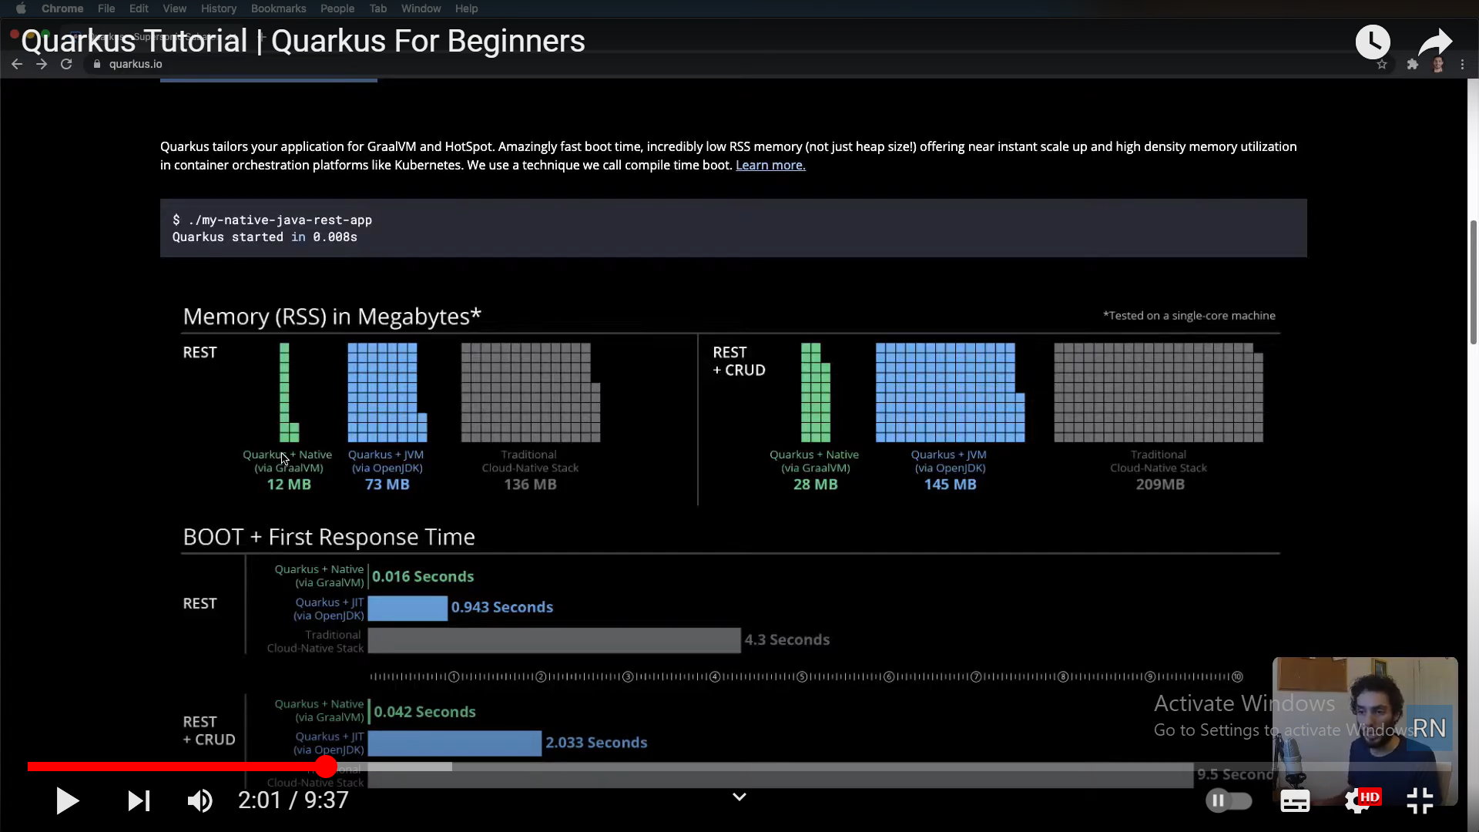
Comparing Quarkus with traditional Java frameworks (Spring Boot)

Slide 7
Reactive programming
Reactive programming in Java is a programming paradigm that focuses on building applications that are:
Asynchronous and Non-Blocking:
Reactive applications handle events and data streams in a non-blocking manner, allowing them to efficiently manage resources and scale under high load.
Event-Driven:
These applications react to events, such as data arriving from a stream or a user interaction, rather than following a traditional imperative programming flow.
Resilient:
Reactive applications are designed to handle failures gracefully, ensuring that the system remains responsive even in the face of errors.

Slide 8
Key Concepts
Streams:
Reactive programming revolves around streams, which represent a sequence of events or data items. These streams can be manipulated and transformed using various operators.
Publishers and Subscribers:
Publishers produce data streams, while subscribers consume them. This model allows for decoupling between components, making the system more flexible and maintainable.
Backpressure:
Backpressure is a mechanism that allows subscribers to control the rate at which they receive data from publishers, preventing them from being overwhelmed.

Slide 9
Popular Libraries:
Project Reactor:
A popular reactive programming library for Java, providing the Flux and Mono types for working with streams of data.
RxJava:
Another widely used reactive programming library in Java, offering a rich set of operators and functionalities.
Spring WebFlux:
A module in the Spring Framework that supports reactive programming for building web applications
Benefits:
Improved Performance and Scalability:
Reactive programming enables efficient use of resources, especially for applications that handle a large number of concurrent requests.
Enhanced Responsiveness:
By avoiding blocking operations, reactive applications can provide a more responsive user experience.
Simplified Asynchronous Programming:
Reactive programming offers a structured approach to handling asynchronous operations, making code more readable and maintainable.

Slide 10
Comparing Quarkus Spring Boot
When comparing Quarkus with a traditional Java framework like Spring Boot, several key differences emerge in terms of architecture, performance, resource efficiency, and cloud-native capabilities. Below is a detailed comparison of Quarkus and Spring Boot across various factors:

Slide 11
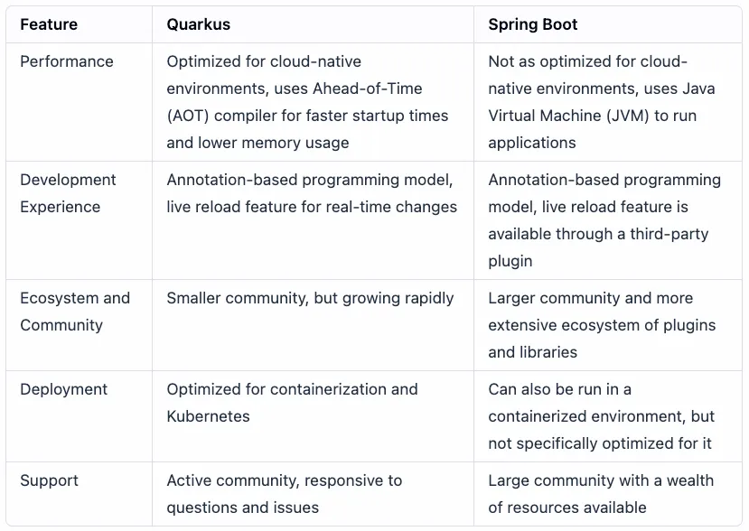
Comparing Quarkus Spring Boot

Slide 12
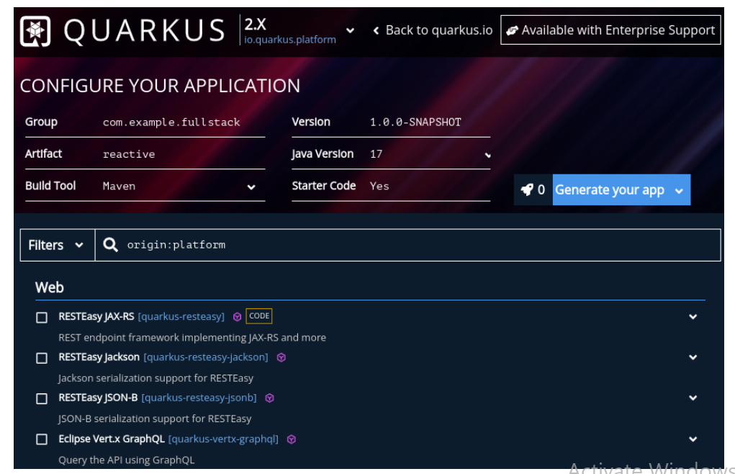
Setting Up the Development Environment & Creating a Quarkus App
Step 1: Navigate with your web browser to https://code.quarkus.io.
Step 2: Fill up the Group Id Artifact Id and rest information as in image

Slide 13
Setting Up the Development Environment & Creating a Quarkus App
Step 3: reactive features, we’ll use RESTEasy Reactive. You can filter through the dependencies by
Step 4: Fill up the Group Id Artifact Id and rest information as in image
Maven coordinates (GAV)
platform:quarkus-bom, Quarkus’ Bill of Materials (BOM), artifact to the current project. This process enforces the use of a consistent
version for all of the provided Quarkus extensions.
RESTEasy Reactive is Quarkus-specific implementation of the JAX-RS specification based on Vert.x. It takes full advantage of Quarkus’
reactive non-blocking capabilities, which improve the overall application performance.
quarkus-resteasy-reactive

Slide 14
CLI installation

