Slide 1
Week-2
Week 2: Java Spring - I

Slide 2
Introduction to Java Spring
Introduction to Spring Framework
Overview of Spring's philosophy and benefits (loose coupling, dependency injection)
Core Spring concepts (beans, annotations, configuration)
Spring Core:
Bean lifecycle and configurations (XML, Annotations)
Dependency Injection (constructor injection, setter injection)
Autowiring by type, by name
Building simple Spring applications with annotations

Slide 3
Introduction to Spring Framework
The Spring Framework is one of the most popular Java frameworks for building enterprise applications.
It provides comprehensive infrastructure support for developing Java applications, making it easier to develop, test, and deploy large-scale applications.
Spring's primary goal is to simplify Java development by offering a wide range of tools, libraries, and best practices.

Slide 4
Key Features of the Spring Framework
1. Dependency Injection (DI) and Inversion of Control (IoC):
Dependency Injection (DI) is a design pattern that allows a class to have its dependencies injected from an external source rather than creating them internally. This promotes loose coupling between classes.
Inversion of Control (IoC) is the principle of letting a framework manage the lifecycle and dependencies of objects. In Spring, this is achieved through IoC containers, which manage object creation and configuration.
2. Aspect-Oriented Programming (AOP):
AOP allows for separating cross-cutting concerns (like logging, security, transactions) from business logic. Spring AOP provides the capability to define aspects, join points, and advice to modularize cross-cutting concerns.
3. Data Access/Integration:
Spring simplifies database interaction with features like JdbcTemplate and integrates well with ORM frameworks like Hibernate. Spring Data provides a consistent, Spring-based programming model for data access, abstracting the complexities of different data storage technologies.

Slide 5
Key Features of Spring
4. Transaction Management:
Spring offers a robust transaction management framework, allowing developers to manage transactions declaratively or programmatically, abstracting the complexities involved in transaction management.
5. Spring MVC (Model-View-Controller):
Spring MVC is a web framework that simplifies the development of web applications by providing a clear separation between the model, view, and controller. It supports RESTful web services and is highly configurable.
6. Spring Boot:
Spring Boot is an extension of the Spring Framework that simplifies the setup, configuration, and deployment of new Spring applications. It offers convention-over-configuration, embedded servers, and production-ready features like metrics and health checks.

Slide 6
Key Features of Spring
Security:
Spring Security is a powerful and highly customizable authentication and access-control framework. It provides features for securing applications, such as user authentication, authorization, and protection against common security attacks.
Testing:
Spring offers extensive support for integration testing, unit testing, and mock objects, making it easier to write and manage tests for Spring applications.

Slide 7
Overview of Spring's philosophy and benefits (loose coupling, dependency injection)
The Spring Framework is designed with a clear philosophy that revolves around making Java development more modular, flexible, and easier to manage.
Two key concepts that encapsulate this philosophy are loose coupling and dependency injection (DI).
These principles not only make the codebase cleaner and more maintainable but also enable developers to build scalable and testable applications.

Slide 8
Spring's Core Philosophy
Loose Coupling:
Definition: Loose coupling refers to reducing dependencies between different parts of an application, making the components less dependent on one another. This enables easier modification, testing, and reusability of components.
Why It Matters:
In tightly coupled systems, changes in one part of the application can have a ripple effect, requiring changes in many other parts. Loose coupling minimizes these dependencies, allowing for more independent development and evolution of different components.
How Spring Achieves It:
Spring achieves loose coupling by using interfaces and dependency injection. Instead of a class directly depending on another concrete class, it relies on an interface or abstract class. The specific implementation is injected at runtime, allowing for easy swapping of implementations without modifying the dependent code.

Slide 9
Dependency Injection (DI):
Definition:
Dependency Injection is a design pattern in which an object receives its dependencies from an external source rather than creating them internally. The dependencies are typically injected through constructor injection, setter injection, or field injection.
Why It Matters:
DI promotes loose coupling and separation of concerns, making the code more modular and easier to test. With DI, classes don't need to manage the lifecycle of their dependencies, which is instead handled by the Spring container.
How Spring Implements DI:
Spring uses its IoC (Inversion of Control) container to manage the lifecycle of beans (objects) and inject dependencies where needed. Developers can define beans and their dependencies either through XML configuration, Java-based configuration, or annotations.

Slide 10
Benefits of Spring's Approach
Modularity and Reusability:
Benefit: Components designed to be loosely coupled and rely on DI can be easily reused across different parts of an application or even in different projects.
Example: A service class that processes orders can be reused in multiple applications, provided it receives the necessary dependencies (e.g., a data repository) via DI.
Testability:
Benefit: Classes that rely on DI are easier to test, especially with unit tests. Since dependencies can be injected, they can also be mocked or stubbed during testing, leading to more isolated and effective tests.
Example: In a unit test, you can inject a mock implementation of a data access object (DAO) into a service class to test its logic without needing a real database connection.

Slide 11
Benefits of Spring Approach
Flexibility and Configurability:
Benefit: Spring provides several ways to configure and wire up components, from XML and Java-based configurations to annotations. This flexibility allows developers to choose the method that best fits their needs and the complexity of their application.
Example: For a small application, annotation-based configuration might be sufficient. For a large enterprise application with complex dependency graphs, a combination of XML and Java-based configuration might be more appropriate
Ease of Integration:
Benefit: Spring's loosely coupled design and DI make it easier to integrate with other frameworks and libraries. Spring's architecture allows it to be used alongside other technologies without major conflicts.
Example: You can easily integrate Spring with Hibernate for ORM (Object-Relational Mapping), with Spring handling transaction management and Hibernate managing the persistence.

Slide 12
Benefits of Spring Approach
Maintainability:
Benefit: Applications built with Spring's principles are easier to maintain over time. Since components are loosely coupled and follow DI, updating or replacing a component is less likely to cause issues elsewhere in the application.
Example: If you need to replace a third-party library with a new one, Spring's DI mechanism allows you to swap out the implementation without having to rewrite significant parts of your application.
Scalability:
Benefit: Spring's design promotes the development of scalable applications. As your application grows, the loosely coupled nature of Spring components ensures that new features can be added with minimal disruption to existing code.
Example: Adding a new payment method to an e-commerce application can be done by introducing a new payment service implementation, which can then be injected where needed, without affecting the existing payment methods.

Slide 13
Core Concepts
1. Beans and the IoC Container
Beans: In Spring, a bean is an object that is managed by the IoC container. Beans are typically defined in a configuration file (XML or Java annotations) and are created, wired together, and managed by the container.
IoC Container: The IoC container is responsible for managing the lifecycle of beans, resolving their dependencies, and injecting those dependencies where needed. The most common IoC containers in Spring are ApplicationContext and BeanFactory.
2. Annotations
Spring introduced annotations to reduce the need for extensive XML configuration. Some commonly used annotations include:
@Component: Marks a Java class as a Spring bean.
@Autowired: Used for automatic dependency injection.
@Configuration: Indicates that a class is a source of bean definitions.
@Service, @Repository, @Controller: Specialized stereotypes for different layers in an application.
@Aspect: Used to define aspects in Spring AOP.

Slide 14
Spring Boot and Spring Initializr
Spring Boot: Provides a rapid application development platform with embedded servers like Tomcat, default configurations, and production-ready features out of the box.
Spring Initializr: A web-based tool provided by Spring to generate a Spring Boot project structure with the desired dependencies, which can be imported directly into an IDE.

Slide 15
Autowiring by type, by name
1. Autowiring by Type
Autowiring by type is a method where Spring resolves and injects a bean based on the type of the property. If a bean's type matches the type of a property in another bean, Spring will automatically wire them together.
How It Works
Spring scans the context for a bean that matches the type of the property.
If exactly one bean of the required type is found, Spring injects it.
If no matching bean is found, Spring will leave the property unset (null), which may cause a NullPointerException if not handled.
If more than one matching bean is found, Spring will throw a NoUniqueBeanDefinitionException, because it cannot determine which bean to inject.

Slide 16
AutoWire
In Spring, autowiring is a feature that allows the framework to automatically inject dependencies into your beans, eliminating the need for explicit configuration. It simplifies the development process by reducing the amount of boilerplate code you need to write.
How it works:
Spring scans your application context for beans that match the required dependencies of a particular bean.
It then automatically injects those dependencies into the bean, based on certain matching rules.
Ways to autowire:
@Autowired annotation:
This is the most common way to enable autowiring. You can use it on fields, constructor parameters, and setter methods.
XML configuration:
You can also configure autowiring using XML, although the annotation-based approach is generally preferred.

Slide 17
Type of AutoWiring
Types of autowiring:
byType: Spring tries to find a bean of the same type as the dependency.
byName: Spring tries to find a bean with the same name as the dependency.
constructor: Spring tries to find a constructor that matches the dependencies.
no: Disables autowiring.

Slide 18
Autowiring by type, by name
Autowiring is a feature that allows the Spring container to automatically resolve and inject dependencies into a bean's properties, constructor, or methods. Spring provides several autowiring modes, including by type and by name. Here’s how you can use these autowiring modes with examples.
1. Autowiring by Type
Autowiring by type means that Spring will look for a bean of the same type as the property to be injected and will automatically inject it.
Example
Let’s consider a simple example where we have a Car class that needs an Engine dependency.

Slide 19
Autowiring by type, by name
In this example:
The Engine class is a Spring component.
The Car class has a dependency on Engine, and it is autowired by type using the @Autowired annotation.
2. Autowiring by Name
Autowiring by name means that Spring will look for a bean with a name that matches the name of the property to be injected.
Example
We will modify the previous example to use autowiring by name.
The Engine bean is named dieselEngine.
The Car class specifies that it wants to inject the dieselEngine bean by using the @Qualifier("dieselEngine") annotation along with @Autowired.

Slide 20
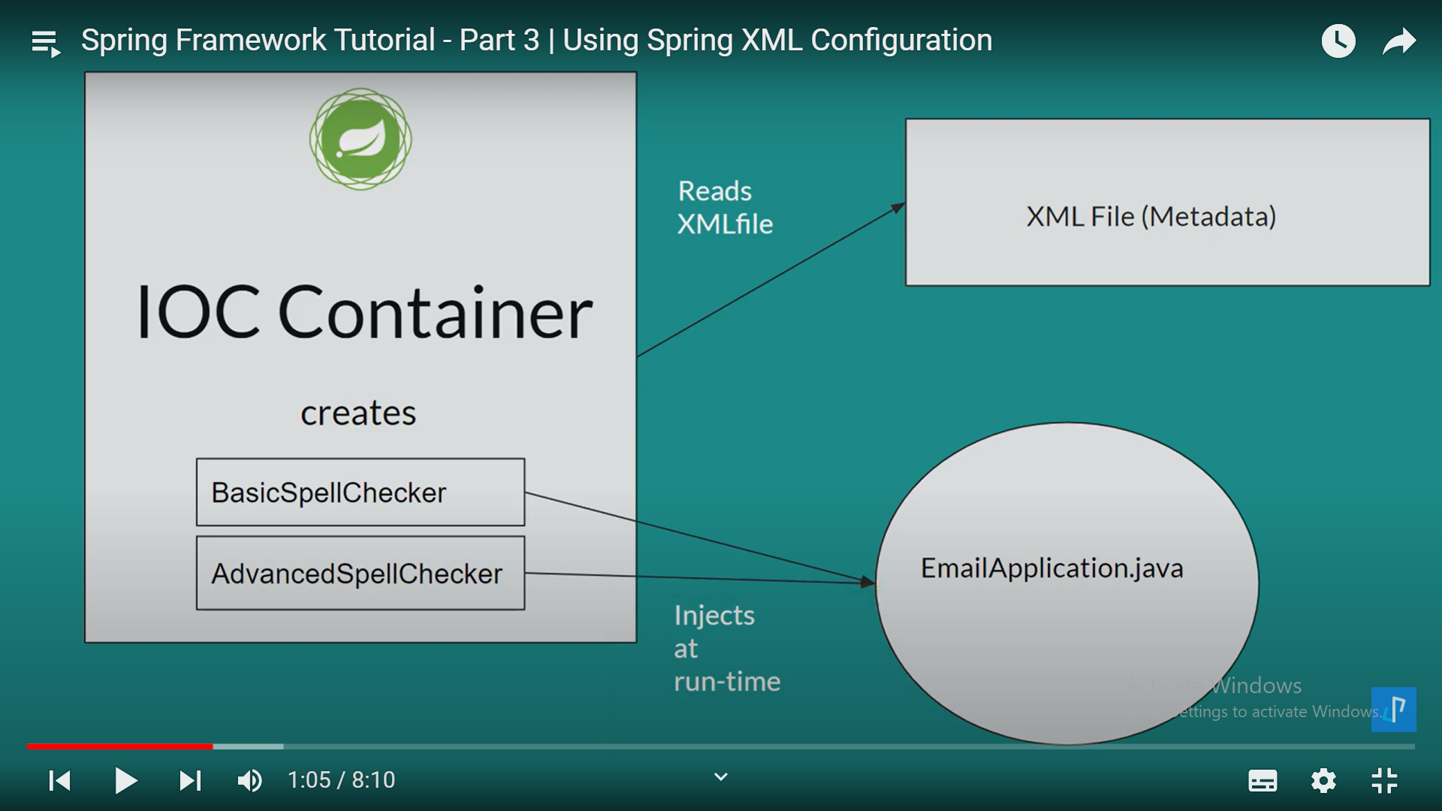

Slide 21
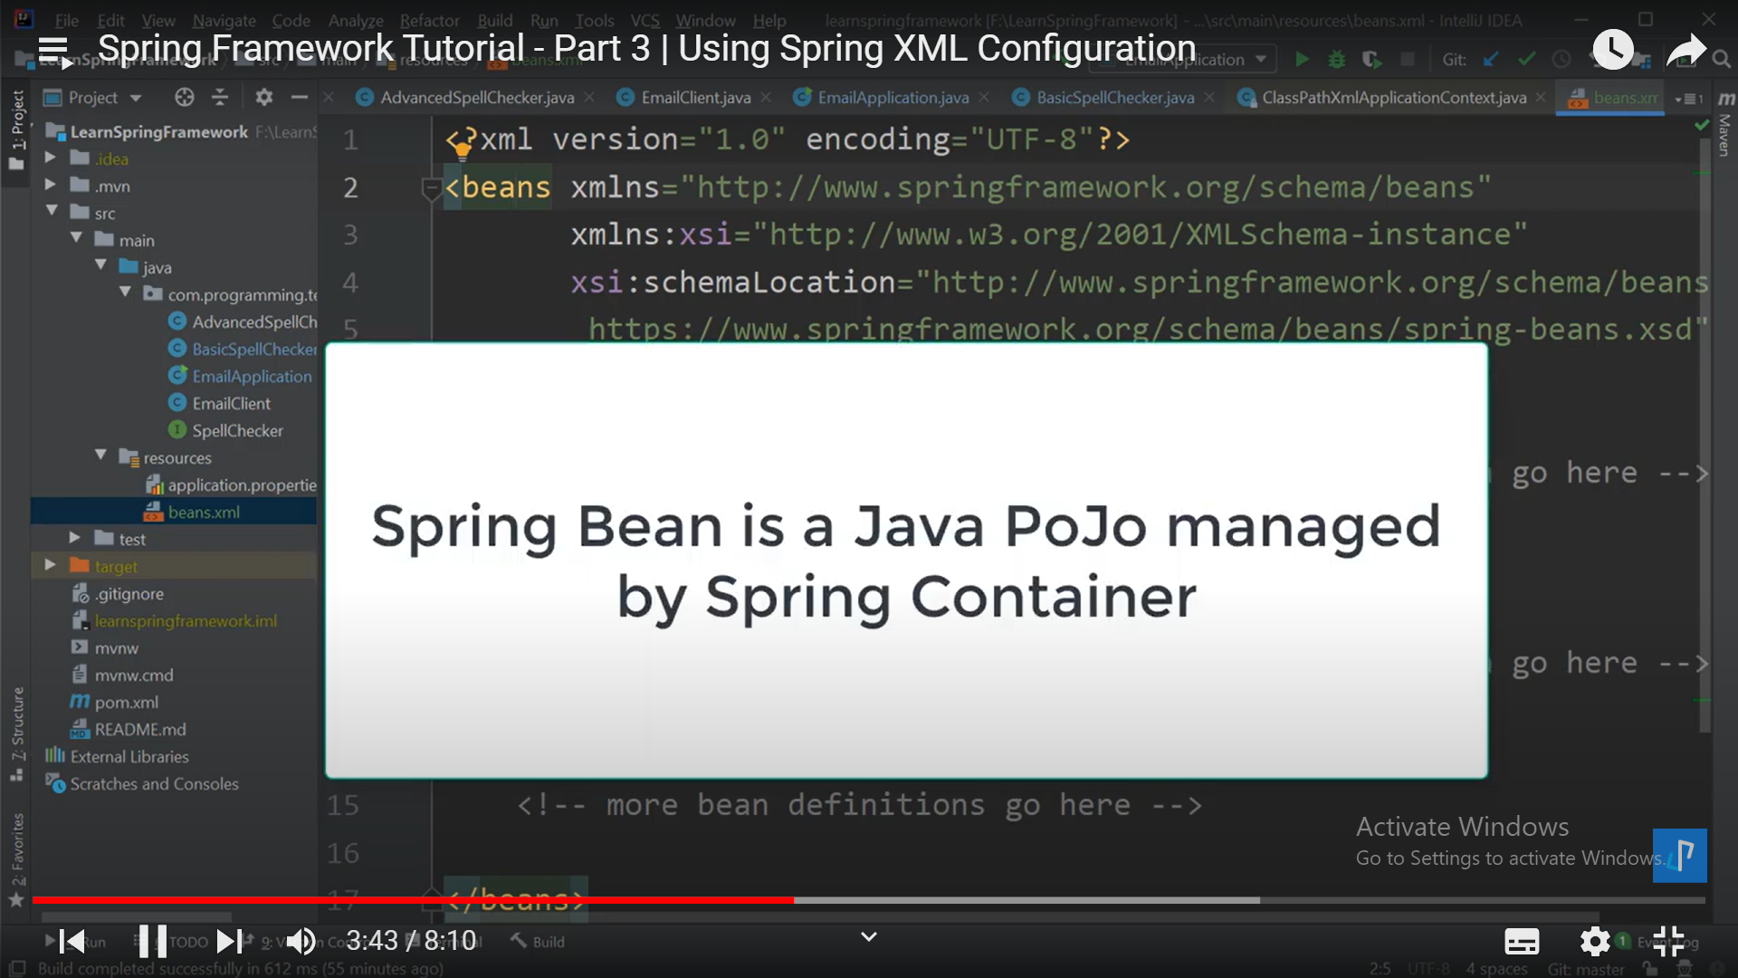
What is a Spring Bean

Slide 22
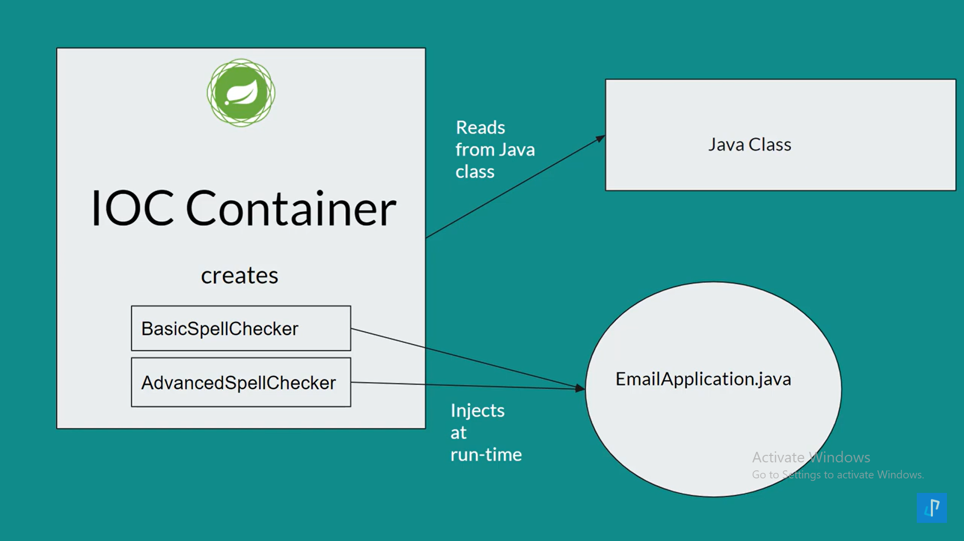

Slide 23


Slide 24
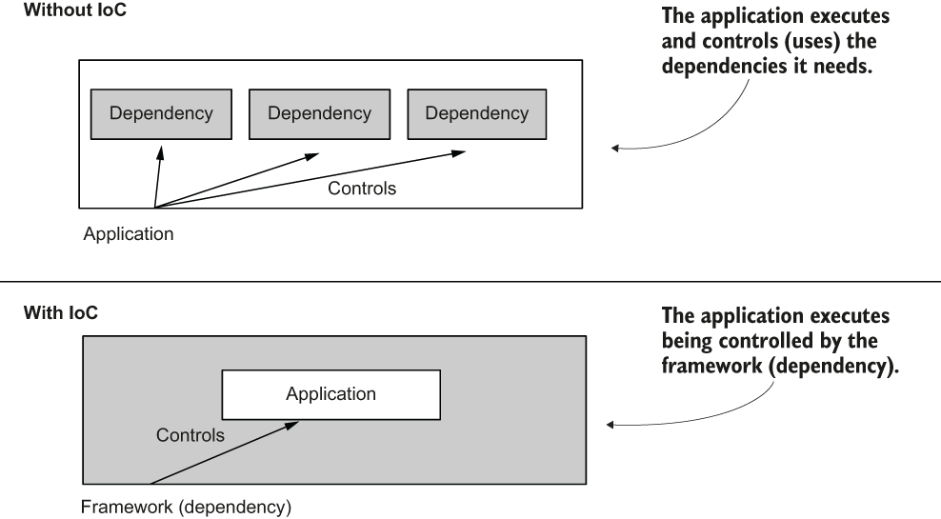
Inversion of Control

Slide 25
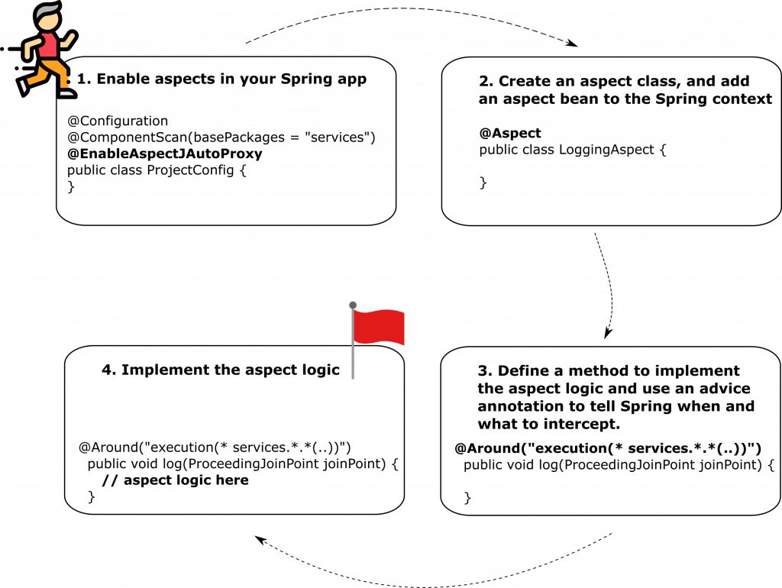
Aspects

Slide 26
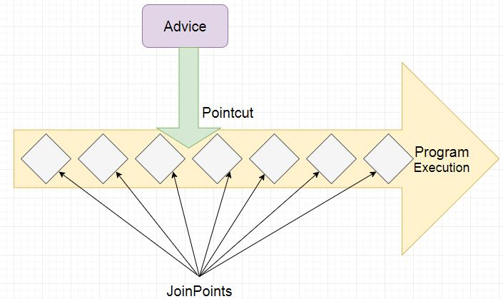
Aspect

