Slide 1
Typescript

Slide 2
Introduction of Typescript
Typescript = Javascript + A type system
Helps us catch errors during development
Uses ‘type annotations’ to analyze our code
The TS type system
Only Active during development
Does’nt provide any performance Optimization

Slide 3
TypeScript code(Javascript with type annotations)
Typescript Compiler
Browser executes plain javascript, has no idea we wrote Typescript
Plain Old Javascript

Slide 4
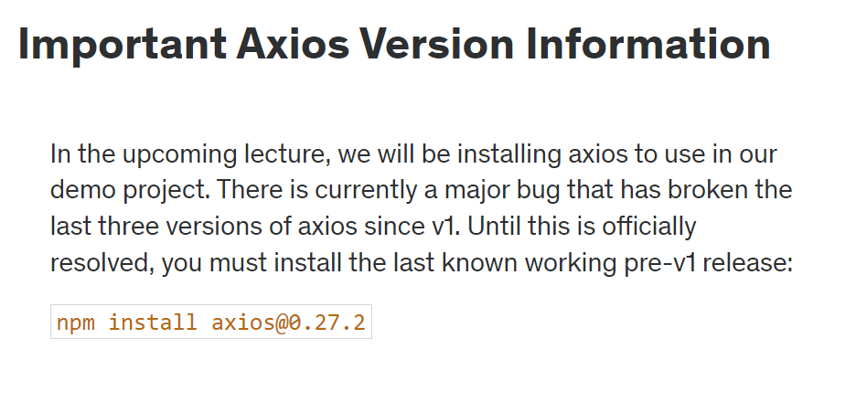

Slide 5
We developers tell typescript the type and typescript guesses the type
Type Annotations Type Inference
When to use When to use
When we declare a variable on one line
Then initialize it later Always
When we want a variable to have a type that
Can’t be inferred
When a function returns the ‘any’
Type and we need to clarify the value

Slide 6
‘false ‘ -> JSON.parse() -> boolean
‘4’ -> JSON.parse() -> number
‘{“value”:5}’ JSON.parse() -> {value:number}
‘{“name”:”Krishna”}’ JSON.parse() -> {name:string}

Slide 7
A type, just as ‘string’ or ‘boolean’
Any type Means TS has no idea what this is - can’t
Check for correct property references
Avoid variables with ‘any’ at all costs

Slide 8
Core Concepts of Webpack
Entry: Think of the entry as the front door to your application. It specifies which module Webpack should use to begin building the internal dependency graph. By default, Webpack looks at ./src/index.js, but this can be configured as per the developer’s requirements.
Output: Once Webpack bundles all the modules together, the output configuration helps in determining where to emit the bundled files and under what name. Typically, it goes into a ./dist folder as main.js.
Loaders: By default, Webpack understands only JavaScript and JSON files. But with loaders, we can instruct Webpack on how to process different types of files (like SASS or TypeScript) and convert them into valid modules.
Plugins: While loaders are used to transform certain types of modules, plugins come into play for a broader range of tasks like bundle optimization, asset management, and injecting environment variables.
Mode: Setting the mode to either development or production tells Webpack to use built-in optimizations suitable for each environment. This simplifies the configuration and helps in better debugging or performance.

Slide 9
What is Babel?
Babel is a powerful JavaScript compiler that has become an indispensable tool for developers, especially those building React applications.
At its core, Babel’s primary function is to transform cutting-edge JavaScript code into versions of JavaScript that can be interpreted by older browsers.
As developers, we constantly strive to utilize the latest and most efficient features in JavaScript. However, many of these features are not natively supported by older browsers.
Babel bridges this gap, ensuring that even users on outdated browsers can experience your React apps seamlessly.

Slide 10
Setting up Babel with Webpack
To integrate Babel with Webpack, the babel-loader is utilized. This loader ensures that all JavaScript files processed by Webpack are first passed through Babel. By configuring your webpack.config.js to use babel-loader and setting up a .babelrc file with the necessary presets and plugins, you forge a harmonious collaboration between the two tools.

Slide 11
JSX Compiler Service
This tool has been removed as JSXTransformer has been deprecated.
We recommend using another tool such as the Babel REPL.

Slide 12
What is Babel?
Babel is a tool to help us transpile newer versions of JavaScript code such as ES6 into older versions of JavaScript — it even helps you transpile TypeScript.

Slide 13
Babel reads the source code based on the configs you define for it and compiles newer JavaScript features such as arrow functions or optional chaining. This happens with Babel’s three major tools:
First, Babel’s parser takes the JavaScript code and converts it to an Abstract Syntax Tree (AST) which is the structure of the source code understandable by the computer
Next, Babel’s traverser takes the AST, explores it and modify it to the intended code we defined in our Babel configs
Lastly, Babel’s generator will translate the modified AST back to the regular code

Slide 14
