Slide 1
Git

Slide 2
Introduction
Git is a distributed revision control and source code management system with an emphasis on speed.
Git was initially designed and developed by Linus Torvalds for Linux kernel development.
Git is a free software distributed under the terms of the GNU General Public License version 2.

Slide 3
Version Control System
Version Control System (VCS) is a software that helps software developers to work together and maintain a complete history of their work.
Listed below are the functions of a VCS −
Allows developers to work simultaneously.
Does not allow overwriting each other’s changes.
Maintains a history of every version.

Slide 4
The types of VCS −
Centralized version control system (CVCS).
Distributed/Decentralized version control system (DVCS).

Slide 5
Centralized version control system (CVCS).
Centralized version control system (CVCS) uses a central server to store all files and enables team collaboration.
But the major drawback of CVCS is its single point of failure, i.e., failure of the central server.
Unfortunately, if the central server goes down for an hour, then during that hour, no one can collaborate at all. And even in a worst case, if the disk of the central server gets corrupted and proper backup has not been taken, then you will lose the entire history of the project.

Slide 6
Distributed Version Control System
DVCS clients not only check out the latest snapshot of the directory but they also fully mirror the repository.
If the server goes down, then the repository from any client can be copied back to the server to restore it.
Every checkout is a full backup of the repository.
Git does not rely on the central server and that is why you can perform many operations when you are offline.
You can commit changes, create branches, view logs, and perform other operations when you are offline. You require network connection only to publish your changes and take the latest changes.

Slide 7
Advantages of Git
Free and open source
GPL (General Public License) is a free license software that is popularly used across the world. It allows users to study, run, share, and modify the software. Git is released under GPL’s open source license
Fast and small
Most of the operations are performed locally, it gives a huge benefit in terms of speed. Git does not rely on the central server; that is why, there is no need to interact with the remote server for every operation
Implicit backup
The chances of losing data are very rare when there are multiple copies of it. Data present on any client side mirrors the repository, hence it can be used in the event of a crash or disk corruption.

Slide 8
Advantages of GIt
Security
Git uses a common cryptographic hash function called secure hash function (SHA1), to name and identify objects within its database. Every file and commit is check-summed and retrieved by its checksum at the time of checkout. It implies that, it is impossible to change file, date, and commit message and any other data from the Git database without knowing Git.
No need of powerful hardware
In case of DVCS, developers don’t interact with the server unless they need to push or pull changes. All the heavy lifting happens on the client side, so the server hardware can be very simple indeed.

Slide 9
Advantages of GIt
Easier branching
branch management with Git is very simple. It takes only a few seconds to create, delete, and merge branches.

Slide 10
Local Repository
Every VCS tool provides a private workplace as a working copy. Developers make changes in their private workplace and after commit, these changes become a part of the repository.
Git takes it one step further by providing them a private copy of the whole repository.
Users can perform many operations with this repository such as add file, remove file, rename file, move file, commit changes, and many more.

Slide 11
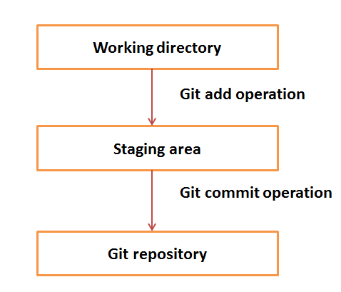
Basic workflow of Git.
Step 1 − You modify a file from the working directory.
Step 2 − You add these files to the staging area.
Step 3 − You perform commit operation that moves the files from the staging area. After push operation, it stores the changes permanently to the Git repository.

Slide 12
Suppose you modified two files, namely “sort.c” and “search.c” and you want two different commits for each operation. You can add one file in the staging area and do commit. After the first commit, repeat the same procedure for another file.

Slide 13
Install Git and Create GitHub account
Step1:
https://git-scm.com/download/win
Download from above url
Step 2: Create a local git repository
Initializing a Repository in an Existing Directory
If you have a project directory that is currently not under version control and you want to start controlling it with Git, you first need to go to that project’s directory.
for Windows:
$ cd /c/user/my_project
and type:
$ git init
This creates a new subdirectory named .git that contains all of your necessary repository files —
a Git repository skeleton. At this point, nothing in your project is tracked yet.

Slide 14
If you want to start version-controlling existing files (as opposed to an empty directory), you should probably begin tracking those files and do an initial commit. You can accomplish that with a few git add commands that specify the files you want to track, followed by a git commit:
$ git add *.c
$ git add LICENSE
$ git commit -m 'initial project version'

Slide 15
Cloning an Existing Repository
If you want to get a copy of an existing Git repository — for example, a project you’d like to
contribute to — the command you need is
git clone.
You clone a repository with git clone <url>. For example, if you want to clone the Git linkable library called libgit2, you can do so like this:
$ git clone https://github.com/libgit2/libgit2
That creates a directory named libgit2, initializes a .git directory inside it, pulls down all the data for that repository, and checks out a working copy of the latest version. If you go into the new libgit2 directory that was just created, you’ll see the project files in there, ready to be worked on or used.
If you want to clone the repository into a directory named something other than libgit2, you can specify the new directory name as an additional argument:
$ git clone https://github.com/libgit2/libgit2 mylibgit
That command does the same thing as the previous one, but the target directory is called mylibgit.

Slide 16
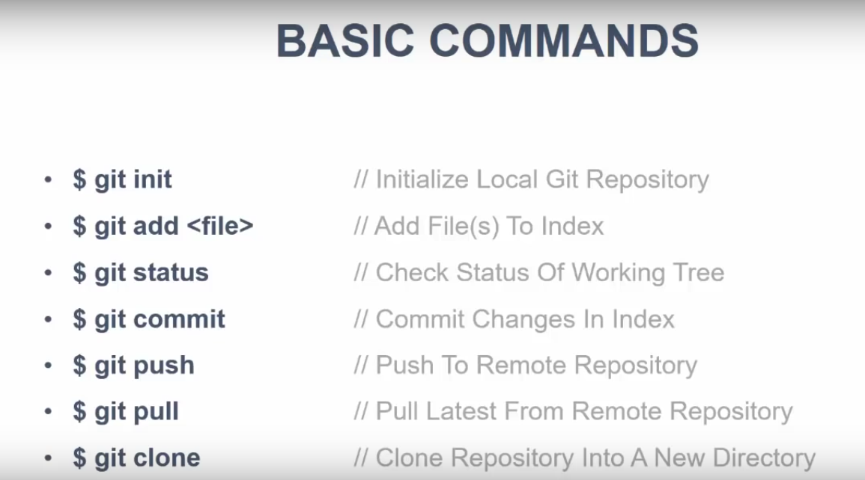

Slide 17
Bit Bucket
https://www.atlassian.com/git/tutorials/learn-git-with-bitbucket-cloud

