Slide 1
Introduction to Vectors

Slide 2
What are Vectors?
Vectors are pairs of a direction and a magnitude. We usually represent a vector with an arrow:
The direction of the arrow is the direction
of the vector, the length is the magnitude.

Slide 3
Multiples of Vectors
Given a real number c, we can multiply a vector by c by multiplying its magnitude by c:
2v
-2v
v
Notice that multiplying a vector by a
negative real number reverses the direction.

Slide 4
Adding Vectors
Two vectors can be added using the Parallelogram Law
u + v
u
v

Slide 5
Combinations
These operations can be combined.
2u
2u - v
u
v
-v

Slide 6
Components
To do computations with vectors, we place them in the plane and find their components.
v
(5,6)
(2,2)

Slide 7
Components
The initial point is the tail, the head is the terminal point. The components are obtained by subtracting coordinates of the initial point from those of the terminal point.
v
(5,6)
(2,2)

Slide 8
Components
The first component of v is 5 -2 = 3.
The second is 6 -2 = 4.
We write v = <3,4>
v
(5,6)
(2,2)

Slide 9
Magnitude
The magnitude of the vector is the length of the segment, it is written ||v||.
v
(5,6)
(2,2)

Slide 10
Scalar Multiplication
Once we have a vector in component form, the arithmetic operations are easy.
To multiply a vector by a real number, simply multiply each component by that number.
Example: If v = <3,4>, -2v = <-6,-8>

Slide 11
Addition
To add vectors, simply add their components.
For example, if v = <3,4> and w = <-2,5>,
then v + w = <1,9>.
Other combinations are possible.
For example: 4v – 2w = <16,6>.

Slide 12
Unit Vectors
A unit vector is a vector with magnitude 1.
Given a vector v, we can form a unit vector
by multiplying the vector by 1/||v||.
For example, find the unit vector in the
direction <3,4>:

Slide 13
Special Unit Vectors
A vector such as <3,4> can be written as
3<1,0> + 4<0,1>.
For this reason, these vectors are given special names: i = <1,0> and j = <0,1>.
A vector in component form v = <a,b> can be written ai + bj.

Slide 14
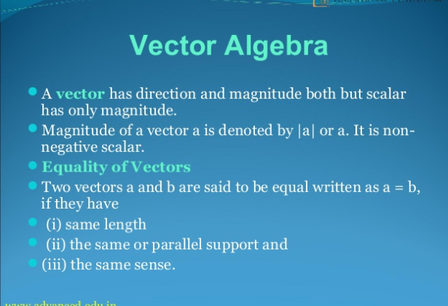

Slide 15
