Slide 1
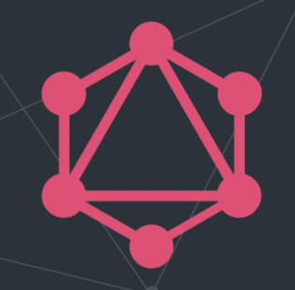
GraphQL
GraphQL is a query language (that's what the “QL” stands for) for APIs and a runtime for fulfilling those queries with your existing data
Notes:
GraphQL is a query language designed to build client application by providing an intuitive and flexible syntax for describing their data requirement. Yep, that is the most perfect definition and little bit jargon too. Let me explain that in better and easier syntax.Often endpoints without IDs just return everything and end points with ID returns full information about 1 resource. The biggest issue is you are either under fetching or over fetching information. Imagine you are over fetching 100s of IDs and making 100 API calls and then filtering just 5 values form it. It is expensive on servers. Servers like cricket information and Facebook.

Slide 2
Introduction to GraphQL
GraphQL is a query language for your API, and a server-side runtime for executing queries using a type system you define for your data. GraphQL isn't tied to any specific database or storage engine and is instead backed by your existing code and data.
A GraphQL service is created by defining types and fields on those types, then providing functions for each field on each type. For example, a GraphQL service that tells you who the logged in user is (me) as well as that user's name might look like this:

Slide 3
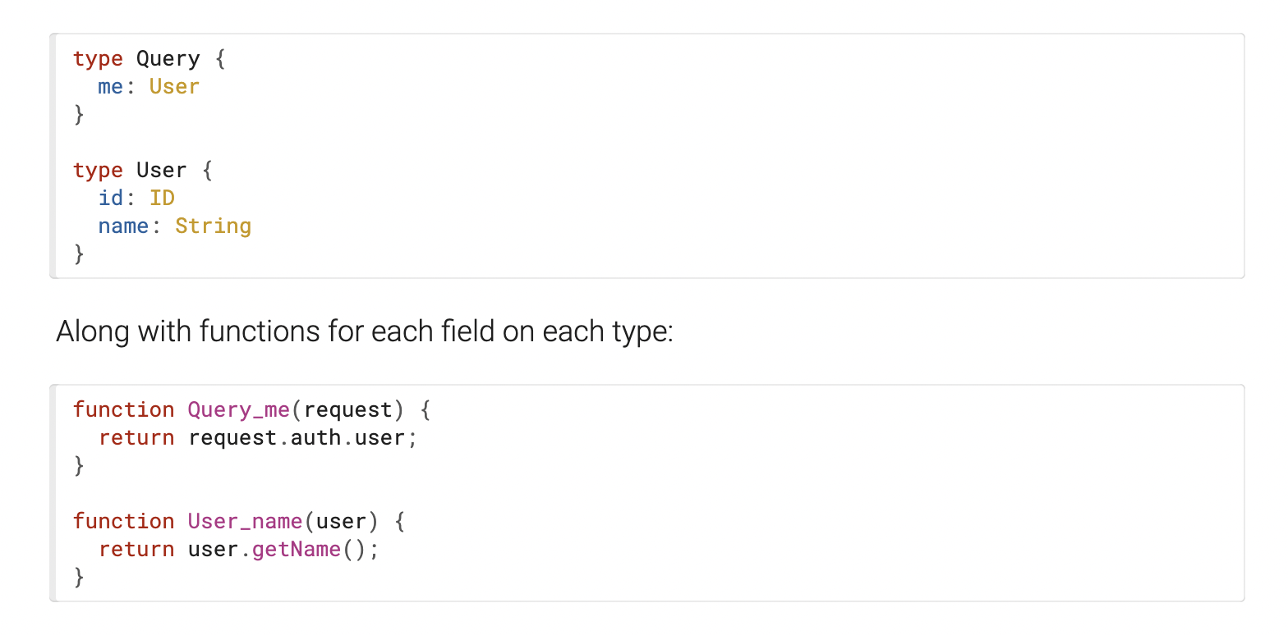

Slide 4
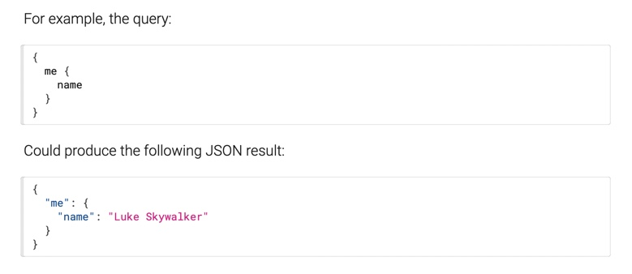
After a GraphQL service is running (typically at a URL on a web service),
it can receive GraphQL queries to validate and execute.
The service first checks a query to ensure it only refers to the types and fields defined,
and then runs the provided functions to produce a result.

Slide 5
What is GraphQL?
GraphQL is a query language and server-side runtime for application programming interfaces (APIs) that prioritizes giving clients exactly the data they request and no more.
GraphQL is designed to make APIs fast, flexible, and developer-friendly. It can even be deployed within an integrated development environment (IDE) known as GraphiQL. As an alternative to REST, GraphQL lets developers construct requests that pull data from multiple data sources in a single API call.
Additionally, GraphQL gives API maintainers the flexibility to add or deprecate fields without impacting existing queries. Developers can build APIs with whatever methods they prefer, and the GraphQL specification will ensure they function in predictable ways to clients.

Slide 6
GraphQL compared to REST Services
A REST API is an architectural concept for network-based software. GraphQL, on the other hand, is a query language, a specification, and a set of tools that operates over a single endpoint using HTTP. In addition, over the last few years, REST has been used to make new APIs, while the focus of GraphQL has been to optimize for performance and flexibility.

Slide 7
Where GraphQL Has the Upper Hand Over REST APIs
When using a REST API to fetch information, you’ll always get back a complete dataset. For example, if you wanted to request information from two objects, you’d need to perform two REST API requests. The advantage of REST APIs is its simplicity—you have one endpoint that does one task, so it’s easy to understand and manipulate. In other words, if you have X endpoint, it provides X data.
Conversely, if you wanted to gather some information from a specific endpoint, you couldn’t limit the fields that the REST API returns; you’ll always get a complete data set. This phenomenon is referred to as over fetching. GraphQL uses its query language to tailor the request to exactly what you need, from multiple objects down to specific fields within each entity. GraphQL would take X endpoint, and it can do a lot with that information, but you have to tell it what you want first.
In essence, GraphQL is extremely powerful, once you know how to use it. Because you are only fetching the data that you require, you limit the amount of processing required. As you begin to look at automation, these savings really start to add up.

Slide 8
Where REST APIs Beat Out GraphQL
REST has become the industry standard for companies deploying APIs. REST endpoints are mature and have been around for a while. Even “late-to-scene” OEMs have REST endpoints now, and if you have done any type of automation, you’re going to be familiar with REST.
Similarly, API analytics are easier to obtain for REST, due to the limited amount of tooling for GraphQL. There is a promise of more insights in the near future, once tools that support GraphQL are made more widely available.

Slide 9
Benefits of Graphql
Being less “talkative” than REST makes GraphQL way faster, as you can cut down on your request by picking only the fields you want to query. The following list shows other major advantages of using a GraphQL API in an application instead of a REST API.
Good fit for complex systems and microservices. By integrating multiple systems behind its API, GraphQL unifies them and hides their complexity. The GraphQL server is then responsible for fetching the data from the existing systems and packaging it up in the GraphQL response format. This is particularly relevant for legacy infrastructures or third-party APIs that have expanded over the years and now present a maintenance burden.

Slide 10
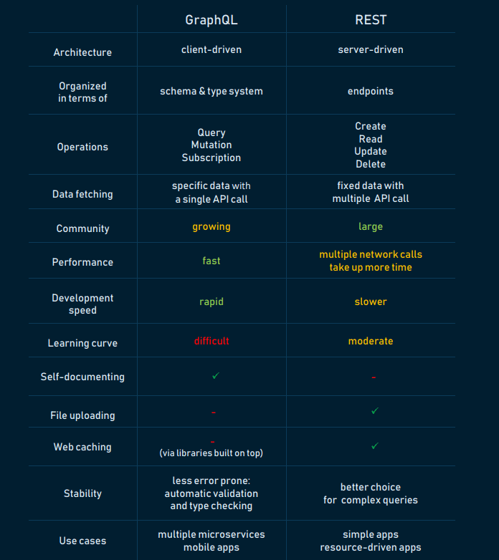
When migrating from a monolithic backend application to a microservice architecture, a GraphQL API can help handle communication between multiple microservices by merging them into one GraphQL schema. While each microservice defines its own GraphQL schema and has its own GraphQL endpoint, one GraphQL API gateway consolidates all schemas into one global schema.

Slide 11
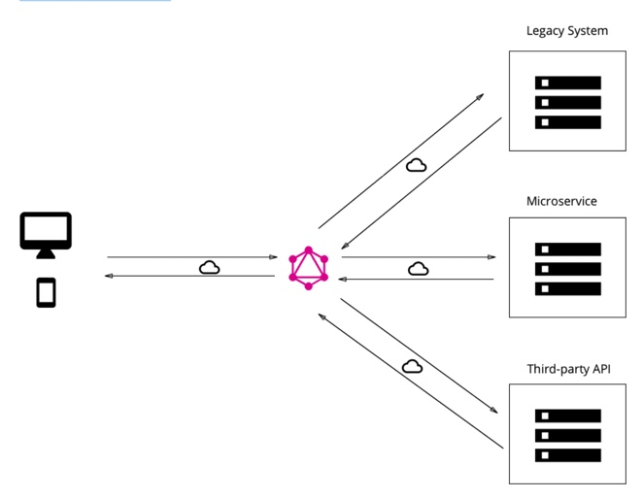
Fetching data with a single API call. The main difference between GraphQL and REST is that the latter is centered around individual endpoints, so to collect all needed data, a developer has to combine multiple endpoints. Whereas GraphQL focuses on the task itself, in this case, a developer can request the needed data with just one API call.
No over- and under-fetching problems. REST responses are known for either containing too much data or not enough of it, creating the need for another request. GraphQL solves this efficiency problem by fetching the exact data in a single request.
Caption

Slide 12
Apollo compared to Flux, Redux, and Relay
Apollo and Redux are primarily classified as "Platform as a Service" and "State Management Library" tools respectively.
Apollo vs Redux: What are the differences?
Developers describe Apollo as "GraphQL server for Express, Connect, Hapi, Koa and more". Build a universal GraphQL API on top of your existing REST APIs, so you can ship new application features fast without waiting on backend changes. On the other hand, Redux is detailed as "Predictable state container for JavaScript apps".
Redux helps you write applications that behave consistently, run in different environments (client, server, and native), and are easy to test. On top of that, it provides a great developer experience, such as live code editing combined with a time traveling debugger.

Slide 13
Apollo compared to Flux, Redux, and Relay
When developing modern React applications, at some point you need to solve the problem of managing your client-side state. Modern applications can’t afford to wait for the server to react, can’t always refetch when changing pages – they need to be reactive and feel as if everything is happening as fast as possible.
The state management layer of your application is responsible for this. You can also call it your caching layer or a model layer.
Redux and Relay are libraries for implementing this layer in your application.
Instagram, Intuit, and OpenGov are some of the popular companies that use Redux, whereas Apollo is used by CircleCI, Swat.io, and Flexport. Redux has a broader approval, being mentioned in 1036 company stacks & 836 developers stacks; compared to Apollo, which is listed in 131 company stacks and 127 developer stacks.

Slide 14
What is Redux?
It helps you write applications that behave consistently, run in different environments (client, server, and native), and are easy to test. t provides a great experience, such as live code editing combined with a time traveling debugger.

Slide 15
Benefits of GraphQL
GraphQL advantages
Good fit for complex systems and microservices. ...
Fetching data with a single API call. ...
No over- and under-fetching problems. ...
Tailoring requests to your needs. ...
Validation and type checking out-of-the-box. ...
Autogenerating API documentation. ...
API evolution without versioning. ...
Code-sharing.

