Slide 1

JIRA- SFT instance
Overview for Jira project leaders
Scheme & Associations
Issue Types
Components
Screens
Fields
Custom Fields
Github & Jira
Gitlab & Jira

Slide 2

Jira, by Atlassian
JIRA is a tool developed by Australian Company Atlassian. It is used for bug tracking, issue tracking, and project management. The name "JIRA" is actually inherited from the Japanese word "Gojira" which means "Godzilla".
The basic use of this tool is to
track issue and bugs related to your software and Mobile apps.
It is also used for project management.
The JIRA dashboard consists of many useful functions and features which make handling of issues easy.

Slide 3
JIRA Scheme
Inside JIRA scheme, everything can be configured, and it consists of
Workflows
Issue Types
Custom Fields
Screens
Field Configuration
Notifications
Permissions
All those definitions are instantiated and associated together in order to define the information that will be contained, edited and visualized in each Jira project

Slide 4
Jira scheme associations
Visibility and other properties are specified in:
Field Configuration
Field Configuration Scheme
Field
Is mapped to Issue Operation by:
Issue Type Screen Scheme
Is associated to a:
PROJECT
Visualized by placing it on:
Screen Scheme
Is mapped to Issue Types by:
Screen
Is mapped to Issue transition (Open Close …) by:
Workflow
Workflow Scheme

Slide 5
Issue types
All types of items that can be created and tracked via JIRA.
Name | type | Description
Bug | Standard | A problem which impairs or prevents the functions of the product.
Epic | Standard | Created by Jira Software - do not edit or delete. Issue type for a big user story that needs to be broken down.
Improvement | Standard | An improvement or enhancement to an existing feature or task.
Incident | Standard
Issue template (WBSGantt) | Standard | Issue template
New Feature | Standard | A new feature of the product, which has yet to be developed.
Question | Standard
Story | Standard | Created by Jira Software - do not edit or delete. Issue type for a user story.
Suggestion | Standard
support | Standard | New issue type for support tickets required from Savannah import.
Task | Standard | A task that needs to be done.
Bug sub-task | Sub-Task
Improvement sub-task | Sub-Task
Sub-task | sub-task | The sub-task of the issue
Technical task | Sub-Task | A technical task.

Slide 6
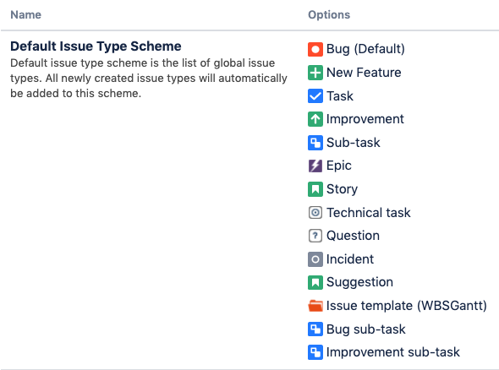
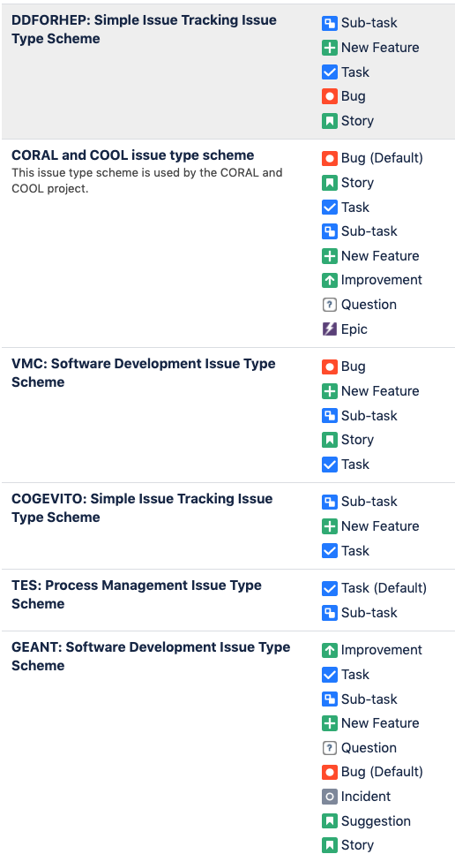
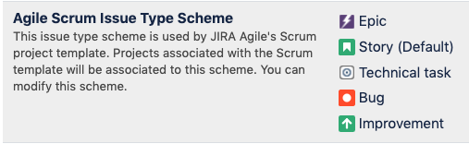
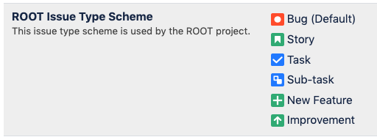
Issue schemes
An Issue scheme in Jira is a collection of different types of Jira Issues

Slide 7
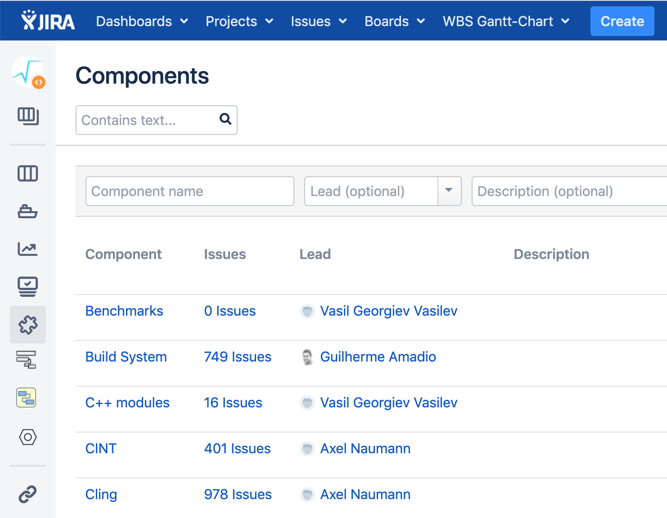
Components
Components are sub-sections of a project; they are used to group issues within a project into smaller parts.
Components add some structures to the projects, breaking it up into features, teams, modules, subprojects and more.
Using components you can generate reports, collect statistics, and display it on dashboards and so on.
To add new components, as shown in the screen below, you can add name, description, component lead and default assignee.

Slide 8
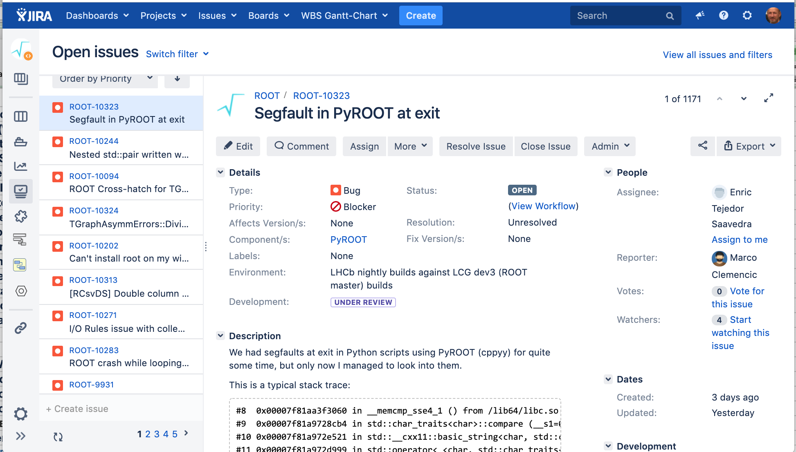
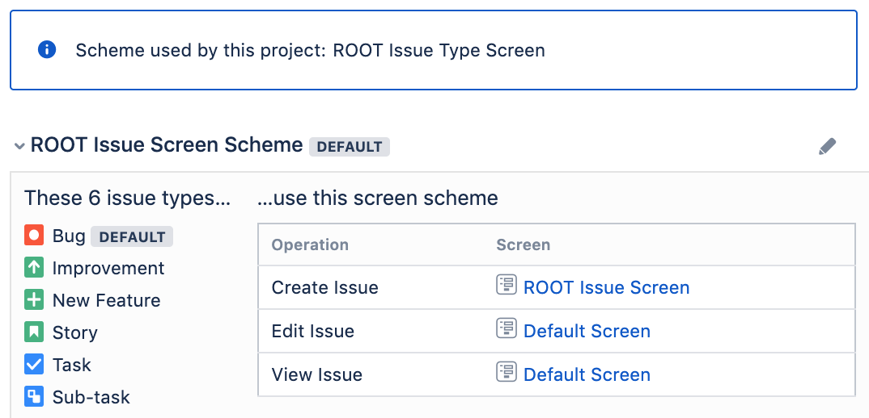
Jira Screen
“Screen”, is used by Jira to build the interface in order to create, modify and display an issue.
A Screen is defined with
a name and description
…. it needs to be configured by adding a list of fields
In order to associate a Screen to an issue operation it is needed to create a “Screen Scheme” by assigning a name a description and a “Screen”
To add or associate an issue operation with a screen you have to:
go in main menu and click on Issues
then click on Screen Schemes and
then click on "Associate an issue operation with a screen" and
add the screen according to the requirement.
In this example the specified fields of a “bug” issue type are displayed by using the following screen:

Slide 9
Jira Fields
Actual End
Actual Start
Affects Version/s
Approver
Ariadne
Assignee
Attachment
Baseline Effort
Baseline End
Baseline finish date (WBSGantt)
Baseline Start
Baseline start date (WBSGantt)
Bug / Feature
Business Value
Cause
Change scope
Comment
Component/s
Customer
Date of Baselining
Description REQUIRED
Destination sites
Development LOCKED
Due Date
Effort
Environment
Epic Colour LOCKED
Epic Link LOCKED
Epic Name REQUIRED LOCKED
Epic Status LOCKED
Epic/Theme
External issue ID
External issue URL
External reporter
Finish date (WBSGantt)
Fix Version/s
Flagged
Gantt Chart
Gantt Options
Group watchers
Issue Type REQUIRED
Item Group
Labels
Latest End
Latest Start
Linked Issues
Locking
Log Work
Manually scheduled (WBSGantt)
Milestone (WBSGantt)
MS-Project ID
Operating System
Original Reporter
Originator Email
Other Custom Fields
Output types
Percent Complete
PercentDone
Planned End
Planned Release
Planned Start
PlannedEnd
PlannedStart
Platforms
Priority
Progress (WBSGantt)
Project/Package
Rank (Obsolete)
Rank (Obsolete) LOCKED
Rank LOCKED
Release Version History
Reporter REQUIRED
Request/Incident domain
Resolution
Savana Fields Container
Savannah Fields Container
Security Level
Severity
Should Start On
Sprint LOCKED
Start date (WBSGantt)
Story Points
Summary REQUIRED
Tag
Time Tracking
Units (WBSGantt)
Velocity %

Slide 10
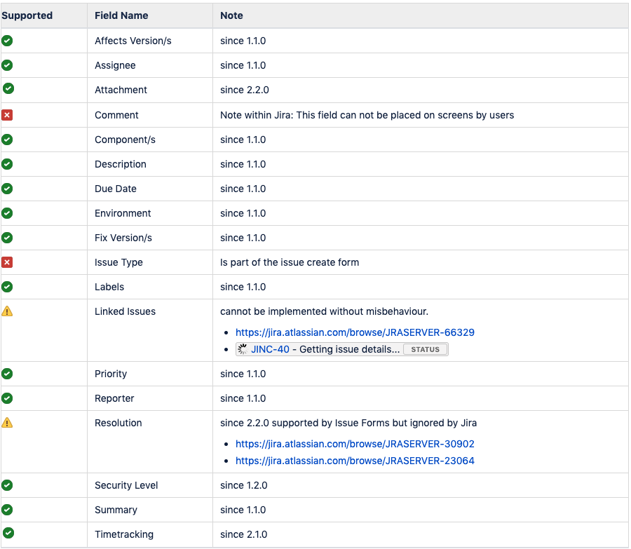
Jira Core standard Fields
Source: https://aevolu.atlassian.net/wiki/spaces/JINC/pages/58884098/List+of+supported+Custom+Fields+and+Custom+Field+Types

Slide 11
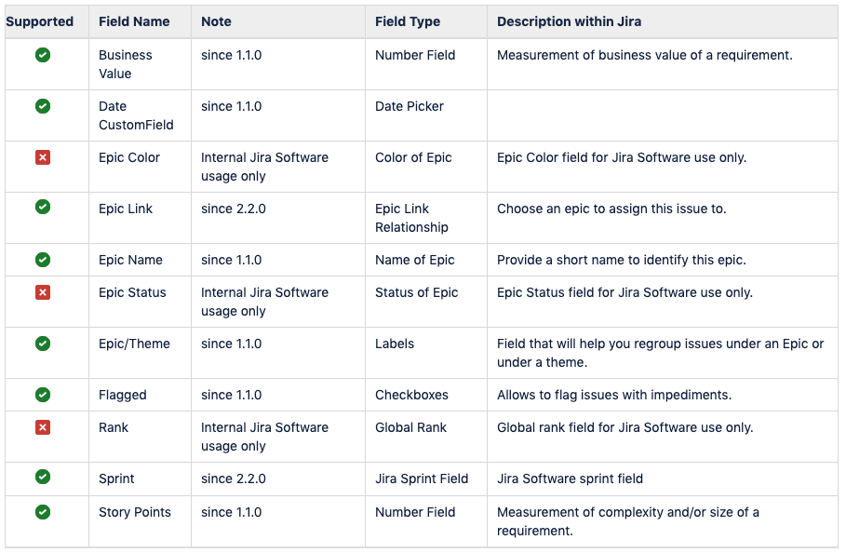
Jira Software standard Custom Fields
Source: https://aevolu.atlassian.net/wiki/spaces/JINC/pages/58884098/List+of+supported+Custom+Fields+and+Custom+Field+Types

Slide 12
Custom fields
It is possible to create new customized fields for each project whenever there is need for that.
It may be useful in some cases to use project specific custom fields because the projects are dynamic and may change their requirements in time. For example, using a “field” with values from a predefined list, it may be a problem if it is needed to modify the list in case it is used by other projects also in the same Jira instance.
Jira disposes of a wide type of field types that may be chosen from a predefined list which is shown in the next slide

Slide 13
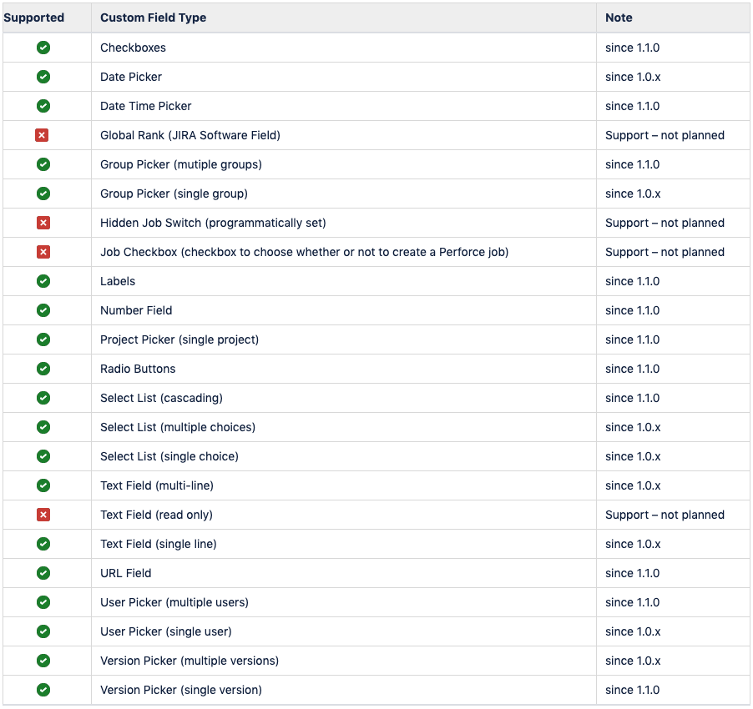
Standard Custom Field Types
Source: https://aevolu.atlassian.net/wiki/spaces/JINC/pages/58884098/List+of+supported+Custom+Fields+and+Custom+Field+Types

Slide 14
SFT Jira projects
Project | Key | Project lead | Project category | Last issue update | Issues
Complex Geometry Visualizzation Tool | COGEVITO | Ilias Goulas | Applications Area | 25.Jun.19 | 18
CernVM | CVM | Gerardo Ganis | No category | 14.Jul.19 | 1,782
CF4hep | CFHEP | Pere Mato Vila | No category | 21.Dec.17 | 183
CORAL and COOL | CORALCOOL | Charles Delort | No category | 05.Jul.19 | 3,038
DD4hep | DDFORHEP | Markus Frank | No category | 26.Aug.16 | 24
FCC Experiments Software | FCC | Colin Bernet | No category | 10.Oct.16 | 65
Geant detector simulation prototype | GEANT | Pere Mato Vila | No category | 04.Jun.19 | 398
GEANT-VAL | GEANTVAL | Dmitri Konstantinov | No category | 15.Jul.19 | 65
HepMC - a C++ Event Record for Monte Carlo Generators | HEPMC | Witold Pokorski | No category | 26.May.17 | 186
Issue Tracking test project | ITTP | Alvaro Gonzalez Alvarez | No category | 21.Sep.16 | 3
LHCb Deployment | LHCBDEP | Ben Couturier | No category | 31.May.18 | 3,805
MC Generator Services | GENSER | Witold Pokorski | No category | 07.Jun.19 | 428
Persistency Framework (OBSOLETE) | PF | Andrea Valassi | Applications Area | -- | --
podio | PODIO | Alvaro Gonzalez Alvarez | No category | 03.Oct.16 | 13
PROOF | PROOF | Gerardo Ganis | No category | 19.Dec.14 | 34
ROOT | ROOT | Axel Naumann | No category | 13.Jul.19 | 10,209
Simulation | SIM | Gabriele Cosmo | No category | 11.Jul.19 | 744
SPI | SPI | Gerardo Ganis | Applications Area | 14.Jul.19 | 1,356
Test Project | TP | Ilias Goulas | No category | 23.Apr.19 | 6
TestProject | TES | Alvaro Gonzalez Alvarez | No category | 22.May.19 | 5
VecGeom | VECGEOM | Gabriele Cosmo | No category | 14.Jul.19 | 531
Virtual Monte Carlo | VMC | Ivana Hrivnacova | No category | 20.Aug.18 | 11

Slide 15

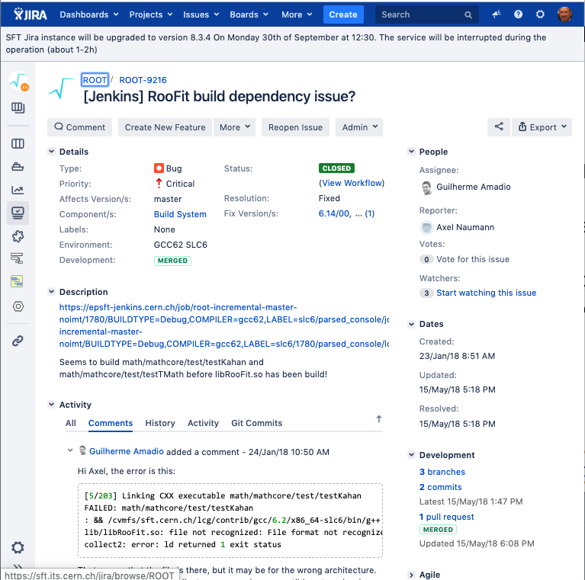
Jira and GitHub
Connect Jira Cloud to GitHub
When GitHub is linked to JIRA Software, branches, commit messages and pull requests are all seamlessly referenced in JIRA Software issues.
This allows JIRA Software to display information about your development activity in the corresponding issue
https://confluence.atlassian.com/adminjiracloud/connect-jira-cloud-to-github-814188429.html

Slide 16

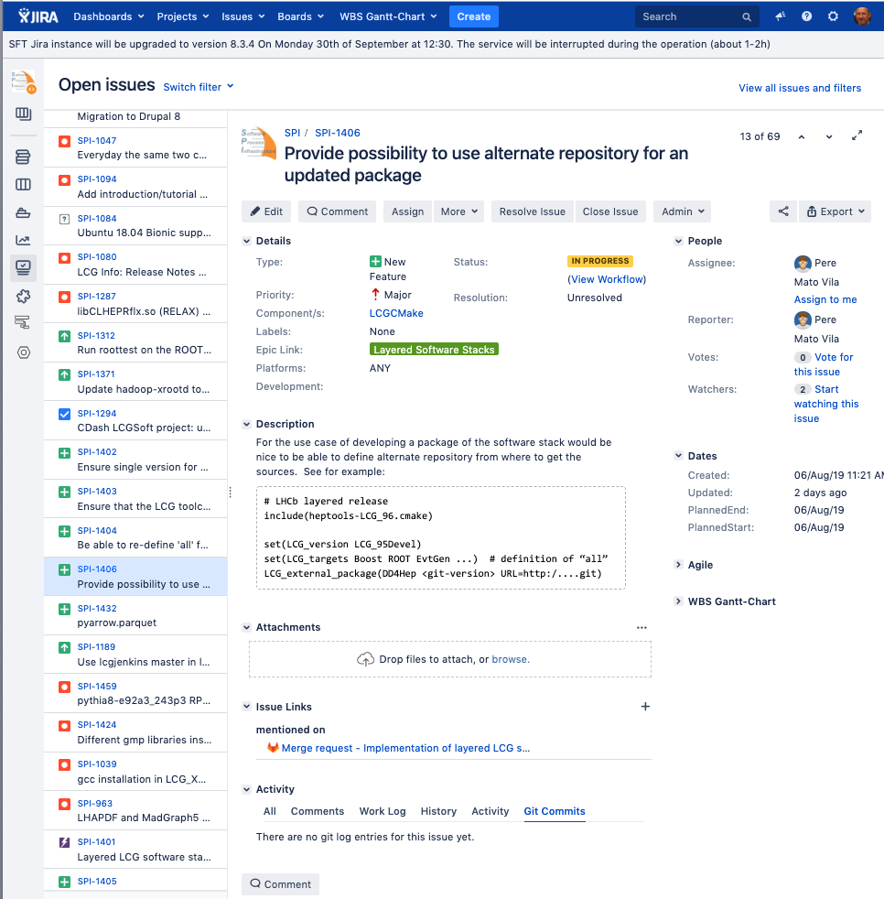
Jira and GitLab
GitLab Jira integration
Once the GitLab project is integrated with the Jira instance, its possible to automatically detect and cross-reference activity between the GitLab project and any of project in Jira.
This includes the ability to close or transition Jira issues when the work is completed in GitLab.
https://docs.gitlab.com/ee/user/project/integrations/jira.html

Slide 17
Conclusion
The SFT Jira instance is a private instance which is maintained by our group for all functional aspects and we ask for the support of IT for specific issues like “upgrade” or for complex problems that we cannot solve.
It has the advantage of being able to define as many new specific “Screens” and “Custom fields” as needed for the best functionality of our projects. This is not possible in the central instance of Jira because of the high number of projects.

