Slide 1






SUMMER
INNOVATION
Challenge
La Gironde

Slide 2



SUMMER
INNOVATION
Week 1
Week 2
Week 3
Week 4
La Gironde

Slide 3
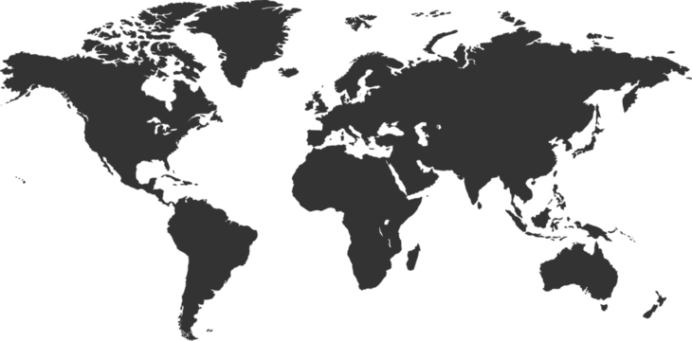

SUMMER
INNOVATION
CHALLENGE
Week 1
Week 2
Week 3
Week 4

Slide 4
SUMMER
INNOVATION
CHALLENGE
Week 2
Week 1
Week 3
Week 4

Slide 5
SUMMER
INNOVATION
CHALLENGE
Week 3
Week 2
Week 1
Week 4

Slide 6

SUMMER
INNOVATION
CHALLENGE
Week 4
Week 3
Week 2
Week 1

Slide 7
SUMMER
INNOVATION
Week 1
Week 2
Week 3
Week 4
CHALLENGE

Slide 8
SUMMER
INNOVATION
Challenge
La Gironde

Slide 9
Week 1
Week 2
Week 3
Week 4
SUMMER
INNOVATION
CHALLENGE
La Gironde

Slide 10
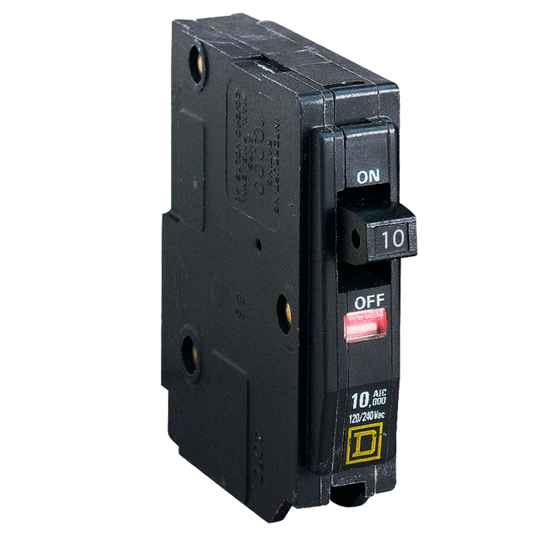




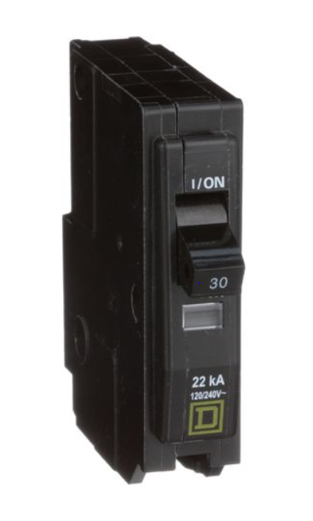

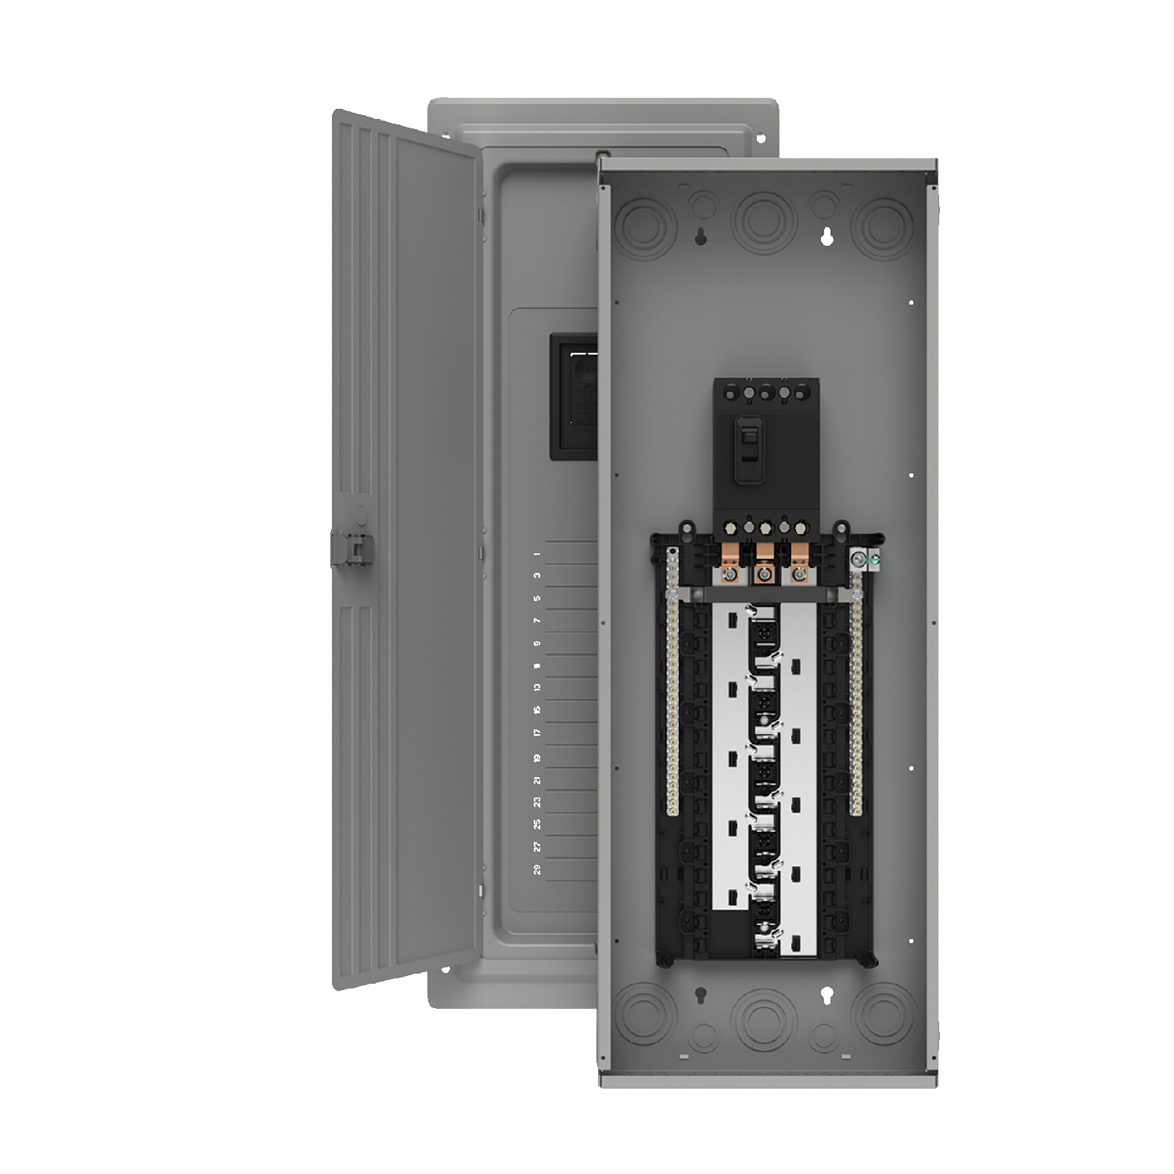

Interruptor Square D

Slide 11
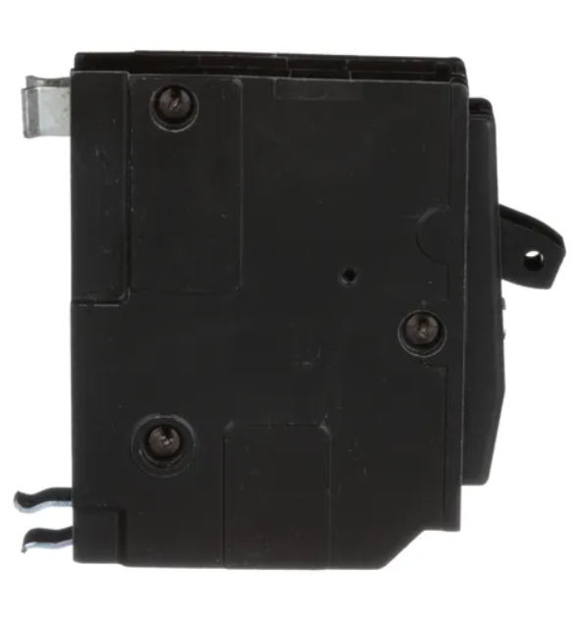
Interruptor Square D

Slide 12
Interruptor Square D

Slide 13
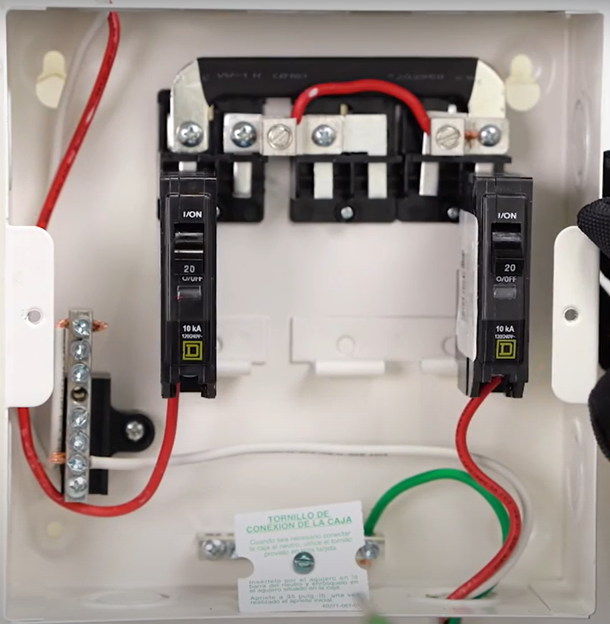

Slide 14
