Slide 1

Let’s get fun! Tool DEMO

Slide 2
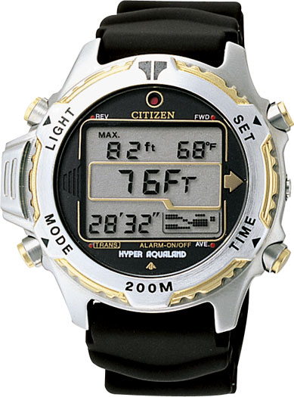
The citizen watch
Button
a
Initial
alarm 1
T1
start
a
Display
displays
a
T2
alarm 2
David Harel. 1987. Statecharts: A visual formalism for complex systems. Sci. Comput. Program. 8, 3 (June 1987), 231-274.

Slide 3
The citizen watch
Initial
alarm 1
T1
doActivity
while(alarm1.active){
println(‘(1) beep’)
}
start
a
displays
a
doActivity
while(alarm1.active){
println(‘(2) beep’)
}
T2
alarm 2
Core FSM: State Machine, States, Transitions, Triggers
Imperative Language: Program, Loop, Conditions, …
David Harel. 1987. Statecharts: A visual formalism for complex systems. Sci. Comput. Program. 8, 3 (June 1987), 231-274.

Slide 4
The citizen watch
Provided
Interface
Core FSM: State Machine, States, Transitions, Triggers
Imperative Language: Program, Loop, Conditions, …
Required
Interface
aggregation

Slide 5
The citizen watch
Initial
alarm 1
T1 OR t1
doActivity
while(alarm1.active){
println(‘(1) beep’)
}
start
a
displays
a
doActivity
while(alarm1.active){
println(‘(2) beep’)
}
T2 OR t2
alarm 2
Core FSM: State Machine, States, Transitions, Triggers
Complex Triggers: AND, OR, NOR
David Harel. 1987. Statecharts: A visual formalism for complex systems. Sci. Comput. Program. 8, 3 (June 1987), 231-274.

Slide 6
The citizen watch
Initial
Initial
alarm 1
alarm 1
T1
T1
start
a
start
a
displays
a
displays
T2
T2
alarm 2
alarm 2
Core FSM: State Machine, States, Transitions, Triggers
+
CompositeStates: CompositeState, …
David Harel. 1987. Statecharts: A visual formalism for complex systems. Sci. Comput. Program. 8, 3 (June 1987), 231-274.

Slide 7
The citizen watch
Initial
alarm 1
T1
doActivity
while(alarm1.active){
println(‘(1) beep’)
}
start
a
displays
doActivity
while(alarm1.active){
println(‘(2) beep’)
}
T2
alarm 2
Core FSM: State Machine, States, Transitions, Triggers
+
CompositeStates: CompositeState, …
David Harel. 1987. Statecharts: A visual formalism for complex systems. Sci. Comput. Program. 8, 3 (June 1987), 231-274.

Slide 8
The citizen watch
Provided
Interface
Core FSM: State Machine, States, Transitions, Triggers
Imperative Language: Program, Loop, Conditions, …
Required
Interface
Extension Point
aggregation
Extension
extension
CompositeStates: CompositeState, …

Slide 9

Some cool features coming…
Melange
From Variability Models to Software Languages Engineering in the Large

Slide 10
Some cool features coming…
Structural heterogeneities

Slide 11

FOR YOUR ATTENTION, THANK YOU! QUESTIONS, COMMENTS, FEEDBACK?

