Slide 1

Modular Design of xDSML Tool DEMO

Slide 2
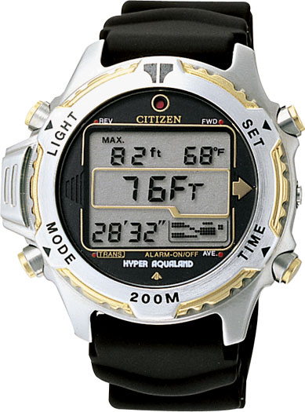
The citizen watch
Button
a
Initial
alarm 1
T1
start
a
Display
displays
a
T2
alarm 2
David Harel. 1987. Statecharts: A visual formalism for complex systems. Sci. Comput. Program. 8, 3 (June 1987), 231-274.

Slide 3
The citizen watch
Initial
alarm 1
T1
doActivity
while(alarm1.active){
println(‘(1) beep’)
}
start
a
displays
a
doActivity
while(alarm1.active){
println(‘(2) beep’)
}
T2
alarm 2
Core FSM: State Machine, States, Transitions, Triggers
Imperative Language: Program, Loop, Conditions, …
David Harel. 1987. Statecharts: A visual formalism for complex systems. Sci. Comput. Program. 8, 3 (June 1987), 231-274.

Slide 4
The citizen watch
Provided
Interface
Core FSM: State Machine, States, Transitions, Triggers
Imperative Language: Program, Loop, Conditions, …
Required
Interface

Slide 5
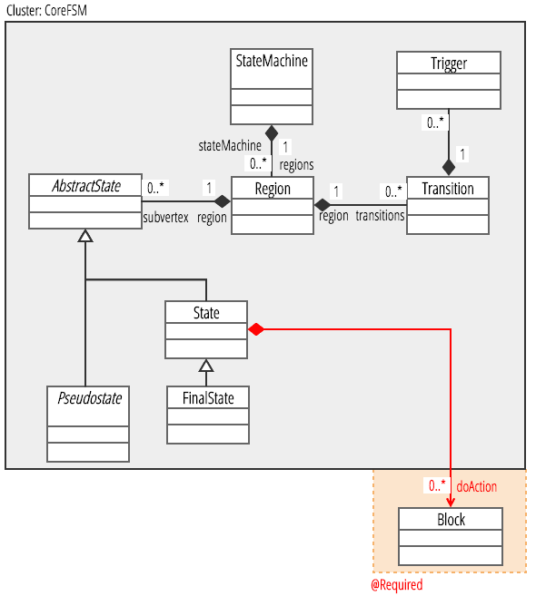
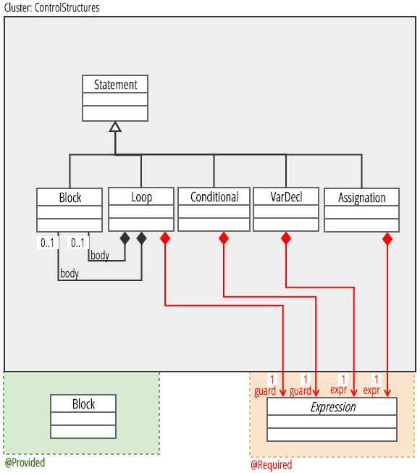
The citizen watch

Slide 6
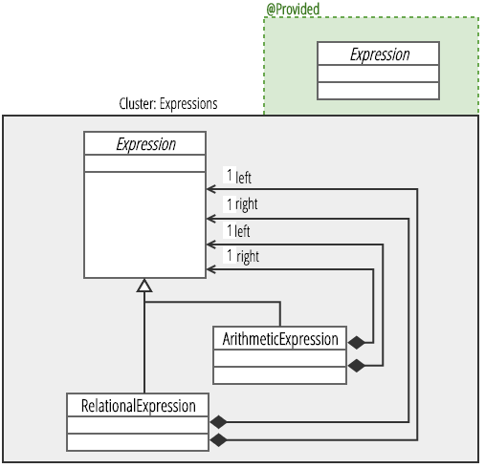
The citizen watch

Slide 7
The citizen watch
Initial
alarm 1
T1 AND OK
doActivity
while(alarm1.active){
println(‘(1) beep’)
}
start
a
displays
!a
doActivity
while(alarm1.active){
println(‘(2) beep’)
}
T2 OR t2
alarm 2
Core FSM: State Machine, States, Transitions, Triggers
Complex Triggers: AND, OR, NOT
David Harel. 1987. Statecharts: A visual formalism for complex systems. Sci. Comput. Program. 8, 3 (June 1987), 231-274.

Slide 8
The citizen watch
Provided
Interface
Core FSM: State Machine, States, Transitions, Triggers
Imperative Language: Program, Loop, Conditions, …
Required
Interface
Provided
Interface
(Ext. Point)
Required
Interface
Complex Triggers: AND,
OR, NOT

Slide 9
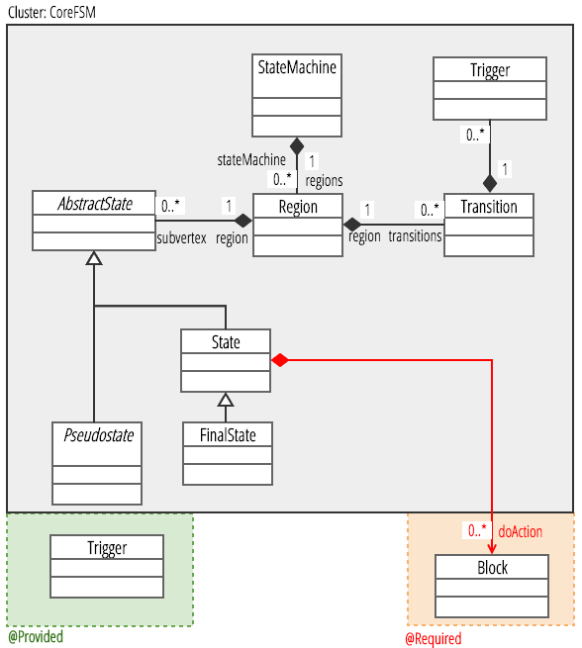
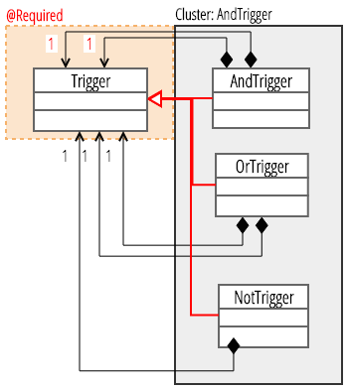
The citizen watch

Slide 10
The citizen watch
Initial
Initial
alarm 1
alarm 1
T1 AND OK
T1 AND OK
start
a
start
a
displays
!a
displays
T2 OR t2
T2 OR t2
alarm 2
alarm 2
Core FSM: State Machine, States, Transitions, Triggers
+
CompositeStates: CompositeState, …
David Harel. 1987. Statecharts: A visual formalism for complex systems. Sci. Comput. Program. 8, 3 (June 1987), 231-274.

Slide 11
The citizen watch
Initial
alarm 1
T1
doActivity
while(alarm1.active){
println(‘(1) beep’)
}
start
a
displays
doActivity
while(alarm1.active){
println(‘(2) beep’)
}
T2
alarm 2
Core FSM: State Machine, States, Transitions, Triggers
+
CompositeStates: CompositeState, …
David Harel. 1987. Statecharts: A visual formalism for complex systems. Sci. Comput. Program. 8, 3 (June 1987), 231-274.

Slide 12
The citizen watch
Provided
Interface
Core FSM: State Machine, States, Transitions, Triggers
Imperative Language: Program, Loop, Conditions, …
Required
Interface
Provided
Interface
(Ext. Point)
Required
Interface
Required
Interface
Complex Triggers: AND,
OR, NOT
Hierarchical FSM: Composite States, …

Slide 13
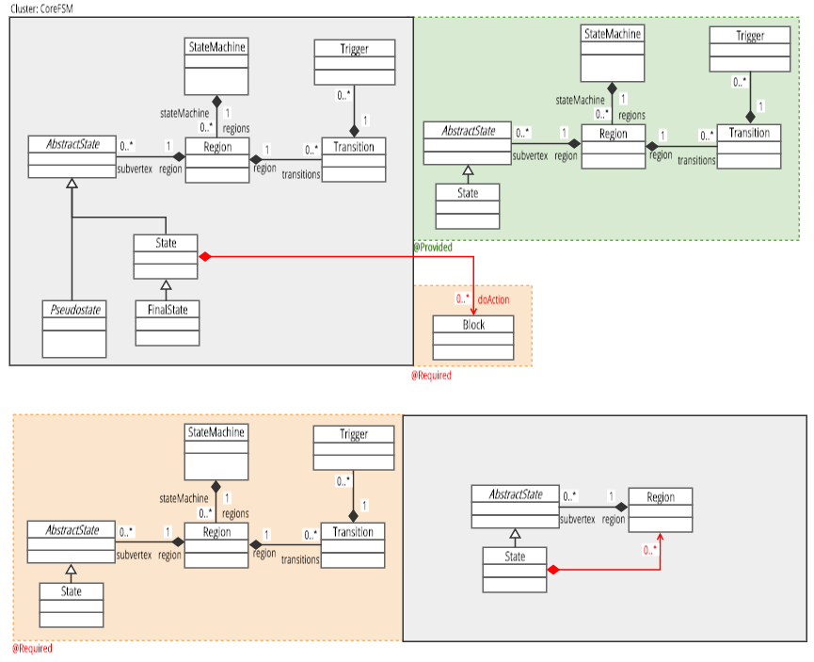
The citizen watch

