Slide 1


Department of Information Technology
V R Siddhartha Engineering College
3D Interior Layout Generation from CAD-Based Floor Plan Files
B.Tech in Information Technology
MAJOR Project Review Presentation
Batch-18
Presented by
D.Harika (228W1A1280)
K.Yashmitha (228W1A1298)
Under the guidance of
Dr. Y. Sandeep
Sr. Assistant Professor

Slide 2
Agenda
Introduction and Project Evolution
Motivation
Problem Statement
Objectives and Outcomes
Literature Survey
Dataset and Requirements
Architecture Diagram
Methodology
Algorithms used
Complete Results
Results Analysis
References

Slide 3
Introduction
Converting 2D CAD floor plans into 3D interior models is an essential task in architecture and interior design.
Traditional methods require manual modeling, which is time-consuming and prone to errors.
This project proposes an automated system to transform CAD-based floor plan files (DXF format) into interactive 3D room layouts.
The system extracts structural elements such as walls, doors, and windows and converts them into a structured format for 3D visualization.
It also integrates modern technologies to provide realistic and interactive interior design experiences.
The goal is to improve efficiency, accuracy, and ease of visualization in interior planning.

Slide 4
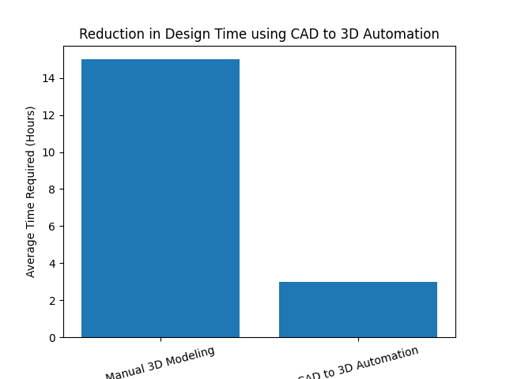
Motivation
• Manual 3D modeling from floor plans is time-consuming and labor-intensive.
• Designers recreate walls, doors, and windows manually in 3D tools.
• Errors may occur during manual interpretation of 2D drawings.
• Need for automated conversion from CAD floor plans to 3D models.
• Proposed system reduces design time and improves efficiency.

Slide 5
Problem Statement
Designing 3D interior models from 2D CAD floor plans is a time-consuming and manual process.
Architects and designers typically recreate walls, doors, and windows manually in 3D modeling software based on 2D drawings. This process:
Requires significant time and technical expertise
Increases the possibility of human errors
Leads to inefficiencies in visualization and modification
Slows down the interior planning workflow
There is a need for an automated system that can directly convert CAD-based floor plan files into structured 3D interior layouts without manual reconstruction.

Slide 6
Objectives
To automate the conversion of CAD floor plans into 3D interior models. • To extract walls, doors, and windows from DXF files. • To convert CAD data into structured JSON format.
Outcomes
• Accurate extraction of structural elements from CAD files. • Automatic generation of 3D interior layouts. • Reduction in manual modeling time and effort. • Improved efficiency in interior design visualization.

Slide 7
Literature Survey
Title & Publication Details | Model / Techniques Used | Purpose & Evaluation Metrics | Remarks
From Blueprints to Reality: Converting 2D Plans into 3D Models (Sep 2025) | Computer vision + vector extraction + automation pipeline | Automate 2D blueprint → 3D model conversion. Evaluated on accuracy of geometry conversion and prototyping utility. | Focuses on bridging 2D drafting and interactive 3D spaces using vision and CAD extraction.
Sketch2BIM: A Human-AI Pipeline to Convert Hand-Drawn Floor Plans to 3D BIM (Oct 2025, arXiv) | Multi-agent framework with MLLMs + semantic layout → BIM scripting | Converts unscaled hand-drawn plans into 3D BIM. Metrics: precision, recall, F1 score, geometric error RMSE/MAE. | Combines AI and refinement feedback for robust extraction and semantic alignment.
CHOrD: Digital Twins for 3D Indoor Scenes (Mar 2025, arXiv) | 2D image layout + scene synthesis pipeline | Create collision-free, house-scale indoor digital twins from layout representations. Evaluated on dataset performance and layout coherence. | Not straight 2D-to-3D but relevant to 3D scene generation with geometric and semantic constraints.

Slide 8
Literature Survey
Title & Publication Details | Model / Techniques Used | Purpose & Evaluation Metrics | Remarks
MitUNet: Hybrid Mix-Transformer + U-Net for Floor Plan Segmentation (Dec 2025, arXiv) | Mix-Transformer encoder + scSE-U-Net decoder, Tversky loss function | Improves segmentation accuracy for thin and complex floor plan structures. Evaluation metrics: F1-score, IoU, boundary accuracy. | Highly useful as a preprocessing stage in automated 2D-to-3D reconstruction pipelines. Enhances structural extraction precision.
Automatic Floor Plan Analysis: Methods & Applications (Review) (Oct 2025, ScienceDirect) | Comprehensive survey of segmentation, detection, recognition, and reconstruction techniques | Reviews automation methods for floor plan understanding. Evaluated qualitatively based on task coverage and application effectiveness. | Provides strong theoretical foundation and identifies research gaps in 2D floor plan digitization and 3D model generation workflows.

Slide 9
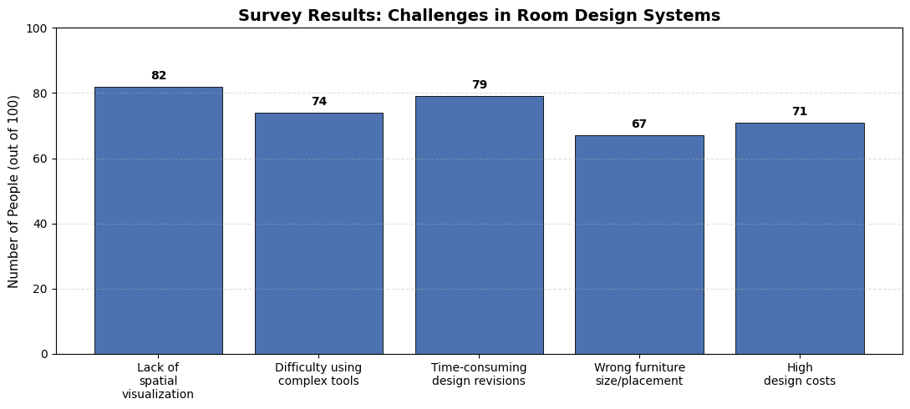
Summary
Existing methods focus on converting 2D floor plans into 3D models using computer vision and deep learning techniques.
Models like DeepPlan and DXF-Net improve accuracy in detecting walls, doors, and other structural elements.
Advanced approaches such as Plan2Scene generate complete 3D scenes using AI and graph-based methods.
Most existing solutions are complex and resource-intensive, creating a need for simpler systems that directly process CAD files efficiently.

Slide 10
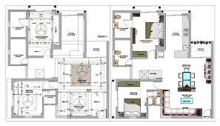
Data Sets Used
CAD Floor Plan Files (DXF Format)
Sample 2D architectural floor plans created using CAD software Contain wall lines, door blocks, and window entities
Software Requirements
Frontend:
React.js
Three.js
Backend:
Python
OpenCV
ezdxf (CAD file parsing library)
Sample Floor Plan in CAD

Slide 11
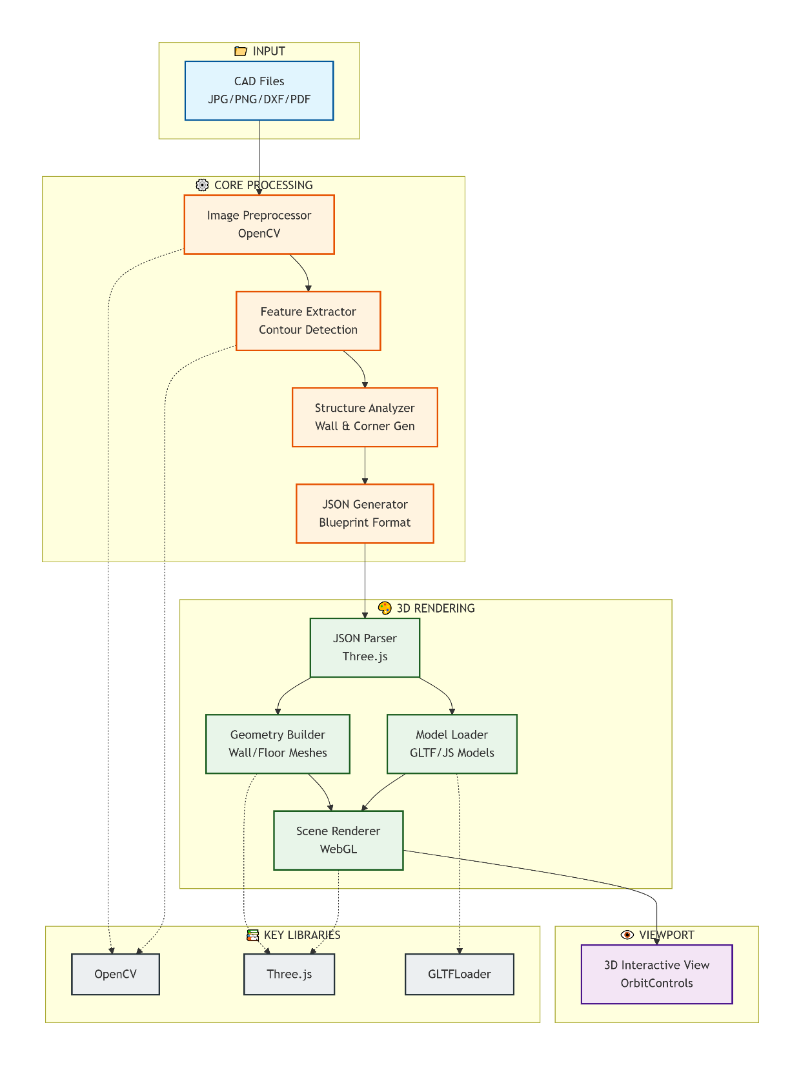
Architecture\Project flow Diagram
CAD to 3D Visualization Architecture

Slide 12
METHODOLOGY
1. DXF File Upload
User uploads architectural DXF file through the frontend.
2. Backend Processing
DXF file is sent to backend via REST API. ezdxf library parses layers and extracts wall coordinates.
3. Data Structuring
Extracted data is converted into structured JSON format.
4. Coordinate Mapping
2D floor plan coordinates are mapped into 3D space.
5. Wall Extrusion
Wall extrusion algorithm converts 2D lines into 3D walls with height and thickness.
6. 3D Mesh Generation
Meshes are generated and rendered using Three.js.
7. Interactive Output
Collision detection applied and interactive 3D model displayed to user.

Slide 13
ALGORITHMS USED:
Algorithm 1: DXF Parsing & Structural Extraction
Input: CAD File
Output: {corners, walls, rooms, openings}
Process:
Step 1: Load DXF File
- Read file using ezdxf.readfile()
- Access model space entities
Step 2: Extract Walls
- For each entity in model space:
If entity type = LINE and layer = "Walls":
Store wall as (start_point, end_point)
Step 3: Detect Corners (Intersections)
- For each pair of walls:
Check if they intersect
If intersection exists:
Compute intersection point:
P = (x1 + t(x2-x1), y1 + t(y2-y1))
If 0 ≤ t ≤ 1 and 0 ≤ u ≤ 1:
Store as corner

Slide 14
Step 4: Detect Openings (Doors & Windows)
- For each entity:
If entity type = INSERT:
If name contains "DOOR":
Mark as door
Else if name contains "WINDOW":
Mark as window
- Map opening to nearest wall
Step 5: Form Rooms
- Connect walls to form closed loops
- Each closed loop represents a room
Return {walls, corners, rooms, openings}

Slide 15
ALGORITHMS USED:
Algorithm 2: GeometryToBlueprintJSON
Input: {walls, corners, rooms, openings}
Output: Blueprint3D JSON
Process:
Step 1: Initialize JSON Structure
- Create base JSON:
floorplan → corners, walls, textures
items → doors/windows
Step 2: Convert Corners to Unique IDs
- For each corner:
Generate unique ID (UUID)
Store as:
corner_id → (x, y)
Step 3: Map Walls with Corner References
- For each wall:
Replace coordinates with corner IDs:
wall = {corner1: id1, corner2: id2}

Slide 16
Step 4: Convert Openings to Items
- For each opening:
Compute position along wall:
Position = P1 + t × (P2 − P1)
Compute rotation:
angle = atan2(dy, dx)
- If door → set door properties
- If window → set window properties
- Add to items list
Step 5: Apply Room Textures
- For each room:
Assign floor texture based on room type
Step 6: Generate Final JSON
- Combine floorplan and items
- Convert to JSON format
Return Blueprint3D JSON

Slide 17
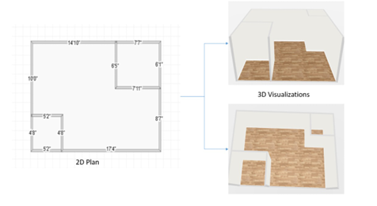
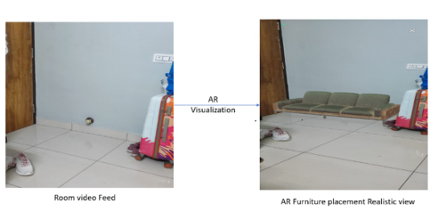
Results Obtained
2D Floorplan → 3D Room Model Design
• Developed a system for 2D Floor Plan to 3D Room Model Conversion
• Generated interactive 3D room structures from 2D layouts
• Focused on geometric accuracy and basic interior visualization
2D to 3D Conversion
Augmented Reality
• Extended the system with Augmented Reality (AR) Integration
• Enabled real-time furniture placement in user’s physical room
• Provided true-scale visualization on mobile devices
AR Visualization

Slide 18
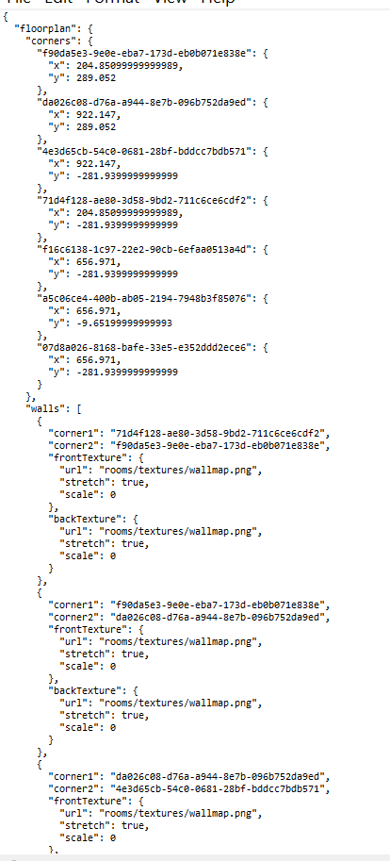
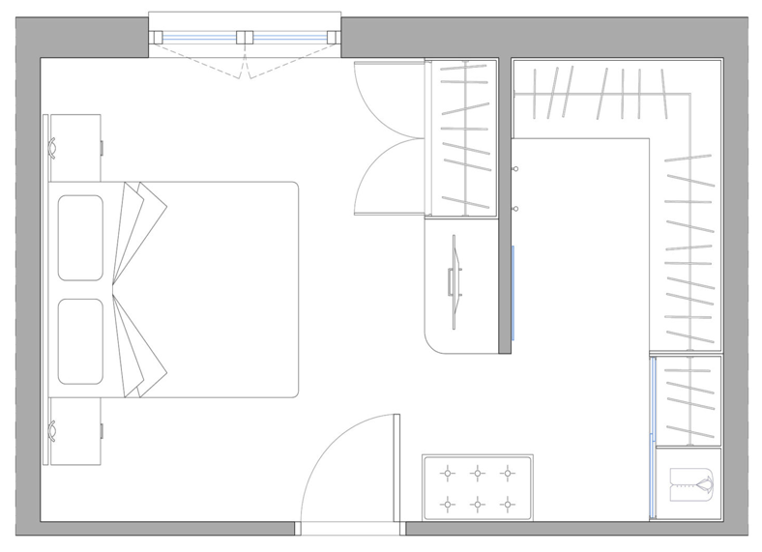
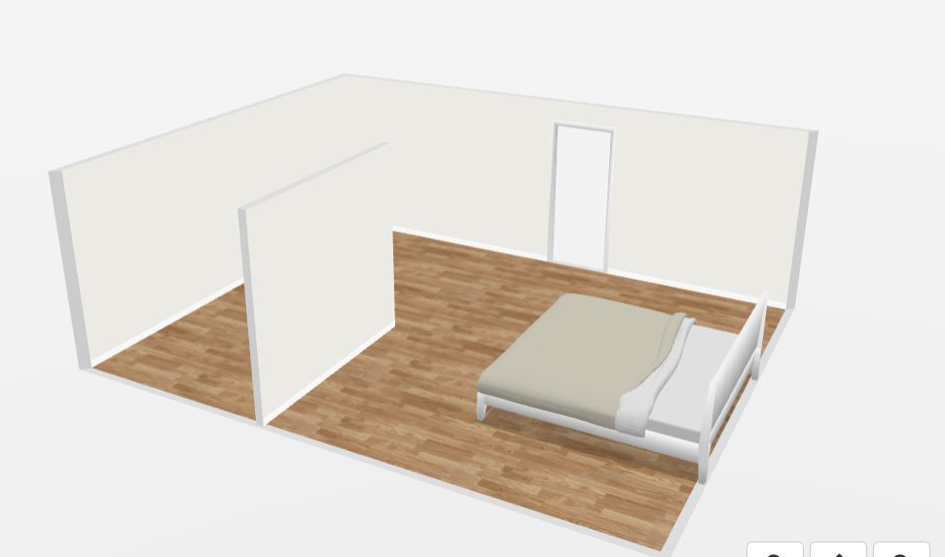
Results Obtained

Slide 19
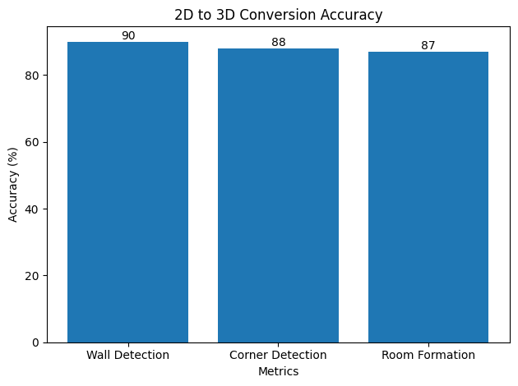
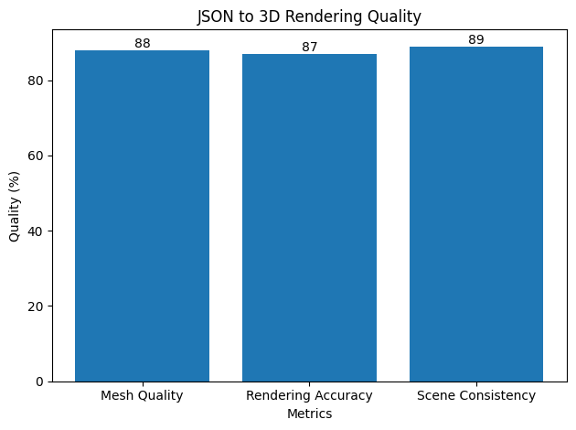
Result Analysis

Slide 20
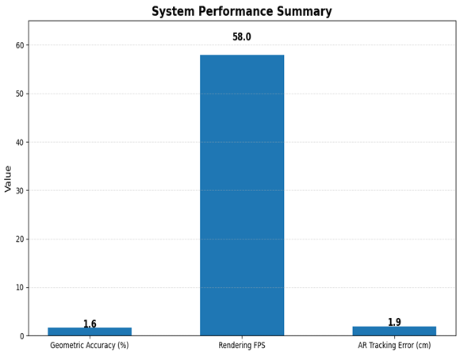
Result Analysis

Slide 21
Conclusion
Successfully automated conversion of 2D CAD floor plans into accurate and interactive 3D interior models.
Achieved efficient extraction and transformation of structural elements into JSON and high-quality 3D visualization.
Enhanced user experience through real-time rendering and Augmented Reality integration.
Future Work
Improve accuracy and scalability using advanced AI/ML techniques for complex floor plans.
Extend support to multiple CAD formats and optimize performance for large-scale designs.
Enhance AR features with realistic effects and develop a mobile-based application for better accessibility.

Slide 22
References
[1] J. Doe et al., “Floor Plan Analysis and 3D Reconstruction: A Survey,” IEEE Access, 2024.
[2] A. Smith and B. Lee, “DeepPlan: Deep Neural Network for Floor Plan Recognition and Semantic Labeling,” IEEE Transactions on Multimedia, 2025.
[3] M. Zhang and S. Liu, “DXF-Net: Direct Structural Recognition from CAD Floor Plans,” in Proc. IEEE/CVF Int. Conf. Computer Vision Workshops (ICCVW), 2025.
[4] R. Kumar et al., “Plan2Scene: 3D Scene Generation from 2D Architectural Plans Using Graph Neural Networks,” in Proc. IEEE/CVF Conf. Computer Vision and Pattern Recognition (CVPR), 2025.

