Slide 1
Steps to programming the Seeed Studio XIAO SAMD21

Slide 2
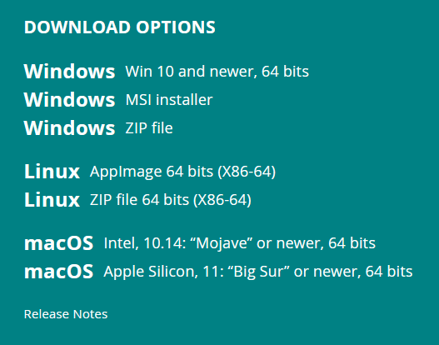
The Arduino IDE
The first step is to download and install the Arduino IDE for your operating system which can done from here:
https://www.arduino.cc/en/software
Generally, you can skip the various donation and email subscription options and press the “Just Download” buttons.

Slide 3
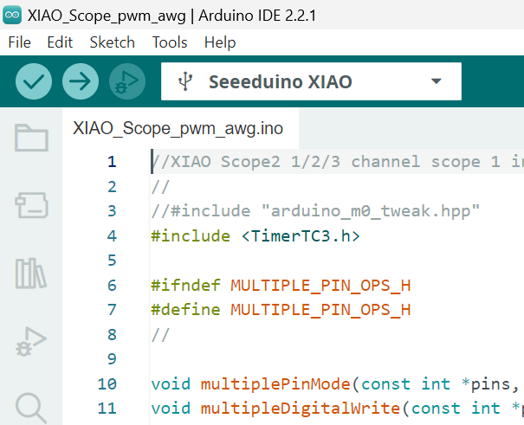
Create a folder on your computer named: XIAO_Scope_pwm_awg
Download this file to that new folder: https://github.com/damercer/Arduino-Scopes/blob/main/XIAO/XIAO_Scope_pwm_awg/XIAO_Scope_pwm_awg.ino
In the (newly installed) Arduino IDE, pull down file to Open and open this INO file.

Slide 4
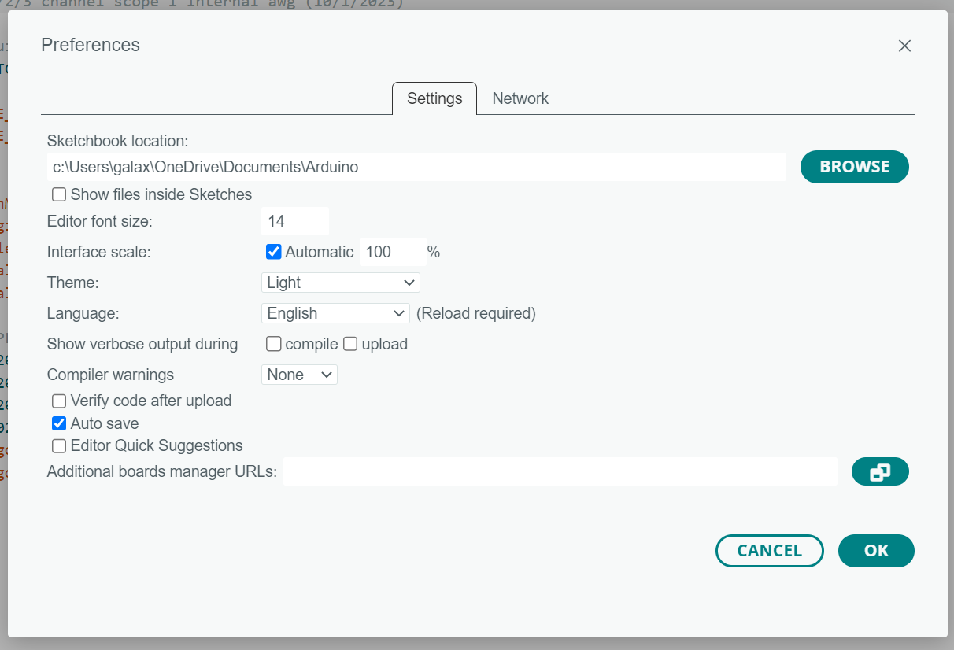
In the IDE, pull down File to Preferences and click on the “Additional URLs” button.

Slide 5
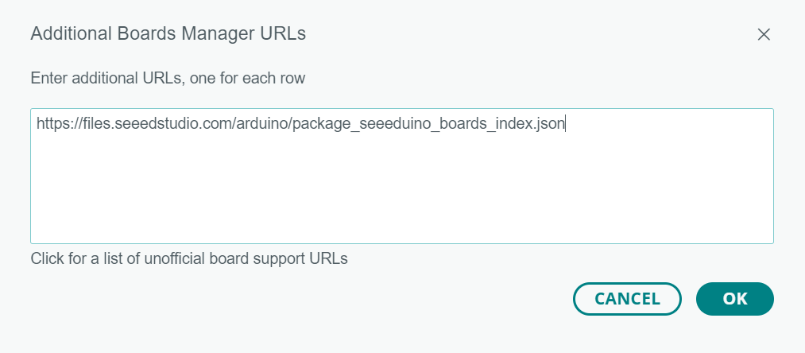
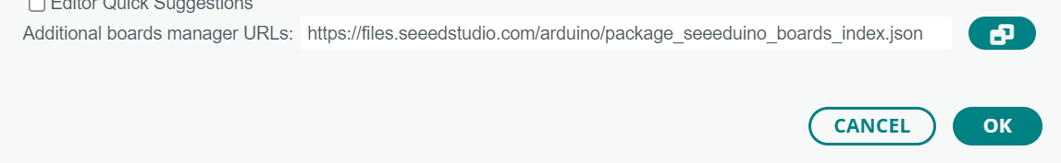
Copy and paste the following URL into the edit window and click OK. https://files.seeedstudio.com/arduino/package_seeeduino_boards_index.json
1
2
Click OK to accept this preference change.
3

Slide 6
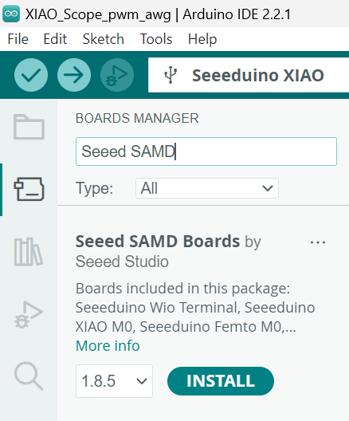
Open the Boards Manager and type “Seeed SAMD” in the Search bar and click INSTALL.
2
Search
Boards Manager
1
3
Install

Slide 7
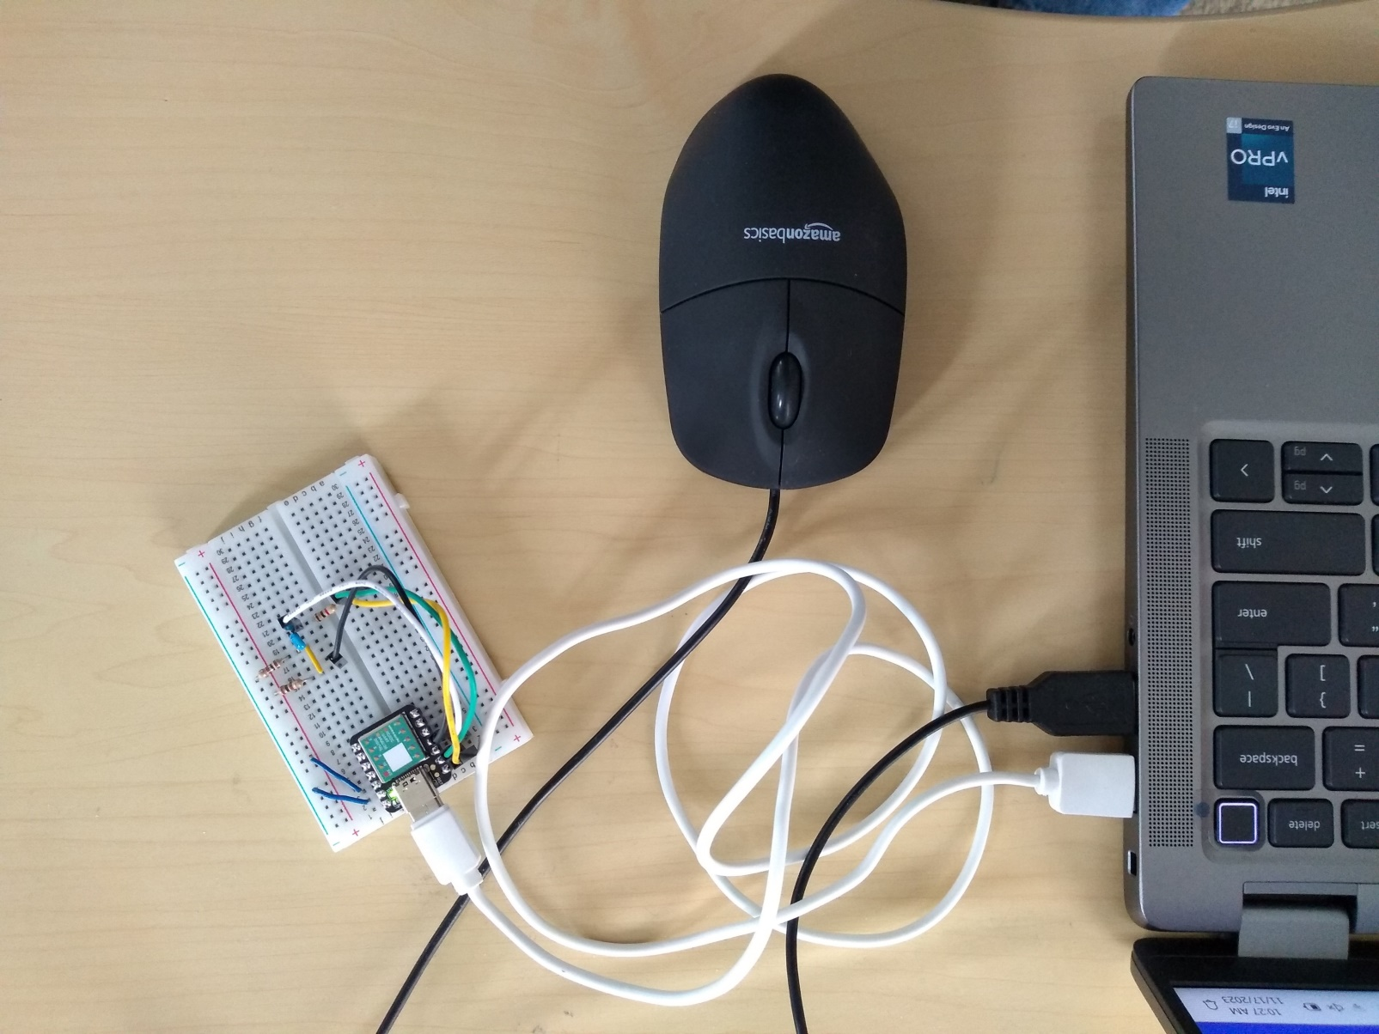
Plug the board into a USB port.
The green Power LED should be on.
Note: A new board fresh from the factory will probably be running the “Blink” program where the orange LED slowly blinks.

Slide 8
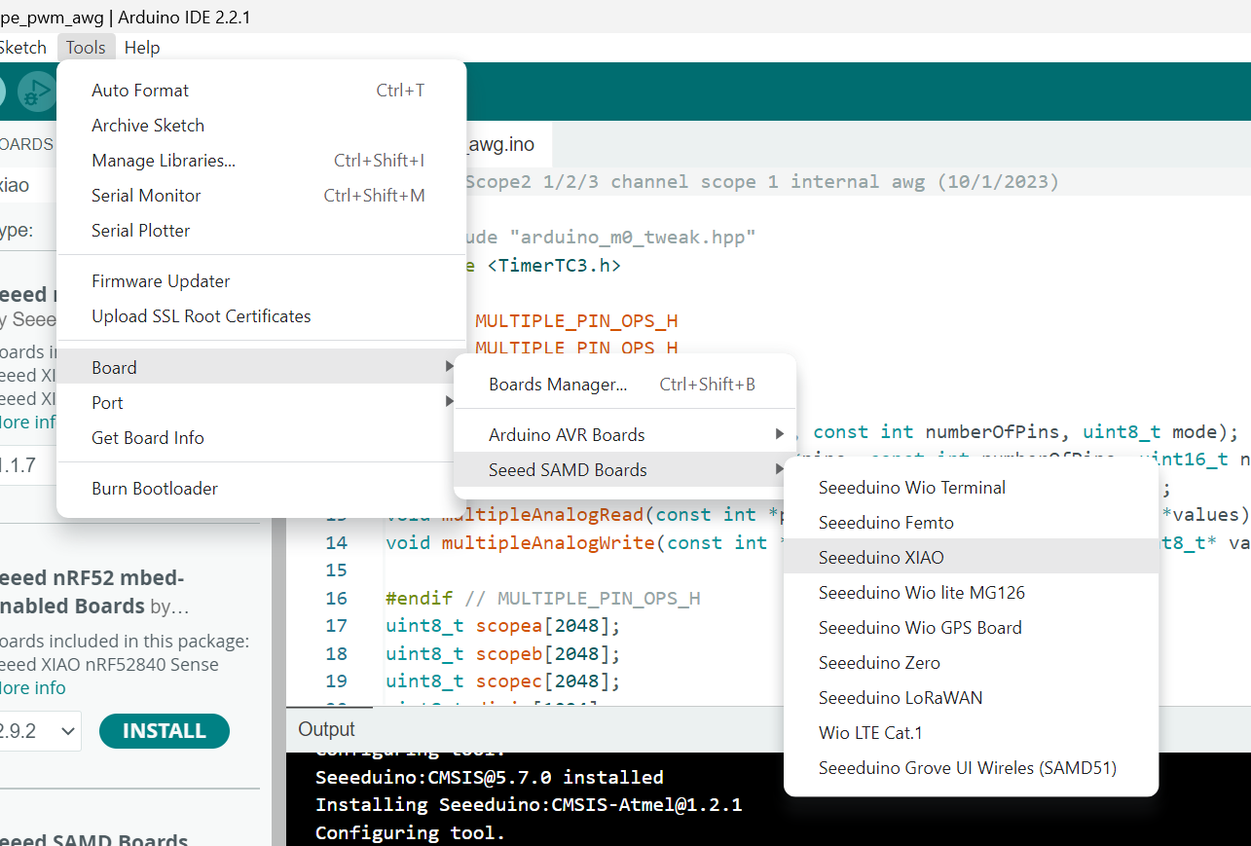
Select the board from the board manager.
Check Mark Here

Slide 9
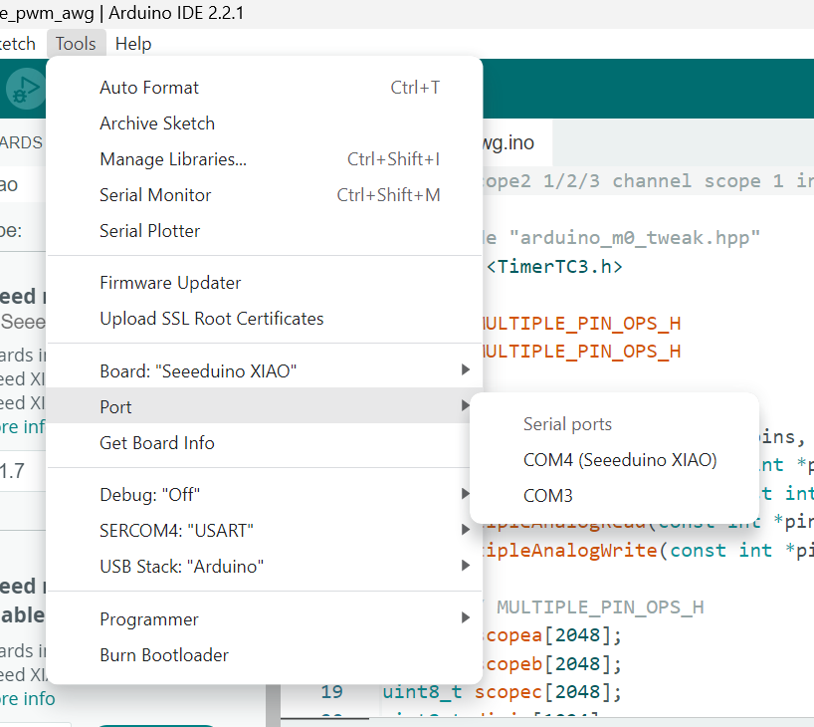
Select the COM port for the Arduino. (Your port number may vary.)
Check Mark Here

Slide 10
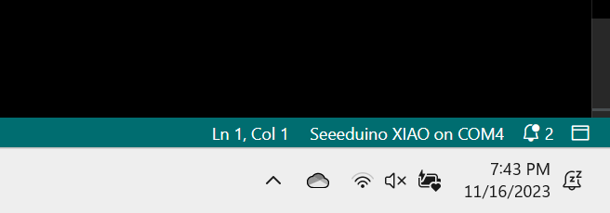
Confirm port selection in the lower right-hand corner of the IDE.

Slide 11
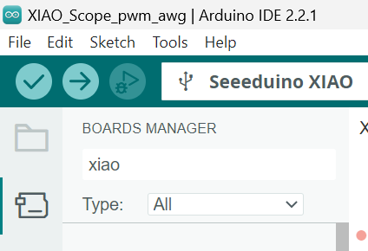
Click on the right pointing arrow to compile and upload the software to the board.

Slide 12
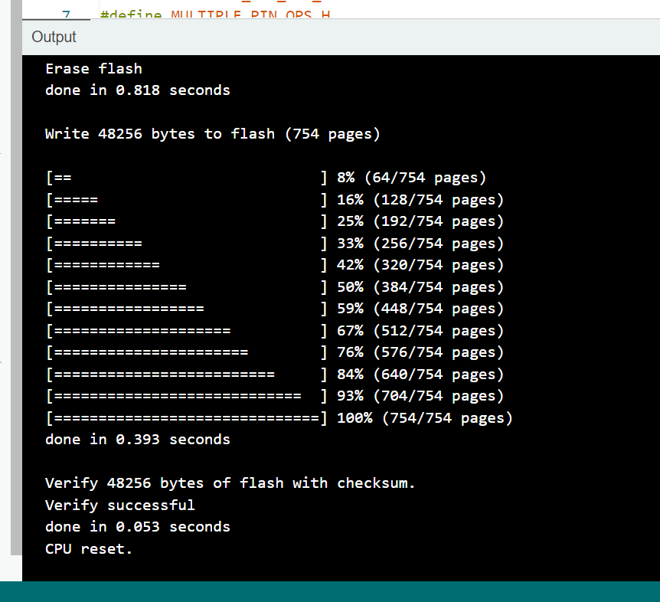
Confirmation of the upload.

Slide 13
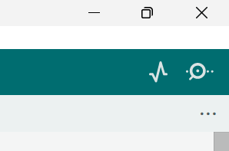
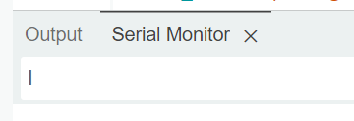
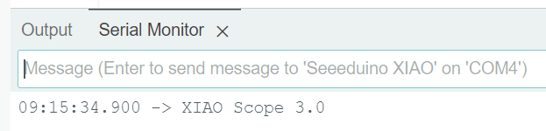
Confirm Board is functioning.
1- In the Arduino IDE, in the upper right corner, click on the icon that looks like a circle with a dot to open the serial monitor.
1
2- Type a capital I (eye) + Enter in the text entry line which appears in the middle of the screen.
2
Just the Green Power LED should be on.
Note: The Blue LED will flash whenever the PC communicates with the board.
3- The board will respond, confirming that the code is loaded and running,
3

Slide 14
The XIAO SAMD21 board is now programmed to work with Universal ALICE GUI.

