Slide 1
Document Object Model

Slide 2
Agenda
What is DOM?
What DOM is not?
The DOM tree
Types of DOM nodes
Traversing the DOM tree
Modifying the DOM tree

Slide 3
What is DOM?
An object-based, language-neutral API for XML and HTML documents
allows programs and scripts to build documents, navigate their structure, add, modify or delete elements and content
Provides a foundation for developing querying, filtering, transformation, rendering etc. applications on top of DOM implementations

Slide 4
Why DOM?
To provide uniform access to structured documents in diverse applications (parsers, browsers, editors, databases)

Slide 5
DOM Structure Model
Based on O-O concepts:
methods (to access or change object’s state)
interfaces (declaration of a set of methods)
objects (encapsulation of data and methods)

Slide 6
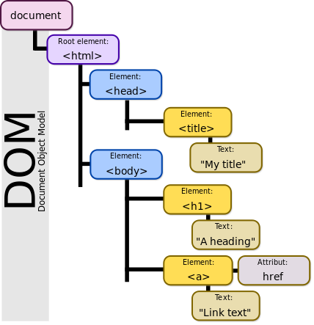
Contd.,

Slide 7
Structure of DOM Level 1
I: DOM Core Interfaces
Fundamental interfaces
basic interfaces to structured documents
Extended interfaces
XML specific: CDATASection, DocumentType, Notation, Entity, EntityReference, ProcessingInstruction
II: DOM HTML Interfaces
more convenient to access HTML documents

Slide 8
DOM Level 2
Level 1: basic representation and manipulation of document structure and content (No access to the contents of a DTD)
DOM Level 2 adds
support for namespaces
accessing elements by ID attribute values
optional features
interfaces to document views and style sheets
an event model (for, say, user actions on elements)
methods for traversing the document tree and manipulating regions of document (e.g., selected by the user of an editor)
Loading and writing of docs not specified (-> Level 3)

Slide 9
Core Interfaces: Node & its variants
Node
Document
DocumentFragment
Element
CharacterData
Comment
Text
CDATASection
“Extended
interfaces”
DocumentType
Notation
Entity
EntityReference
ProcessingInstruction

Slide 10
DOM Language Bindings
Language-independence:
DOM interfaces are defined using OMG Interface Definition Language.
Language bindings (implementations of DOM interfaces) defined in the Recommendation for
Java and
ECMAScript (standardised JavaScript)

Slide 11
DOM Tree Traversal

Slide 12
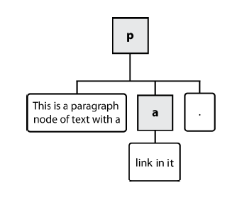
Types of DOM nodes
<p>
This is a paragraph of text with a
<a href="/path/page.html">link in it</a>.
</p> HTML
element nodes (HTML tag)
can have children and/or attributes
text nodes (text in a block element)
attribute nodes (attribute/value pair)
text/attributes are children in an element node
cannot have children or attributes
not usually shown when drawing the DOM tree

Slide 13
Node
DOM interfaces: Document
Document
getDocumentElement
createAttribute(name)
createElement(tagName)
createTextNode(data)
getDocType()
getElementById(IdVal)
invoice
form="00"
type="estimatedbill"
invoicepage
addressee
addressdata
Document
name
address
Element
Leila Laskuprintti
streetaddress
postoffice
Text
NamedNodeMap
Pyynpolku 1
70460 KUOPIO

Slide 14
Node
DOM interfaces: Element
Element
getTagName
getAttributeNode(name)
setAttributeNode(attr)
removeAttribute(name)
getElementsByTagName(name)
hasAttribute(name)
invoice
form="00"
type="estimatedbill"
invoicepage
addressee
addressdata
Document
name
address
Element
Leila Laskuprintti
streetaddress
postoffice
Text
NamedNodeMap
Pyynpolku 1
70460 KUOPIO

Slide 15
Node
getNodeType
getNodeValue
getOwnerDocument
getParentNode
hasChildNodes getChildNodes
getFirstChild
getLastChild
getPreviousSibling
getNextSibling
hasAttributes getAttributes
appendChild(newChild)
insertBefore(newChild,refChild)
replaceChild(newChild,oldChild)
removeChild(oldChild)
DOM interfaces: Node
invoice
form="00"
type="estimatedbill"
invoicepage
addressee
addressdata
Document
name
address
Element
Leila Laskuprintti
streetaddress
postoffice
Text
NamedNodeMap
Pyynpolku 1
70460 KUOPIO

Slide 16
What DOM is NOT
It does not implement all of DHTML. (Events)
It is not a binary specification
Is not a way of presenting objects to XML / HTML.
Is not a set of data structures
It does not define the “true inner semantics” of XML/HTML

