Slide 1
Internship At Moveinsync
Presented by
RAMPAVAN DAMERLA
E18CSE044
EB02
Submitted
to
DEPARTMENT OF COMPUTER SCIENCE ENGINEERING
BENNETT UNIVERSITY, GREATER NOIDA, 201310, UTTAR PRADESH, INDIA

Slide 2
OUTLINE
Introduction & Background
About Internship
Problem statement
Social Importance
Proposed Solution
Tools used
Results Analysis and Validation
Conclusion and Future Work
References

Slide 3


Introduction & Background
Moveinsync was founded in 2009. Moveinsync started with there product called employee transport system. It’s a software as a service company. It has investors from nexus venture partners, Qualcomm ventures, saama capital, etc. Moveinsync has its footprints in 24cities and also It has connections with 35+ fortune 500 companies. Later they introduced there new product Workinsync. Workinsync is a office management tool. Workinsync will establish a hybrid workspace in organisations.

Slide 4
About Internship
I got this internship from placement cell of Bennett University.
It’s a one year Internship.
I joined company on 9th August 2021
I am a backend Intern in the company
I am working in workinsync which is one of their product
I have worked on teams and user groups service.

Slide 5
Problem Statement
clients need to give only some set of permissions to there employee according to there role for there hybrid workspace in workinsync application.
Has to reduce to optimize the existing code and to improve code functionality in some of their services.
Has to write test cases in authorization service
Has to solve existing bugs in some of their services.

Slide 6
Social Importance
For many big organizations they have multiple offices and branches
To maintain their offices, with all their employees is a very big deal especially after the covid situation
Now a days companies are moving to hybrid work culture
To maintain employees and offices in hybrid workspace Workinsync application was development which will monitor employee's temperature, their office utilization, attendance etc.

Slide 7
Proposed Solution
I was introduced to there service called teams and user groups.
In this service we created roles where for each role there are some set of permissions client can assign those roles to their employee to give those permissions in hybrid workspace
Client can also create their own roles and can assign
Client can manage their employees in groups as well as teams
Group is which people are arranged with there designation
Teams are which the employees are arranged in there working teams
I used a tool called sonar which will analyses code and will suggest the necessary code optimization and code improvements.
Has written Junit test cases for existing functions to test the workflow of the code.

Slide 8
Challenges faced
At starting of internship, It was taken time for me to sync with organization workflow of company.
Bugs solving is one of the complex task I must understand their service in order to solve them.
Faced a tricky bug which was employees are not getting adding to user group, but employee is in a team.

Slide 9



Tools Used
Worked on Java11.
Spring Framework is used.
Written Junit Test cases.
Postgres SQL is used.
JIRA for project management.
Jenkins for deployment of code.
RESTApi’s.

Slide 10
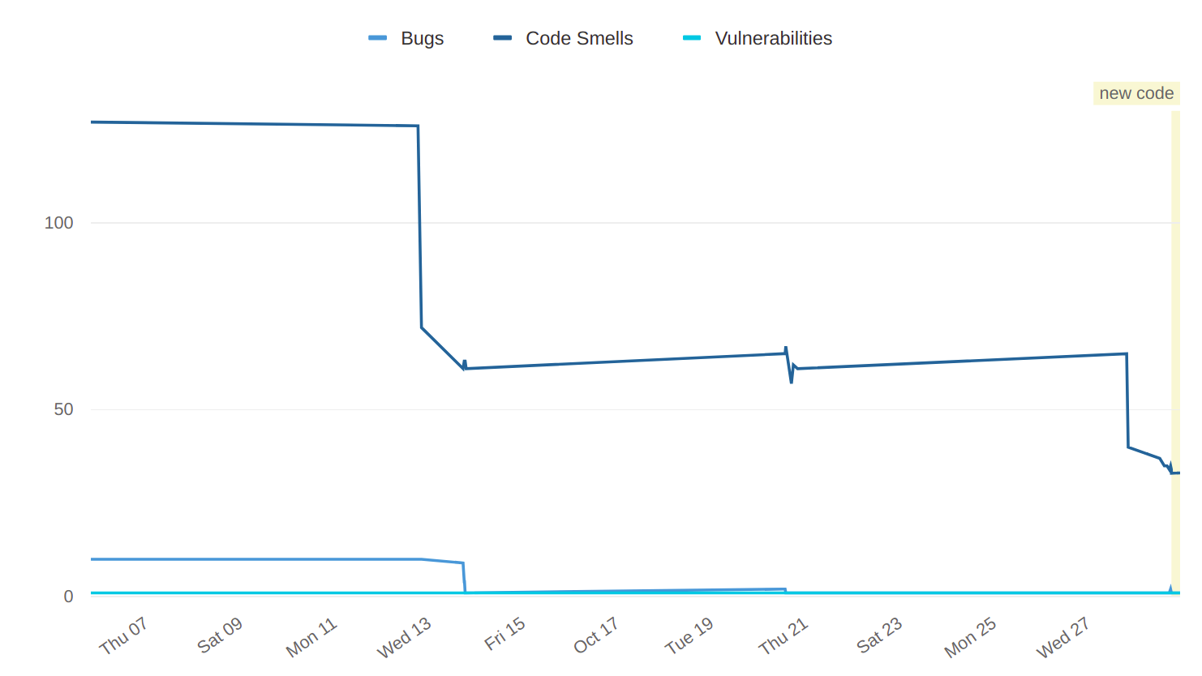
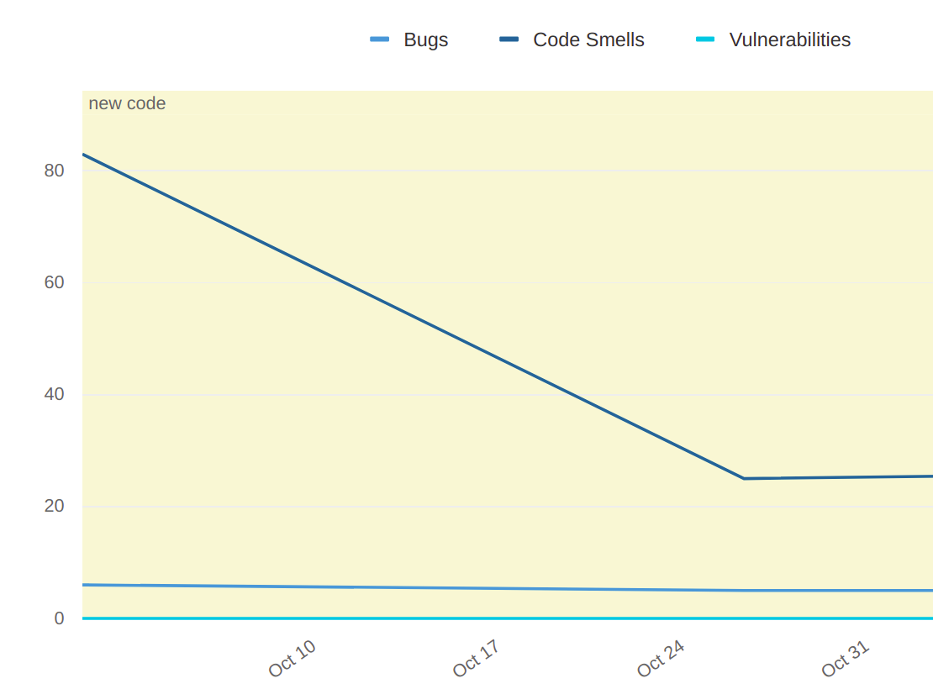
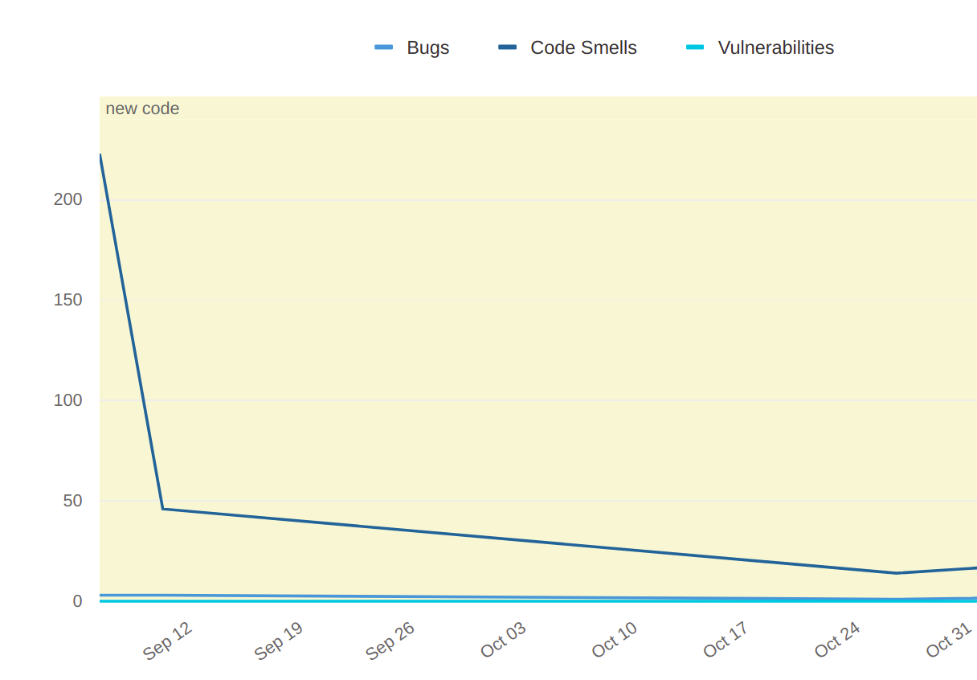
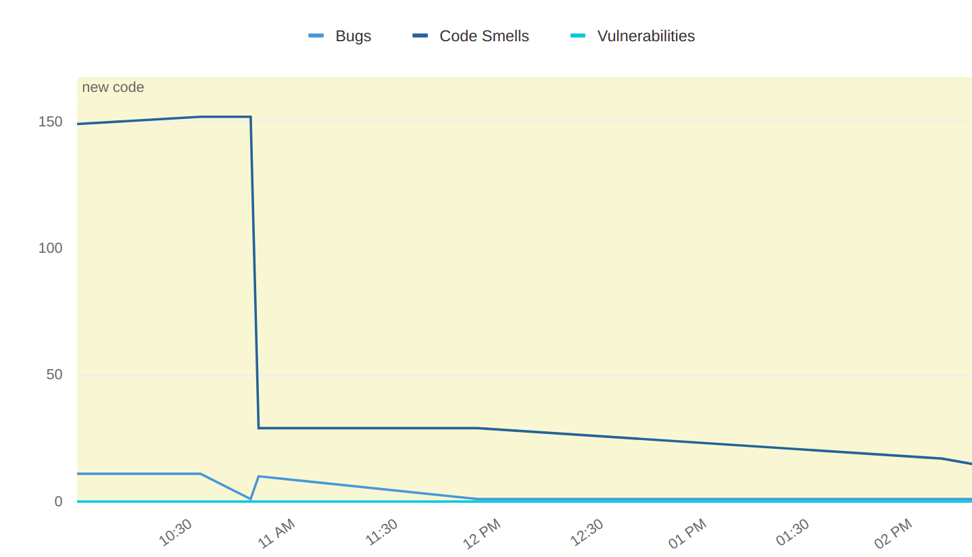
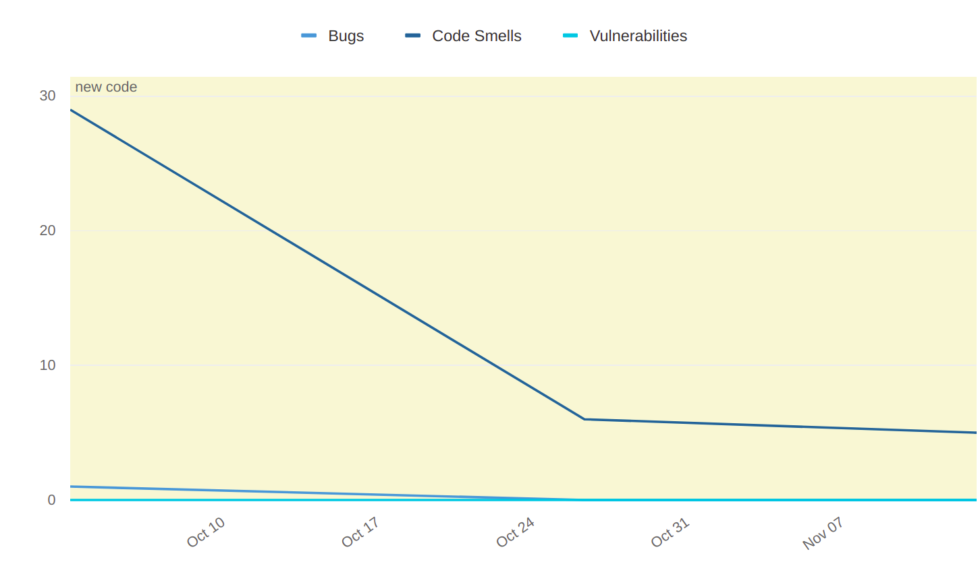
Results Analysis and Validation

Slide 11
Conclusion and Future Work
Have completed the tasks of doing user groups and teams.
Written Junit Test cases for the functions.
Solved the bugs in some of their services.
Code optimization and code improvements using sonar.
Since it’s a one-year internship more excited to work on more services of their product.

Slide 12
References
Spring boot was learned from (https://spring.io/ ).
Java 11 concepts are learned from (https://www.tutorialspoint.com/java11/java11_quick_guide.htm).
Junit 5 learned from (https://junit.org/junit5/docs/current/user-guide/ ).
JPA quarry was learned form (https://www.baeldung.com/spring-data-jpa-query ).

Slide 13
YouTube Video Link and Blog link
YouTube video Web Link https://youtu.be/X8wUQl7SzYw
LinkedIn https://www.linkedin.com/posts/rampavan-damerla-894330171_internship-bennettuniversity-backenddeveloper-activity-6870412240814653440-oDte

Slide 14
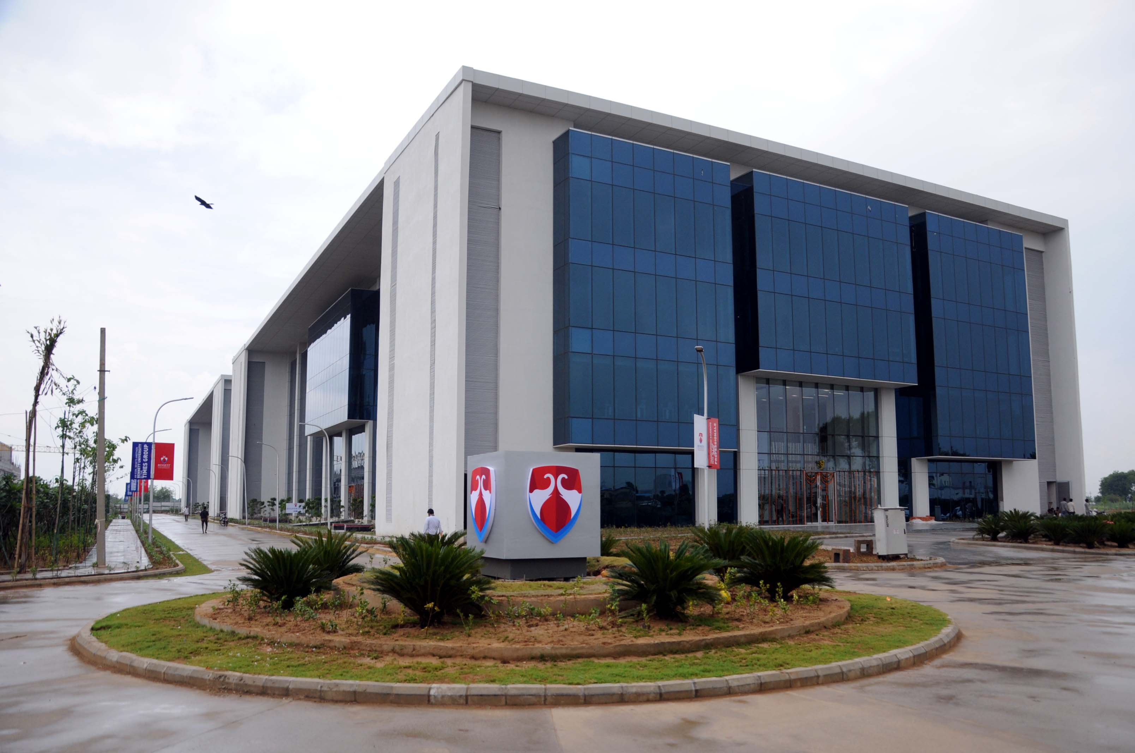
Question Please Thank You

