Slide 1






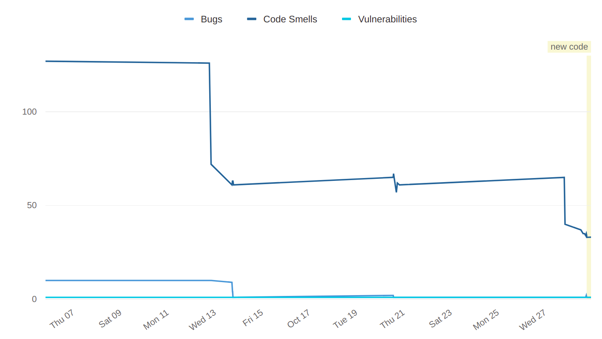
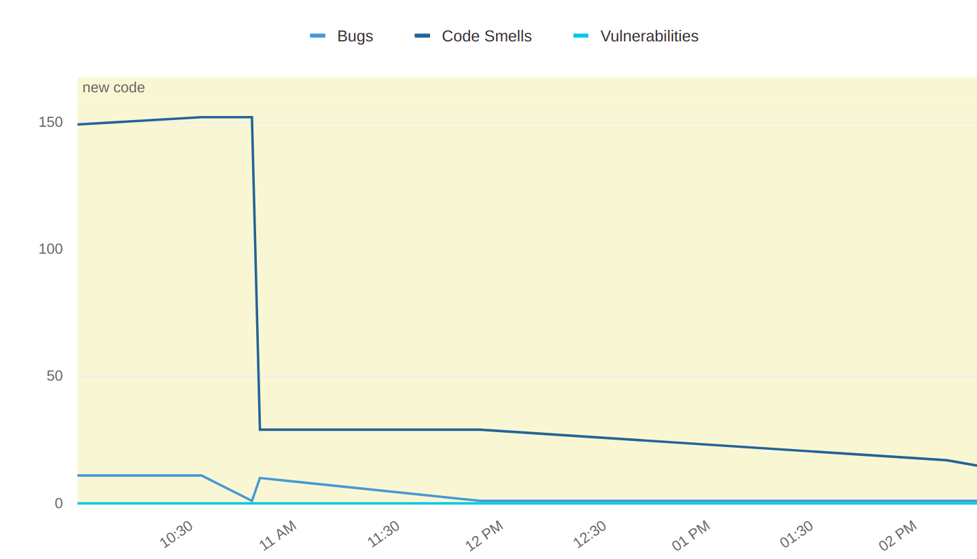
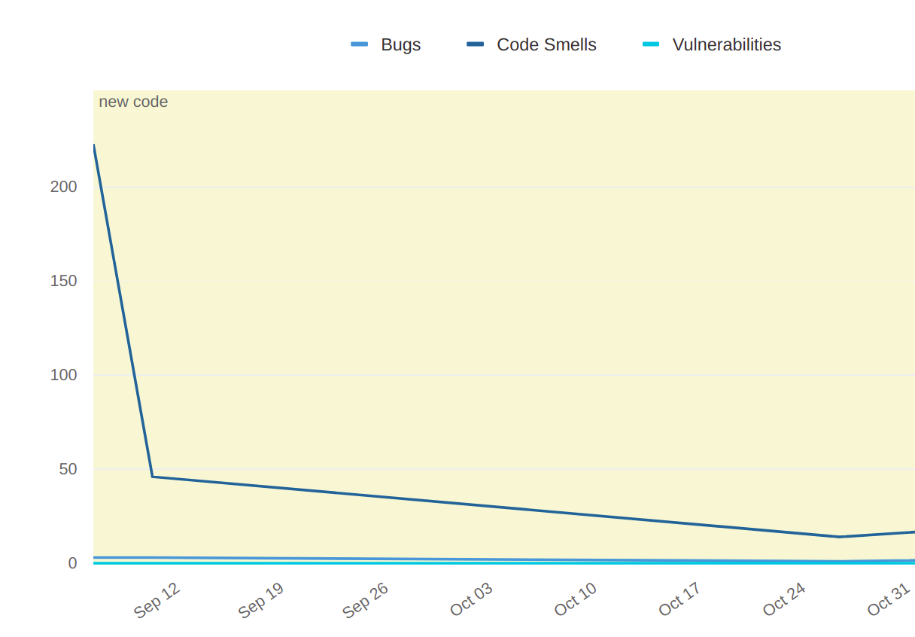
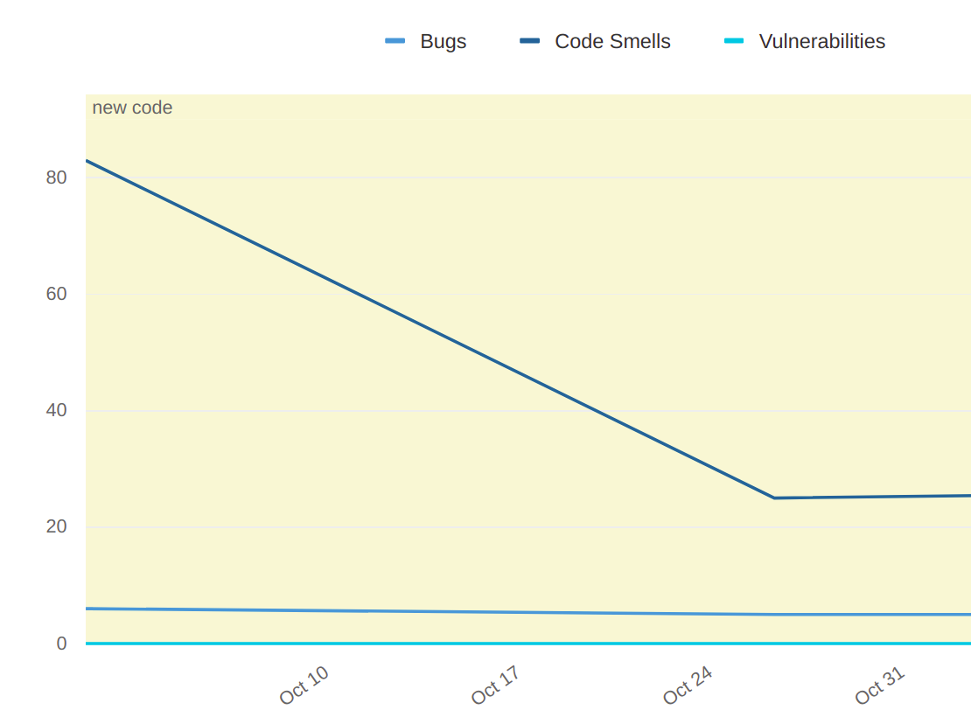

Internship at Moveinsync
by
RAMPAVAN DAMERLA (E18CSE044)
Department of computer Science Engineering, Bennett University
Abstract
Proposed Method
When a clients what's to his organisation to be a hybrid workspace. There has to me some set of permissions that a employee has according to their designation in the hybrid workspace. In WorkInsync a hybrid workspace software as a service as well has to assign some set of rules to the employees in there application. There rules will restrict the user to have access to set of features. For employees to adapt hybrid work space every client will have there own set of rules and restrictions.
I was introduced to there service called teams and user groups.
In this service we created roles where for each role there are some set of permissions client can assign those roles to their employee to give those permissions in hybrid workspace
Client can also create their own roles and can assign
Client can manage their employees in groups as well as teams
Group is which people are arranged with there designation
Teams are which the employees are arranged in there working teams
I used a tool called sonar which will analyses code and will suggest the necessary code optimization and code improvements.
Has written Junit test cases for existing functions to test the workflow of the code.
Bugs solving is one of the complex task I have to understand their service in order to solve them.
Introduction
Tools used
Moveinsync was founded in 2009. Moveinsync started with there product called employee transport system. It’s a software as a service company. It has investors from nexus venture partners, Qualcomm ventures, saama capital, etc. has its footprints in 24cities and also It has connections with 35+ fortune 500 companies. Later they introduced there new product Workinsync. Workinsync is a office management tool. Workinsync will establish a hybrid workspace in organisations. I got the moveinsync internship opportunity from the bennett university placement cell. it’s a one-year duration internship. I joined on 9th Aug 2021. my role in the company is a backend Intern. faang companies and many companies they have multiple offices and branches. To maintain their offices, with their employees is a very big deal especially after the covid situation. Now a days companies are moving to hybrid work culture. In hybrid workspace it has become a problem for comapies to maintain employees and offices. Moveinsync has came into the picture and solved the problem with there product Workinsync. I got this internship from placement cell of Bennett University. It’s a one year Internship. I joined company on 9th August 2021. I am working as a backend Intern in the company. I am working in workinsync which is one of their product
I have worked on teams and user groups service.
Worked on Java11.
Spring Framework is used.
Written Junit Test cases.
Postgres SQL is used.
JIRA for project management.
Jenkins for deployment of code.
REST Api’s.
Sonar analysis graph
Problem Statement
Conclusions
Organisations need to give only some set of permissions to there employee according to there role for there hybrid workspace in workinsync application.
Has to reduce and optimize the existing code and to improve code functionality.
Has to write test cases in authorization service
Has to solve existing bugs in some of their services.
Created and added some feature in user groups and teams of workinsync application.
Written Junit Test cases for the functions in authorization service.
Code optimization and code improvements has done with sonar qube application.
Since it’s a one-year internship more excited to work on more services of their product.
Challenges faced
References
At starting of internship, It was taken time for me to sync with organization workflow of company.
Bugs solving is one of the complex task I must understand their service in order to solve them.
Faced a tricky bug which was employees are not getting adding to user group, but employee is in a team.
Spring boot was learned from (https://spring.io/ ).
Java 11 concepts are learned from (https://www.tutorialspoint.com/java11/java11_quick_guide.htm).
Junit 5 learned from (https://junit.org/junit5/docs/current/user-guide/ ).
JPA quarry was learned form (https://www.baeldung.com/spring-data-jpa-query ).
Team No. - X

