Slide 1
The Twin Instrument and the Fertility-Investment Trade-off
Sonia Bhalotra* Damian Clarke**
*University of Essex
**University of Oxford
8 January 2014: Preliminary and in progress

Slide 2
The QQ Tradeoff
Cross-sectional data within and across regions suggests that children from larger families have weaker educational outcomes, e.g. Hanushek 1992, Blake 1989.
This empirical regularity is often attributed to a quantity-quality (qq) tradeoff in parental investments: Becker 1960, Becker and Lewis 1973, Becker and Tomes 1976.
A key feature of the qq model is that child quality and child quantity enter multiplicatively in the budget constraint. So
  Exogenous increases in quality raise the shadow price of having more children.
  Exogenous reductions in the number of children reduce the marginal cost of investing in quality
06/04/14

Slide 3
Relevance and Evidence
The negative reinforcing mechanism between q & q plays a central role in macro-growth models with endogenous fertility. Becker and Barro 1988, Becker et al. 1990, Moav 2005.
Many countries have implemented aggressive fertility control policies, e.g. China, India, Mexico, Indonesia. Echoes Malthus. Idea is that this is good for human capital and growth.
But there is limited evidence of a QQ tradeoff.
Using twins as an instrument, Black et al. 2005 (Norway) and Angrist et al. 2010 (Israel) find no evidence of a relationship between fertility and schooling.
  Some evidence of a trade off using other quality indicators: Juhn et. al. 2013, Conley and Glauber 2006, Caceres-Delpiano 2006.
06/04/14

Slide 4
Our Contributions
We argue that an underlying QQ tradeoff may be obscured for two reasons.
Twin birth is not exogenous (even if twin conception is)
  In particular, the health of the mother is a potential omitted variable in previous studies.
2. Twin births more clearly shock family size if their incidence takes fertility above the target level
  We use subjective reports of desired fertility to assess this
3. We assemble a large micro-data sample for developing countries and assess whether the tradeoff is more evident in poor countries.

Slide 5
IV Procedure
schooling = β fertility + Xδ + e
fertility = γ twins + Xλ + ε
E[fertility.e]≠0, E[twins.e]=0
Reduced form: schooling = μ twins+ Xθ + e
Previous studies assume twin incidence is a valid instrument.
A key concern is whether IV estimates are precise enough to be informative (and distinguishable from OLS estimates): Angrist et al.
06/04/14
Notes:
Twin-IV estimates generate the average causal effect of treatment on the non-treated, treatment being an indicator for another child.
Treated: always-takers plus compliers with the instrument switched on. Untreated: never-takers plus compliers with the instrument switched off. But with twins there are no never-takers.
If twinning is as good as randomly assigned, causal effects for the untreated are the same as causal effects on all compliers.
2SLS estimates capture (older) siblings’ weighted average response to the birth of an additional child for parents who were induced to have another by virtue of a twin birth.

Slide 6
Innovations
Refurbish X. First attempt to condition on mother’s health. Assess possibility that there is a QQ tradeoff, obscured in recent studies by bias associated with assuming twin exogeneity.
Adjust for target fertility.
  The Wald estimator is the weighted average causal response for people from families induced by an instrument to go from having fewer than j to at least j children, weighted over j by the probability of crossing this threshold.
  The denominator normalizing the weights is the Wald first stage.
  Individuals with C_{1i} ≥j ≥ C_{0i} are compliers a la Angirst, Imbens, Rubin 1996. Differences in 1st stage coefficients indicate differences in probability of compliance across groups.
06/04/14

Slide 7
Data and Descriptive Statistics

Slide 8
Data and Context
Comparable cross-country micro-data for developing countries from the Demographic and Health Surveys
  Complete fertility histories, subjective reports of desired fertility, indicators of maternal health, maternal education and child education.
Merge all surveys between 1991 and 2013: sample of 3,617,428 children from 69 countries
  Large sample useful given twin are rare (sample mean 1.89%)
  Outcome: schooling (z-score). Retain children age 8-16 at survey date.
  Birth cohorts 1971-20121971-2012
Countries classified as low vs middle income by the World Bank
  Women in poor countries under-nourished and less able to take twin conceptions to term. Higher desired fertility, twins are less likely than otherwise to take actual over desired fertility. Low schooling. QQ more likely given weak credit markets.

Slide 9
Analysis Samples
Effects of twins at parity j on outcomes for births j-1 and before (as in Angrist et al. 2010).
  Predictions are for infra-marginal children.
2+ sample: Firstborn subjects in families with at least two births (allowing that a birth may be twin).
  Instrument with twins at second birth.
3+ sample: First and second born subjects in families with at least three births
  Instrument with twins at second birth. [etc.]
Twin subjects are dropped.
06/04/14

Slide 10
contd
  By restricting to families with at least j births on average we ensure that preferences over family size are the same in the families with twins at the jth birth and those with singleton births.
  By restricting the sample to children born before birth j, we avoid selection problems that arise because families who choose to have another child after a twin birth may differ from families who choose to have another child after a singleton birth.
06/04/14

Slide 11
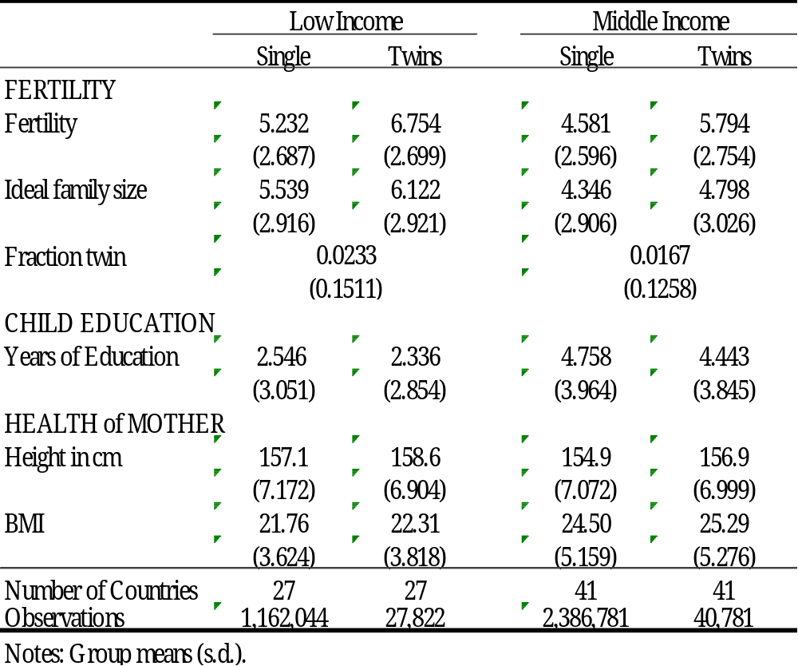
Summary Statistics
06/04/14

Slide 12
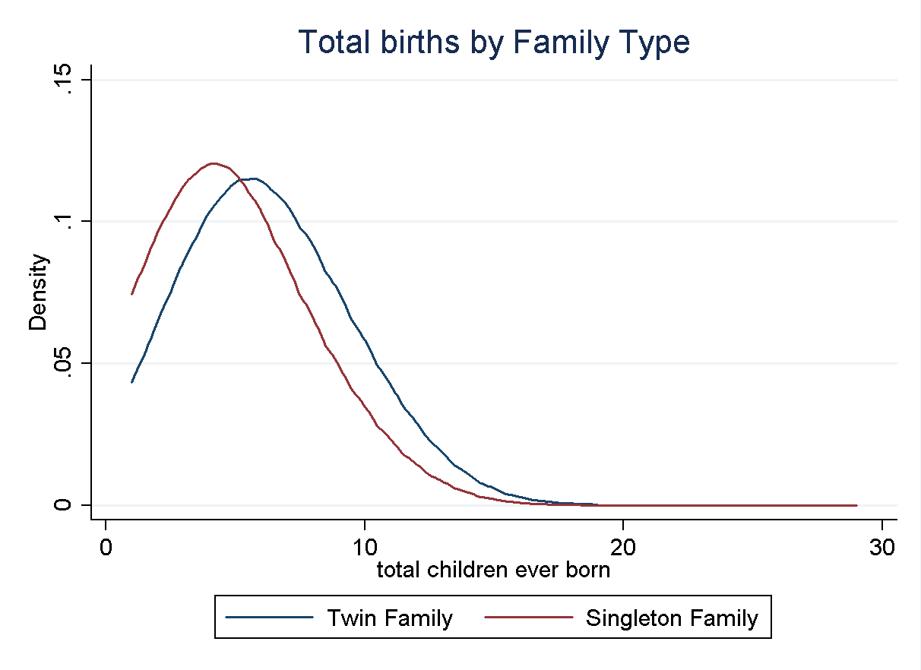
Twins Shift Distribution of Family Size Rightward

Slide 13
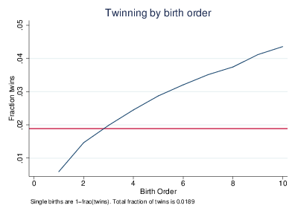
Twins Are More Likely to Occur at Higher Birth Orders

Slide 14
Mother’s Health
Cross-country microdata evidence from the cross-country microdata sample shows that indicators of the health of the mother influence child birth-weight, survival and growth (stunting): Bhalotra and Rawlings (2011).
This makes it plausible that mother’s health influences foetal survival.
  A standard deviation decrease in mother's height or BMI raises the risk of poor child health (birth-weight, mortality, stunting) by between 5 and 10 per cent, depending on the measure.
  The risks of low birth weight and neonatal mortality are higher by 5.7% and 16.9% of their mean rates amongst mothers who have anemia relative to mothers who do not.
No previous evidence (or discussion) of maternal health being a predictor of twin births.
06/04/14

Slide 15
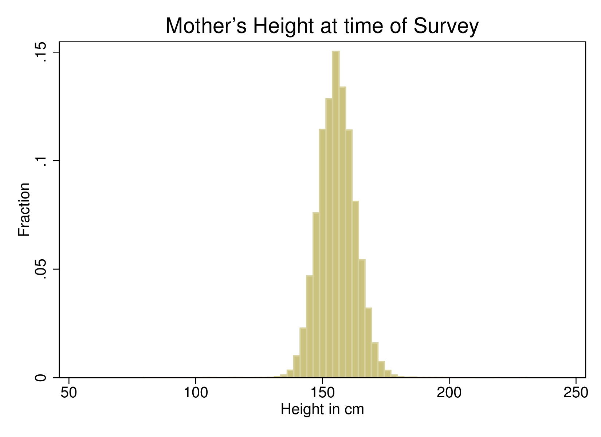
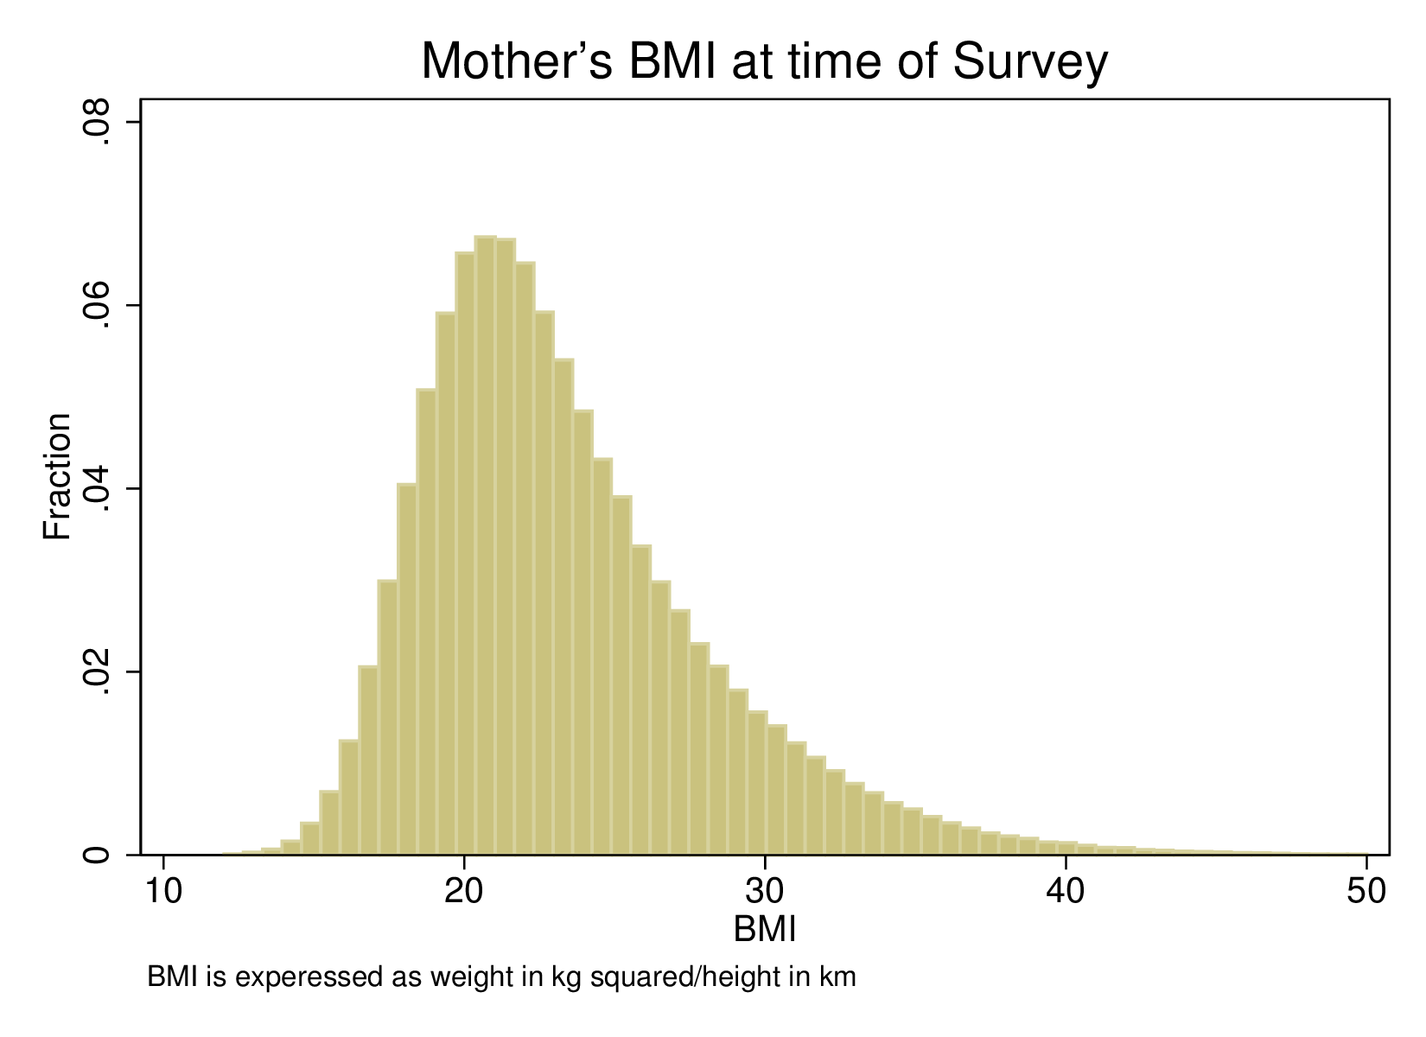
Distribution of available indicators of mother’s health in the sample
Percent Underweight (BMI<18.5) in sample 11.8%
Percent Low Height (<5 foot 2) in sample 40.8%
06/04/14

Slide 16
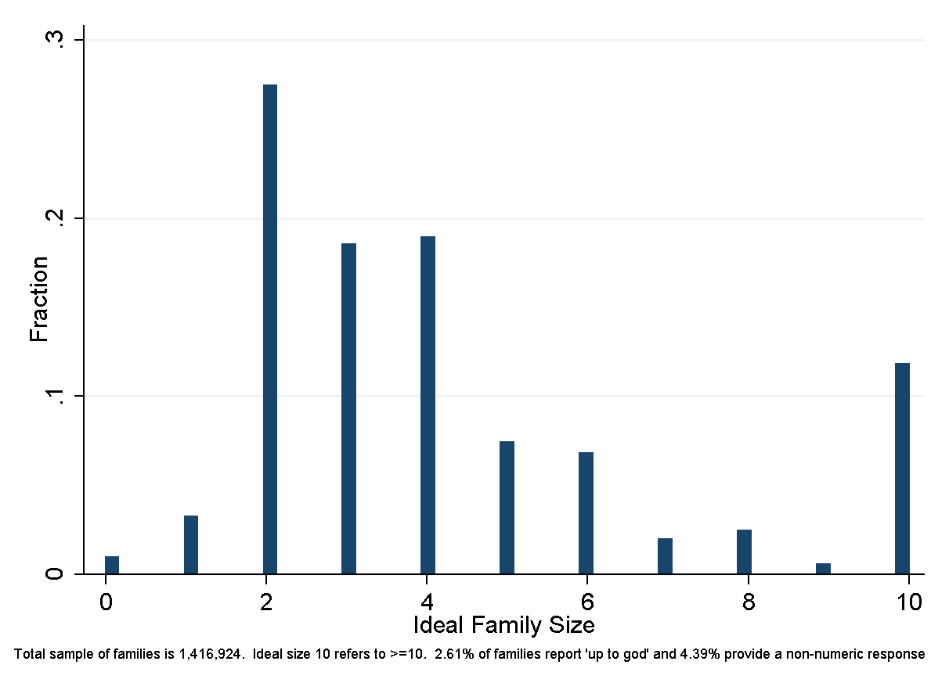
Reported Ideal Family Size

Slide 17
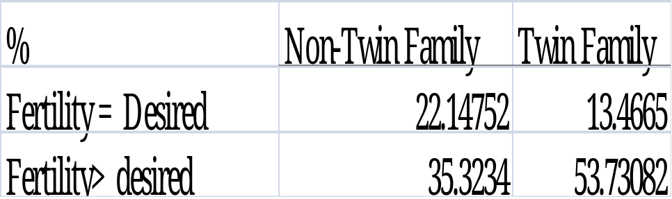
Actual fertility is more likely to cross target fertility in families that have had a twin
06/04/14

Slide 18
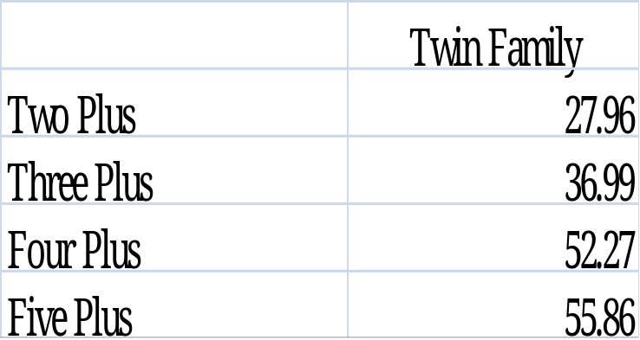
Fraction of families with twins at parity j who state desired fertility ≤ j
06/04/14

Slide 19
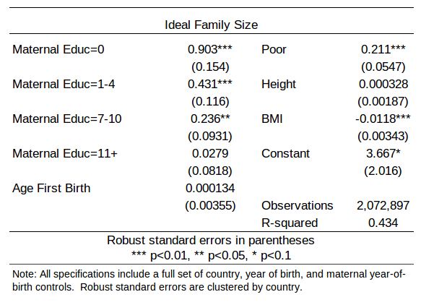
Evidence that Fertility Preferences are Correlated with Maternal Characteristics
Reported ideal family size is correlated with observable maternal characteristics
This suggests actual fertility is likely to be endogenous.
So OLS estimates of the QQ tradeoff are biased.

Slide 20
Estimates

Slide 21
Investigating Exogeneity of Twins
P(twin) = Xδ₀ + u
X are mother characteristics potentially correlated with child quality: age, wealth, education, height, BMI, antenatal care, smoking/drinking/drugs during pregnancy.
If twin birth is a random event, δ₀ =0.
Can typically condition on only a subset of predictors X
Quality indicator (t-k) = α twins (t)+ Xδ₁ + e
Compare child quality in families with and without twins at parity p for children born at earlier parities.
But use a measure of quality (investment) that is necessarily determined before twins occur: infant mortality.
If twins occur randomly, α=0
06/04/14

Slide 22
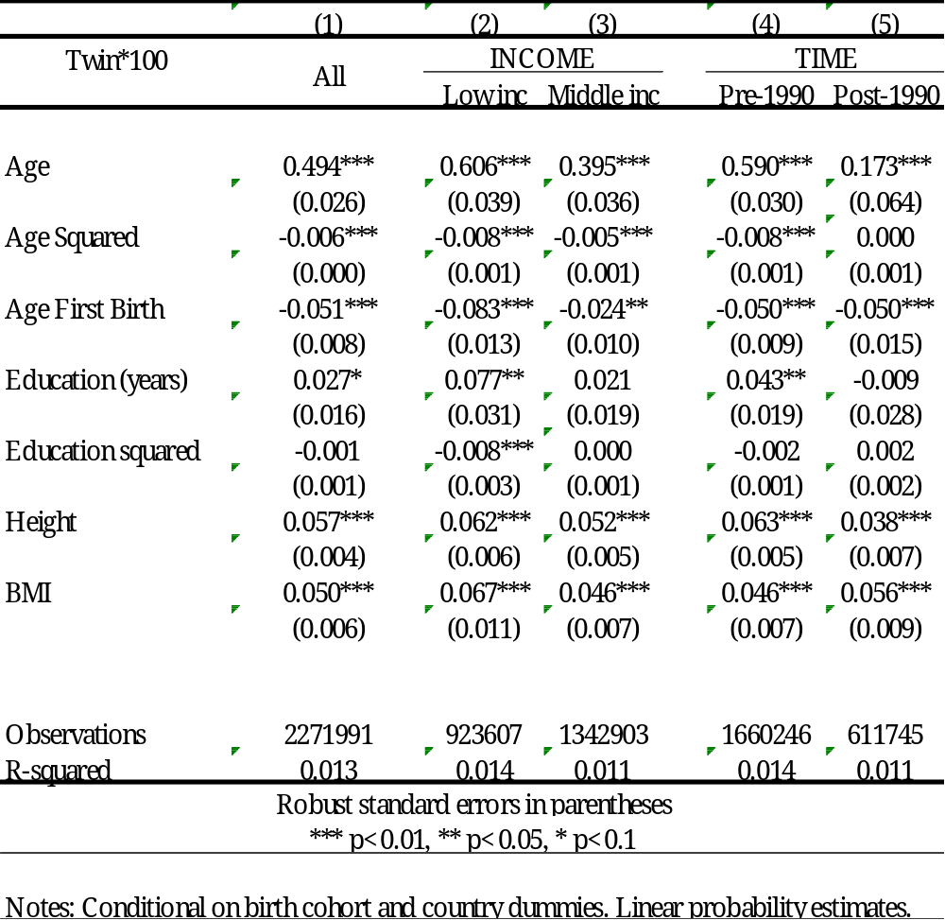
Probability of a Twin Birth
Systematic correlations with mother characteristics
06/04/14

Slide 23
Effect Sizes
Substantial marginal effects of observed indicators of mother’s health on the probability of twin birth (mean=2%)
A one s.d. change in the height of the mother results in an increase of 0.44% points (22% of mean)
A one s.d. change in mother’s BMI results in an increase of 0.20% points (10% of mean)
06/04/14

Slide 24
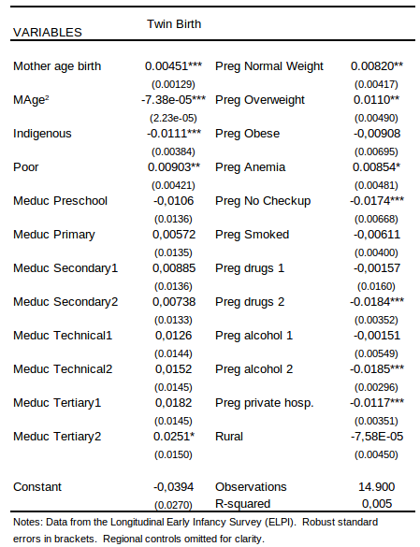
Table 5: Probability of Twin Births in Chile: Data on Pregnancy Behaviours

Slide 25
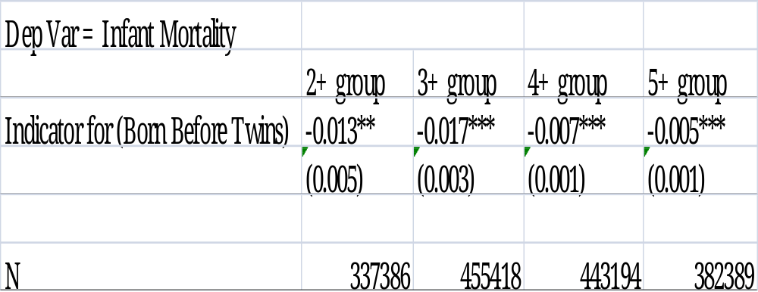
Test of Exogeneity of Twins
Comparison of child outcome determined before twins arise across families who do and do not subsequently have a twin birth
Results indicate that twin births occur in families with a tendency towards lower infant morality, possibly healthier (or better-off) families.
Large effect size; mean IMR: 0.01
06/04/14

Slide 26
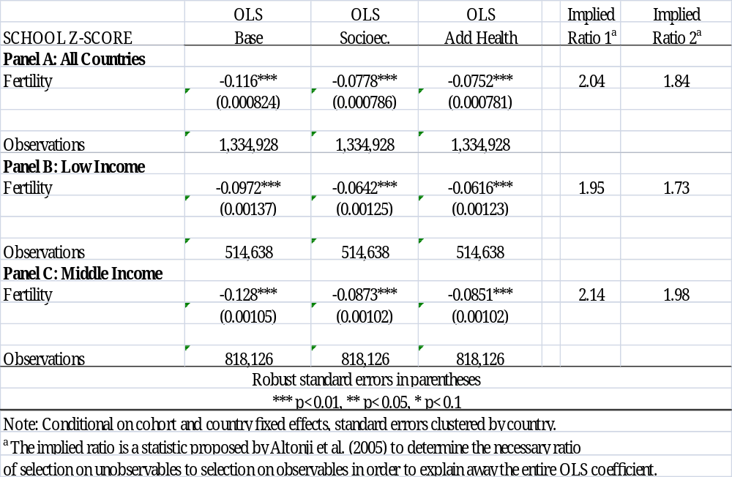
OLS Estimates
Adding controls for predictors of twin birth diminishes the estimated trade-off
06/04/14

Slide 27
Altonji, Elder, Taber 2005, extension in Bellows and Miguel 2009
schooling = β fertility + Xδ + e
Fertility is endogenous and instrumented by twins and X is a vector of relevant controls, conditional upon which twins are a valid instrument.
Suppose we observe only a random sub-set of X.
Assume that the observed and unobserved components of X are correlated and selection on unobservables is similar to selection on observables.
Compute the ratio of β_{c}/ β_{n} –β_{c} . A large ratio (given by controls not changing β much) suggests it is implausible that unobservables can explain away the estimated impact.
06/04/14

Slide 28
Our estimate
The Altonji et al. statistic computed from OLS estimates with and without controls for twin predictors is ~2.
So for unobservables to explain the OLS coef (-0.12), the variation explained by unobservables would need to be about twice as large as the variation that is explained by the covariates included in our specification.
06/04/14

Slide 29
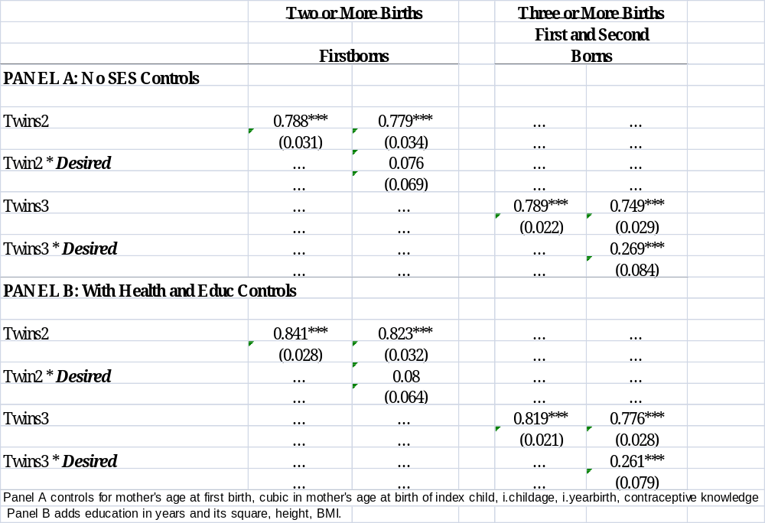
First Stage: The incidence of twins predicts an increase in fertility of ~0.8 children. For twins born at parity 3 or after that take the family beyond target, the increase is 1 [Similar if completed fertility]
06/04/14

Slide 30
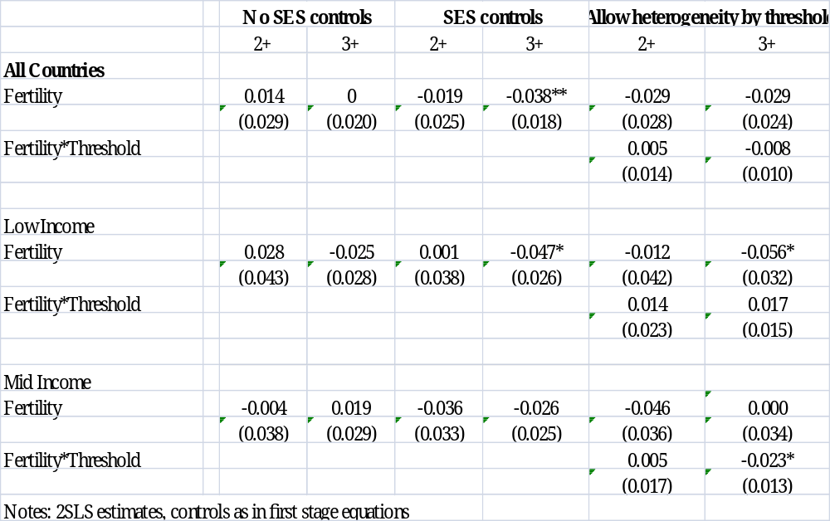
2SLS second stage estimates: Role of controls for twin predictors. Separate sample in which twin occurence leads to fertility crossing the target (threshold) level
06/04/14

Slide 31
Taking Stock
High fertility women are negatively selected, so controlling for fertility predictors weakens OLS estimates of the QQ tradeoff.
Women who are predisposed toward having twins are positively selected, so controlling for predictors of twin birth strengthens IV estimates of the QQ tradeoff.
First stage indicates twin birth is a powerful instrument. For families in which twin birth leads to exceeding target fertility, twin birth predicts 1 additional birth.
Conditional upon available SES and health controls, the OLS estimate is -0.08* (parity pooled) and IV estimates are -0.02 (2+) or -0.04* (3+ sample).
Larger in low-income group. “Threshold sample..”

Slide 32
Allowing twins to be plausibly exogenous rather than strictly exogenous: Conley et al. 2012
2SLS biased if twins not strictly exogenous.
We implement an alternative approach to inference for IV models with instruments whose validity is debatable.
schooling = β fertility + γ twins + Xδ + e
  Relax the exclusion restriction that γ=0.
Plausible exogeneity corresponds to having prior information that γ is near 0 but not exactly 0. Still sufficient structure to allow inference to proceed.
  The 2SLS estimator is less sensitive to violations of the exclusion restriction when the instrument is strong (related, Bound, Jaeger, Baker 1995). Conley et al are motivated by cases such as ours where the instrument is strong but may not be strictly exogenous.
06/04/14

Slide 33
The procedure
Conley et al. 2012 present four complementary inference strategies that use prior information about γ to different extents. Today I present estimates for the first, others – work in progress.
We specify a set of plausible values for γ and obtain interval estimates for β conditional upon each. {Grid over 0 to largest}.
Taking the union of these interval estimates across values of γ provides a conservative interval estimate for β.
The plus is that we don’t need to specify a prior distribution for γ, just a range of plausible values.
The minus is that the estimated interval around β may be wide.
The next two approaches view prior probabilities for γ as analogous to objective probabilities in a 2-step DGP. The fourth is a full Bayesian analysis that requires priors over all model parameters.
06/04/14

Slide 34
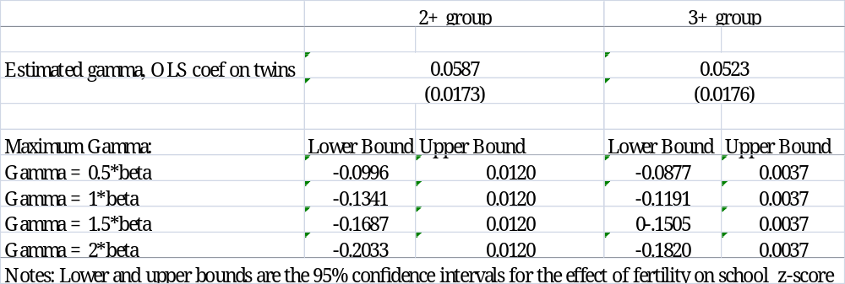
Estimates-Union of Confidence Intervals Approach
06/04/14

Slide 35
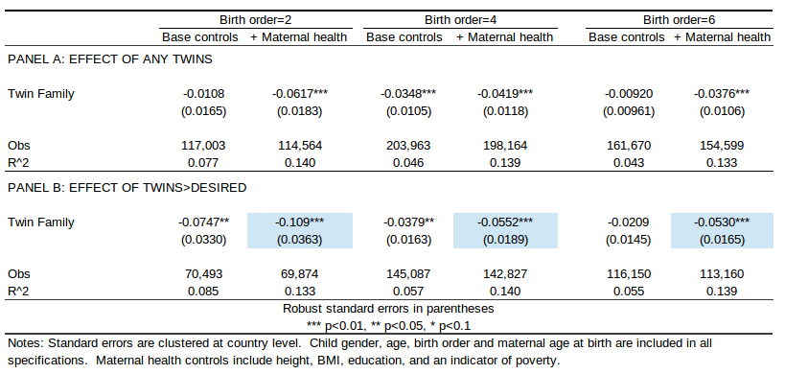
Reduced Form Estimates
Pooling across parity at which twins occur
Controlling for height as an indicator of maternal health
Isolating “treatment” in families in which twins take fertility over target level

Slide 36
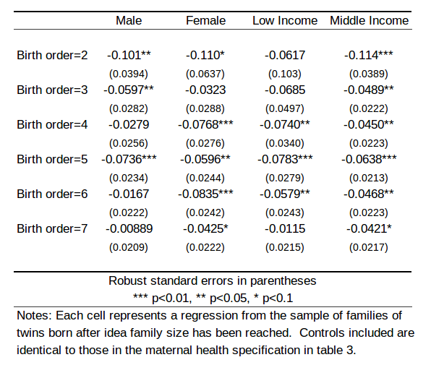
Reduced Form Estimates: Heterogeneity
By low/middle income country group, birth order and gender
Table 7: Q-Q by subgroup

Slide 37
Conclusions
Indicators of mother’s health, education, wealth and age are significant predictors of twin birth. Families that at some date have a twin have significantly lower infant mortality rates prior to occurrence of twins (consistent with their being healthier).
Conditioning upon available twin predictors produces some evidence of a tradeoff in IV (-0.04 sd) and RF estimates.
More robust in lower income sample. (~)
Recognizing that twins are at best plausibly exogenous results in a QQ parameter interval with an upper bound as large as (-)0.12 or (-)0.18 s.d . Working on tightening interval.
There is some evidence of a clearer, well-determined QQ parameter in families in which twin occurrence leads to the family crossing its stated fertility target (~ middle income sample; IV vs RF).

Slide 38
Stop here
06/04/14

Slide 39
We use information on the target fertility of families to identify samples in which the occurrence of twins results in the family crossing their target.
First stage estimates are significantly larger in families in which twins lead to threshold-crossing (the estimate is 1).
2SLS estimates are not significantly different for the two samples. (precision?).
But reduced form estimates are larger.
Descriptive evidence s.t. twin families are more likely than no-twin families to exceed desired fertility but that there is considerable excess fertility in both samples.
06/04/14

Slide 40
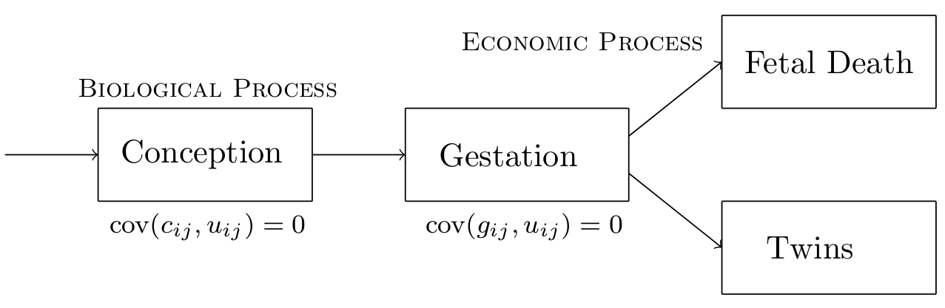
Twin Births May Depend Upon Poverty, Health and Fertility
Figure 4: Requirement for twin exogeneity

Slide 41

Methodology (OLS)
For child i in family j we are interested in estimating:
for educational (or other 'quality') outcomes Y_{ij} and fertility Q_{j}.
The Q-Q model predicts p<0:
Problem is that fertility is endogenous
  If women with high desired fertility have weaker preferences over education, then estimated p will be negatively biased
Controlling for maternal education will partially control for maternal preferences, and we should observe estimated p become less negative

Slide 42
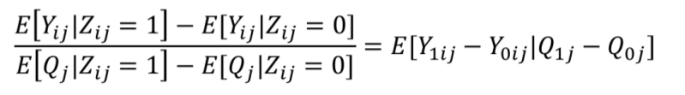
Methodology (Twins)
Since preferences cannot be fully observed, instrument fertility with twins:
This is a Wald estimate, or the LATE of the effect of an additional birth on compliers.
Our point:
  Healthy mothers are more likely to have twins, and are more likely to invest in education of children
  Twins (our Z_{ij}) is not ‘as good as randomly assigned’
This creates a positive bias in estimated p (under-stating true trade-off)

Slide 43
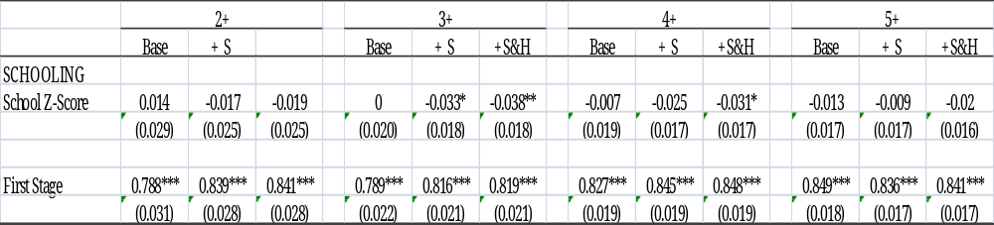
2SLS Estimates: Twins at higher parities
06/04/14

