Slide 1
The Twin Instrument and the Fertility-Investment Trade-off
Sonia Bhalotra* Damian Clarke**
*University of Essex
**University of Oxford
8 May 2014: Preliminary and in progress

Slide 2
The QQ Tradeoff
Cross-sectional data within and across regions suggests that children from larger families have weaker educational outcomes, e.g. Hanushek 1992, Blake 1989.
This empirical regularity is often attributed to a quantity-quality (qq) tradeoff in parental investments: Becker 1960, Becker and Lewis 1973, Becker and Tomes 1976.
A key feature of the qq model is that child quality and child quantity enter multiplicatively in the budget constraint. So
  Exogenous increases in quality raise the shadow price of having more children.
  Exogenous reductions in the number of children reduce the marginal cost of investing in quality
06/04/14

Slide 3
Relevance and Evidence
The negative reinforcing mechanism between q & q plays a central role in macro-growth models with endogenous fertility. Becker and Barro 1988, Becker et al. 1990, Moav 2005.
Many countries have implemented aggressive fertility control policies, e.g. China, India, Mexico, Indonesia. Echoes Malthus. Idea is that this is good for human capital and growth.
But there is limited evidence of a QQ tradeoff.
Using twins as an instrument, Black et al. 2005 (Norway) and Angrist et al. 2010 (Israel) find no evidence of a relationship between fertility and schooling.
  Some evidence of a trade off using other quality indicators: Juhn et. al. 2013, Conley and Glauber 2006, Caceres-Delpiano 2006.
06/04/14

Slide 4
Our Contributions
We argue that an underlying QQ tradeoff may be obscured for two reasons.
Twin birth is not exogenous (even if twin conception is)
  In particular, the health of the mother is a potential omitted variable in previous studies.
2. Twin births more clearly shock family size if their incidence takes fertility above the target level
  We use subjective reports of desired fertility to assess this
3. We assemble a large micro-data sample for developing countries and assess whether the tradeoff is more evident in poor countries.

Slide 5
IV Procedure
schooling = β fertility + Xδ + e
fertility = γ twins + Xλ + ε
E[fertility.e]≠0, E[twins.e]=0
Reduced form: schooling = μ twins+ Xθ + e
Previous studies assume twin incidence is a valid instrument.
A key concern is whether IV estimates are precise enough to be informative (and distinguishable from OLS estimates): Angrist et al.
06/04/14
Notes:
Twin-IV estimates generate the average causal effect of treatment on the non-treated, treatment being an indicator for another child.
Treated: always-takers plus compliers with the instrument switched on. Untreated: never-takers plus compliers with the instrument switched off. But with twins there are no never-takers.
If twinning is as good as randomly assigned, causal effects for the untreated are the same as causal effects on all compliers.
2SLS estimates capture (older) siblings’ weighted average response to the birth of an additional child for parents who were induced to have another by virtue of a twin birth.

Slide 6
Innovations
Refurbish X. First attempt to condition on mother’s health. Assess possibility that there is a QQ tradeoff, obscured in recent studies by bias associated with assuming twin exogeneity.
Adjust for target fertility.
  The Wald estimator is the weighted average causal response for people from families induced by an instrument to go from having fewer than j to at least j children, weighted over j by the probability of crossing this threshold.
  The denominator normalizing the weights is the Wald first stage.
  Individuals with C_{1i} ≥j ≥ C_{0i} are compliers a la Angirst, Imbens, Rubin 1996. Differences in 1st stage coefficients indicate differences in probability of compliance across groups.
06/04/14

Slide 7
Data and Descriptive Statistics

Slide 8
Data and Context
Comparable cross-country micro-data for developing countries from the Demographic and Health Surveys
  Complete fertility histories, subjective reports of desired fertility, indicators of maternal health, maternal education and child education.
Merge all surveys between 1991 and 2013: sample of 3,617,428 children from 69 countries
  Large sample useful given twin are rare (sample mean 1.89%)
  Outcome: schooling (z-score). Retain children age 8-16 at survey date.
  Birth cohorts 1971-20121971-2012
Countries classified as low vs middle income by the World Bank
  Women in poor countries under-nourished and less able to take twin conceptions to term. Higher desired fertility, twins are less likely than otherwise to take actual over desired fertility. Low schooling. QQ more likely given weak credit markets.

Slide 9
Analysis Samples
Effects of twins at parity j on outcomes for births j-1 and before (as in Angrist et al. 2010).
  Predictions are for infra-marginal children.
2+ sample: Firstborn subjects in families with at least two births (allowing that a birth may be twin).
  Instrument with twins at second birth.
3+ sample: First and second born subjects in families with at least three births
  Instrument with twins at second birth. [etc.]
Twin subjects are dropped.
06/04/14

Slide 10
contd
  By restricting to families with at least j births on average we ensure that preferences over family size are the same in the families with twins at the jth birth and those with singleton births.
  By restricting the sample to children born before birth j, we avoid selection problems that arise because families who choose to have another child after a twin birth may differ from families who choose to have another child after a singleton birth.
06/04/14

Slide 11
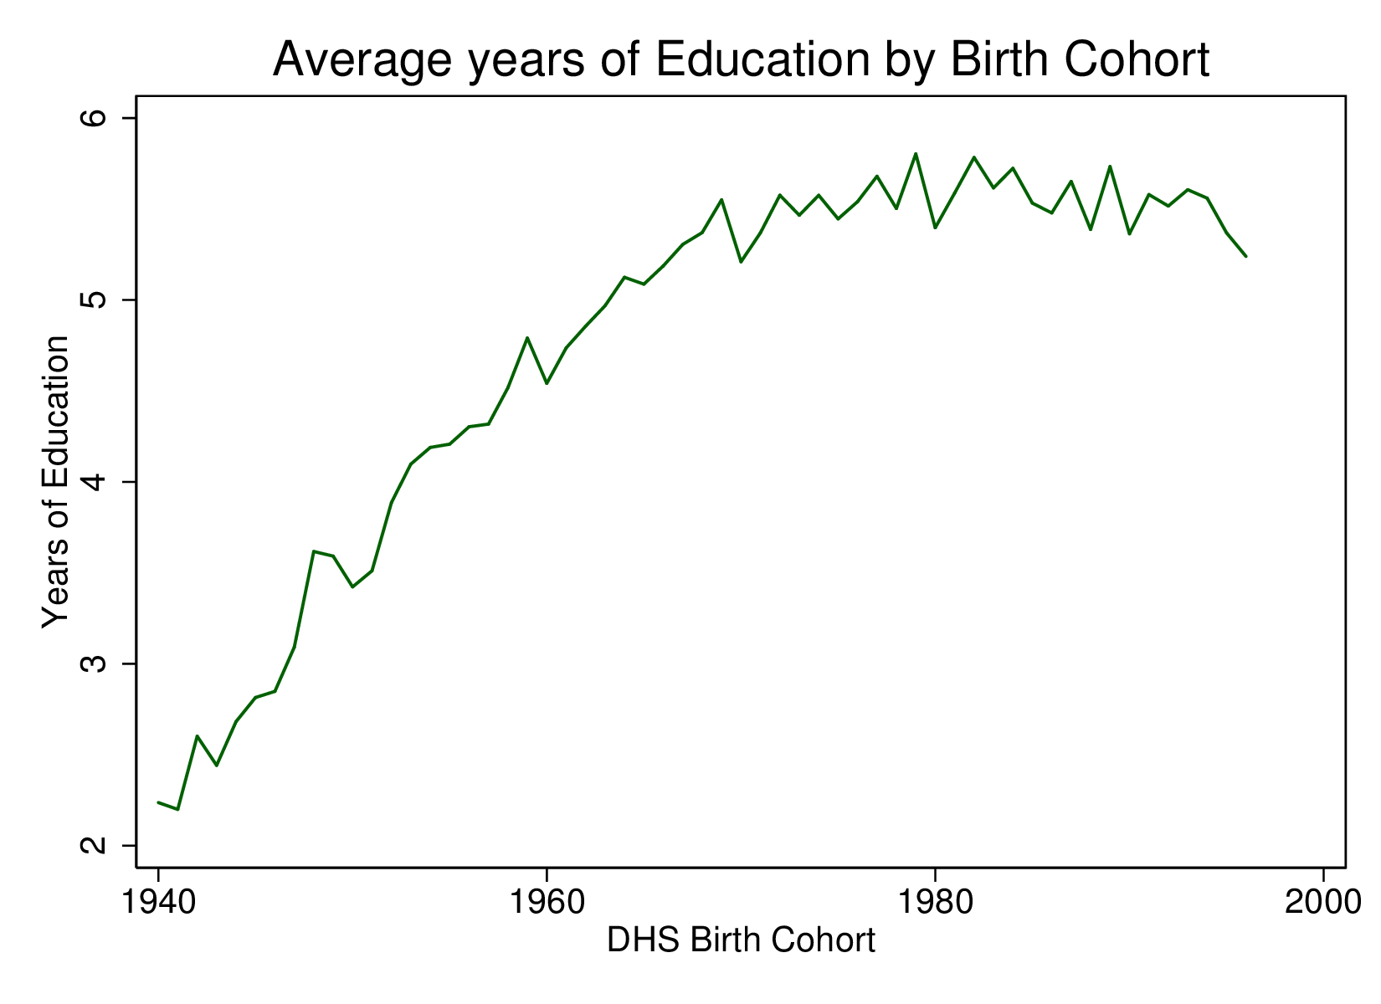
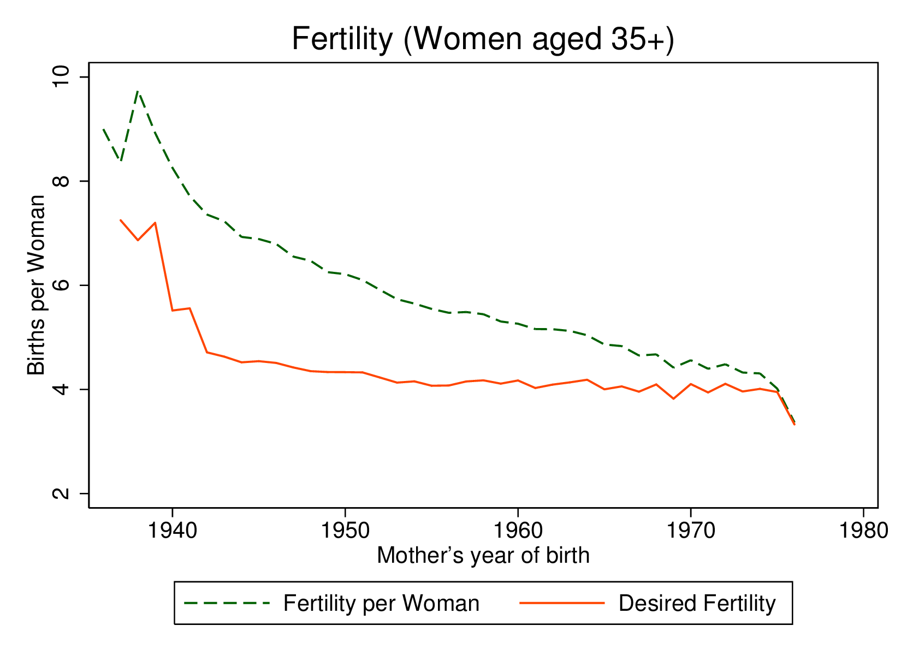
Trends in Education, Fertility, Fertility Control
Note to figures: both figures are restricted to groups in DHS who have largely finished education/fertility (16+ and 35+ respectively)
06/04/14

Slide 12
Summary Statistics
 | Low Income |  |  | Middle Income
 | Single | Twins |  | Single | Twins | All
FERTILITY
Fertility | 3.749 | 6.223 |  | 3.412 | 5.584 | 3.689
 | (2.392) | (2.622) |  | (2.308) | (2.687) | (2.406)
Desired Family Size | 4.193 | 5.328 |  | 3.38 | 4.19 | 3.921
 | (2.530) | (2.885) |  | (2.130) | (2.555) | (2.440)
Fraction Twin | 0.02 |  |  | 0.0179 |  | 0.0191
 | (0.1402) |  |  | (0.1326) |  | (0.1370)
HEALTH OF MOTHER
Height in cm | 155.5 | 157.6 |  | 155.6 | 157.2 | 155.6
 | (7.093) | (7.065) |  | (6.966) | (6.945) | (7.053)
BMI | 21.9 | 22.5 |  | 25.9 | 26.63 | 23.39
 | (4.027) | (4.175) |  | (5.118) | (5.512) | (4.867)
CHILDREN'S OUTCOMES
Education (Years) | 3.66 | 3.204 |  | 5.445 | 5.043 | 4.446
 | (3.576) | (3.293) |  | (3.867) | (3.760) | (3.810)
Education (Z-Score) | -0.00843 | -0.0156 |  | 0.0119 | -0.0428 | 0.000144
 | (1.001) | (0.963) |  | (0.998) | (0.987) | (1.000)
Number of Countries | 39 | 39 |  | 28 | 28 | 67
Number of Children | 2,231,844 | 45,654 |  | 1,614,358 | 29,430 | 3,921,286
Number of Mothers | 875,587 | 12,908 |  | 653,969 | 8,605 | 1,586,899
Notes: group means (sd)
06/04/14

Slide 13
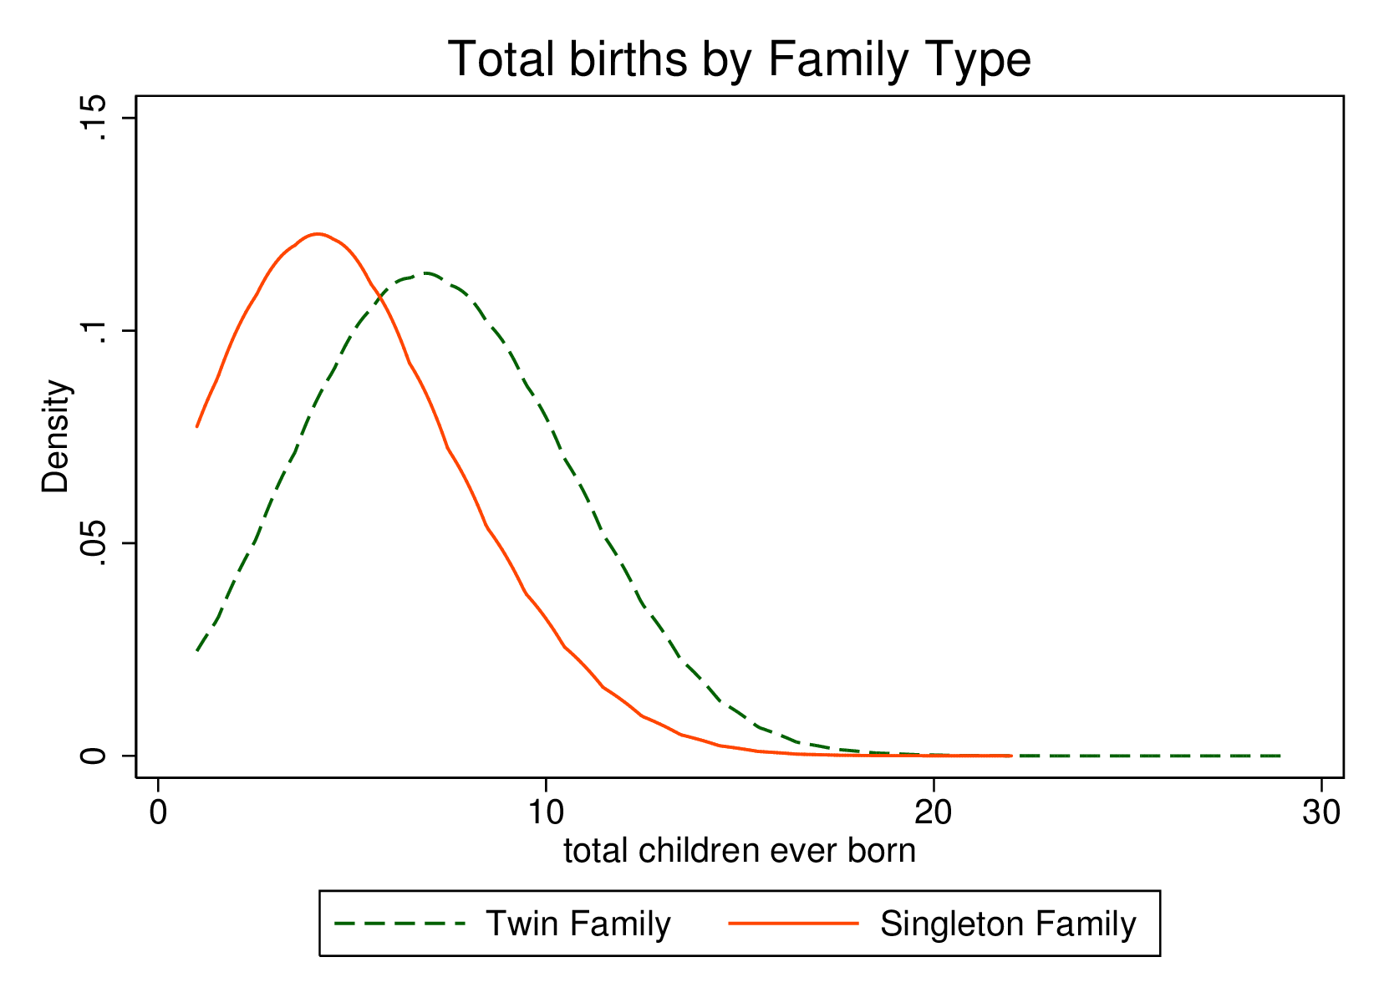
Twins Shift Distribution of Family Size Rightward

Slide 14
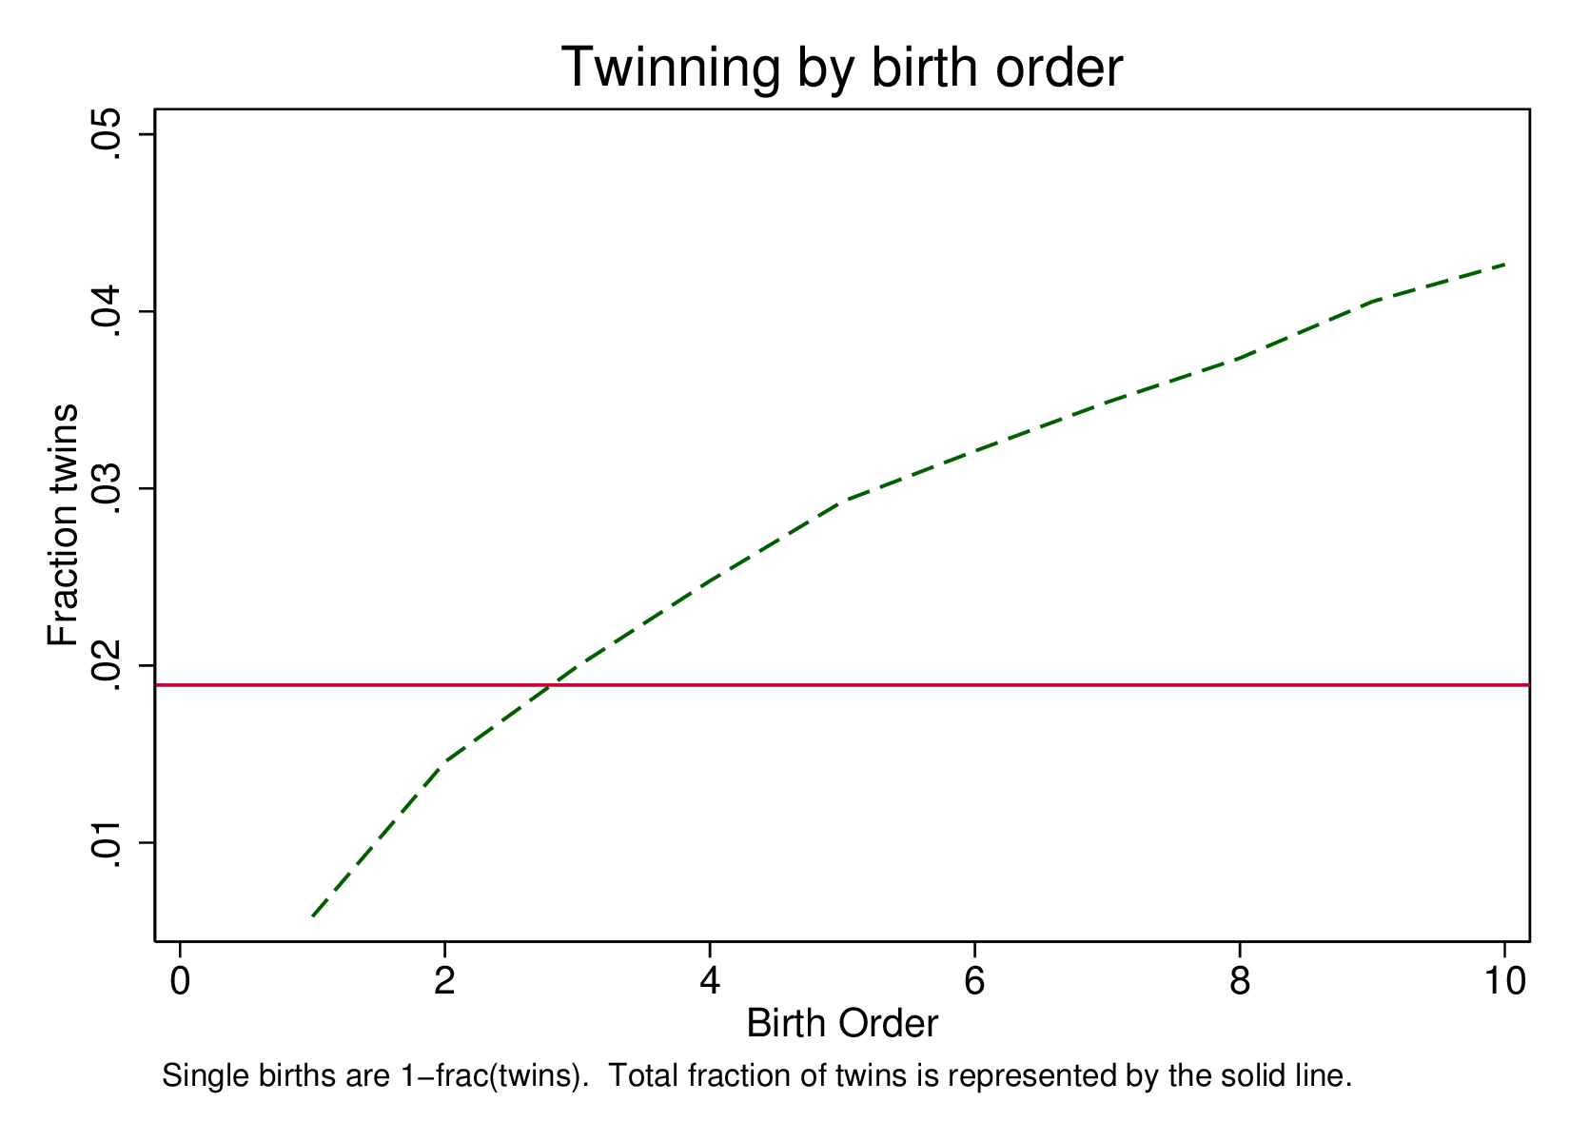
Twins Are More Likely to Occur at Higher Birth Orders

Slide 15
Mother’s Health
Cross-country microdata evidence from the cross-country microdata sample shows that indicators of the health of the mother influence child birth-weight, survival and growth (stunting): Bhalotra and Rawlings (2011).
This makes it plausible that mother’s health influences foetal survival.
  A standard deviation decrease in mother's height or BMI raises the risk of poor child health (birth-weight, mortality, stunting) by between 5 and 10 per cent, depending on the measure.
  The risks of low birth weight and neonatal mortality are higher by 5.7% and 16.9% of their mean rates amongst mothers who have anemia relative to mothers who do not.
No previous evidence (or discussion) of maternal health being a predictor of twin births.
06/04/14

Slide 16
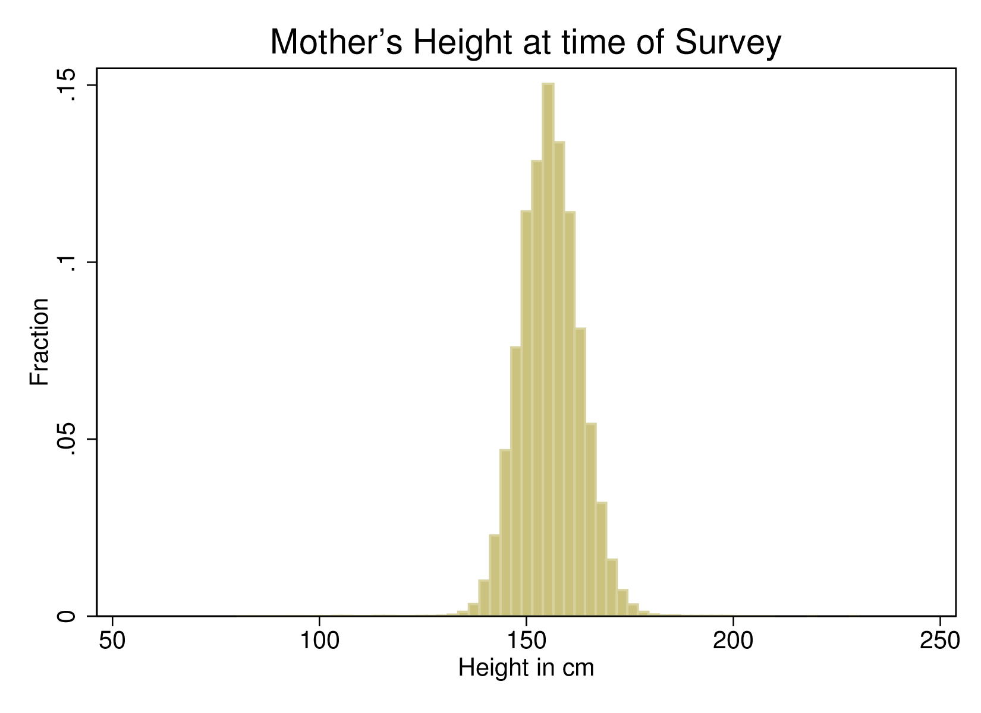
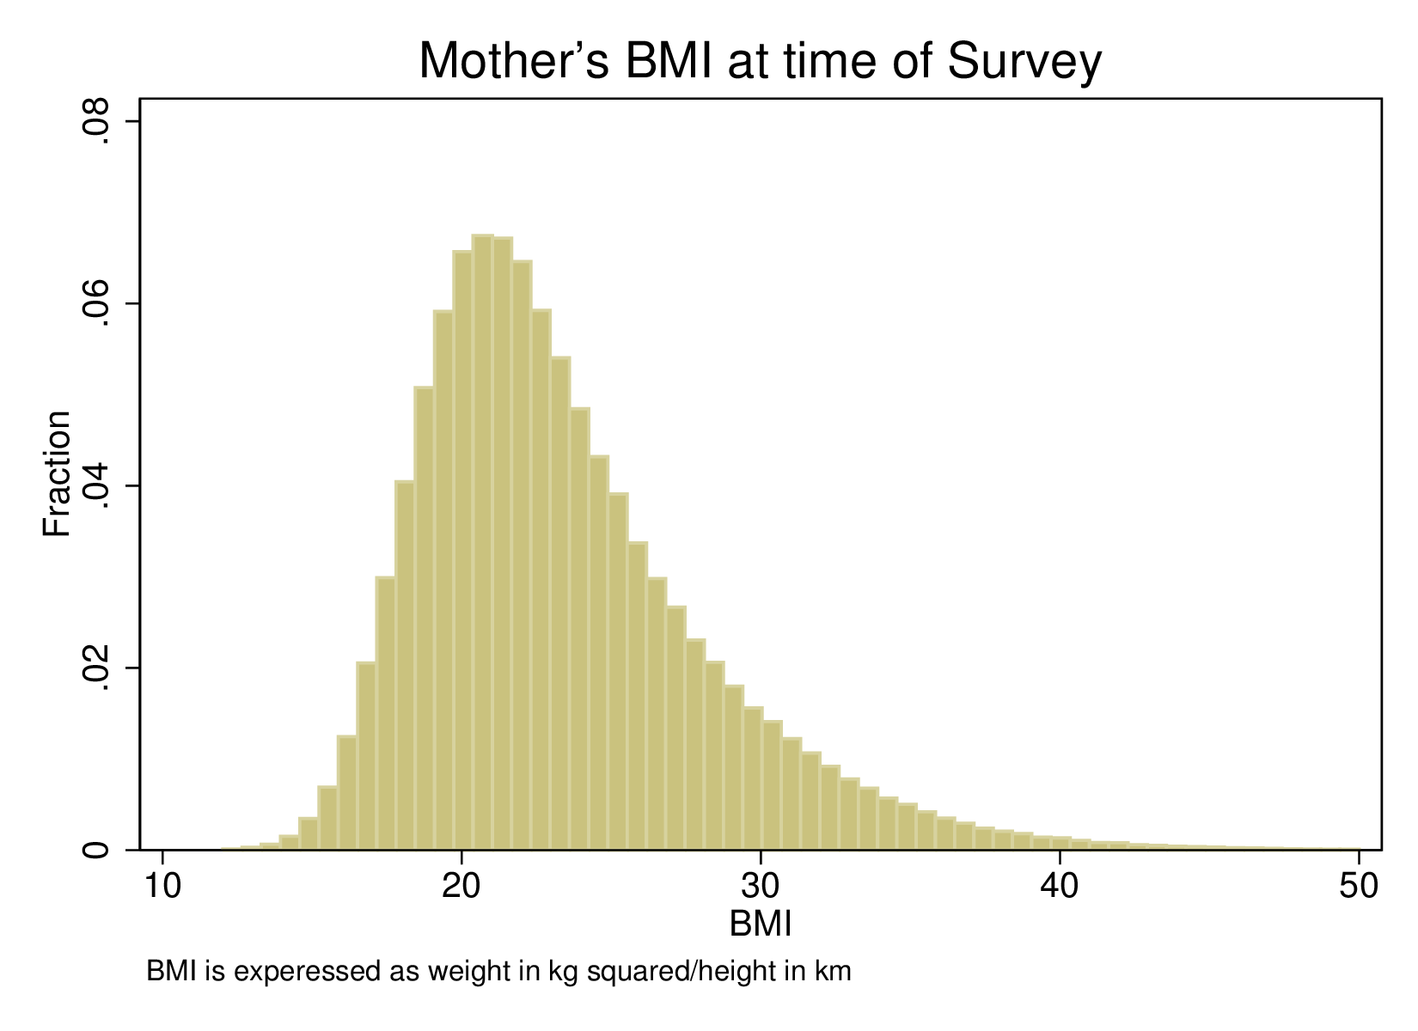
Distribution of available indicators of mother’s health in the sample
Percent Underweight (BMI<18.5) in sample 11.8%
Percent Low Height (<5 foot 2) in sample 40.8%
06/04/14

Slide 17
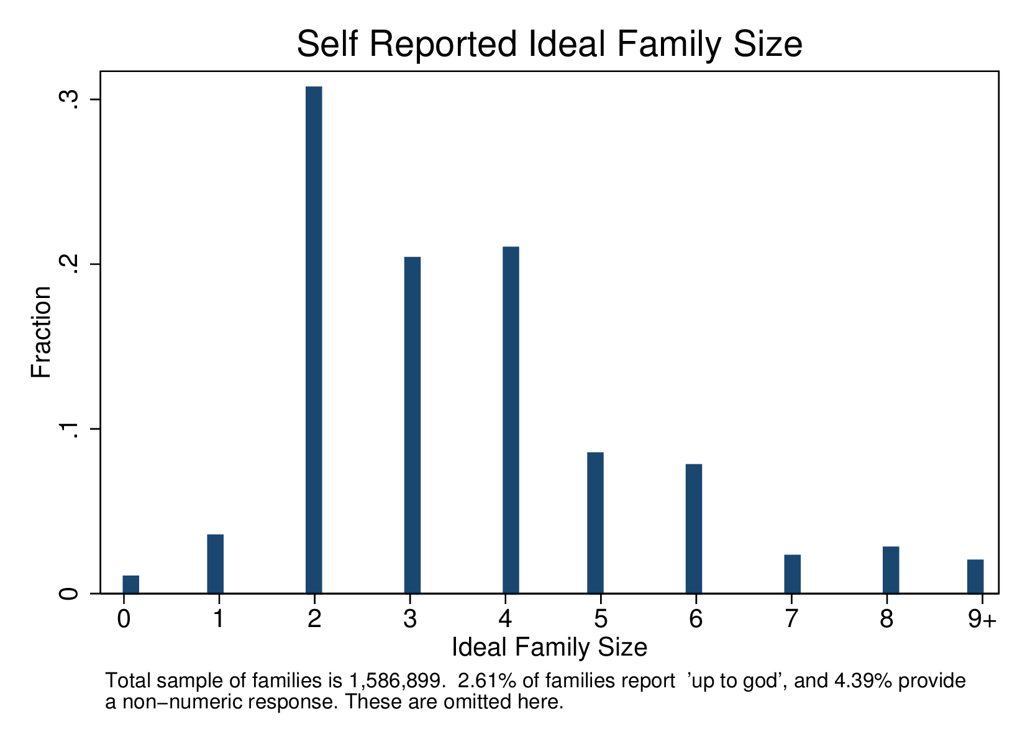
Reported Ideal Family Size

Slide 18
Actual fertility is more likely to cross target fertility in families that have had a twin
 | Low Income |  |  | Middle Income
 | Single | Twins |  | Single | Twins | All
FERTILITY
Actual Births>Desired | 0.31 | 0.526 |  | 0.324 | 0.575 | 0.321
 | (0.463) | (0.499) |  | (0.468) | (0.494) | (0.467)
Desired Family Size | 4.193 | 5.328 |  | 3.38 | 4.19 | 3.921
 | (2.530) | (2.885) |  | (2.130) | (2.555) | (2.440)
06/04/14

Slide 19
Fraction of families with twins at parity j who state desired fertility ≤ j
Parity | Percent
Two Plus | 27.96
Three Plus | 36.99
Four Plus | 52.27
Five Plus | 55.86
06/04/14

Slide 20
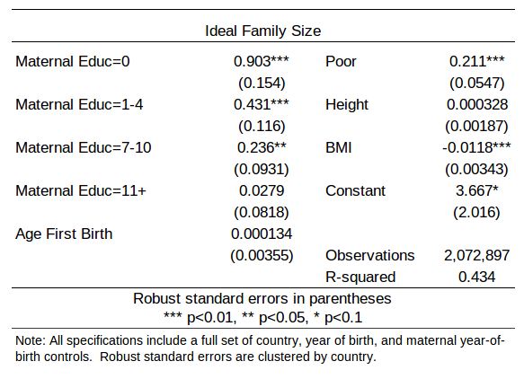
Evidence that Fertility Preferences are Correlated with Maternal Characteristics
Reported ideal family size is correlated with observable maternal characteristics
This suggests actual fertility is likely to be endogenous.
So OLS estimates of the QQ tradeoff are biased.

Slide 21
Estimates

Slide 22
Investigating Exogeneity of Twins
P(twin) = Xδ₀ + u
X are mother characteristics potentially correlated with child quality: age, wealth, education, height, BMI, antenatal care, smoking/drinking/drugs during pregnancy.
If twin birth is a random event, δ₀ =0.
Can typically condition on only a subset of predictors X
Quality indicator (t-k) = α twins (t)+ Xδ₁ + e
Compare child quality in families with and without twins at parity p for children born at earlier parities.
But use a measure of quality (investment) that is necessarily determined before twins occur: infant mortality.
If twins occur randomly, α=0
06/04/14

Slide 23
Probability of a Twin Birth
Systematic correlations with mother characteristics
 | (1) | (2) | (3) | (4) | (5) | (6)
Twin*100 | All | Income |  | Time |  | Prenatal
 |  | Low inc | Middle inc | 1990-2013 | 1972-1989
Age | 0.491*** | 0.489*** | 0.498*** | 0.587*** | 0.168*** | 0.632***
 | (0.026) | (0.033) | (0.045) | (0.030) | (0.064) | (0.040)
Age Squared | -0.006*** | -0.006*** | -0.007*** | -0.008*** | 0 | -0.009***
 | (0.000) | (0.001) | (0.001) | (0.001) | (0.001) | (0.001)
Age First Birth | -0.051*** | -0.082*** | -0.002 | -0.050*** | -0.051*** | -0.041***
 | (0.008) | (0.010) | (0.013) | (0.009) | (0.015) | (0.013)
Education (years) | 0.027* | 0.065*** | -0.008 | 0.044** | -0.008 | -0.071**
 | (0.016) | (0.021) | (0.027) | (0.019) | (0.028) | (0.028)
Education squared | -0.001 | -0.005** | 0.001 | -0.002 | 0.002 | 0.003
 | (0.001) | (0.002) | (0.002) | (0.001) | (0.002) | (0.002)
Height | 0.057*** | 0.056*** | 0.058*** | 0.063*** | 0.038*** | 0.059***
 | (0.004) | (0.005) | (0.006) | (0.005) | (0.007) | (0.007)
BMI | 0.050*** | 0.059*** | 0.043*** | 0.046*** | 0.056*** | 0.045***
 | (0.006) | (0.008) | (0.008) | (0.007) | (0.009) | (0.011)
Prenatal (Doctor) |  |  |  |  |  | 0.917***
 |  |  |  |  |  | (0.129)
Prenatal (Nurse) |  |  |  |  |  | 0.076
 |  |  |  |  |  | (0.109)
Prenatal (None) |  |  |  |  |  | -0.479***
 |  |  |  |  |  | (0.133)
R-squared | 0.01 | 0.01 | 0.01 | 0.01 | 0.01 | 0.01
N | 2271948 | 1430703 | 841245 | 1660253 | 611695 | 624990
Notes: Conditional on birth cohorts and country dummies. Linear probability estimates. Prenatal column only estimated on births five years preceding date of survey.
06/04/14

Slide 24
Effect Sizes
Substantial marginal effects of observed indicators of mother’s health on the probability of twin birth (mean=2%)
A one s.d. change in the height of the mother results in an increase of 0.44% points (22% of mean)
A one s.d. change in mother’s BMI results in an increase of 0.20% points (10% of mean)
06/04/14

Slide 25
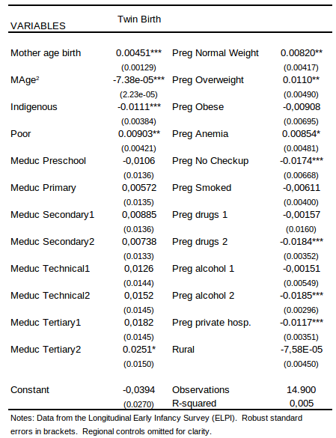
Table 5: Probability of Twin Births in Chile: Data on Pregnancy Behaviours

Slide 26
Test of Exogeneity of Twins
Comparison of child outcome determined before twins arise across families who do and do not subsequently have a twin birth
Results indicate that twin births occur in families with a tendency towards lower infant morality, possibly healthier (or better-off) families.
Large effect size; mean IMR: 0.01
IMR*1000 | Base | +S&H | Observations
Treated (2+) | -1.396** | -1.402** | 337378
 | (0.639) | (0.638)
Treated (3+) | -1.565*** | -1.570*** | 455372
 | (0.362) | (0.363)
Treated (4+) | -0.634*** | -0.620*** | 443165
 | (0.066) | (0.066)
Treated (5+) | -0.423*** | -0.412*** | 382405
 | (0.139) | (0.139)
NOTES: The sample for these regressions consist of all children who have been entirely exposed to the risk of infant mortality (ie those over 1 year of age). Subsamples 2+, 3+, 4+ and 5+ are generated to allow comparison of children born at similar birth orders. For a full description of these groups see the the body of the paper or notes to tables 5, 6, 12 or13 respectively. Treated=1 refers to children who are born before a twin while Treated=0 refers to children of similar birth orders not born before a twin. Base and S+H controls are described in table 5.* p<0.1, ** p<0.05, *** p<0.01
06/04/14

Slide 27
OLS Estimates
Adding controls for predictors of twin birth diminishes the estimated trade-off
 | Base |  |  | Altonji | Altonji
 | Controls | Socioec | Health | Ratio 1 | Ratio 2
Panel A: All Countries
Fertility | -0.115*** | -0.0777*** | -0.0751*** | 2.083 | 1.882
 | (0.000815) | (0.000776) | (0.000771)
Observations | 1334874 | 1334874 | 1334874
R-squared | 0.094 | 0.161 | 0.167
Panel B: Low Income
Fertility | -0.110*** | -0.0734*** | -0.0712*** | 2.005 | 1.835
 | (0.00106) | (0.000988) | (0.000975)
Observations | 831476 | 831476 | 831476
R-squared | 0.091 | 0.171 | 0.181
Panel C: Middle Income
Fertility | -0.125*** | -0.0875*** | -0.0854*** | 2.333 | 2.157
 | (0.00128) | (0.00126) | (0.00126)
Observations | 503398 | 503398 | 503398
R-squared | 0.106 | 0.154 | 0.156
NOTES: Base controls consist of child gender, mother's age and age squared mother's age at first birth, child age, country, and year of birth dummies. Socioeconomic augments `Base' to include mother's education and education squared, and Health includes mother's height and BMI. ``Desire'' takes 1 if the child is born before the family reaches it's desired size, and 0 if the child is born after the desired size is reached. The \citet{Altonjietal2005} ratio determines how important unobservable factors must be compared with included observables to imply that the true effect of fertilty on educational attainment is equal to zero. Ratio 1 compares no controls to socioeconomic controls, while ratio 2 compares no controls to socioeconomic and health controls. Standard errors are clustered at the level of the mother. * p<0.1, ** p<0.05, *** p<0.01
06/04/14

Slide 28
Altonji, Elder, Taber 2005, extension in Bellows and Miguel 2009
schooling = β fertility + Xδ + e
Fertility is endogenous and instrumented by twins and X is a vector of relevant controls, conditional upon which twins are a valid instrument.
Suppose we observe only a random sub-set of X.
Assume that the observed and unobserved components of X are correlated and selection on unobservables is similar to selection on observables.
Compute the ratio of β_{c}/ β_{n} –β_{c} . A large ratio (given by controls not changing β much) suggests it is implausible that unobservables can explain away the estimated impact.
06/04/14

Slide 29
Our estimate
The Altonji et al. statistic computed from OLS estimates with and without controls for twin predictors is ~2.
So for unobservables to explain the OLS coef (-0.12), the variation explained by unobservables would need to be about twice as large as the variation that is explained by the covariates included in our specification.
06/04/14

Slide 30
First Stage: The incidence of twins predicts an increase in fertility of ~0.8 children. For twins born at parity 3 or after that take the family beyond target, the increase is 1 [Similar if completed fertility]
 | 2+ |  |  | 3+ |  |  | 4+
FERTILITY | Base | +S | +S&H | Base | +S | +S&H | Base | +S | +S&H
Pre-Twins
Twin | 0.798*** | 0.839*** | 0.841*** | 0.796*** | 0.821*** | 0.824*** | 0.841*** | 0.860*** | 0.863***
 | (0.030) | (0.028) | (0.028) | (0.027) | (0.026) | (0.026) | (0.027) | (0.026) | (0.026)
Pre-Twins (+bord)
Twin | 0.796*** | 0.838*** | 0.839*** | 0.793*** | 0.825*** | 0.828*** | 0.842*** | 0.863*** | 0.865***
 | (0.030) | (0.028) | (0.028) | (0.027) | (0.026) | (0.026) | (0.026) | (0.026) | (0.026)
Low-Income
Twin | 0.844*** | 0.861*** | 0.861*** | 0.804*** | 0.822*** | 0.824*** | 0.863*** | 0.866*** | 0.868***
 | (0.037) | (0.036) | (0.036) | (0.033) | (0.032) | (0.032) | (0.032) | (0.032) | (0.032)
Middle-Income
Twin | 0.741*** | 0.803*** | 0.806*** | 0.774*** | 0.810*** | 0.815*** | 0.790*** | 0.844*** | 0.846***
 | (0.051) | (0.045) | (0.045) | (0.047) | (0.044) | (0.044) | (0.047) | (0.043) | (0.043)
Desired-Threshold
Twin | 0.779*** | 0.818*** | 0.819*** | 0.750*** | 0.778*** | 0.782*** | 0.804*** | 0.825*** | 0.826***
 | (0.034) | (0.032) | (0.032) | (0.029) | (0.028) | (0.028) | (0.031) | (0.030) | (0.030)
Twin*desire | 0.076 | 0.077 | 0.081 | 0.269*** | 0.246*** | 0.243*** | 0.149** | 0.142** | 0.146**
 | (0.069) | (0.065) | (0.065) | (0.084) | (0.080) | (0.079) | (0.060) | (0.058) | (0.059)
NOTES: Each cell represents the coefficient from the first-stage of a two-stage regression. The first-stage represents the effect of twinning at parity $N$ on total fertility where $N$ is 2, 3 or 4 for 2+, 3+ and 4+ groups respectively. The 2+ group includes all first borns in families with at least 2 births, the 3+ group includes first and second borns in families with at least 3 births, and the 4+ group includes all first to third borns in families with at least four births. In each regressions the sample is made up of all children aged between 6-18 years from families in the DHS who fulfill these birth order conditions. Controls in each case are identical to those described in table 5. Standard errors are clustered at the level of the mother.* p<0.1, ** p<0.05, *** p<0.01
06/04/14

Slide 31
2SLS second stage estimates: Role of controls for twin predictors. Separate sample in which twin occurence leads to fertility crossing the target (threshold) level
 | Base
 | Controls | Socioec | Health | Obs.
All Families
Fertility | -0.01 | -0.038* | -0.042** | 390985
 | (0.023) | (0.021) | (0.021)
All Families (bord dummies)
Fertility | -0.01 | -0.038* | -0.042** | 390985
 | (0.023) | (0.021) | (0.020)
Low-Income Countries
Fertility | 0.006 | -0.029 | -0.034 | 244928
 | (0.029) | (0.026) | (0.025)
Middle-Income Countries
Fertility | -0.045 | -0.061* | -0.064* | 146057
 | (0.039) | (0.035) | (0.035)
Desired-Threshold
Fertility | 0.001 | -0.044* | -0.047** | 390985
 | (0.027) | (0.024) | (0.024)
Fertility*desire | -0.011 | 0.002 | 0.001
 | (0.010) | (0.009) | (0.009)
First Stage
All Families
Twins | 0.796*** | 0.821*** | 0.824*** | 390985
 | (0.027) | (0.026) | (0.026)
Notes: Three plus group consists of all first and second born children in families with at least three births.
06/04/14

Slide 32
2SLS: two plus, four plus
 | Base
 | Controls | Socioec | Health | Obs.
Pre-Twins
All Families
Fertility | 0.002 | -0.023 | -0.025 | 258243
 | (0.027) | (0.025) | (0.025)
All Families (bord dummies)
Fertility | 0.002 | -0.023 | -0.025 | 258243
 | (0.027) | (0.025) | (0.025)
Low-Income Countries
Fertility | 0.023 | 0.012 | 0.009 | 156847
 | (0.032) | (0.029) | (0.029)
Middle-Income Countries
Fertility | -0.057 | -0.084* | -0.085* | 101396
 | (0.050) | (0.045) | (0.045)
Desired-Threshold
Fertility | 0.008 | -0.021 | -0.023 | 258243
 | (0.032) | (0.028) | (0.028)
Fertility*desire | -0.004 | 0 | -0.001
 | (0.013) | (0.013) | (0.013)
First Stage (Pre-Twins)
All Families
Twins | 0.798*** | 0.839*** | 0.841*** | 258243
 | (0.030) | (0.028) | (0.028)
Notes: Two plus group consists of all first born children in families with at least two births.
 | Base
 | Controls | Socioec | Health | Obs.
Pre-Twins
All Families
Fertility | -0.016 | -0.029 | -0.034* | 403124
 | (0.024) | (0.021) | (0.020)
All Families (bord dummies)
Fertility | -0.016 | -0.029 | -0.034* | 403124
 | (0.024) | (0.020) | (0.020)
Low-Income Countries
Fertility | -0.012 | -0.014 | -0.023 | 261555
 | (0.028) | (0.025) | (0.024)
Middle-Income Countries
Fertility | -0.023 | -0.049 | -0.05 | 141569
 | (0.043) | (0.036) | (0.036)
Desired-Threshold
Fertility | 0.003 | -0.01 | -0.014 | 403124
 | (0.026) | (0.023) | (0.023)
Fertility*desire | -0.014* | -0.014* | -0.015**
 | (0.008) | (0.007) | (0.007)
First Stage (Pre-Twins)
All Families
Twins | 0.841*** | 0.860*** | 0.863*** | 403124
 | (0.027) | (0.026) | (0.026)
Notes: Four plus group consists of all first to third born children in families with at least four births.
06/04/14

Slide 33
Taking Stock
High fertility women are negatively selected, so controlling for fertility predictors weakens OLS estimates of the QQ tradeoff.
Women who are predisposed toward having twins are positively selected, so controlling for predictors of twin birth strengthens IV estimates of the QQ tradeoff.
First stage indicates twin birth is a powerful instrument. For families in which twin birth leads to exceeding target fertility, twin birth predicts 1 additional birth.
Conditional upon available SES and health controls, the OLS estimate is -0.08* (parity pooled) and IV estimates are -0.02 (2+) or -0.04* (3+ sample).
Larger in low-income group. “Threshold sample..”

Slide 34
Allowing twins to be plausibly exogenous rather than strictly exogenous: Conley et al. 2012
2SLS biased if twins not strictly exogenous.
We implement an alternative approach to inference for IV models with instruments whose validity is debatable.
schooling = β fertility + γ twins + Xδ + e
  Relax the exclusion restriction that γ=0.
Plausible exogeneity corresponds to having prior information that γ is near 0 but not exactly 0. Still sufficient structure to allow inference to proceed.
  The 2SLS estimator is less sensitive to violations of the exclusion restriction when the instrument is strong (related, Bound, Jaeger, Baker 1995). Conley et al are motivated by cases such as ours where the instrument is strong but may not be strictly exogenous.
06/04/14

Slide 35
The procedure
Conley et al. 2012 present four complementary inference strategies that use prior information about γ to different extents. We implement two of these: union of confidence interval (UCI) and local to zero (LTZ)
We specify a set of plausible values for γ and obtain interval estimates for β conditional upon each. {Grid over 0 to largest}.
Taking the union of these interval estimates across values of γ provides a conservative interval estimate for β .
The plus is that we don’t need to specify a prior distribution for γ, just a range of plausible values.
The minus is that the estimated interval around β may be wide
The LTZ approach views prior probabilities for γ as analogous to objective probabilities in a 2-step DGP. Here we must specificy a prior distribution
06/04/14

Slide 36
Conley et al: Estimating γ from DHS
 | (1) | (2) | (3) | (4)
School Z-Score
Fertility | -0.149*** | -0.143*** | -0.128*** | -0.110***
 | (0.00112) | (0.000940) | (0.000959) | (0.00105)
Twin (2nd birth) | 0.108***
 | (0.0145)
Twin (3rd birth) |  | 0.0945***
 |  | (0.0110)
Twin (4th birth) |  |  | 0.0852***
 |  |  | (0.0103)
Twin (5th birth) |  |  |  | 0.0898***
 |  |  |  | (0.0103)
Constant | -0.327 | -0.992*** | -0.900 | -1.011
 | (1,137) | (0.321) | (1,865) | (1,009)
Observations | 447,682 | 666,035 | 675,492 | 594,035
R-squared | 0.098 | 0.088 | 0.076 | 0.072
Columns 1 to 4 include the 2+ to 5+ subgroups respectively. Standard errors clustered at the leve of the mother are in parentheses.*** p<0.01, ** p<0.05, * p<0.1
06/04/14

Slide 37
Estimates-UCI and LTZ Approaches
 | UCI: gamma in [0,delta] |  | LTZ: gamma ~ U(0,delta)
 | Lower Bound | Upper Bound | Lower Bound | Upper Bound
Two Plus | -0.1827 | 0.0173 | -0.1584 | -0.0008
Three Plus | -0.1659 | -0.0019 | -0.1485 | -0.0155
Four Plus | -0.1486 | -0.0062 | -0.1332 | -0.0186
Five Plus | -0.1329 | 0.0203 | -0.1182 | 0.0076
NOTES: This table presents upper and lower bounds of a 95% confidence interval for the effects of family size on (standardised) children's education attainment. These are estimated by the methodology of Conley et al. 2012 under various priors about the direct effect that being from a twin family has on educational outcomes (gamma). In the UCI (union of confidence interval) approach, it is assumed the true gamma\in[0,delta], while in the LTZ (local to zero) approach it is assumed that gamma ~ U(0,delta. In each case delta is estimated by including twinning in the first stage equation and observing the effect size of estimated gamma. Estimated gamma's are (respectively for two plus to five plus): 0.1077, 0.0931, 0.0810, 0.0870.
06/04/14

Slide 38
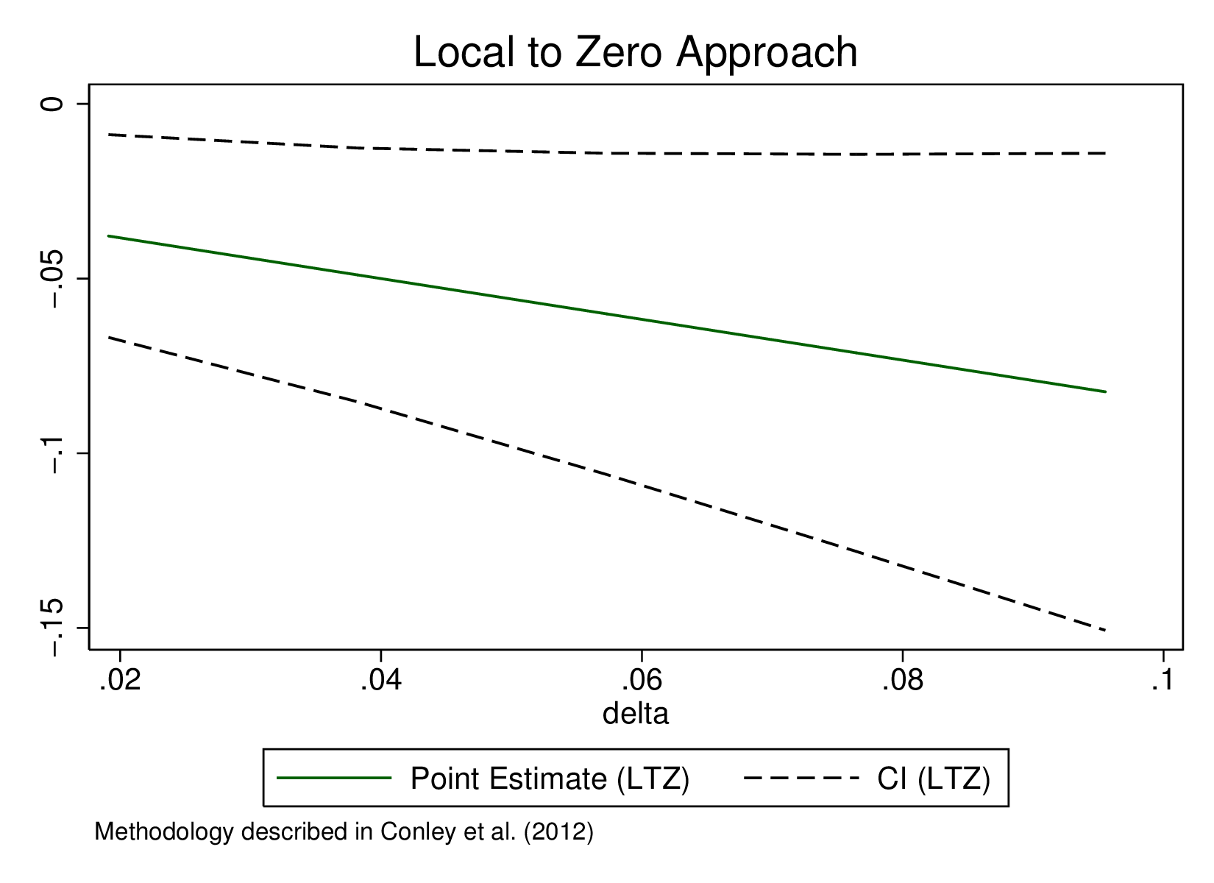
Estimates (3+) Assuming that gamma ~ U(0,delta)
06/04/14

Slide 39
IV Estimates: Heterogeneity
By gender of index child
Table 7: Q-Q by subgroup
 | Females |  |  |  | Males
 | Base | Socioec | Health | Obs. | Base | Socioec | Health | Obs.
Two Plus | 0.014 | -0.018 | -0.023 | 126527 | -0.008 | -0.027 | -0.027 | 131716
 | (0.040) | (0.036) | (0.035) |  | (0.038) | (0.034) | (0.034)
Three Plus | -0.02 | -0.047* | -0.050* | 194176 | 0.001 | -0.028 | -0.033 | 196809
 | (0.032) | (0.028) | (0.028) |  | (0.029) | (0.027) | (0.027)
Four Plus | -0.036 | -0.051** | -0.056** | 201174 | 0.003 | -0.007 | -0.01 | 201950
 | (0.030) | (0.026) | (0.026) |  | (0.030) | (0.027) | (0.027)
NOTES: Female or male refers to the gender of the index child of the regression. All regressions include full controls including socioeconomic and maternal health variables. The full lis of controls are available in the notes to table 5. Full IV results for male and female children are presented in table 14. Standard errors are clustered by mother.* p<0.1, ** p<0.05, *** p<0.01

Slide 40
Conclusions
Indicators of mother’s health, education, wealth and age are significant predictors of twin birth. Families that at some date have a twin have significantly lower infant mortality rates prior to occurrence of twins (consistent with their being healthier).
Conditioning upon available twin predictors produces some evidence of a tradeoff in IV (-0.02 to -0.04 sd) and RF estimates.
Significantly higher for certain groups (middle income countries, female children)
Recognizing that twins are at best plausibly exogenous results in a QQ parameter interval with an upper bound as large as (-)0.15 s.d.
There is some evidence of a clearer, well-determined QQ parameter in families in which twin occurrence leads to the family crossing its stated fertility target

Slide 41
Stop here
06/04/14

Slide 42
We use information on the target fertility of families to identify samples in which the occurrence of twins results in the family crossing their target.
First stage estimates are significantly larger in families in which twins lead to threshold-crossing (the estimate is 1).
2SLS estimates are not significantly different for the two samples. (precision?).
But reduced form estimates are larger.
Descriptive evidence s.t. twin families are more likely than no-twin families to exceed desired fertility but that there is considerable excess fertility in both samples.
06/04/14

Slide 43
Testing for Balance Between Twin and Non-twin Families
 | Non-Twin | Twin | Diff
 | Family | Family | (Diff. SE)
Total Fertilty | 4.457 | 6.783 | -2.325***
 |  |  | (0.0252)
Desired Fertility | 4.455 | 5.57 | -1.115***
 |  |  | (0.0308)
Age First Birth | 19.15 | 18.98 | 0.175***
 |  |  | (0.0420)
Mother's Education | 4.287 | 3.372 | 0.916***
 |  |  | (0.0518)
Father's Education | 5.527 | 4.729 | 0.798***
 |  |  | (0.0579)
Mother's Height | 156.1 | 157.9 | -1.744***
 |  |  | (0.0830)
Pr(BMI < 18.5) | 0.12 | 0.0934 | 0.0263***
 |  |  | (0.00377)
Prenatal care (doctor) | 0.314 | 0.212 | 0.101***
 |  |  | (0.00539)
Prenatal care (nurse) | 0.454 | 0.524 | -0.0695***
 |  |  | (0.00582)
Prenatal care (none) | 0.19 | 0.179 | 0.0110*
 |  |  | (0.00457)
Mother's Age | 25.54 | 27.62 | -2.079***
 |  |  | (0.0558)
Child Mortality | 0.0103 | 0.0259 | -0.0156***
 |  |  | (0.000908)
Infant Mortality | 0.00583 | 0.0172 | -0.0114***
 |  |  | (0.000602)
Wealth Quintile 1 | 0.258 | 0.272 | -0.0142**
 |  |  | (0.00512)
Wealth Quintile 2 | 0.219 | 0.226 | -0.00717
 |  |  | (0.00484)
Wealth Quintile 3 | 0.198 | 0.201 | -0.00341
 |  |  | (0.00466)
Wealth Quintile 4 | 0.176 | 0.177 | -0.00043
 |  |  | (0.00445)
Wealth Quintile 5 | 0.149 | 0.124 | 0.0252***
 |  |  | (0.00415)
06/04/14

Slide 44
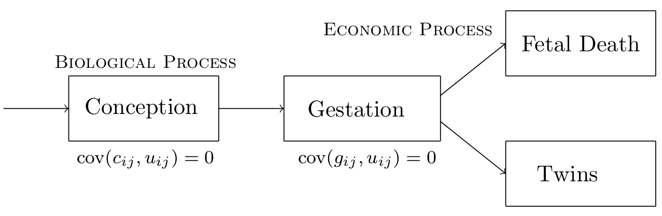
Twin Births May Depend Upon Poverty, Health and Fertility
Figure 4: Requirement for twin exogeneity

Slide 45

Methodology (OLS)
For child i in family j we are interested in estimating:
for educational (or other 'quality') outcomes Y_{ij} and fertility Q_{j}.
The Q-Q model predicts p<0:
Problem is that fertility is endogenous
  If women with high desired fertility have weaker preferences over education, then estimated p will be negatively biased
Controlling for maternal education will partially control for maternal preferences, and we should observe estimated p become less negative

Slide 46
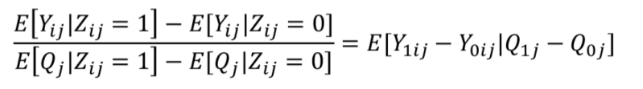
Methodology (Twins)
Since preferences cannot be fully observed, instrument fertility with twins:
This is a Wald estimate, or the LATE of the effect of an additional birth on compliers.
Our point:
  Healthy mothers are more likely to have twins, and are more likely to invest in education of children
  Twins (our Z_{ij}) is not ‘as good as randomly assigned’
This creates a positive bias in estimated p (under-stating true trade-off)

Slide 47
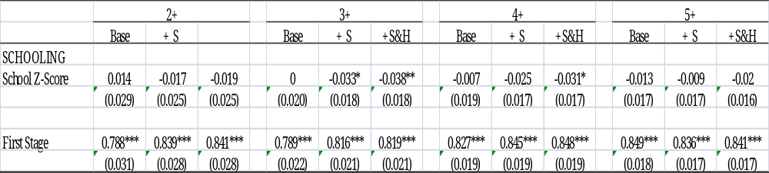
2SLS Estimates: Twins at higher parities
06/04/14

